Slide 1
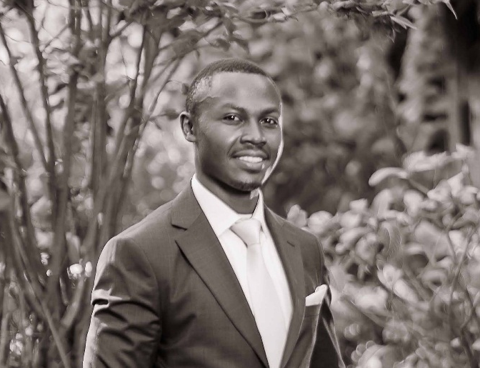
Autobiography of Iyaya Phanuel Makhakha

Slide 2
Early Beginnings
Birth and Early Life
Date & Place: Born March 5, 1997, in Kenya.
Parents: Hardworking, instilled values of perseverance, integrity, and education.
Childhood: Vibrant village life with lush forests and community spirit.
Early Interests: Curiosity about technology; took apart radios and clocks.
First Encounter with Technology
Village’s First Computer: Excitement at the community center.
Initial Learning: Typed first words and saw first lines of code.

Slide 3
Primary Education
St. Paul Thomas Academy (2008-2010)
Start of Formal Education: Began at age 11.
Favorite Subjects: Mathematics and Science.
First Experiences:
Mathematics: Enthusiastic problem solver.
Science: Interest in electricity and machines.
Computer Lab: Introduced to word processing, spreadsheets, and programming.
Influential Teacher: Mrs. Njeri’s encouragement in technology.
Achievements
KCPE Exams: Scored 386 marks, achieving an A- grade.

Slide 4
Secondary Education
St. Anthony Boys High School (2011-2014)
Transition: From primary to a more demanding secondary school.
Academic Focus: Chose Mathematics, Physics, and Computer Studies.
Key Experience:
First Program: Created a simple calculator application.
Final Exams: Achieved an A- grade with 79 points.

Slide 5
University Years
Dedan Kimathi University of Technology (2015-2019)
Degree Pursued: Bachelor of Science in Information Technology.
Campus Life:
Tech Club: Collaborated on tech projects.
Specialization: Networking and security.
Research and Certifications:
CCNA: Cisco Certified Network Associate.
Fortinet NSE: Network Security Expert certifications.
Internships and Practical Experience
Internships: Local ISP, Technical Support, and other roles.

Slide 6
Early Career and Professional Development
Career Milestones
Rimaya Cyber (2015): Cyber manager.
Microsoft Office Trainer (2017-2018): Training in productivity tools.
ICT Technical Support Specialist (2020): Nairobi Centre for International Arbitration.
Otomart Supermarket Mutalia (2021): Maintenance and sales of electronics.
Additional Certifications
Internet of Things, Networking Basics, Introduction to Cybersecurity.

Slide 7
Skills and Expertise
Hardware: Assembly, maintenance, and troubleshooting.
Software: Proficient in Microsoft Office, debugging, and troubleshooting.
Operating Systems: Windows, Linux, Google Chrome OS.
Networking: Configuration, troubleshooting, CCNA.
Security: Firewalls, intrusion detection, cybersecurity policies.

Slide 8
Personal Interests and Future Aspirations
Volunteer Work and Hobbies
Volunteering: Basic computer literacy classes for youth.
Reading: Books on technology and biographies.
Blogging: “Tech Horizons with Iyaya” - Discussing IT trends and insights.
Future Goals
Aspirations: Advancing in IT, exploring new technologies, and using skills for societal betterment.

Slide 9
Conclusion
Summary
Journey: From dismantling radios to becoming a skilled IT professional.
Commitment: Continuous learning, personal growth, and contribution to the tech community.
Future Vision: Creating a more connected and efficient world through technology

