Slide 1
Graduation Thesis
20191
Vietnamese Speech Recognition for People with Speech Disabilities using Deep Learning

Slide 2

Phan Xuan Phuc
20156248
Mentor: TS. Nguyen Hong Quang
Ha Noi University of Science and Technology
January 15, 2019

Slide 3
Outline
Introduction
Common Approachs
Dataset
Our Approach
Results
Future Works
Source code: https://gitlab.com/faker_phan/masr2
Documents: https://gitlab.com/faker_phan/masr2/tree/master/reports

Slide 4
Outline
Introduction
Common Approachs
Dataset
Our Approach
Results
Future Works

Slide 5
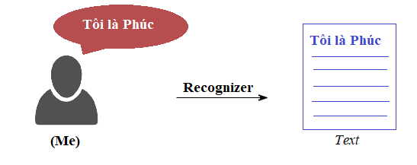
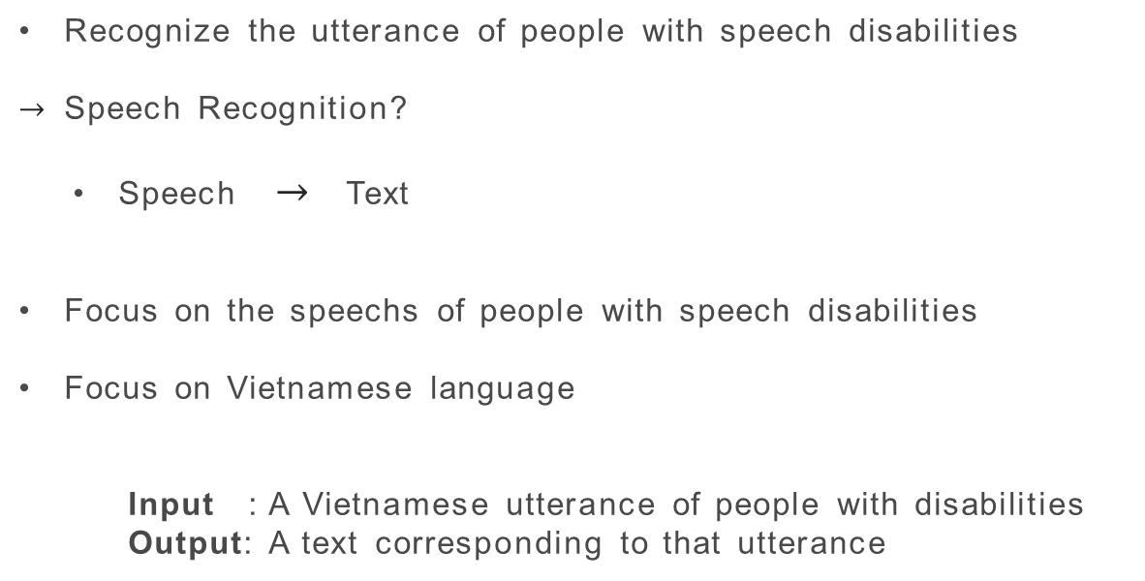
Problem Statement
Recognize the utterance of people with speech disabilities
$→$ Speech Recognition?
  Speech $→$ Text
Focus on the speechs of people with speech disabilities
Focus on Vietnamese language
  Input : A Vietnamese utterance of people with disabilities
  Output: A text corresponding to that utterance

Slide 6




Motivation

Slide 7
Outline
Introduction
Common Approachs
Dataset
Our Approach
Results
Future Works

Slide 8
Common Approachs
Acoustic-phonetic analysis
Pattern recognition techniques
Artificial intelligence
  Gaussian mixture model (GMM)
  Hidden markov model (HMM)
  Neural networks (NN)

Slide 9
Evaluation Metrics
Evaluation metrics for Speech Recognition
  WER (Word Error Rate)
  CER (Character Error Rate)
  SER (Sentence Error Rate)

Slide 10
Outline
Introduction
Common Approachs
Dataset
Our Approach
Results
Future Works

Slide 11
Dataset
Understand context before solving
  I have only a little more than 3 month
  I have no prepared data
Solution plan
  Collect data by recording 1,600 random common vocabulary words in Vietnamese of 3 people with speech disabilities at 4 different times.
  3 different people
    3 man (My father, My brother and Me)
    0 woman
  Training: 1,600 utterances/ 1 people at 3 different times
  Evaluation: 1,600 utterances/ 1 people at the remaining times

Slide 12
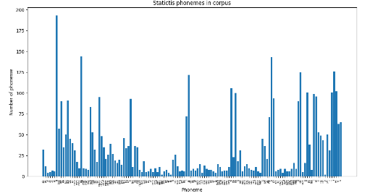

Dataset
Total 134 phonemes in Vietnamese
Distribution phonemes in dataset
$→$ Imbalancing

Slide 13
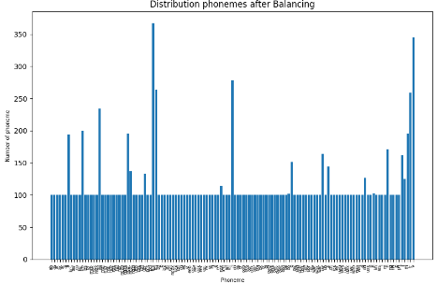
Dataset
Balancing data with Over Sampling
Distribution phonemes after balacing

Slide 14
Outline
Introduction
Common Approachs
Dataset
Our Approach
Results
Future Works

Slide 15
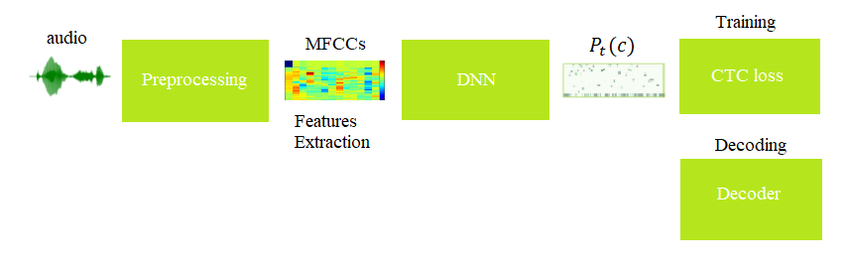
Our Approach
- Balacing data

Slide 16
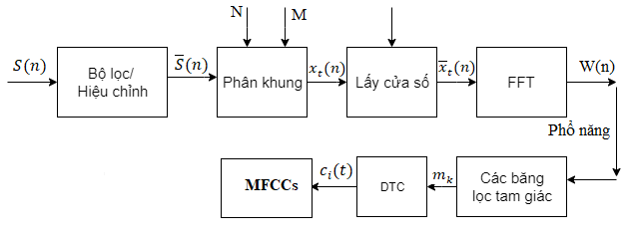
Our Approach – Features extraction

Slide 17
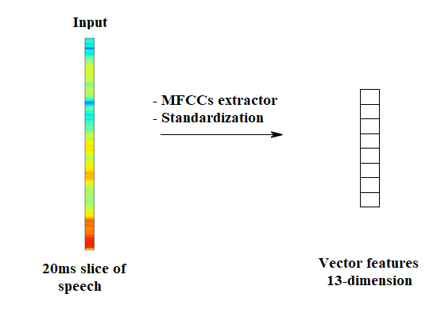
Our Approach
Each frame corresponding to each vector feature 13-dimension
Input : A frame 20ms of the speech
Output : A feature vector represents the frame

Slide 18
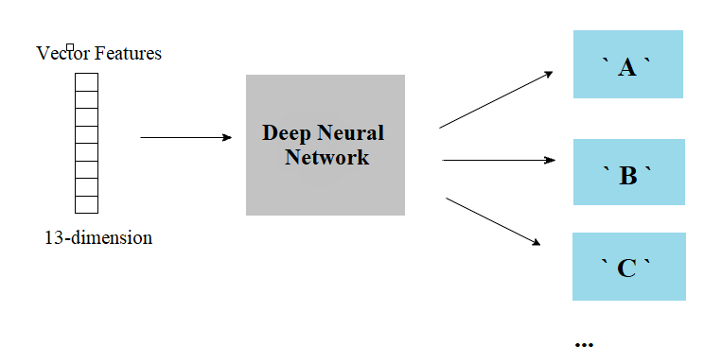
Our Approach
Input : Features vectors represents for the speech
Output : A probability distribution over all-characters

Slide 19
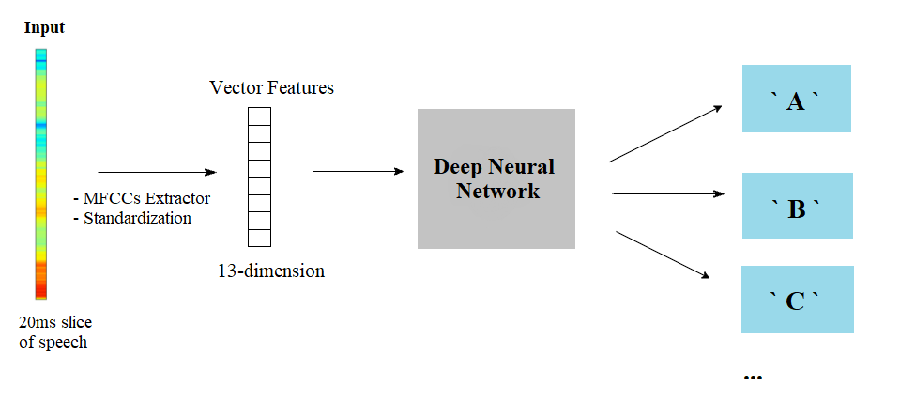
Our Approach

Slide 20
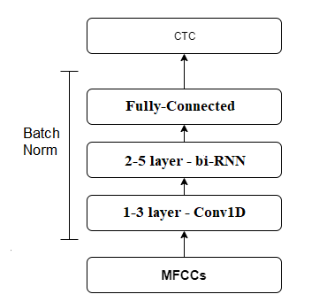
Our Approach – Architecture Model
Refer to the architecture of Deep Speech mode$l^{[1]}$
[1]:Dario Amodei. “Deep Speech 2: End-to-End Speech Recognition in English and Mandarin”. In arXiv:1512.02595 (2016)

Slide 21
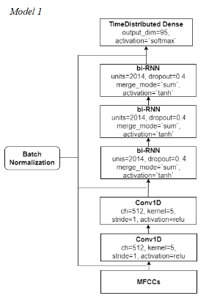
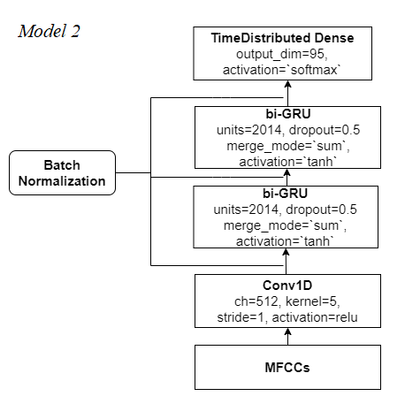
Our Approach – Architecture Model

Slide 22
Our Approach – Architecture Model
Input : Vector features for signal speech have 13-dimension.
Output: A matrix distribution probability of 95-character (class) on each time-step.

Slide 23
Our Approach – Decoding
Character set consist of: 89 Vietnamese letters including tones; 4 letter in English { f, j, w, z }; 1 `space` character and 1 `blank` character.
Decoding Algorithm
  Greedy Search (Max Decoding)
  Beam Search
Input : A matrix distribution probabilitiy
Output: A decoded ouput

Slide 24
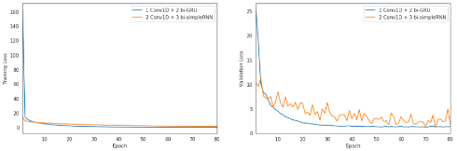
Our Approach – Training
Training on CTC loss with 80 epochs
  Optimizer: Stochasitic Gradient Descent (SGD) with:
    Learning rate = 0.02;
    L2 Weight decay = 1e-6;
    Momentum = 0.9;
    ClipNorm = 5;
    Batch size = 32;
    Using Neterove technique
The orange line represents the loss of model 1, and the blue line represents the loss of model 2

Slide 25
Outline
Introduction
Common Approachs
Dataset
Our Approach
Results
Future Works

Slide 26
Results
 | CER | WER | SER
Model 1 ( 2 Conv1D + 3 bi-simple RNN ) | 17.03 | 41.70 | 42.44
Model 2 ( 1 Conv1D + 2 bi-GRU ) | 7.73 | 19.67 | 20.16
Kết quả so sánh hai mô hình thử nghiệm sử dụng mạng bidirectional-simple RNN và bidirectional-GRU dựa trên 3 độ đo CER, WER và SER. (%)
Model 2 outperforms Model 1
Generally, the model brings positive results for the Vietnamese speech recognition problem of people with speech disabilities

Slide 27
Results
Collecte and processing data
Processing audio data and Extracte features for speech signals.
Build models and apply experiments to the problem
The model achieves positive results for speech recognition for people with speech disabilities

Slide 28
Disadvantage
Limited data
Likely to overfiting
The recognition is simple with sound of short duration, mainly from single words

Slide 29
Outline
Introduction
Common Approachs
Dataset
Our Approach
Results
Future Works

Slide 30
Future works
Enhance data for training and testing
Improve the extracted features problem
Improve decoding problems, such as integrating Beam search decoding algorithm with language models
Study the problem of direct conversion of people with speech disabilities

Slide 31
Thanks your for attention!
Any questions?
Contract me
phanxuanphuc@gmail.com

