Slide 1

TEAM 1
“NO BUG NO LIFE”

Slide 2
LOGISTIC SYSTEM
Member:
Dương Mục Huân
Phan Đức Cảnh
Chu Chiêu Dủ An
Đỗ Kim Long
Trần Thế Pháp

Slide 3
Overview
Classify | Contents
Service | Manage warehouse, shipping and delivery quickly and accurately
Background | In the context of deepening international integration and the mainstream of the digital economy, logistics activities are an indispensable component today.
Purpose | Digitize the warehouse to manage and connect to create a quick and convenient supply chain
Expected effect | More and more connected with more e-commerce platforms
Main Function | Login to use service Import/Export package in repository Delivery management Package tracking
Main Customer | e-commerce platforms.
Service Channel | Web
Other(open time) | 23/07/2021

Slide 4
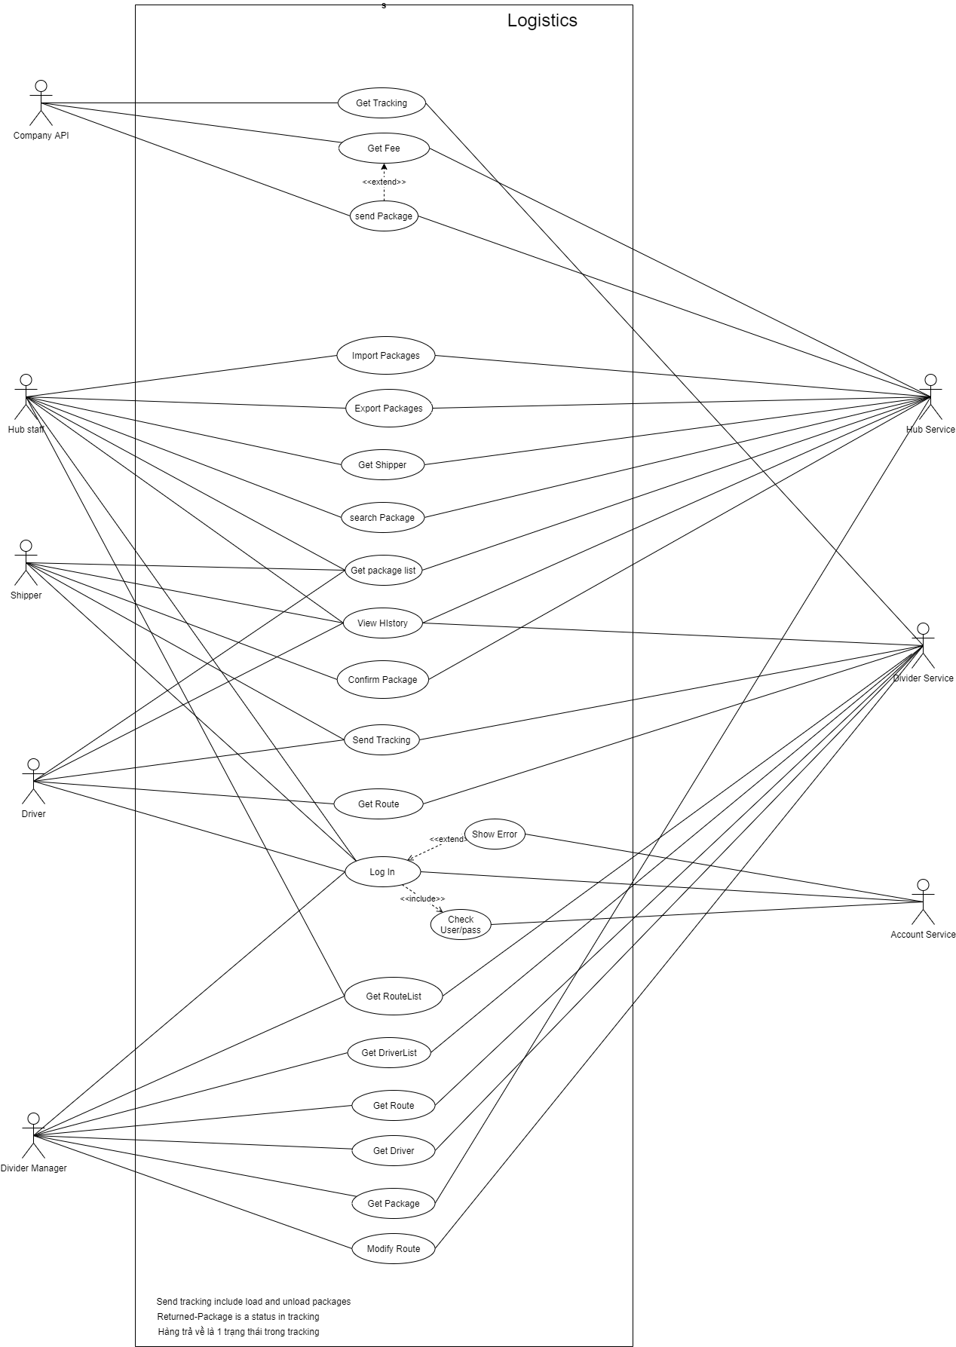
USECASE DIAGRAM
Click to see

Slide 5
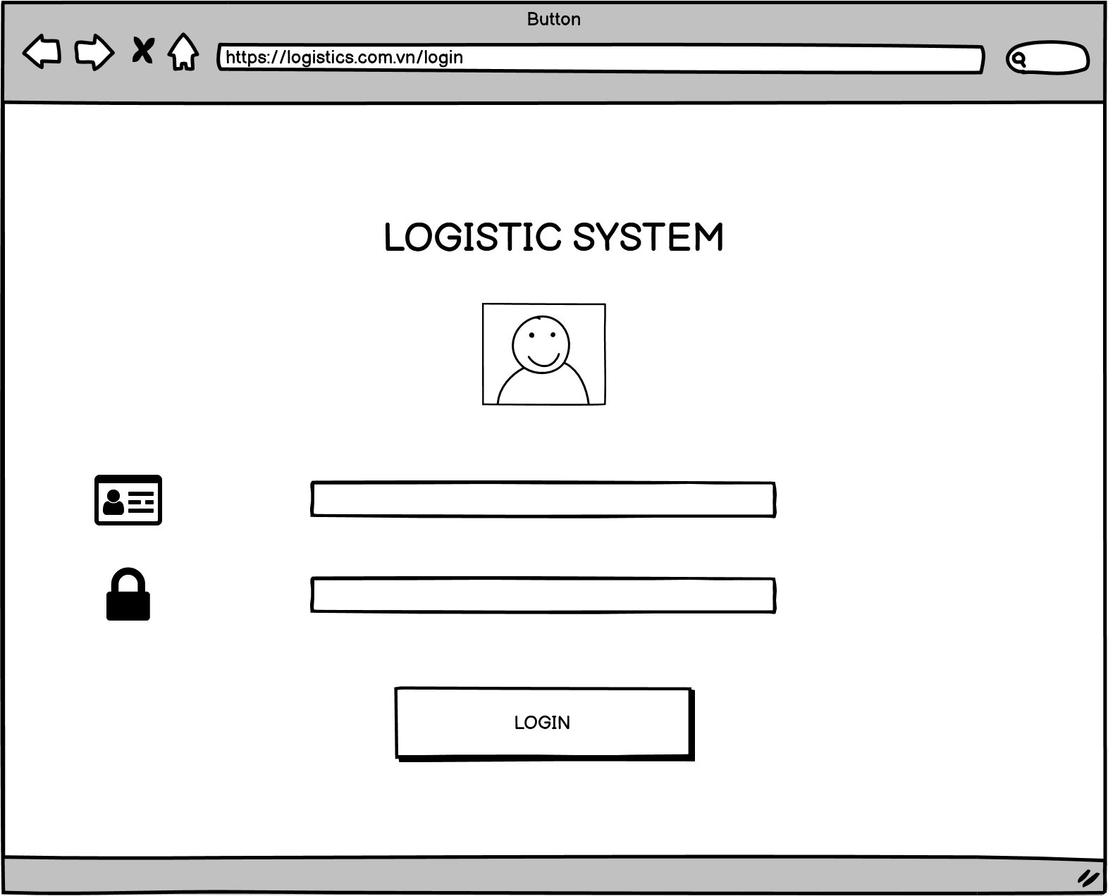
STORY BOARD: LOGISTIC SYSTEM SITE
1
DEVELOP Description
1 | Go to the page with the path URL
2 | Enter username
3 | Enter password
4 | Click LOGIN button
2
3
4

Slide 6
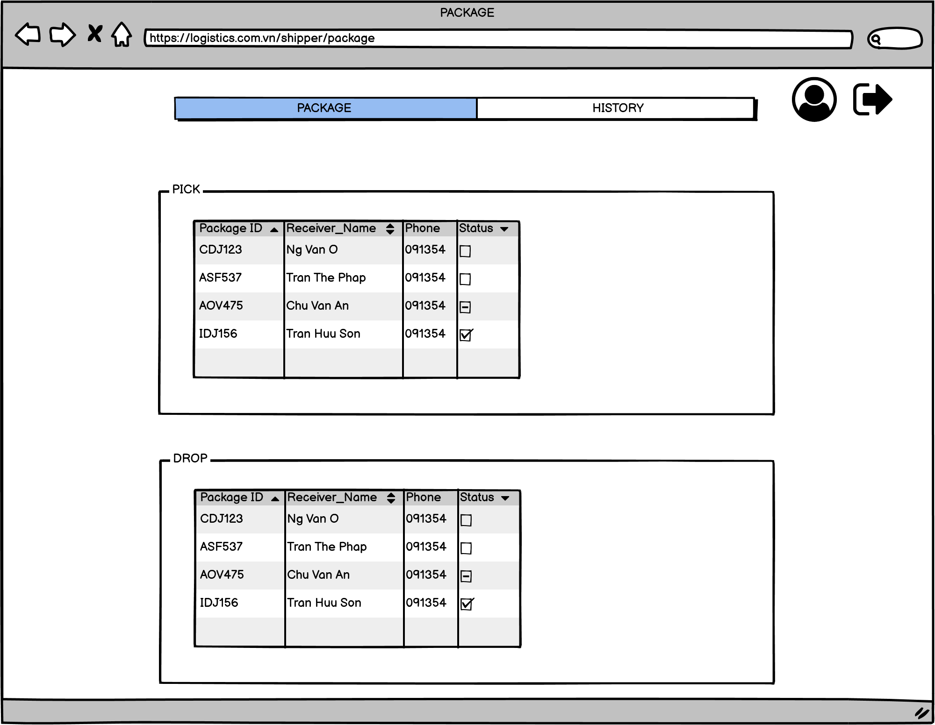
STORY BOARD: LOGISTIC SYSTEM SITE
SHIPPER’S INTERFACE
DEVELOP Description
1 | Click Package for delivery information
2 | Click History to view delivery history
3 | Click to see your personal information on the system
4 | Click to log out of the shipper account on the system
5 | Shipper's pick-up information status table
6 | Shipper's delivery information status table
1
2
3
4
5
6

Slide 7
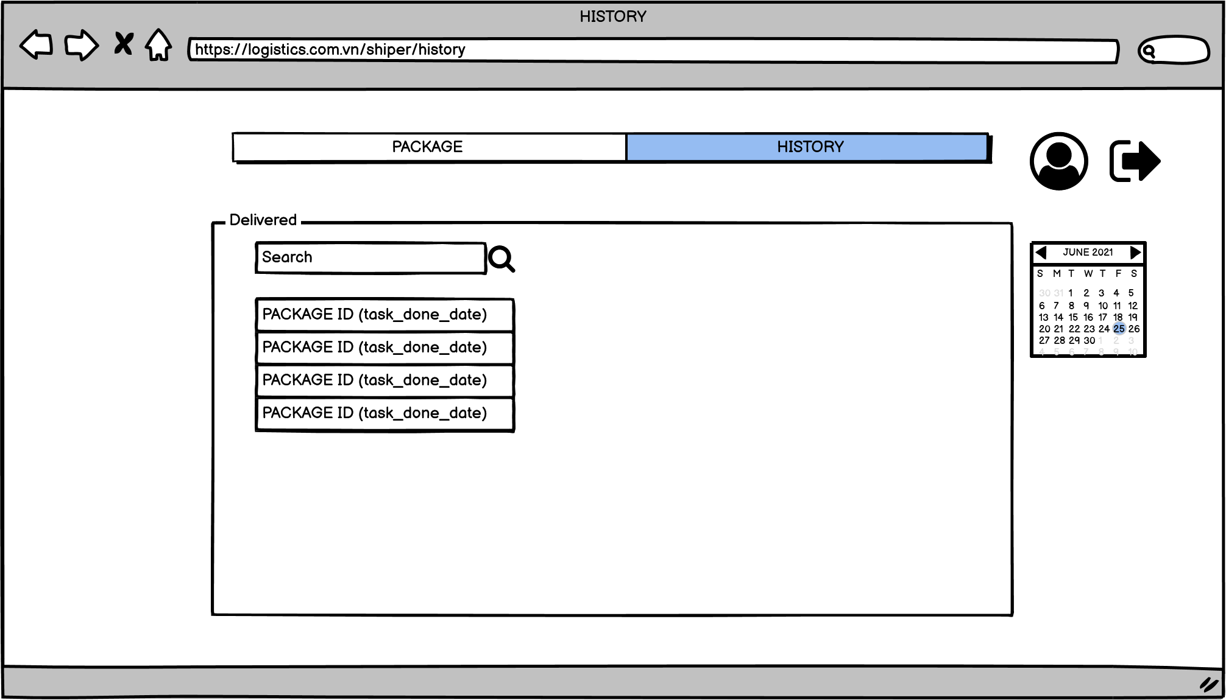
STORY BOARD: LOGISTIC SYSTEM SITE
SHIPPER’S INTERFACE
DEVELOP Description
1 | Click Package for delivery information
2 | Click History to view delivery history
3 | Click to see your personal information on the system
4 | Click to log out of the shipper account on the system
5 | Calendar tab
6 | Commodity information search box
7 | Search button
8 | Delivery history list
3
4
1
2
6
7
5
8

Slide 8
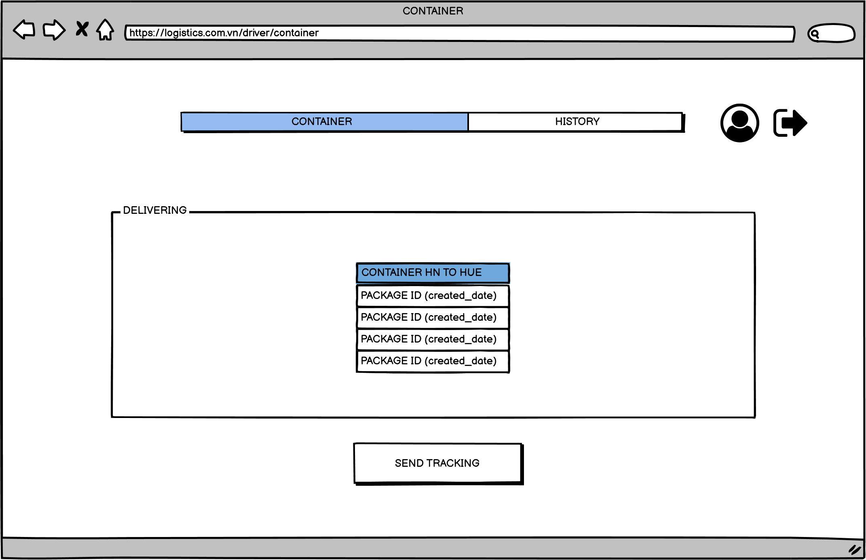
STORY BOARD: LOGISTIC SYSTEM SITE
DRIVER INTERFACE
DEVELOP Description
1 | Click to view information container trucks
2 | Click History to view vehicle movement history
3 | Click to see your personal information on the system
4 | Click to log out of the driver account on the system
5 | Vehicle list on the system
6 | Click send tracking to track shipments
3
4
1
2
5
6

Slide 9
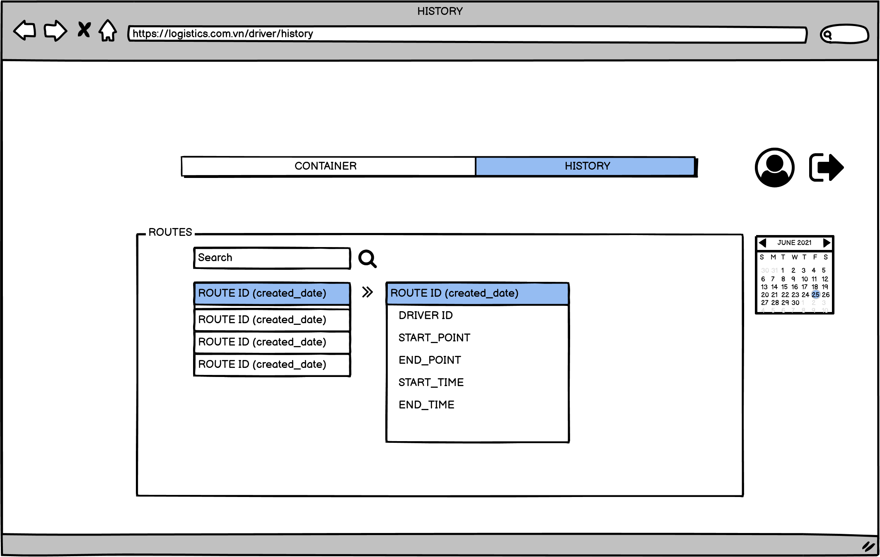
STORY BOARD: LOGISTIC SYSTEM SITE
DRIVER INTERFACE
DEVELOP Description
1 | Click to view information container trucks
2 | Click History to view vehicle movement history
3 | Click to see your personal information on the system
4 | Click to log out of the driver account on the system
5 | Calendar tab
6 | Commodity information search box
7 | Search button
8 | Detailed history of the vehicle
3
4
1
2
6
7
5
8

Slide 10
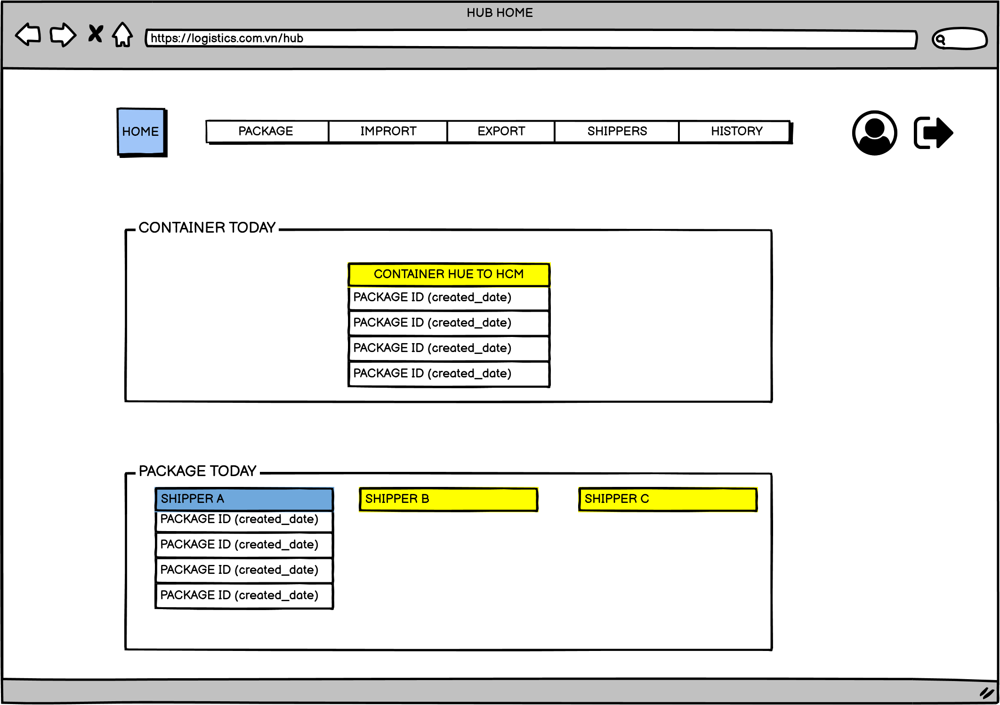
STORY BOARD: LOGISTIC SYSTEM SITE
HUB INTERFACE
DEVELOP Description
1 | Press home to show hub's watch list
2 | Click package to display package information
3 | Click import to import goods into the system
4 | Click export to export the goods from the system
5 | Click to view information in the system shipper
6 | Click to view import and export history
7 | Click to see your personal information on the system
8 | Click to log out of the hub account on the system
9 | List of the day's activities vehicles
10 | List of goods will be delivered within the day
1
2
3
4
5
6
7
8
9
10

Slide 11
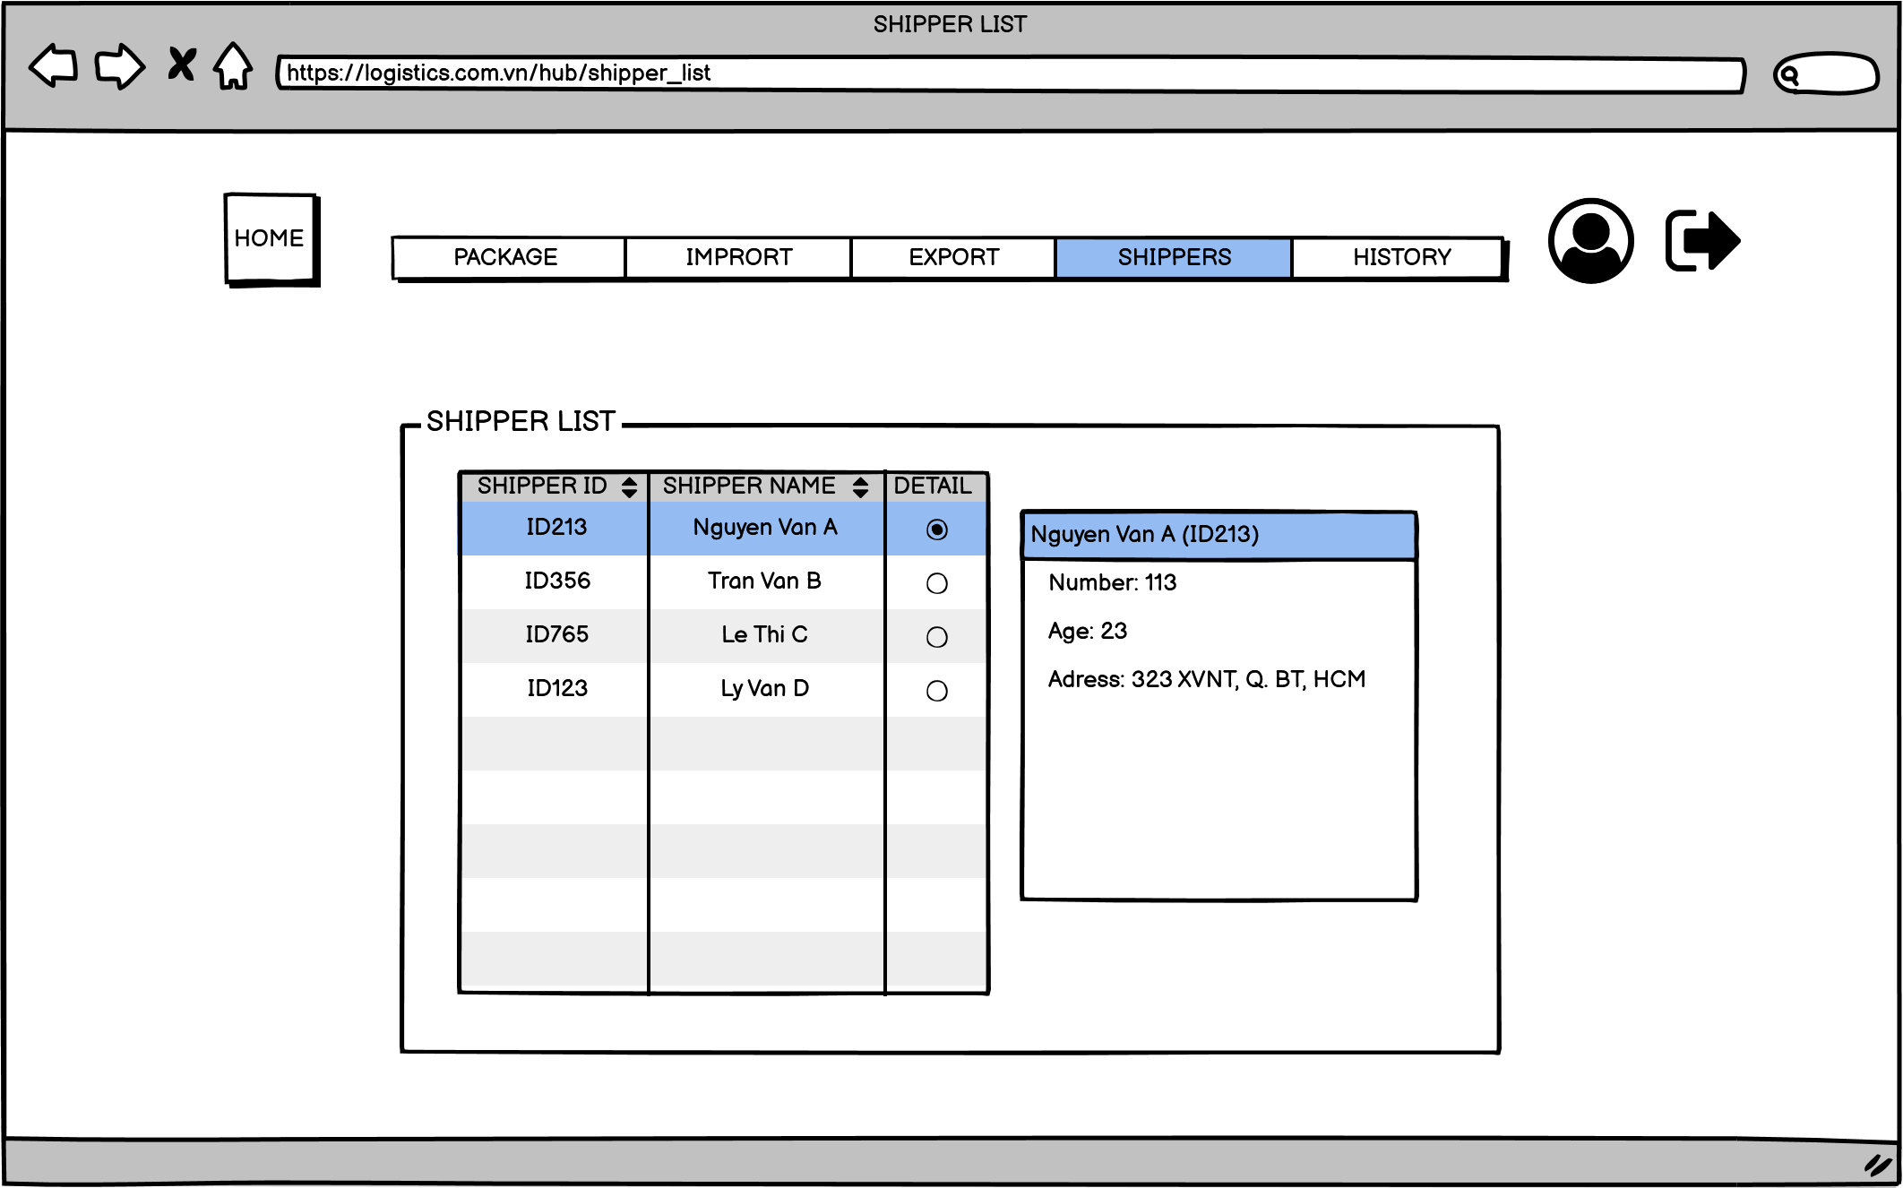
STORY BOARD: LOGISTIC SYSTEM SITE
HUB INTERFACE
DEVELOP Description
1 | Press home to show hub's watch list
2 | Click package to display package information
3 | Click import to import goods into the system
4 | Click export to export the goods from the system
5 | Click to view information in the system shipper
6 | Click to view import and export history
7 | Click to see your personal information on the system
8 | Click to log out of the hub account on the system
9 | Detailed list of active shippers
7
8
1
2
3
4
5
6
9

Slide 12
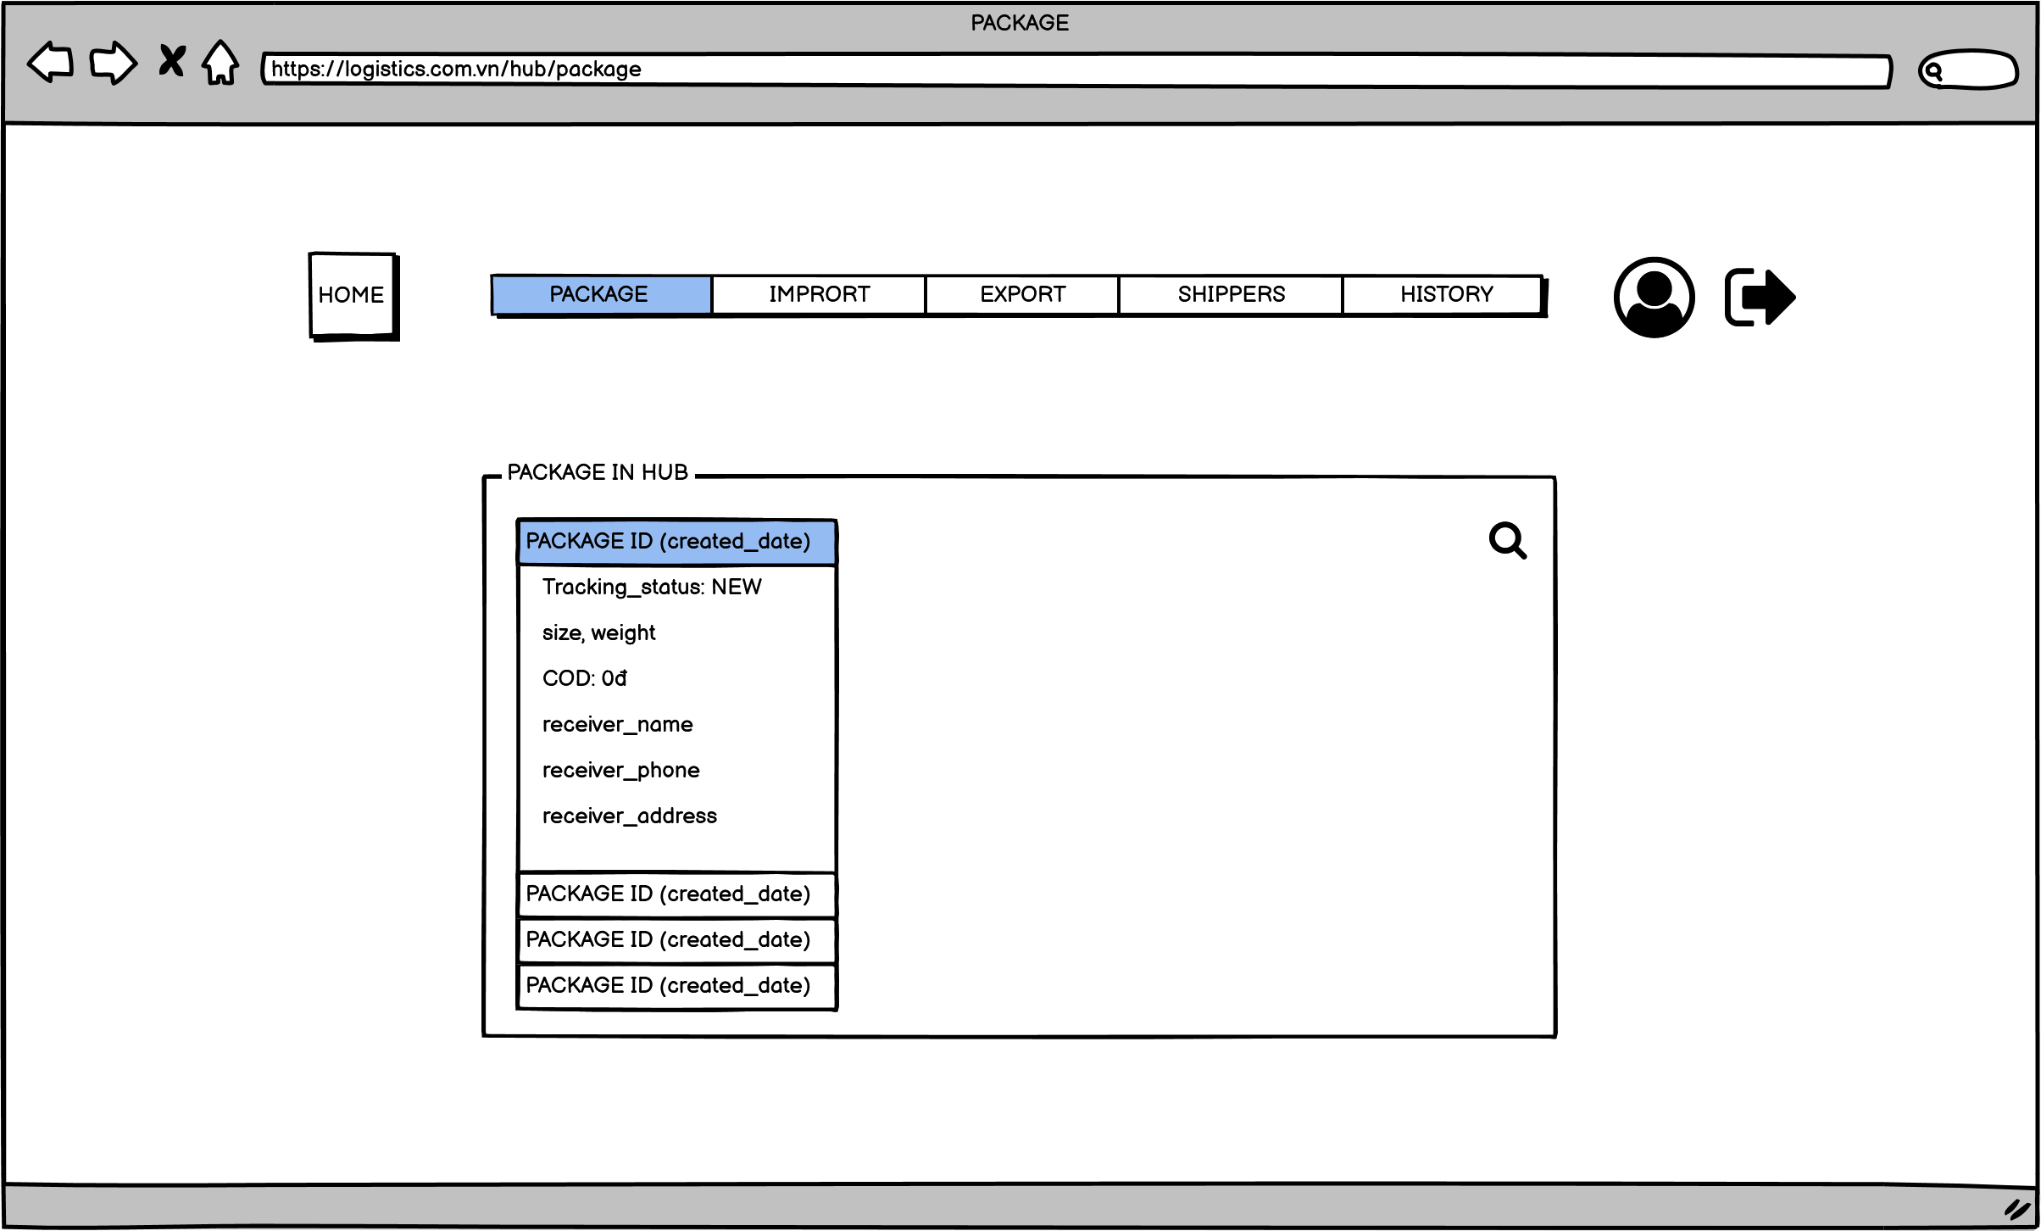
STORY BOARD: LOGISTIC SYSTEM SITE
HUB INTERFACE
DEVELOP Description
1 | Press home to show hub's watch list
2 | Click package to display package information
3 | Click import to import goods into the system
4 | Click export to export the goods from the system
5 | Click to view information in the system shipper
6 | Click to view import and export history
7 | Click to see your personal information on the system
8 | Click to log out of the hub account on the system
9 | Detailed list of goods stored in stock
7
8
1
2
3
4
5
6
9

Slide 13
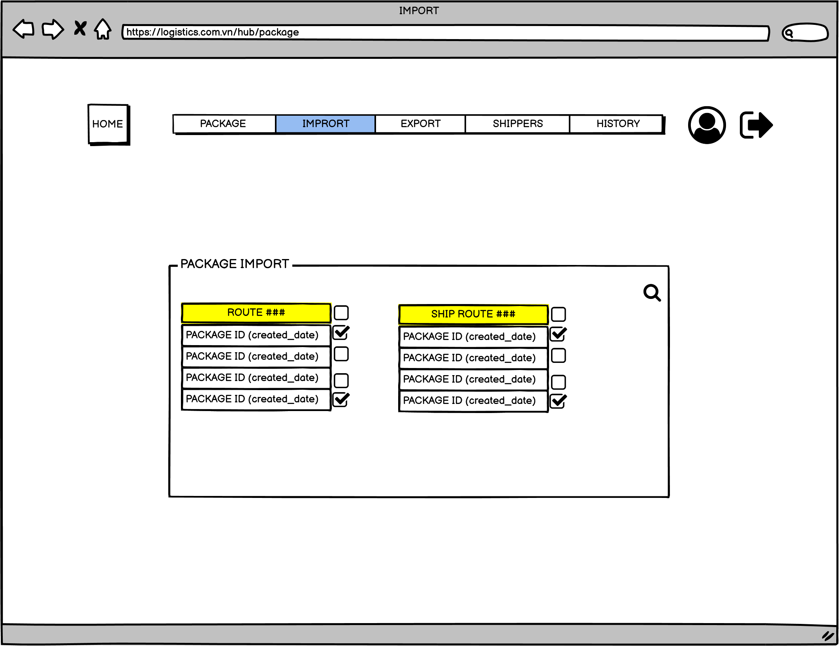
STORY BOARD: LOGISTIC SYSTEM SITE
HUB INTERFACE
DEVELOP Description
1 | Press home to show hub's watch list
2 | Click package to display package information
3 | Click import to import goods into the system
4 | Click export to export the goods from the system
5 | Click to view information in the system shipper
6 | Click to view import and export history
7 | Click to see your personal information on the system
8 | Click to log out of the hub account on the system
9 | Import status table
7
8
1
2
3
4
5
6
9

Slide 14
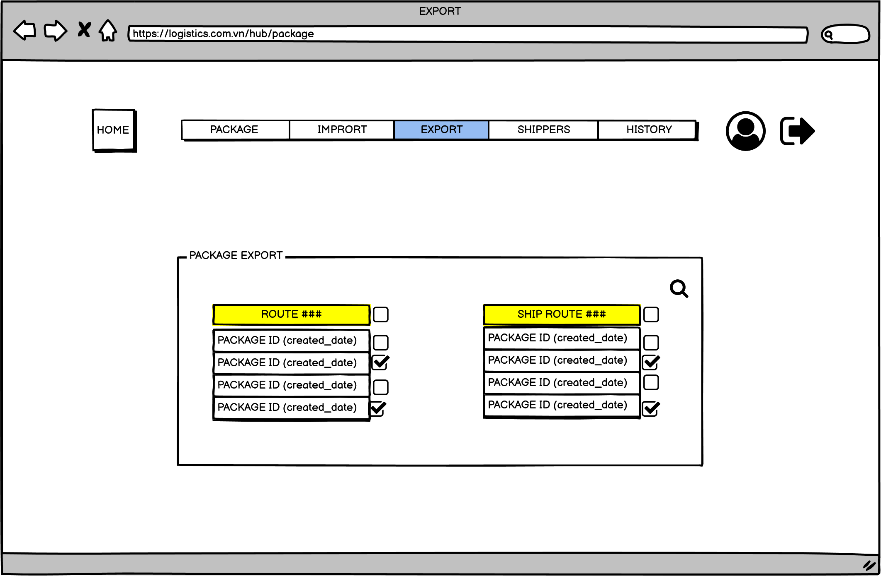
STORY BOARD: LOGISTIC SYSTEM SITE
HUB INTERFACE
DEVELOP Description
1 | Press home to show hub's watch list
2 | Click package to display package information
3 | Click import to import goods into the system
4 | Click export to export the goods from the system
5 | Click to view information in the system shipper
6 | Click to view import and export history
7 | Click to see your personal information on the system
8 | Click to log out of the hub account on the system
9 | Export status table
7
8
1
2
3
4
5
6
9

Slide 15
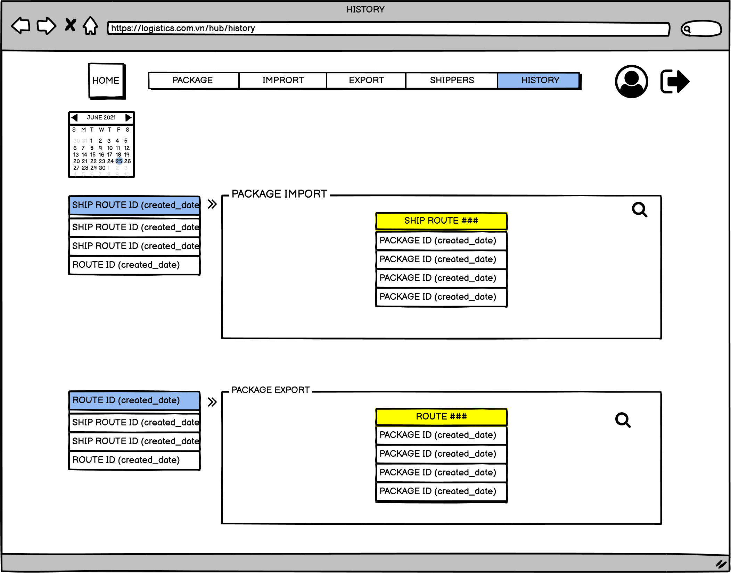
STORY BOARD: LOGISTIC SYSTEM SITE
HUB INTERFACE
DEVELOP Description
1 | Press home to show hub's watch list
2 | Click package to display package information
3 | Click import to import goods into the system
4 | Click export to export the goods from the system
5 | Click to view information in the system shipper
6 | Click to view import and export history
7 | Click to see your personal information on the system
8 | Click to log out of the hub account on the system
9 | Calendar tab
10 | Imported goods list
11 | List have entered by date
12 | Exported goods list
13 | List of goods shipped by date
1
2
3
4
5
6
7
8
9
10
11
12
13

Slide 16
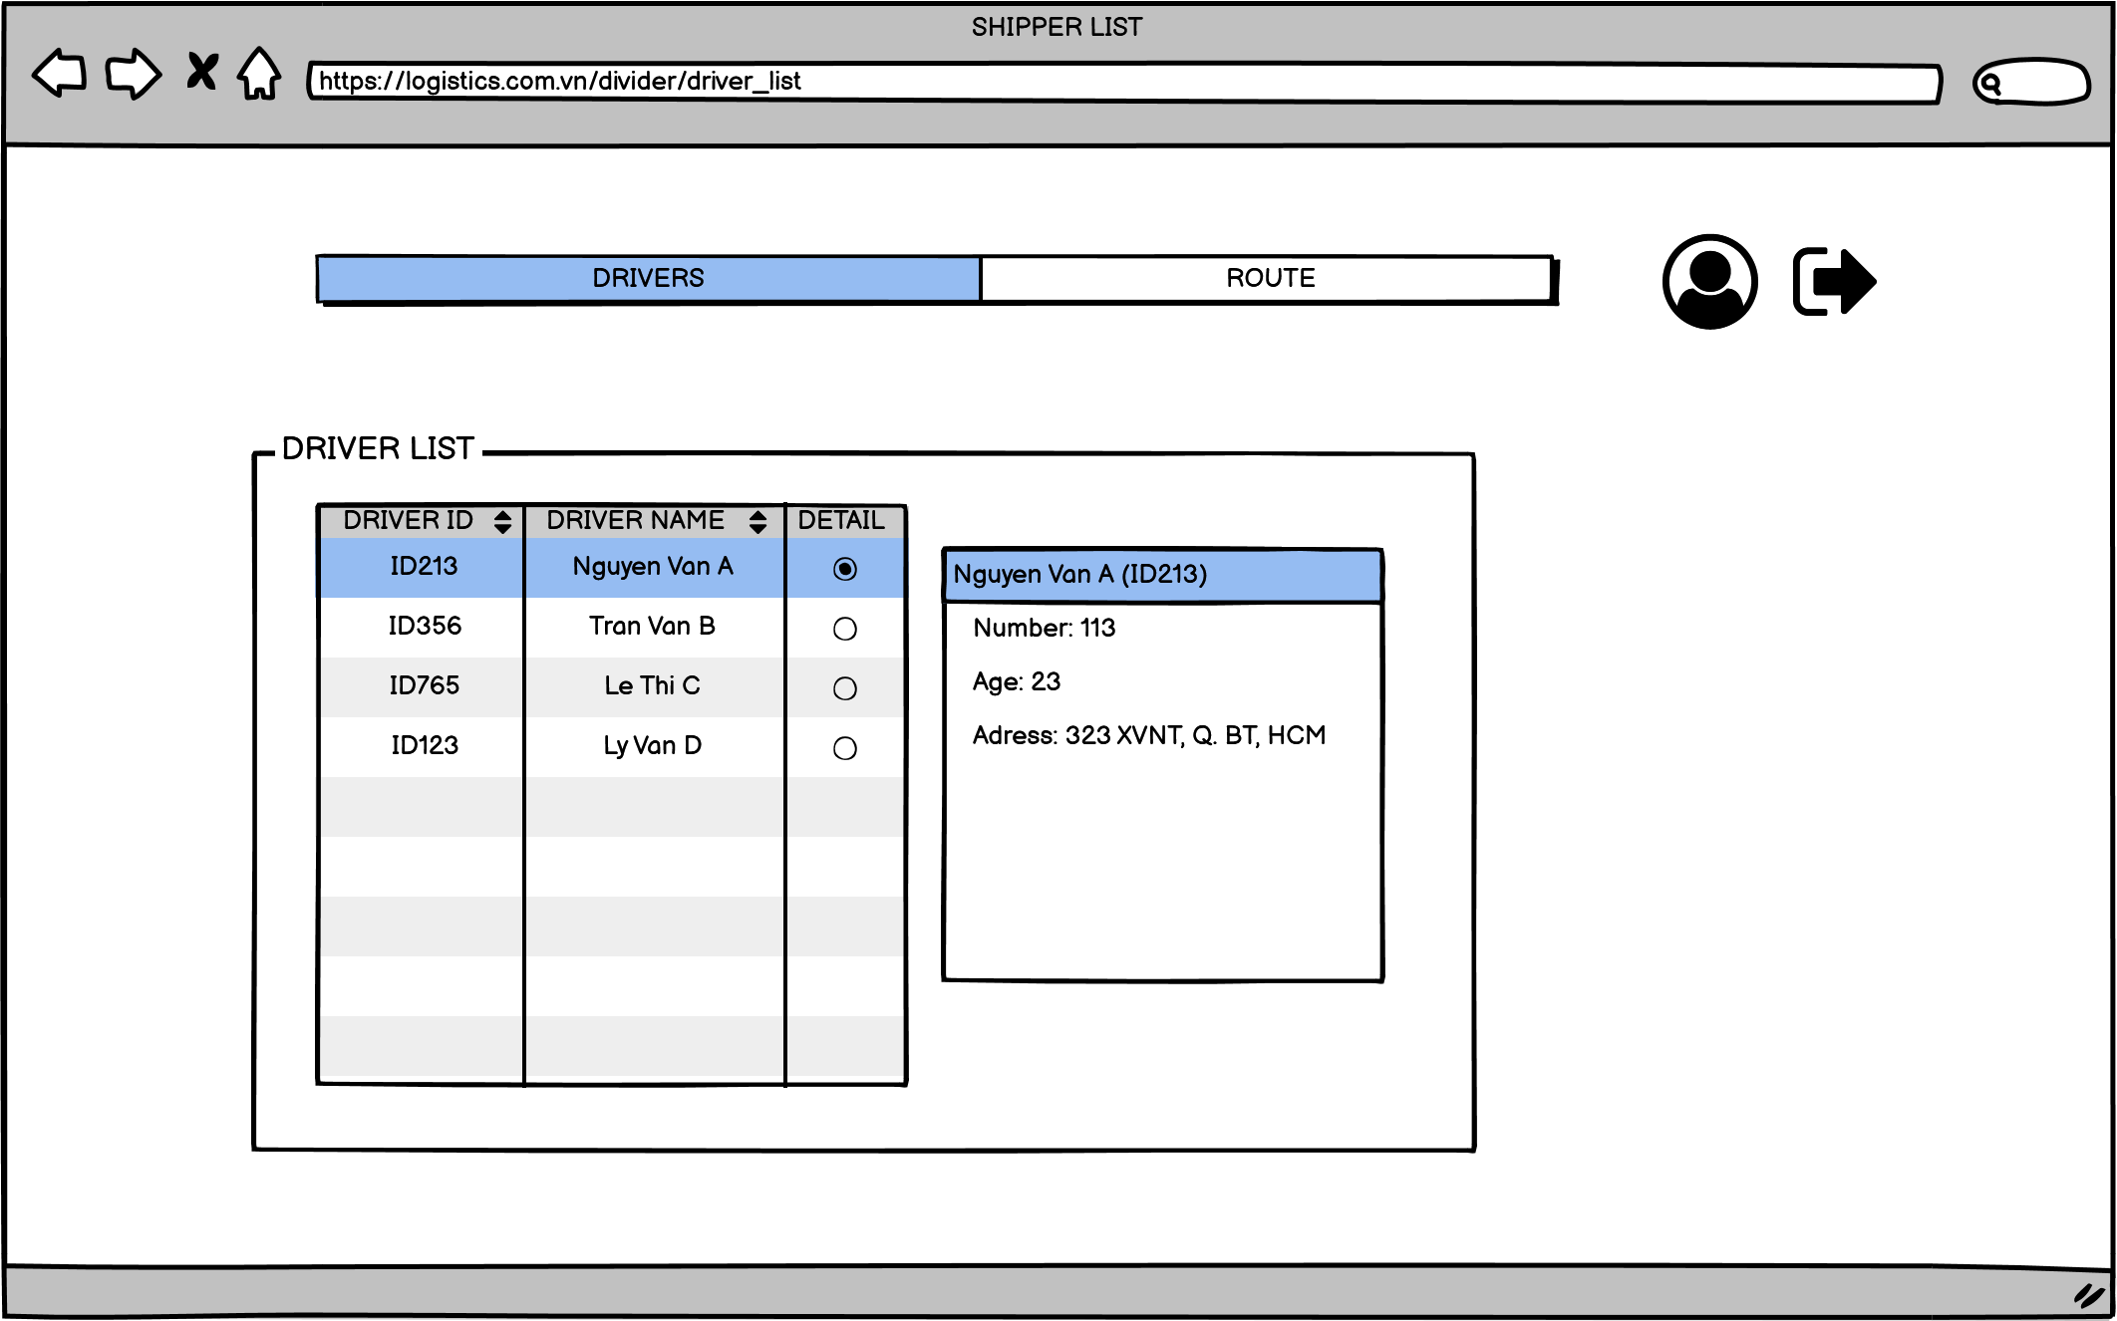
STORY BOARD: LOGISTIC SYSTEM SITE
DRIVER INTERFACE
DEVELOP Description
1 | Click driver to view driver list and detailed information
2 | Click to see the route
3 | Click to see your personal information on the system
4 | Click to log out of the driver account on the system
5 | Driver details
3
4
1
2
5

Slide 17
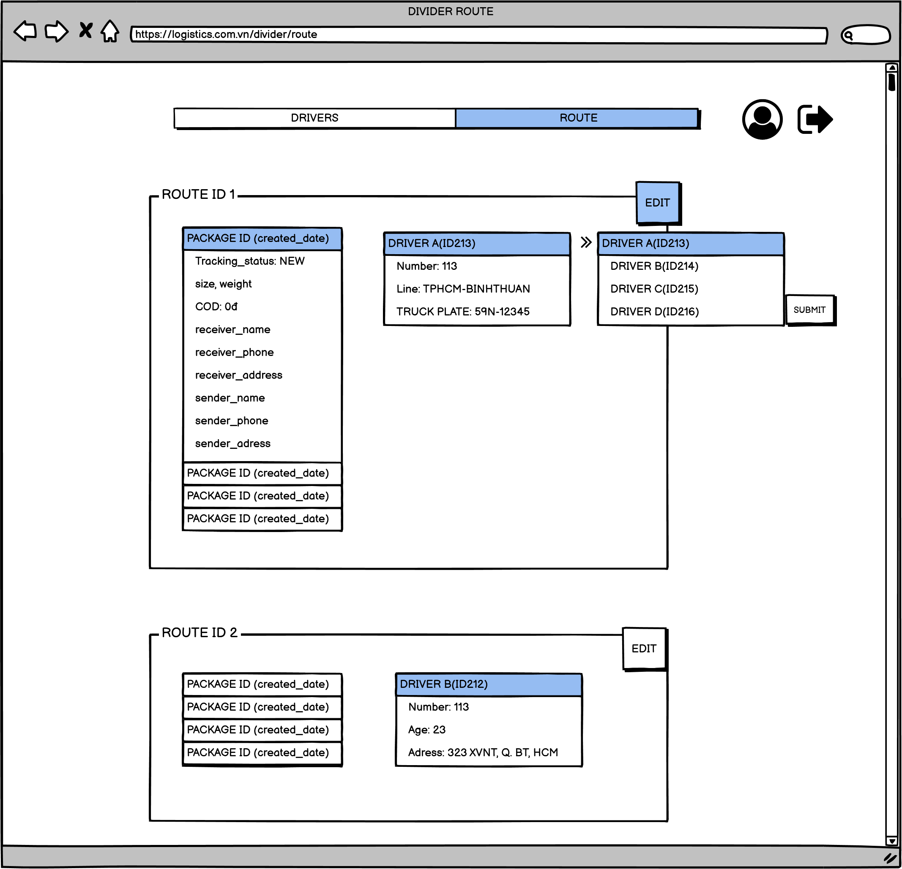
STORY BOARD: LOGISTIC SYSTEM SITE
DRIVER INTERFACE
DEVELOP Description
1 | Click driver to view driver list and detailed information
2 | Click to see the route
3 | Click to see your personal information on the system
4 | Click to log out of the driver account on the system
5,7 | Detailed route information
6,8 | Click to edit route
3
4
1
2
6
5
8
7

Slide 18
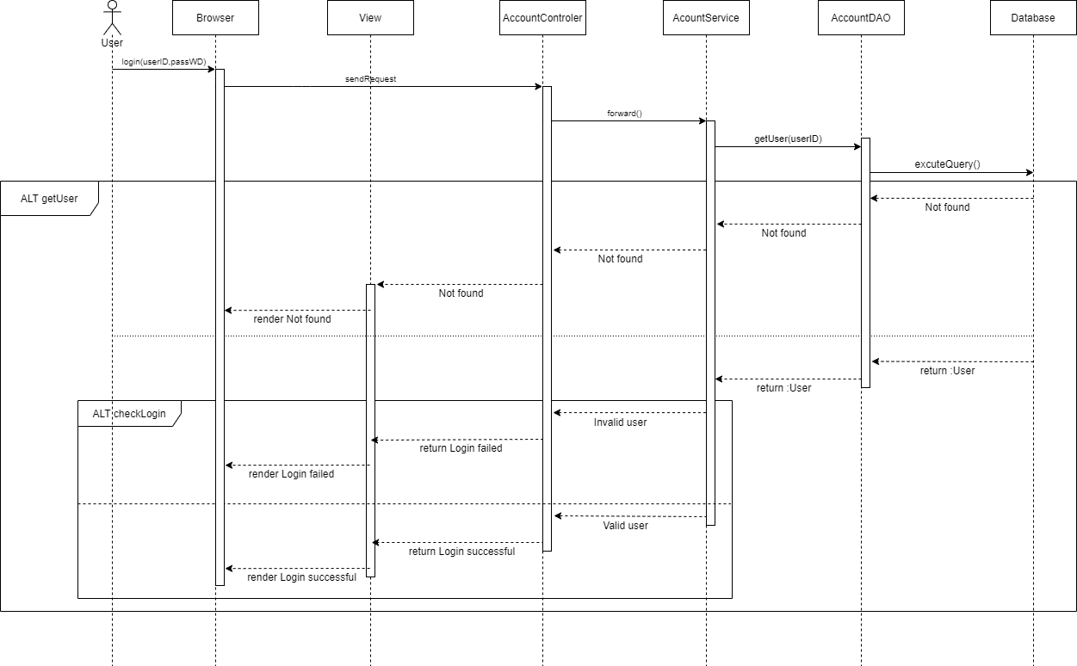
SEQUENCE DIAGRAM LOGIN
login

Slide 19
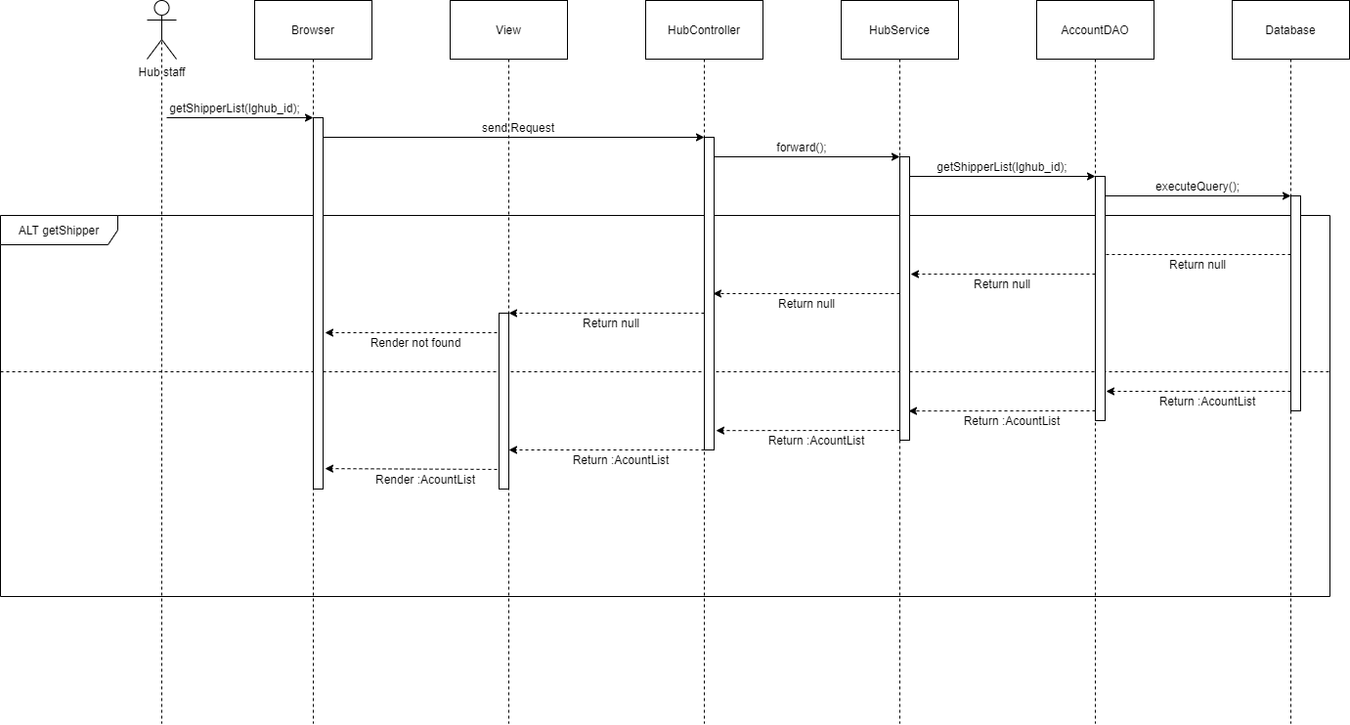
SEQUENCE DIAGRAM HUB STAFF
getShipperList

Slide 20
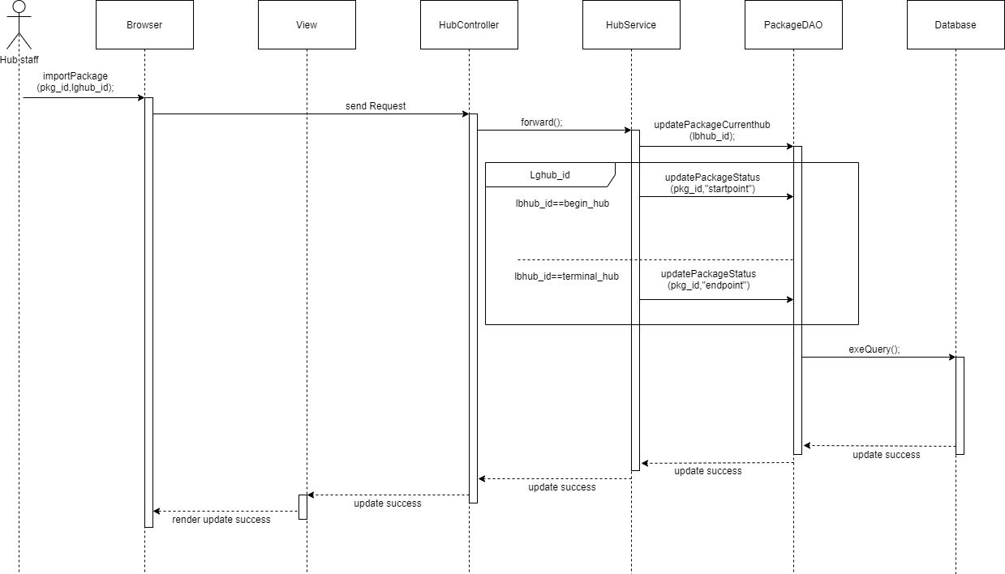
SEQUENCE DIAGRAM HUB STAFF
Import Package

Slide 21
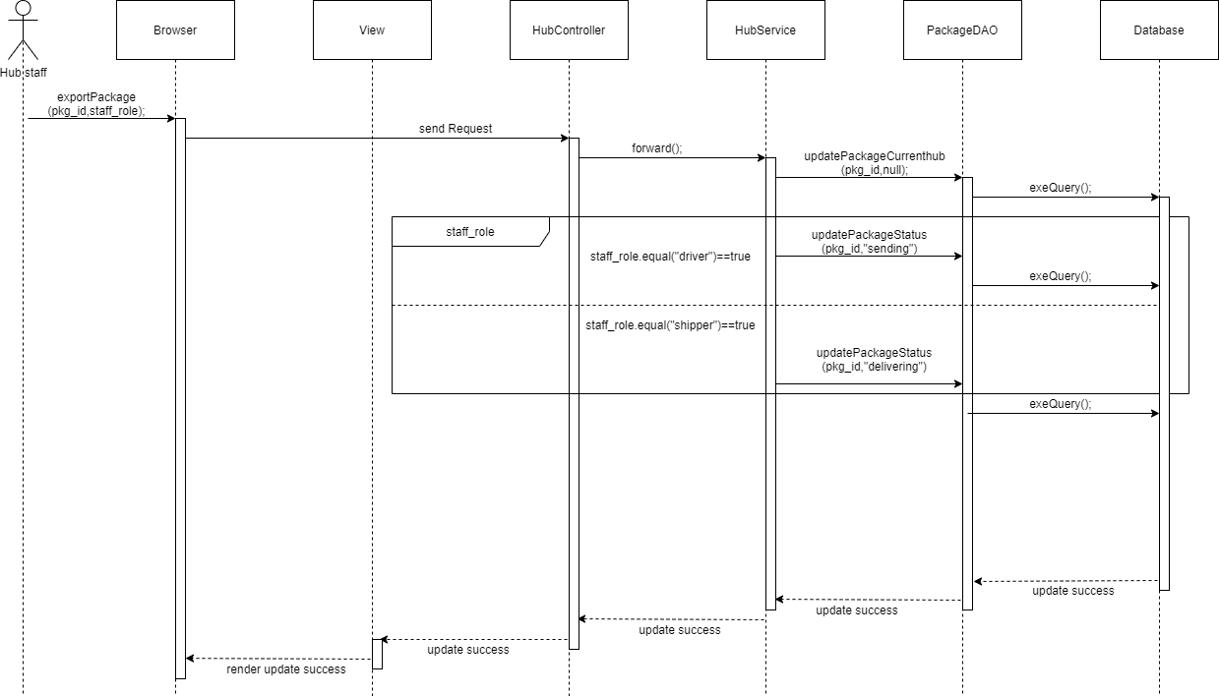
SEQUENCE DIAGRAM HUB STAFF
Export Package

Slide 22
SEQUENCE DIAGRAM HUB STAFF
getShiperList

Slide 23
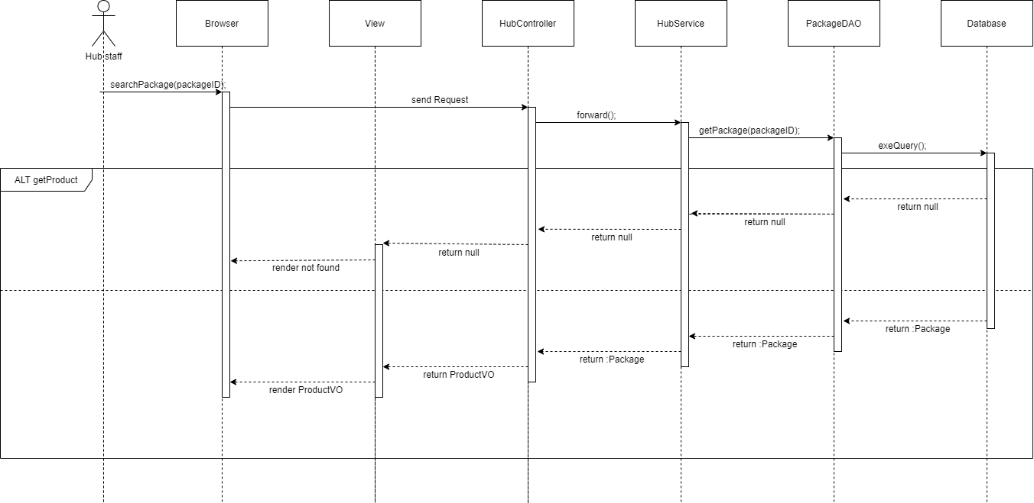
SEQUENCE DIAGRAM HUB STAFF
searchPackage

Slide 24
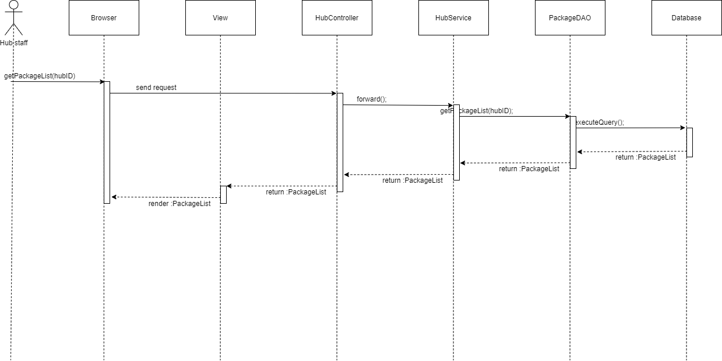
SEQUENCE DIAGRAM HUB STAFF
getPackageList

Slide 25
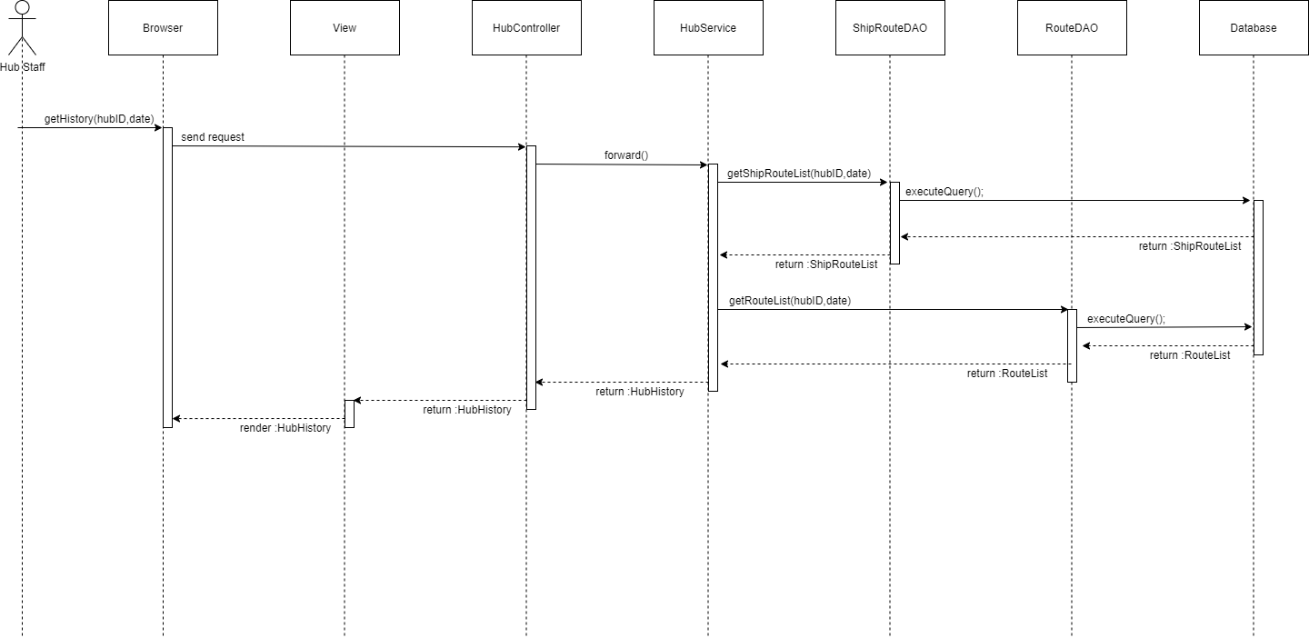
SEQUENCE DIAGRAM HUB STAFF
getHistory

Slide 26
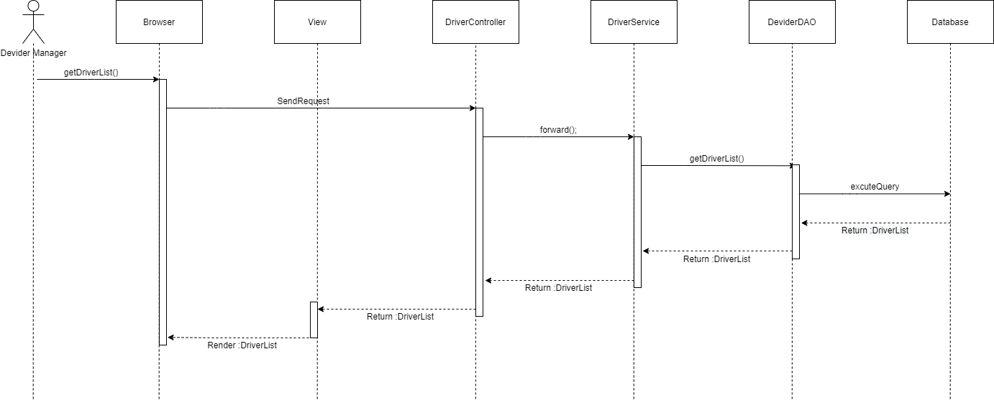
SEQUENCE DIAGRAM DIVIDER MANAGER
getDriverList

Slide 27
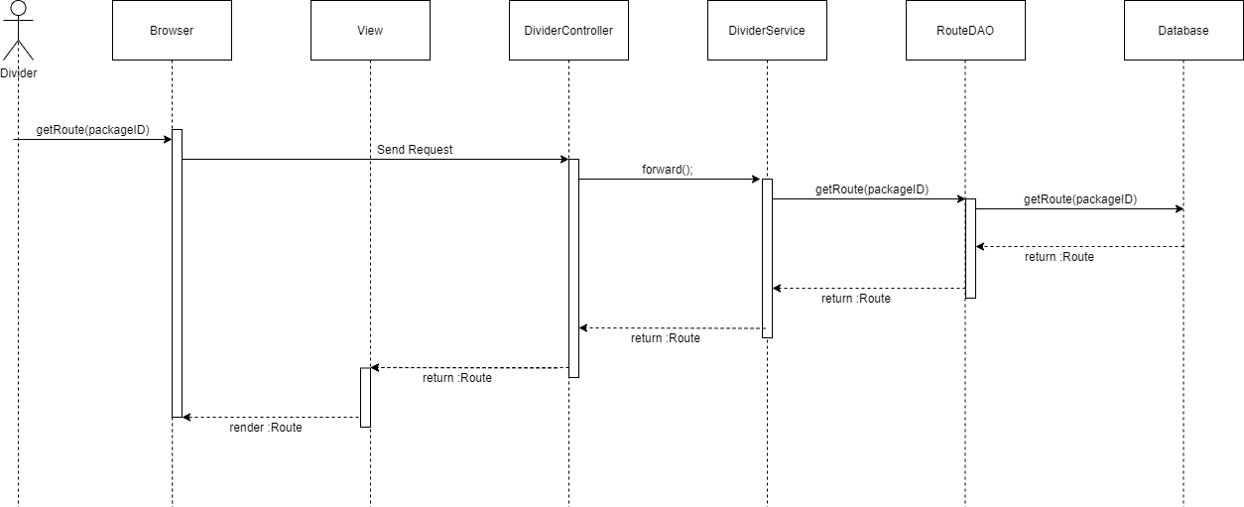
SEQUENCE DIAGRAM DIVIDER MANAGER
getRoute

Slide 28
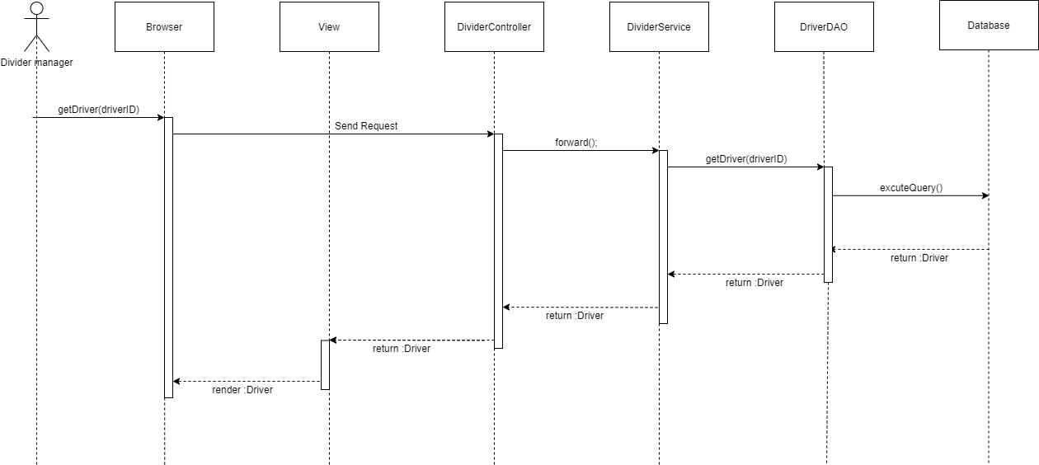
SEQUENCE DIAGRAM DIVIDER MANAGER
getDriver

Slide 29

SEQUENCE DIAGRAM DIVIDER MANAGER
getPackage

Slide 30
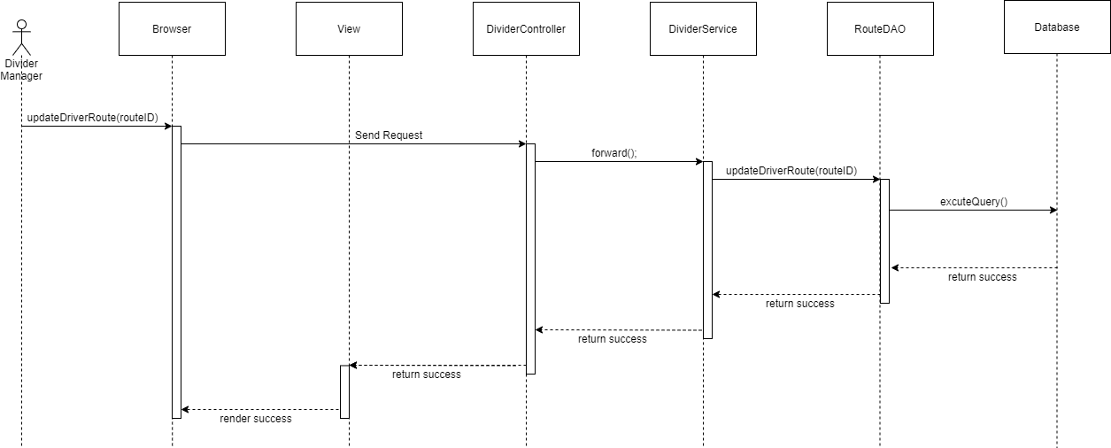
SEQUENCE DIAGRAM DIVIDER MANAGER
MordifyRoute

Slide 31
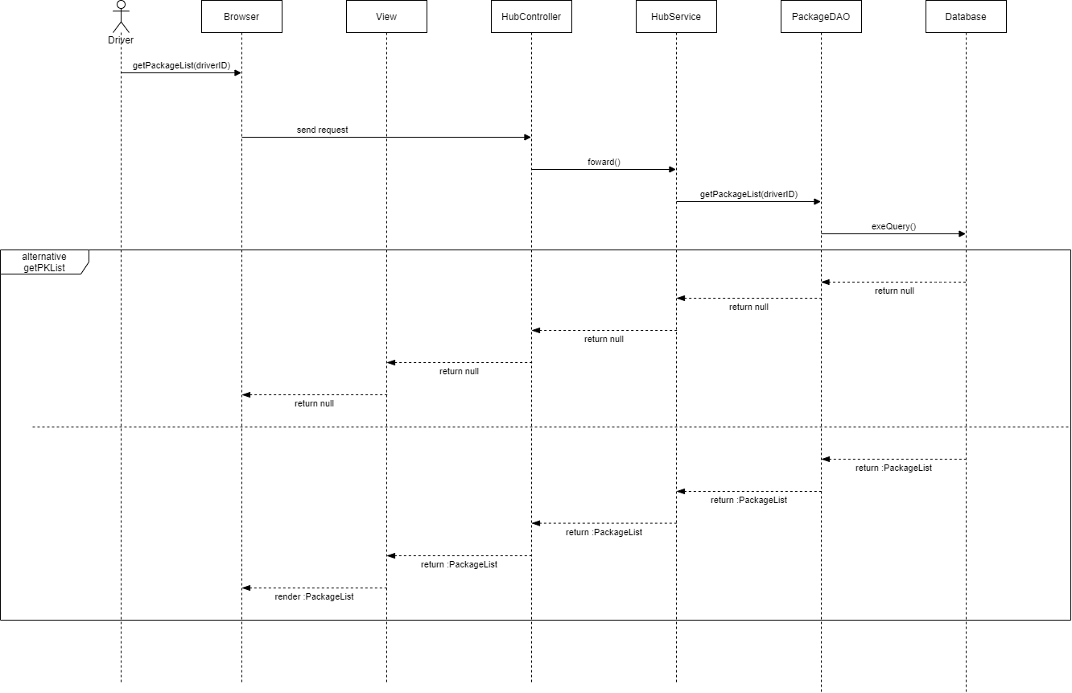
SEQUENCE DIAGRAM DRIVER
getPackageList

Slide 32
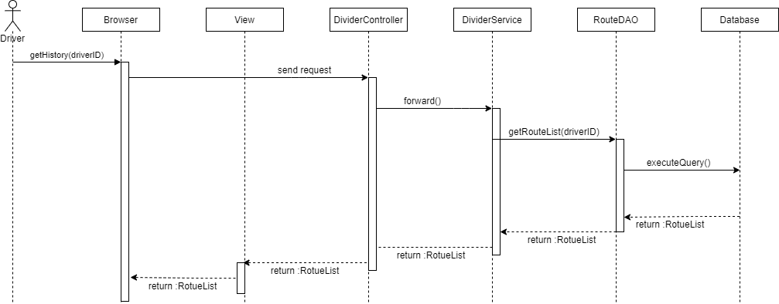
SEQUENCE DIAGRAM DRIVER
viewHistory

Slide 33
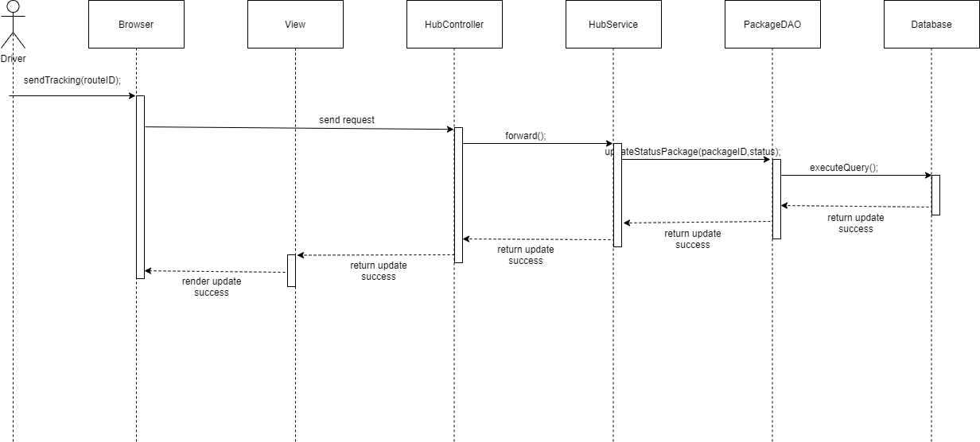
SEQUENCE DIAGRAM DRIVER
sendTracking

Slide 34
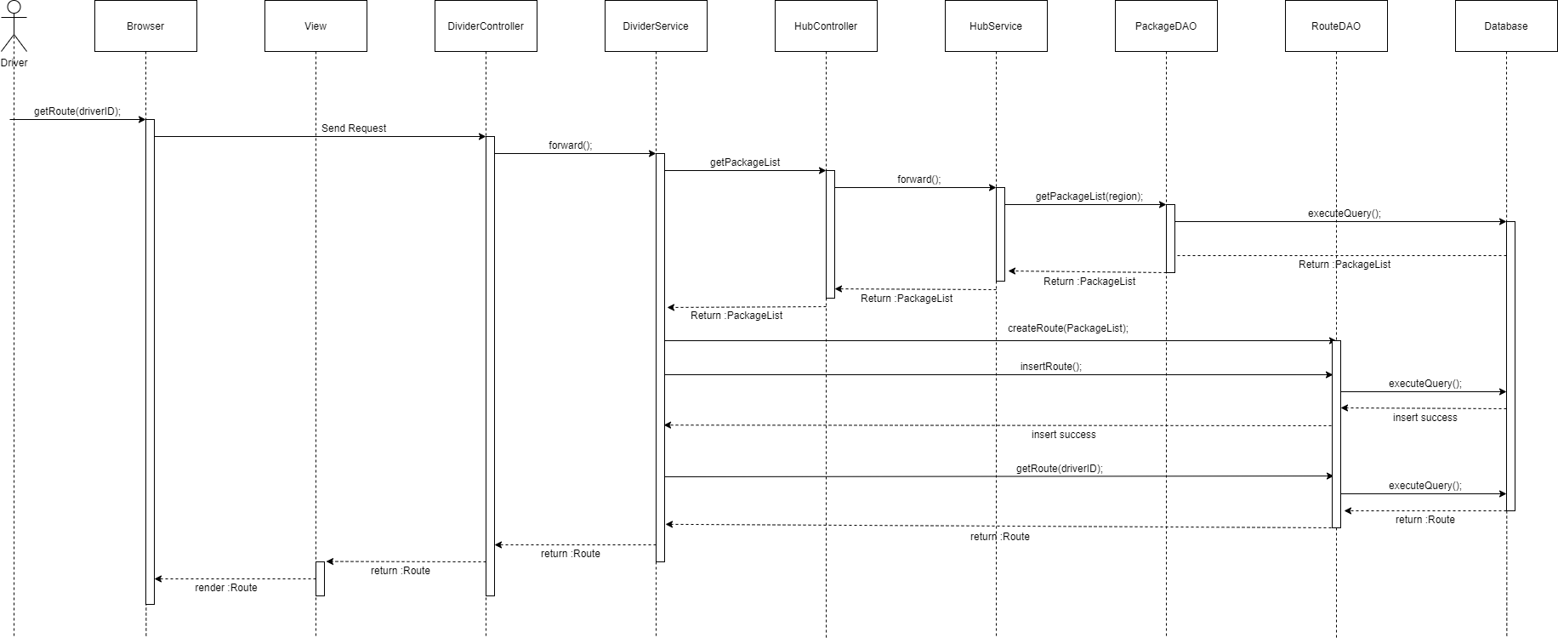
SEQUENCE DIAGRAM DRIVER
getRoute

Slide 35
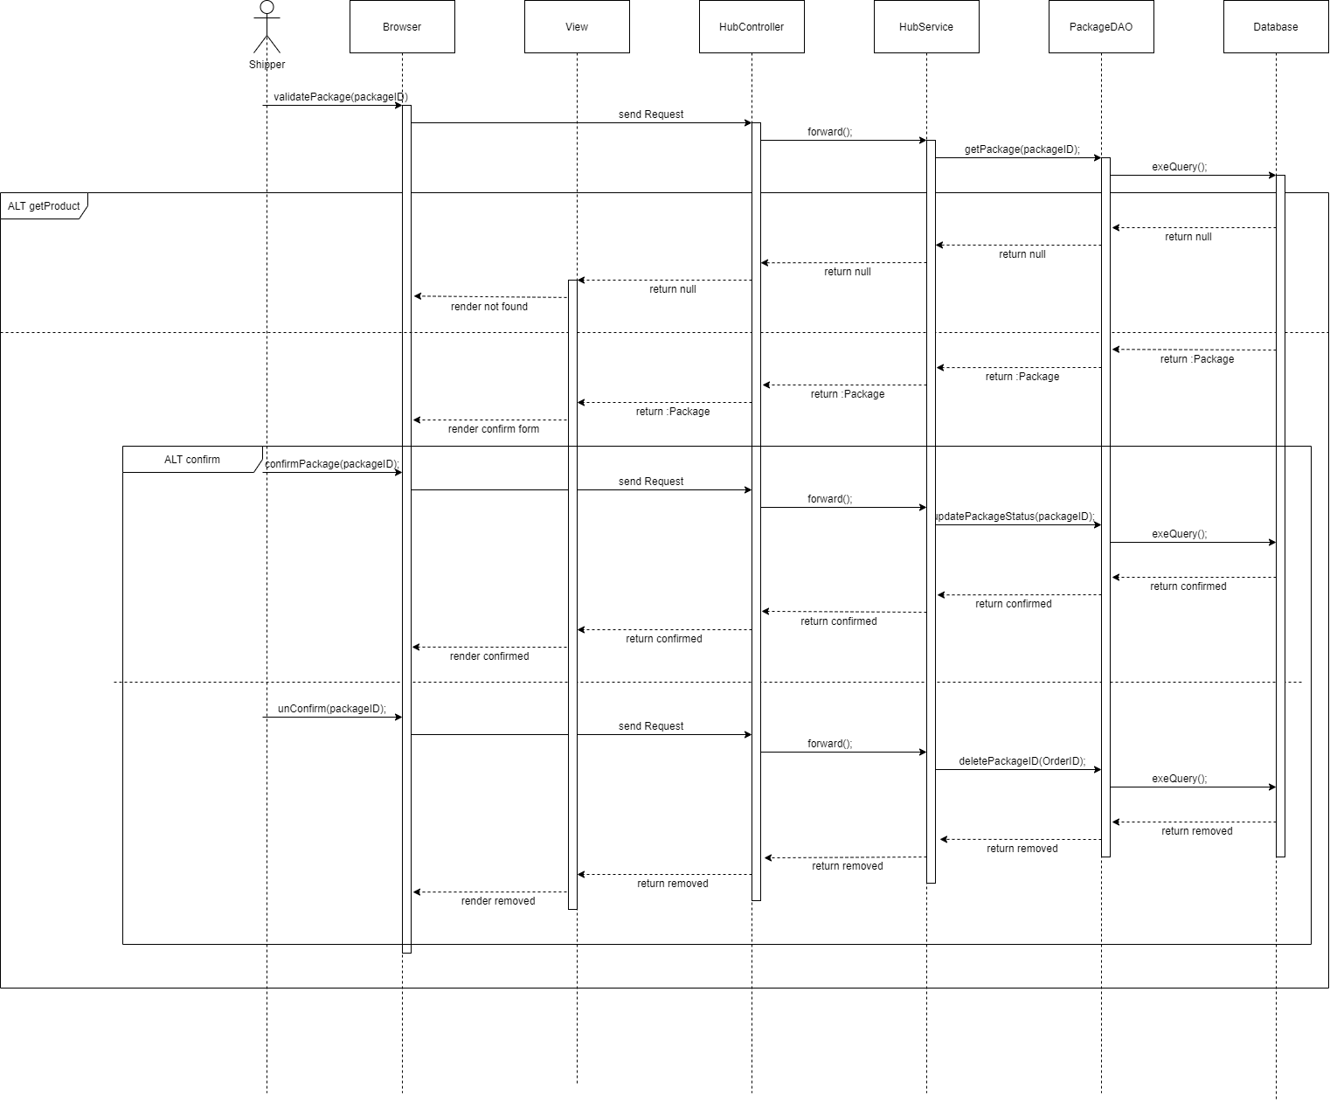
SEQUENCE DIAGRAM SHIPPER
Confirm Package

Slide 36
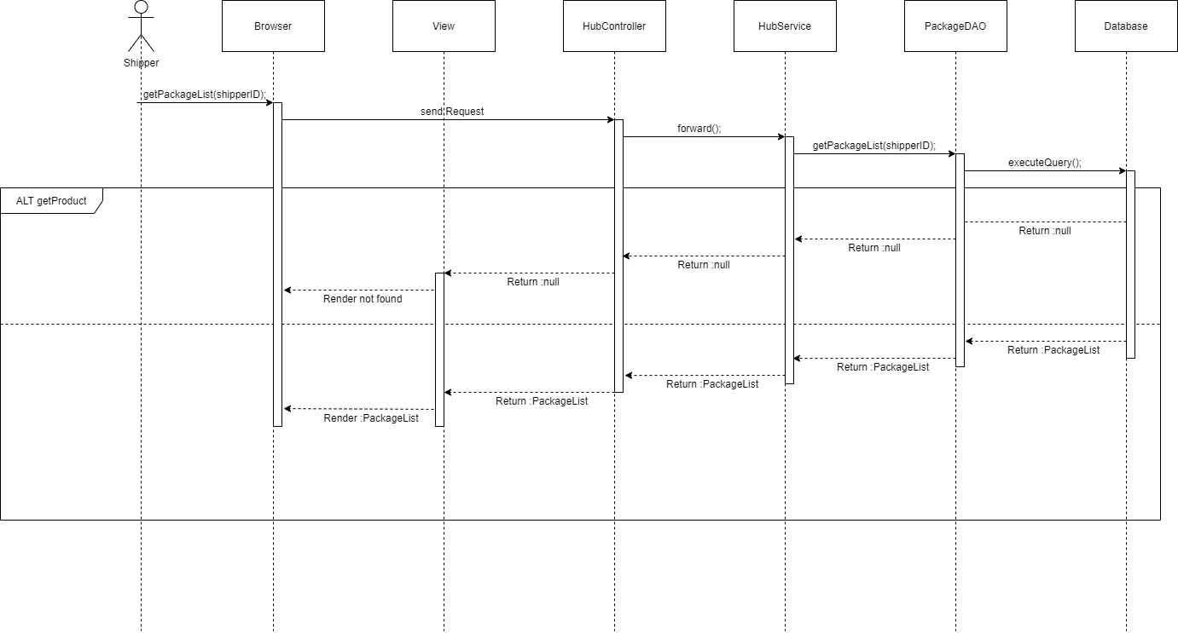
SEQUENCE DIAGRAM SHIPPER
getPackageList

Slide 37
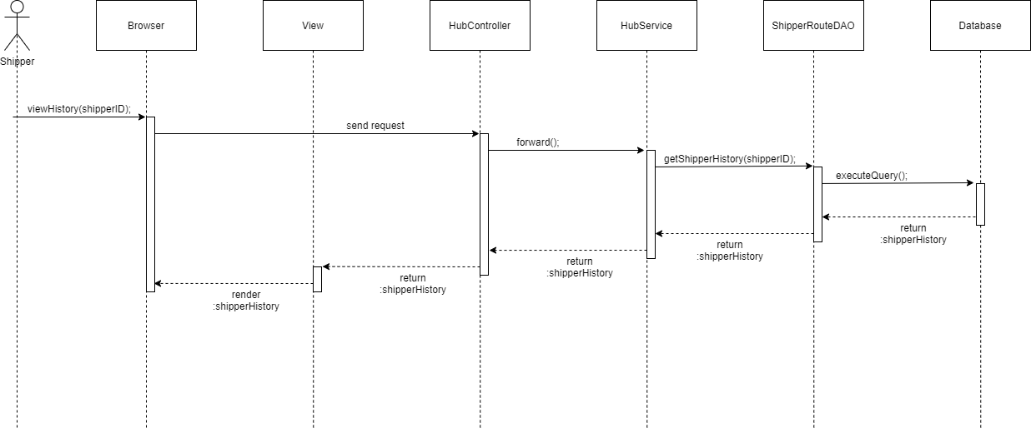
SEQUENCE DIAGRAM SHIPPER
viewHistory

Slide 38
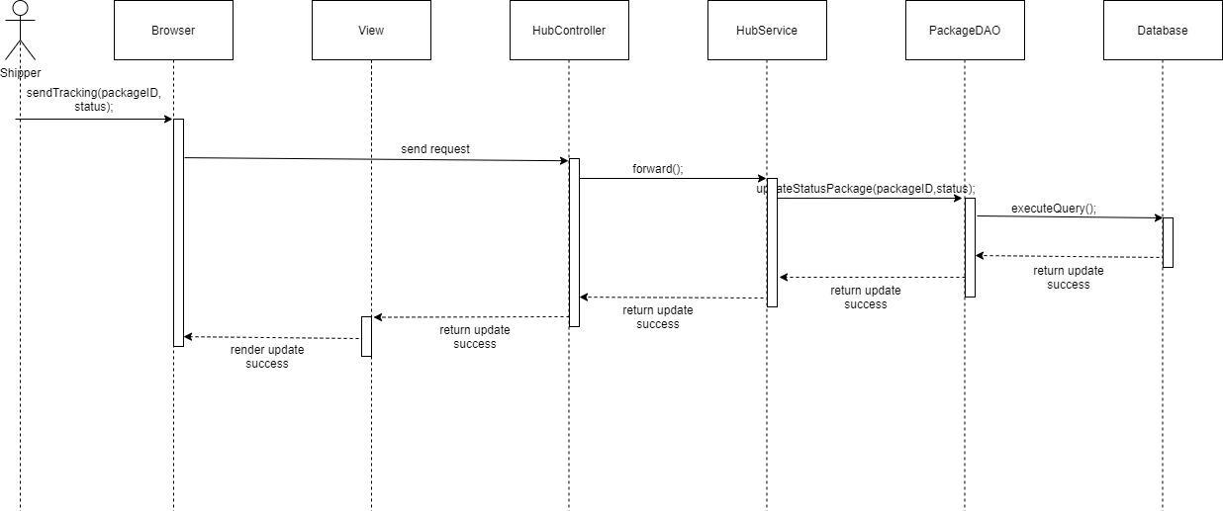
SEQUENCE DIAGRAM SHIPPER
sendTracking

Slide 39
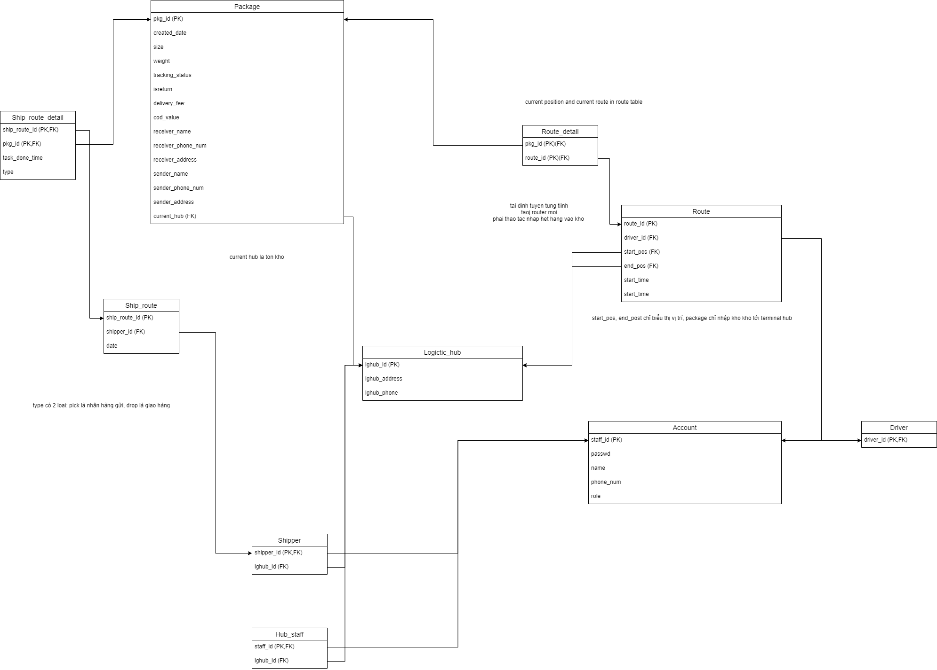
DATABASE
Click to see

