Slide 1




$$F$$
$$m$$
.
$$k∗x$$
$$c∗x$$

Slide 2
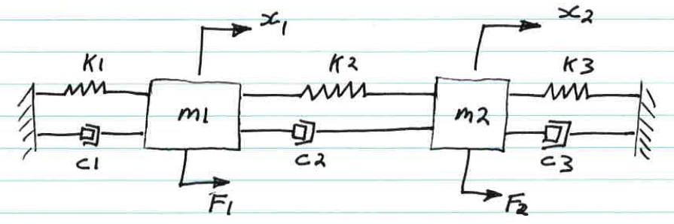
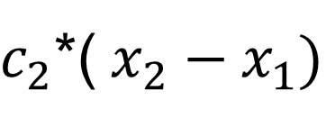

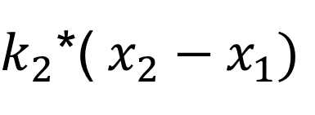

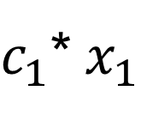

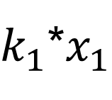
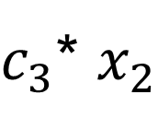

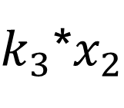
$k_{1}$*$x_{1}$
$k_{2}$*(${ x}_{2} − x_{1})$
$k_{3}$*$x_{2}$
$$m_{1}$$
$$m_{2}$$
.
.
.
.
$c_{1}$*${ x}_{1}$
$c_{2}$*(${ x}_{2} − x_{1})$
$c_{3}$* $x_{2}$
$$F_{1}$$
$$F_{2}$$

Slide 3
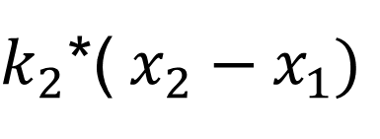

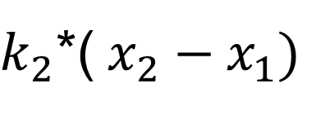


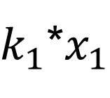

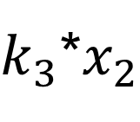
$k_{1}$*$x_{1}$
$k_{2}$*(${ x}_{2} − x_{1})$
$k_{2}$*(${ x}_{2} − x_{1})$
$k_{3}$*$x_{2}$
$$m_{1}$$
$$m_{2}$$
.
.
.
.
.
.
$c_{1}$*${ x}_{1}$
$c_{2}$*(${ x}_{2} − x_{1})$
$c_{2}$*(${ x}_{2} − x_{1})$
$c_{3}$* $x_{2}$
$$F_{1}$$
$$F_{2}$$

