Slide 1

WELCOME

Slide 2
Group Members
Rashmi dongarkar 210543181076
Vaishnavi Patil 210543181066
Akshay Phargade 210543181072
Sayali Dhaygude 210543181094

Slide 3

Presentation on craft foundry

Slide 4

Introduction
Craft foundry concept
About our system

Slide 5
What is craft foundry
The concept of this project is to develop a general purpose e-commerce store where product can be bought from the comfort of home through the Internet. It will Provide a platform to skilled people to sell there handmade product.

Slide 6
About our system
Our system is an e-commers website from where people can buy product plus can sell the product
Admin monitore the activity of the users and coustomer

Slide 7
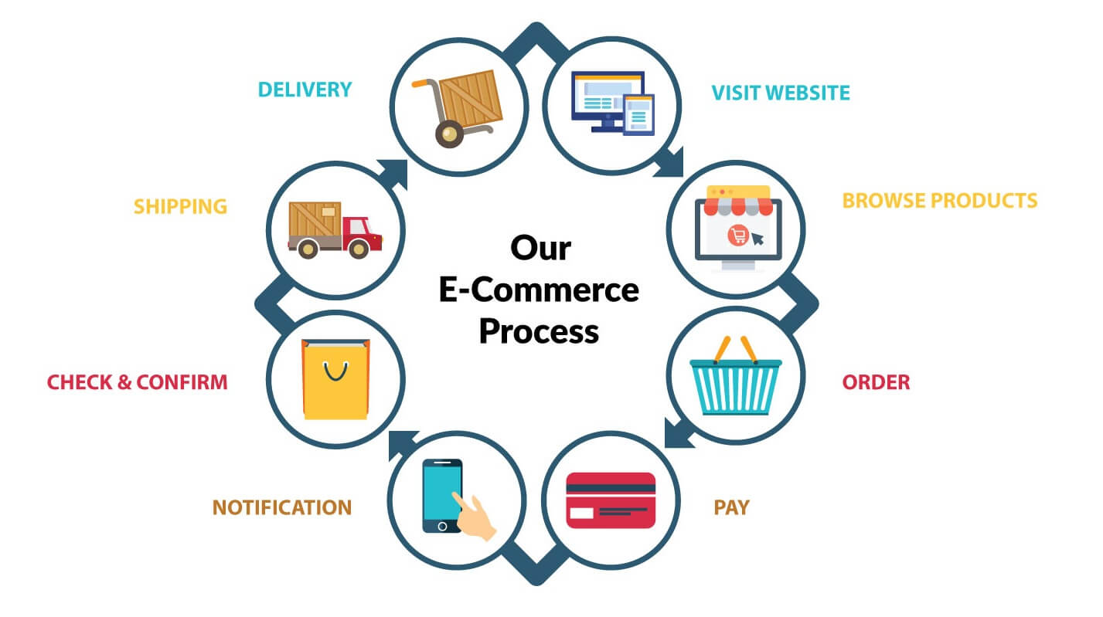
The process of craft foundry

Slide 8
Features
It tracks all the information related with user registration, order, etc.
Product tracking. ...
Order tracking. ...
User tracking….
Product suggestion. ...
Notification. ...
Product/Order report ...
Skilled person will be sell their product.
It will Provide a platform to skilled people to sell there handmade product.
The customer will be able to directly buy from the manufacturer.
All types of handmade items will be available.
Only handicrafts items will be allowed to sell.

Slide 9
Languages Tools
HTML 5,
CSS 3,
JAVA SCRIPT,
JQUERY,
AJAX,
BOOTSTRAP,
REACT JS
BACKEND - Java, SPRING
DATABASE - MYSQL

Slide 10
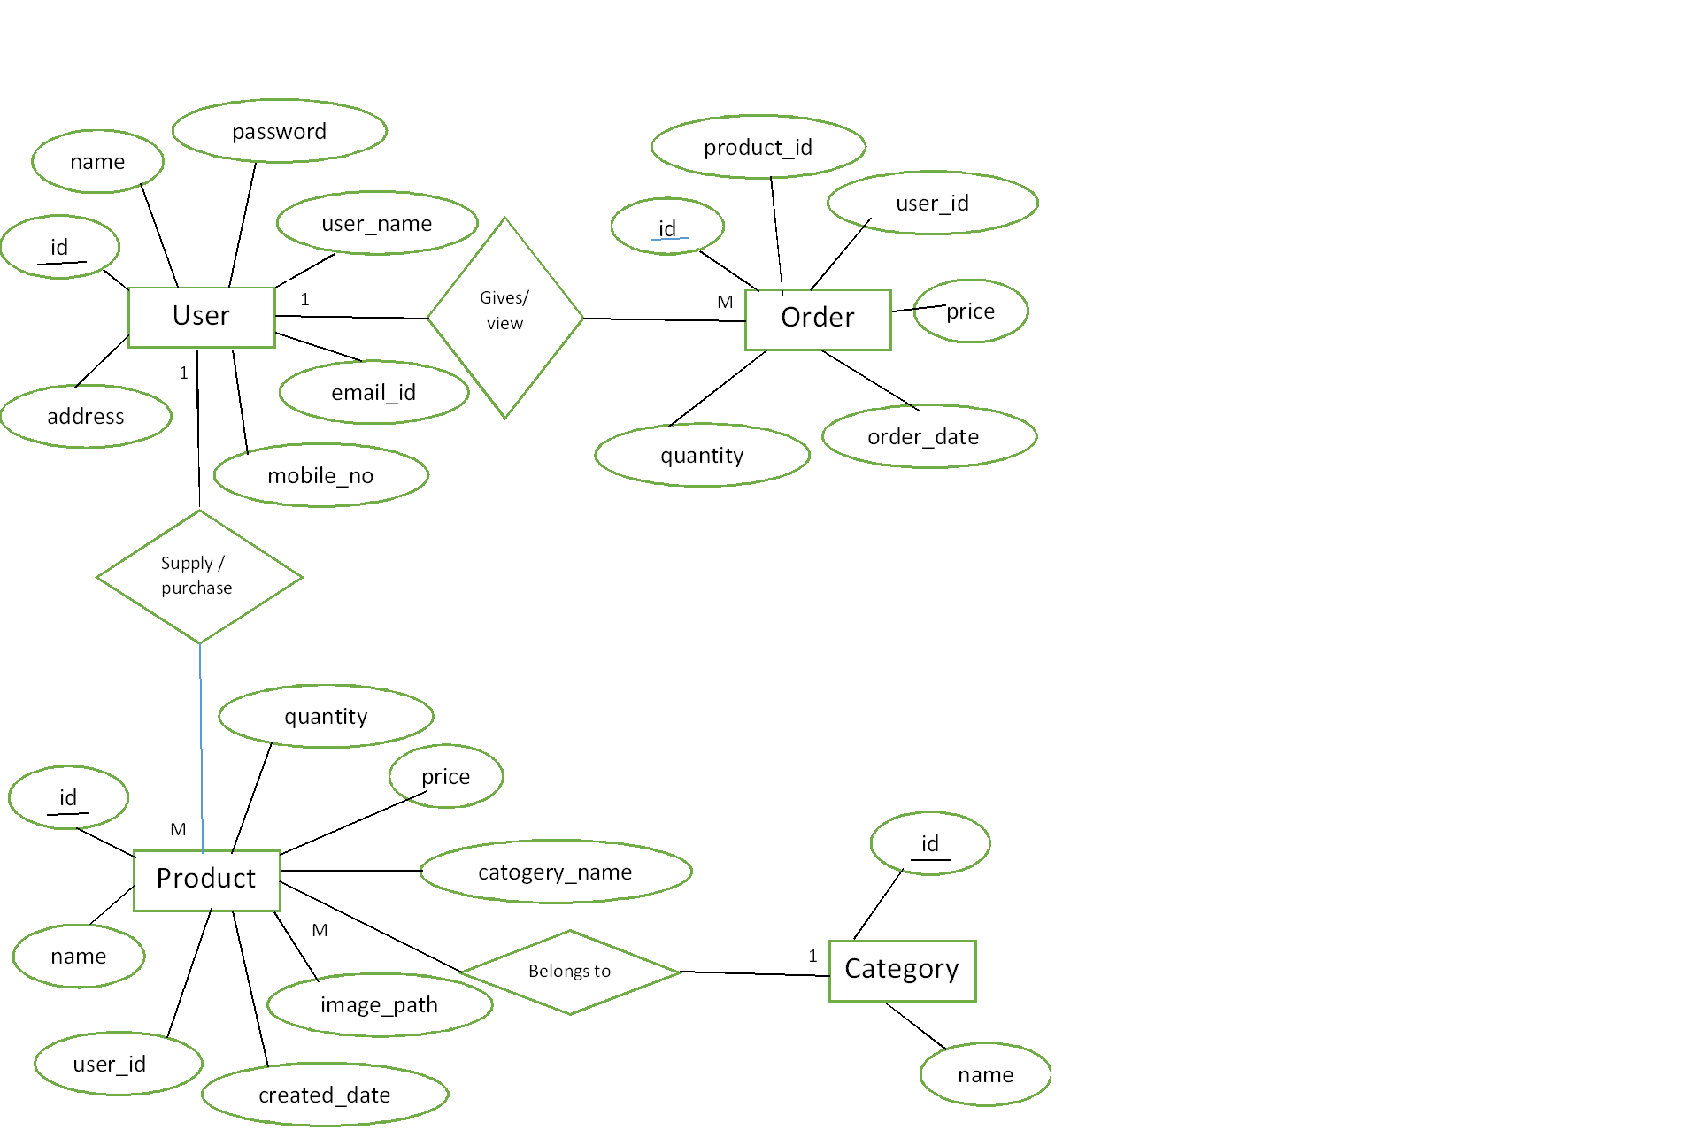
ER -Diagram

Slide 11
Advantages of Craft Foundry
Confidence boost
Increases empathy
Enhances brain productivity
There is more variety
Environment friendly
Good quality and uniqueness
Minimum investment
Improves the creativity and skills

Slide 12
Future Plan
We are thinking of some modification and adding some advantages new features in our system. Some of them are
GUI Modification(More user friendly)
User can sell their Product
User can sign up/Login using their social media account such as facebook ,Google etc.

Slide 13
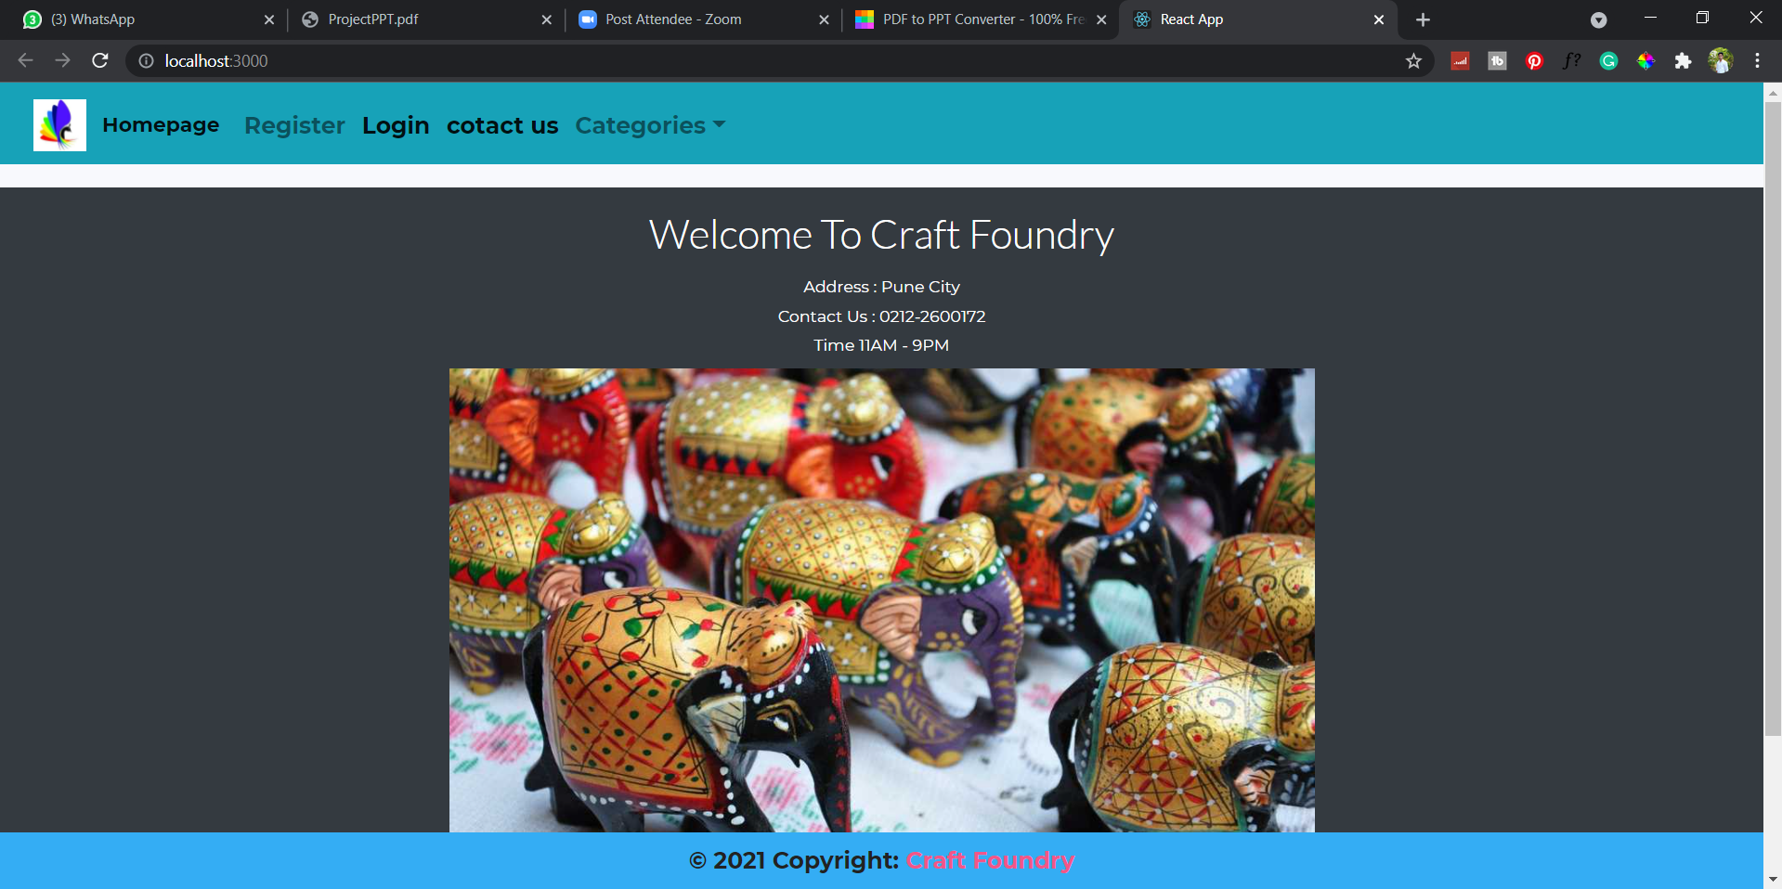
Homepages

Slide 14
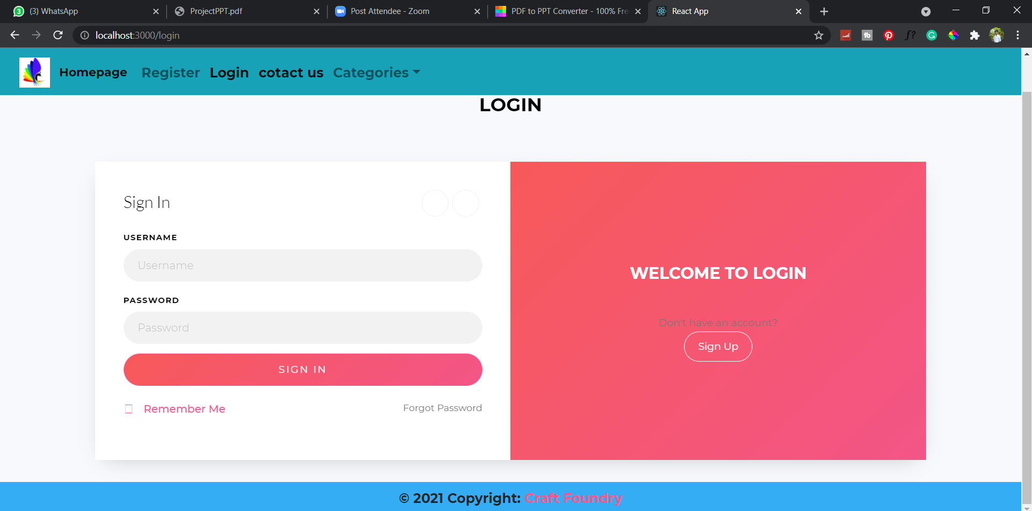
Login Page:

Slide 15
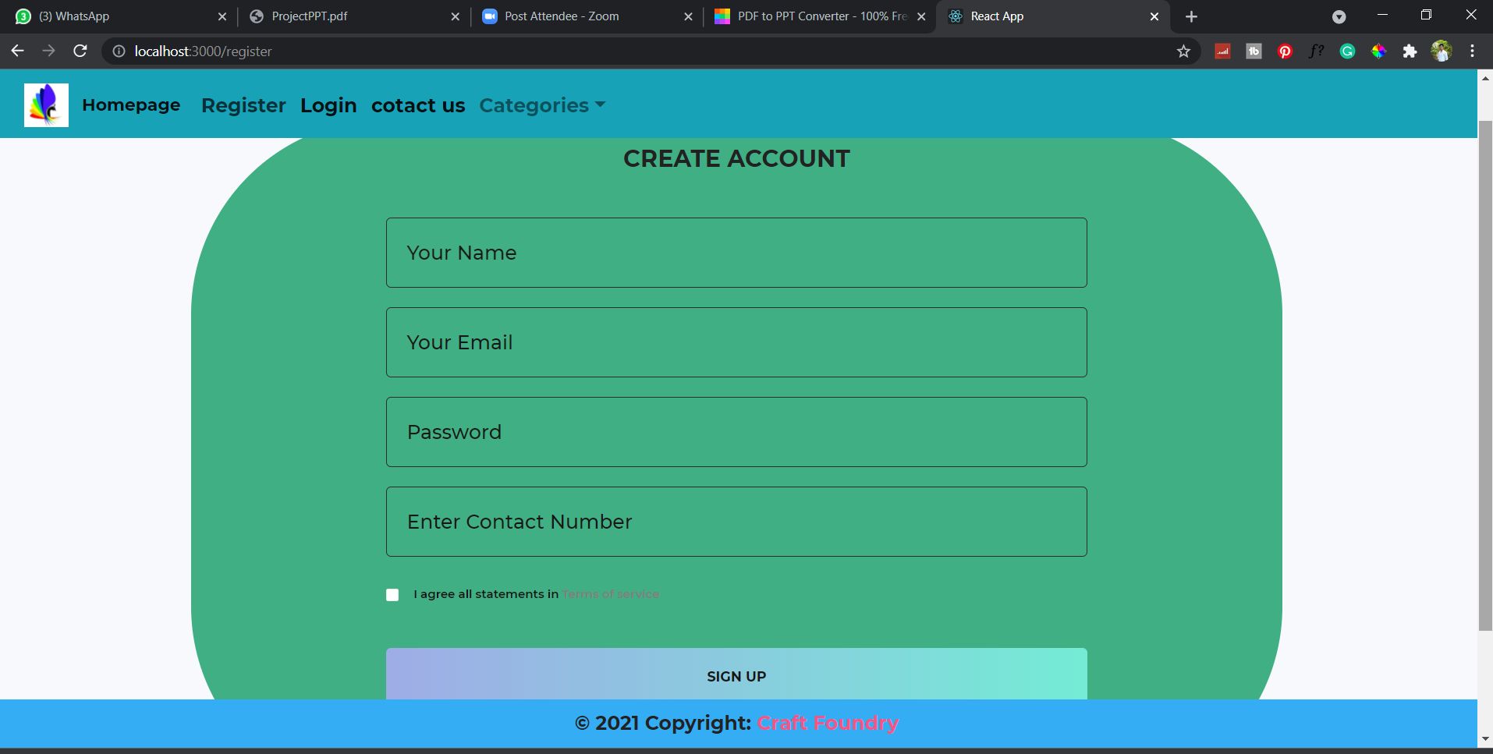
Sign Up Page:

Slide 16
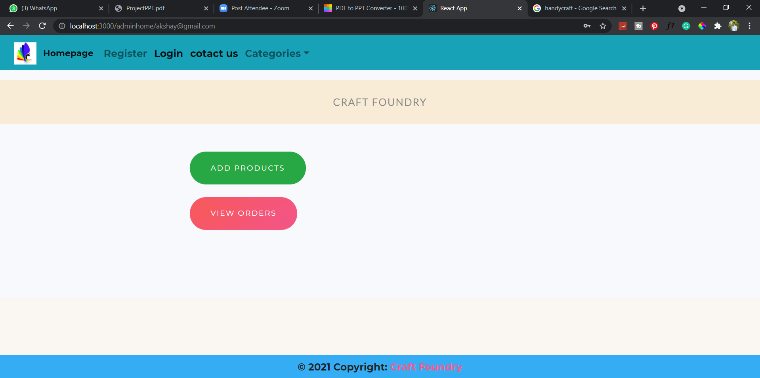
Admin Panel

Slide 17
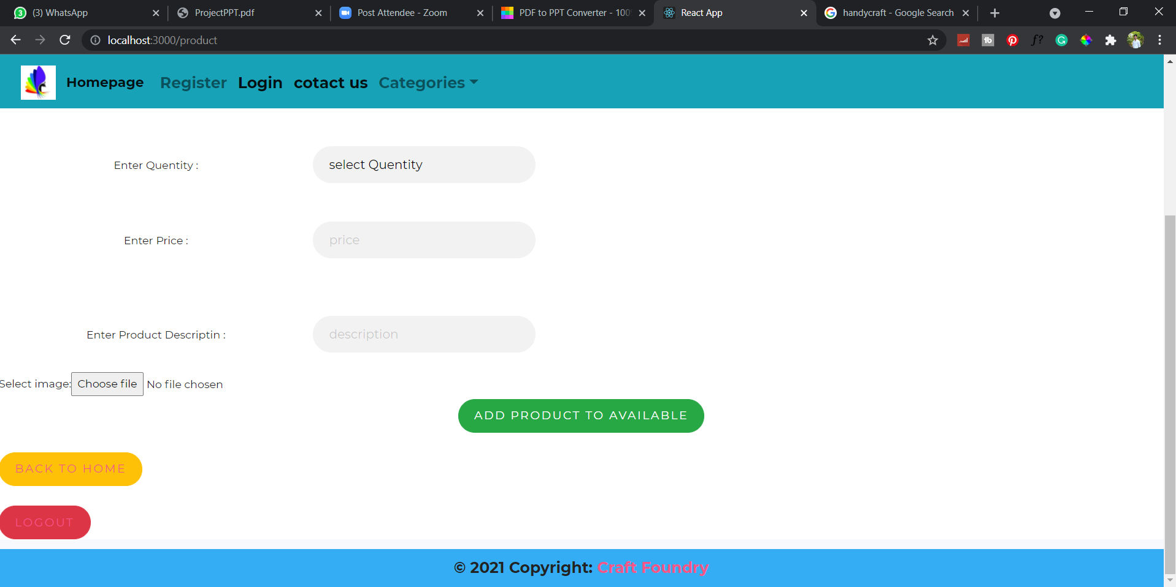

Slide 18
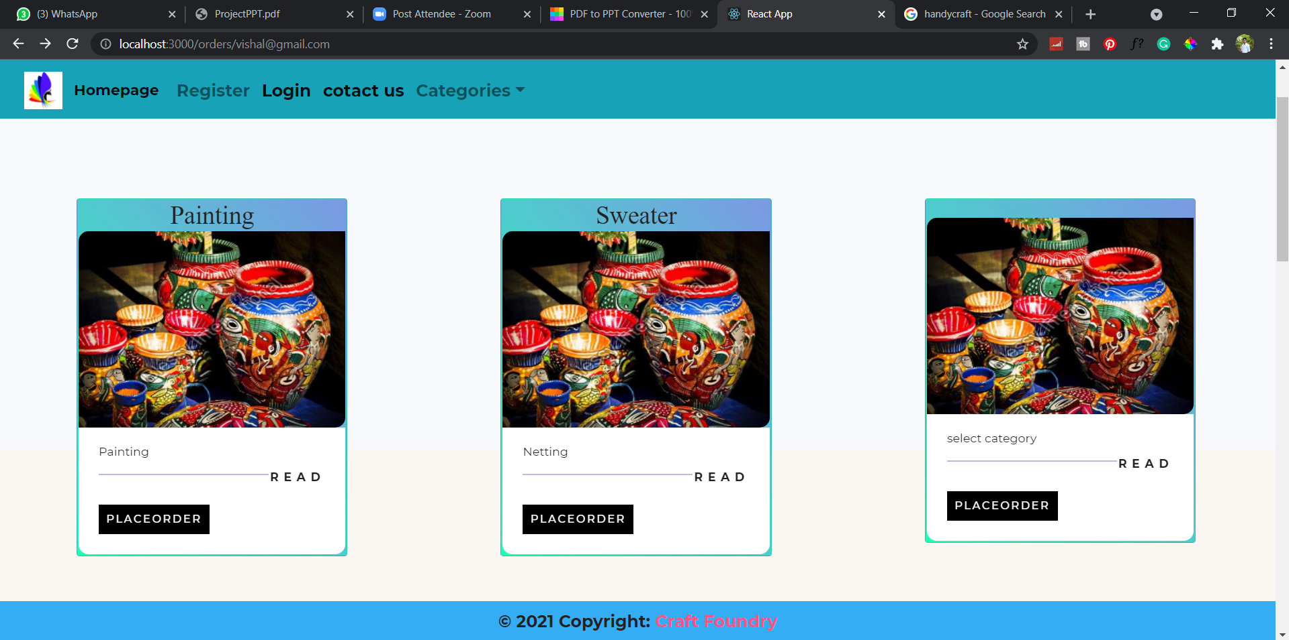
Insert Product Images

Slide 19
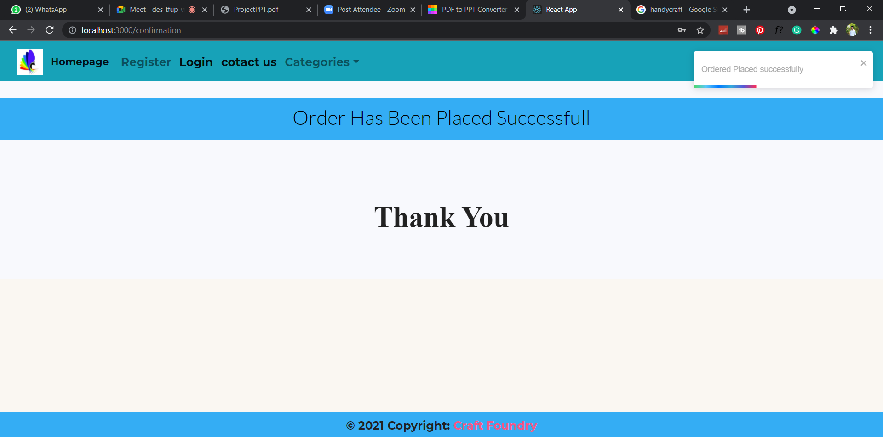
Order Placed page:

Slide 20

Thank
YOU

