Slide 1
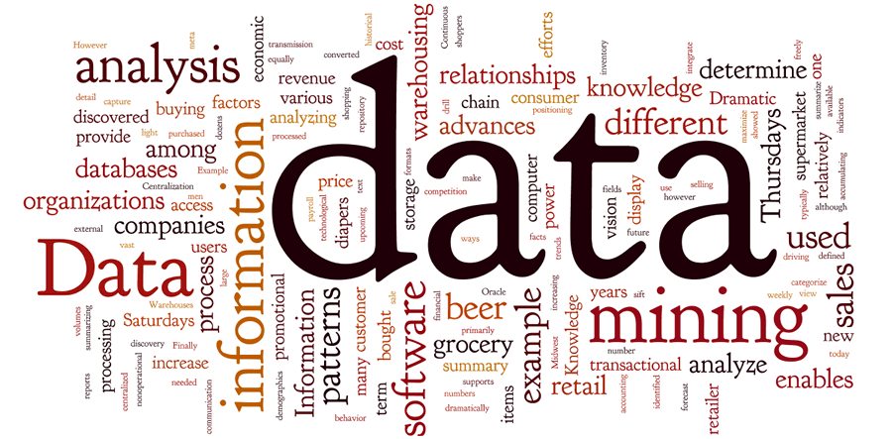
Breast Cancer Prediction
Using Data Mining
Supervised by
Dr. Suzan Arslantürk
Presented by
Debadeep Pharikal
Bipasha Banerjee

Slide 2
Table of Contents
01
02
03
About the Project
Dataset
Pre-Processing
04
05
Model Analysis
Conclusion

Slide 3
Introduction
After skin cancer, breast cancer is the most common cancer diagnosed in women in the United States.
Breast Cancer occurs when some breast cells begin to grow abnormally. These cells divide more rapidly than healthy cells do and continue to accumulate, forming a lump or mass.

Slide 4
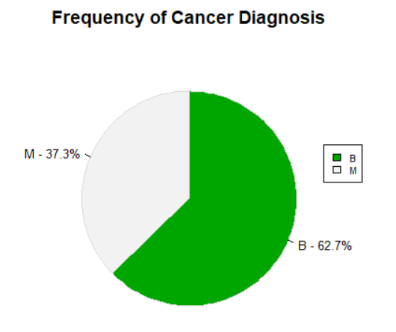
Dataset
Breast Cancer Wisconsin (Diagnostic) Data Set from UCI
Number of instances: 569
Number of attributes: 32 (ID, diagnosis, 30 real-valued input features)
Diagnosis is a categorical variable used as class label.
Class distribution: 357 benign, 212 malignant.
Missing attribute values: none

Slide 5
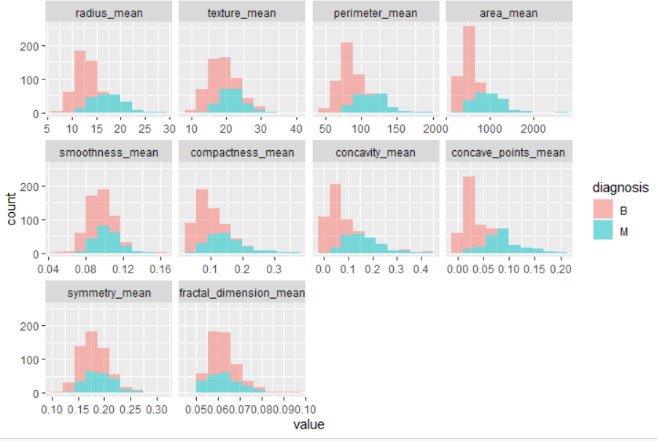
Data Exploration

Slide 6
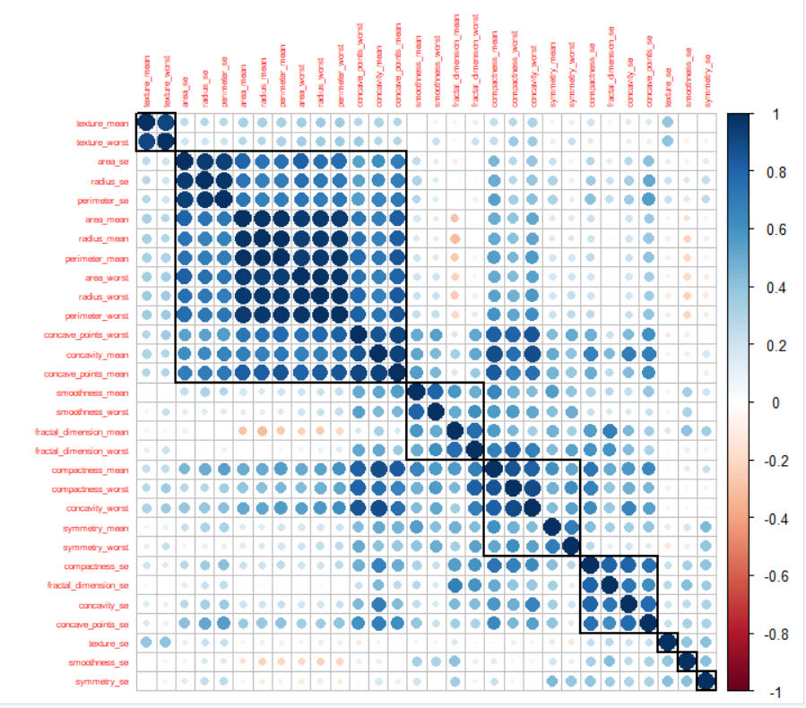
Attribute Co-relation

Slide 7
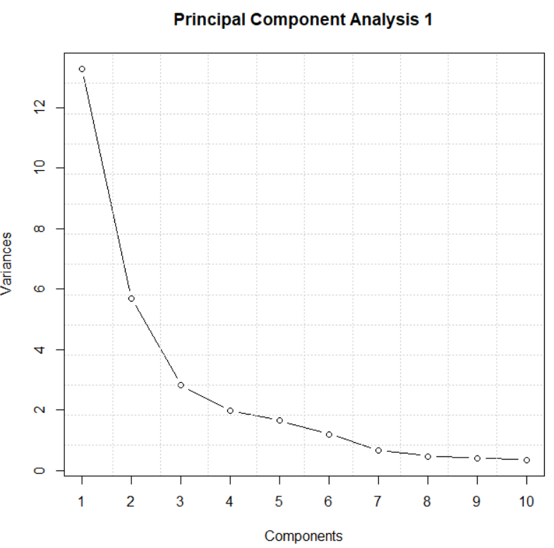
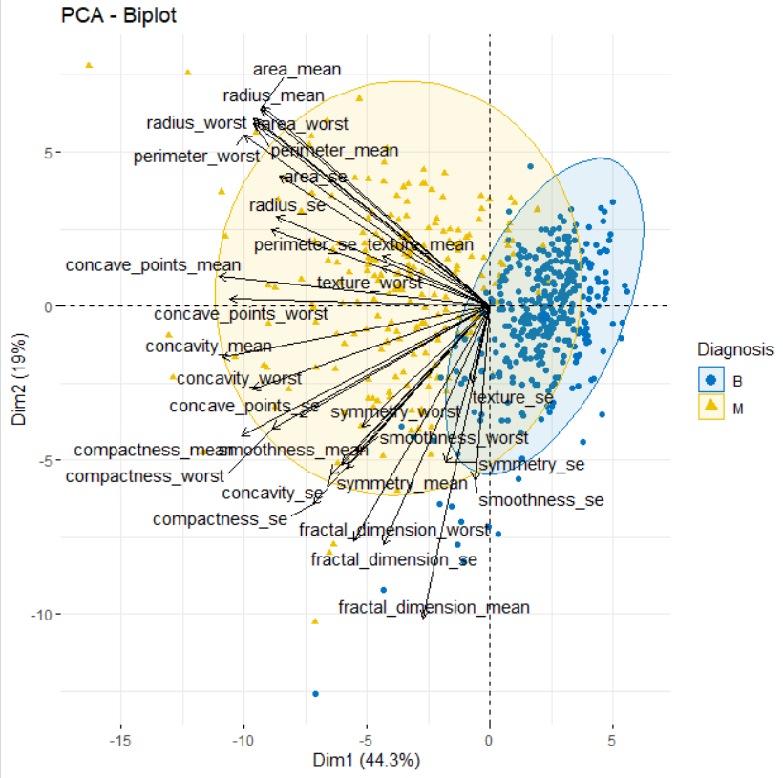
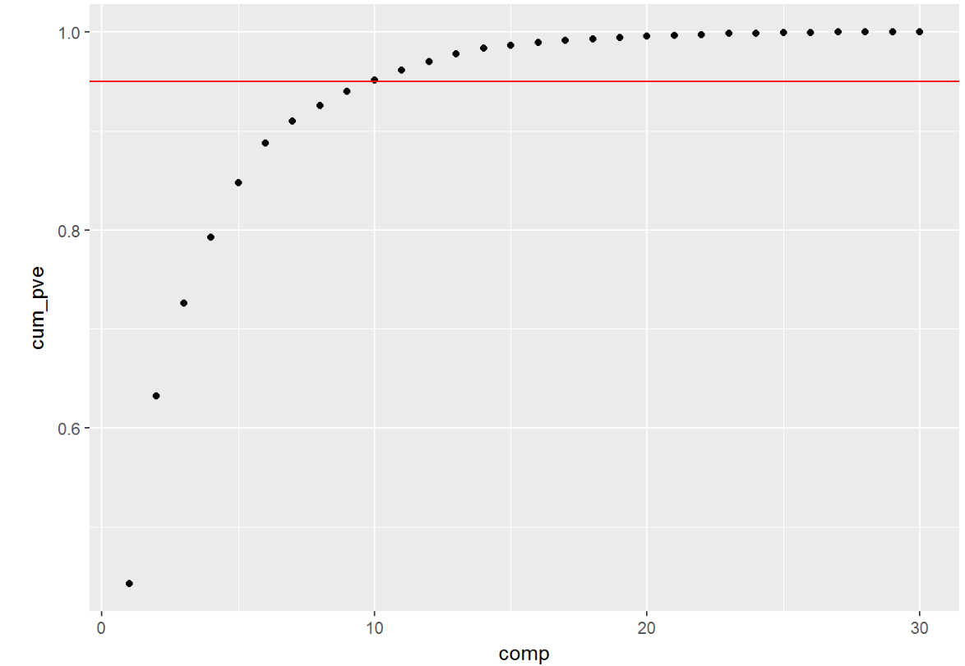
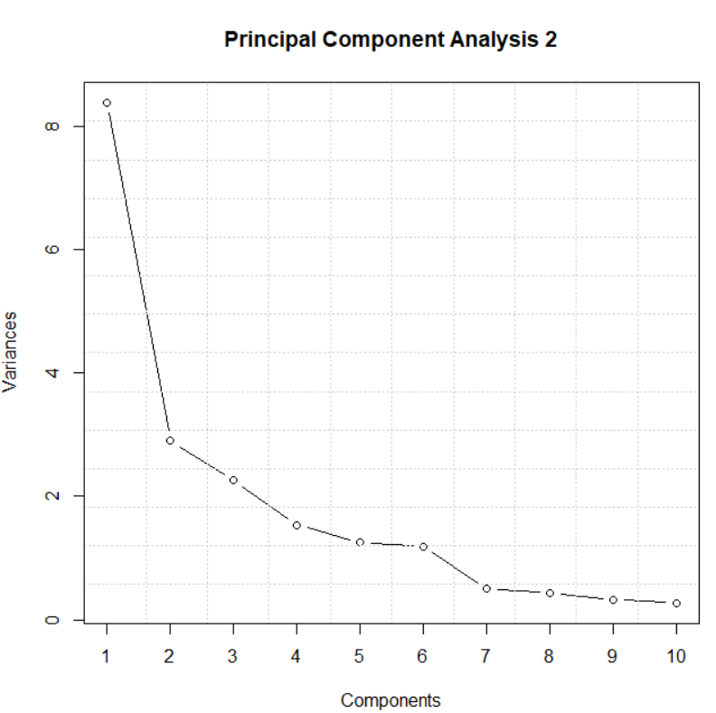
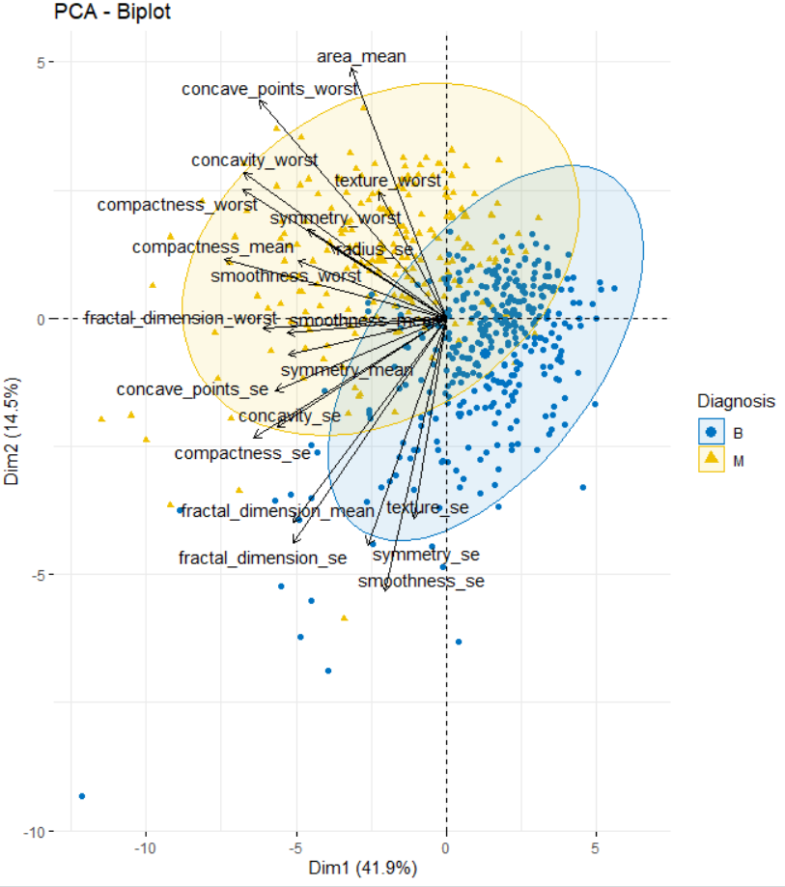
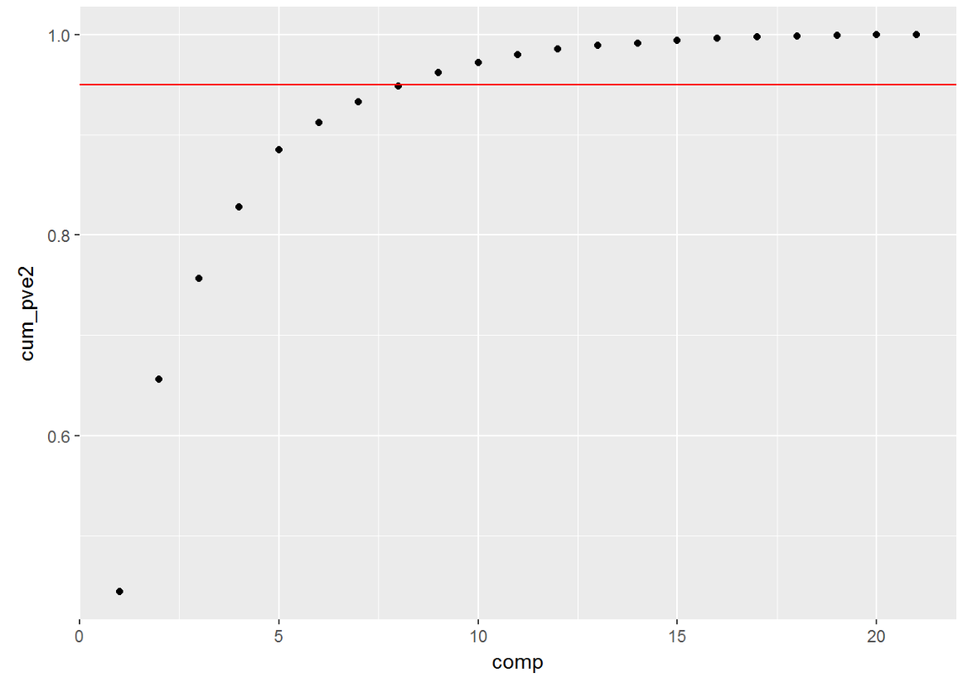
Principal Component Analysis

Slide 8
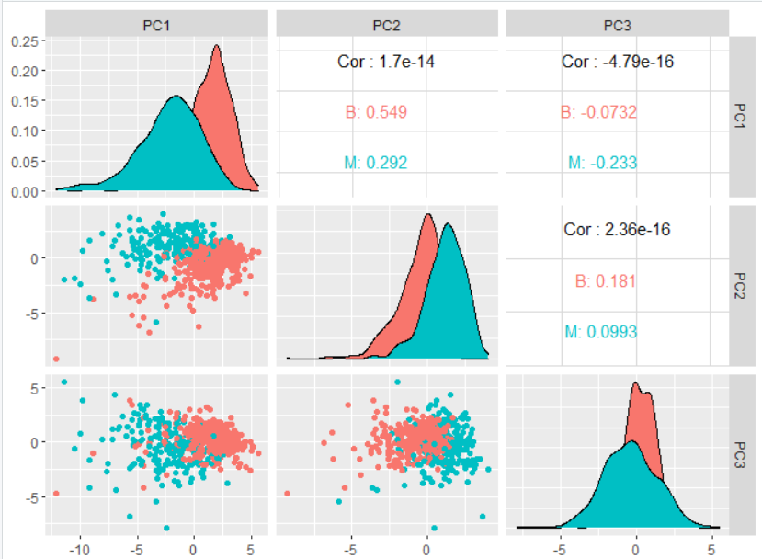
PCA Visualization

Slide 9
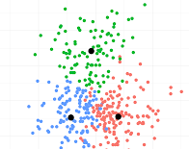
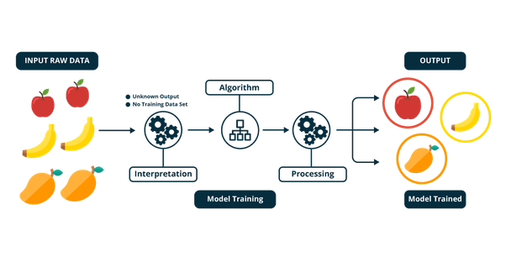
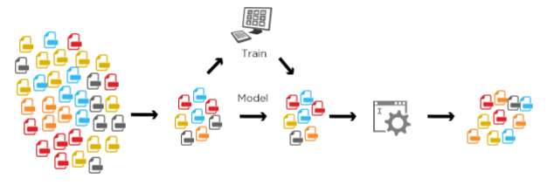
Modeling Approach
Un-Supervised
Supervised
Semi-Supervised
(Without labelled data)
(With labelled data)
(Combination of labelled & unlabeled data)

Slide 10
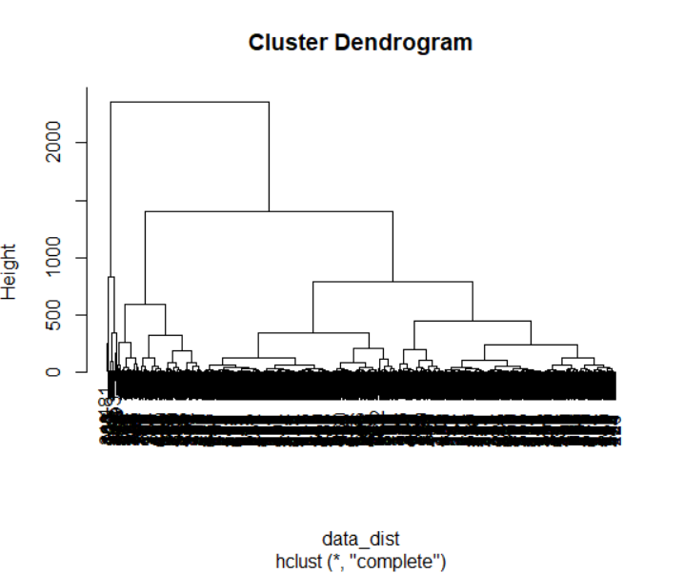
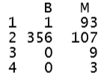

Unsupervised Learning
Hierarchical Clustering: cut into 4 clusters
K- Means : 2 cluster
Hierarchical to actual diagnosis
K-means to actual diagnosis

Slide 11
Supervised Learning
Naive Bayes
Logistic Regression
SVM with radial kernel
Random Forest
K Nearest Neighbor
Neural Network

Slide 12
Supervised Learning
Model Parameters:
Dataset is divided into 80:20 ratio for training & testing
Model evaluation with PCA variables Used caret preProcess
with a 0.99 threshold.
Keras & Tensorflow used for Neural Network (implemented in R)

Slide 13
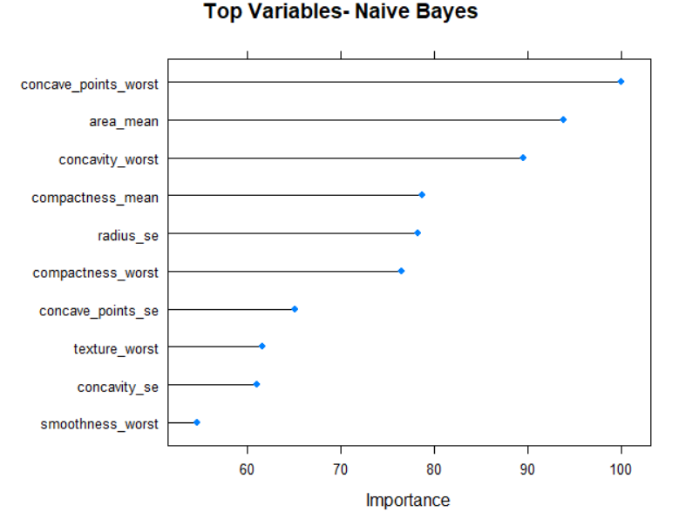
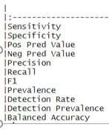

Naïve Bayes
Confusion Matrix
B M
B 67 5
M 4 37
Results
Balanced Accuracy : 91.23%

Slide 14
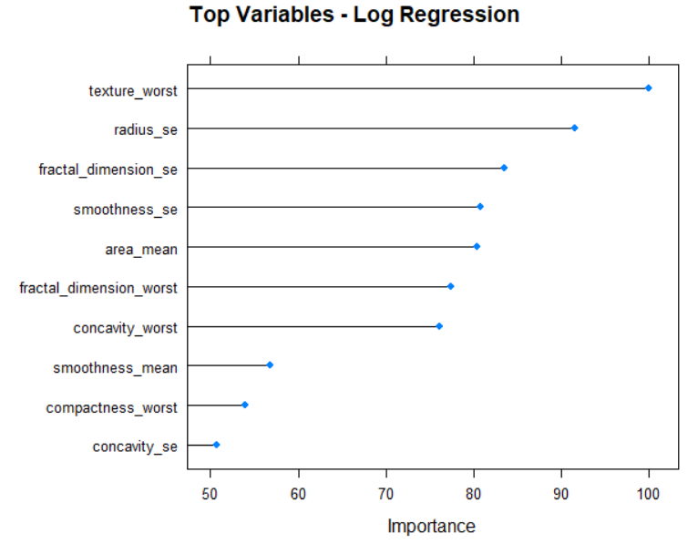
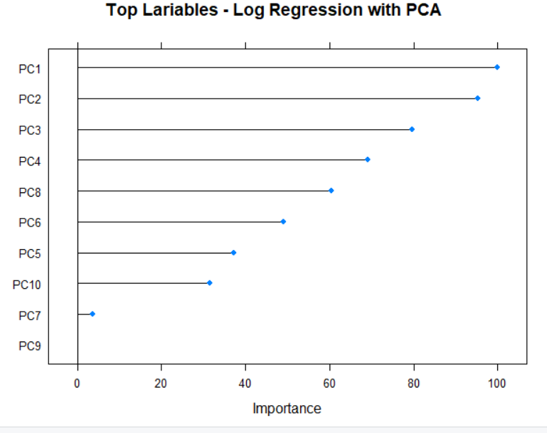
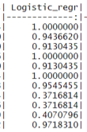
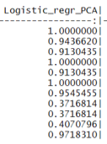
Logistic Regression
Confusion Matrix
B M
B 67 0
M 4 42
Results
Balanced Accuracy : 97.18%
No Impact on results using PCA

Slide 15
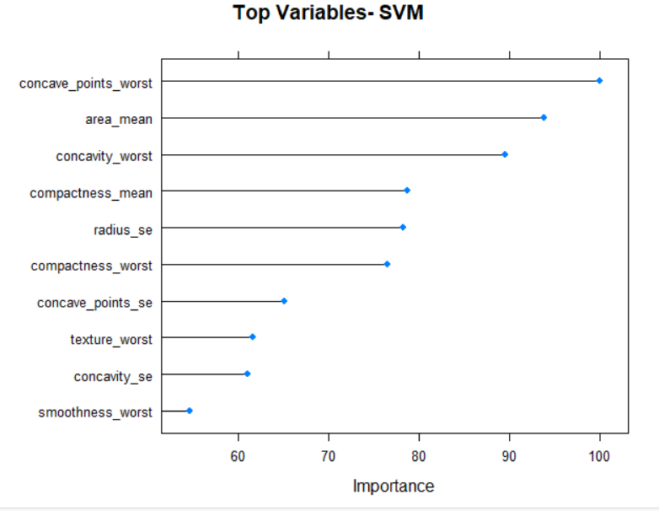

Support Vector Machines
Confusion Matrix
B M
B 69 2
M 2 40
Results
Gaussian RBF (Radial Basis Function) kernel method is used
Balanced Accuracy : 96.21%

Slide 16
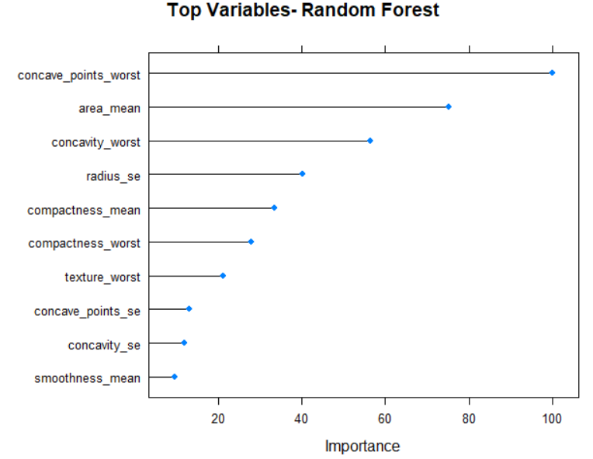
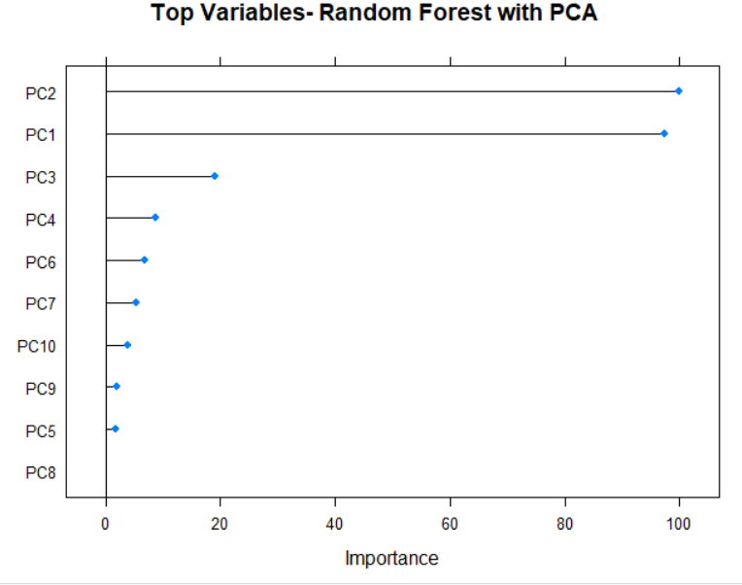
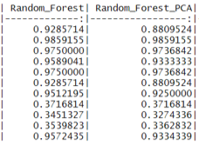
Random Forest
B M
B 70 5
M 1 37
Confusion Matrix
B M
B 70 3
M 1 39
Confusion Matrix(PCA)
Result:
Balanced Accuracy : 95.72%
Balanced Accuracy (PCA) : 93.34%
PCA variables produce comparatively lower accuracy

Slide 17
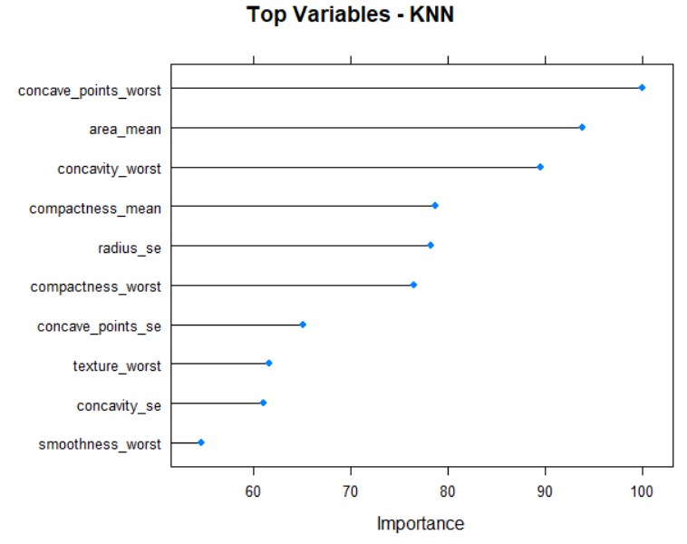

K-Nearest Neighbor
Confusion Matrix
B M
B 71 6
M 0 36
Results
Balanced Accuracy : 92.86%

Slide 18
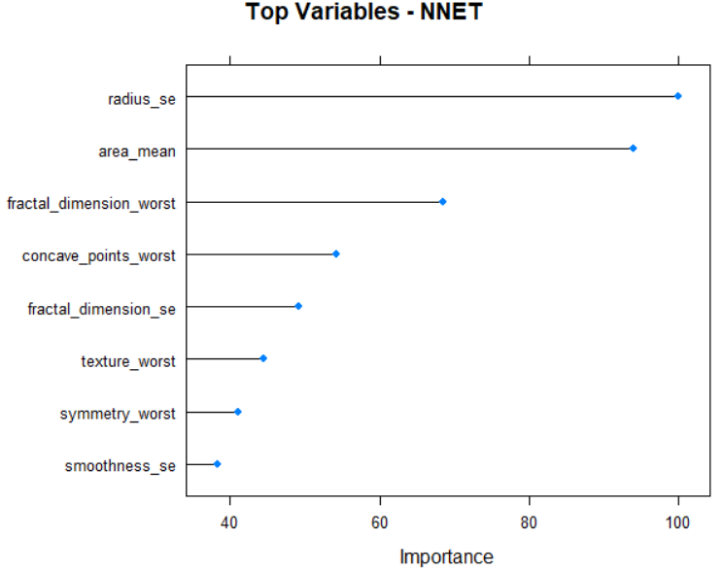
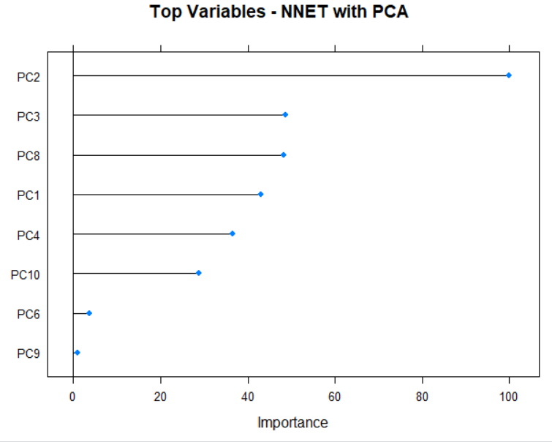
Neural Networks
Confusion Matrix
Confusion Matrix(PCA)
Confusion Matrix(LDA)
B M
B 69 2
M 2 40
B M
B 68 1
M 3 41
B M
B 70 1
M 1 41

Slide 19
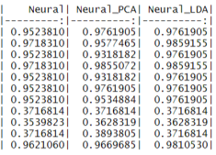
Neural Networks
Results
Balanced Accuracy : 96.21%
Balanced Accuracy (PCA) : 96.69%
Balanced Accuracy (LDA) : 98.10%

Slide 20
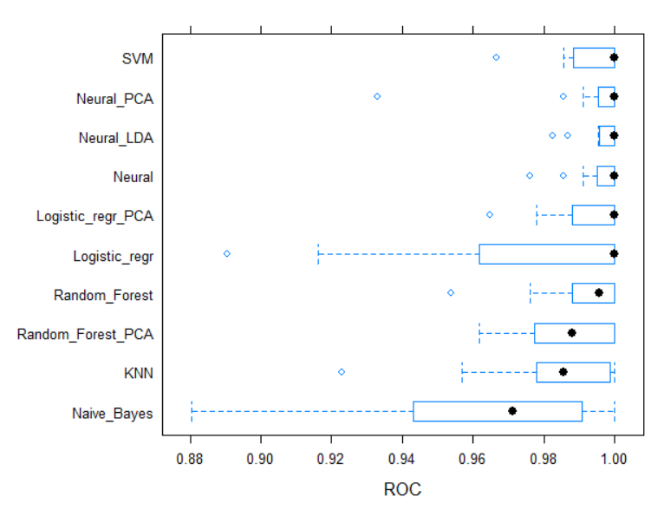
Comparison (ROC)
Highest Balanced Accuracy obtained in Neural Network
Best suitable model
Need experiment with multiple layers and various activation function for robustness

Slide 21
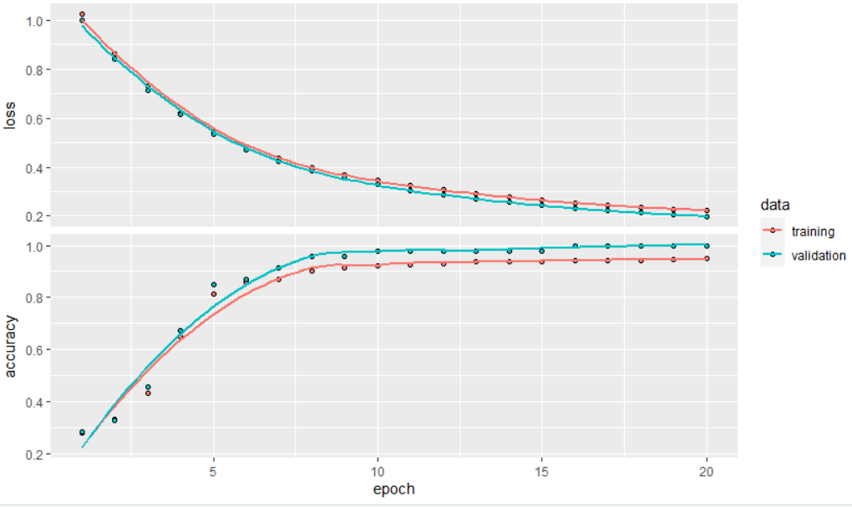
Multi Layer Perceptron

Slide 22
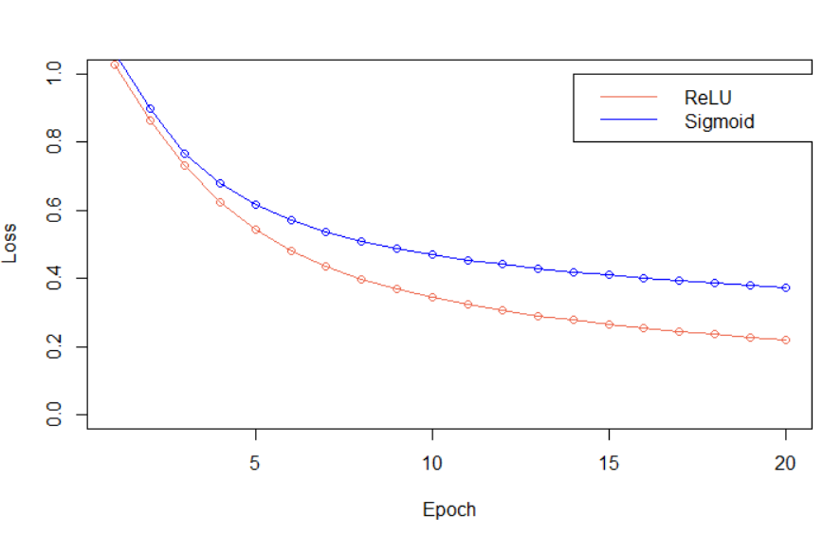
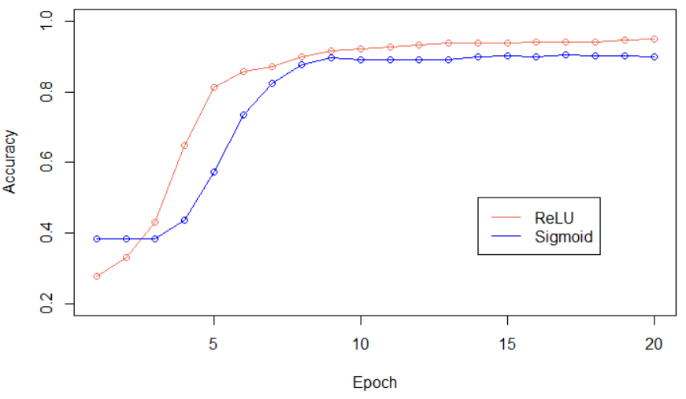
ReLU vs Sigmoid

Slide 23
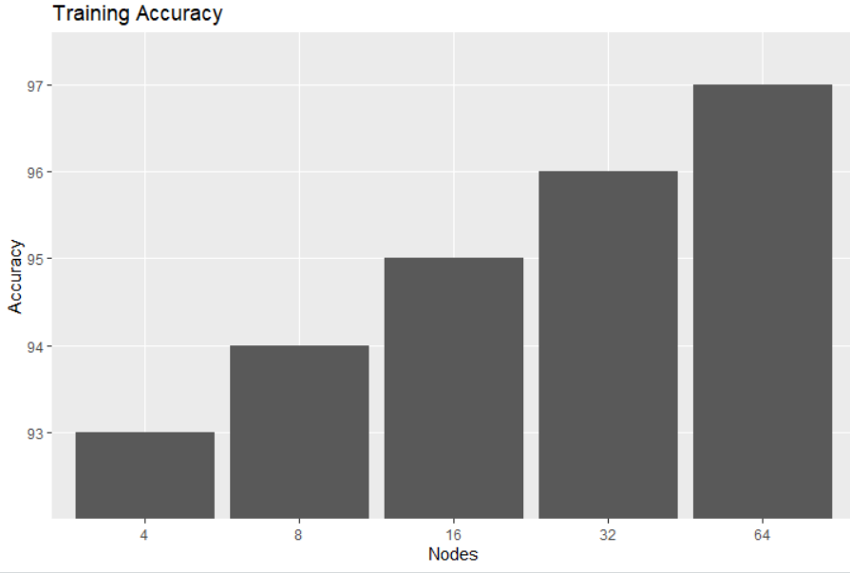
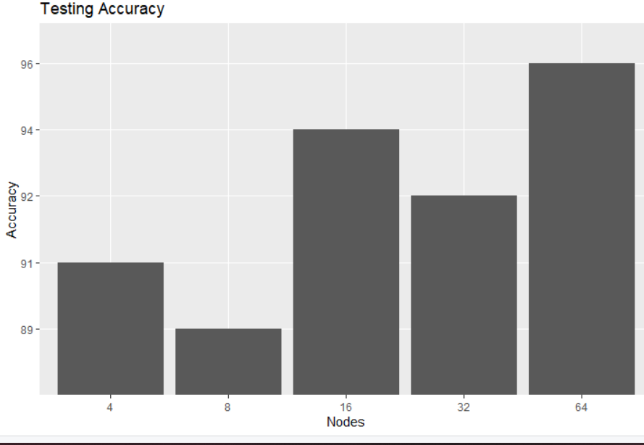
Experiment with multiple Hidden Layers

Slide 24
Semi-Supervised Learning
Previous Literature Review & Novel area of Project:
Self-Training (Yarowsky, 1995)
Self-Training with Editing : SETRED (Li and Zhou, 2005)
Self-training Nearest Neighbor Rule using Cut Edges : SNNRCE (Wang et al., 2010)
Tri-training (Zhou and Li, 2005)
Co-training (Blum and Mitchell, 1998)
Democratic Co-Learning (Zhou and Goldman, 2004)

Slide 25
Semi-Supervised Learning
Model Parameters:
Dataset is divided into 70:30 ratio for training & testing
From Training Set : 70% data is being Unlabeled to support Semi-Supervised Model
Base Classifier Used for all model: k-SVM
Only democratic method requires the specification of more than one base classifier. KNN, SVM and decision trees(C5.0)
All model is compared with k-SVM supervised model

Slide 26
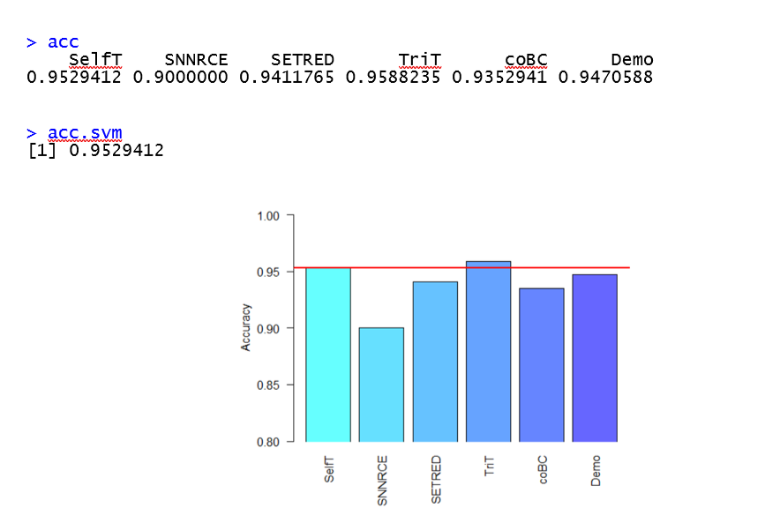
SSL: Comparison with SL

Slide 27
Conclusion
Unsupervised Learning is not best-fit
High Accuracy with Supervised model
Neural Layer is the best model
Activation Function has great impact in accuracy prediction
Changing Perceptron Layer change accuracy
Novel method implemented in SSL
Has impressive and comparable accuracy w.r.t SL

Slide 28

Thank You..

