Slide 1
Navigating Programming Language Transitions in Pharma
Community Meeting
12:00 EST
26th Nov, 2024

Slide 2








R Consortium Pragmatic Support with Global Reach
R Consortium Community Grants and Sponsorships Over USD $1.4 Million
Organize large scale collaborative projects
R Validation Hub
R-Ladies
R Submissions Working Group
Co-host multidisciplinary data science forums
Stanford Data Institute
Direct support for key R events
useR!, New York R, R/Medicine, R/Pharma, more
Direct support for R User Groups

Slide 3

Join the R Consortium! The R Validation Hub is a Working Group under the R Consortium
Enhance the R ecosystem
Help ensure the future of R
Collaborate with your peers across industry
Provide leadership in the R Community
Protect your investment in R
Support open source
Notes:
The R Consortium enables companies in competitive industries to act collectively when approaching government agencies: e.g. the R Validation Hub project driven by the pharmaceutical industry.
The R Consortium is positioned to cooperate with other data science organizations to work for the common good: e.g. the COVID-19 Data Forum
R Consortium technical working groups provide seed funding and a focus for large scale cooperation for exploratory projects.
The R Consortium promotes and enables diversity in practical and concrete ways that are highly influential: e.g. R-Ladies and the Diversity & Inclusion working group.
Membership on R Consortium technical working groups provides opportunities to shape emerging technology.
The R Consortium helps companies protect their long range investment in R.

Slide 4













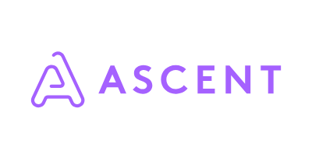





Our Membership
Notes:
are always up to date.
I changed RStudio logo for posit logo

Slide 5

Understanding our audience (poll)
What industry you are in?
What programming language do you use for most of your work (R, SAS, etc)?
What does your programming support? (GxP work, Exploratory Data analysis, etc)
Is there interest in your company in switching over to R for clinical work?

Slide 6

Structure of today’s community meeting
Overview of industry examples of using R
Discussion
Do you have preferences in using R vs SAS for different kinds of work? For instance, for submissions, general analysis, etc.
Are there any obstacles to switching and what are the parts that make it easy?
Examples of success/pain points in transitioning to R
And more…

Slide 7
Thank you for joining!

