Slide 1

Learnings and Reflection from RvalHub Case Studies
Juliane Manitz, Doug Kelkhoff, Andy Nicholls, Lyn Taylor, Joseph Rickert, Paulo Bargo, Keaven Anderson, Eric Milliman, Aaron Clark and Preetham Palukuru
on behalf of the R Validation Hub, an R Consortium-funded ISC Working Group
Notes:
Hi my name is Juliane Manitz, and I wanted to give you an update on behalf of the R validation Hub

Slide 2
Outline
Recap
White Paper
Case Studies
Breakout Rooms
Notes:
In 2018, we have started out wondering whether it would be possible to integrate R into Pharma
long history of licensed, proprietary tools dedicated for statistical analysis
ensure reproducibility of analysis software
proof of reliability, reproducibility and documentation measures of risk to justify the use of the software
The main challenge of using R in late-phase trials is ensuring validation documentation
Working with R in pharma means working in a regulated industry. We are facing a number of different regulations. Here we just want to mention two important ones:
The Good clinical practice (GCP) guidelines by the ICH (International Conference on Harmonisation of Technical Requirements for Registration of Pharmaceuticals for Human Use) provide international quality standards for conducting clinical trials. They state “software used should be reliable, and documentation of appropriate software testing procedures should be available”
In the United States, the Food and Drug Administration has similar guidelines and further specifies *Validation* as “[e]stablishing documented evidence which provides a high degree of assurance that a specific process consistently produces a product meeting its predetermined specifications and quality attributes.”

Slide 3
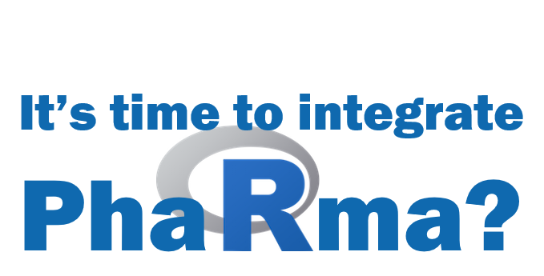
R validation Hub 2018
Notes:
In 2018, we have started out wondering whether it would be possible to integrate R into Pharma
long history of licensed, proprietary tools dedicated for statistical analysis
ensure reproducibility of analysis software
proof of reliability, reproducibility and documentation measures of risk to justify the use of the software
The main challenge of using R in late-phase trials is ensuring validation documentation
Working with R in pharma means working in a regulated industry. We are facing a number of different regulations. Here we just want to mention two important ones:
The Good clinical practice (GCP) guidelines by the ICH (International Conference on Harmonisation of Technical Requirements for Registration of Pharmaceuticals for Human Use) provide international quality standards for conducting clinical trials. They state “software used should be reliable, and documentation of appropriate software testing procedures should be available”
In the United States, the Food and Drug Administration has similar guidelines and further specifies *Validation* as “[e]stablishing documented evidence which provides a high degree of assurance that a specific process consistently produces a product meeting its predetermined specifications and quality attributes.”

Slide 4
What is the R validation Hub?
started by the PSI AIMS Special Interest Group
R Consortium Working Group
approx. 100 members; > 50 organizations
Mission: R Validation Hub is a cross-industry initiative whose mission is to enable the use of R by the Bio-Pharmaceutical Industry in a regulatory setting, where the output may be used in submissions to regulatory agencies.
Notes:
We started as the PSI AIMS Special Interest Group
within PSI. Supporting the R Validation Hub is one of the SIG’s stated objectives along with bridging the gap to SAS and educating members in R more broadly.
In June 2018, the R-Consortium awarded funding to create an online repository for R package validation in accordance with regulatory standards
We have members from approximately 60 companies with regular meeting

Slide 5
Resources / Achievements
Website www.pharmaR.org
White paper
Blog posts
Presentations at several conferences
Case Studies
ASA BIOP report publication
Tools available on GitHub / CRAN
R Package riskmetric: provides a number of metrics to help quantify R package quality; led by Eric Milliman
riskassessment App: Shiny Application for riskmetric package; led by Aaron Clark
Notes:
Since we have started, there is a collection of resources that can be found on pharmaR.org
White paper outlining a framework for risk-based approach to assess R package accuracy within a validated infrastructure
We also provide various blog posts and conference presentations
Most recently we conducted a 3-part series of case studies where a number off companies have presented their implementation of the framework
Under the umbrella of the RvalHub, there were also a number of tools developed:
R Package riskmetric: provides a number of metrics to help quantify R package quality; led by Eric Milliman
Risk Assessment App: Shiny Application for riskmetric package; led by Marly Gotti

Slide 6
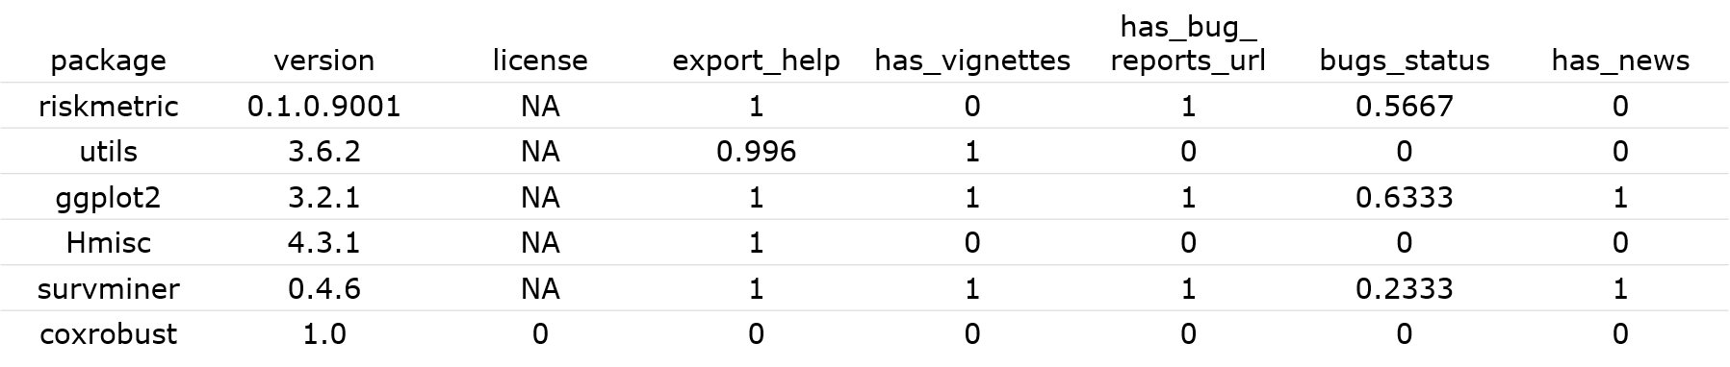
R package riskmetric
library(riskmetric)
pkg_tbl <- pkg_ref(c("riskmetric", "utils", "ggplot2",
"Hmisc", "survminer", "coxrobust"))
res <- pkg_tbl %>%
pkg_assess() %>%
pkg_score() %>%
mutate(risk = summarize_scores(.))
https://cran.r-project.org/web/packages/riskmetric
Notes:
The {riskmetric} R package supports risk-based validation R packages.
Its an interface to collect package information from a
variety of sources such as public package repositories, public source code repositories, local source code or locally installed package libraries
pkg_ref(): builds a collection of package metadata which may be helpful for a risk assessment.
pkg_assess(): derives a number of package metrics from this metadata
Finally, pkg_score() consolidates the metrics into numeric indications of their quality and allowing for aggregate comparison of individual packages or package cohorts.

Slide 7
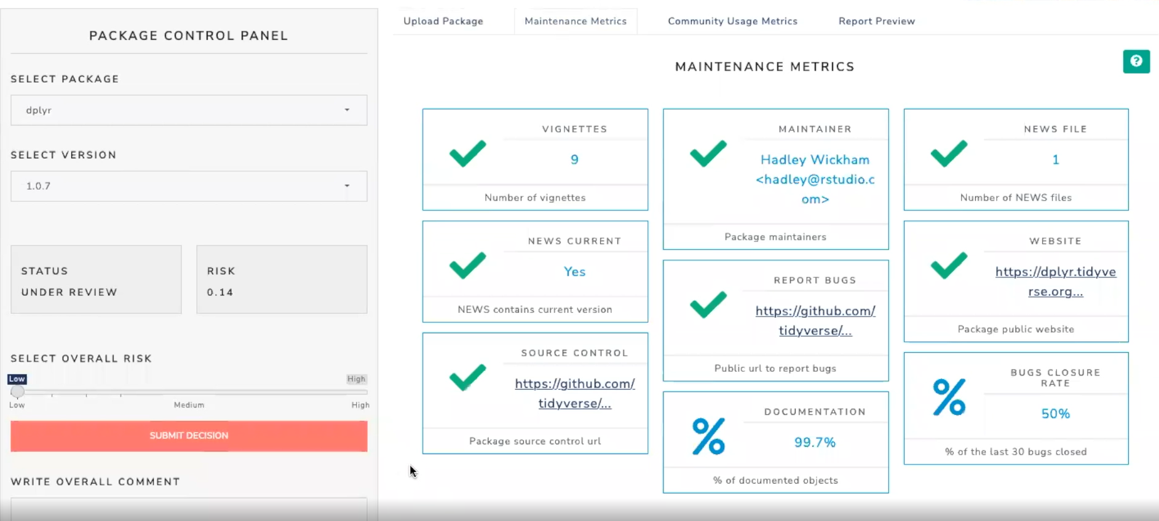
Risk Assessment App
https://github.com/pharmaR/riskassessment
Notes:
The shiny application has the following functionalities:
- inherits the advantages of the shiny R package, i.e. no R programming knowledge is needed to use the application,
- gathers information on community and maintenance metrics of the package,
- has embedded authorized personnel that can perform risk assessments and modify metric weights depending on the user access level,
allows users to provide feedback on the risk calculated by riskmetric,
stores historical comments and final decisions,
- contains a reporting tool that allows users to share the assessment insights with other reviewers as either a Word Document or an HTML file

Slide 8

Partner Initiatives
R Tables for Regulatory Submissions Working Group
Create tables that meet the requirements of FDA submission document standards
R Submission Pilot WG
Focus on IT and platform challenges to make “all R” regulatory submissions
Comparing Analysis Method Implementations in Software (CAMIS)
Seeks to provide a framework and repository for assessing the fundamental differences for a particular statistical analysis across languages
R/Pharma
Annual conference focus on the use of R in clinical drug development

Slide 9
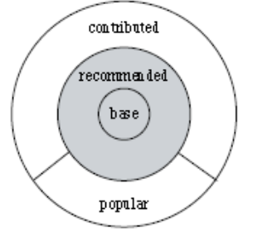
White Paper
Provides arguments that there is minimal risk in using Core R for regulatory analysis and reporting
Suggests a pipeline for risk-based assessment of contributed R packages based on
Intended use
Type of implemented method
Maintenance quality
Community usage
Remediation and testing
https://www.pharmar.org/white-paper/
Notes:
To review those resources, lets start with the white paper
Suggests a pipeline for risk-based assessment of contributed R packages
For Core R (base and recommended packages), the R Foundation has provided a guidance document on regulatory compliance and validation issues. Based on that, it can be concluded that there is minimal risk in using Core R for regulatory analysis and reporting
For contributed R packages there is a large variation of quality, robustness, and trustworthiness. CRAN passes a series of technical checks, but these do not necessarily guarantee the accuracy of the package.
The RvalHub outlines a framework to assess the accuracy of R packages and document that process
It recommends to focus on the way that components of the system will be used.
Higher standards for packages implement statistical methods or algorithms
Consider Maintenance of Good Practice (Software Development Life Cycle)
But also Community usage and Testing coverage

Slide 10
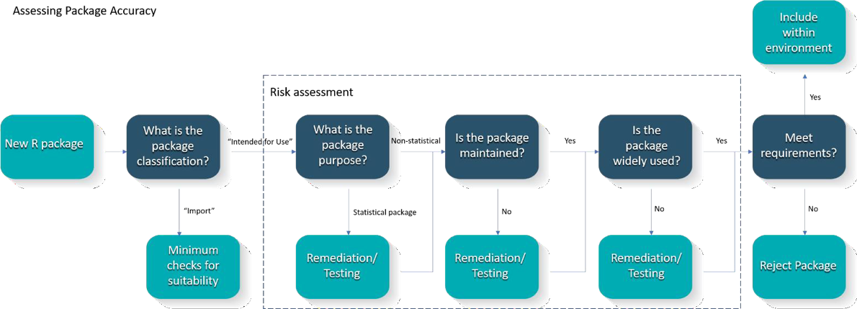
White Paper
https://www.pharmar.org/white-paper/
Notes:
To review those resources, lets start with the white paper
Suggests a pipeline for risk-based assessment of contributed R packages
For Core R (base and recommended packages), the R Foundation has provided a guidance document on regulatory compliance and validation issues. Based on that, it can be concluded that there is minimal risk in using Core R for regulatory analysis and reporting
For contributed R packages there is a large variation of quality, robustness, and trustworthiness. CRAN passes a series of technical checks, but these do not necessarily guarantee the accuracy of the package.
The RvalHub outlines a framework to assess the accuracy of R packages and document that process
It recommends to focus on the way that components of the system will be used.
Higher standards for packages implement statistical methods or algorithms
Consider Maintenance of Good Practice (Software Development Life Cycle)
But also Community usage and Testing coverage

Slide 11
Case Studies
R validation hub initiated a three-part presentation series on “case studies”
Eight pharma companies participated a case series sharing different experiences on building a GxP framework with R
Highlight aspects that were easy to implement which those which were more challenging.
Recordings of these sessions are available on the R Validation minutes page.
Discussion and exchange to be continued on GitHub, where you are welcome to contribute and learn from others.
https://github.com/pharmaR/case_studies
Notes:
Most recently, we have initiated a 3-part presentation series on *case studies* where 8 different pharma companies shared their experiences building a GxP framework with R highlighting aspects that were easy to implement which those which were more challenging.
You have recordings available, and an
Active discussion on github, where you are welcome to pitch in
It was interesting to see how the “theoretical” framework for risk assessment was implemented with different flavors
Different weights were assigned to the testing coverage and various suggested maintenance metrics
Different risk remediation strategies have been applied
Common challenges included
ensuring R package reviewers have the right technical expertise
Finding appropriate test data and sharing test cases
Active discussion and exchange to be continued on github, where you are welcome to pitch in and learn from others

Slide 12
Case Studies: Common Themes
All implementations follow the risk validation process for R packages as outlined in the white paper
Classification of package quality into high/medium/low or a binary high/low categorization, however the approach to the assessments themselves varies.
High importance of test coverage as assessment metric
Trusted resources: R Foundation, thus core R (base and recommended packages) are treated as a collective of “low risk” packages; some organizations also trust Rstudio developments, i.e. tidyverse, etc.
The majority focused risk assessments only on “Intended-for-Use” packages but several also ran metrics on the Imports.
https://github.com/pharmaR/case_studies
Notes:
Most recently, we have initiated a 3-part presentation series on *case studies* where 8 different pharma companies shared their experiences building a GxP framework with R highlighting aspects that were easy to implement which those which were more challenging.
You have recordings available, and an
Active discussion on github, where you are welcome to pitch in
It was interesting to see how the “theoretical” framework for risk assessment was implemented with different flavors
Different weights were assigned to the testing coverage and various suggested maintenance metrics
Different risk remediation strategies have been applied
Common challenges included
ensuring R package reviewers have the right technical expertise
Finding appropriate test data and sharing test cases
Active discussion and exchange to be continued on github, where you are welcome to pitch in and learn from others

Slide 13
Case Studies: Differences in Approach
Varied degrees of automation in risk classification and qualification i.e. either complete automation or no automation
Different weights were assigned to the testing coverage and various suggested metadata metrics: acceptable threshold for test coverage ranges between 50-80% for low-risk packages
Different risk remediation strategies have been applied:
some organizations will immediately introduce their own unit tests,
others restrict package use to only the tested subset of package functionality.
https://github.com/pharmaR/case_studies
Notes:
Varied levels of automation vs manual assessment
Some packages get classified automatically as low risk, with little or no human intervention; for higher risk packages there were typically pathways for additional human assessment
Some organizations are relying on human-guided assessments throughout.
It was interesting to see how the “theoretical” framework for risk assessment was implemented with different flavors
Different weights were assigned to the testing coverage and various suggested maintenance metrics
Different risk remediation strategies have been applied
Common challenges included
ensuring R package reviewers have the right technical expertise
Finding appropriate test data and sharing test cases
Active discussion and exchange to be continued on github, where you are welcome to pitch in and learn from others

Slide 14
Case Studies: Common Challenges
R package assessment is a resource-intense activity
Time has proven to be a considerable challenge.
Ensuring R package reviewers have the right technical expertise
Alignment of different contributors across the organization: IT, Quality Assurance and with their own Statistics, Data Science, or Programming lines.
Finding appropriate test datasets, test cases and expected model output
Long-term management and maintenance as well as oversight of the risk-based package assessment process
https://github.com/pharmaR/case_studies
Notes:
Most recently, we have initiated a 3-part presentation series on *case studies* where 8 different pharma companies shared their experiences building a GxP framework with R highlighting aspects that were easy to implement which those which were more challenging.
You have recordings available, and an
Active discussion on github, where you are welcome to pitch in
It was interesting to see how the “theoretical” framework for risk assessment was implemented with different flavors
Different weights were assigned to the testing coverage and various suggested maintenance metrics
Different risk remediation strategies have been applied
Common challenges included
ensuring R package reviewers have the right technical expertise
Finding appropriate test data and sharing test cases
Active discussion and exchange to be continued on github, where you are welcome to pitch in and learn from others

Slide 15
Breakout rooms (15mins)
Please select one of the following breakout rooms:
Package score thresholds (low, medium, or high vs accepted/rejected) and metric weights [Eric]
Repository for common packages and their metrics [Doug]
Sharing test data and test cases [Juliane]
Ensuring and documenting R package reviewers have the right technical expertise [Preetham]
Notes:
Most recently, we have initiated a 3-part presentation series on *case studies* where 8 different pharma companies shared their experiences building a GxP framework with R highlighting aspects that were easy to implement which those which were more challenging.
You have recordings available, and an
Active discussion on github, where you are welcome to pitch in
It was interesting to see how the “theoretical” framework for risk assessment was implemented with different flavors
Different weights were assigned to the testing coverage and various suggested maintenance metrics
Different risk remediation strategies have been applied
Common challenges included
ensuring R package reviewers have the right technical expertise
Finding appropriate test data and sharing test cases
Active discussion and exchange to be continued on github, where you are welcome to pitch in and learn from others

Slide 16
Summary
The R validation hub helped to:
Establish open-source mentality of sharing within biopharmaceutical industry
Provide tools for risk-based assessment of R packages
Supports a framework in which R can be used for regulatory submissions
Further Information
Website: www.pharmaR.org
White paper: https://github.com/pharmaR/white_paper
GitHub Repo: https://github.com/pharmaR
Thank you to anyone who has contributed to the R validation Hub and its partner initiatives. If you want to get more involved, contact us!

