Slide 1
Analyzing change in assessed risk across package releases
Community Meeting
12:00 EST
20th Aug, 2024

Slide 2

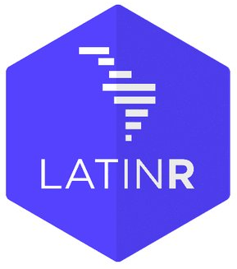
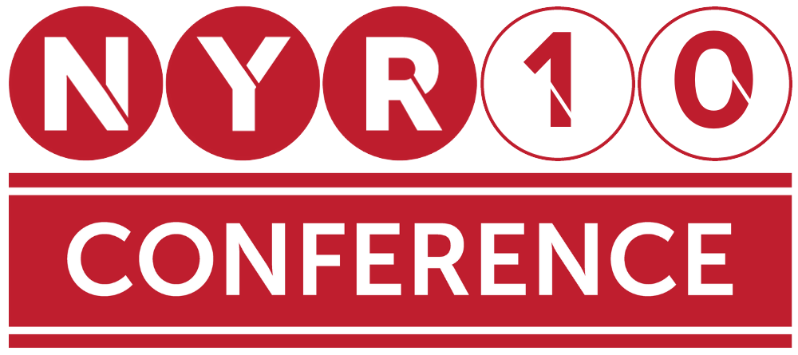


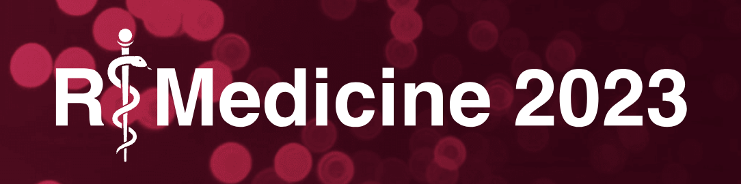


R Consortium Pragmatic Support with Global Reach
R Consortium Community Grants and Sponsorships Over USD $1.4 Million
Organize large scale collaborative projects
R Validation Hub
R-Ladies
R Submissions Working Group
Co-host multidisciplinary data science forums
Stanford Data Institute
Direct support for key R events
useR!, New York R, R/Medicine, R/Pharma, more
Direct support for R User Groups

Slide 3

Join the R Consortium! The R Validation Hub is a Working Group under the R Consortium
Enhance the R ecosystem
Help ensure the future of R
Collaborate with your peers across industry
Provide leadership in the R Community
Protect your investment in R
Support open source
Notes:
The R Consortium enables companies in competitive industries to act collectively when approaching government agencies: e.g. the R Validation Hub project driven by the pharmaceutical industry.
The R Consortium is positioned to cooperate with other data science organizations to work for the common good: e.g. the COVID-19 Data Forum
R Consortium technical working groups provide seed funding and a focus for large scale cooperation for exploratory projects.
The R Consortium promotes and enables diversity in practical and concrete ways that are highly influential: e.g. R-Ladies and the Diversity & Inclusion working group.
Membership on R Consortium technical working groups provides opportunities to shape emerging technology.
The R Consortium helps companies protect their long range investment in R.

Slide 4
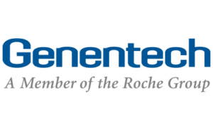

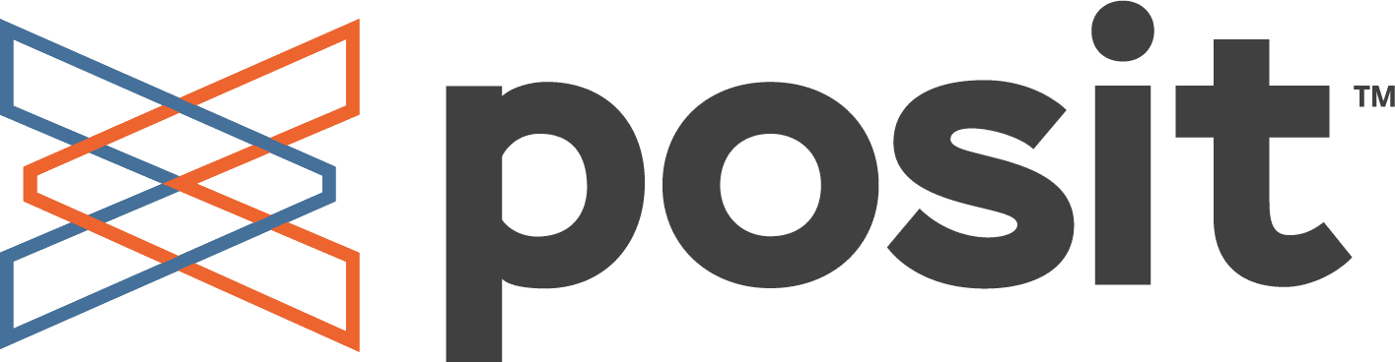










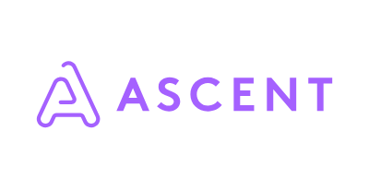



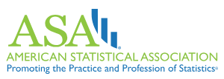

Our Membership
We see R as the future of statistical analysis because of its flexibility and the strong active community behind it.” – Alun Bedding, Director of Biostatistics at Genentech
Notes:
are always up to date.
I changed RStudio logo for posit logo

Slide 5

Understanding our audience (poll)
What time of day would be the best for you for future community meetings? Pros/cons of noon meetings
Ease of validation at your current company (streamlined/tedious)?

Slide 6

Structure of today’s community meeting
Presentation by Brid Roberts (Novartis)
Q&A
Discussion
Does your company follow a different process when up-versioning?
Have they implemented any aspects of R Validation Hub’s {riskmetric} or {riskassessment} within your company's validation processes?

Slide 7
Thank you for joining!

