Slide 1

A Risk-based approach for assessing R package accuracy within a validated infrastructure
Juliane Manitz, EMD Serono; Andy Nicholls, GSK; Paulo Bargo, Janssen R&D; Doug Kelkhoff, Roche; Yilong Zhang, Merck & Co., Inc.; Lyn Taylor , Phastar; Joe Rickert, R Consortium; Marly Gotti, Biogen; Keaven M Andersen, Merck & Co. Inc.

Slide 2
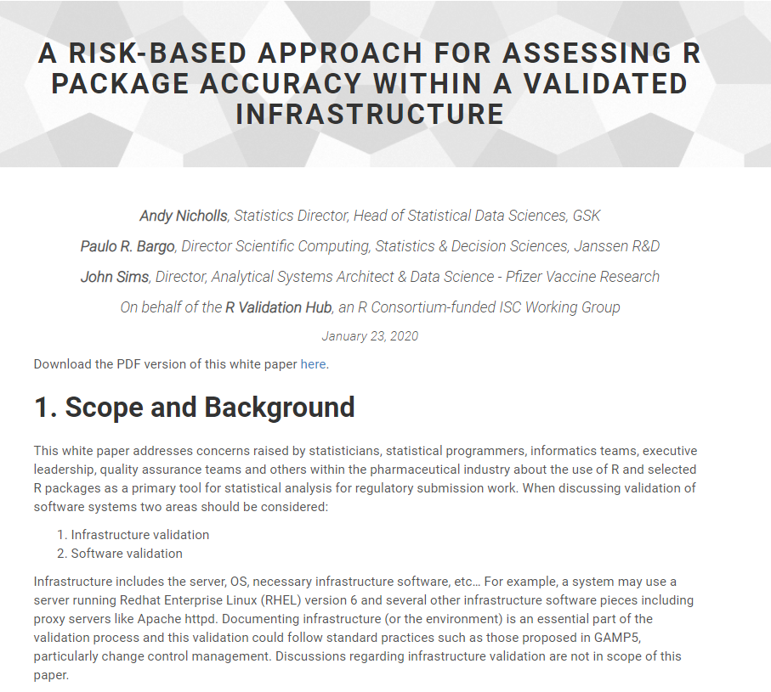
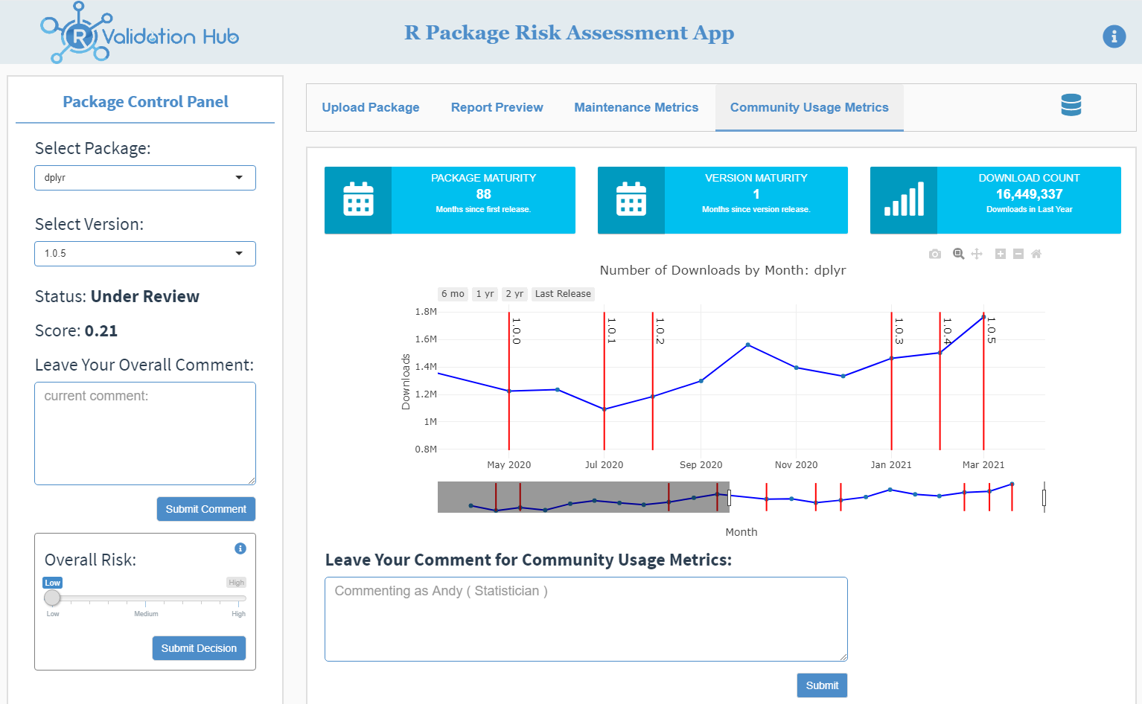
What is the R validation Hub?
R Validation Hub is a collaboration to support the adoption of R within a biopharmaceutical regulatory setting
Notes:
The main challenge of using R in late-phase trials is ensuring validation documentation. In June 2018, the R-Consortium awarded funding to create an online repository for R package validation in accordance with regulatory standards.
We focus on designing a framework that assesses the quality of an R package.
The R Validation Hub comprises of participants from across the pharmaceutical industry. Participants contribute to the effort through our regular group meetings, as well as the various workstreams that make up the project. If you are interested in getting involved please contact psi.aims.r.validation@gmail.com. Else you can sign up to our mailing list here.

Slide 3

How do I validate R?

Slide 4
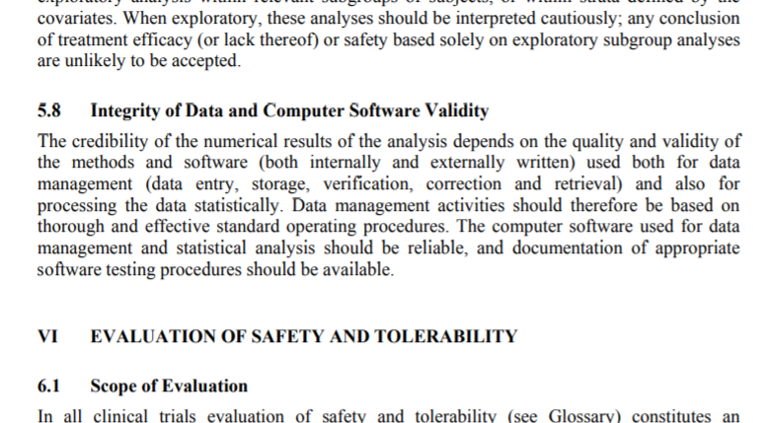
Reliable Software
5.8 Integrity of Data and Computer Software Validity
The credibility of the numerical results of the analysis depends on the quality and validity of the methods and software (both internally and externally written) used both for data management (data entry, storage, verification, correction and retrieval) and also for processing the data statistically. Data management activities should therefore be based on thorough and effective standard operating procedures. The computer software used for data management and statistical analysis should be reliable, and documentation of appropriate software testing procedures should be available.
ICH E9: https://www.ema.europa.eu/en/documents/scientific-guideline/ich-e-9-statistical-principles-clinical-trials-step-5_en.pdf
Notes:
ICH: “… **should be reliable**, and documentation of **appropriate software testing procedures** should be available”
‘Validation’ isn’t actually mentioned.

Slide 5
Is my software reliable?

Slide 6
Reliable Software
Why do we trust a software output?
“I know the actual answer”
“It’s in the ballpark of what I might expect to see”
“I’ve used the software before and it did what I expected”
“Many others use the software and it does what they expect”
“When I learnt statistics, I was taught using the software”
“The software is used/cited in statistical literature”
“I trust that the software owner develops it using best practice”
“The software owner provides tests that I can use to verify that it is working”
Intuition
Community Exposure
Developer SDLC
Notes:
Intuition only gets us so far. Difficult to explain to an auditor.
Community Exposure and SDLC are measurable.
The software owner develops it using best practice, e.g. 2015 the R consortium published Regulatory Compliance and Validation Issues for base R and recommended packages
- R: Regulatory Compliance and Validation Issues A Guidance Document for the Use of R in Regulated Clinical Trial Environments
- tidyverse, tidymodels, r-lib, and gt R packages: Regulatory Compliance and Validation Issues

Slide 7
So why is it so difficult to use Open Source languages for GxP analyses?!

Slide 8
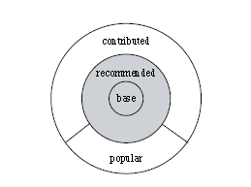
Challenge 1: The R Ecosystem
Core R (Base+Recommended) - Low risk
Contributed - Variable risk
Many different authors
Varying SDLCs
Varying levels of popularity
Potentially lots of unknowns
Image source: German, D.M. & Adams, Bram & Hassan, Ahmed E.. (2013). The Evolution of the R Software Ecosystem. Proceedings of the Euromicro Conference on Software Maintenance and Reengineering, CSMR. 243-252. 10.1109/CSMR.2013.33.
Notes:
Each analysis uses a number of packages, which come with a network of interconnected package dependencies
We can’t avoid risk completely. We must do our best to mitigate it. Focus effort on the biggest risk areas.

Slide 9
Summary
Definitely possible
“The computer software used for data management and statistical analysis should be reliable, and documentation of appropriate software testing procedures should be available”
ICH E9
More of a challenge!
Thank You

Slide 10
Further Reading
R
R Validation Hub
R: Regulatory Compliance and Validation Issues A Guidance Document for the Use of R in Regulated Clinical Trial Environments
tidyverse, tidymodels, r-lib, and gt R packages: Regulatory Compliance and Validation Issues
ICH
E9
FDA
FDA Statistical Software Clarifying Statement
21 CFR Part 11
Guidance for Industry Part 11, Electronic Records; Electronic Signatures — Scope and Application
Glossary of Computer System Software Development Terminology
General Principles of Software Validation; Final Guidance for Industry and FDA Staff
EMA
Notice to sponsors on validation and qualification of computerised systems used in clinical trials
Q&A: Good clinical practice (GCP)

Slide 11
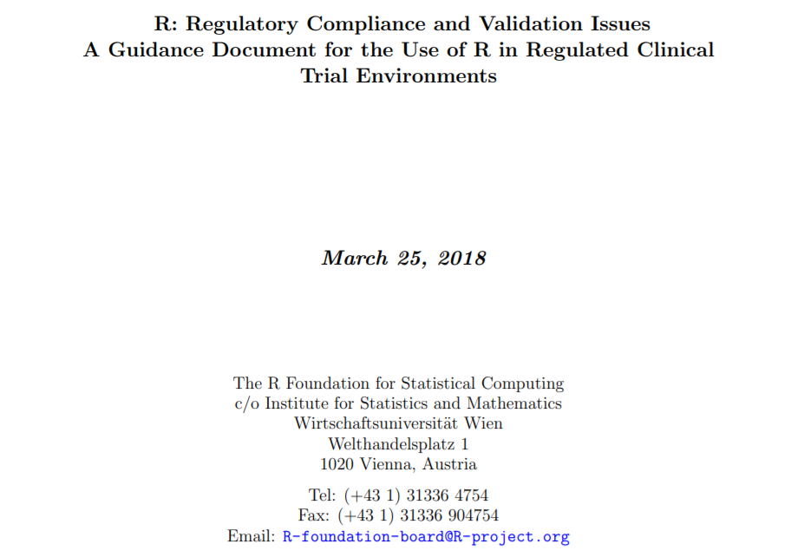
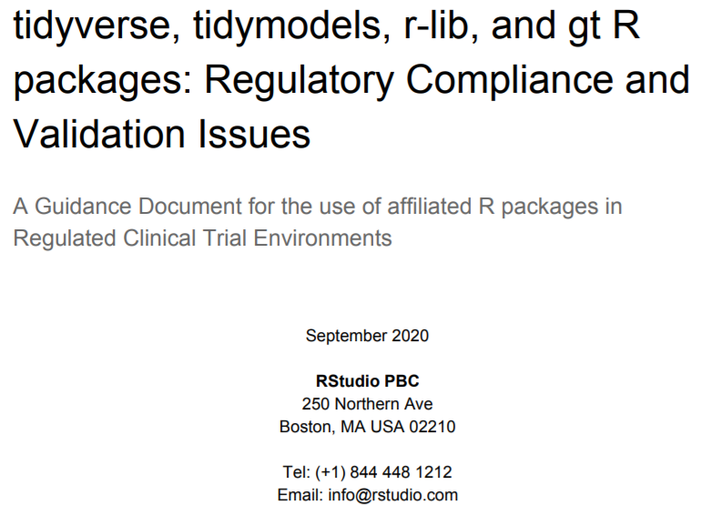
I trust that the software owner develops it using best practice
https://www.r-project.org/doc/R-FDA.pdf
https://resources.rstudio.com/assets/img/validation-tidy.pdf

