Slide 1

Implementation of Risk Assessment for R packages: Learnings and Reflection
Juliane Manitz, Marly Gotti, Andy Nicholls, Lyn Taylor, Joseph Rickert, Doug Kelkhoff,
Yilong Zhang, Paulo Bargo, Keaven Anderson, and Preetham Palukuru
on behalf of the R Validation Hub, an R Consortium-funded ISC Working Group

Slide 2
Abstract
This contribution has the aim to reflect on the implementation of risk-based approaches to assess R package accuracy within a validated infrastructure. The discussion reflects thinking of the R Validation Hub working group, which is a cross-industry initiative funded by the R Consortium. Our mission is to enable the use of R by the bio-pharmaceutical industry in a regulatory setting, where the output may be used in submissions to regulatory agencies. In early 2020, the R validation Hub has published a white paper which addresses concerns raised by statisticians, statistical programmers, informatics teams, executive leadership, quality assurance teams and others within the pharmaceutical industry about the use of R and selected R packages as a primary tool for statistical analysis for regulatory submission work. In the meanwhile, the R consortium has successfully submitted a fully R-based test package to FDA and various companies have implemented the concept of risk-based R package validation into their standard processes. We will present our learnings from those applied case studies. We highlight which aspects were easy to implement into practice and where difficulties occurred. We also review how new developments in the `riskmetric` R package and shiny app can help with the recent learnings.
Notes:
Will not be presented, just included for reference

Slide 3
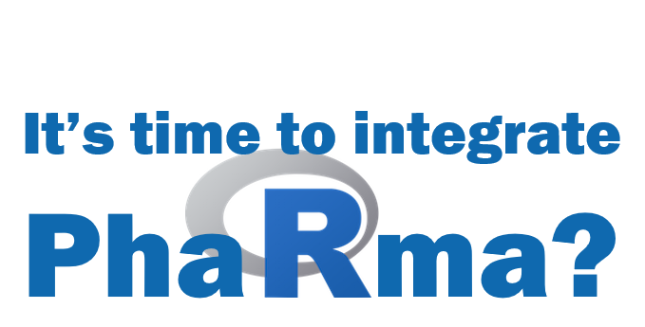
R validation Hub 2018

Slide 4
What is the R validation Hub?
started by the PSI AIMS Special Interest Group
R Consortium Working Group
approx. 100 members; > 50 organizations
Mission: R Validation Hub is a cross-industry initiative whose mission is to enable the use of R by the Bio-Pharmaceutical Industry in a regulatory setting, where the output may be used in submissions to regulatory agencies.
Notes:
within PSI. Supporting the R Validation Hub is one of the SIG’s stated objectives along with bridging the gap to SAS and educating members in R more broadly.

Slide 5
Resources / Achievements
Website www.pharmaR.org
Blog posts
Presentations
White paper
Case Studies
Tools available on GitHub / CRAN
R Package riskmetric: provides a number of metrics to help quantify R package quality; led by Doug Kelkhoff (Roche)
Risk Assessment App: Shiny Application for riskmetric package; led by Marly Gotti (Biogen)

Slide 6
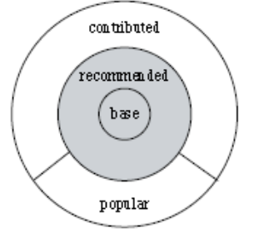
White Paper
Provides arguments that there is minimal risk in using Core R for regulatory analysis and reporting
Suggests a pipeline for risk-based assessment of contributed R packages based on
Intended use
Type of implemented method
Maintenance quality
Community usage
Remediation and testing
https://www.pharmar.org/white-paper/

Slide 7
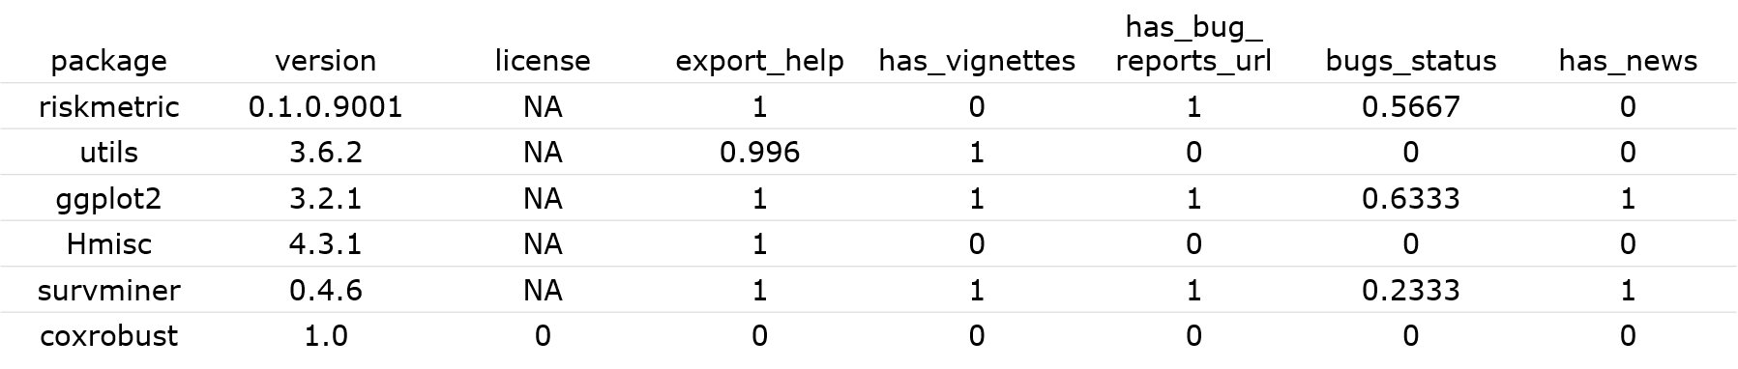
R package riskmetric
library(riskmetric)
pkg_tbl <- pkg_ref(c("riskmetric", "utils", "ggplot2",
"Hmisc", "survminer", "coxrobust"))
res <- pkg_tbl %>%
pkg_assess() %>%
pkg_score() %>%
mutate(risk = summarize_scores(.))
https://cran.r-project.org/web/packages/riskmetric

Slide 8
Risk Assessment App
The shiny application has the following functionalities:
inherits the advantages of the shiny R package (no R programming knowledge is needed to use the application),
allows users to provide feedback on the risk calculated by riskmetric,
gathers information on community and maintenance metrics of the package,
has embedded authorized personnel that can perform risk assessments and modify metric weights depending on the user access level,
stores historical comments and final decisions,
contains a reporting tool that allows users to share the assessment insights with other reviewers as either a Word Document or an HTML file.
https://github.com/pharmaR/risk_assessment
Notes:
Consider to replace with a screenshot and copy this to the notes

Slide 9
Case Studies
Several pharma companies participated a case series sharing different experiences on building a GxP framework with R
All implementations follow the risk validation process for R packages as outlined in the white paper
Different weights were assigned to the testing coverage and various suggested maintenance metrics
Different risk remediation strategies have been applied
Common challenges included
Ensuring R package reviewers have the right technical expertise
Finding appropriate test data and sharing test cases
https://github.com/pharmaR/case_studies
Notes:
Several pharma companies highlighted aspects that were easy to implement which those which were more challenging.

Slide 10

Partner Initiatives
R Tables for Regulatory Submissions Working Group
Create tables that meet the requirements of FDA submission document standards
R Submission Pilot WG
Focus on IT and platform challenges to make “all R” regulatory submissions
Clinical Statistical Reporting in a Multilingual World
Seeks to provide a framework for assessing the fundamental differences for a particular statistical analysis across languages
R/Pharma
Annual conference focus on the use of R in clinical drug development

Slide 11
Summary
The R validation hub helped to:
Establish open-source mentality of sharing within biopharmaceutical industry
Provide tools for risk-based assessment of R packages
Supports a framework in which R can be used for regulatory submissions
Further Information
Website: www.pharmaR.org
White paper: https://github.com/pharmaR/white_paper
GitHub Repo: https://github.com/pharmaR
Thank you to anyone who has contributed to the R validation Hub and its partner initiatives. If you want to get more involved, contact us!

