Slide 1
Tackling Hurdles: Embracing Open-Source Packages in Projects
Community Meeting
12:00 EST
21th May, 2024

Slide 2
Placeholder for slide on R validation hub and R consortium

Slide 3

Understanding our audience (poll)
What role are you in within open source? (Developer, user, administrative, etc)
Have you ever engaged with developers to provide feedback or report bugs?

Slide 4

The relationship of open source and corporate environments
What do you think may be an obstacle in engaging with open-source technologies?
Do you find it difficult to separate your engagement as an individual R user from your engagement as a member of a broader company?
If you work at a company that is starting to use open-source languages, do you feel a conflict in the way you engage with open-source?
Unwritten rules/etiquette/responsibilities of users and developers, for example regarding feedback or contributions

Slide 5
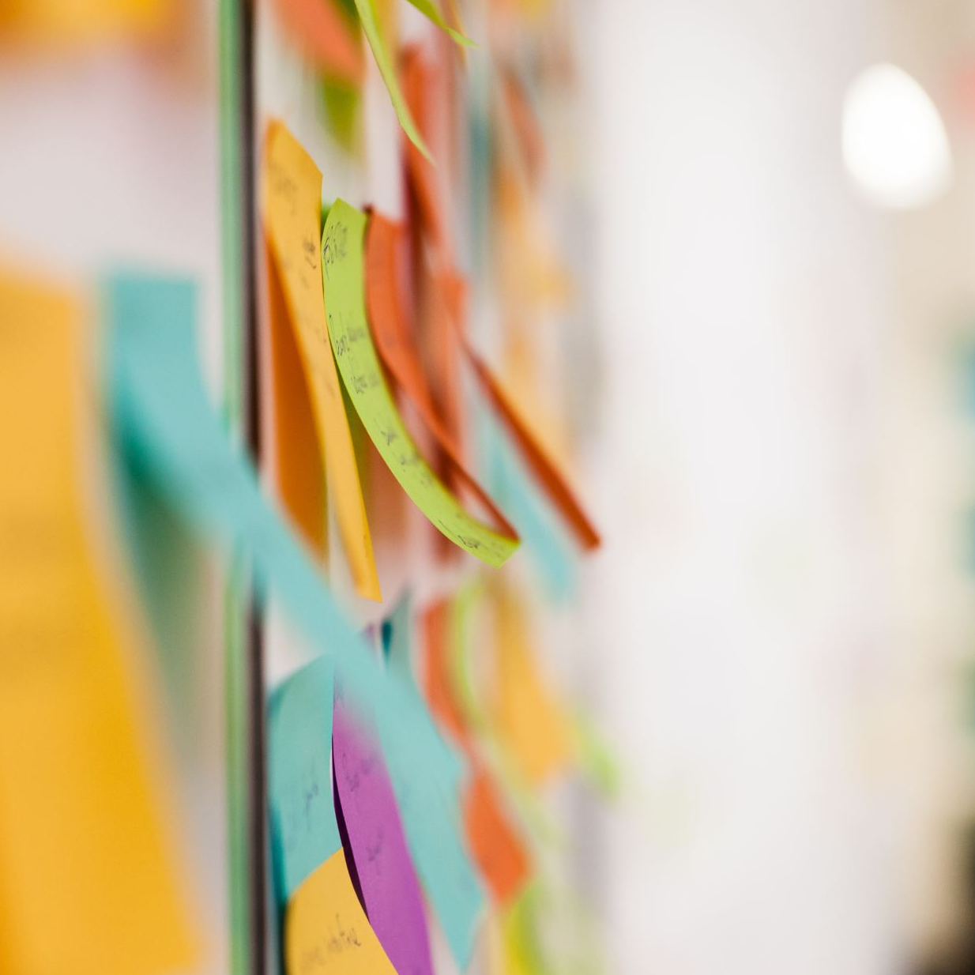
Structure of today’s community meeting
Chats in breakout rooms with 6-8 people (depending the number of participants today)
Someone from R validation hub in each room to help out
Approx. 10-15 minutes
We discuss together at the end

Slide 6
Thank you for joining!

