Slide 1
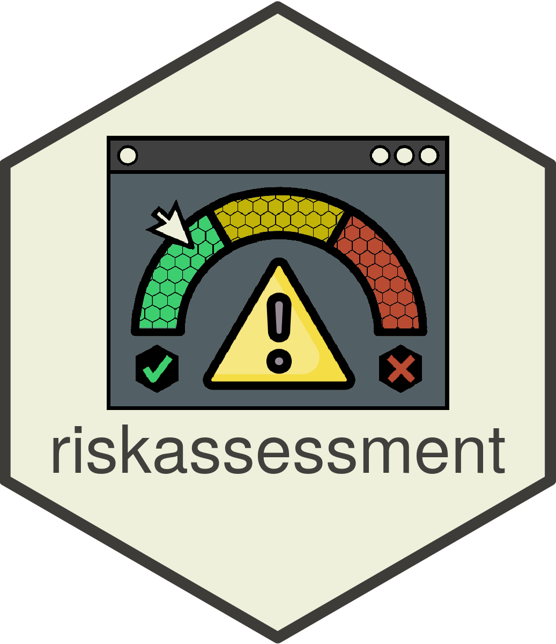
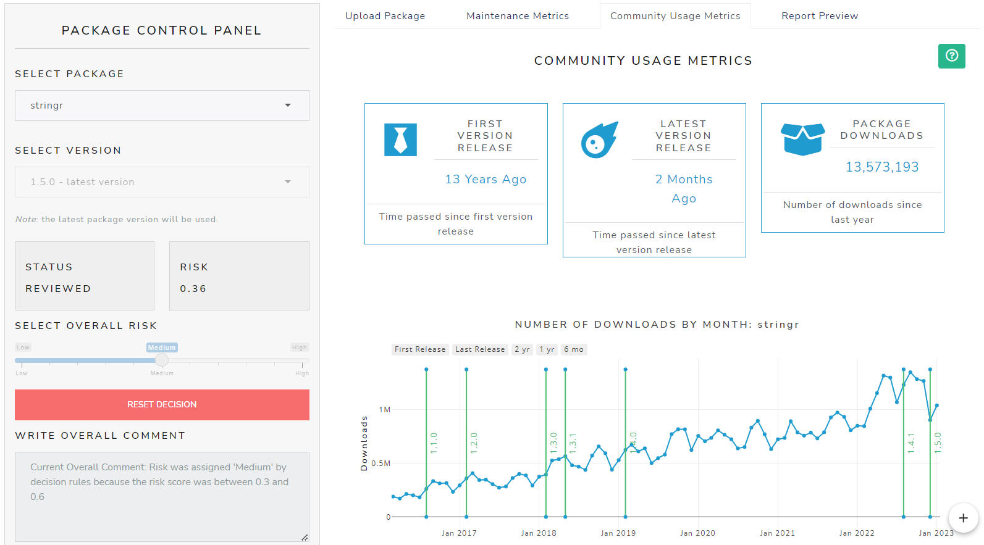

{riskassessment} for R-package Validation
Aaron Clark | Biogen R Validation Hub Executive Member
Notes:
The last project I am going to talk about today is my work with the R validation hub, a consortia of companies with the goal to incorporate oss into regulated IT environments.

Slide 2

VALIDATING OPEN-SOURCE SOFTWARE
Consortia of ~50 companies (mostly pharma and biotech)
Focus on designing/building a framework to validate R and R packages with an eye to all open-source software.
pharmar.org to learn about all workstreams and to get involved!
The main goal is ensuring proper validation documentation exists in accordance with expectations of regulatory agencies.

Slide 3
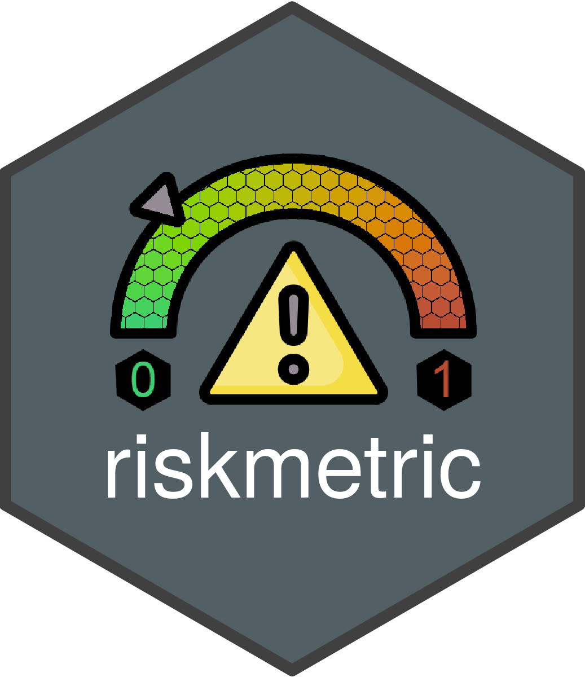
TWO TOOLS
Quantify Risk Programmatically
Interactive app for an Organization

Slide 4
WHAT DO THEY DO?
{riskmetric} is a framework to quantify an R package’s “risk”
… by assessing several meaningful metrics designed to evaluate package development best practices, code documentation, community engagement, and development sustainability.
{riskassessment} is a full-fledged R package containing a shiny front-end
… that augments the utility of {riskmetric}. The application's goal is to provide a central hub for an organization to review and assess the risk of R packages, providing handy tools and guide rails along the way.

Slide 5
SOFTWARE QUALITY MITIGATES POTENTIAL RISKS
Sometimes “quality” is measurable! Software dev best practices dictate an R-package should have:
A license
Source code available for browsing
An easy to contact maintainer
Up-to-date news regarding new features and bugs
A place to report bugs
Evidence that new bugs are being addressed
Package documentation & user guides/ perhaps a website
Complete Function documentation
Adequate test coverage
Community usage
Many more!

Slide 6
WHY CREATE A SHINY APP?
The app extends the functionality of {riskmetric} by managing the review process within an organizational context, empowering the reviewer to:
Analyze {riskmetric} output without the need to write R code
Run {riskmetric} on the same machine with the same environment – creating central hub for reproducibility of risk scores
Facilitate and store communication on certain packages / metrics
Automatically categorize a package with an overall decision (i.e., low, medium, or high risk) based on {riskmetric} scores
Or take a more hands-on approach categorizing packages using subjective opinions from yourself or consensus from other users
Generate reports with the risk score, metrics outputs, reviewer comments, and more
Log assessments in a database for future viewing or historical backup
Leverage user authentication with admin roles to manage users and tasks like org-level metric weighting

Slide 7

VALIDATING OPEN-SOURCE SOFTWARE

Slide 8

VALIDATING OPEN-SOURCE SOFTWARE

Slide 9

VALIDATING OPEN-SOURCE SOFTWARE

Slide 10

VALIDATING OPEN-SOURCE SOFTWARE

Slide 11
DEMO ON SHINYAPPS.IO

Slide 12



Links
bit.ly/raa_demo
bit.ly/raa_gh bit.ly/raa_docs
bit.ly/raa_survey
pharmar.org/

Slide 13
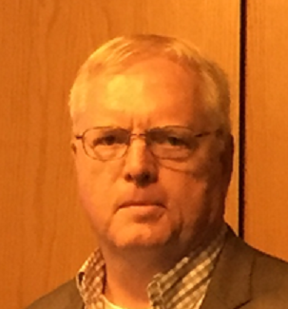



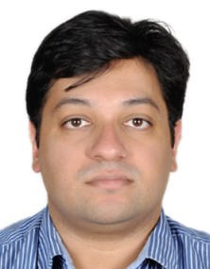

CURRENT DEV TEAM
Aaron Clark, Biogen
Robert Krajcik, Cytel
Jeff Thompson, Cytel
Andrew Borgman, Biogen
bit.ly/riskassessment_gh
Lars Anderson, Boehringer-Ingelheim
Imran Hossain, Cytel
Scott Schumacker, Canary Medical

Slide 14
DEMO ON SHINYAPPS.IO
bit.ly/raa_demo

Slide 15
Let’s Connect
bit.ly/raa_demo
bit.ly/raa_gh bit.ly/raa_docs
bit.ly/raa_survey
pharmar.org/

