Slide 1
Navigating Programming Language Transitions in Pharma
Community Meeting
12:00 EST
26th Nov, 2024

Slide 2

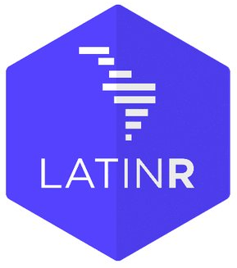



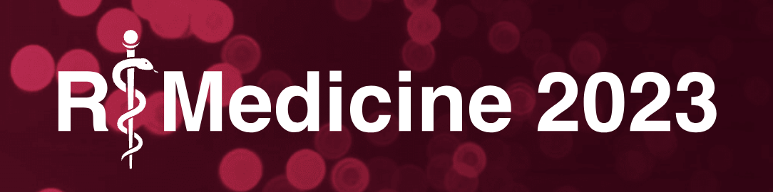


R Consortium Pragmatic Support with Global Reach
R Consortium Community Grants and Sponsorships Over USD $1.4 Million
Organize large scale collaborative projects
R Validation Hub
R-Ladies
R Submissions Working Group
Co-host multidisciplinary data science forums
Stanford Data Institute
Direct support for key R events
useR!, New York R, R/Medicine, R/Pharma, more
Direct support for R User Groups

Slide 3

Join the R Consortium! The R Validation Hub is a Working Group under the R Consortium
Enhance the R ecosystem
Help ensure the future of R
Collaborate with your peers across industry
Provide leadership in the R Community
Protect your investment in R
Support open source
Notes:
The R Consortium enables companies in competitive industries to act collectively when approaching government agencies: e.g. the R Validation Hub project driven by the pharmaceutical industry.
The R Consortium is positioned to cooperate with other data science organizations to work for the common good: e.g. the COVID-19 Data Forum
R Consortium technical working groups provide seed funding and a focus for large scale cooperation for exploratory projects.
The R Consortium promotes and enables diversity in practical and concrete ways that are highly influential: e.g. R-Ladies and the Diversity & Inclusion working group.
Membership on R Consortium technical working groups provides opportunities to shape emerging technology.
The R Consortium helps companies protect their long range investment in R.

Slide 4
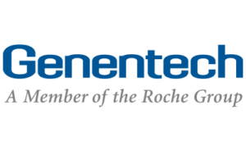






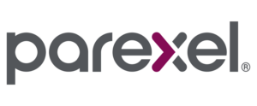

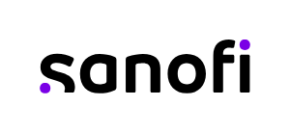



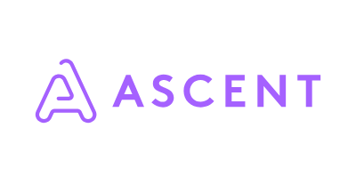


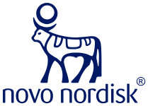
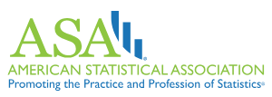

Our Membership
Notes:
are always up to date.
I changed RStudio logo for posit logo

Slide 5

Understanding each other (poll)
What industry you are in?
What programming language do you use for most of your work (R, SAS, etc)?
What does your programming support? (GxP work, Exploratory Data analysis, etc)
Is there interest in your company in switching over to R for clinical work?

Slide 6

Structure of today’s community meeting
Overview of industry examples of using R
Discussion
Do you have preferences in using R vs SAS for different kinds of work? For instance, for submissions, general analysis, etc.
Are there any obstacles to switching and what are the parts that make it easy?
Examples of success/pain points in transitioning to R
And more…

Slide 7

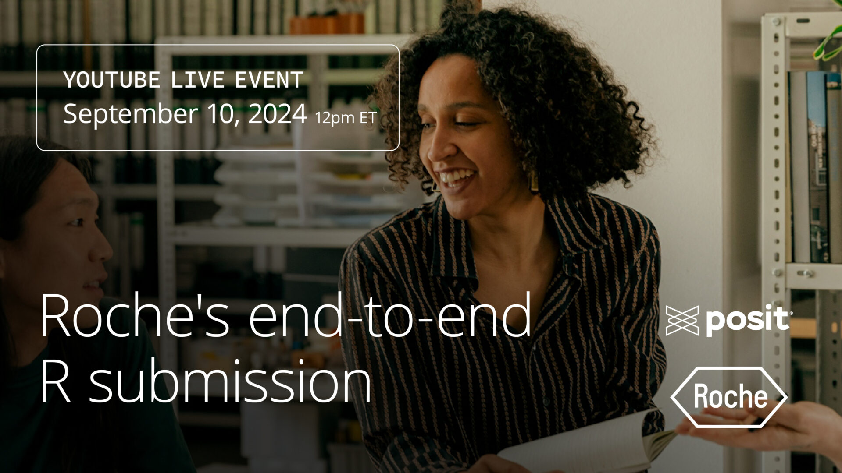
Examples of R in the Industry
Novo Nordisk: Journey to an R-based FDA submission
(posit.co blog link / YouTube link) – September 2023
Submitted its first R-driven package to the FDA
An in-depth look at Novo Nordisk’s computing platform and internal R package suite
Risk assessment categorization heavily based on the R Validation Hub {riskmetric} along with an internal app for users to submit packages
Roche’s end-to-end R submission for a new drug application
(posit.co blog link / YouTube link) – September 2024
Showcases use of open-source R in regulatory submission process
Effective presentation and validation of R-generated data and documentation
Broadly followed R Validation Hub’s white paper
These are just a couple of examples! Which others can you think of?

Slide 8
Discussion Questions
Do you have preferences in using R vs SAS for different kinds of work? For instance, for submissions, general analysis, etc.
Are there any obstacles to switching and what are the parts that make it easy?
Examples of success/pain points in transitioning to R
And discuss anything more under related to our discussion topic (Navigating Programming Language Transitions in Pharma) as you wish!

Slide 9
Thank you for joining!

