Slide 1
Validating R for Pharma
Streamlining the Validation of Open-Source R Packages within Highly Regulated Pharmaceutical Work
Anuja Das
Anuja Das is a Technology Project Specialist within the Data Visualizations and Application Development group at Biogen and a member of the Communications Workstream within the R Validation Hub. She enjoys bringing innovation, automation, and new ways of working to the existing clinical submissions process and has led projects that deploy applications created in multiple languages that enable better data review and output generation.
Jaxon Abercrombie
Jaxon Abercrombie is a Data Scientist at Genentech with a core focus on analyzing clinical trial data and supporting regulatory submissions, particularly for GLP-1/GIP receptor agonist therapies. Beyond his core work, Jaxon is an advocate for open-source tools, loves creating visualizations, and has contributed to the R Validation Hub Communications Workstream since 2023.

Slide 2

Agenda
What is the R Validation Hub?
The White Paper
{riskmetric}
{riskassessment}
{val.*} Packages
Regulatory R Repository
Communications
1
2
3
4
5
6
7

Slide 3


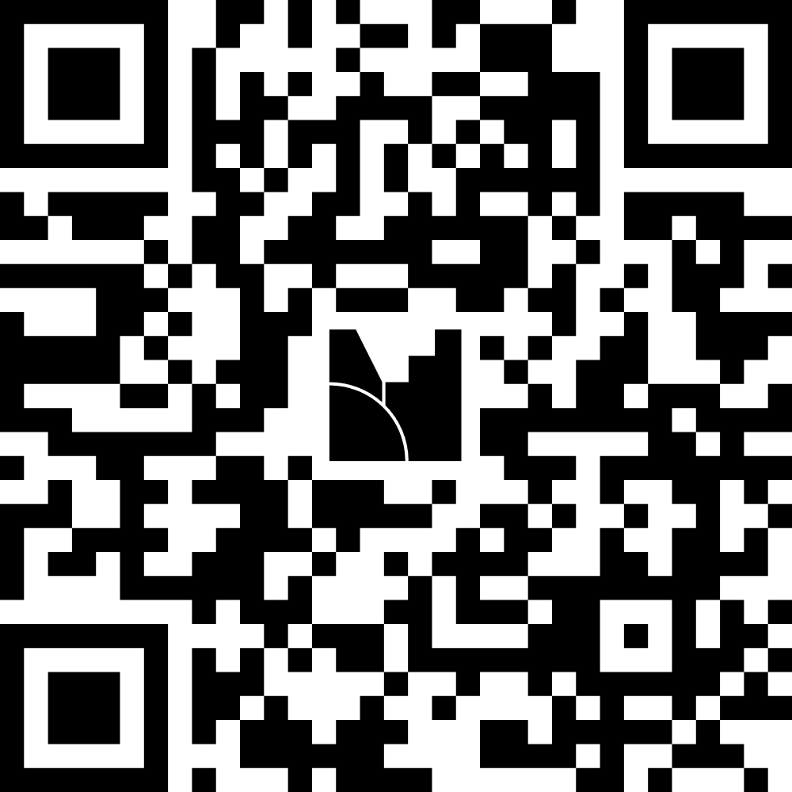
But First…

Slide 4

What is the R Validation Hub?
Some companies are:
Abbvie
Biogen
Lilly
Merck
Parexel
Posit
Roche
Sanofi
And many more…
Nested under the R Consortium
Cross industry collaboration of over fifty biotech and pharmaceutical companies
Initial aim: Consolidate definitions, regulations, and best practices for qualification and validation of the open-source language
Current State: Grown to include a variety of workstreams that produce resources and tools for open-source use aligning with the expectations of regulatory agencies

Slide 5
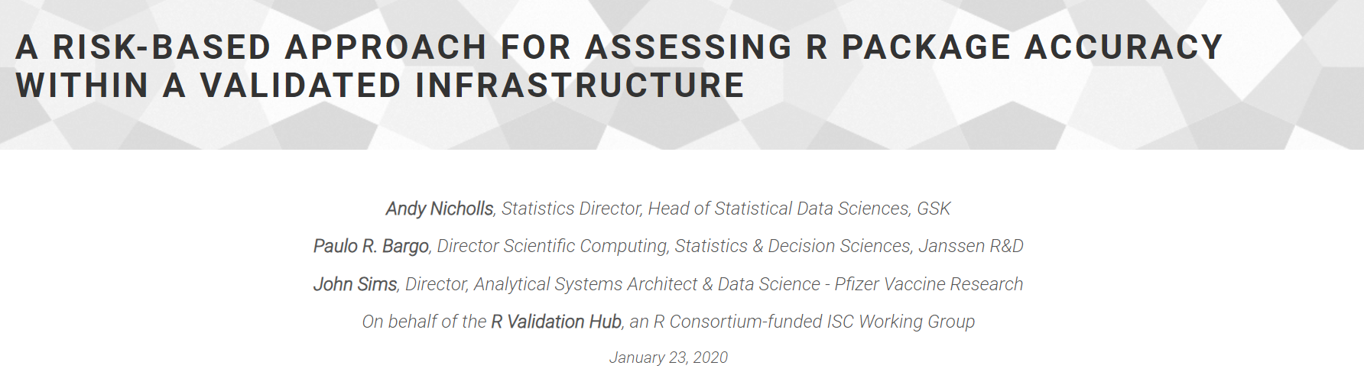
The White Paper

Slide 6



A Risk-Based Approach for Assessing R Package Accuracy within a Validated Infrastructure
The White Paper
Focuses on systems validation and adequate testing and documentation in keeping with the FDA’s “Statistical Software Clarifying Statement”
Accuracy
Reproducibility
Traceability
“For Intended Use”

Slide 7
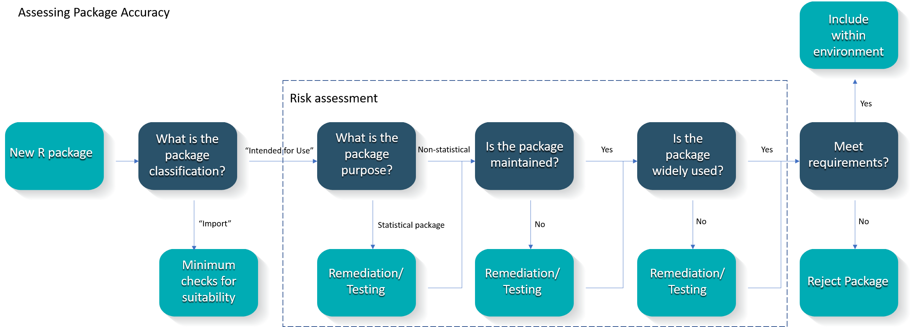
Proposed Risk-Based Approach to Assess Accuracy
The White Paper

Slide 8
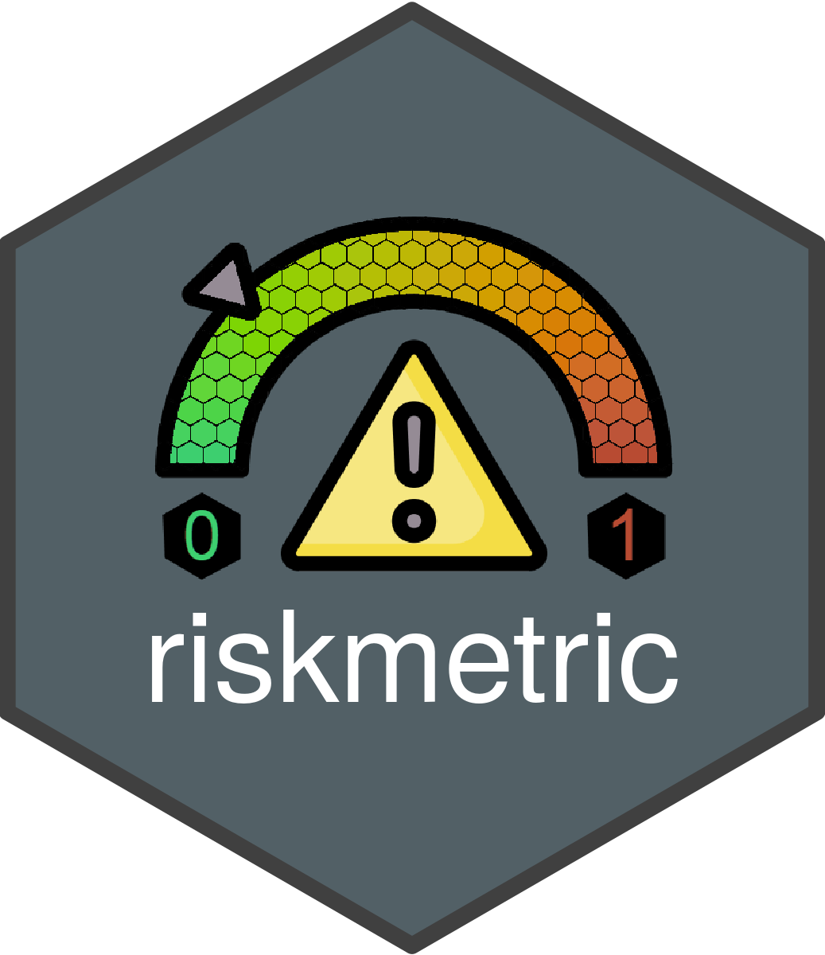
{riskmetric}

Slide 9
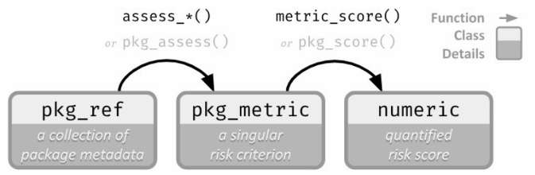
How It Works
{riskmetric}
Perceived Risk
Quantified Risk

Slide 10
How Quality can be Quantified
{riskmetric}
Unit Testing Metrics
A license
Source code available for browsing
An easy to contact maintainer
Up-to-date news regarding new features and bugs
A place to report bugs
Evidence that new bugs are being addressed
Package documentation & user guides/ perhaps a website
Complete Function documentation
Adequate test coverage
Community usage
and many more!
Documentation Metrics
Community Engagement
Maintenance & Reusability

Slide 11
Who can use {riskmetric}?
{riskmetric}
Package Developers
Initial testing and subsequent assessment of package complexity and use
Programmers
Determining packages to use in day-to-day work
System Administrator
Understanding additional validation needed

Slide 12
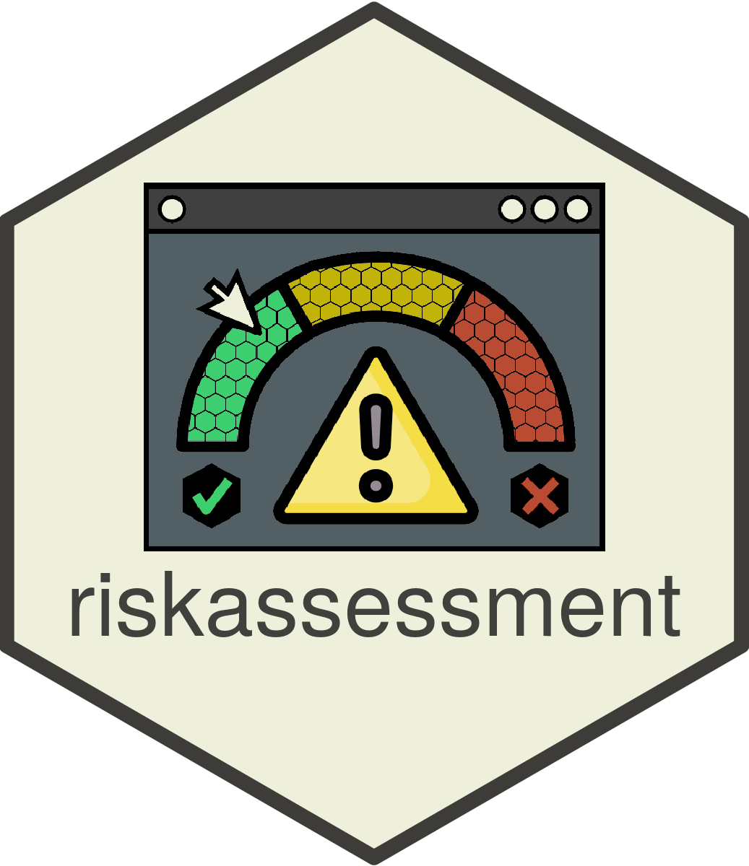

{riskassessment}
Voted ‘Best App’ at Shiny Conference 2023

Slide 13
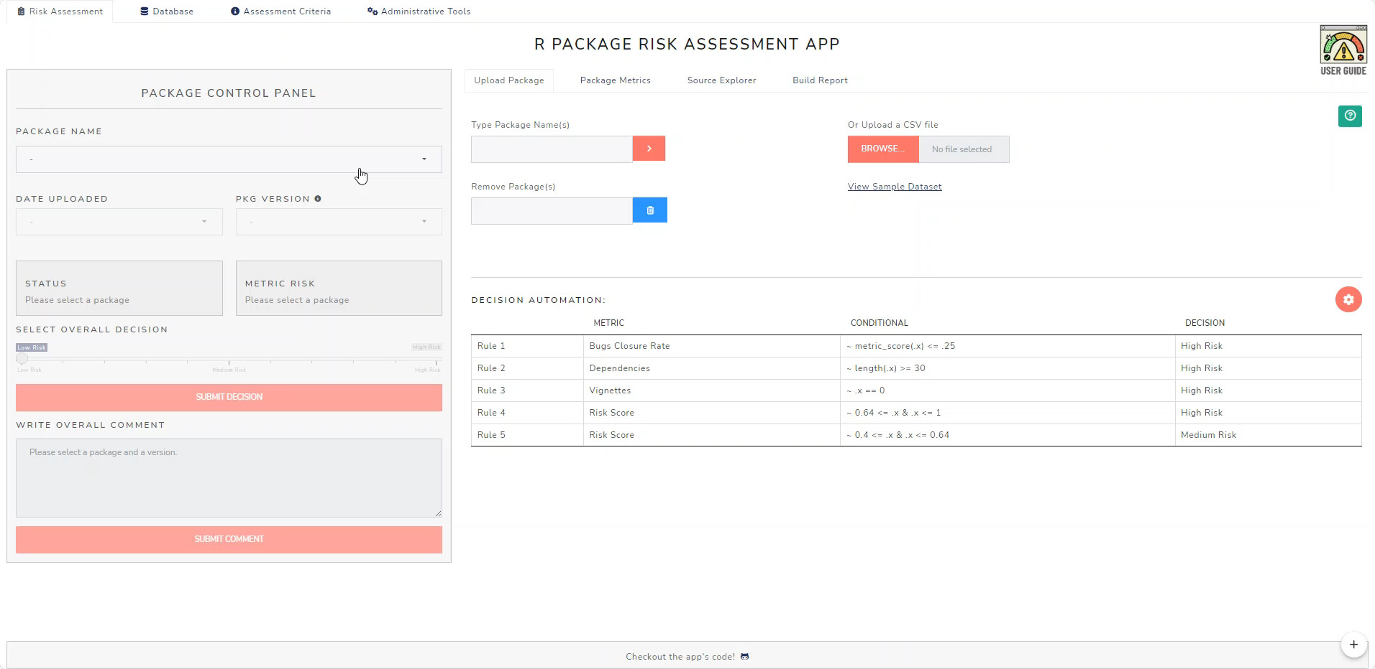
How It Works
{riskassessment}

Slide 14
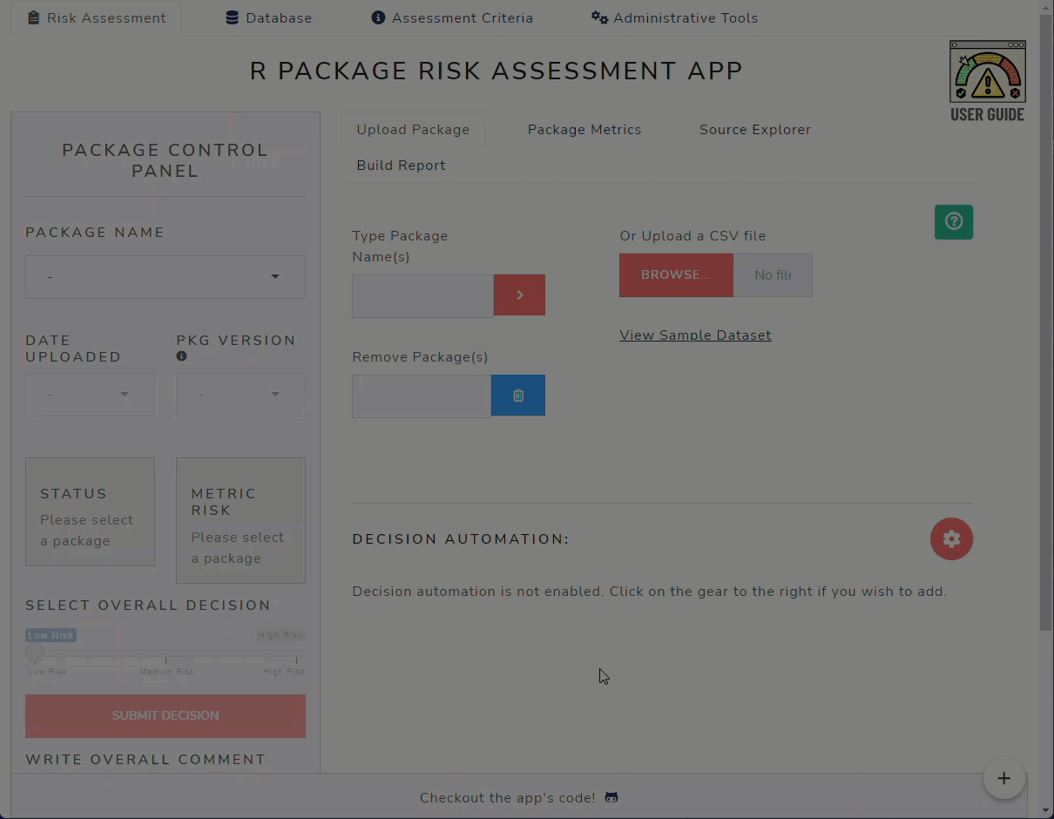
Decision Automation – Integration with {riskassessment}
{riskassessment}

Slide 15
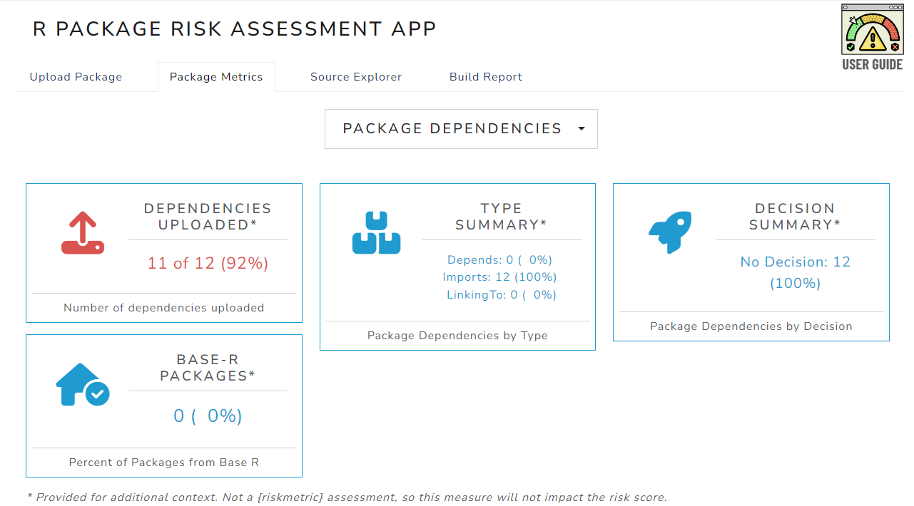
Exploring Dependencies
{riskassessment}

Slide 16
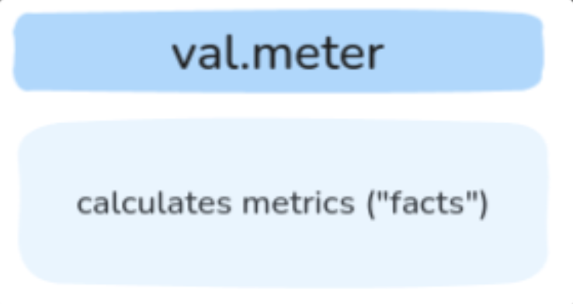
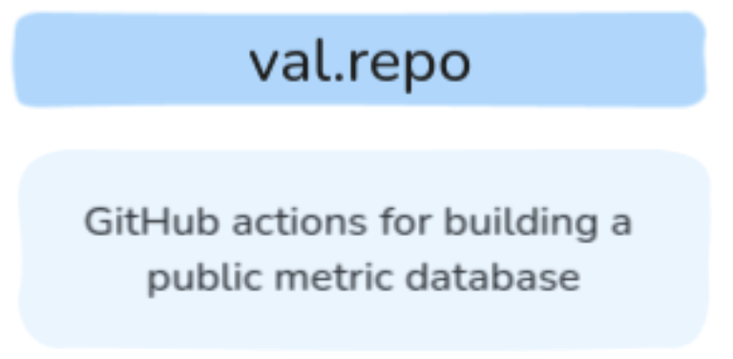
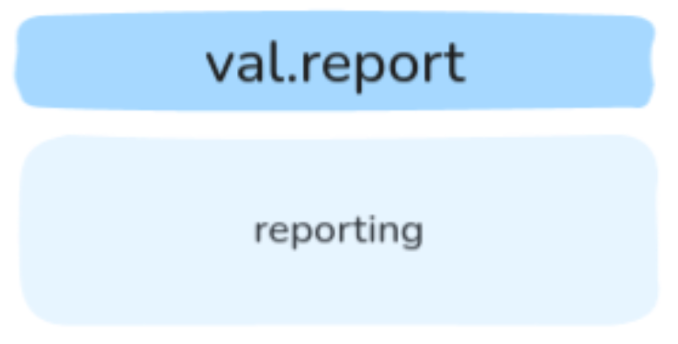
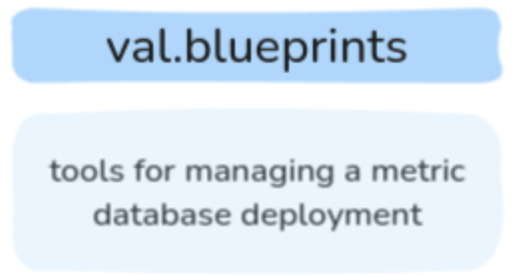
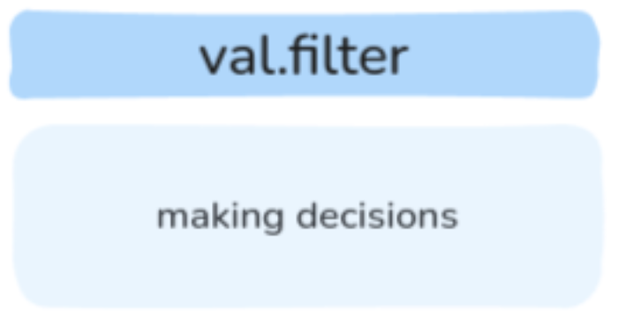
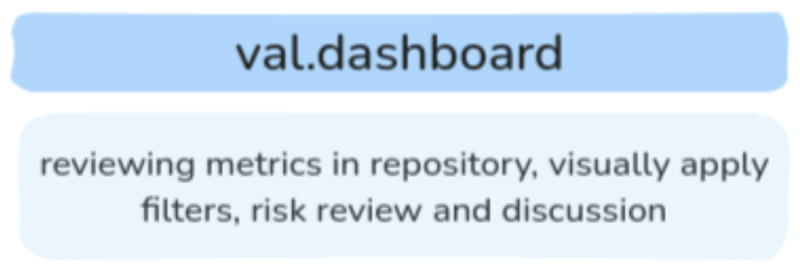
{val.*} Packages
Our newest endeavor for package quantification in
support of the regulatory use of R!
Currently exist

Slide 17
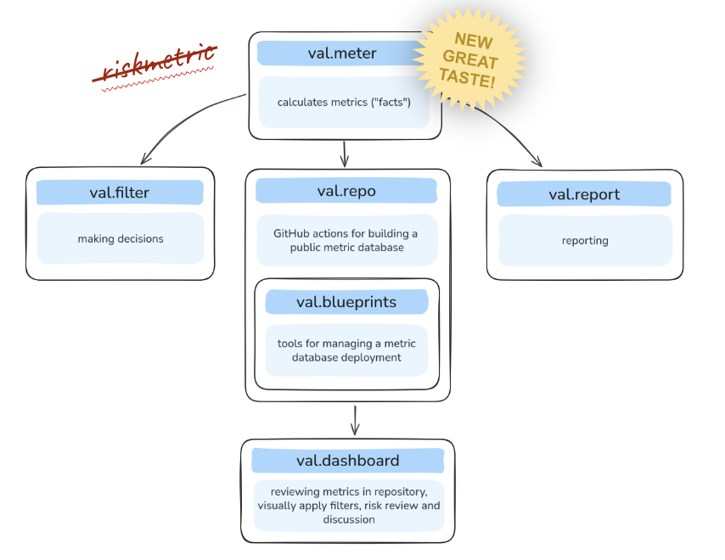
Evolution into {val.*} Packages
{val.*} Packages
A Dev Day hosted in April 2025 inspired an evolution from {riskmetric}; some decisions:
  Focus on PACKAGES file
  Commitment to “no guessing” strategy and focus on “facts” not “opinions” (eg 1M downloads, not “enough downloads”)
  Adopt S7 and avoid S3-style double dispatch
  Data to be co-located
Plan: split up the mature {riskmetric} solution into a family of packages

Slide 18
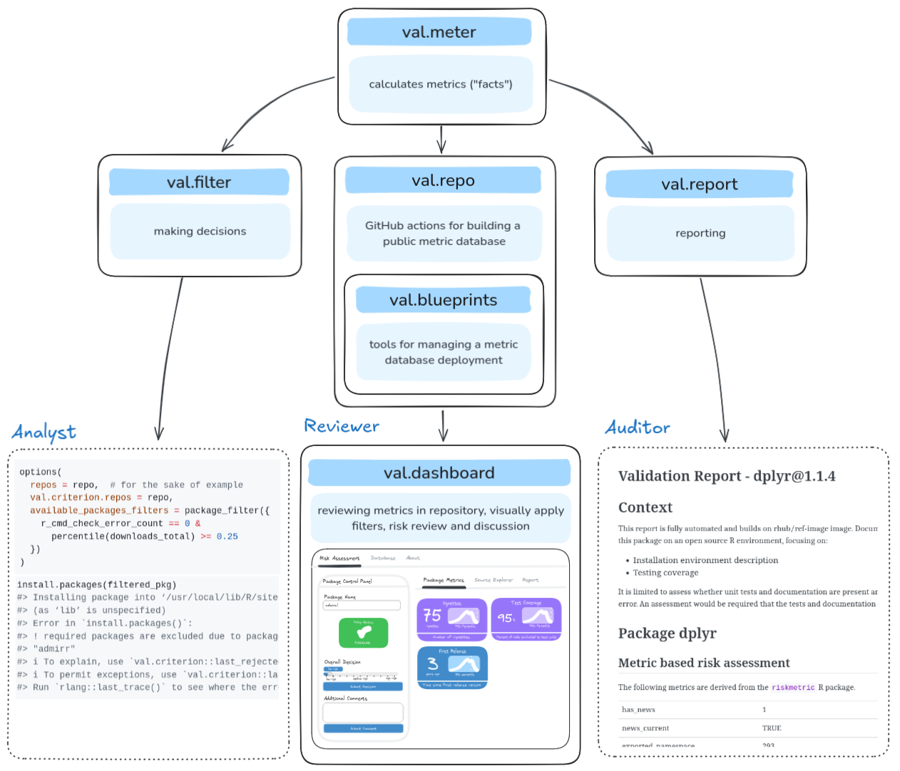
Who is {val.*} Intended for?
{val.*} Packages
Analysts, reviewers, and auditors alike!

Slide 19

Regulatory R Repository

Slide 20
About the Initiative
Regulatory R Repository
What It Is / Our Vision
  An open-source repository (CRAN-like) of risk assessments available to all, providing quantifiable package qualities
  A future part of an R Validation Hub Submissions working group pilot (2026); health authority experimentation
Goals
  Empower consistent, reproducible, and transparent validation
  Lower the barrier to entry for start-ups
  Empower consistency among contract research organizations (CROs)
  Improve the speed of regulatory review for established enterprises
Recent strides
  Progress with {val.*} packages to bring us closer to public-facing dashboard
  Companies providing talent for development

Slide 21
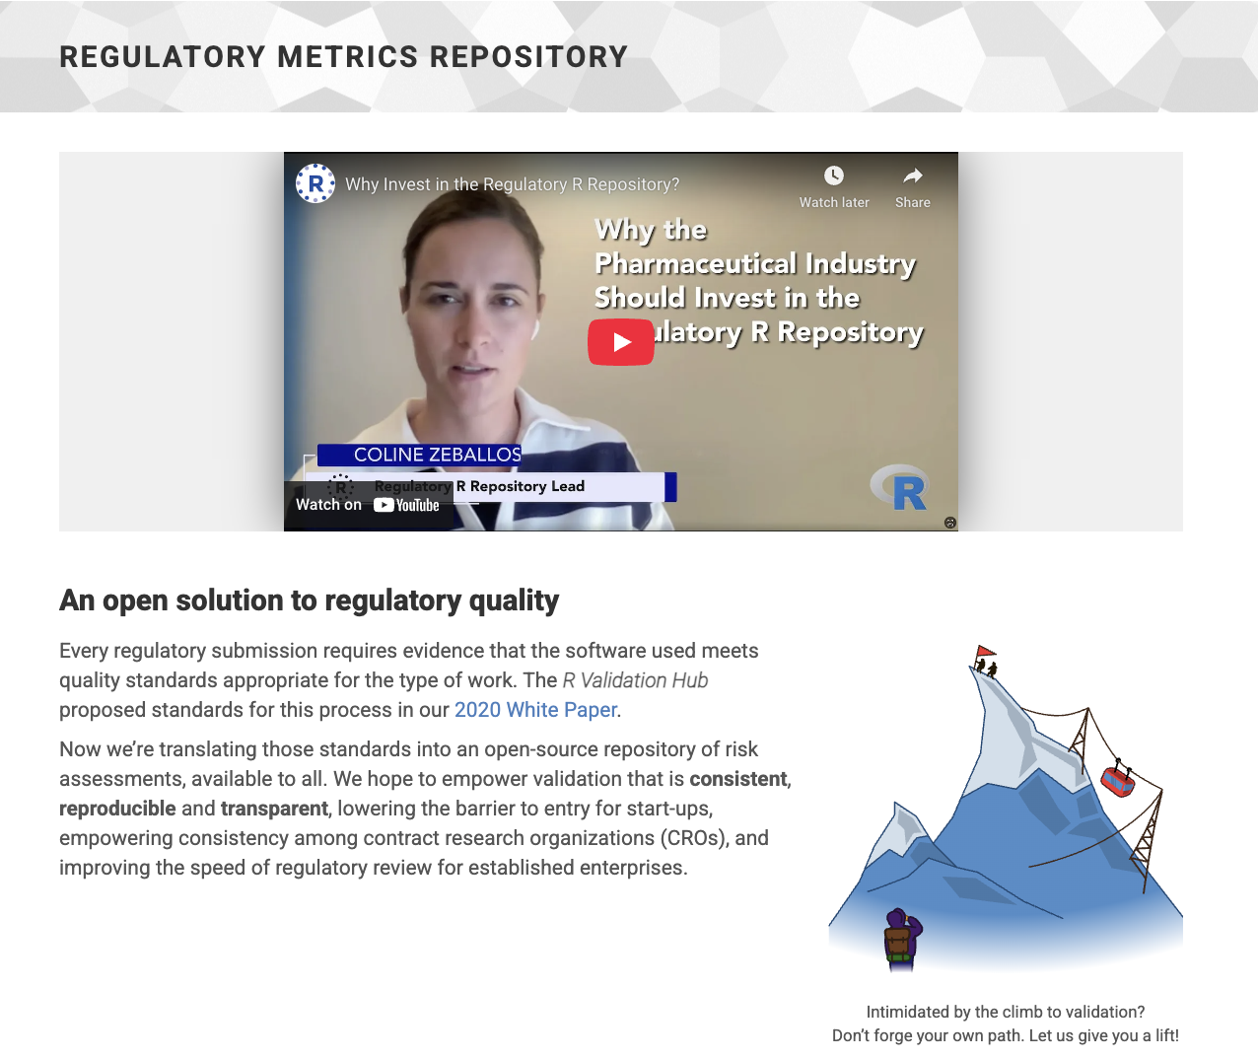
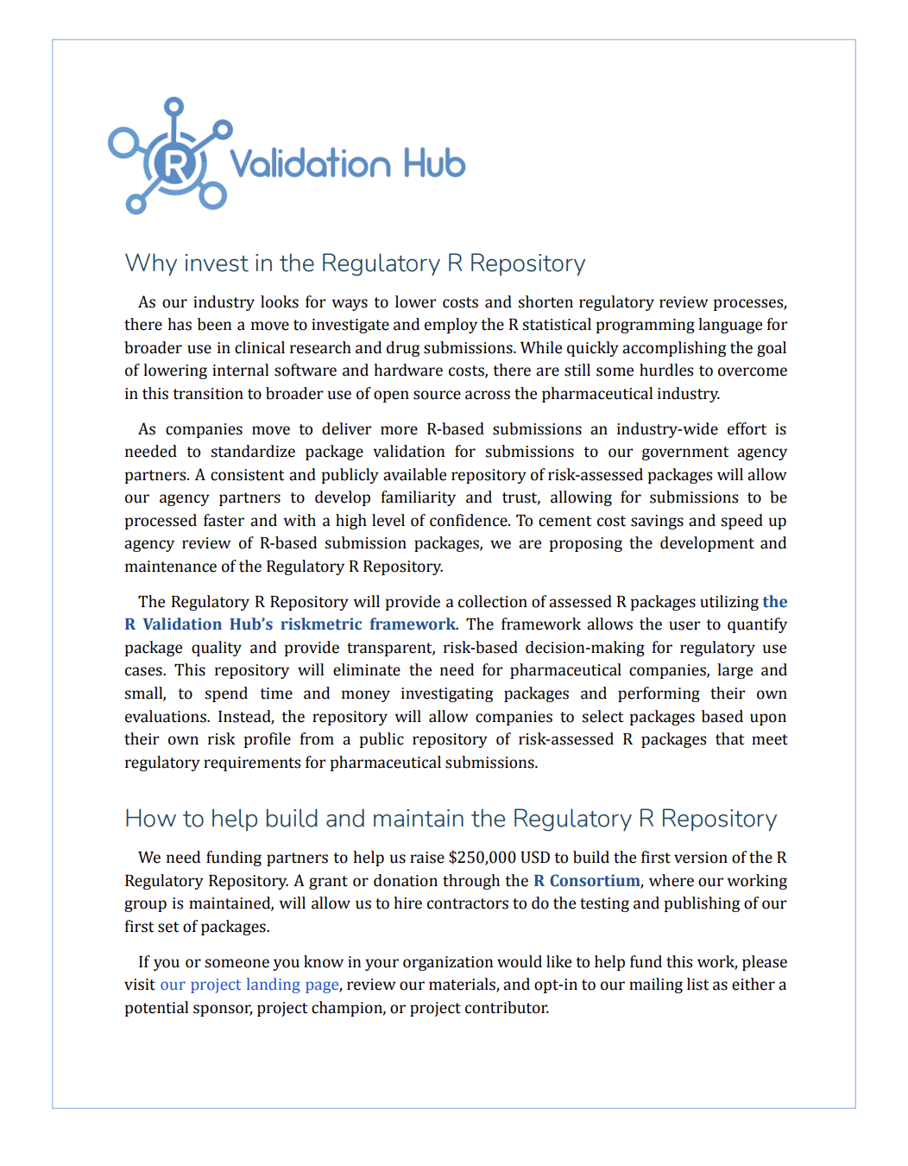
Check Out More on Our Site!
Regulatory R Repository
https://pharmar.org/repository/

Slide 22

Communications

Slide 23
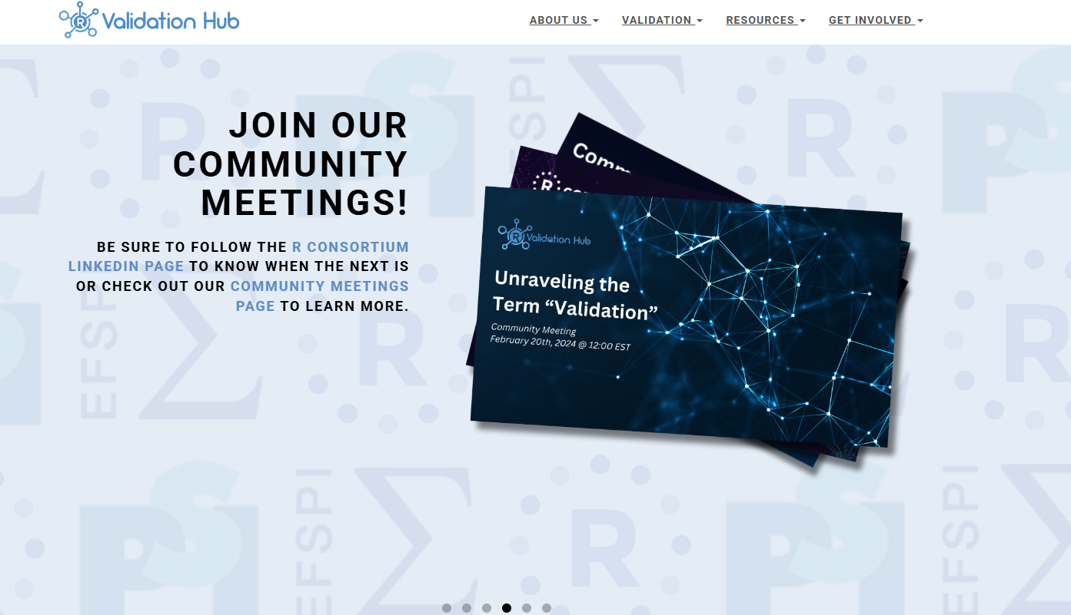
Our Platforms
Communications
Website (pharmar.org)
Community Meetings
Past topics have included…
Unraveling the term ‘Validation’
Shiny App Validation in Regulatory Submissions
Analyzing Change in Assessed Risk Across Package Releases

Slide 24




Get Involved!!
Communications
The R Validation Hub is always looking to expand its network. These are a few ways to join in!
Be a part of our Working Groups
Join our mailing list and attend Community Meetings
Tell us your ideas
Submit a Case Study

Slide 25
Name: Anuja Das
Organization: Biogen
E-mail: Anuja.das@biogen.com
Web: pharmar.org

