Slide 1
A basic example Rmd document
Paul Northrop

Slide 2
Text, bullets, links
library(knitr)
For more information see the accessr site on GitHub
Bullet 1
Bullet 2

Slide 3
Displayed equations
$$\begin{matrix}T=\left\{\begin{matrix}\overline{X} & \text{ with probability }1−1/n , \\ \overline{X}+n & \text{ with probability }1/n .\end{matrix}\right.\end{matrix}$$
$$\begin{matrix}P\left(X≤x\right) & =P\left(F^{−1}\left(U\right)≤x\right) \\ & =P\left(F\left(F^{−1}\left(U\right)\right)≤F\left(x\right)\right) \\ & =P\left(U≤F\left(x\right)\right)=F\left(x\right).\end{matrix}$$
Tips (prompted by issues when creating Word output):
We need to wrap LaTeX maths environments in $$ ... $$. Otherwise, the maths is ignored.
Use \text{} or \mbox{} for text in an maths environment. (\rm{} causes problems.)

Slide 4
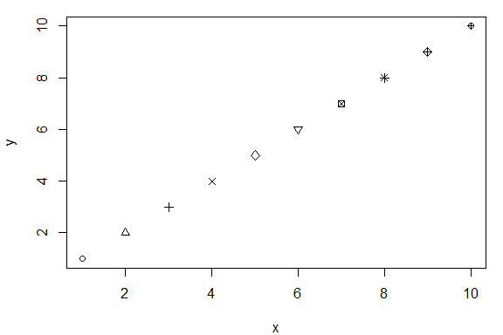
R-generated figure
plot(1:10, 1:10, pch = 1:10, xlab = "x", ylab = "y")
Use knitr chunk options fig.alt (alternative text) and fig.cap (caption).

Slide 5
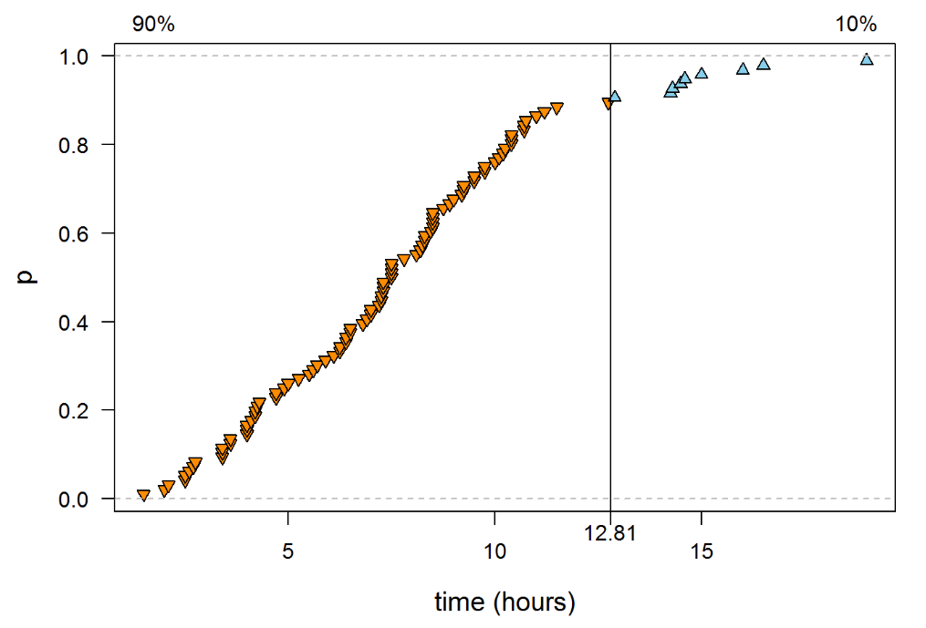
External figure (png file)
include_graphics(system.file(package = "accessr", "examples", "plot.png"))
Use knitr::include_graphics().

Slide 6
Table
The table will only appear if both of the packages dplyr or huxtable are installed. The huxtable code is hidden because it is lengthy. Of course, there are many other ways to create tables in R markdown.
clinic | drug | success (S) | failure (F)
1 | A | 36 | 24
 | B | 24 | 16
2 | A | 4 | 16
 | B | 16 | 64

Slide 7
Hiding stuff using echo
This text will appear only if params$hide = FALSE

Slide 8
Hiding a figure using eval
plot(1:10, 1:10, pch = 1:10, xlab = "x", ylab = "y")
This figure appears only if params$hide = FALSE.

