Slide 1

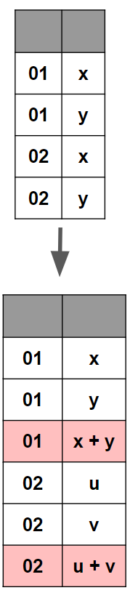
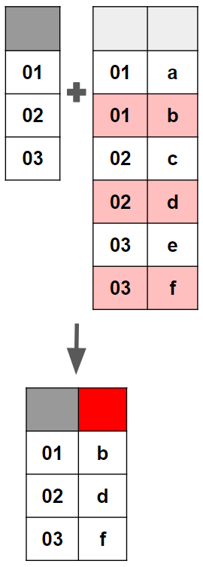
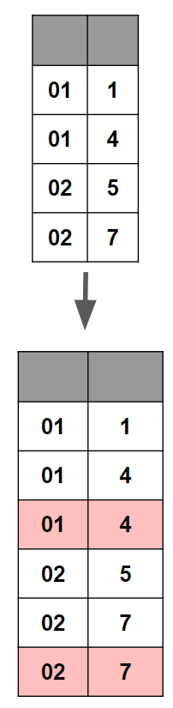
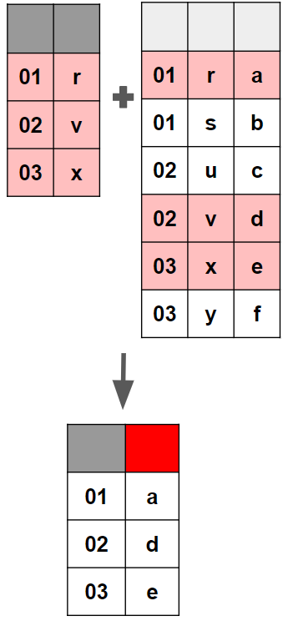
admiral :: CHEAT SHEET
What you need to know
Generic Parameter-Adding Functions
Functions Treating
Days/Dates/Datetimes
{admiral} is an open-source, modularized toolbox that enables the development of ADaM datasets in R.
{admiral} code is comprised of interchangeable blocks, i.e. function calls, that sequentially derive new variables or parameters to help construct an ADaM dataset.
derive_param_computed(dataset,
dataset_add = NULL, by_vars, parameters,
set_values_to, …)
Add a parameter computed from the analysis value of other parameters.
derive_param_computed(
dataset = advs,
by_vars = exprs(USUBJID, VISIT),
parameters = c("SYSBP", "DIABP"),
set_values_to = exprs(
AVAL = (AVAL.SYSBP+2*AVAL.DIABP)/3,
PARAMCD = "MAP",
PARAM = "Mean Arterial Pressure",
AVALU = "mmHg"
)
)
derive_vars_(dt/dtm)(dataset, new_vars_prefix, …)
Derive or impute a date/datetime from a date character Vector.
derive_vars_dt(admh, new_vars_prefix = "AST", dtc = MHSTDTC)
Generic Variable-Adding Functions
derive_vars_merged(dataset, dataset_add, new_vars, filter_add, order, mode…)
Add new variable(s) to the input dataset based on variables from another dataset. Merged observations can be selected by a condition and/or selecting the first/last observation for each by group.
derive_vars_merged(
dataset = adsl,
dataset_add = vs,
by_vars = exprs(STUDYID, USUBJID),
order = exprs(convert_dtc_to_dtm(VSDTC)),
mode = "last",
new_vars = exprs(LASTWGT = VSSTRESN),
filter_add = VSTESTCD == "WEIGHT")
derive_vars_dy(dataset, reference_date, source_vars)
Adds relative day variables (--DY).
derive_vars_dy(
dataset = adsl, reference_date = TRTSDTM,
source_vars = exprs(TRTSDTM, ASTDTM, AENDT)
)
derive_vars_dtm_to_(dt/tm)(dataset, source_vars,…)
Derive date/time variables from datetime variables.
derive_vars_dtm_to_tm(
dataset = adcm, source_var = exprs(TRTSDTM)
)
derive_extreme_records(dataset, dataset_add, dataset_ref, by_vars, order, mode, keep_source_vars, set_values_to, …)
Add the first or last observation for each by group as new observations. The new observations can be selected from the input dataset or an additional dataset.
derive_extreme_records(
dataset = adlb, dataset_add = adlb,
by_vars = exprs(USUBJID),
order = exprs(AVAL, AVISITN),
mode = "first", filter_add = !is.na(AVAL),
keep_source_vars = exprs(AVAL),
set_values_to = exprs(DTYPE = "MIN"))
derive_vars_duration(dataset, new_var, new_var_unit, start_date, end_date).
Derive duration between two dates.
derive_vars_duration(
dataset = adsl, new_var = AAGE, new_var_unit = AAGEU,
start_date = BRTHDT, end_date = RANDDT,
out_unit = "years"
)
derive_vars_joined(dataset, dataset_add, new_vars, join_type, filter_add, order, mode…)
Add variables from an additional dataset to the input dataset. The selection of the observations from the additional dataset can depend on variables from both datasets.
derive_vars_joined(
dataset = adae, dataset_add = period_ref,
by_vars = exprs(STUDYID, USUBJID),
join_vars = exprs(APERSDT, APEREDT),
join_type = "all",
filter_join = APERSDT <= ASTDT & [...])
Computation Functions for Vectors
Notable others:
derive_expected_records() derive_locf_records()
derive_extreme_event() derive_param_exposure()
derive_summary_records()
These functions do what their names suggest and can be used inside dplyr:: mutate() or other {admiral} functions.
Notable others:
derive_vars_extreme_event() derive_vars_merged_lookup()
derive_vars_transposed() derive_var_merged_ef_msrc()
derive_vars_computed() derive_vars_merged_summary()
derive_var_extreme_flag() derive_vars_joined_summary()
derive_vars_cat() derive_vars_crit_flag()
compute_age_years()
compute_dtf()
compute_duration()
compute_tmf()
compute_scale()
convert_date_to_dtm()
transform_range()
convert_dtc_to_dt()
convert_dtc_to_dtm()
Note: These functions are just some examples of the many generic variable/parameter-adding functions in {admiral}. Check the reference page for all of them!
Links: Github Repo - Documentation - Join the Pharmaverse Slack

Slide 2
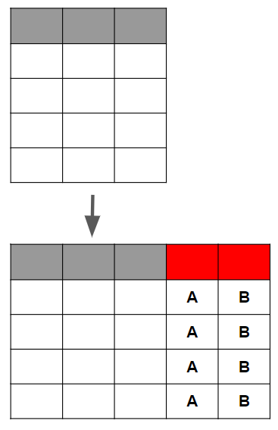
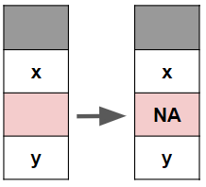
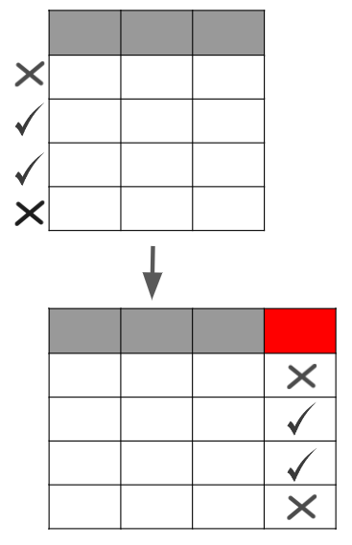
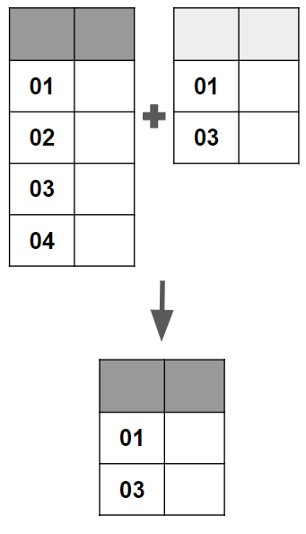
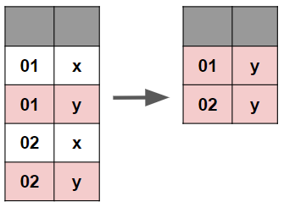
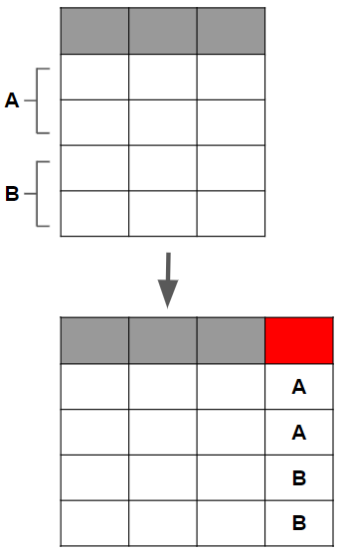
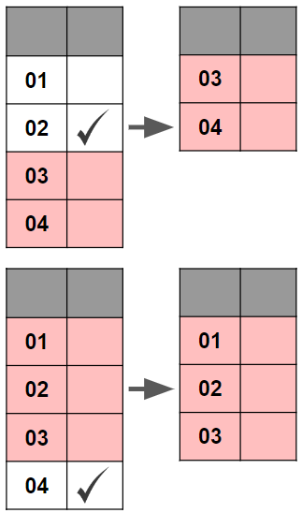
Special Variable-Adding Functions
Higher Order Functions
Templates
derive_var_age_years(dataset, age_var, age_unit, new_var)
Derive age in years.
Meta-functions that take {admiral} functions as input and facilitate their execution.
Example scripts to be used as a starting point for ADaM creation.
derive_vars_period(dataset, dataset_ref, new_vars)
Add ADSL subperiod, period, or phase variables.
list_all_templates(package)
List all available ADaM templates in {admiral} (or another package).
call_derivation(dataset, derivation, variable_params, …)
Call a single derivation multiple times with some parameters/arguments fixed across calls and others varying.
call_derivation(
dataset = adae,
derivation = derive_vars_dt,
variable_params = list(
params([...]),
params([...])
))
derive_var_anrind(dataset, use_a1h1lo, …)
Derive analysis reference range indicator (ANRIND)
derive_var_atoxgr_dir(dataset, new_var, tox_description_var, meta_criteria, criteria_direction, get_unit_expr, signif_dig) Derive character lab grade based on severity or toxicity criteria.
use_ad_template(adam_name, package,
overwrite, open)
Open an ADaM template script. use_ad_template("adsl")
Utilities
derive_var_(base/chg/pchg)(dataset, …)
Derive baseline/change/percent change variables.
convert_blanks_to_na()
Turn SAS blank strings into R NAs.
convert_blanks_to_na(c("a", "", "b"))
derive_vars_crit_flag(dataset, condition, description, …)
Derive criterion flag variables (CRITy, CRITyF(L/N)).
derive_var_ontrtfl(dataset, start_date, ref_start_date, ref_end_date, ref_end_window …)
Derive on-treatment flag (ONTRTFL) with a single assessment date (e.g ADT) or event start and end dates (e.g. ASTDT/AENDT).
restrict_derivation(dataset, derivation, args, filter)
Execute a derivation on a subset of the input dataset.
restrict_derivation(
dataset = adlb,
derivation = derive_vars_merged,
args = params([...]),
filter = AVISITN > 0
)
filter_exist(dataset, dataset_add, by_vars, filter_add)
Returns all records in the input dataset belonging to by groups present in a (possibly filtered) source dataset.
filter_exist(
dataset = adsl, dataset_add = adae,
by_vars = exprs(USUBJID),
filter_add = AEDECOD == "FATIGUE"))
derive_var_trtemfl(dataset, new_var, start_date, end_date, trt_start_date, trt_end_date, end_window, …)
Derive treatment emergent analysis flag (TRTEMFL).
derive_vars_query(dataset, dataset_queries)
Derive query variables.
derive_vars_atc(dataset, dataset_facm, by_vars, id_vars, value_var)
Derive ATC class variables from FACM to ADCM.
Special Parameter-Adding Functions
filter_extreme(dataset, by_vars, order, mode, check_type = "warning")
Filters the first/last record in by group.
filter_extreme(by_vars = exprs(USUBJID),
order = exprs(EXSEQ), mode = "first")
*derive_param_bmi(dataset, by_vars, set_values_to, …)
Derive BMI parameter.
slice_derivation(dataset, derivation, args, ...)
The input dataset is split into slices (subsets) and for each slice the derivation is called separately. Some or all arguments of the derivation may vary depending on the slice.
slice_derivation(
dataset = advs,
derivation = derive_vars_dtm,
args = params([...]),
derivation_slice(filter = [...], args = [...]),
derivation_slice(filter = [...], args = [...]),
)
*derive_param_bsa(dataset, by_vars, set_values_to, …)
Derive body surface area parameter (multiple methods).
filter_relative (dataset, by_vars, order, condition, mode, selection, inclusive…)
Filters the observations before or after the observation where a specified condition is fulfilled for each by group.
filter_relative(
response,
by_vars = exprs(USUBJID),
order = exprs(AVISITN),
condition = AVALC == "PD",
mode = "first", selection = "before",
inclusive = TRUE)
*derive_param_map(dataset, by_vars, set_values_to, …)
Derive mean arterial pressure parameter.
derive_param_doseint(dataset, by_vars, set_values_to, …)
Derive dose intensity parameter.
derive_param_tte(dataset, dataset_adsl, source_datasets, by_vars, start_date, event_conditions, censor_conditions, …)
Derive time-to-event parameter.
* wrapper of derive_param_computed().
Note: These functions are just some examples of the many special variable/parameter-adding functions in {admiral}. Check the reference page for all of them!
Links: Github Repo - Documentation - Join the Pharmaverse Slack

