Slide 1


Track: Biostatistics
Indian Society for Clinical Research ISCR Conference 2024
Transformations in Clinical research for Better Patient Outcomes 02-03 Feb 2024
SESSION: Biostatistics and Statistical Programmer
02-February 2024
Topic: Traverse the "Pharmaverse": ouR insights
Speaker : Pooja Kumari
ISCR 2024

Slide 2
Traverse the "Pharmaverse": ouR insights
Disclaimer
The view and opinions expressed in this presentation are the views, thoughts, and opinions belonging solely to the presenter, and not necessarily to the presenter’s employer, organization, committee or other group or individual. No data or confidential information belonging to GSK has been used in this presentation.
ISCR 2024

Slide 3
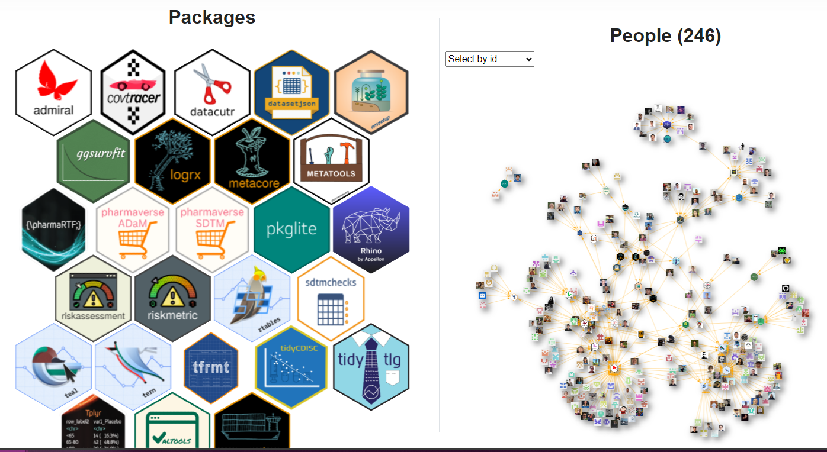
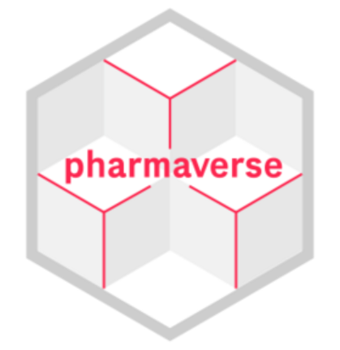

Traverse the "Pharmaverse": ouR insights
Introduction to Pharmaverse
Intrigued by this revolutionary concept of tidyverse, the origin of Pharmaverse was seeded into the minds of some R enthusiast.
Source: pharmaverse (github.com)
ISCR 2024

Slide 4
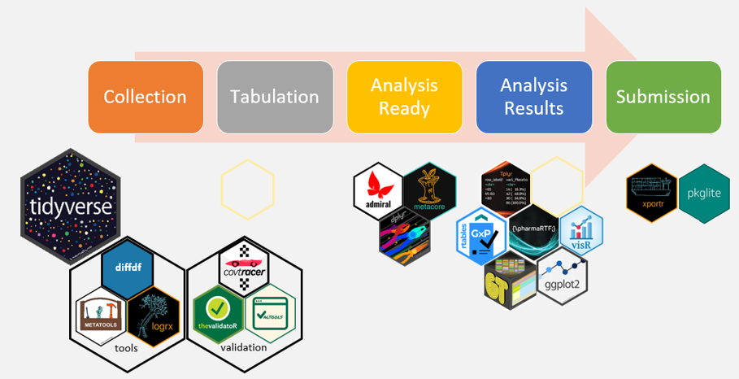
Traverse the "Pharmaverse": ouR insights
Understanding Pharmaverse
Source: pharmaverse
ISCR 2024

Slide 5
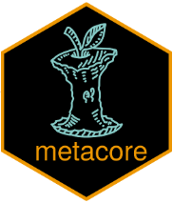
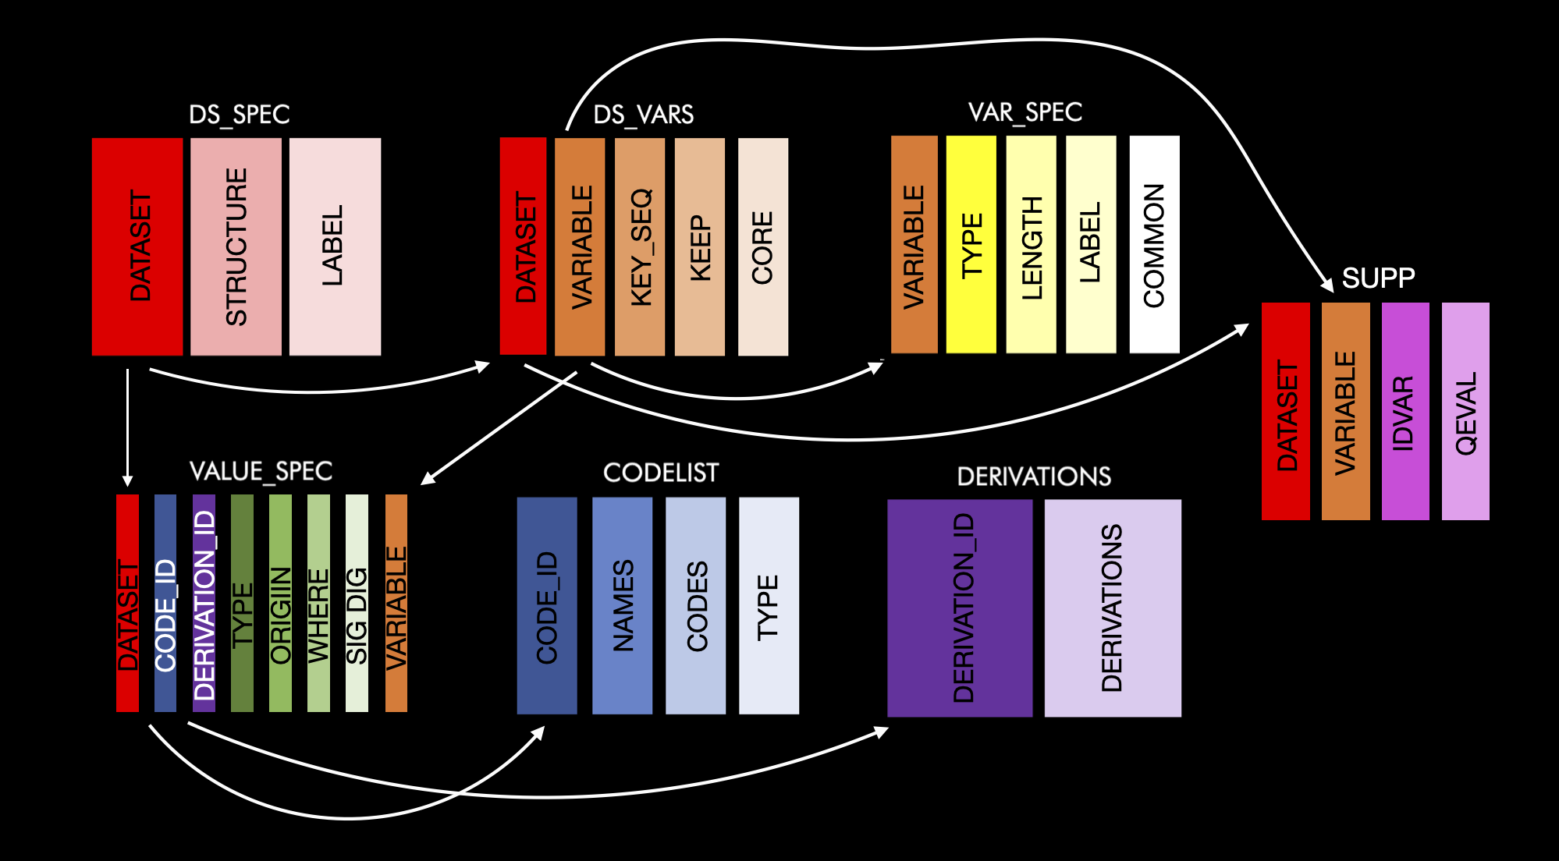
Traverse the "Pharmaverse": ouR insights
Understanding metacore
Load specification file and create “metacore” object
PURPOSE
To establish a common foundation for the use of metadata within an R session. This is done by creating an R object that can hold the necessary data in a standardized, immutable structure (using R6) that makes it easy to extract out necessary information when needed.
metacore (atorus-research.github.io)
ISCR 2024

Slide 6

Traverse the "Pharmaverse": ouR insights
Understanding metatools
Create categorical Variable from codelist (e.g.: AGEGR1)
PURPOSE
The goal of metatools is to enable the use of metacore objects. Metatools can be used to build datasets or enhance columns in existing datasets as well as checking datasets against the metadata in metacore.
Create “Predecessor” variables
Combine Domain and Supplemental Qualifier
Compare Planned and Actual dataset values/attributes
Create numeric version of variables from codelist (e.g.: TRT01PN)
metatools (pharmaverse.github.io)
ISCR 2024

Slide 7

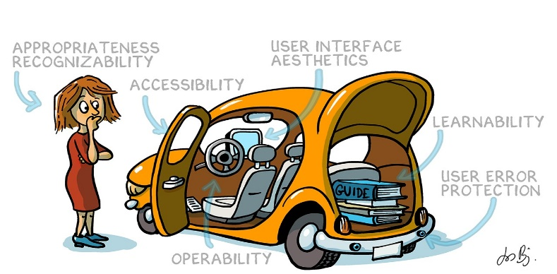
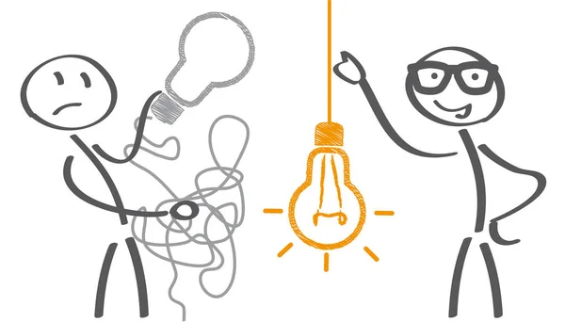

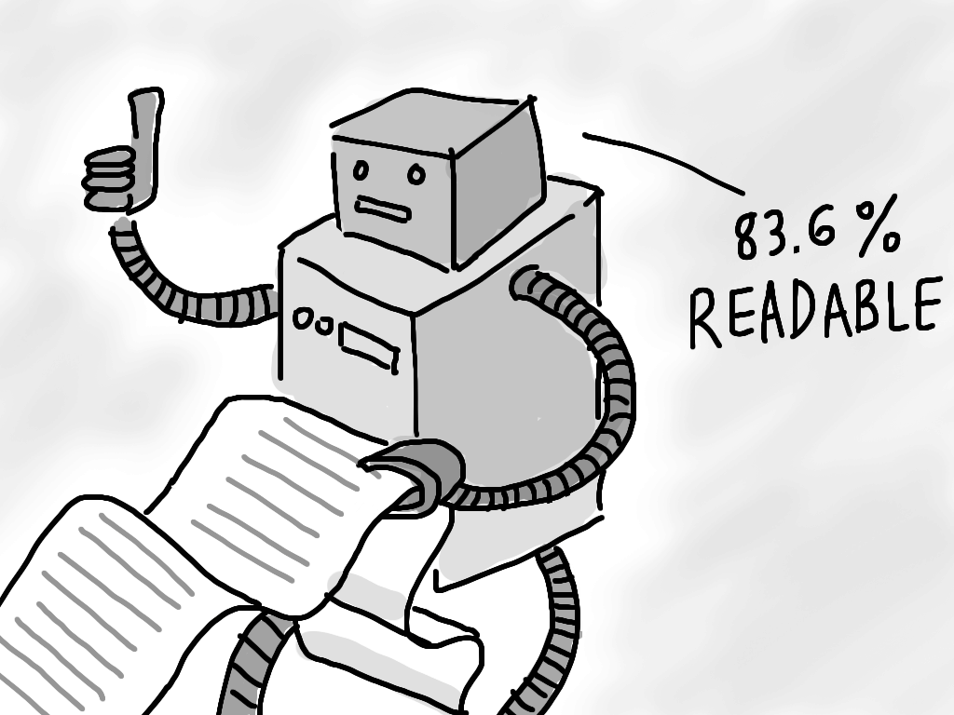
Traverse the "Pharmaverse": ouR insights
Understanding admiral
Derive Assigned/Derived variables
PURPOSE
Usability
Simplicity
To provide an open source, modularized toolbox that enables the pharmaceutical programming community to develop ADaM datasets in R.
Findability
Readability
admiral (pharmaverse.github.io)
ISCR 2024

Slide 8

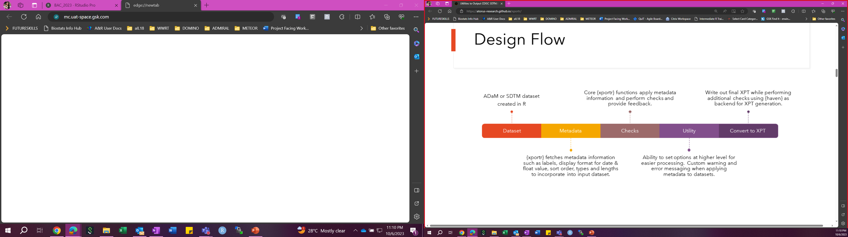
Traverse the "Pharmaverse": ouR insights
Understanding xportr
Final transportable file creation and validation
PURPOSE
This package has the functionality to associate metadata information to a local R data frame, perform data set level validation checks and convert into a transport v5 file(xpt).
xportr (atorus-research.github.io)
ISCR 2024

Slide 9

Traverse the "Pharmaverse": ouR insights
Workflow
INITIALIZE : Load libraries and required input datasets
PROCESSING
EXECUTION
Read Metadata Specification file
Create Derived/Assigned variables as per specification
Fetch Predecessor variables
Assign variable attributes (e.g.: label, length, formats, etc. )
Create METACORE object
Create variables using codelist
Create final ADaM dataset
Write final .xpt ADaM
Load control terms
Perform dataset validation check
ISCR 2024

Slide 10
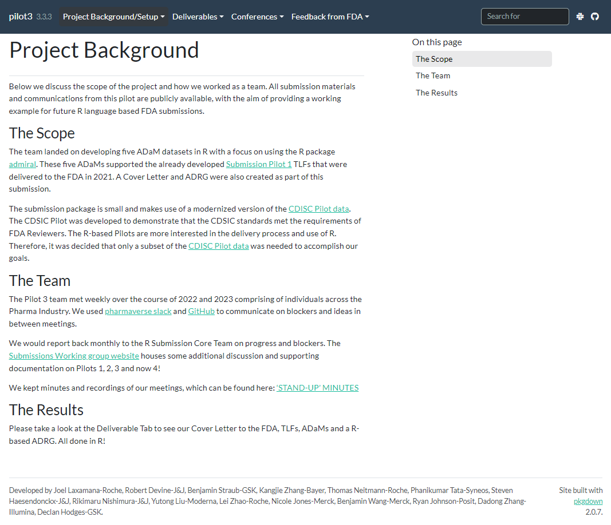
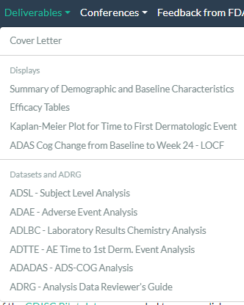
Traverse the "Pharmaverse": ouR insights
R Pilot submission story
Project Background • pilot3 (rconsortium.github.io)
ISCR 2024

Slide 11
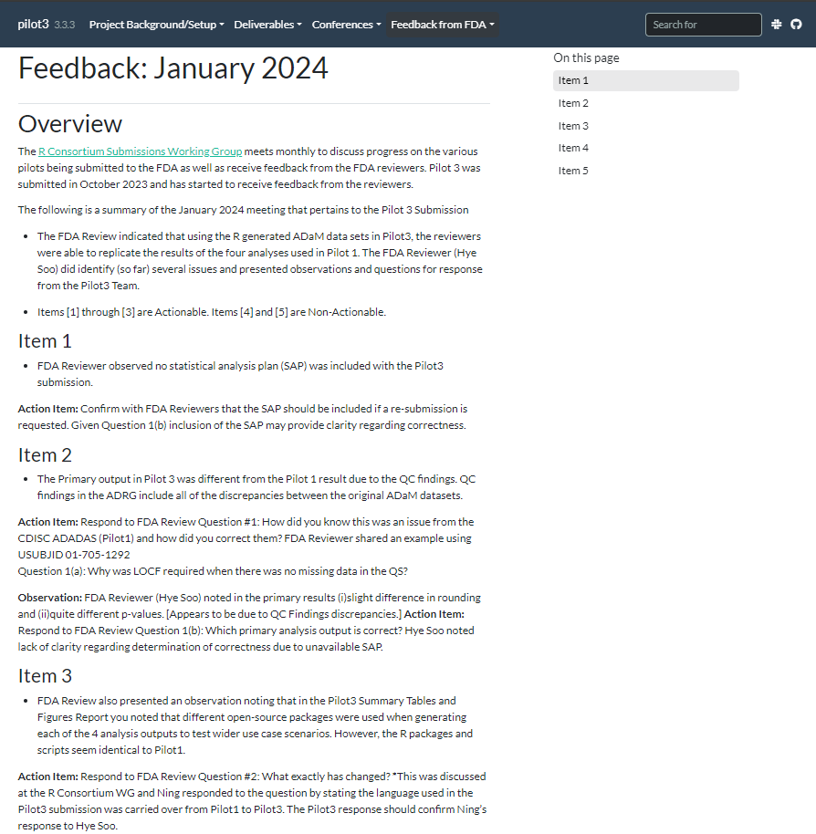
Traverse the "Pharmaverse": ouR insights
R Pilot submission story
Project Background • pilot3 (rconsortium.github.io)
ISCR 2024

Slide 12
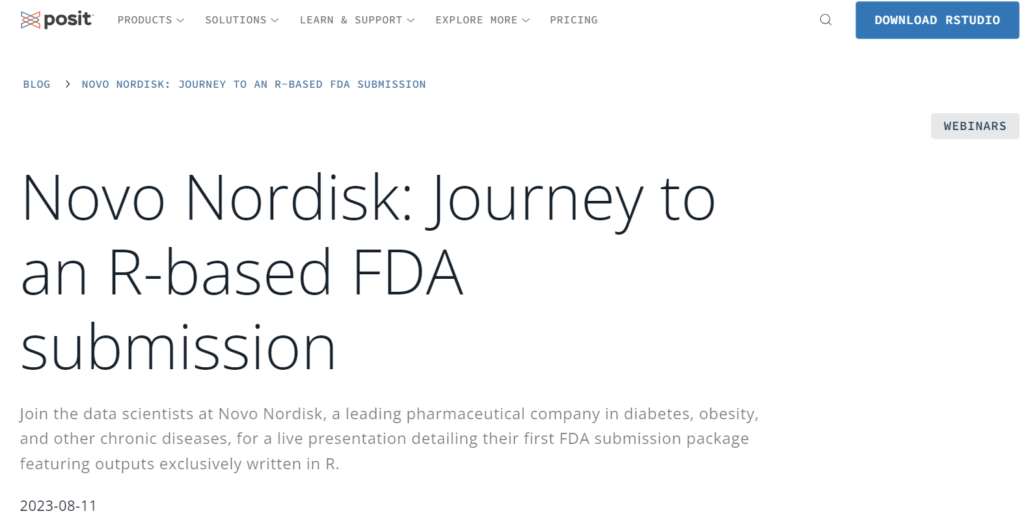
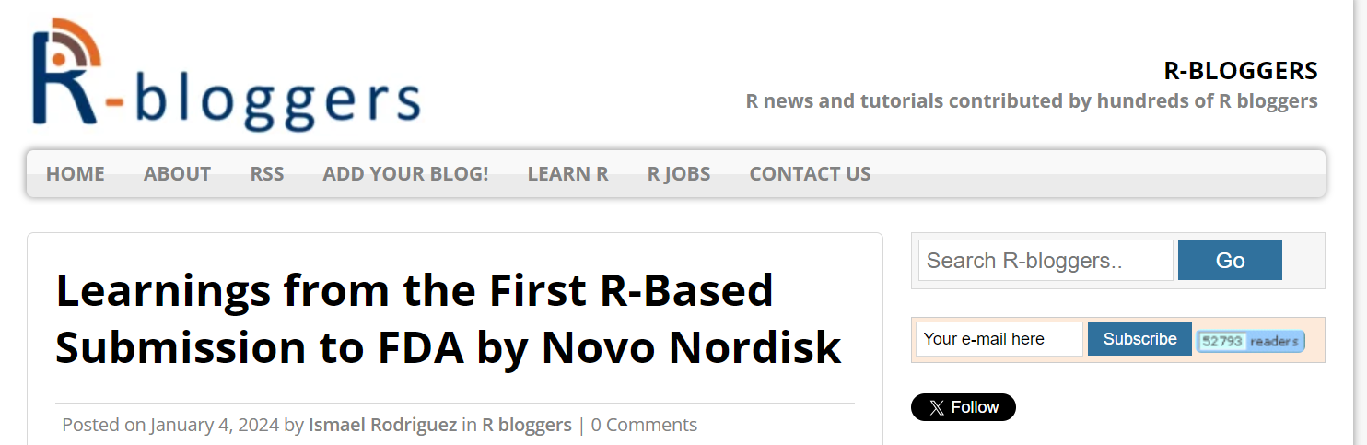
Traverse the "Pharmaverse": ouR insights
R Submission success stories
Learnings from the First R-Based Submission to FDA by Novo Nordisk | R-bloggers
Gives a nice summary of past projects as well, talks about Pilot 1,2,3,4
Novo Nordisk: Journey to an R-based FDA submission – Posit
You Tube link: Novo Nordisk's Journey to an R based FDA Submission - YouTube
ISCR 2024

Slide 13
Traverse the "Pharmaverse": ouR insights
References
pharmaverse : https://pharmaverse.org/
{metacore}: https://atorus-research.github.io/metacore/
{metatools}: https://pharmaverse.github.io/metatools/
{admiral}: https://pharmaverse.github.io/admiral/cran-release/
{xportr}: https://atorus-research.github.io/xportr/
I would like to acknowledge Ben Straub and all the contributors of above-mentioned packages for their support and kind contributions to R for clinical programming open-source community. My colleague Tanisha Gupta for helping me with the presentation. Also, ISCR organizing committee for providing us the opportunity to share our experience.
ISCR 2024

Slide 14

Thank You!!!
Don’t Keep calm and explore Pharmaverse.
ISCR 2024

