Slide 1
{falcon}: A Collaborative Leap Forward Towards Harmonization of Clinical Reporting Standards
Vincent Shen, Roche
Juergen Boehl, Boehringer Ingelheim
PHUSE EU 2023

Slide 2
Agenda
History & Motivation
Current Progress
Learnings, Outlook, & Call for Collaboration

Slide 3
History & Motivation

Slide 4
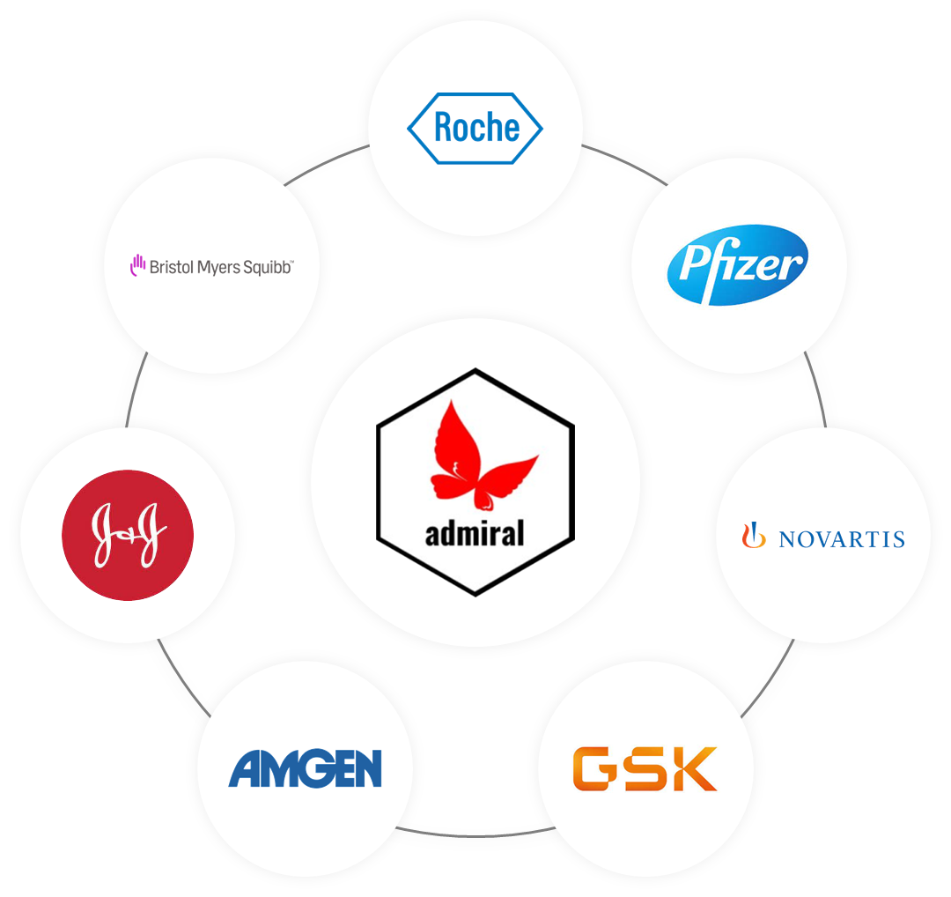
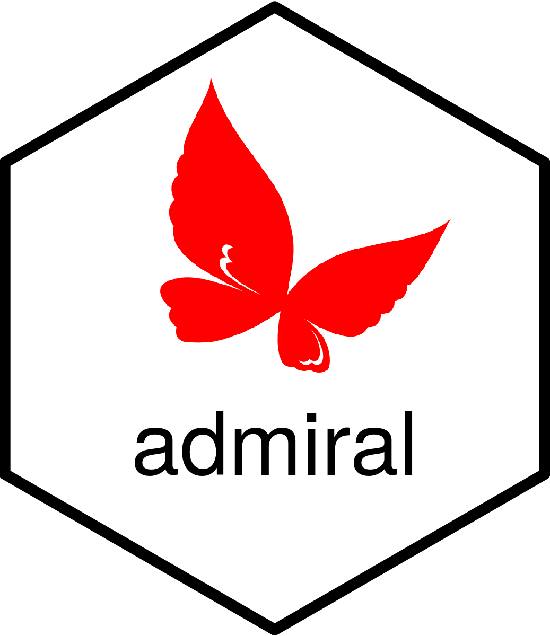





Pharma Industry Has Very Well Established Data Standards
SDTM & ADaM have brought great benefits to clinical trial conduct & analyses
Universally agreed standards not only enable easier data sharing & re-use, but also foster industry collaboration

Slide 5
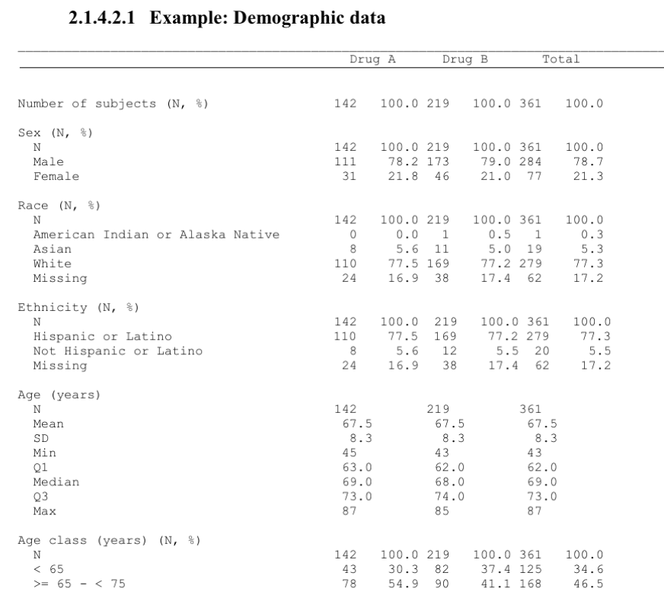
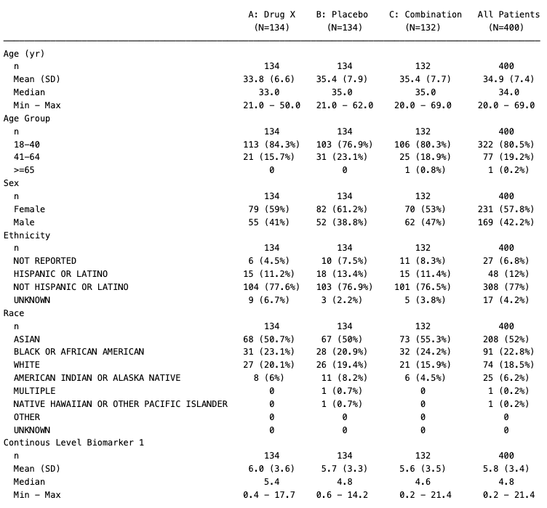
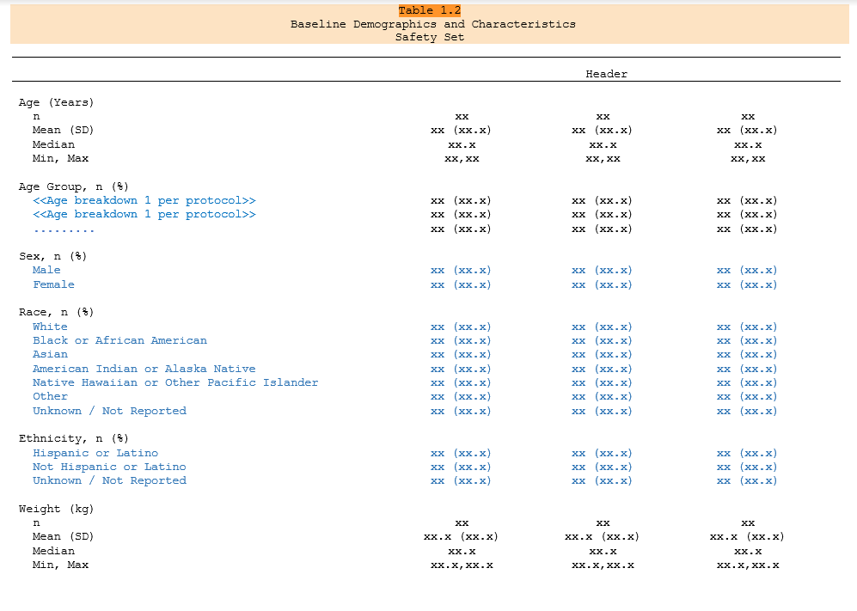
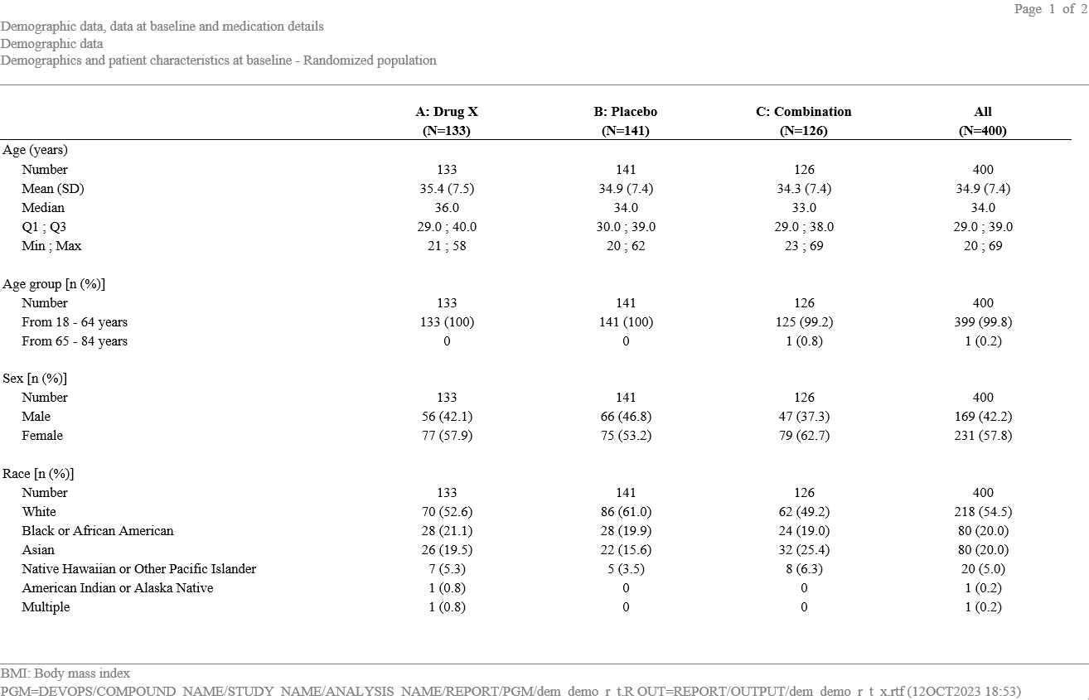
How About TLGs?
We all create demographic tables, yet in a thousand different ways
Notes:
Which of the above is the best demographic table? Is there really one that is better than all others?
Why don’t we try to do a bit harmonization on TLG layouts? (especially on the most commonly used ones)

Slide 6
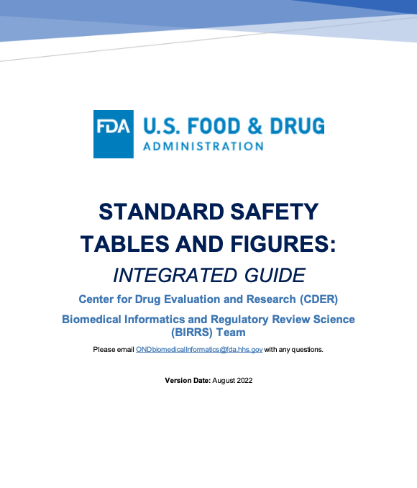





An Opportunity Arose
FDA proposed an integrated guide for standard safety tables & figures
Common Toolkit:
Open-source R packages for TLG creation are available
Shared Resource:
Developers come from different companies
One Layout:
A much easier entry point for collaboration
Instead of potentially implementing this guide individually, why don’t we do it together?

Slide 7

{falcon}
First industry collaborative effort for TLG creation
An industry collaborative effort with the aspiration of open-sourcing a catalog of harmonized TLGs for clinical study reporting and simplifying the process of output review, re-use, and meta-analyses

Slide 8
Current Progress

Slide 9




Our Journey
What have we achieved so far?
Future Plans
Increasing Awareness
- CRAN release
- Alignment with CDISC’s ARD/ARM efforts
- Expanding scope of work to common analyses in trials, and further promoting a harmonized TLG standard
Active Development
{falcon} workshop was conducted in this year’s RinPharma conference. CDISC and more pharma companies have reached out to inquire about future collaborations
Team Setup
A website was launched to share development progress, template code, upcoming events, etc. ~20 templates are now publicly available
Kickoff
Github repository & slack channel was created. Product owners & developers were onboarded to the project
Companies agreed to co-develop TLG templates, using FDA’s guide as a starting point
2022 Q4
2023 Q1
Q2-Q3
Q4
2024+

Slide 10
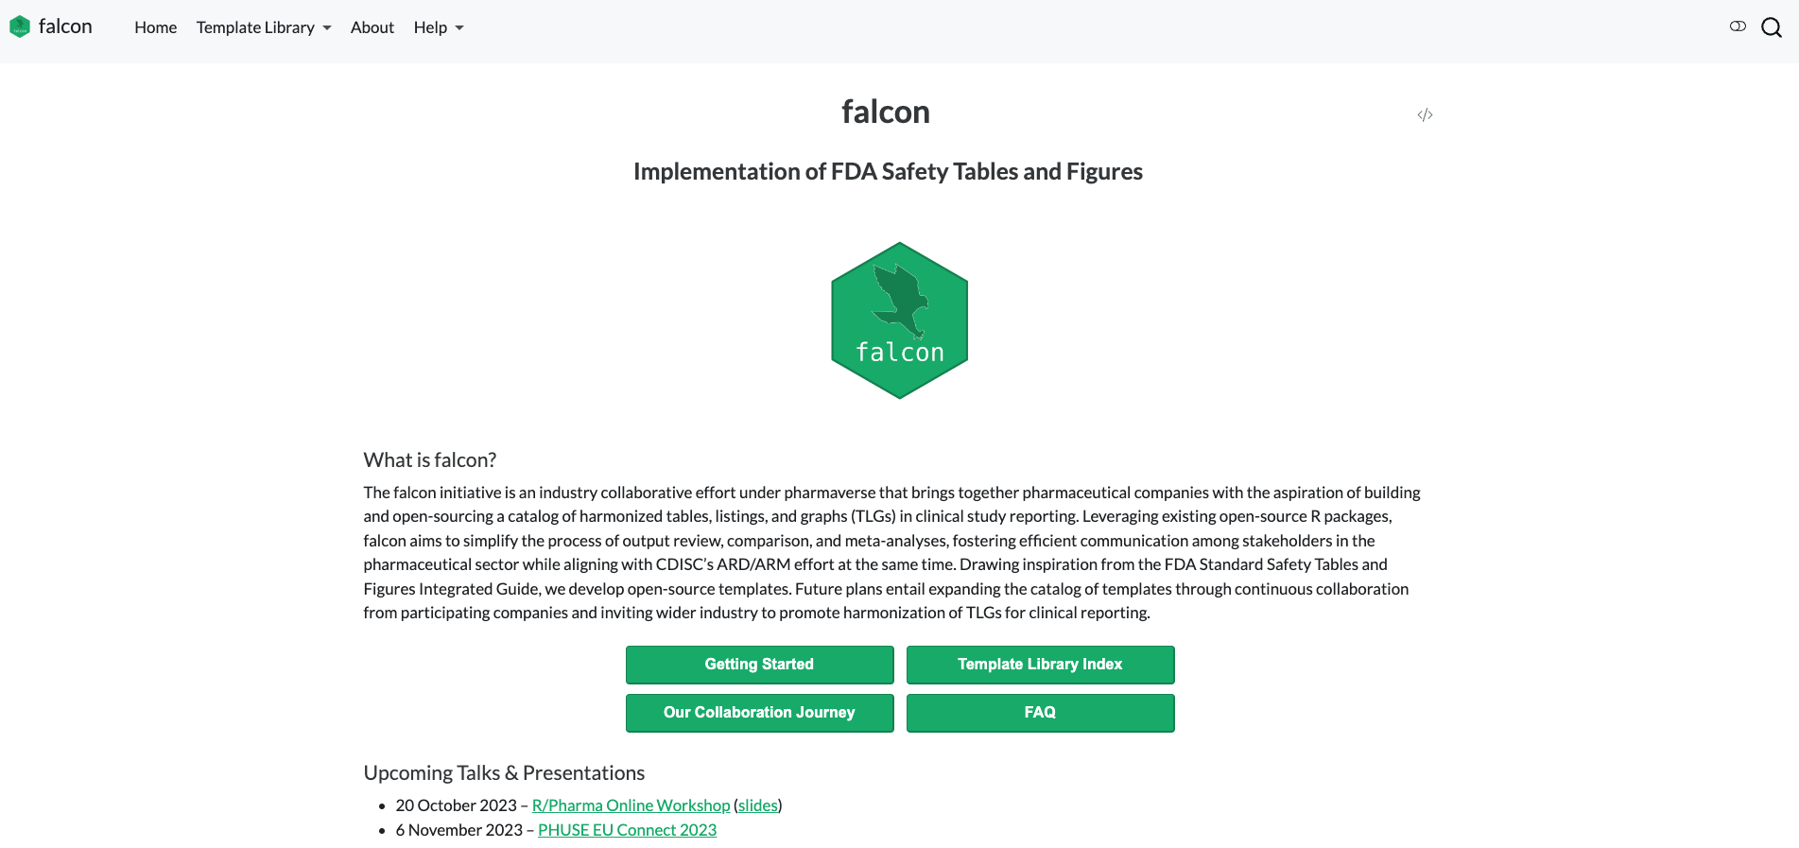
A Deeper Look
Explore {falcon} in detail
https://pharmaverse.github.io/falcon/

Slide 11


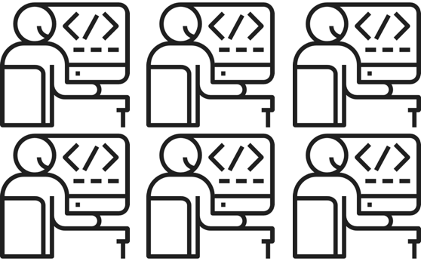

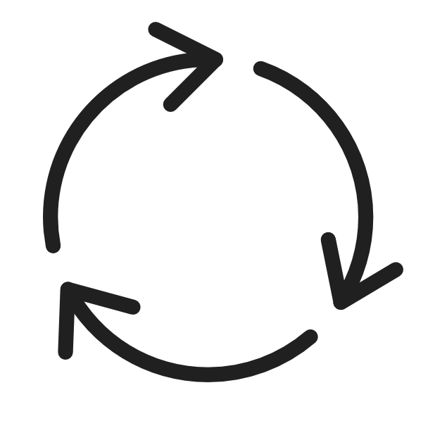
Project Coordination
How does a cross-company team work?
Product Owners
Feature prioritization
Refine requirements
Project roadmap
Developers
Agile package development
Weekly standup meeting
GitHub project board to track progress

Slide 12
Learnings, Outlook, & Call for Collaboration

Slide 13



Key Learnings
Reflections on our collaboration so far
Collaboration entry point is significantly lower when an industry-wide standard is established
Developers are motivated to work on open-source project, which opens new career opportunities
Building open-source solutions together across pharma companies is less resource intensive and more efficient

Slide 14


Future Outlook
How to fully realize the potential of {falcon}?
Engage more companies and collaborate closely with CDISC & health authorities
An industry harmonized TLG standard for clinical reporting would replace all internal standards, and the implementation is freely accessible for all

Slide 15


Call for Collaboration
The best time to join the journey was a year ago. The second best time is now.
https://pharmaverse.org/
https://bit.ly/48KVL2R
https://pharmaverse.github.io/falcon/

Slide 16
Acknowledgements
Abinaya Yogasekaram - Roche
Alex Assuied - Sanofi
Emily de la Rua - Roche
Freeman Wang - Sanofi
Huan Lu - Sanofi
Jaime Pires - Roche
Jessica Knizia - Boehringer-Ingelheim
Juergen Boehl - Boehringer-Ingelheim
Kavitha Allala - Boehringer-Ingelheim
Korbinian Matthias - Boehringer-Ingelheim
Lian Lin - Moderna
Padmaja Chiruvolu - Amgen
Pawel Rucki - Roche
Vincent Shen - Roche
Yichen Wang - Moderna
Yoshito Koujin - Boehringer-Ingelheim
Yuye Wang - Moderna

Slide 17
Thank you!

