Slide 1


{falcon}: Harmonizing Clinical Reporting Standards for TLGs
Emily de la Rua, Roche
Jessica Knizia, Boehringer Ingelheim
Note: Content in this slide deck was built based on {falcon} v0.1.0.9043. In the future the {falcon} package will be released on CRAN under a different name due to conflict with another package.
R/Pharma 2023

Slide 2
Agenda
Motivation
Current Progress
Getting Started
Technical Overview
Navigating the {falcon} Website
Goals
Call for Collaboration

Slide 3
Motivation

Slide 4

Established Data Standards Already Exist in the Pharma Industry
CDISC’s SDTM and ADaM standards enable industry collaboration
Data variable attributes (names, inputs, data types, etc.) are standardized across datasets and companies in the industry
TLGs created by different companies process data the same way but differ in layout/appearance
Can we standardize the TLGs created using this data?

Slide 5

The FDA Integrated Guide for Standard Safety Tables and Figures
Idea: We can implement the FDA guide together to create cohesive TLG outputs
A common toolkit: Use open-source R packages already available on CRAN for TLG creation
Pooled Resources: Developers from different companies collaborate to establish best practices and design standardized templates for each TLG
One layout: Standardized layouts allow for easy collaboration in the future and a more efficient data review process, allowing pharma companies to deliver products quicker

Slide 7
Current Progress

Slide 8






Our Current Team
6 Product Owners
9 Active Developers

Slide 9




What Have We Accomplished So Far?
Increasing Awareness
Active Development
{falcon} will be presented at PHUSE EU in November. CDISC and more pharma companies have reached out to inquire about future collaborations
Team Setup
A website was launched to share development progress, template code, upcoming events, etc. ~20 templates are now publicly available
Kickoff
GitHub repository & Slack channel were created. Product Owners & Developers were onboarded to the project
Companies agreed to co-develop TLG templates, using FDA’s guide as a starting point
2022 Q4
2023 Q1
Q2-Q3
Q4

Slide 10
Getting Started

Slide 11
{falcon} is Built Using an Open-Source Toolkit
All table-generating functions are built using functions from {rtables} & {tern}
NEST-falcon Dependency Graph
{rlistings}
{formatters}
{falcon}
{rtables}
{tern}

Slide 12
{falcon} is Built Using an Open-Source Toolkit
To gauge interest in other table engines, some table functions are also built using {Tplyr} & {gtsummary}
Alternative 1:
Alternative 2:
{Tplyr}
{gtsummary}
{falcon}
{falcon}
{tfrmt}

Slide 13
Package Installation
Ensure NEST package dependencies are installed from CRAN:
if (!require("formatters")) install.packages("formatters")
if (!require("rtables")) install.packages("rtables")
if (!require("rlistings")) install.packages("rlistings")
if (!require("tern")) install.packages("tern")
Install the latest development version of {falcon} from GitHub:
if (!require("remotes")) install.packages("remotes")
remotes::install_github("pharmaverse/falcon")

Slide 14
Technical Overview

Slide 15
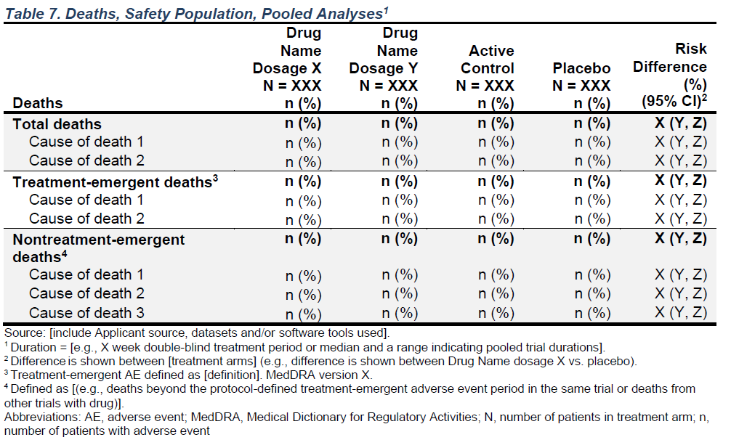
Breaking Down a TLG-Generating Function
FDA Integrated Guide - Table 7: Deaths, Safety Population, Pooled Analyses

Slide 16
Breaking Down a TLG-Generating Function
Table generated using {falcon}
Table 7. Deaths, Safety Population, Pooled Analyses
——————————————————————————————————————————————————————————————————————————————————————————————————————
A: Drug X B: Placebo C: Combination Risk Difference (%) (95% CI)
Deaths (N=134) (N=134) (N=132) (N=268)
——————————————————————————————————————————————————————————————————————————————————————————————————————
Total deaths 23 (17.2%) 18 (13.4%) 19 (14.4%) 3.7 (-4.9 - 12.3)
ADVERSE EVENT 8 (34.8%) 6 (33.3%) 10 (52.6%) 1.5 (-3.8 - 6.8)
DISEASE PROGRESSION 8 (34.8%) 5 (27.8%) 6 (31.6%) 2.2 (-2.9 - 7.4)
LOST TO FOLLOW UP 2 (8.7%) 1 (5.6%) 1 (5.3%) 0.7 (-1.8 - 3.3)
MISSING 2 (8.7%) 3 (16.7%) 1 (5.3%) -0.7 (-4.0 - 2.5)
SUICIDE 2 (8.7%) 2 (11.1%) 1 (5.3%) 0.0 (-2.9 - 2.9)
UNKNOWN 1 (4.3%) 1 (5.6%) 0 0.0 (-2.1 - 2.1)
Treatment-emergent deaths 12 (9.0%) 14 (10.4%) 15 (11.4%) -1.5 (-8.6 - 5.6)
ADVERSE EVENT 3 (25.0%) 5 (35.7%) 9 (60.0%) -1.5 (-5.6 - 2.6)
DISEASE PROGRESSION 3 (25.0%) 5 (35.7%) 4 (26.7%) -1.5 (-5.6 - 2.6)
LOST TO FOLLOW UP 1 (8.3%) 0 0 0.7 (-0.7 - 2.2)
MISSING 2 (16.7%) 1 (7.1%) 1 (6.7%) 0.7 (-1.8 - 3.3)
SUICIDE 2 (16.7%) 2 (14.3%) 1 (6.7%) 0.0 (-2.9 - 2.9)
UNKNOWN 1 (8.3%) 1 (7.1%) 0 0.0 (-2.1 - 2.1)
Nontreatment-emergent deaths 11 (8.2%) 4 (3.0%) 4 (3.0%) 5.2 (-0.2 - 10.7)
ADVERSE EVENT 5 (45.5%) 1 (25.0%) 1 (25.0%) 3.0 (-0.5 - 6.5)
DISEASE PROGRESSION 5 (45.5%) 0 2 (50.0%) 3.7 (0.5 - 6.9)
LOST TO FOLLOW UP 1 (9.1%) 1 (25.0%) 1 (25.0%) 0.0 (-2.1 - 2.1)
MISSING 0 2 (50.0%) 0 -1.5 (-3.5 - 0.6)
——————————————————————————————————————————————————————————————————————————————————————————————————————
Source: [include Applicant source, datasets and/or software tools used].
Abbreviations: AE, adverse event; MedDRA, Medical Dictionary for Regulatory Activities;
N, number of patients in treatment arm; n, number of patients with adverse event

Slide 17
Breaking Down a TLG-Generating Function
Function Arguments Overview
make_table_07 <- function(adae,
alt_counts_df = NULL,
show_colcounts = TRUE,
arm_var = "ARM",
saffl_var = "SAFFL",
lbl_overall = NULL,
risk_diff = NULL,
prune_0 = TRUE,
na_level = "MISSING",
annotations = NULL) {...}

Slide 18
Breaking Down a TLG-Generating Function
Standard arguments used across most tables
Which dataset is expected for this template (or df if no dataset-specific variables are needed), in this case ADAE.
make_table_07 <- function(adae,
alt_counts_df = NULL,
show_colcounts = TRUE,
arm_var = "ARM",
saffl_var = "SAFFL",
lbl_overall = NULL,
risk_diff = NULL,
prune_0 = TRUE,
na_level = "MISSING",
annotations = NULL) {...}

Slide 19
Breaking Down a TLG-Generating Function
Standard arguments used across most tables
make_table_07 <- function(adae,
alt_counts_df = NULL,
show_colcounts = TRUE,
arm_var = "ARM",
saffl_var = "SAFFL",
lbl_overall = NULL,
risk_diff = NULL,
prune_0 = TRUE,
na_level = "MISSING",
annotations = NULL) {...}
An optional secondary dataset used only to calculate overall patients counts & percentages, in most cases ADSL.

Slide 20
Breaking Down a TLG-Generating Function
Standard arguments used across most tables
make_table_07 <- function(adae,
alt_counts_df = NULL,
show_colcounts = TRUE,
arm_var = "ARM",
saffl_var = "SAFFL",
lbl_overall = NULL,
risk_diff = NULL,
prune_0 = TRUE,
na_level = "MISSING",
annotations = NULL) {...}
Whether total counts (N=XX) should be printed for each column.

Slide 21
Breaking Down a TLG-Generating Function
Standard arguments used across most tables
make_table_07 <- function(adae,
alt_counts_df = NULL,
show_colcounts = TRUE,
arm_var = "ARM",
saffl_var = "SAFFL",
lbl_overall = NULL,
risk_diff = NULL,
prune_0 = TRUE,
na_level = "MISSING",
annotations = NULL) {...}
Name of the arm variable used to split data into columns.

Slide 22
Breaking Down a TLG-Generating Function
Standard arguments used across most tables
make_table_07 <- function(adae,
alt_counts_df = NULL,
show_colcounts = TRUE,
arm_var = "ARM",
saffl_var = "SAFFL",
lbl_overall = NULL,
risk_diff = NULL,
prune_0 = TRUE,
na_level = "MISSING",
annotations = NULL) {...}
Name of the variable that indicates inclusion in a safety population.

Slide 23
Breaking Down a TLG-Generating Function
Standard arguments used across most tables
make_table_07 <- function(adae,
alt_counts_df = NULL,
show_colcounts = TRUE,
arm_var = "ARM",
saffl_var = "SAFFL",
lbl_overall = NULL,
risk_diff = NULL,
prune_0 = TRUE,
na_level = "MISSING",
annotations = NULL) {...}
A label for the “overall” population column if one should be included in the table.

Slide 24
Breaking Down a TLG-Generating Function
Standard arguments used across most tables
make_table_07 <- function(adae,
alt_counts_df = NULL,
show_colcounts = TRUE,
arm_var = "ARM",
saffl_var = "SAFFL",
lbl_overall = NULL,
risk_diff = NULL,
prune_0 = TRUE,
na_level = "MISSING",
annotations = NULL) {...}
Settings for the “risk difference” column: columns to compare, label, etc., if this column is needed.

Slide 25
Breaking Down a TLG-Generating Function
Standard arguments used across most tables
make_table_07 <- function(adae,
alt_counts_df = NULL,
show_colcounts = TRUE,
arm_var = "ARM",
saffl_var = "SAFFL",
lbl_overall = NULL,
risk_diff = NULL,
prune_0 = TRUE,
na_level = "MISSING",
annotations = NULL) {...}
Whether all-zero rows should be pruned from the table.

Slide 26
Breaking Down a TLG-Generating Function
Standard arguments used across most tables
make_table_07 <- function(adae,
alt_counts_df = NULL,
show_colcounts = TRUE,
arm_var = "ARM",
saffl_var = "SAFFL",
lbl_overall = NULL,
risk_diff = NULL,
prune_0 = TRUE,
na_level = "MISSING",
annotations = NULL) {...}
A string that should be used in the table to indicate missing (NA) values.

Slide 27
Breaking Down a TLG-Generating Function
Standard arguments used across most tables
make_table_07 <- function(adae,
alt_counts_df = NULL,
show_colcounts = TRUE,
arm_var = "ARM",
saffl_var = "SAFFL",
lbl_overall = NULL,
risk_diff = NULL,
prune_0 = TRUE,
na_level = "MISSING",
annotations = NULL) {...}
Any titles and footnotes that should be printed for the table.

Slide 28
Breaking Down a TLG-Generating Function
Function Contents: Pre-Processing
checkmate::assert_subset(c(
"USUBJID", "TRTEMFL", "DTHFL", "DTHCAUS", arm_var, saffl_var
), names(adae))
assert_flag_variables(adae, c(saffl_var, "TRTEMFL", "DTHFL"), na_level = na_level)
adae <- adae %>%
filter(.data[[saffl_var]] == "Y", DTHFL == "Y") %>%
mutate(
TRTEMFL = ifelse(TRTEMFL == "Y", "Y", "N") %>% factor(levels = c("Y", "N")),
trtem_lab = ifelse(TRTEMFL == "Y", "Treatment-emergent deaths", "Nontreatment-emergent deaths")
) %>%
df_explicit_na(na_level = na_level)
alt_counts_df <- alt_counts_df_preproc(alt_counts_df, arm_var, saffl_var)
Variable checks
Data processing

Slide 29
Breaking Down a TLG-Generating Function
Function Contents: Layout Creation
lyt <- basic_table_annot(show_colcounts, annotations) %>%
split_cols_by_arm(arm_var, lbl_overall, risk_diff) %>%
split_rows_by(
var = "TRTEMFL", labels_var = "trtem_lab",
split_fun = add_overall_level("Total deaths")
) %>%
summarize_num_patients(
var = "USUBJID",
riskdiff = !is.null(risk_diff),
.stats = "unique", .labels = c(unique = NULL)
) %>%
count_occurrences(
vars = "DTHCAUS",
denom = "n", drop = FALSE,
riskdiff = !is.null(risk_diff)
) %>%
append_topleft(c("", "Deaths"))
A: Drug X B: Placebo C: Combination
Deaths (N=134) (N=134) (N=132)
———————————————————————————————————————————————————————————————————————
Total deaths 23 (17.2%) 18 (13.4%) 19 (14.4%)
ADVERSE EVENT 8 (34.8%) 6 (33.3%) 10 (52.6%)
DISEASE PROGRESSION 8 (34.8%) 5 (27.8%) 6 (31.6%)
LOST TO FOLLOW UP 2 (8.7%) 1 (5.6%) 1 (5.3%)
MISSING 2 (8.7%) 3 (16.7%) 1 (5.3%)
SUICIDE 2 (8.7%) 2 (11.1%) 1 (5.3%)
UNKNOWN 1 (4.3%) 1 (5.6%) 0
Treatment-emergent deaths 12 (9.0%) 14 (10.4%) 15 (11.4%)
ADVERSE EVENT 3 (25.0%) 5 (35.7%) 9 (60.0%)
DISEASE PROGRESSION 3 (25.0%) 5 (35.7%) 4 (26.7%)
LOST TO FOLLOW UP 1 (8.3%) 0 0
MISSING 2 (16.7%) 1 (7.1%) 1 (6.7%)
SUICIDE 2 (16.7%) 2 (14.3%) 1 (6.7%)
UNKNOWN 1 (8.3%) 1 (7.1%) 0
Nontreatment-emergent deaths 11 (8.2%) 4 (3.0%) 4 (3.0%)
ADVERSE EVENT 5 (45.5%) 1 (25.0%) 1 (25.0%)
DISEASE PROGRESSION 5 (45.5%) 0 2 (50.0%)
LOST TO FOLLOW UP 1 (9.1%) 1 (25.0%) 1 (25.0%)
MISSING 0 2 (50.0%) 0

Slide 30
Breaking Down a TLG-Generating Function
Function Contents: Layout Creation
lyt <- basic_table_annot(show_colcounts, annotations) %>%
split_cols_by_arm(arm_var, lbl_overall, risk_diff) %>%
split_rows_by(
var = "TRTEMFL", labels_var = "trtem_lab",
split_fun = add_overall_level("Total deaths")
) %>%
summarize_num_patients(
var = "USUBJID",
riskdiff = !is.null(risk_diff),
.stats = "unique", .labels = c(unique = NULL)
) %>%
count_occurrences(
vars = "DTHCAUS",
denom = "n", drop = FALSE,
riskdiff = !is.null(risk_diff)
) %>%
append_topleft(c("", "Deaths"))
A: Drug X B: Placebo C: Combination
Deaths (N=134) (N=134) (N=132)
———————————————————————————————————————————————————————————————————————
Total deaths 23 (17.2%) 18 (13.4%) 19 (14.4%)
ADVERSE EVENT 8 (34.8%) 6 (33.3%) 10 (52.6%)
DISEASE PROGRESSION 8 (34.8%) 5 (27.8%) 6 (31.6%)
LOST TO FOLLOW UP 2 (8.7%) 1 (5.6%) 1 (5.3%)
MISSING 2 (8.7%) 3 (16.7%) 1 (5.3%)
SUICIDE 2 (8.7%) 2 (11.1%) 1 (5.3%)
UNKNOWN 1 (4.3%) 1 (5.6%) 0
Treatment-emergent deaths 12 (9.0%) 14 (10.4%) 15 (11.4%)
ADVERSE EVENT 3 (25.0%) 5 (35.7%) 9 (60.0%)
DISEASE PROGRESSION 3 (25.0%) 5 (35.7%) 4 (26.7%)
LOST TO FOLLOW UP 1 (8.3%) 0 0
MISSING 2 (16.7%) 1 (7.1%) 1 (6.7%)
SUICIDE 2 (16.7%) 2 (14.3%) 1 (6.7%)
UNKNOWN 1 (8.3%) 1 (7.1%) 0
Nontreatment-emergent deaths 11 (8.2%) 4 (3.0%) 4 (3.0%)
ADVERSE EVENT 5 (45.5%) 1 (25.0%) 1 (25.0%)
DISEASE PROGRESSION 5 (45.5%) 0 2 (50.0%)
LOST TO FOLLOW UP 1 (9.1%) 1 (25.0%) 1 (25.0%)
MISSING 0 2 (50.0%) 0

Slide 31
Breaking Down a TLG-Generating Function
Function Contents: Table Generation & Post-Processing
tbl <- build_table(
lyt,
df = adae,
alt_counts_df = alt_counts_df
)
if (prune_0) tbl <- prune_table(tbl)
tbl
A: Drug X B: Placebo C: Combination
Deaths (N=134) (N=134) (N=132)
——————————————————————————————————————————————————————————————————————————
Total deaths 23 (17.2%) 18 (13.4%) 19 (14.4%)
ADVERSE EVENT 8 (34.8%) 6 (33.3%) 10 (52.6%)
DISEASE PROGRESSION 8 (34.8%) 5 (27.8%) 6 (31.6%)
LOST TO FOLLOW UP 2 (8.7%) 1 (5.6%) 1 (5.3%)
MISSING 2 (8.7%) 3 (16.7%) 1 (5.3%)
Post-study reporting of death 0 0 0
SUICIDE 2 (8.7%) 2 (11.1%) 1 (5.3%)
UNKNOWN 1 (4.3%) 1 (5.6%) 0
Treatment-emergent deaths 12 (9.0%) 14 (10.4%) 15 (11.4%)
ADVERSE EVENT 3 (25.0%) 5 (35.7%) 9 (60.0%)
DISEASE PROGRESSION 3 (25.0%) 5 (35.7%) 4 (26.7%)
LOST TO FOLLOW UP 1 (8.3%) 0 0
MISSING 2 (16.7%) 1 (7.1%) 1 (6.7%)
Post-study reporting of death 0 0 0
SUICIDE 2 (16.7%) 2 (14.3%) 1 (6.7%)
UNKNOWN 1 (8.3%) 1 (7.1%) 0
Nontreatment-emergent deaths 11 (8.2%) 4 (3.0%) 4 (3.0%)
ADVERSE EVENT 5 (45.5%) 1 (25.0%) 1 (25.0%)
DISEASE PROGRESSION 5 (45.5%) 0 2 (50.0%)
LOST TO FOLLOW UP 1 (9.1%) 1 (25.0%) 1 (25.0%)
MISSING 0 2 (50.0%) 0
Post-study reporting of death 0 0 0
SUICIDE 0 0 0
UNKNOWN 0 0 0

Slide 32
Breaking Down a TLG-Generating Function
Function Contents: Table Generation & Post-Processing
tbl <- build_table(
lyt,
df = adae,
alt_counts_df = alt_counts_df
)
if (prune_0) tbl <- prune_table(tbl)
tbl
A: Drug X B: Placebo C: Combination
Deaths (N=134) (N=134) (N=132)
——————————————————————————————————————————————————————————————————————————
Total deaths 23 (17.2%) 18 (13.4%) 19 (14.4%)
ADVERSE EVENT 8 (34.8%) 6 (33.3%) 10 (52.6%)
DISEASE PROGRESSION 8 (34.8%) 5 (27.8%) 6 (31.6%)
LOST TO FOLLOW UP 2 (8.7%) 1 (5.6%) 1 (5.3%)
MISSING 2 (8.7%) 3 (16.7%) 1 (5.3%)
Post-study reporting of death 0 0 0
SUICIDE 2 (8.7%) 2 (11.1%) 1 (5.3%)
UNKNOWN 1 (4.3%) 1 (5.6%) 0
Treatment-emergent deaths 12 (9.0%) 14 (10.4%) 15 (11.4%)
ADVERSE EVENT 3 (25.0%) 5 (35.7%) 9 (60.0%)
DISEASE PROGRESSION 3 (25.0%) 5 (35.7%) 4 (26.7%)
LOST TO FOLLOW UP 1 (8.3%) 0 0
MISSING 2 (16.7%) 1 (7.1%) 1 (6.7%)
Post-study reporting of death 0 0 0
SUICIDE 2 (16.7%) 2 (14.3%) 1 (6.7%)
UNKNOWN 1 (8.3%) 1 (7.1%) 0
Nontreatment-emergent deaths 11 (8.2%) 4 (3.0%) 4 (3.0%)
ADVERSE EVENT 5 (45.5%) 1 (25.0%) 1 (25.0%)
DISEASE PROGRESSION 5 (45.5%) 0 2 (50.0%)
LOST TO FOLLOW UP 1 (9.1%) 1 (25.0%) 1 (25.0%)
MISSING 0 2 (50.0%) 0
Post-study reporting of death 0 0 0
SUICIDE 0 0 0
UNKNOWN 0 0 0

Slide 33
Breaking Down a TLG-Generating Function
Output can be further customized via function parameters
Table 7. Deaths, Safety Population, Pooled Analyses
——————————————————————————————————————————————————————————————————————————————————————————————————————
A: Drug X B: Placebo C: Combination Risk Difference (%) (95% CI)
Deaths (N=134) (N=134) (N=132) (N=268)
——————————————————————————————————————————————————————————————————————————————————————————————————————
Total deaths 23 (17.2%) 18 (13.4%) 19 (14.4%) 3.7 (-4.9 - 12.3)
ADVERSE EVENT 8 (34.8%) 6 (33.3%) 10 (52.6%) 1.5 (-3.8 - 6.8)
DISEASE PROGRESSION 8 (34.8%) 5 (27.8%) 6 (31.6%) 2.2 (-2.9 - 7.4)
LOST TO FOLLOW UP 2 (8.7%) 1 (5.6%) 1 (5.3%) 0.7 (-1.8 - 3.3)
MISSING 2 (8.7%) 3 (16.7%) 1 (5.3%) -0.7 (-4.0 - 2.5)
SUICIDE 2 (8.7%) 2 (11.1%) 1 (5.3%) 0.0 (-2.9 - 2.9)
UNKNOWN 1 (4.3%) 1 (5.6%) 0 0.0 (-2.1 - 2.1)
Treatment-emergent deaths 12 (9.0%) 14 (10.4%) 15 (11.4%) -1.5 (-8.6 - 5.6)
ADVERSE EVENT 3 (25.0%) 5 (35.7%) 9 (60.0%) -1.5 (-5.6 - 2.6)
DISEASE PROGRESSION 3 (25.0%) 5 (35.7%) 4 (26.7%) -1.5 (-5.6 - 2.6)
LOST TO FOLLOW UP 1 (8.3%) 0 0 0.7 (-0.7 - 2.2)
MISSING 2 (16.7%) 1 (7.1%) 1 (6.7%) 0.7 (-1.8 - 3.3)
SUICIDE 2 (16.7%) 2 (14.3%) 1 (6.7%) 0.0 (-2.9 - 2.9)
UNKNOWN 1 (8.3%) 1 (7.1%) 0 0.0 (-2.1 - 2.1)
Nontreatment-emergent deaths 11 (8.2%) 4 (3.0%) 4 (3.0%) 5.2 (-0.2 - 10.7)
ADVERSE EVENT 5 (45.5%) 1 (25.0%) 1 (25.0%) 3.0 (-0.5 - 6.5)
DISEASE PROGRESSION 5 (45.5%) 0 2 (50.0%) 3.7 (0.5 - 6.9)
LOST TO FOLLOW UP 1 (9.1%) 1 (25.0%) 1 (25.0%) 0.0 (-2.1 - 2.1)
MISSING 0 2 (50.0%) 0 -1.5 (-3.5 - 0.6)
——————————————————————————————————————————————————————————————————————————————————————————————————————
Source: [include Applicant source, datasets and/or software tools used].
Abbreviations: AE, adverse event; MedDRA, Medical Dictionary for Regulatory Activities;
N, number of patients in treatment arm; n, number of patients with adverse event

Slide 34
Breaking Down a TLG-Generating Function

Slide 35
Navigating the {falcon} Website

Slide 36
pharmaverse.github.io/falcon

Slide 37
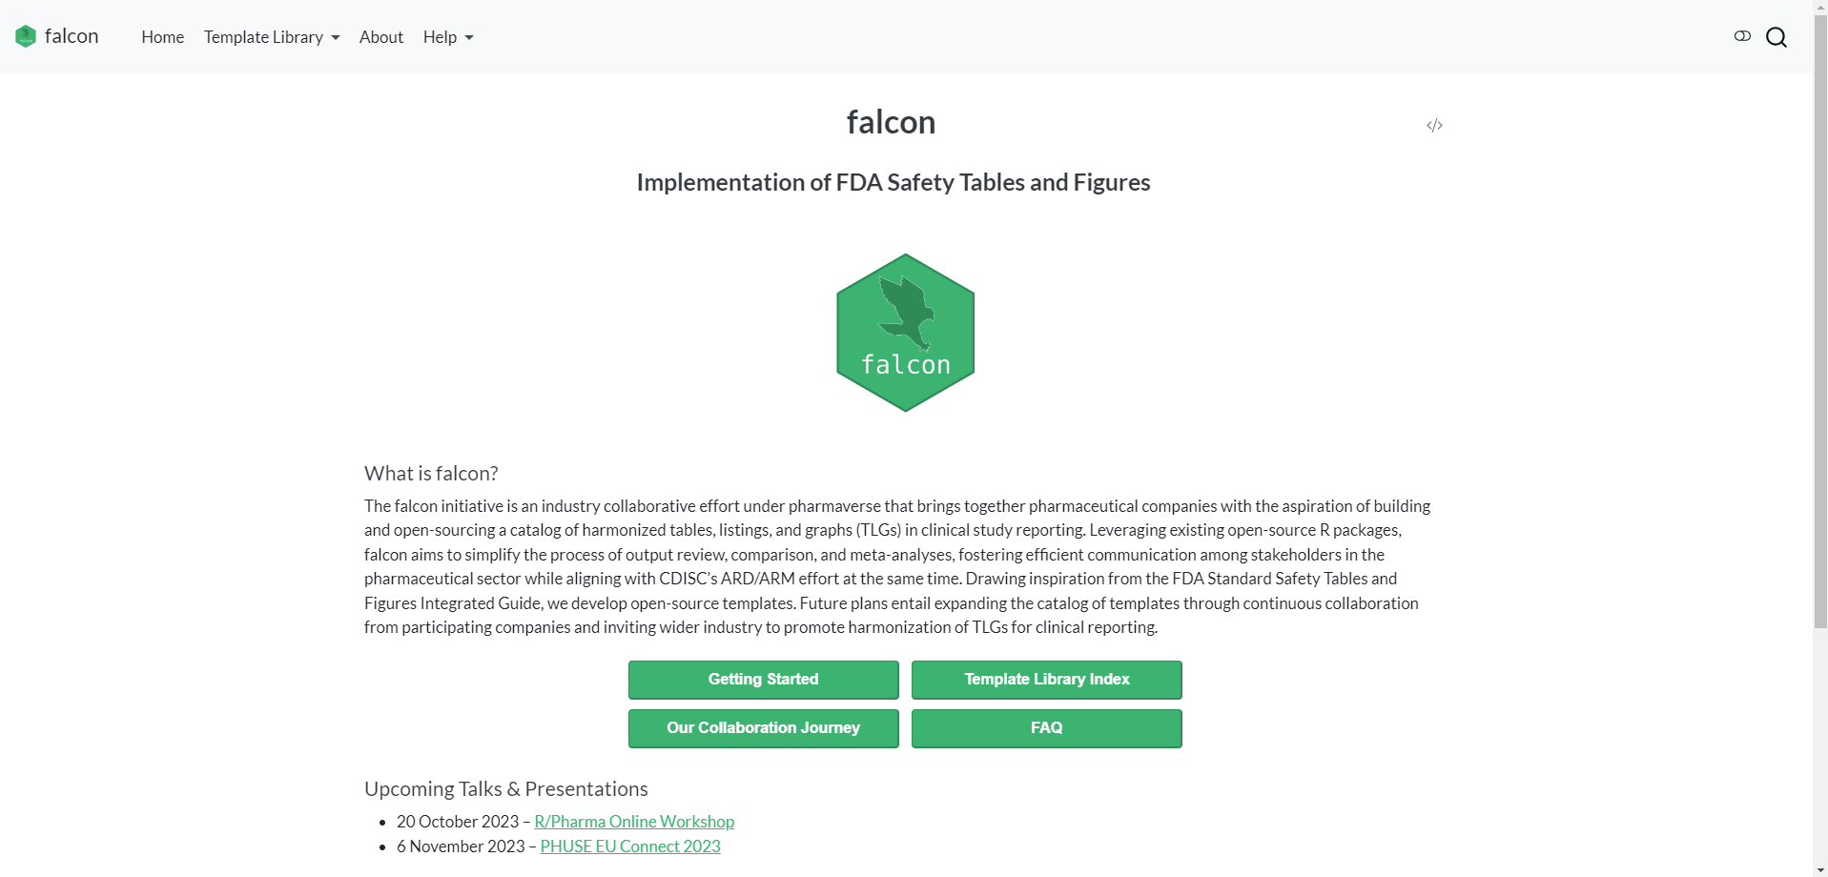
Exploring the Home Page
Introductory information, upcoming talks, & the development team

Slide 38
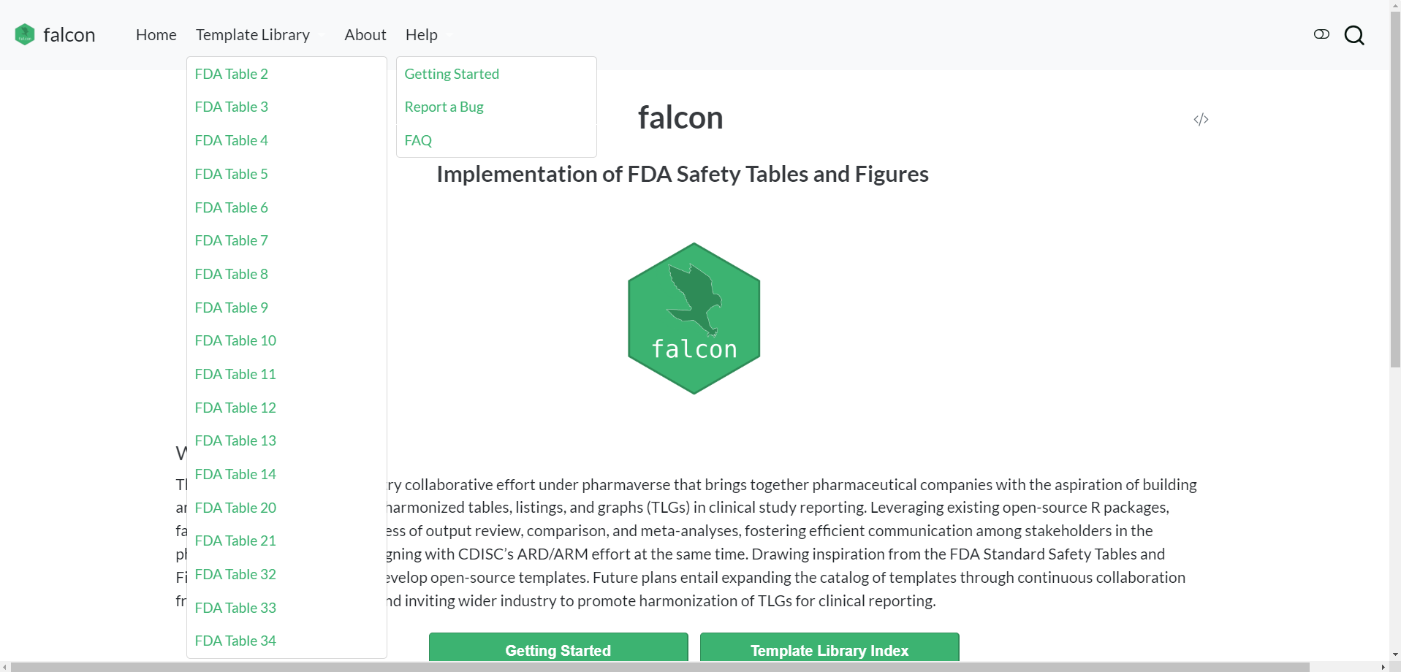
Exploring the Home Page
Additional pages reachable from the navigation bar

Slide 39
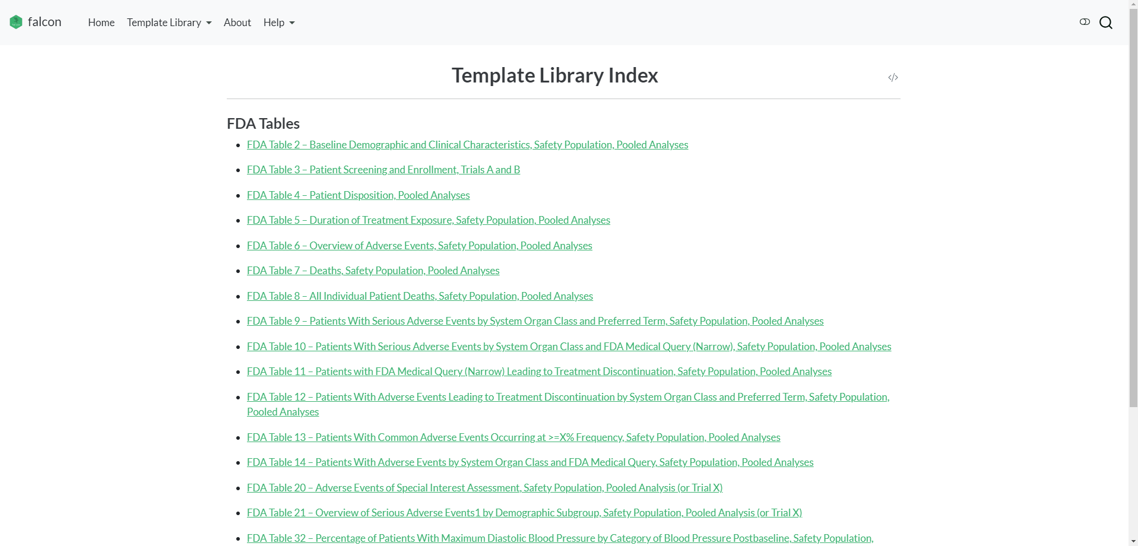
The Template Index - Which Tables are Available?
Accessible via “Template Library Index” button on the Home Page

Slide 40
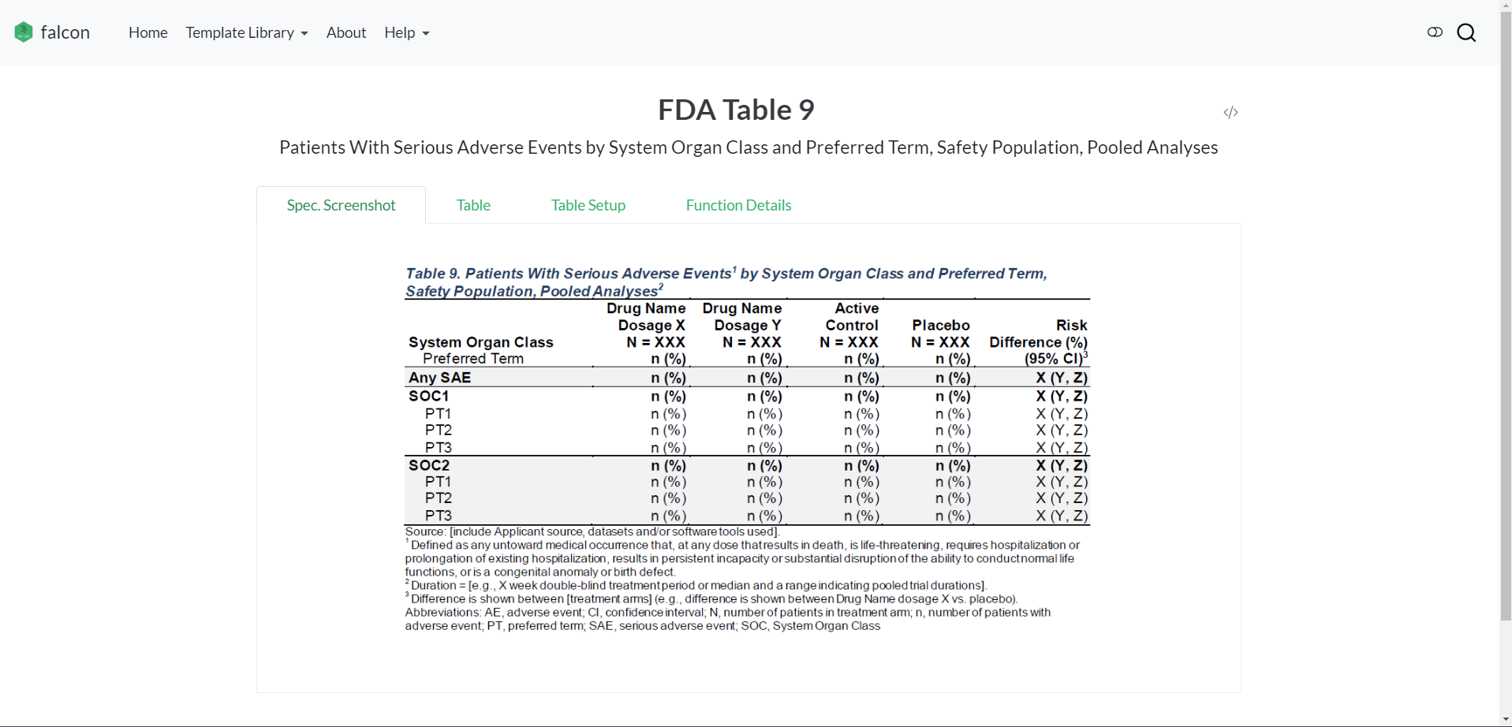
A Deeper Dive into Table Templates
Specification screenshot taken from the FDA Safety TLGs Integrated Guide

Slide 41
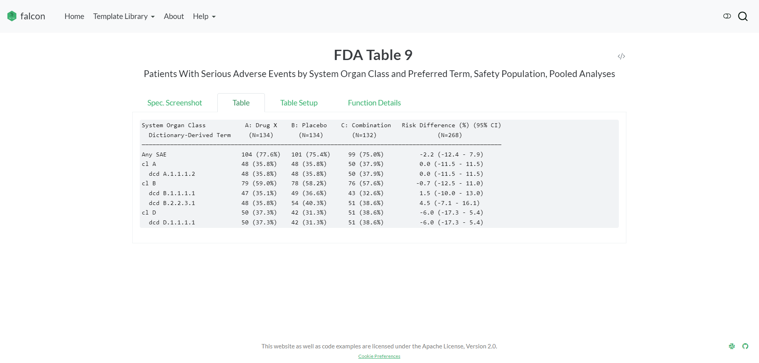
A Deeper Dive into Table Templates
Table created using {falcon}

Slide 42
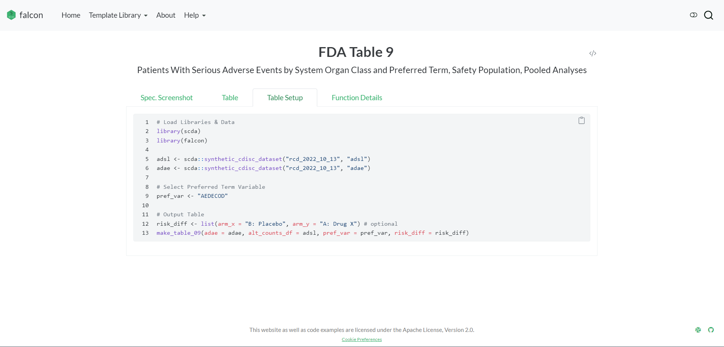
A Deeper Dive into Table Templates
Code used to generate the table via the make_table_09 function

Slide 43
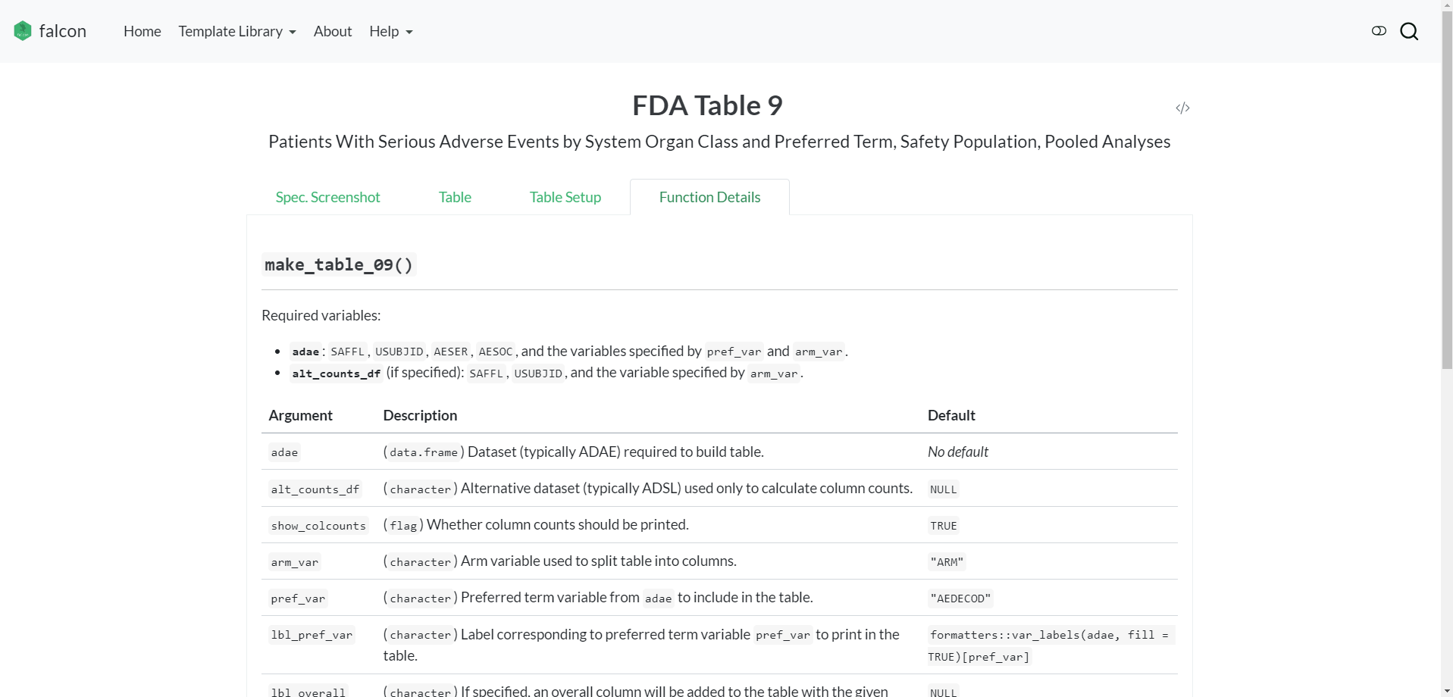
A Deeper Dive into Table Templates
Details on the function used to generate the table

Slide 44
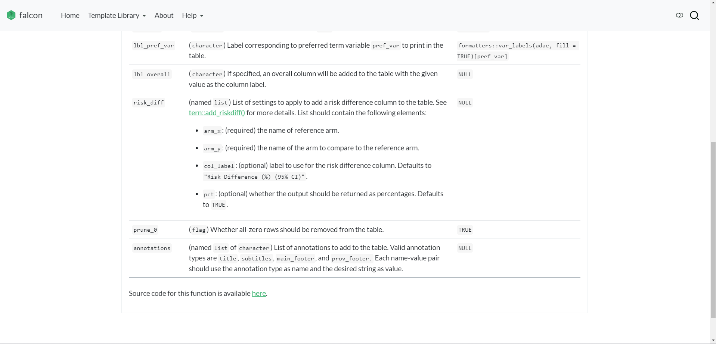
A Deeper Dive into Table Templates
Details on the function used to generate the table

Slide 45
Goals

Slide 46
Goals
Best practices & standard layouts for TLGs
Easier collaboration & more efficient submission
Strengthen open-source products

Slide 47
Our Roadmap
Future Plans
Increasing Awareness
CRAN release
Alignment with CDISC’s ARD/ARM efforts
Expanding scope of work to common analyses in trials, and further promoting a harmonized TLG standard
Active Development
{falcon} will be presented at PHUSE EU in November. CDISC and more pharma companies have reached out to inquire about future collaborations
Team Setup
A website was launched to share development progress, template code, upcoming events, etc. ~20 templates are now publicly available
Kickoff
GitHub repository & Slack channel were created. Product Owners & Developers were onboarded to the project
Companies agreed to co-develop TLG templates, using FDA’s guide as a starting point
2022 Q4
2023 Q1
Q2-Q3
Q4
2024+

Slide 48
Call for Collaboration

Slide 49


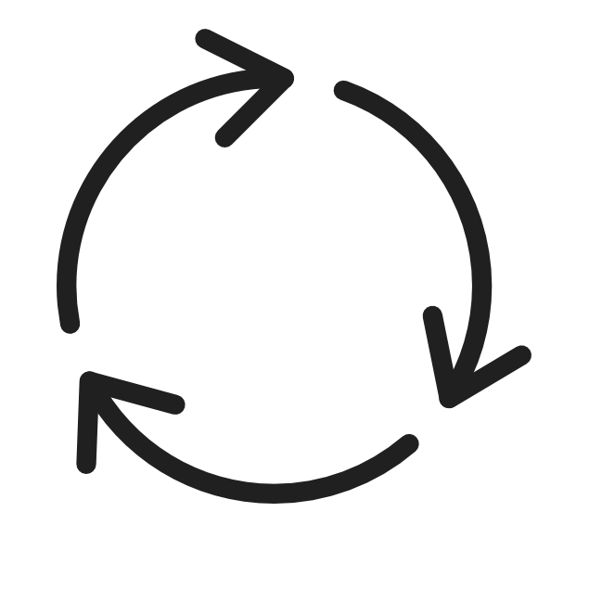
Project Coordination
How does a cross-company team work?
Product Owners
Feature prioritization
Refine requirements
Project roadmap
Developers
Agile package development
Weekly standup meeting
GitHub project board to track progress

Slide 50



Call for Collaboration
Join the {falcon} project!
pharmaverse.org
bit.ly/48KVL2R
bit.ly/45txBaq
pharmaverse.github.io/falcon
Visit the About page on our website for additional details on how you can join as a collaborator!

Slide 51
Acknowledgments
Abinaya Yogasekaram - Roche
Alex Assuied - Sanofi
Emily de la Rua - Roche
Freeman Wang - Sanofi
Huan Lu - Sanofi
Jaime Pires - Roche
Jessica Knizia - Boehringer Ingelheim
Juergen Boehl - Boehringer Ingelheim
Kavitha Allala - Boehringer Ingelheim
Korbinian Matthias - Boehringer Ingelheim
Lian Lin - Moderna
Padmaja Chiruvolu - Amgen
Pawel Rucki - Roche
Vincent Shen - Roche
Yichen Wang - Moderna
Yoshito Koujin - Boehringer Ingelheim
Yuye Wang - Moderna

Slide 52
Thank you!

