Slide 1


Closing the Gap: Creating an End-to-End R Package Toolkit for the Clinical Reporting Pipeline (30 mins)

Slide 2
Outline
Defining the Clinical Reporting Pipeline
Open Source in a Regulated Environment
A collaboration begins between Atorus and GSK
Overview of the 3 Packages – {metacore}, {timber}, {xportr}
Welcome to the {pharmaverse}!

Slide 3
The Clinical Reporting Pipeline
Collected
CRFs
Lab Assays
Tabulation
SDTM
Traceability
Analysis Ready
PK
Medical Coding
Results
Delivery to a Reg Agency
No derivations
Comprehensive
ADaM
“One Proc Away”
Derived data
Traceability
Data Displays
Case Study Report
Submission Package
Quality Control
eCTD Portal
Here we focus on during/after the clinical trials

Slide 4
Challenges of using an Open-Source Language in a Regulated Environment
An Incomplete List of Challenges
SAS® processes have years of use within regulatory agencies and tend to take precedence.
Company Firewalls and VPNs.
Sharing of code and data.
Does a R package bend to SAS® processes or does the package recreate/redefine the process?
Who maintains the open-source product?
An Incomplete List of Solutions
Github, Gitlab and etc. help us to share, fix and build up code in an interactive and version-controlled process.
R Consortium is working with the FDA to investigate delivering a submission in R.
R packages already out there that mimic some of SAS® processes – {haven}, {SASxport}
Pharma companies will have a vested interest in maintaining these packages.

Slide 5
Risk Mitigation
Lessons learned from SASXport experience for xportr
Reach out early to get feel of response and timeline of response
PharmaR/Validation Risk metrics package could be used to make an informed choice – valtools
pharmaR/riskmetric: Metrics to evaluate the risk of R packages (github.com)
insightsengineering/thevalidatoR: Github Action that generates R Package Validation documentation 🏁

Slide 6
Why xportr is not on CRAN – is the rework to haven.

Slide 7

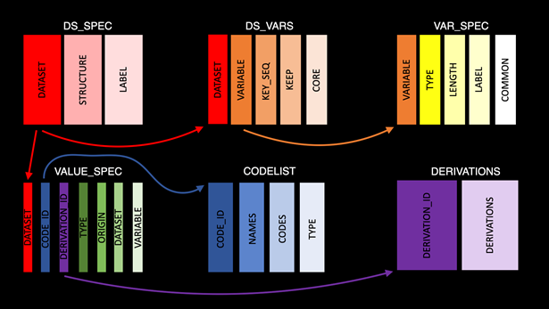
{metacore}
Challenges for R in CRP:​
No available R packages that can ingest and parse metadata for clinical trial datasets or help build a define.xml.
Solutions​
Built functions for parsing xml data and other data types specific to clinical trial datasets.
Functions and objects can be leveraged to help for dataset and variable creation as well as user for creating and codelist and derivations.
Future development path​
Working with different company's metadata files as well as in-development packages, e.g., admiral, to leverage metadata upstream or downstream.

Slide 8

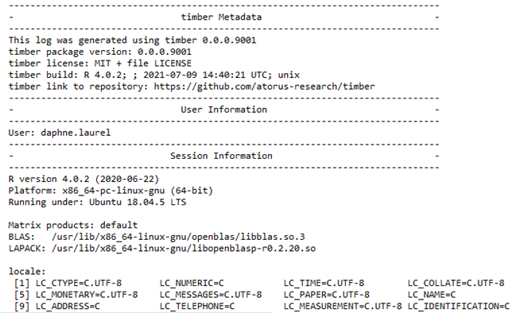
{timber}
Challenges for R in CRP:​
There is no SAS-like log file for R-based programs that show traceability and help to create audit-ready code.
Solutions​
Created a utilities and wrapper functions to capture user info, session information and warnings and errors in an easy-to-read format.
Allows for recreation of script, not just the output.
Future development path​
Interactive display screen to batch submit multiple programs.
What else should go in a log? Companies might have different needs.

Slide 9
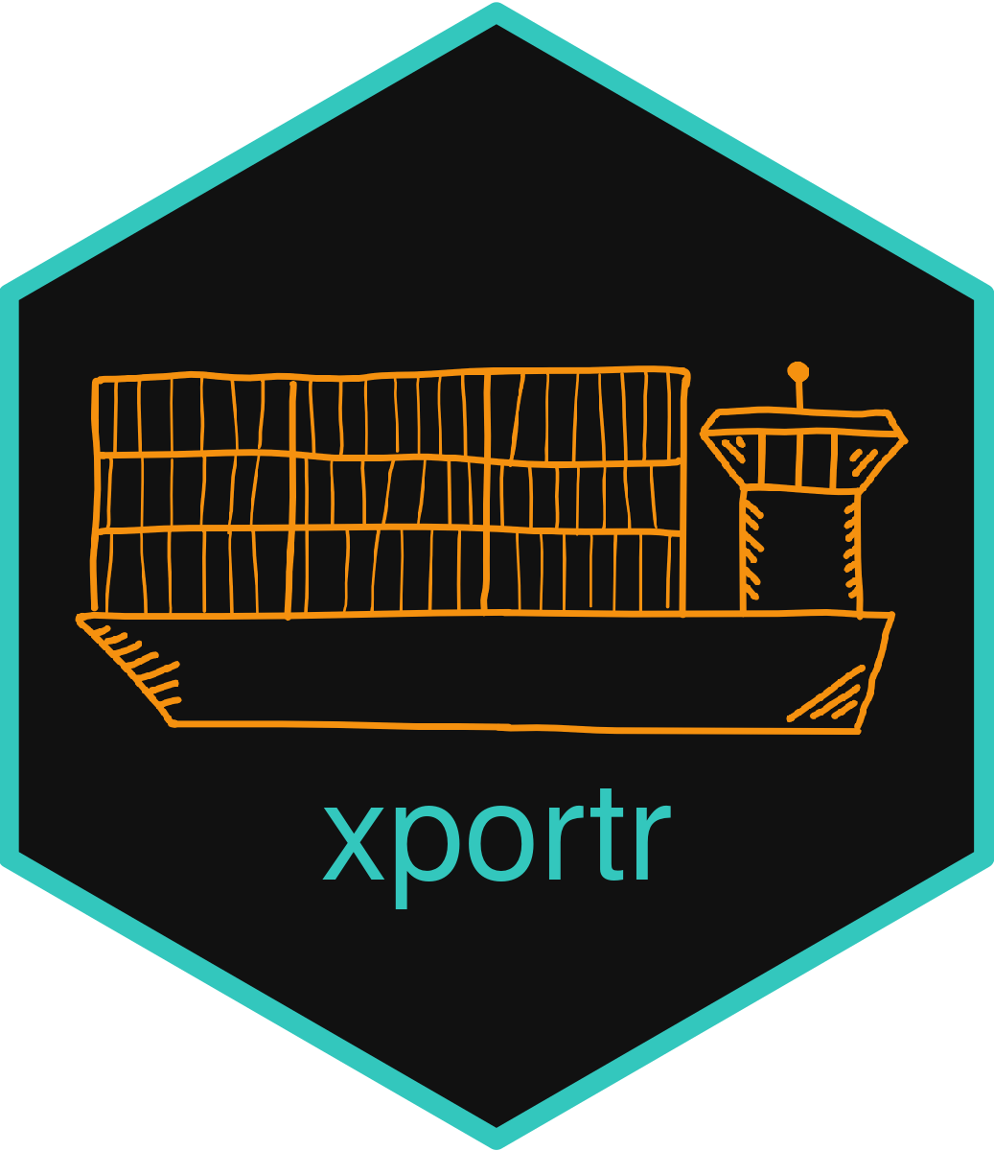
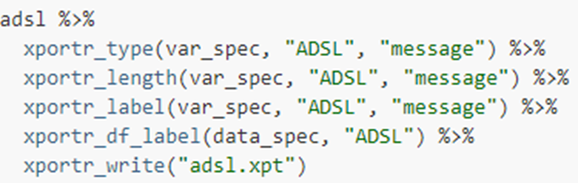
{xportr}
Challenges for R in CRP:
Writing a compliant xpt file using haven or other xpt-supported packages is challenging for types, lengths and labels
Solutions
Adding well defined metadata
Helps to write compliant xpt files
Logs and messages for information about metadata
Checks on the data before final output
Future development path​
How to ingest metadata specifications from different companies and different file formats

Slide 10
End to End Example
end_to_end_examples/_index.Rmd at main · pharmaverse/end_to_end_examples (github.com)

Slide 11









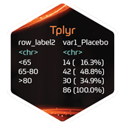


Welcome to the {pharmaverse}!
YOUR ORG
rtables
YOUR
PACKAGE

Slide 12





Project Timeline
October 2020 - November 2020
Created Charter between GSK and Atorus.
Established ways of working e.g.
version control software, agile dev process, R!
Limited time and resources! Where can we make the biggest impact on the Clinical Reporting Pipeline?
January 2021 – March 2021
The Sprints begin! Weekly group meetings to check in on progress and blockers.
December 2020 – January 2021
April 2021
May 2021
Creating tests and vignettes for the packages.
Packagedown sites
Alpha Release Party. Yay!
Challenge:
Interacting with open-source software behind a company firewall
There are no logs in R!?!
How do I work with labels in R. Dataset label, types, lengths?
xpt files? They are not created the same way!
How do I get my metadata into R?
We closed these gaps, now what? Work with R Consortium, RValidationHub, and {pharmaverse} to start getting these packages used!
PHUSE May 2022 will have more updates!

