Slide 1
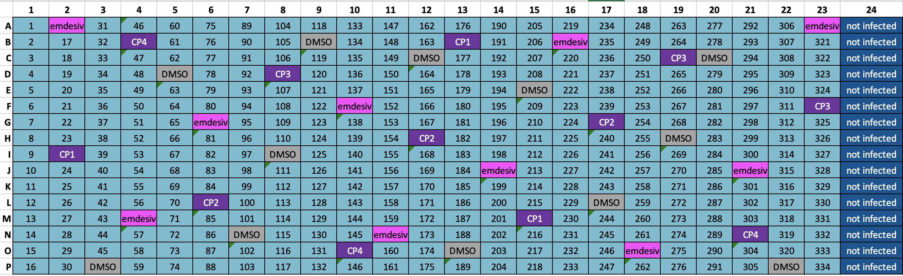
SPECS Sars-CoV2 Screen (SSS)
In summary:
Total of 32 plates (384-well plates, 9 sites)
About 5000 compounds - each present in 2 biological replicates (batch “A” and batch “B”)
Batch A: SS-001A-2 - SS-016A-2
Batch B: SS-001B-2 - SS-016B-2
Each plate is set up like in the example attached below.
Last column (24) has non-infected control wells (which can be used for setting cut-offs for virus infection).
Metadata files can be found here:
https://drive.google.com/drive/folders/1mYFjdHrgunzTgip6G1mVPU9KjQjifRFI?usp=sharing

Slide 2
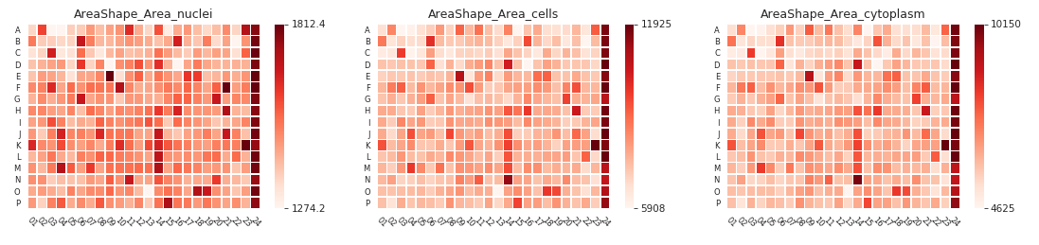
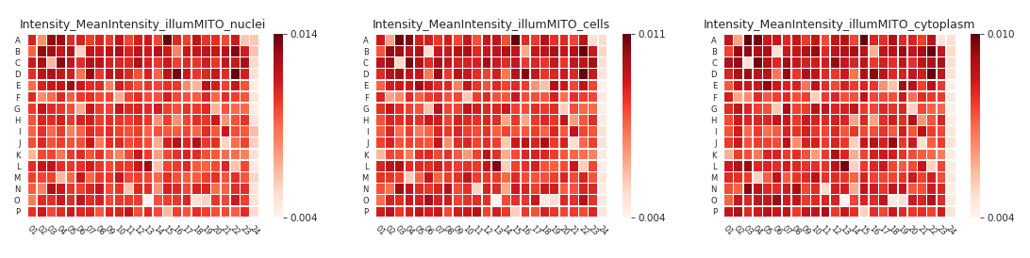
About 1900 cell profiler features
7 feature groups (AreaShape, Correlation, Granularity, Intensity, Location, Neighbors, RadialDistribution)
5 channels (CONC, HOECHST, PHAandWGA, SYTO, MITO == antibody channel)
3 cellular compartments
Heatmaps for one of the plates (SS-001A-2)

Slide 3
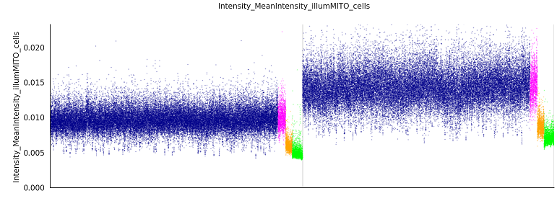
Mean intensities in antibody(MITO channel)
Not infected: 'lime‘
Remdesivir: 'orange', DMSO: 'magenta‘
Compounds: 'darkblue'

Slide 4
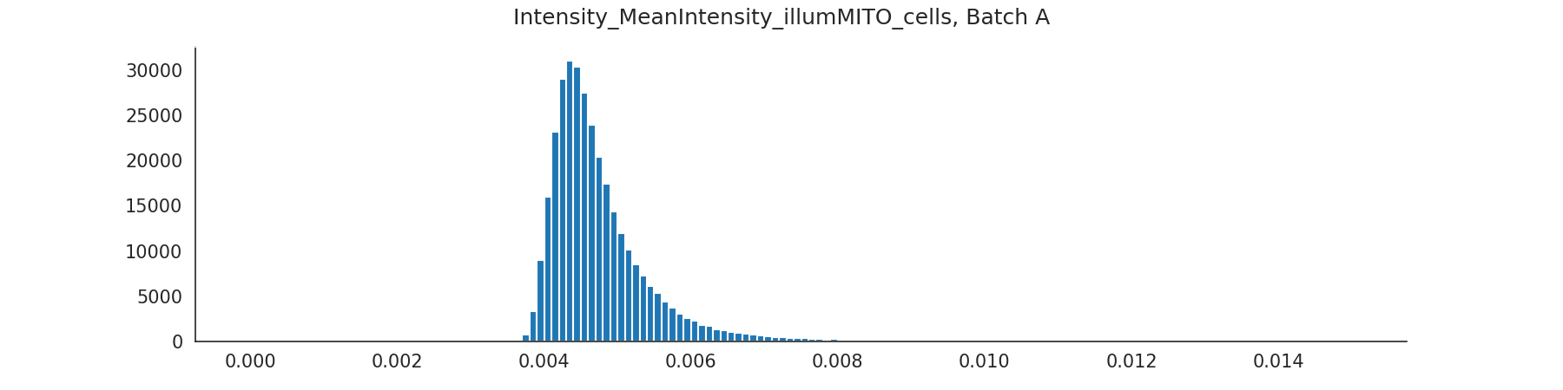
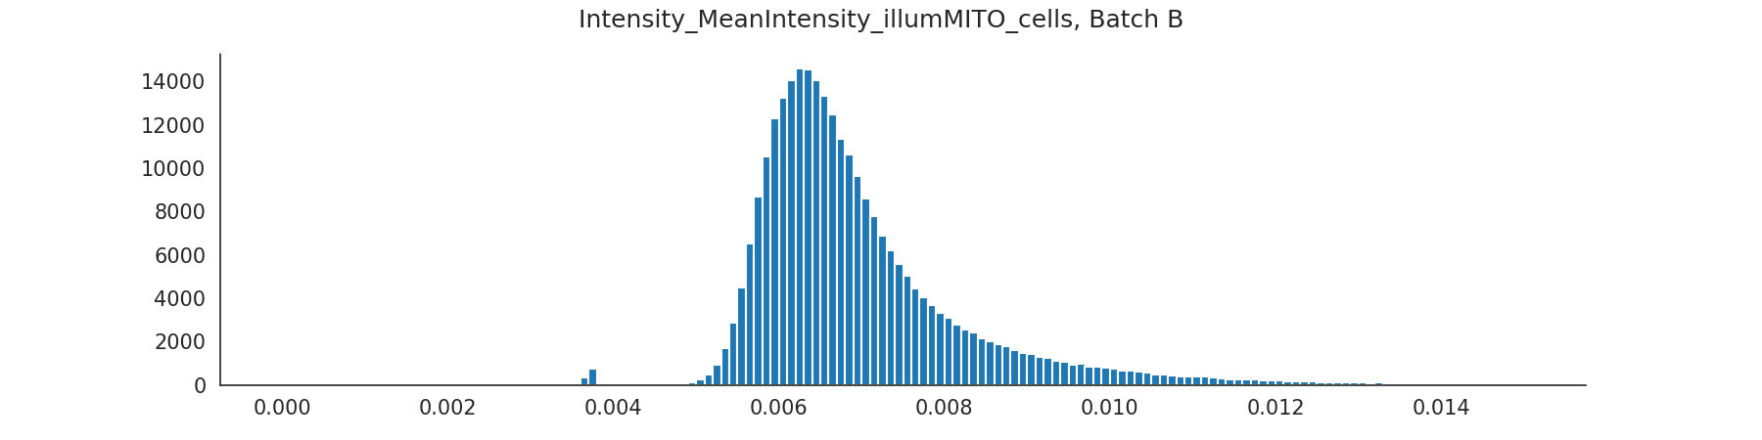
0.0062
0.0083

Slide 5
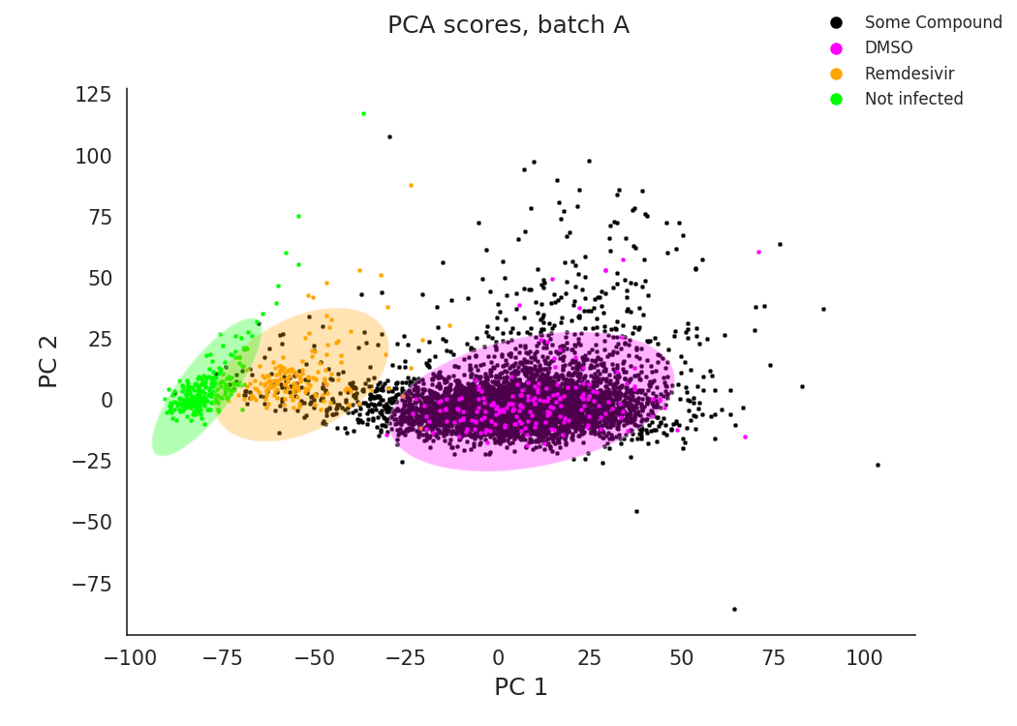

Slide 6
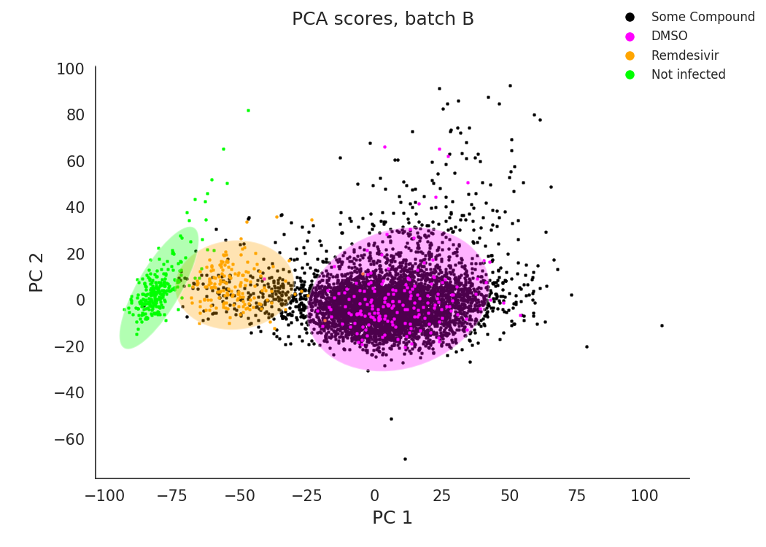

Slide 7
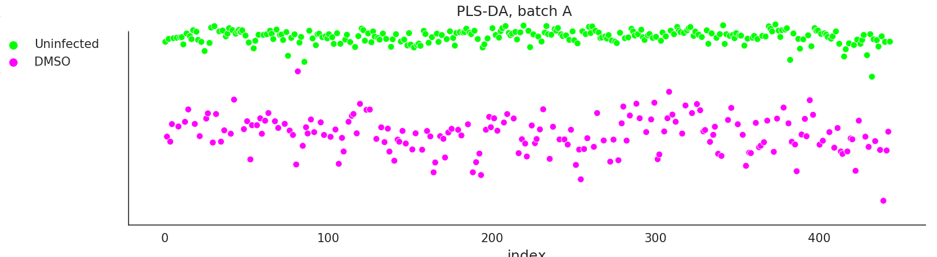
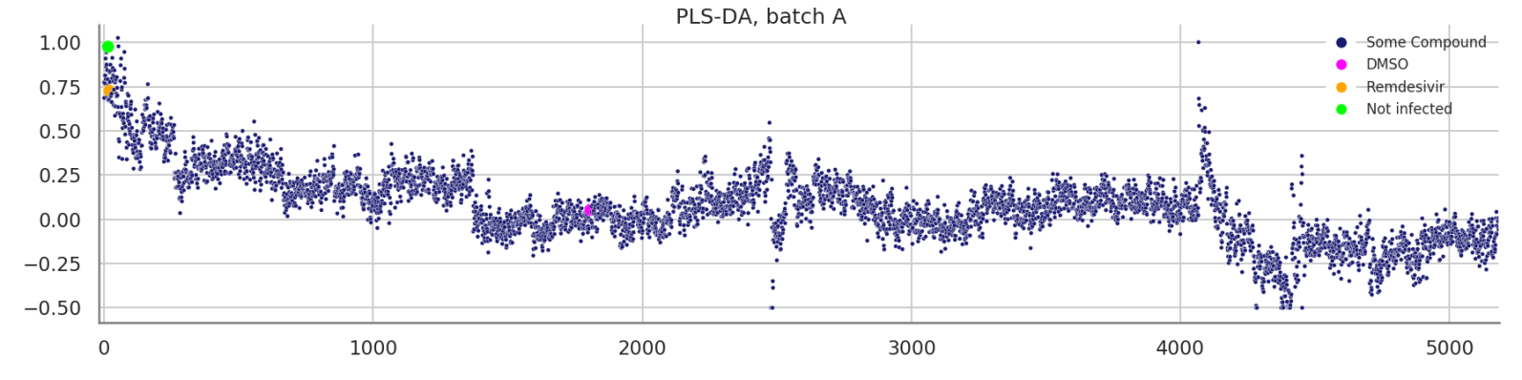

Slide 8
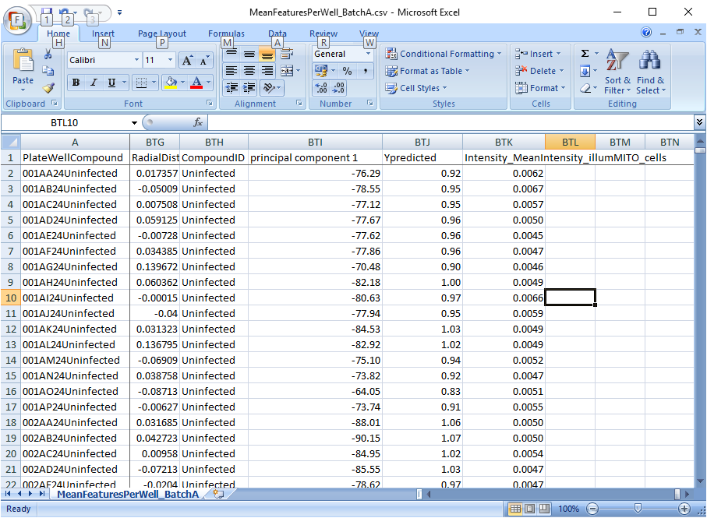

Slide 10
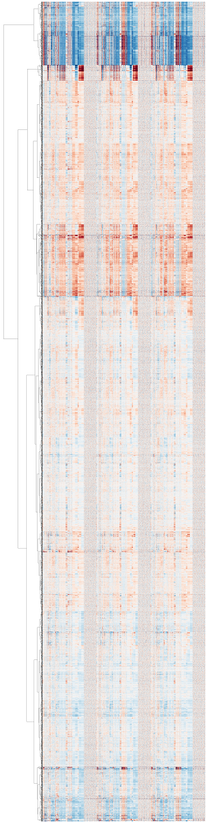

Slide 11
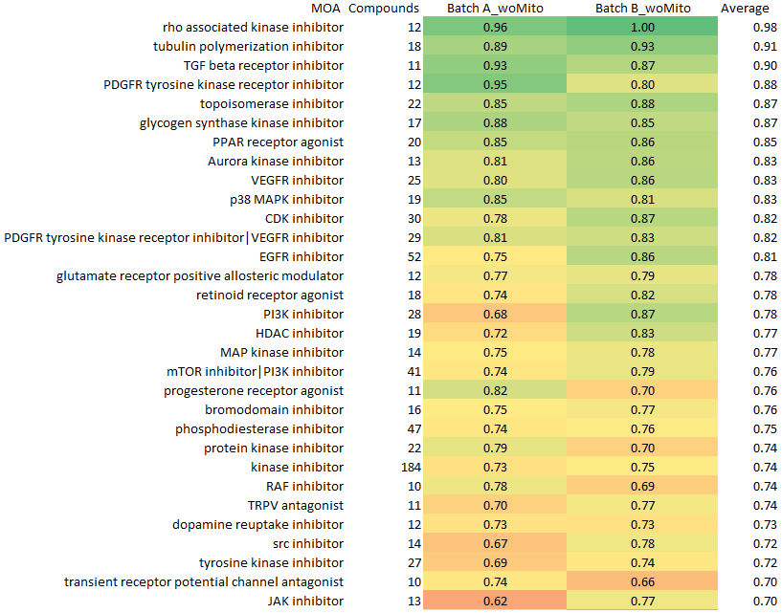
Batches A and B, cross validated AUC for RF models for compound MOA

