Slide 1
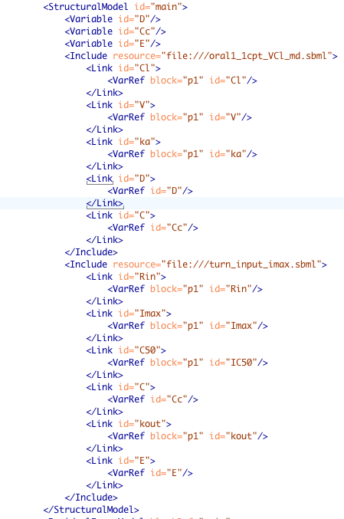
Library
Include
Client Software
Read annotation
Request NONMEM
Model Name
Annotate
Structural Model Ontology
ADVAN2

