Slide 1

Projection of GDP Growth in Conjunction with Internet Accessibility
Phillip Harmon

Slide 2

Goals and Motivation
Determine the relationship between increases in internet accessibility and economic development in a nation
Produce a model that can predict future economic growth due to changes in internet accessiblility

Slide 3
Dataset Selection
Two datasets were chosen to address this problem
Speedtest Data by Ookla
Contains data on internet speeds across many countries, broken down by quarter, for years 2020-2022
Source: Ookla’s Speed Test Service (www.speedtest.net)
GDP Annual Growth for Each Country (1960 – 2020) NEW
Contains annual GDP data for many countries from the years 1960-2020
Source: World Bank National Accounts Data and OECD National Accounts (data.worldbank.org)
Both of these datasets were obtained from Kaggle (www.kaggle.com)

Slide 4
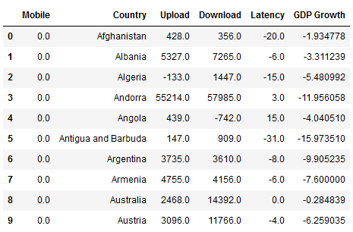
Data Analysis
The input datasets were merged and organized using an extra python script which removed blank data entries, and matched internet speed data to GDP data by country and year
Country: the country which corresponds to the data
Upload: the change in average internet upload speed for the year
Download: the change in average internet download speed for the year
Latency: the change in average internet latency for the year
Mobile: Boolean indicating whether this data was for mobile speeds or fixed connection speeds
GDP Growth: Change in GDP for the year

Slide 5
Model Selection
Fully Connected Neural Network
4 Hidden Layers
16, 13, 9, and 4 Nodes per layer respectively
Tanh nonlinear activation functions on all hidden layers
472 total trainable parameters

Slide 6
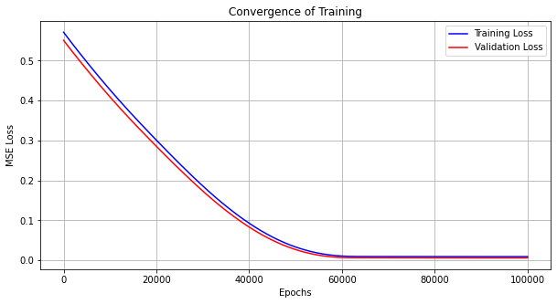
Training Analysis
Input Scaling : min/max
Train/Test Split : 80%/20%
Learning Rate : 1e-6
Epochs : 100,000
Optimizer : Adam
Loss : nn.MSELoss
Final Training Loss : 9.16e-3 Final Validation Loss : 6.06e-3
Loss Over Whole Dataset : 8.54e-3

Slide 7
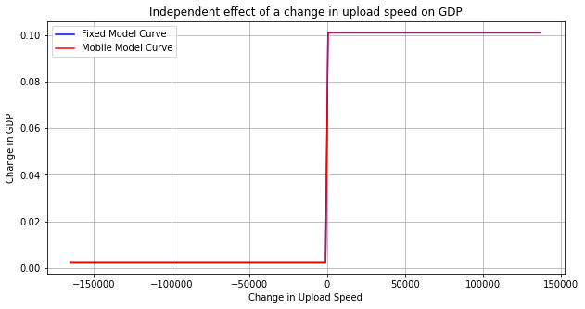
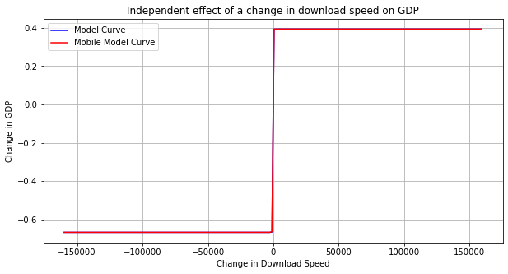
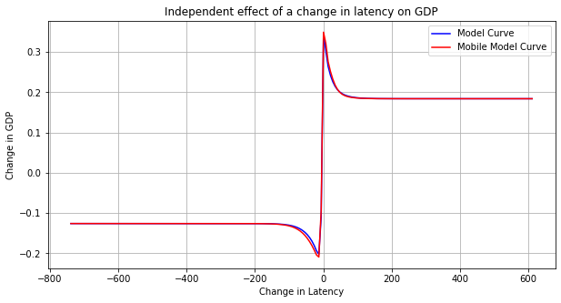
Outcomes
The plots here show naïve independent effects of the change of each internet speed parameter on the change in GDP

Slide 8
Areas for Improvement
Increase the sample size of the data
The available data was limited in scope of year
More years of data will likely yield a more practically useful model
Implement a user interface to allow the input of current data to make predictions about near-future events
This would allow for the model to be used in a real-world setting, rather than just as an engineer’s toy

Slide 9

Thank You for Your Time
Questions?

