Slide 1
IBM University Engagement
Project Submission
"Predicting NSAP Scheme Eligibility using Machine Learning"

Slide 2
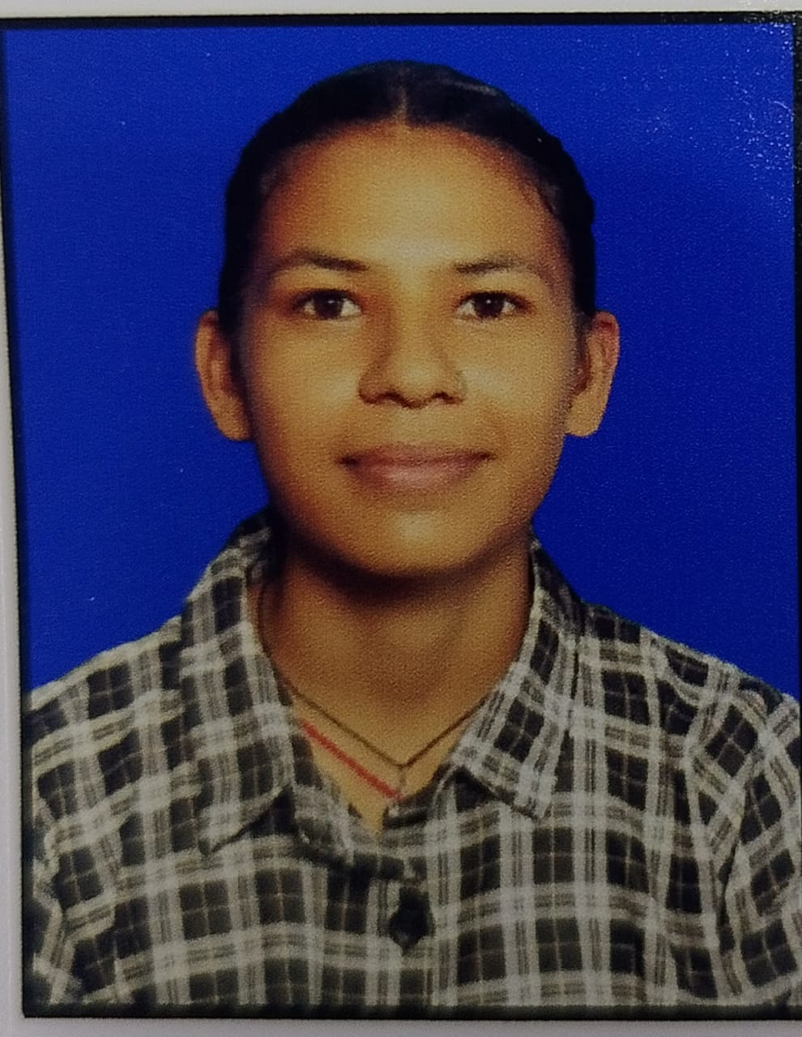
Project Title – NSAP Eligibility Predictor
Domain of Project – Government / Social Welfare
Student Name | Recent Passport Photo | Email ID | Mobile Number
Diksha Phartyal |  | phartyaldiksha05@gmail.com | 9568646077

Slide 3
Problem Statement –
Problem Statement: NSAP Eligibility Predictor (No. 34)
The Challenge
The National Social Assistance Programme (NSAP) provides financial aid to elderly, widows, and disabled persons from BPL households. Manually verifying and assigning the correct scheme is time-consuming and error-prone, leading to delayed or incorrect benefit allocation.
The Objective
Build an ML model that automatically predicts the most appropriate NSAP scheme for a beneficiary based on demographic and socio-economic data. The solution should:
Automatically classify beneficiaries
into IGNOAPS, IGNWPS, IGNDPS, or NFBS schemes based on age, disability, gender, income, and BPL status.
Reduce manual errors
in welfare scheme assignment using AI-driven predictions.
Provide a real-time eligibility dashboard
with analytics for government officials.

Slide 4
Technology Used –
Tech Stack Used:
Random Forest ML + FastAPI + React + IBM Watson Studio
Backend: FastAPI (Python) — REST API server for ML model inference
ML Platform: IBM Watson Studio — Model training, evaluation & deployment
ML Algorithm: Random Forest Classifier — Scikit-learn
Frontend: React + TypeScript — Interactive eligibility dashboard
Visualization: Recharts — Data charts, analytics, state-wise breakdowns
Database/Data: AI Kosh (Government of India) — District-wise NSAP pension data
API Calls: Axios — Frontend-to-backend communication
Embeddings: HuggingFace + FAISS (for future RAG enhancement)

Slide 5
ML Model –
Property | Value
Algorithm | Random Forest Classifier
Dataset | AI Kosh — District-wise NSAP Pension Data
Training Records | 100 district-wise records
Accuracy | 95%
Platform | IBM Watson Studio
Per-Scheme Performance
Scheme | Precision | Recall | F1 Score
IGNOAPS | 100% | 100% | 100%
IGNWPS | 100% | 80% | 89%
IGNDPS | 89% | 100% | 94%
Overall | 96% | 95% | 95%

Slide 6
NSAP Schemes Covered –
IGNOAPS
Indira Gandhi National Old Age Pension Scheme
Beneficiary: Elderly BPL citizens (60+ years)
IGNWPS
Indira Gandhi National Widow Pension Scheme
Beneficiary: Widows from BPL families (40-79 years)
IGNDPS
Indira Gandhi National Disability Pension Scheme
Beneficiary: Severely/multiple disabled persons from BPL
NFBS
National Family Benefit Scheme
Beneficiary: On death of primary breadwinner (18-59 years)

Slide 7
Proposed Solution –
AI-Powered NSAP Welfare Recommendation System
The proposed solution is a Machine Learning-powered eligibility prediction system built using Python, FastAPI, React, and IBM Watson Studio. It automatically classifies NSAP beneficiaries into the correct welfare scheme based on demographic and socio-economic features.
Predictive Inference Engine: Users enter beneficiary details (age, income, disability %, BPL status); Random Forest model predicts the most suitable scheme with confidence score.
Real-Time Dashboard: Analytics Command Center showing 12.4M+ beneficiaries, state-wise distribution, Aadhaar linking progress, fraud detection, and scheme breakdown.
AI Insights Panel: Actionable intelligence panel highlights duplicate beneficiary risk (2.8%), active fraud alerts, unusual district spikes, and AI confidence scores.
Multilingual Support: Hindi language support integrated across UI sections for wider accessibility.
Dataset: 100 district-wise records from AI Kosh (Government of India) with 16 features including state, district, gender, category, and digital inclusion data.

Slide 8
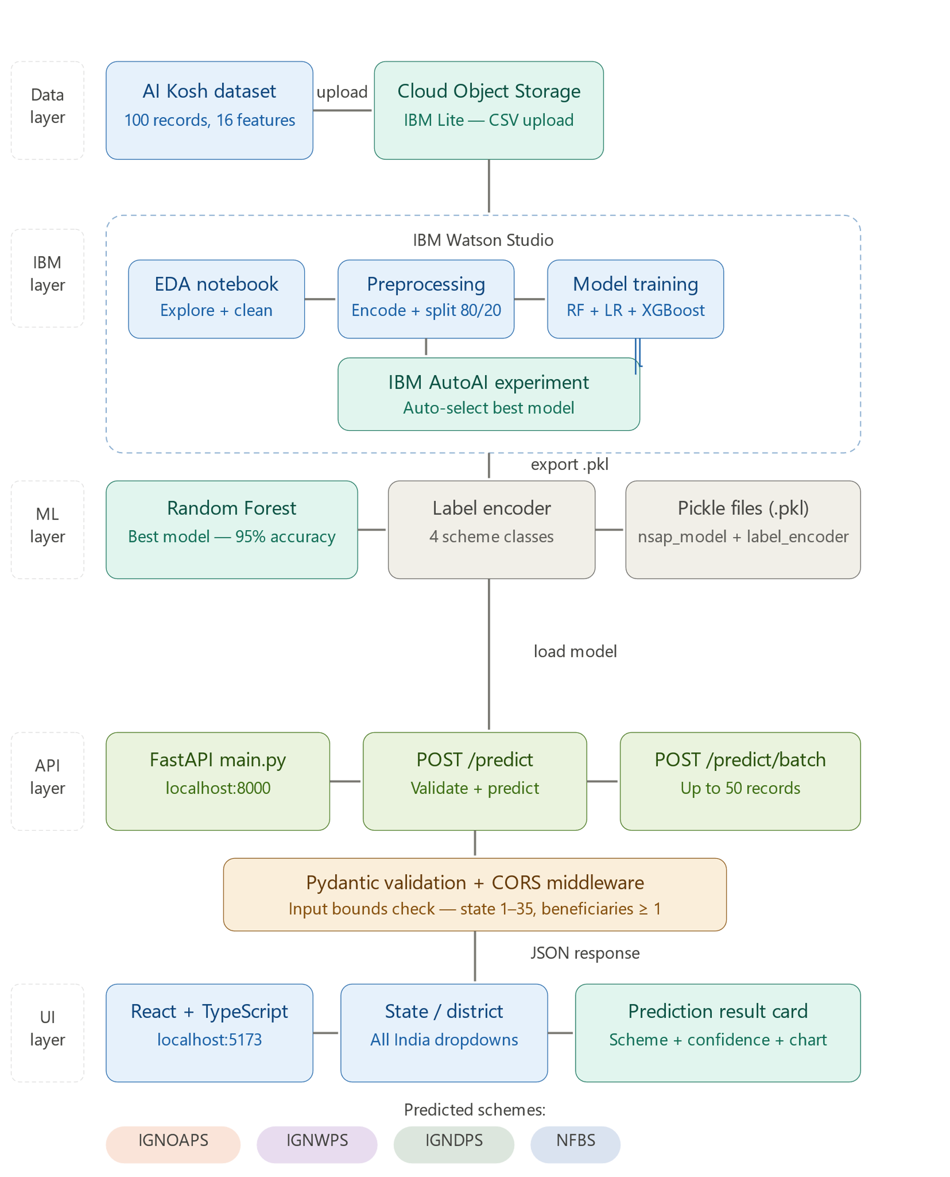
Langflow Workflow –
Multi-agent AI pipeline: Chat Input → NSAP Eligibility Agent → Prediction Engine → Chat Output with scheme recommendation

Slide 9
Architecture Blueprint –
Frontend (React + TypeScript)
Dashboard.tsx, App.tsx, Recharts visualizations, Axios API calls, Multilingual UI
Backend API (FastAPI + Python)
main.py — REST endpoint /predict, Input validation, JSON response with scheme + confidence
ML Layer (IBM Watson Studio)
Random Forest Classifier, nsap_model.pkl + label_encoder.pkl, 95% accuracy on NSAP data
Data Layer (AI Kosh)
100 district-wise NSAP records, 16 features: state, district, gender, BPL, disability, digital inclusion
Data Flow: User Input → FastAPI /predict → Random Forest Model → Scheme + Confidence → React Dashboard

Slide 10
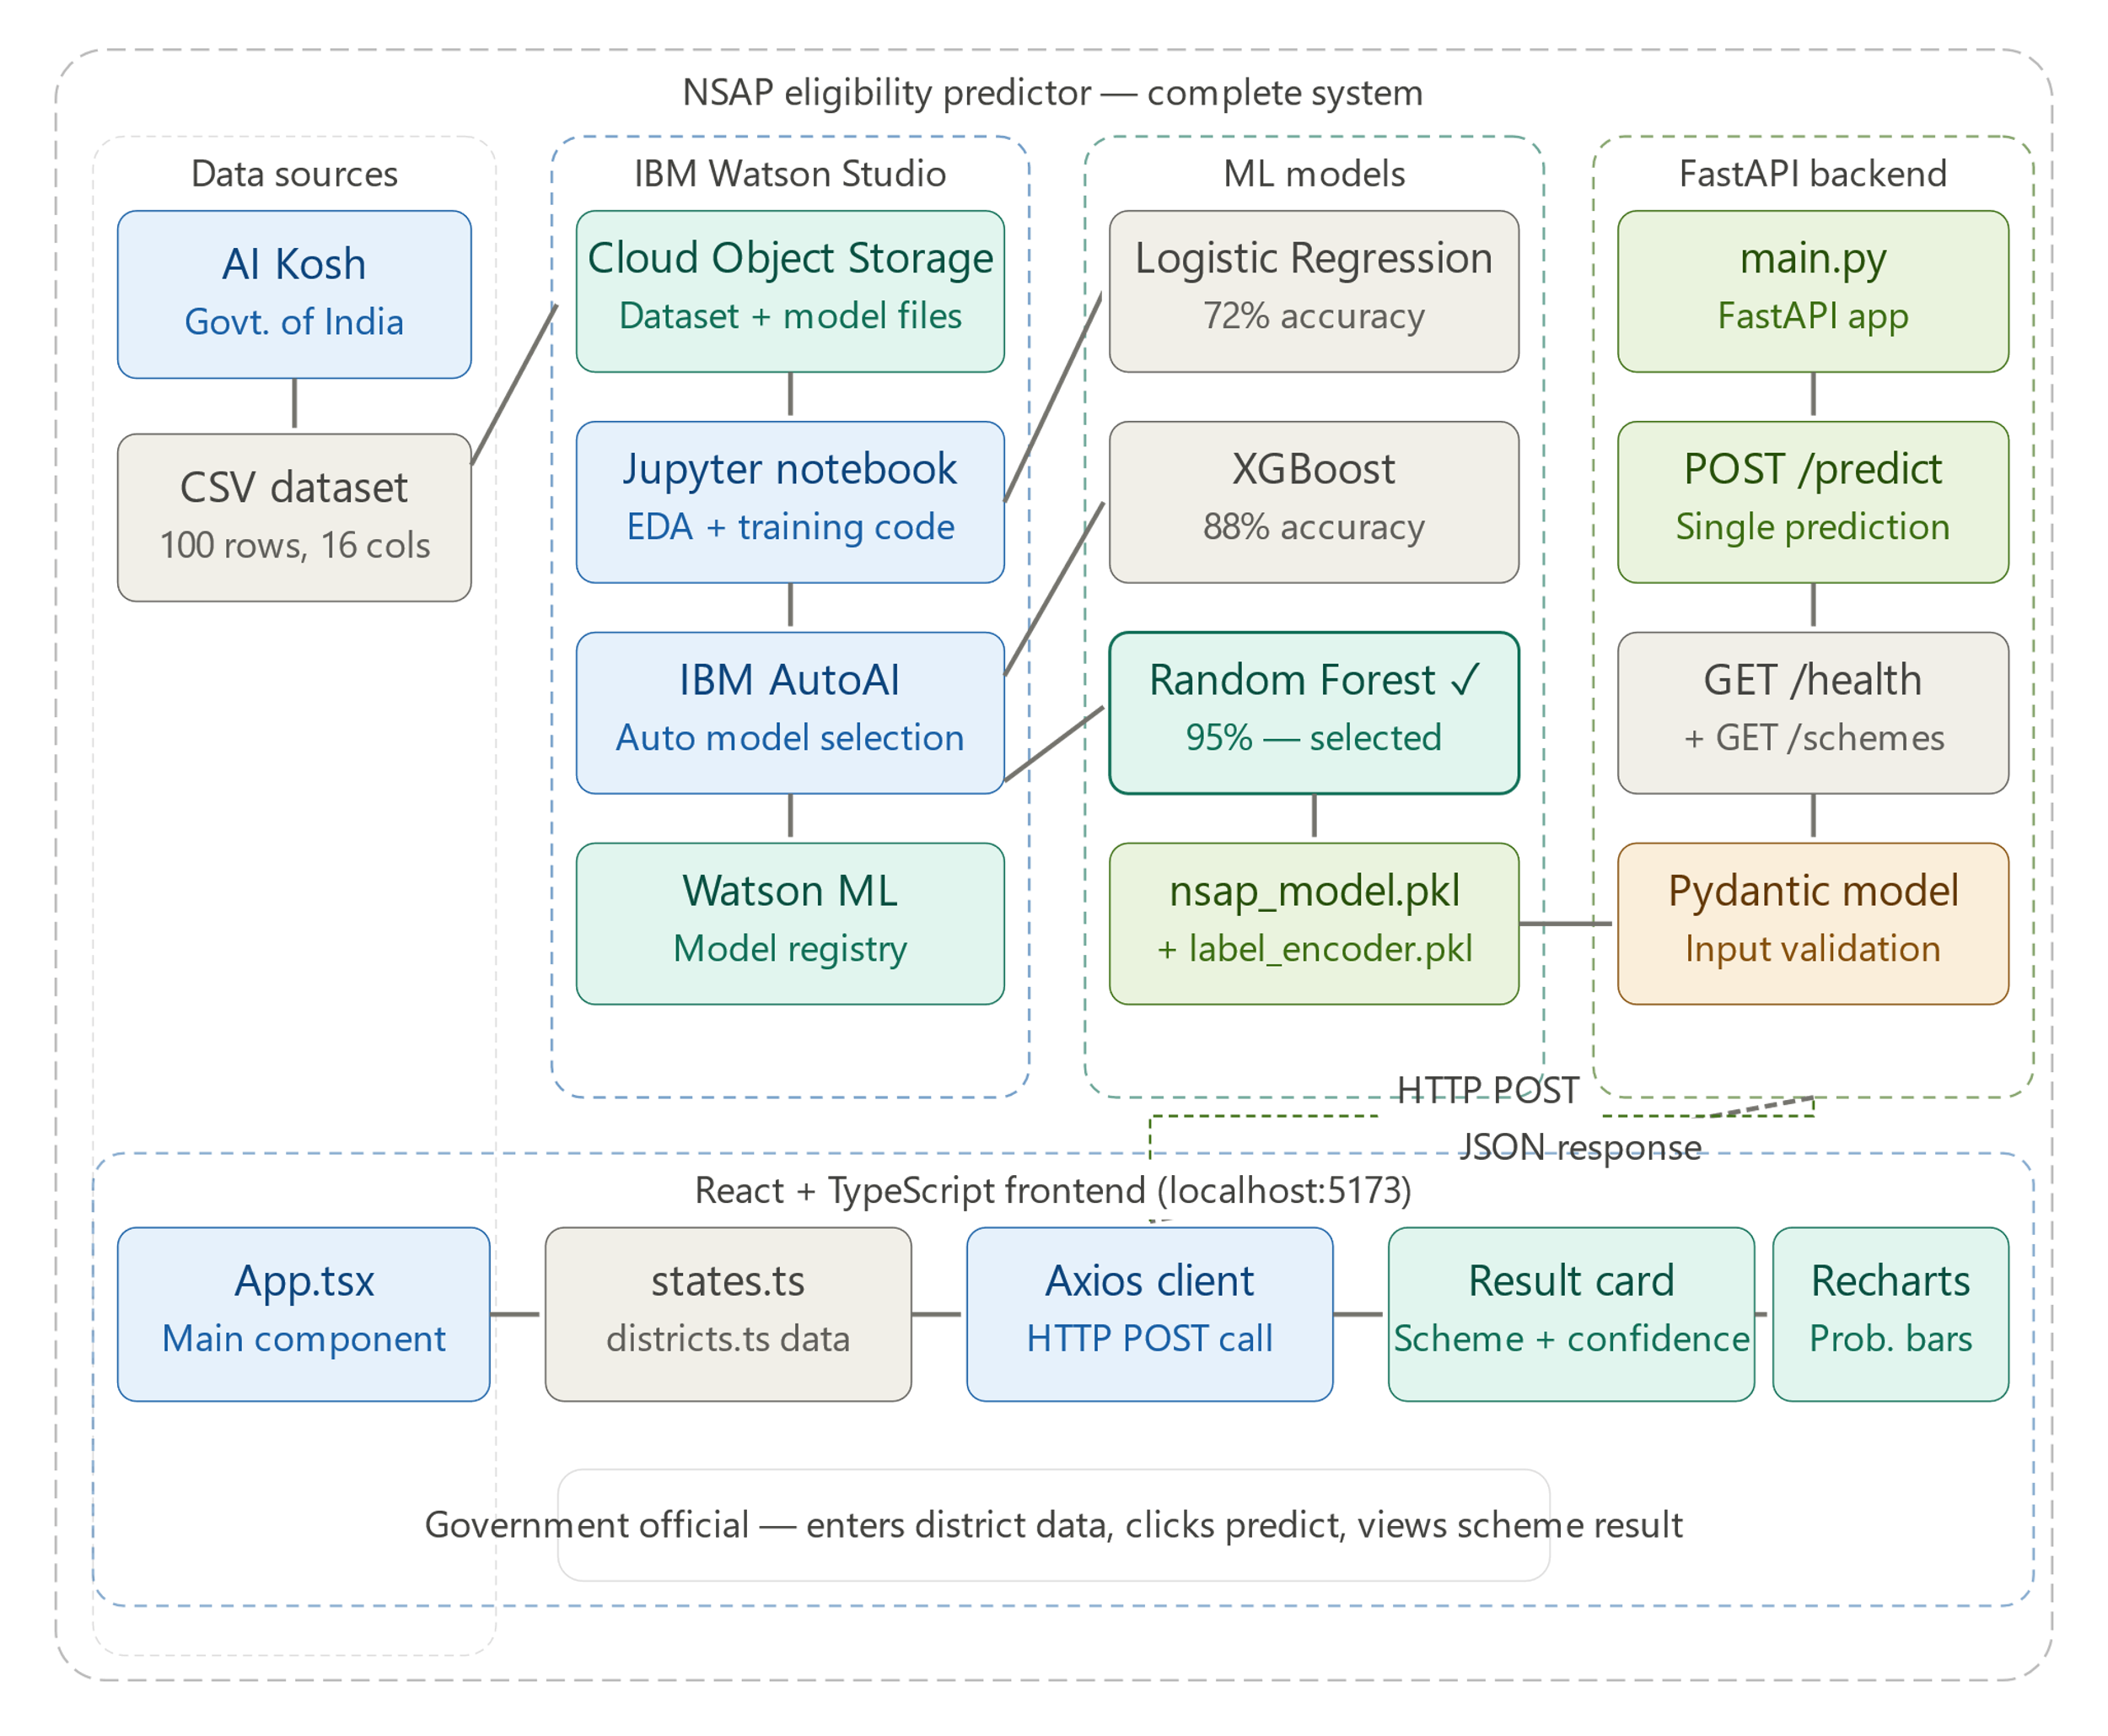
Architecture Blueprint –
End-to-end: Data Pipeline → IBM Watson Studio → Random Forest Model → FastAPI Backend → React Dashboard

Slide 11
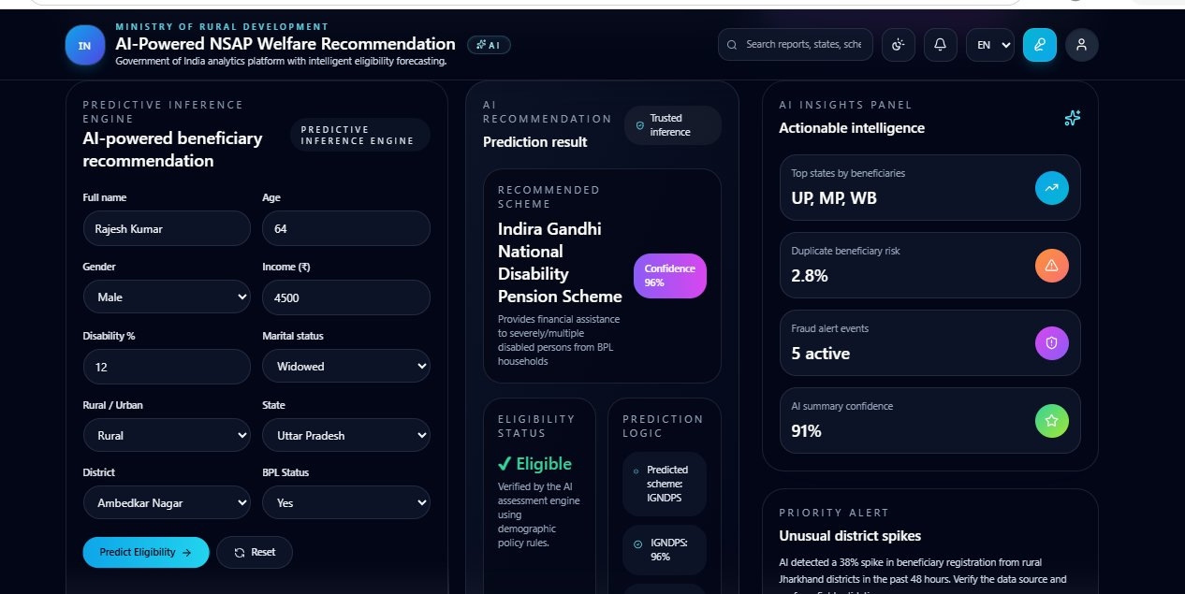
Live Demo – Predictive Inference Engine
AI-powered beneficiary recommendation with real-time eligibility prediction and confidence scoring

Slide 12
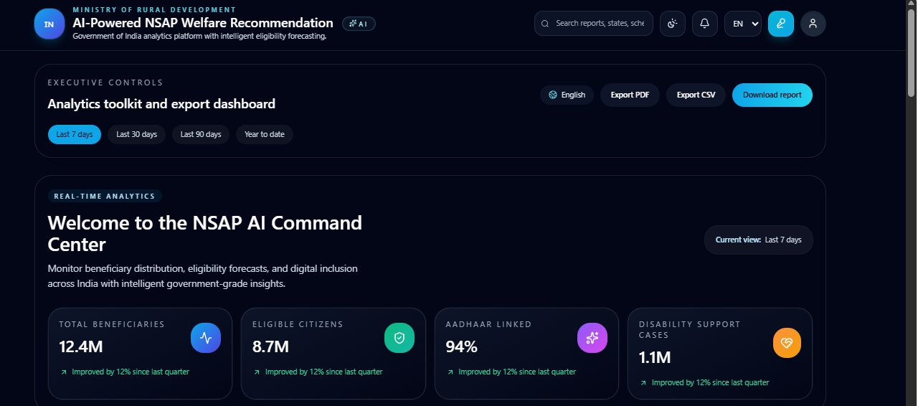
Live Demo – NSAP AI Command Center
Real-time analytics: 12.4M beneficiaries tracked, 8.7M eligible citizens, 94% Aadhaar-linked, 1.1M disability support cases

Slide 13
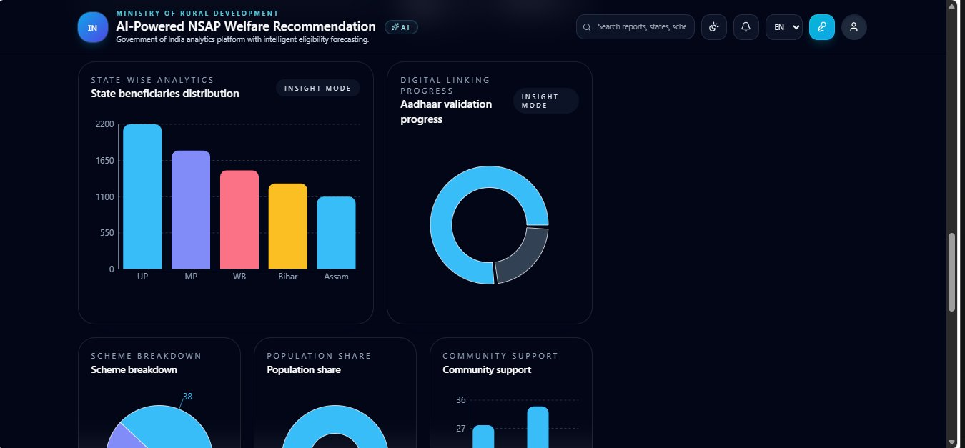
Live Demo – State-wise Analytics & Charts
State beneficiary distribution, Aadhaar validation progress, scheme breakdown, and community support analysis

Slide 14
Novelty and Uniqueness –
AI-Powered Eligibility Prediction: Random Forest model with 95% accuracy automatically assigns the correct NSAP scheme — eliminating manual errors in BPL benefit allocation.
IBM Watson Studio Integration: Model trained and evaluated on IBM's enterprise AI platform, ensuring governance, reproducibility, and production-grade reliability.
Real-Time Fraud & Anomaly Detection: AI Insights Panel flags duplicate beneficiary risks (2.8%), fraud alert events, and unusual district spikes in real time.
Live Institutional Dashboard: Full-stack analytics platform showing 12.4M+ national beneficiaries with state-wise charts, Aadhaar validation progress, and scheme breakdowns.
Government Data Source: Uses AI Kosh (official Government of India dataset) for authentic, policy-aligned training data.
Multilingual Accessibility: Hindi UI support makes the system accessible to rural government officials and beneficiaries.

Slide 15
GitHub Link & Dataset –
GitHub Repository
Please test and paste the working GitHub URL:
https://github.com/phartyaldiksha05-ux/Predicting-NSAP-Scheme-Eligibility-using-ML
Dataset
Source: AI Kosh — Government of India Open Data Platform
Link: https://aikosh.indiaai.gov.in/web/datasets/details/district_wise_pension_data_under_the_national_social_assistance_programme_nsap_1.html
Records: 100 district-wise pension records | Features: 16 columns (state, district, gender, category, digital inclusion, BPL status, disability %)

Slide 16
Thank You!
Thank you for your time and interest

