Slide 1
Anaglyph Raytracer
This raytracer splits images into red & blue channels, combining them in a such a way that red-blue 3D glasses can be used to see depth.
Jadon Fowler, Harshith Shakelli

Slide 2
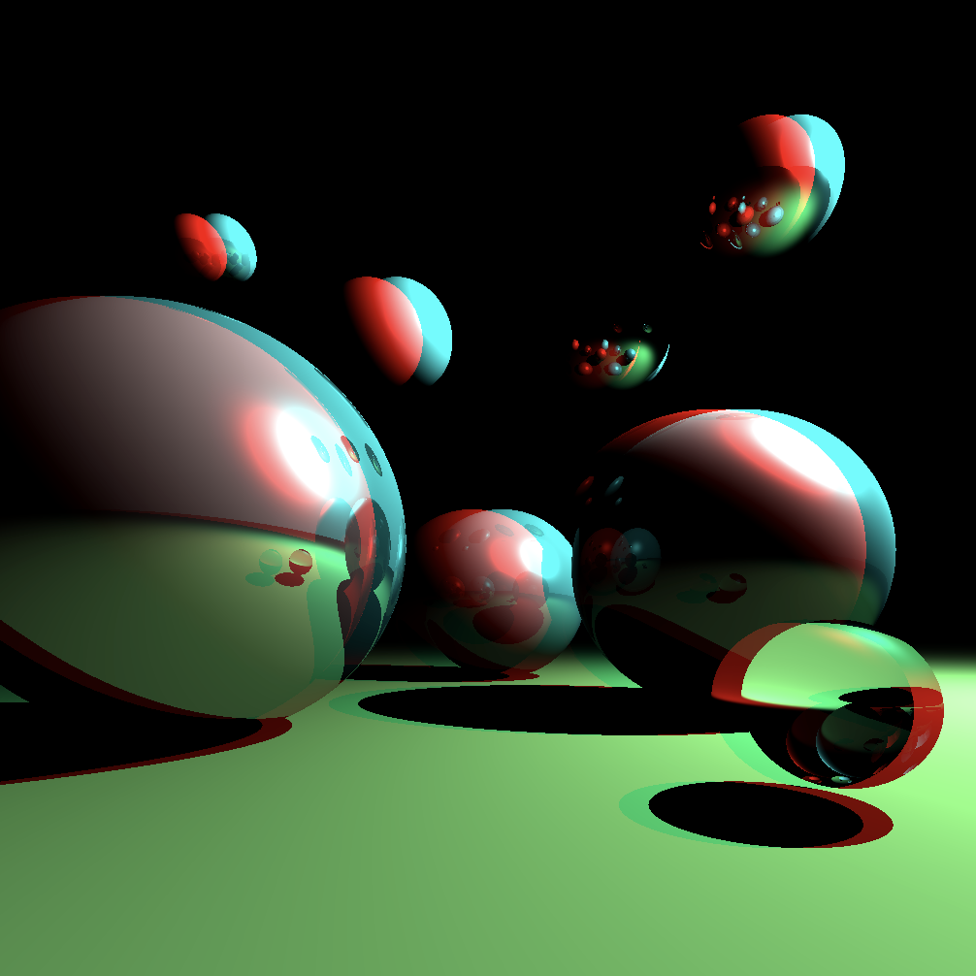

Slide 3
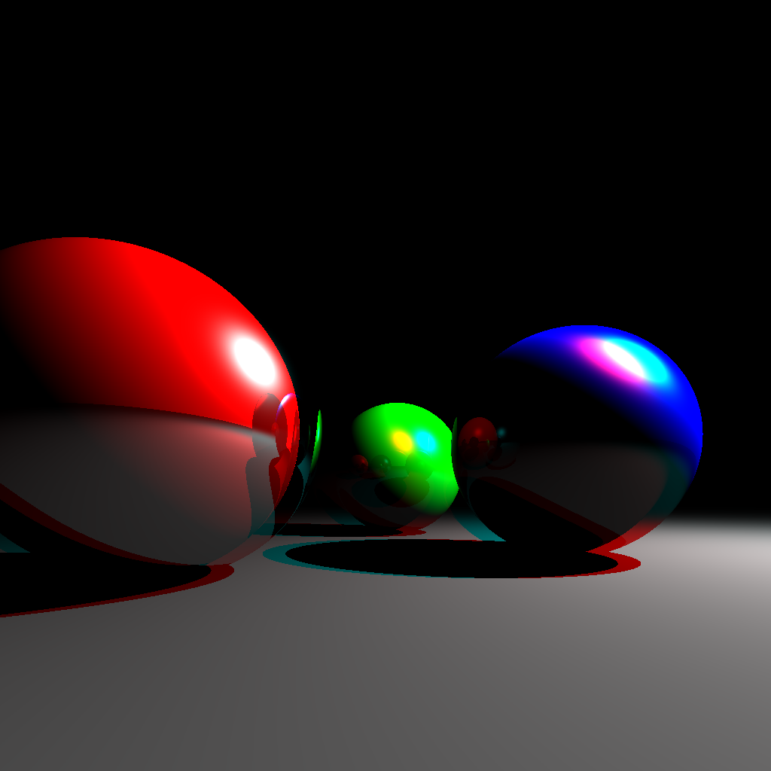

Slide 4
