Slide 1

Planning an IoT Implementation

Slide 2
Planning an IoT Implementation
Define IoT
IoT Infrastructure
Business Benefits and Challenges

Slide 3
Define IoT

Slide 4
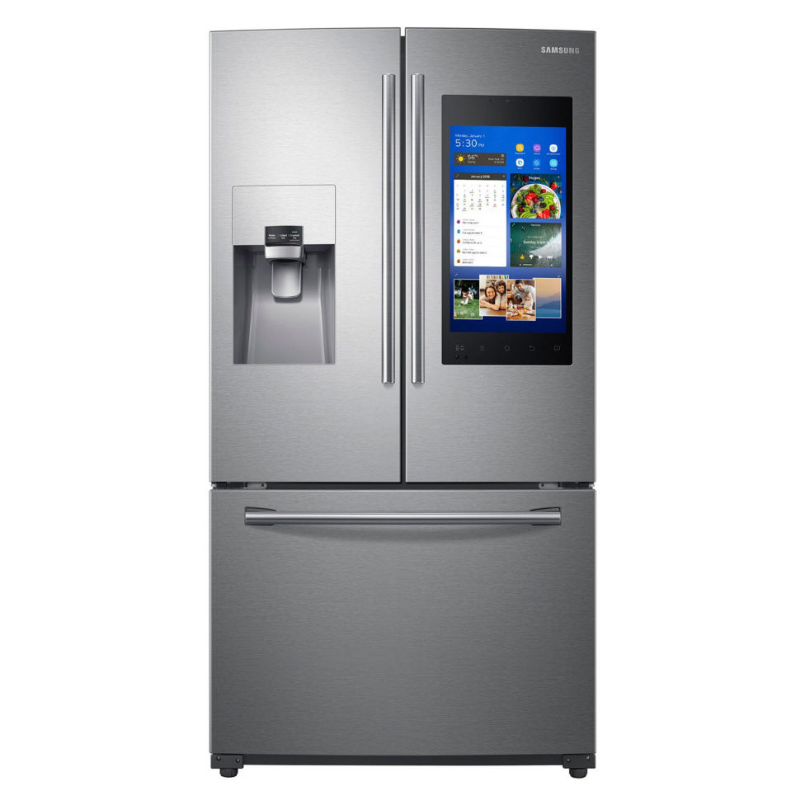
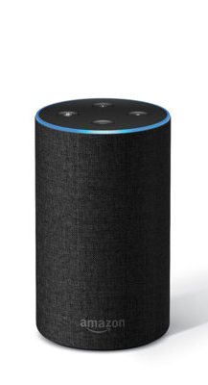
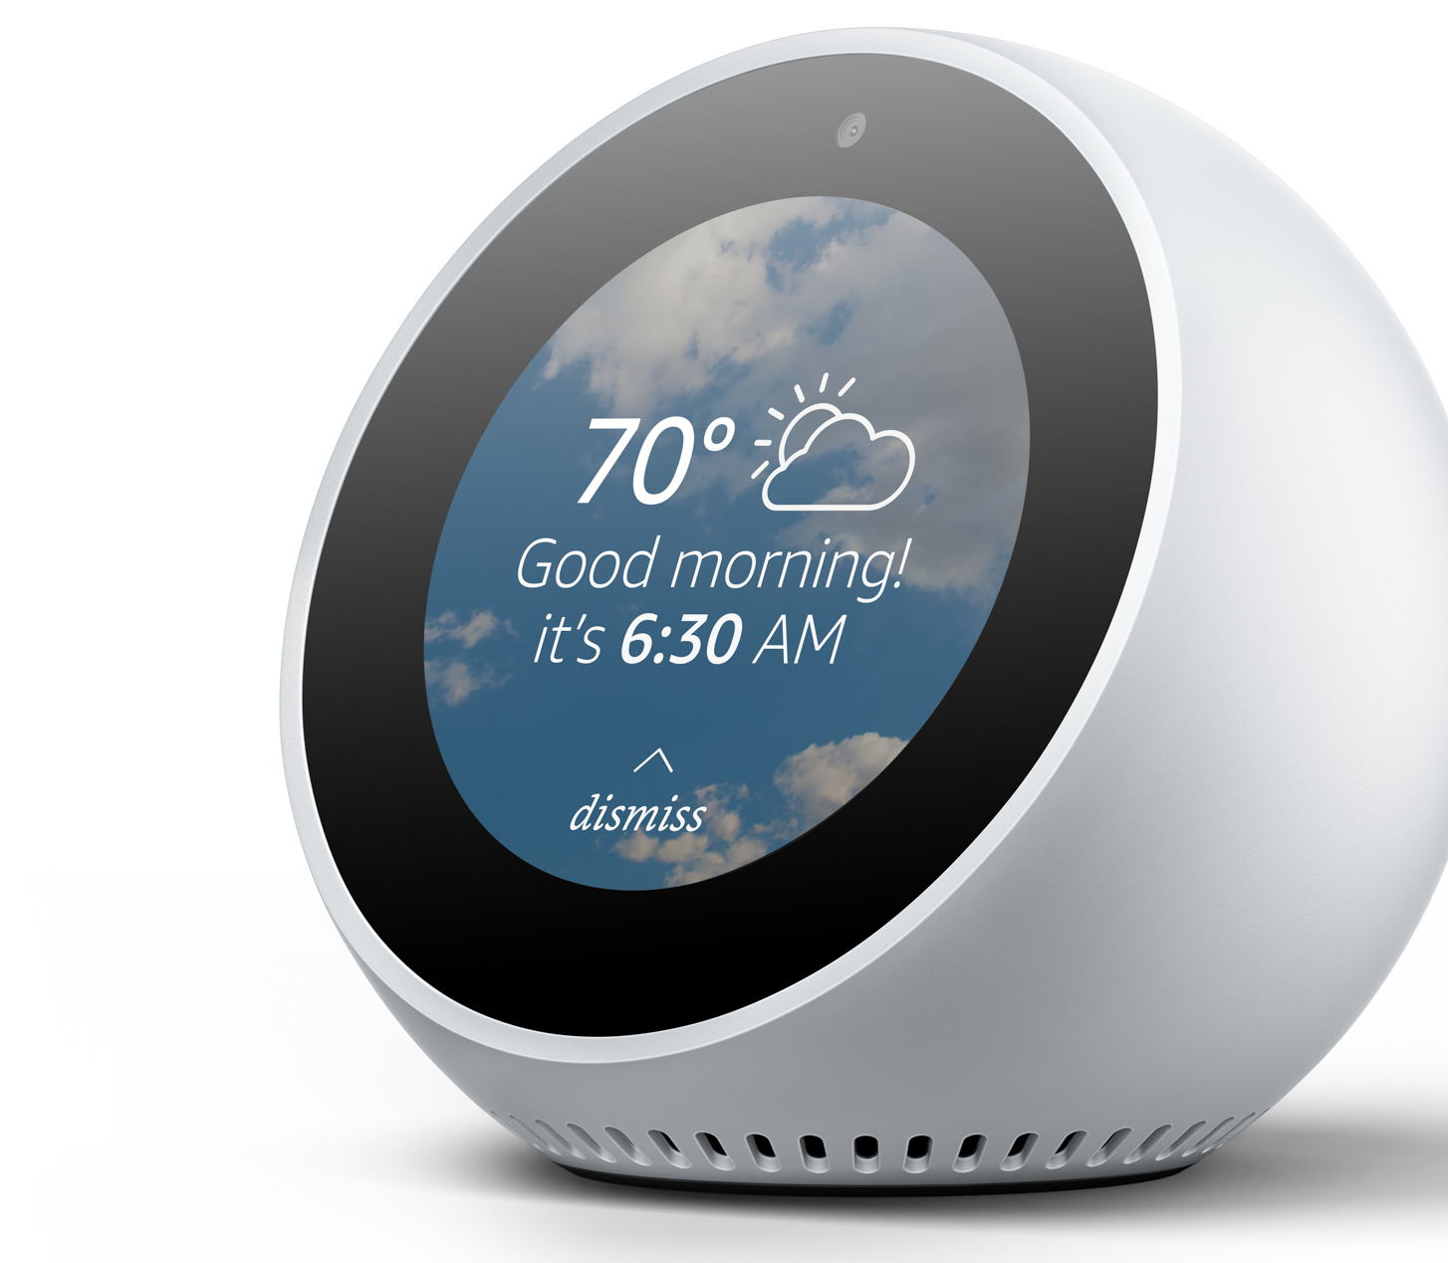
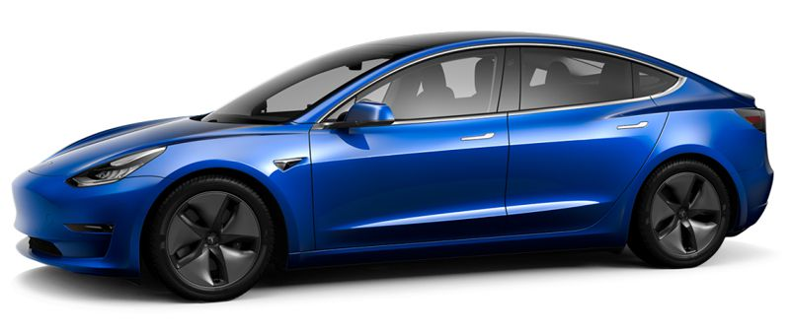
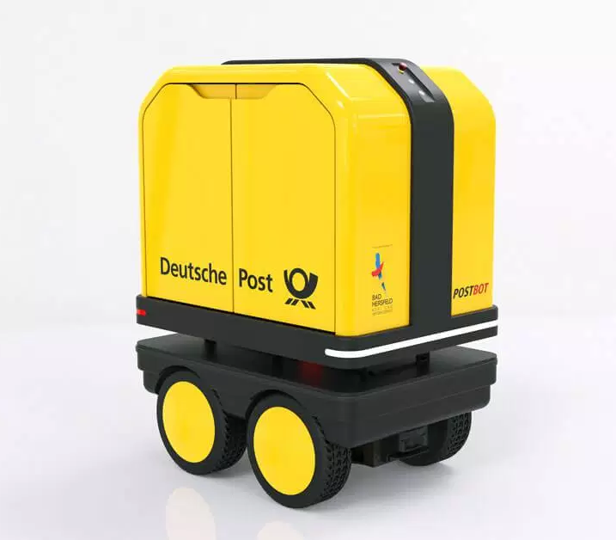
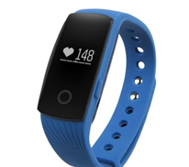
Dawn of a New Day
6:34 A.M.
6:53 A.M.
6:52 A.M.
7:12 A.M.
8:50 A.M.
8:51 A.M.

Slide 5
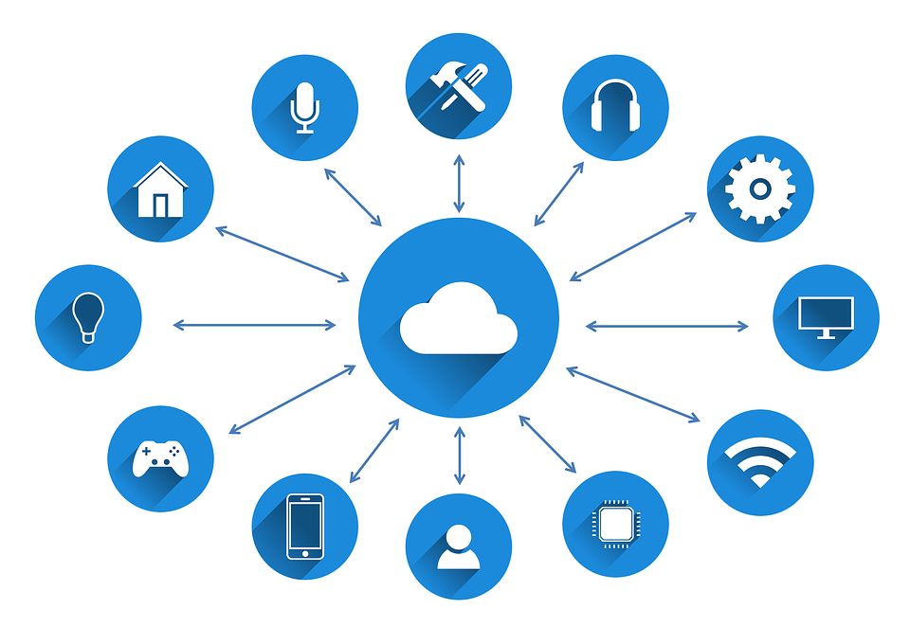
What Is IoT?
Everyday things
Network connected
Data processed in the cloud
Collect data
Share data
Interpret data
Control remote devices
Increase global food production
Promote safety and security
Improve the quality of life in our cities
Create new markets and opportunities
Conserve natural resources

Slide 6
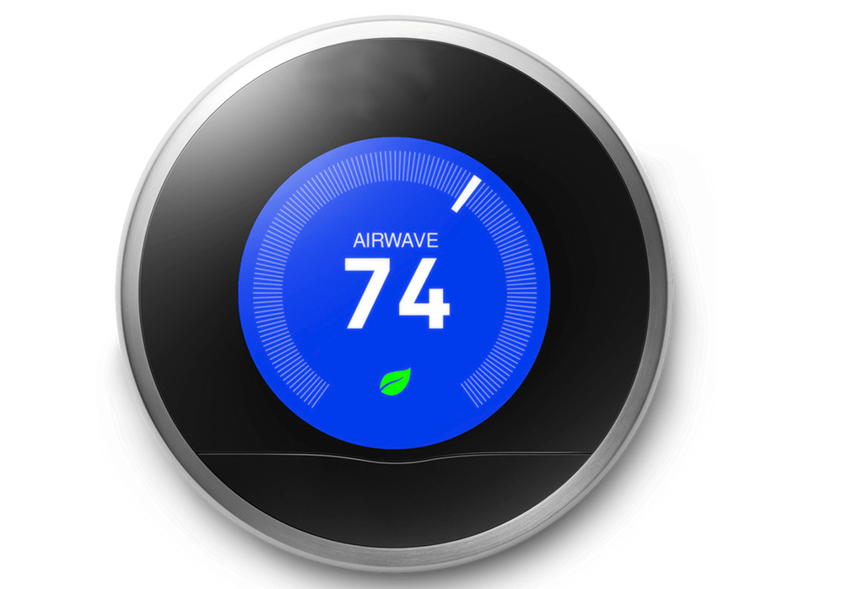
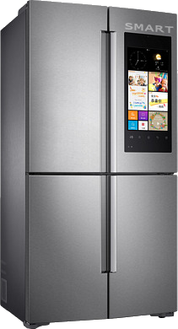
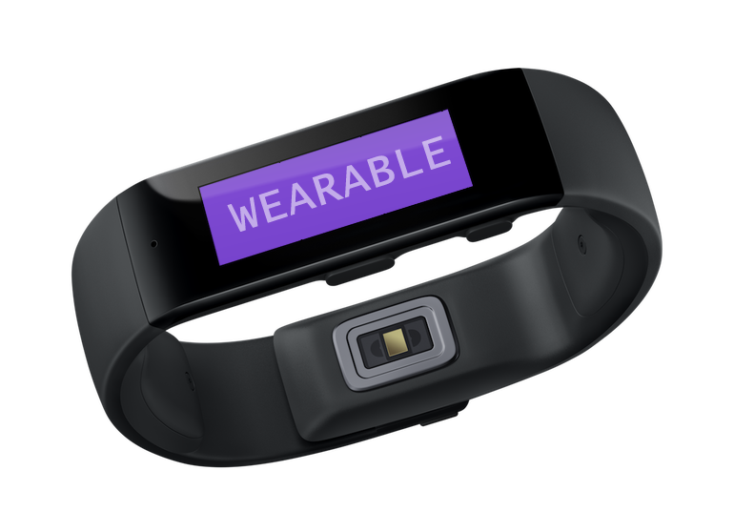
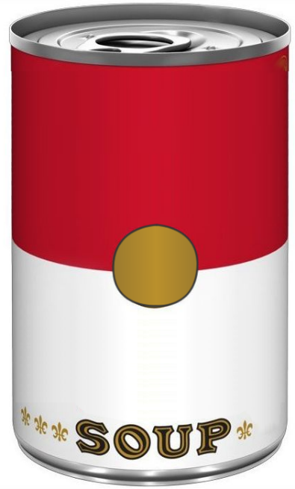
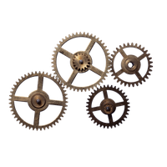

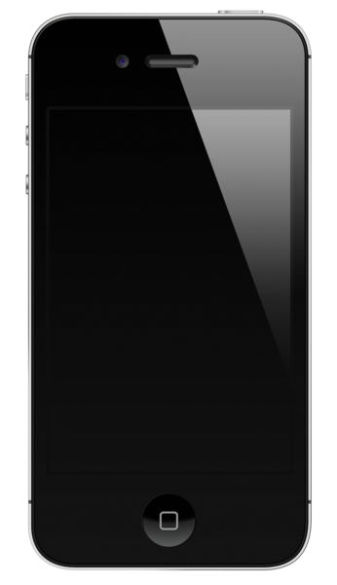

IoT Ingredients
IoT devices
  Sensing
  Active
  Connected
  Smart
The cloud
  Collect data from IoT devices
  Combine with data from
  other sources
  Perform data analytics
Client applications
  Access and view data
  Command IoT devices
Internet Of Things
CONDENSED
TECHNOLOGY

Slide 7
The "Things" in IoT
Devices that are network connected, include embedded processors, and may include sensors and actuators that interact with the physical world around the devices.

Slide 8
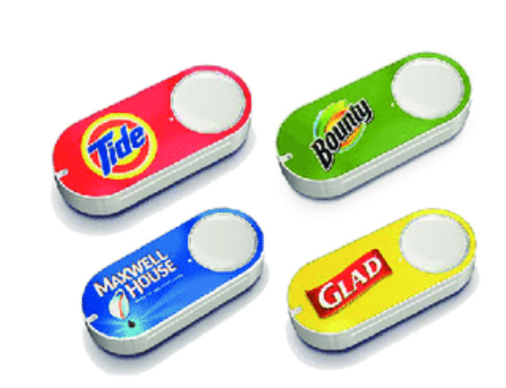

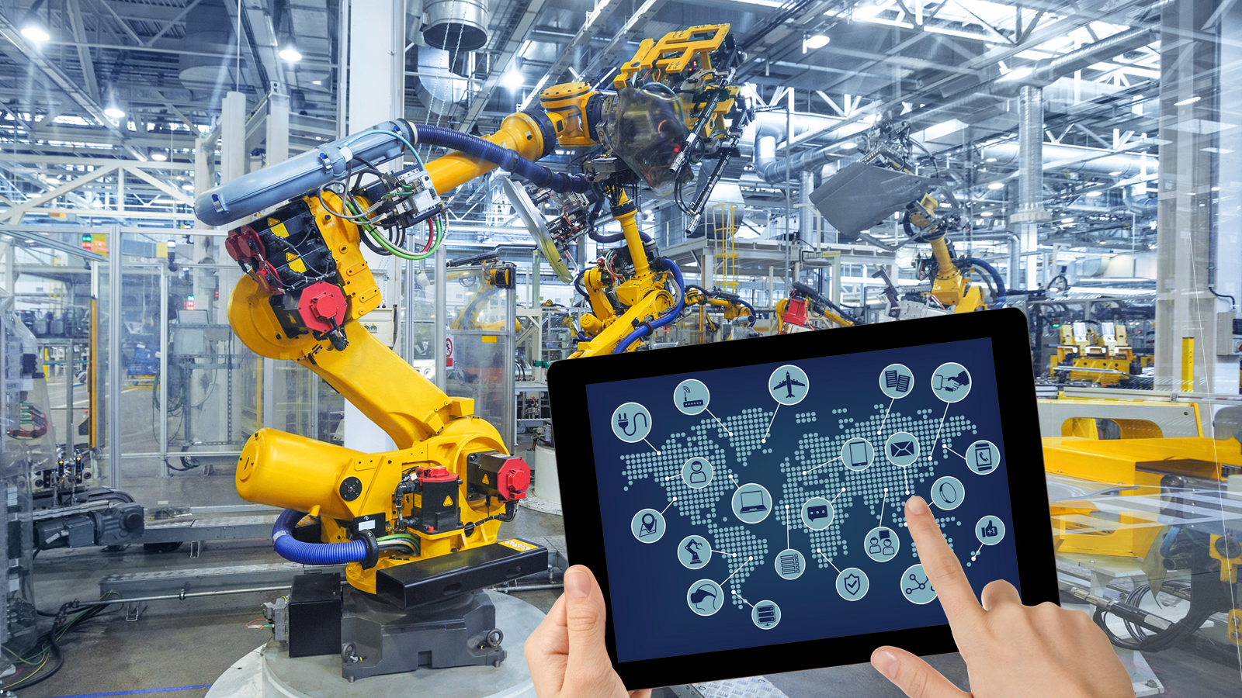
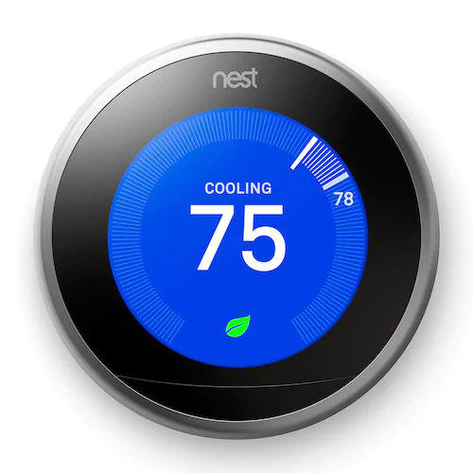
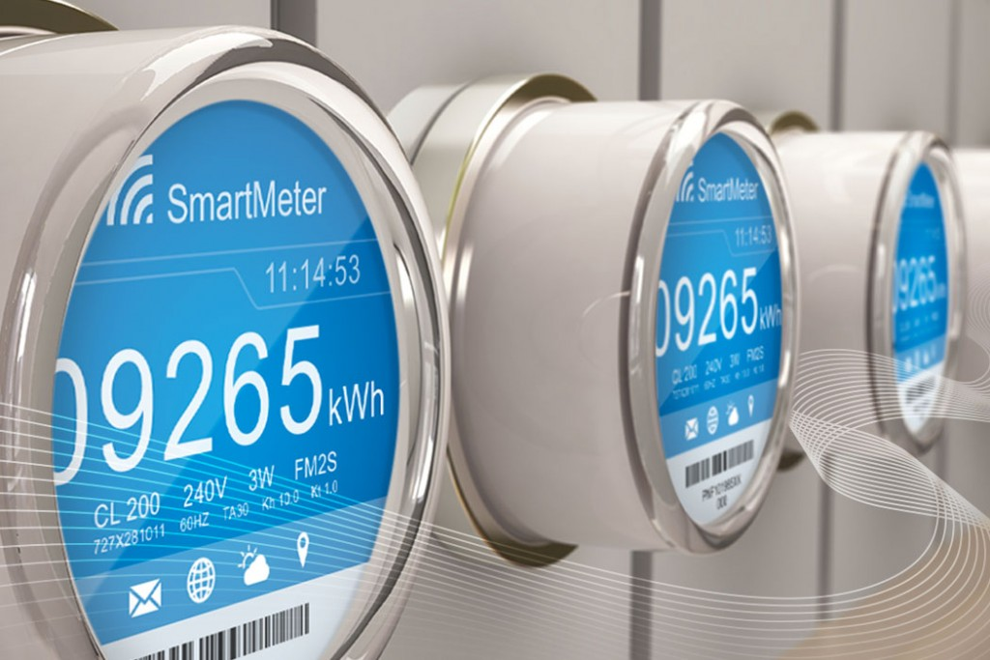
Examples of IoT Devices
Consumer
Industry

Slide 9
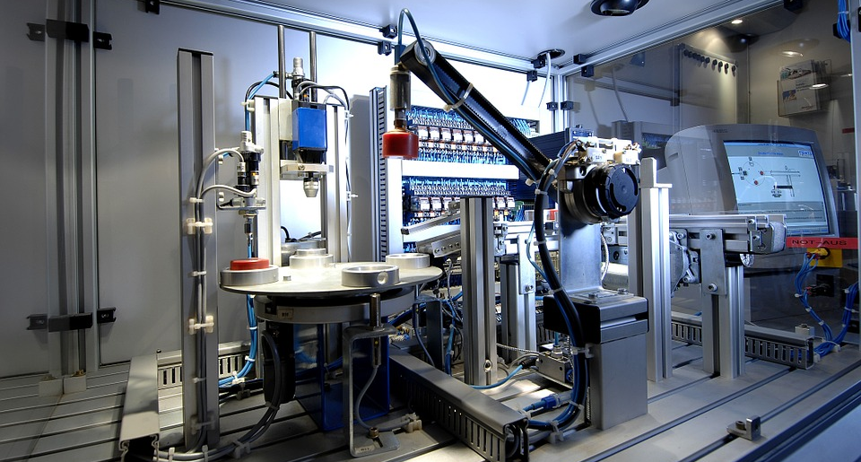
IoT in Industry: Automation Milestones
1970s
1980s
1990s
2000s
2010s
PLCs
M2M data communication
SCADA
PCs
Client–server networks
SCADA interfaced with PCs
PLCs connect to Internet
SCADA starts using open architecture and protocols
OPC
Cloud technologies
Ubiquitous computing
Low-cost microcontrollers, sensors, actuators
High-performing batteries
Industry drives IoT development
Mobile management of manufacturing processes

Slide 10
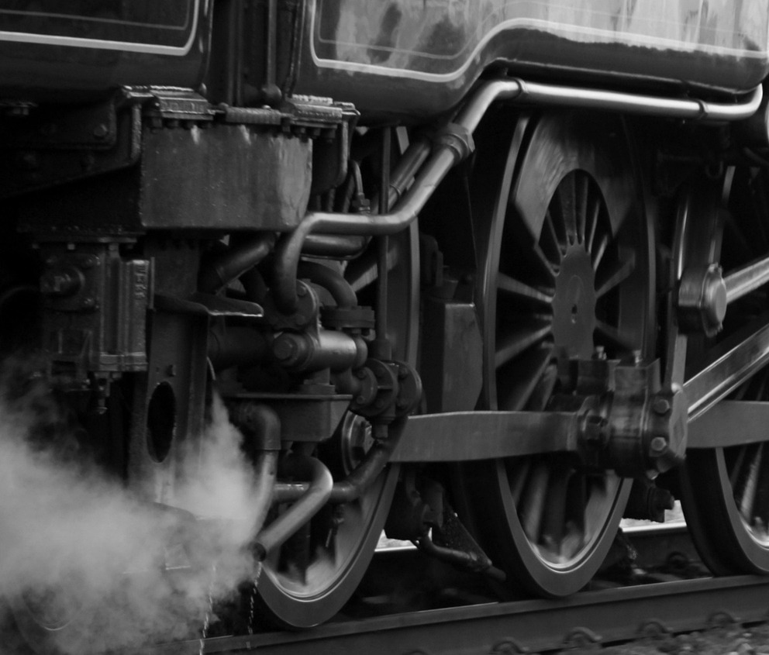
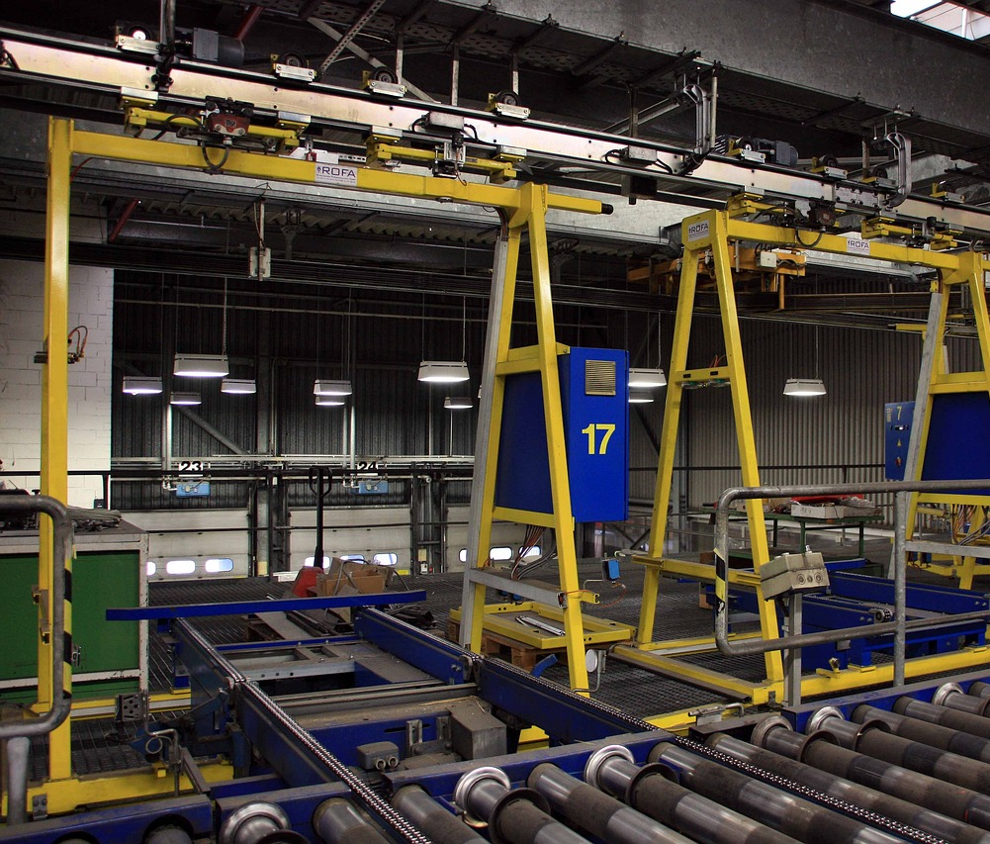
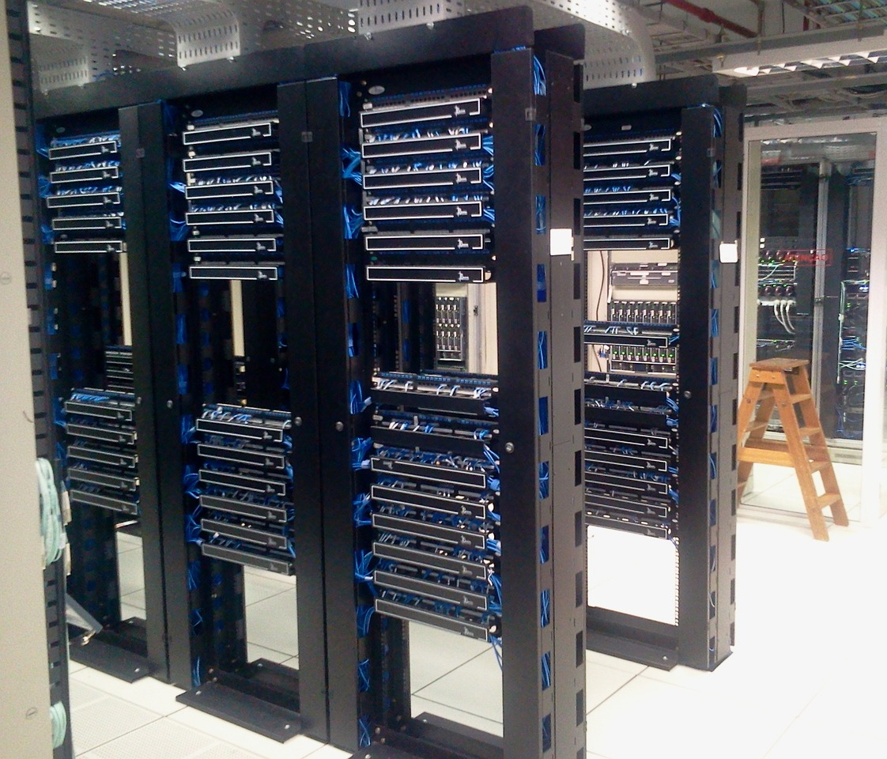

Industry Evolution
Industry 1.0
Industry 2.0
Industry 3.0
Industry 4.0

Slide 11
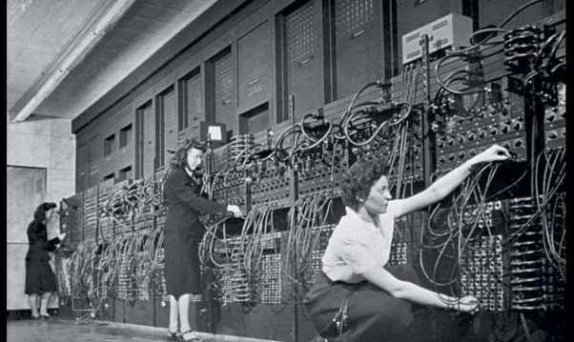
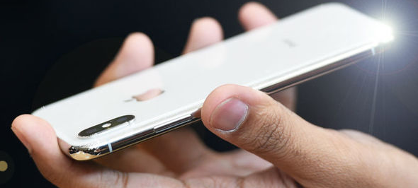
Enabling Technologies
Miniaturization
Connectivity
Advanced power sources
Inexpensive parts
Cloud-based processing
Ubiquitous computing

Slide 12
Industry 4.0 Promise
Digitization
Industry 4.0
Value
Self-Optimizing
Being Prepared

Slide 13

Four Ps of Planned Maintenance
Preventative
  Schedule maintenance at standard intervals.
Predictive
  Routinely inspect components to predict issues.
Proactive
  Control problems that lead to issues.
Prescriptive
  Automate and improve preventative maintenance.

Slide 14
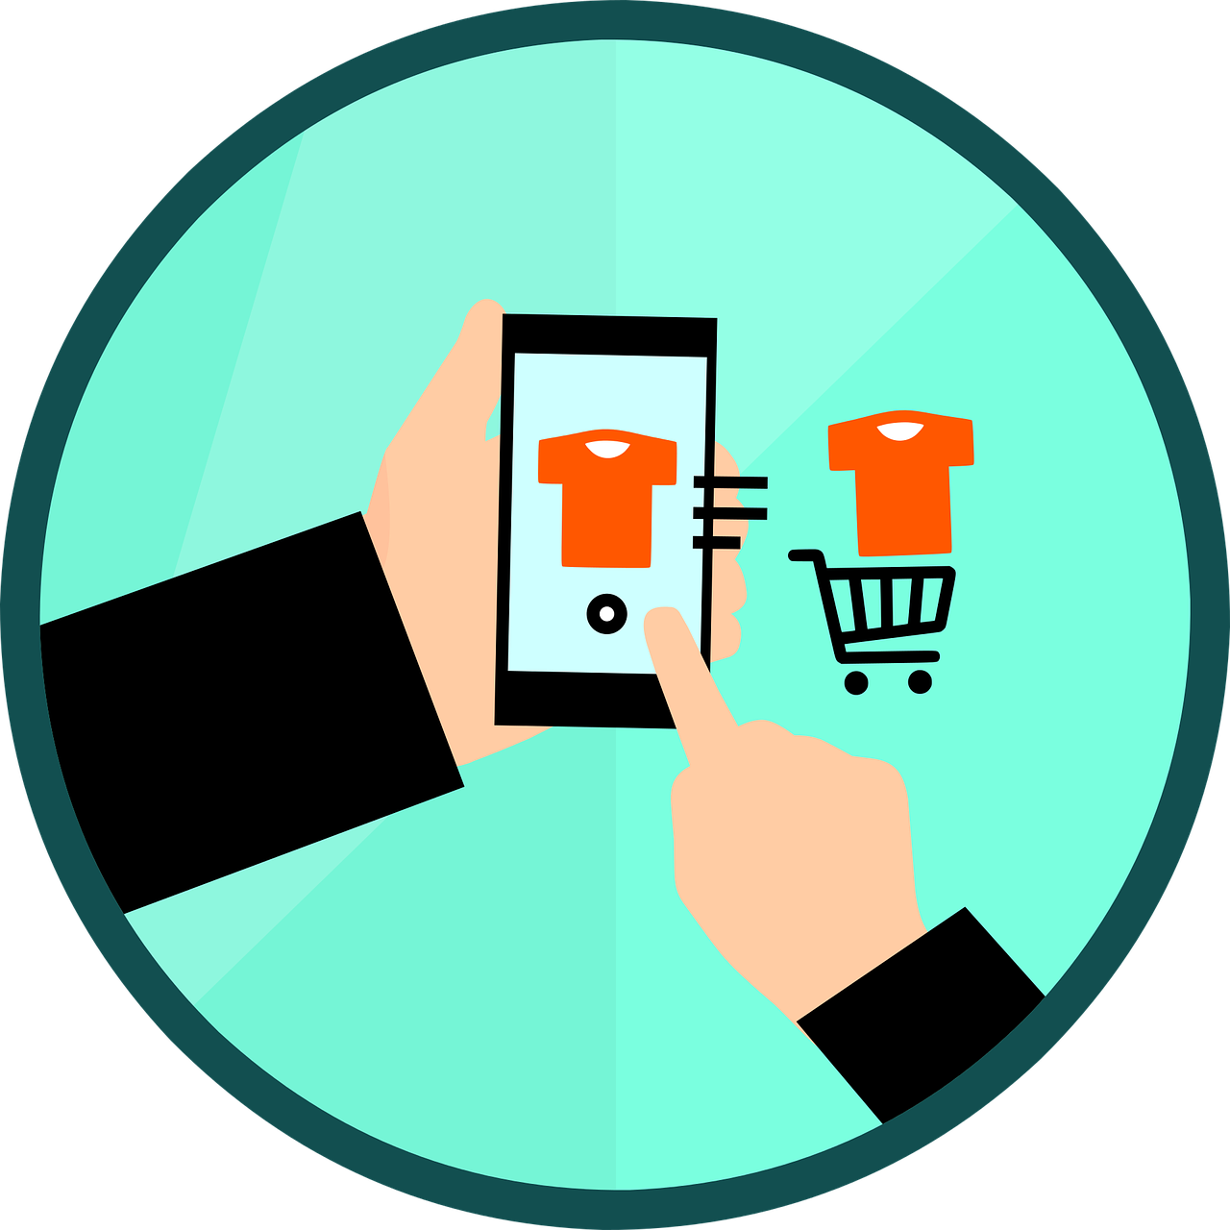

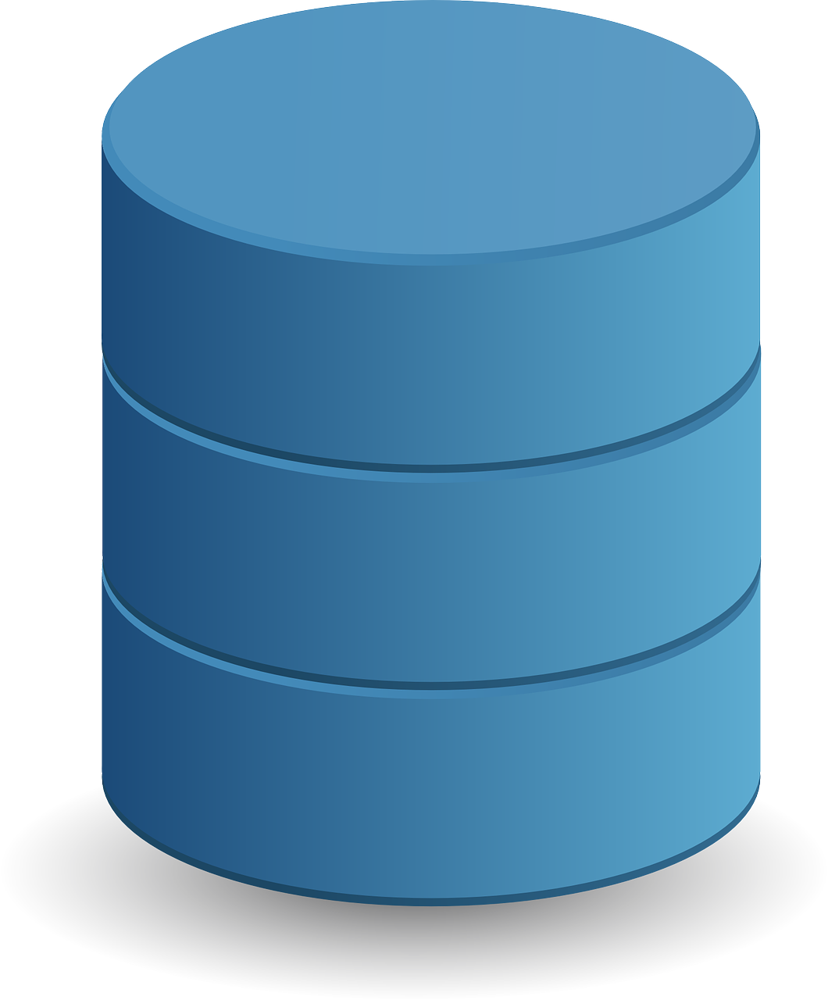
Three Key IoT Business Strategy Steps to Follow
Value
Insights
Data
Before you dive into IoT solutions, you need to solve for these three focus areas in this order.

Slide 15
Activity: Understanding Value, Insights, and Data (Slide 1 of 6)

Slide 16
Scenario: Greene Organix (Slide 2 of 6)
Greene Organix produces fresh roses for the northeast U.S. regional distributors florist market.

Slide 17
A) Identify New/Incremental Value (Slide 3 of 6)
What elements of value would be important to produce year-round, high-quality fresh flowers for Greene Organix's distributors?

Slide 18
B) Understand Insights Needed to Support Value (Slide 4 of 6)
What information may be needed to drive down production costs so you can continue to deliver best-in-class flowers at improved competitive prices?

Slide 19
C) Data (Slide 5 of 6)
What data do you need to collect to support these insights?

Slide 20
D) Identify IoT Capabilities (Slide 6 of 6)
Sensors: What useful information might an IoT device measure in this environment?
Actuators: What actions might an IoT device need to perform in this environment?
Other sources: What external data might be of use to support the insights?

Slide 21
IoT Infrastructure

Slide 22

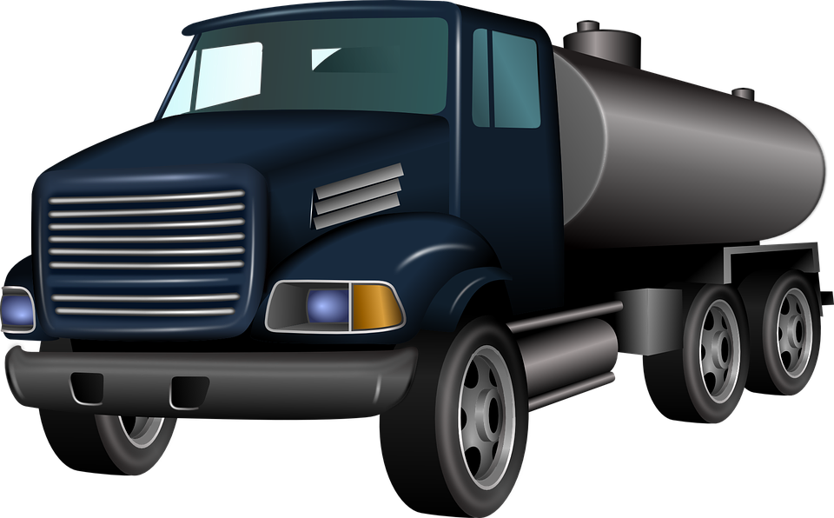
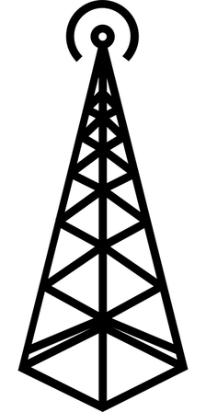

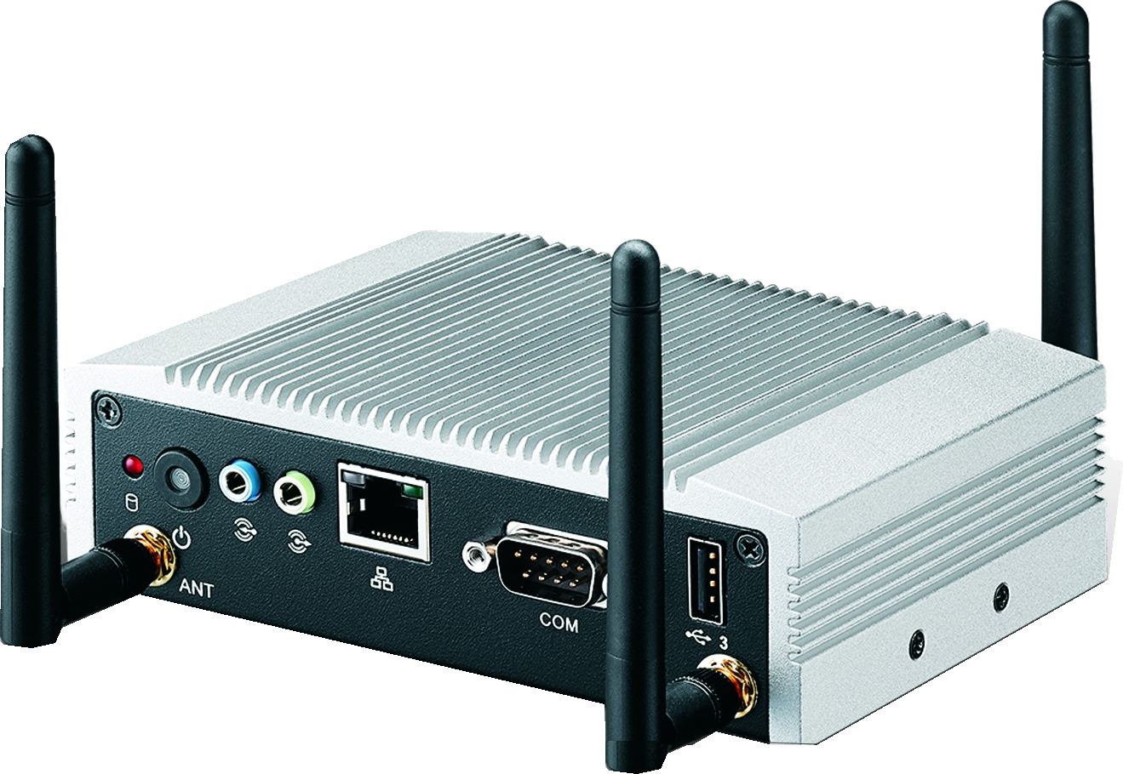
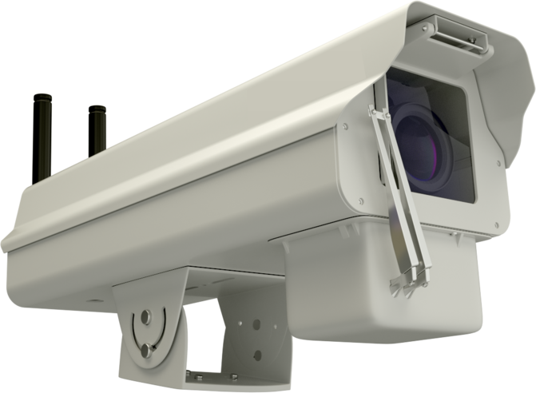
IoT Infrastructure—System of Systems
Mobile
The Edge
Cellular
Wearable
Wireless
IoT
Gateway
Stationary
Wired
IoT Devices
Local Network
Global Network
Cloud Services
User Interface

Slide 23
IoT Gateway
Supports local communication and messaging.
Stores data from IoT devices temporarily.
Forwards data acquired from IoT devices to cloud services.
Performs local data analysis.
Translates between IPv6 and IPv4.
Serves as a local cache for software updates.
Receives device commands from the cloud.

Slide 24
Cloud Services (Slide 1 of 2)
Mobile
The Edge
Cellular
Wearable
Wireless
IoT
Gateway
Stationary
Wired
IoT Devices
Local Network
Global Network
Cloud Services
User Interface

Slide 25
Cloud Services (Slide 2 of 2)
Provide a central point for:
  Storage and analysis of data.
  Integration with other solutions.
Example platforms: AWS, Azure, Google Cloud.
Can also be hosted in own data center.
Can scale as needed.

Slide 26
User Interface (Slide 1 of 2)
Mobile
The Edge
Cellular
Wearable
Wireless
IoT
Gateway
Stationary
Wired
IoT Devices
Local Network
Global Network
Cloud Services
User Interface

Slide 27
User Interface (Slide 2 of 2)
Client apps provide users with access to IoT data and issue commands.
Consumer IoT: smartphone, tablet, desktop apps.
Business intelligence and data dashboards.
Administrative applications.

Slide 28
Software Stacks (Slide 1 of 4)
Layers of software used throughout the IoT infrastructure
The Edge
IoT Devices
Local Network
Global Network
Cloud Services
User Interface

Slide 29

Software Stacks (Slide 2 of 4)
IoT Device
Program
Remote Management
Lightweight Communication
Hardware Abstraction Layer
Operating System (Optional)

Slide 30

Software Stacks (Slide 3 of 4)
IoT Gateway
Data and Messaging Management
Remote Management
Communication
Field Protocols
IoT Protocols
Network Management
Application Runtime Environment
Operating System

Slide 31
Software Stacks (Slide 4 of 4)
Cloud Services
User Interface
Remote Management
Event Management
Analytics
Data Management
Device Management and Registry
Communication and Messaging
Operating System / Platform as a Service

Slide 32
Activity: Selecting an IoT Infrastructure (Slide 1 of 4)

Slide 33
Scenario: The Greenhouse IoT Project (Slide 2 of 4)
Monitor the environment within multiple greenhouses.
Potentially hundreds of IoT sensor devices.
System will:
  Collect data.
  Analyze data.
  Control greenhouse environment for optimal growing conditions.
  Report data as needed.

Slide 34
A) IoT Infrastructure Setup (Slide 3 of 4)
What would be a typical IoT infrastructure setup for our greenhouses?

Slide 35
B) Constraints (Slide 4 of 4)
What are some constraints we may be dealing with within our greenhouse operation?

Slide 36
Business Benefits and Challenges

Slide 37

Business Benefits
Improve competitive position.
Identify new and enhanced revenue streams and markets.
Enable predictive capabilities.
Reduce operational costs and natural resources usage.
Reduce impact on the environment.

Slide 38

Business Considerations (Slide 1 of 4)
What type of work does your organization (or an organization that you serve) perform?
Describe various situations in which your organization is trying to achieve new business value from an IoT solution.

Slide 39
Business Considerations (Slide 2 of 4)
What incremental value are you trying to capture?
Describe various situations in which your organization is trying to achieve new business value from an IoT solution.

Slide 40
Business Considerations (Slide 3 of 4)
What new information (insights) will you need to be able to deliver on this new value?
Describe various situations in which your organization is trying to achieve new business value from an IoT solution.

Slide 41
Business Considerations (Slide 4 of 4)
What data will you need to capture to help facilitate and support this new information?
Describe various situations in which your organization is trying to achieve new business value from an IoT solution.

Slide 42

Business Challenges
Disruption to existing infrastructure and business processes.
Provisioning and tracking thousands of devices.
Value/cost.
Business risk (security/privacy).
Organizational change.
Organizational skills.

Slide 43
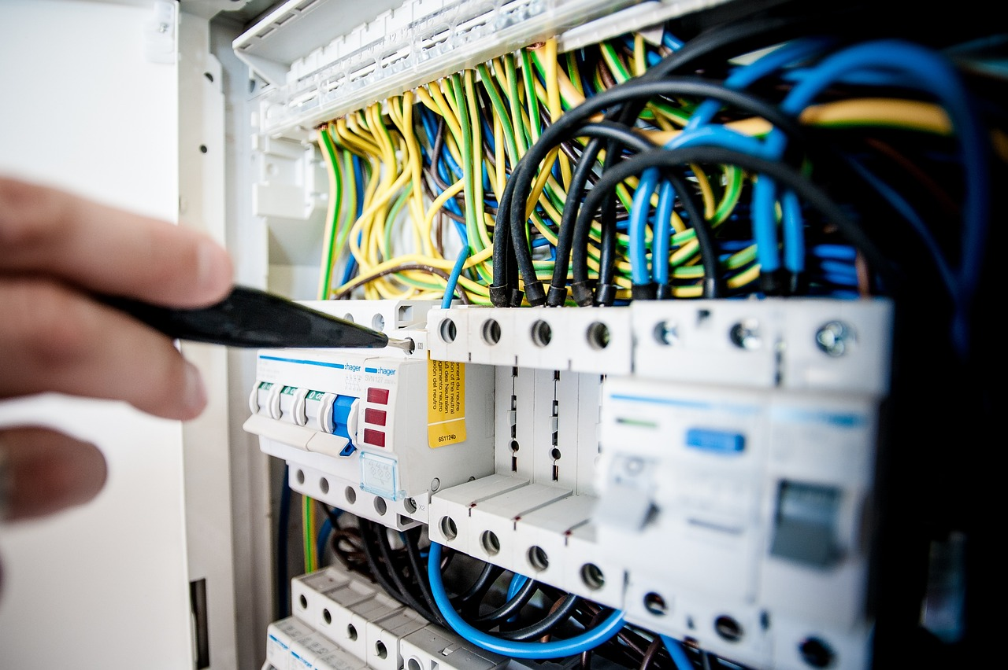
Technical Challenges
Device constraints
Data communication
Interoperability
Real-time operations
Security and privacy
Usability
Updates

Slide 44
Security Challenges
The "S" in IoT stands for "Security."
Wait, there's no "S" in IoT!

Slide 45
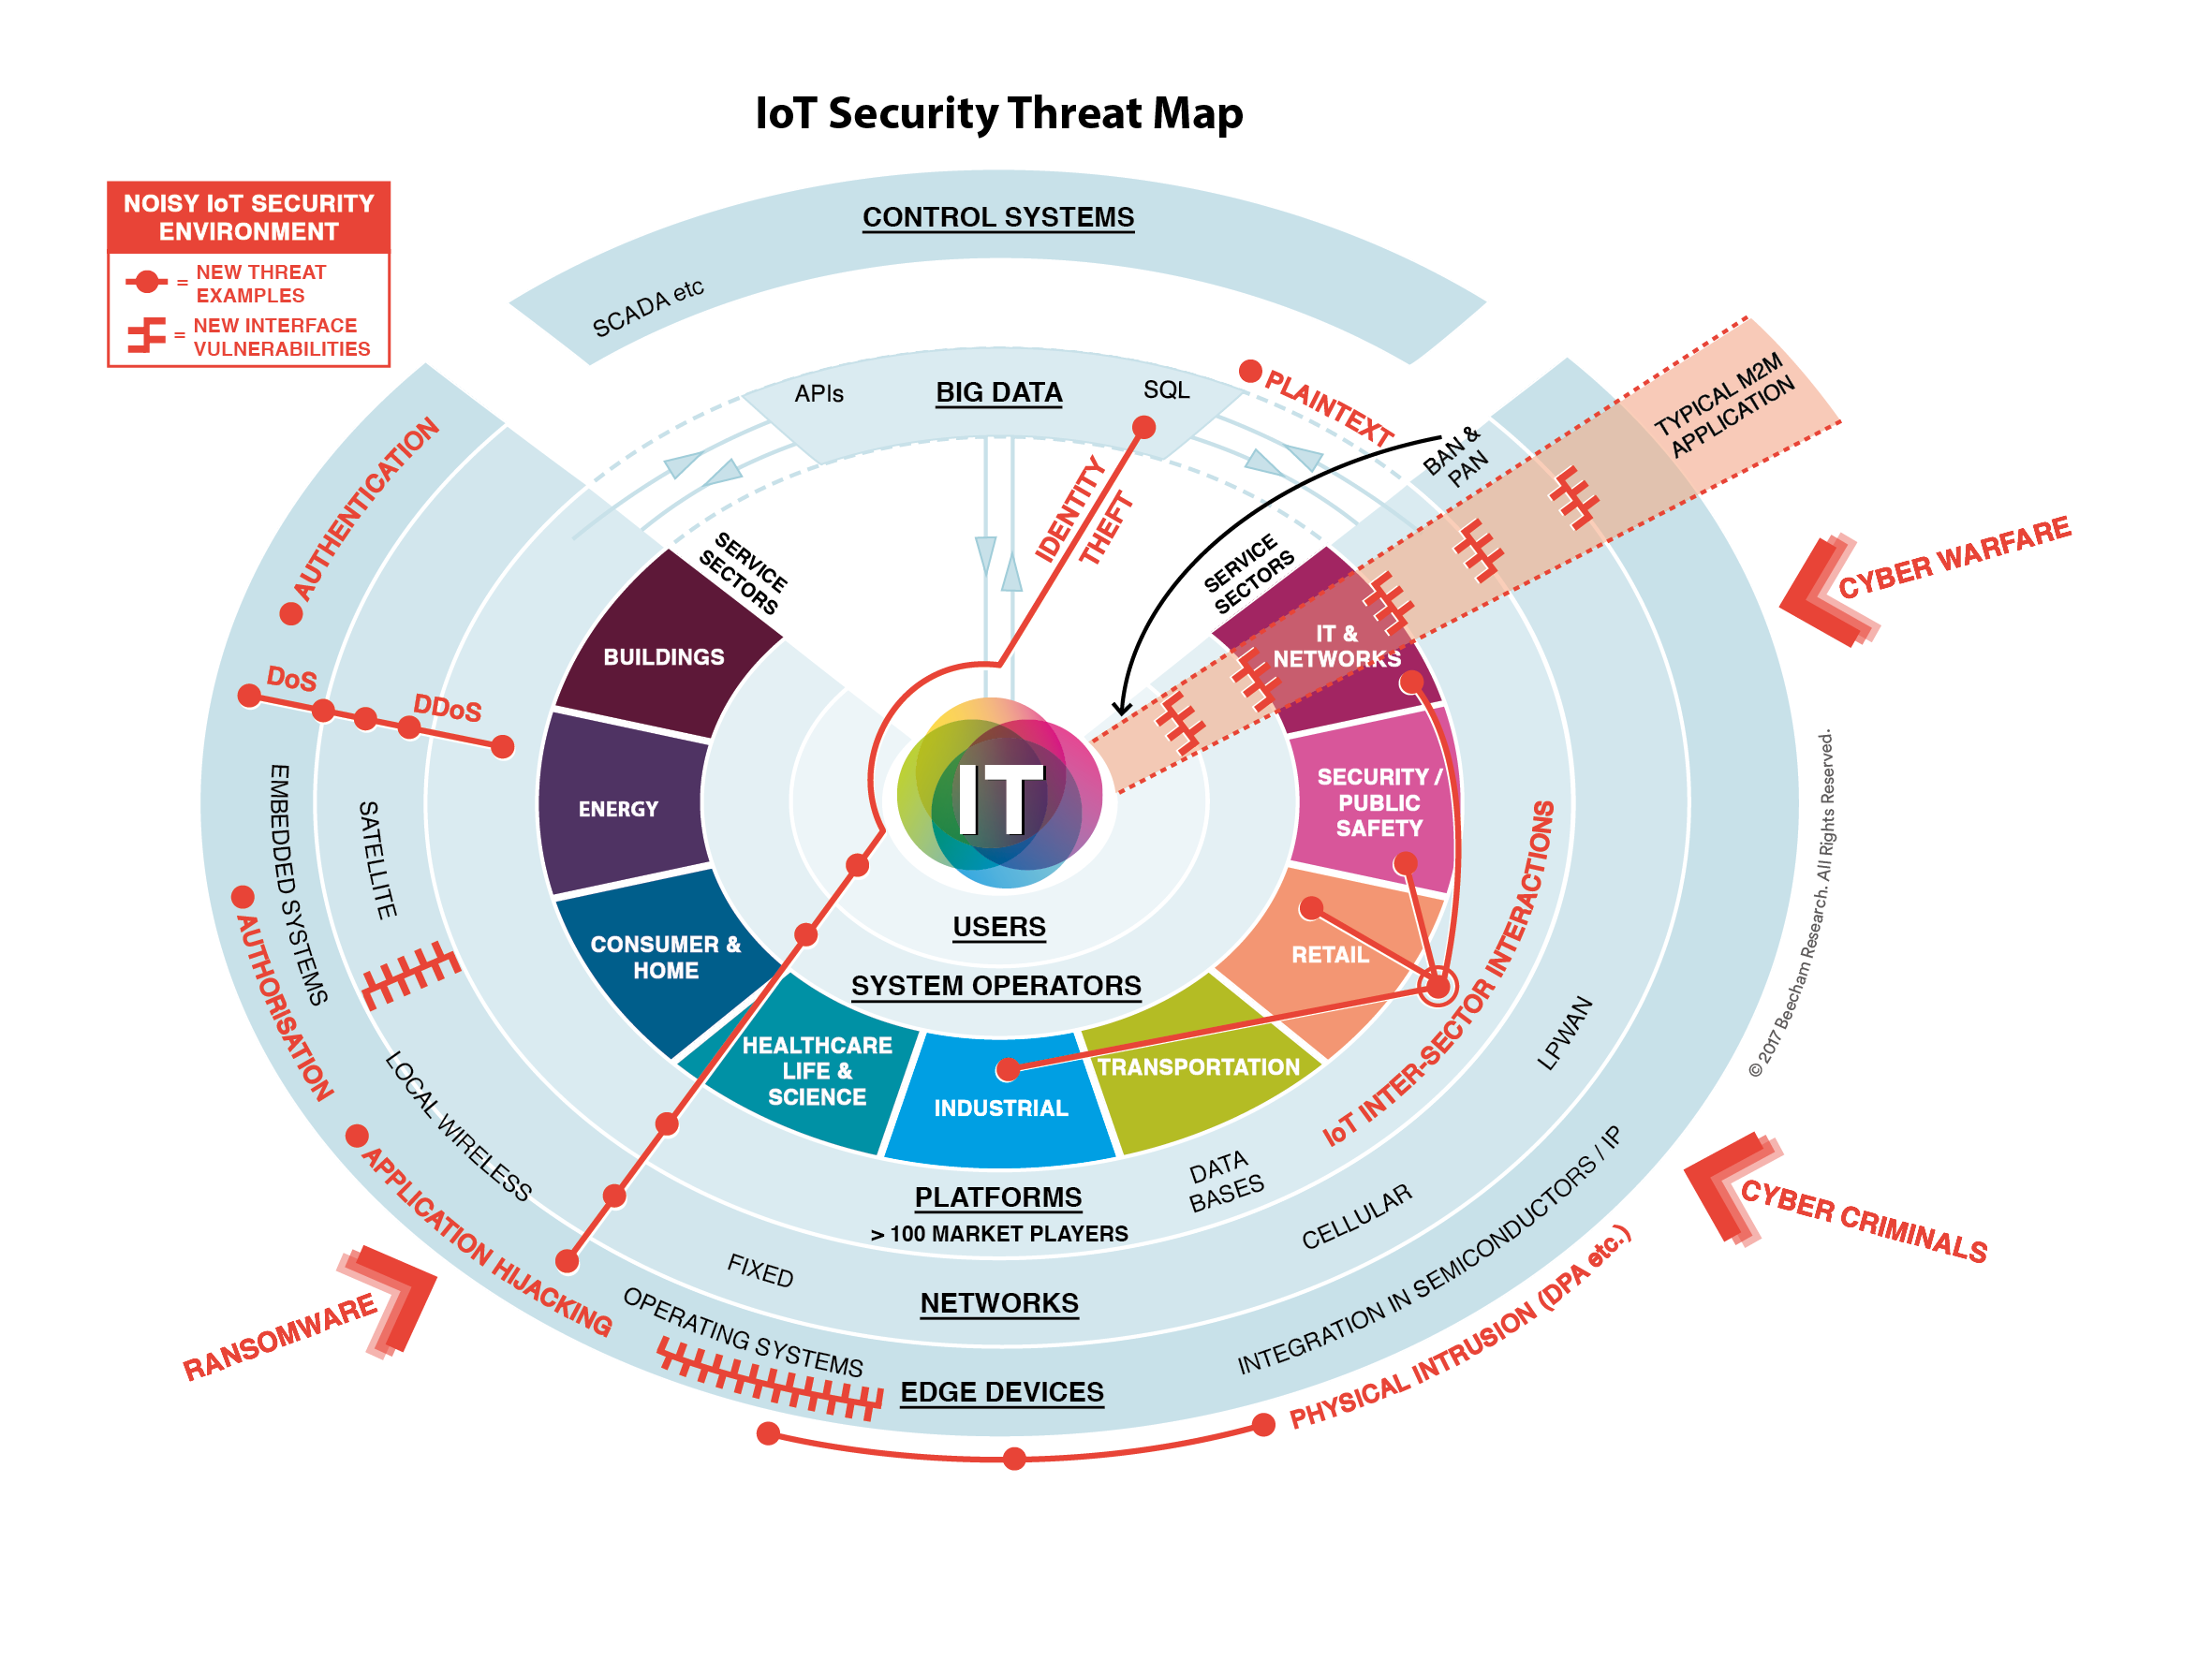
IoT Security Threat Map

Slide 46

IoT Contributes to the Threat Landscape
"In 2016, there were 11 billion devices connected to the Internet, with an expansion to 30 billion
by 2020."
— IDC estimate

Slide 47
The Dyn Attack
"Security by design is a mandatory prerequisite to securing the IoT macrocosm … the Dyn attack was just a practice run."
— James Scott, Sr. Fellow, Institute for Critical Infrastructure Technology

Slide 48
Why IoT Is Lacking Fundamental Security
Lack of industry knowledge
Rapid time to market
Lack of developer knowledge
Requirements analysis
Design
Implementation
Testing
Evolution

Slide 49

Societal Impact (Slide 1 of 3)
Technology has potential to disrupt and change the way things are done.
  May provide benefits as well as harm.
  May affect different people differently
  May have unintended side effects.

Slide 50
Societal Impact (Slide 2 of 3)
What is the potential impact IoT has on an organization and people?
  Machines can efficiently perform tasks that are dangerous, risky, or mundane.
  Eliminating jobs may have a significant negative impact on entire families for years.

Slide 51
Societal Impact (Slide 3 of 3)
What is the potential impact IoT has on the environment?
  Reduce manufacturing waste and the use of natural resources and may significantly help to reduce pollution of the environment.
  There are significant environmental costs for technology.

Slide 52

Organizational Skills Impact
New skillsets for IT staff:
  Embedded devices.
  Sensors and actuators.
  Real-time data processing and networking.
  Edge computing.
  New methos of data processing and analysis.

Slide 53
Activity: Identifying Potential Challenges of IoT (Slide 1 of 2)
What challenges might your organization encounter in implementing an IoT solution?

Slide 54
Activity: Identifying Potential Challenges of IoT (Slide 2 of 2)
How might you address the challenges you identified?

Slide 55
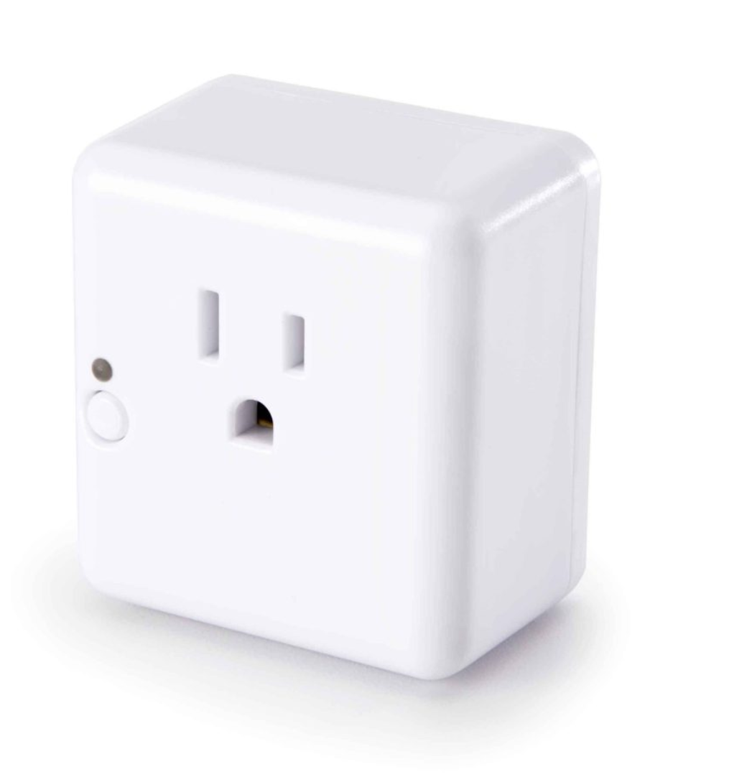

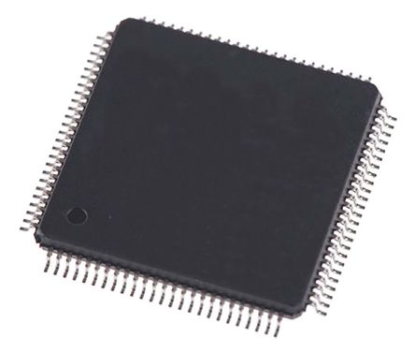
IoT Devices—Common Features
Local Control
Example: Switches on the device enable user to turn it on or off directly and to start Wi-Fi configuration routine.
Local Outputs
Example: LED on the device changes color to show on/off status and when it enters configuration mode.
Remote Control
Example: Switches power on or off through remote app or “smart home” voice-controlled speakers.
Remote Sensing
Example: Sensors in the device monitor power usage and conditions such as overheating and overcurrent.
Connected
Example: Connects to cloud through Wi-Fi to send sensor data and device status and receive commands from apps.
Smart
Example: Onboard microcontroller monitors sensors, controls switching, and communicates with cloud servers.

Slide 56





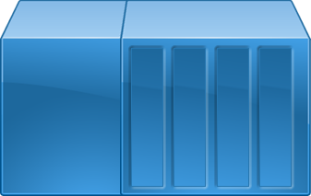


Industrial Controllers
IT Network
Production Network
Remote Network
Management PC
Engineering PC
DCS
Operator PC
Terminal
PLC
Controllers
RTU
Actuators and Sensors
Field Devices
Actuators and Sensors

Slide 57

Key Takeaways
IoT can transform both old and new businesses.
How well you both understand and apply both IoT and your industry domain knowledge before you dive in will determine, to a large extent, how successful your path will be.

