Slide 1

Undertaking an IoT Project

Slide 2
Undertaking an IoT Project
Real-World Applications for IoT
The IoT Development Lifecycle

Slide 3
Real-World Applications for IoT

Slide 4
IoT Market Sectors
Source: IoT Analytics (2018)

Slide 5

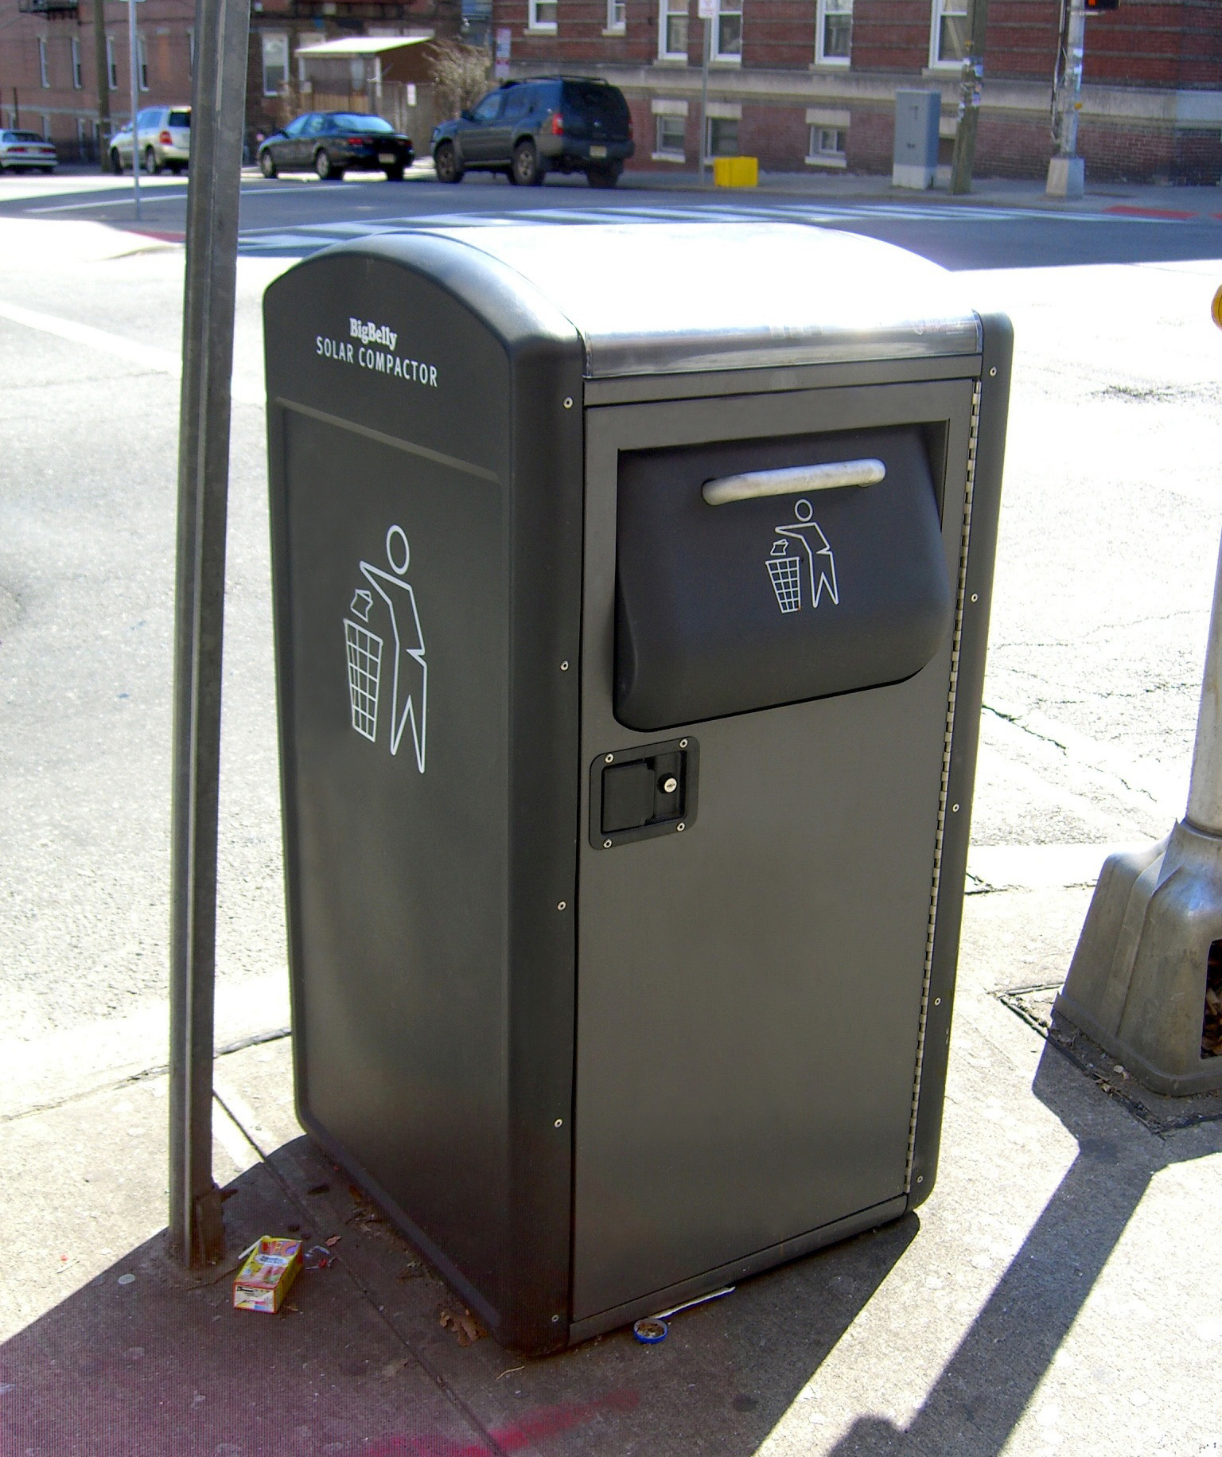


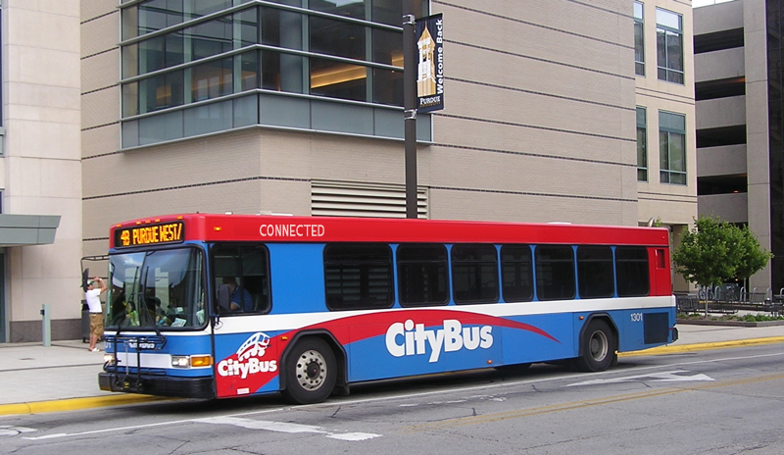
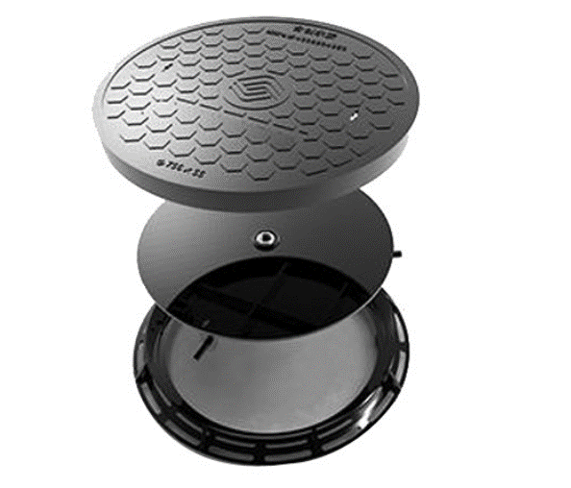
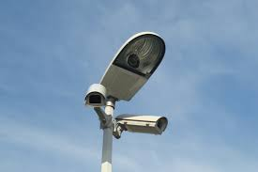


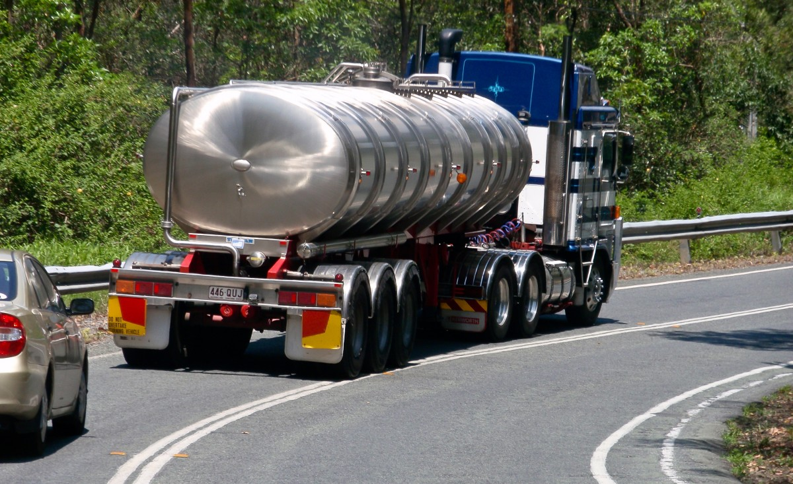
Smart City
Garbage and Waste
Lighting
Streets and Traffic
Connected Vehicles
Connected Manhole Covers
Cameras
Public Transportation
Air Quality
Hazardous Materials

Slide 6

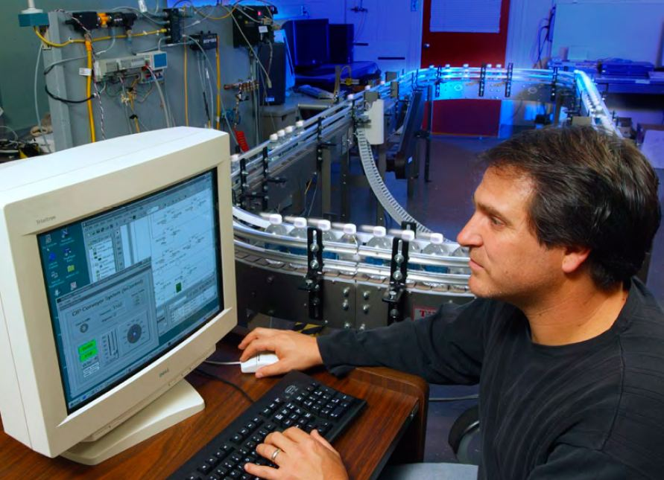
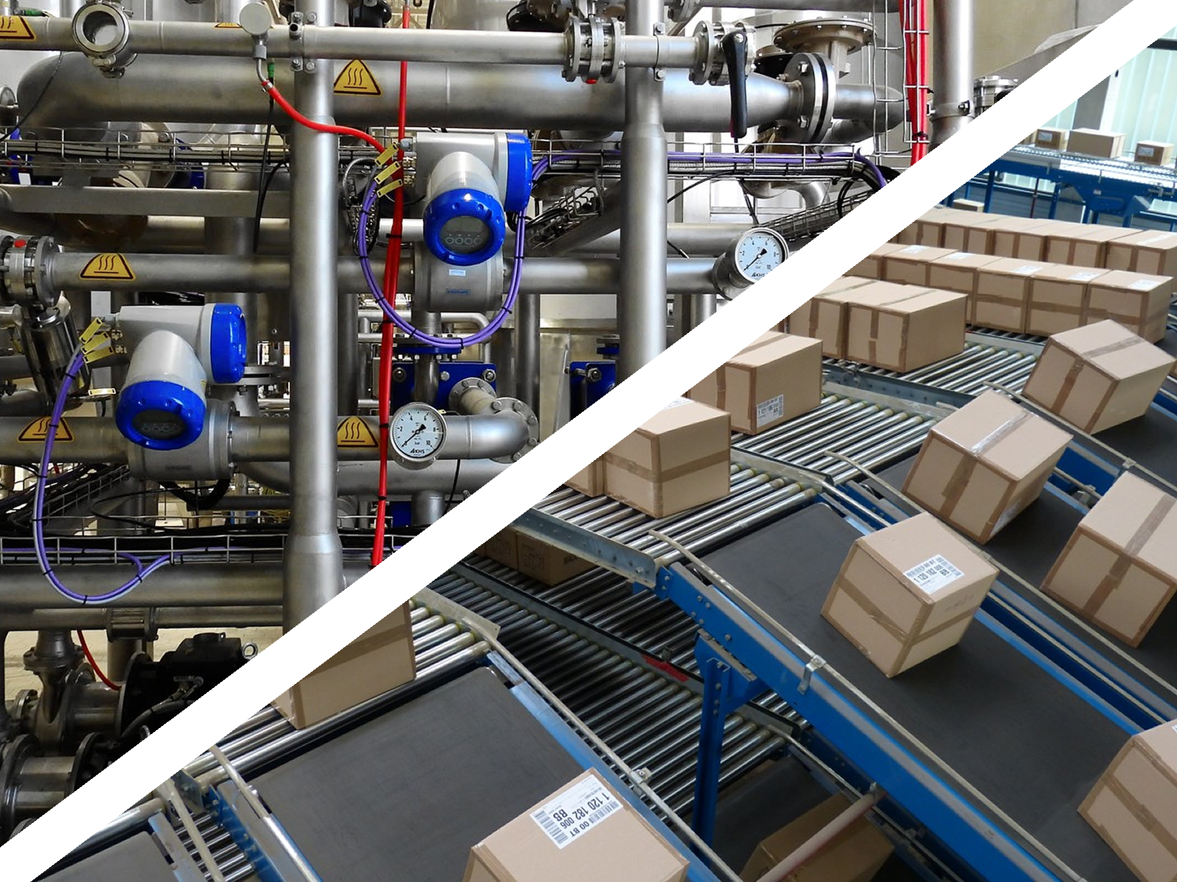
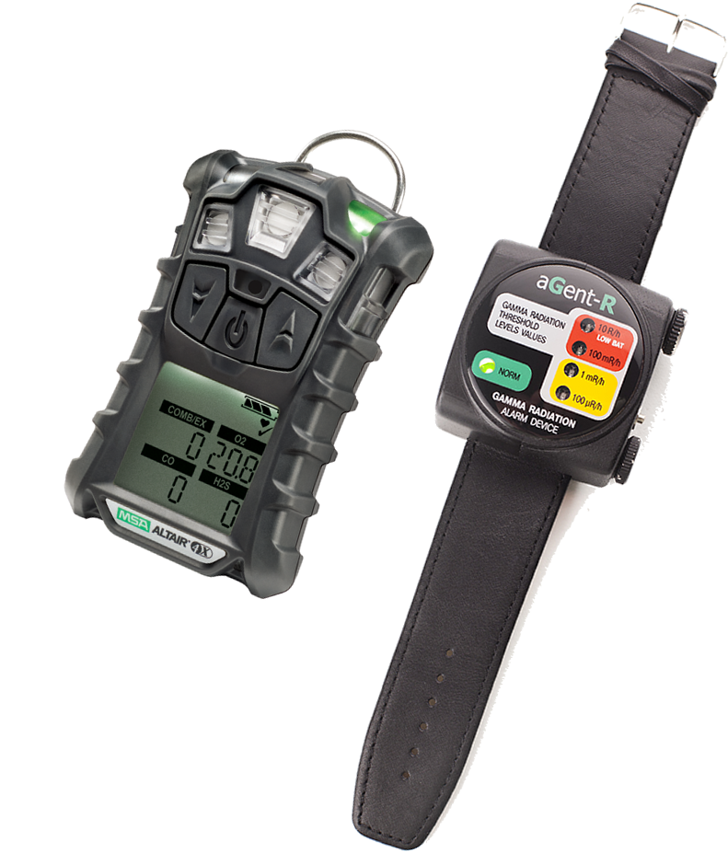

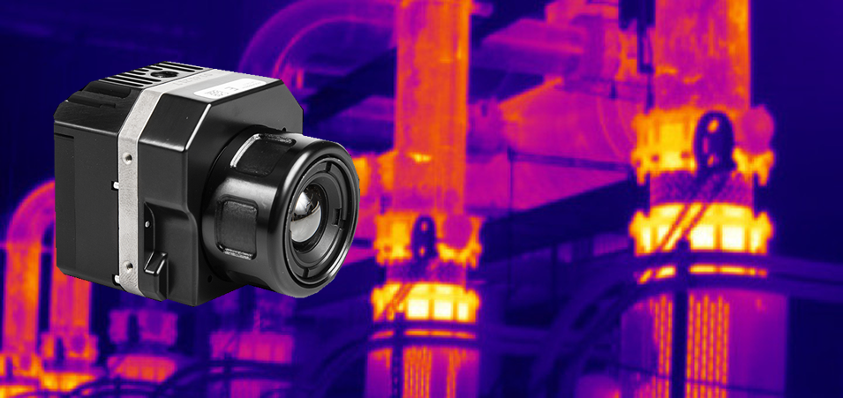

Industry
Industrial Control Systems
Transportation and Distribution
Wearables
Environment
Inspection and Quality
Maintenance

Slide 7

Smart Buildings
Building Traffic
Occupants
Safety and Security
Building Infrastructure

Slide 8
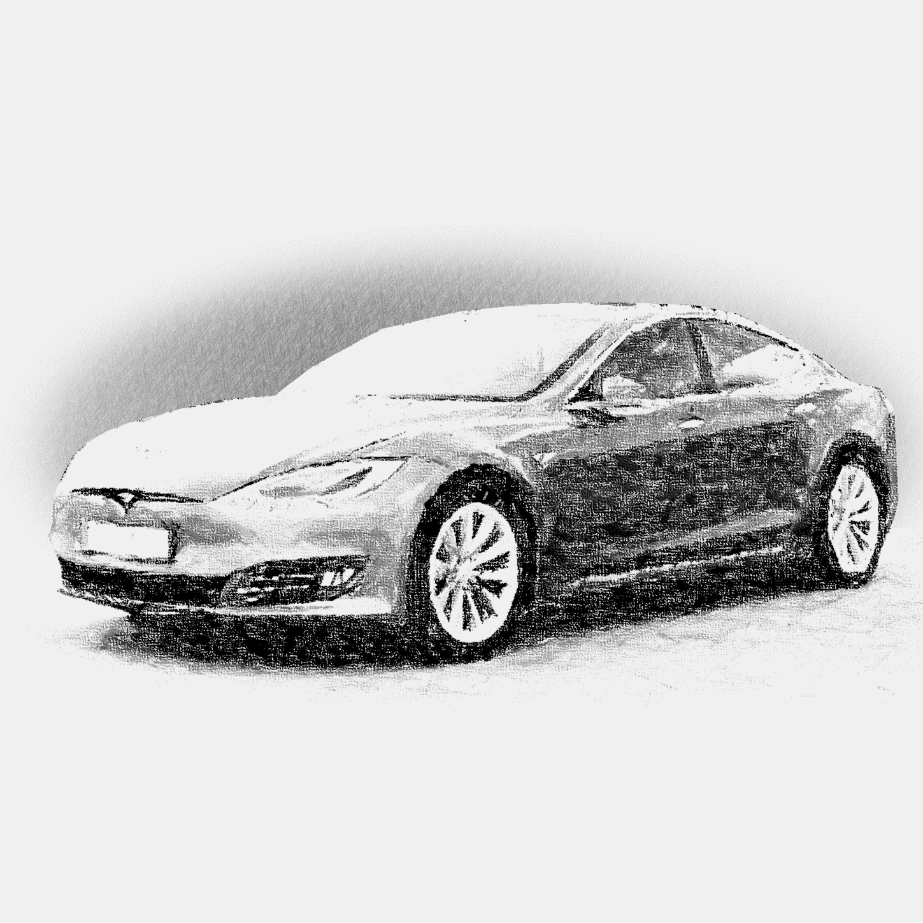
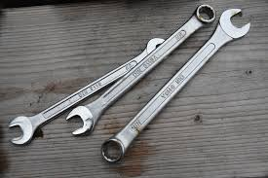
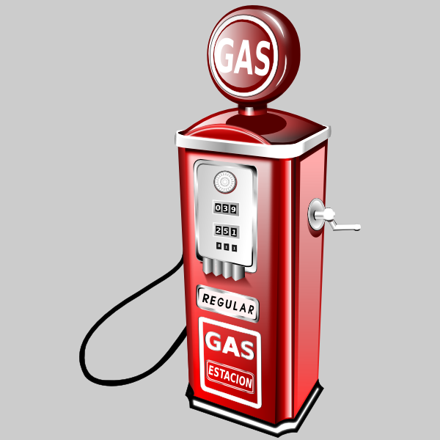
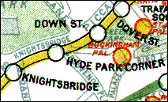


Connected Cars
Maintenance
Economy and Environmental Impact
Navigation
Safety and Security
Comfort and Convenience

Slide 9
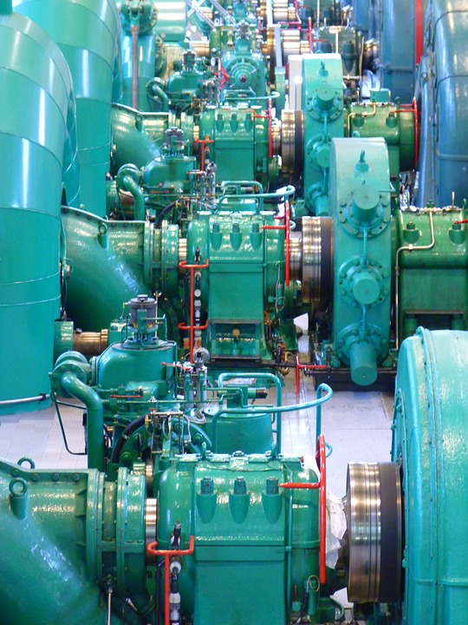

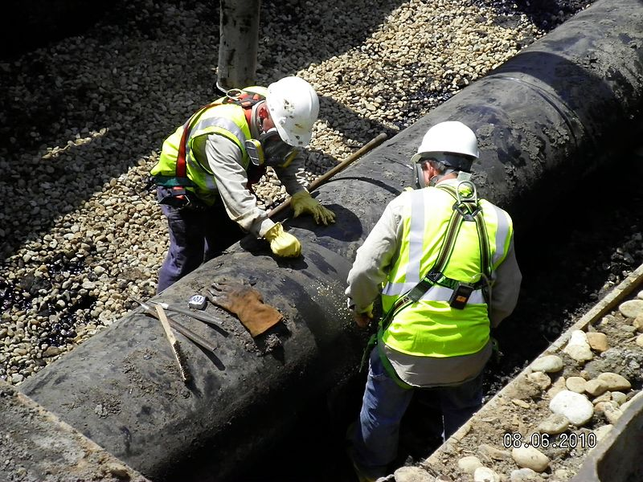

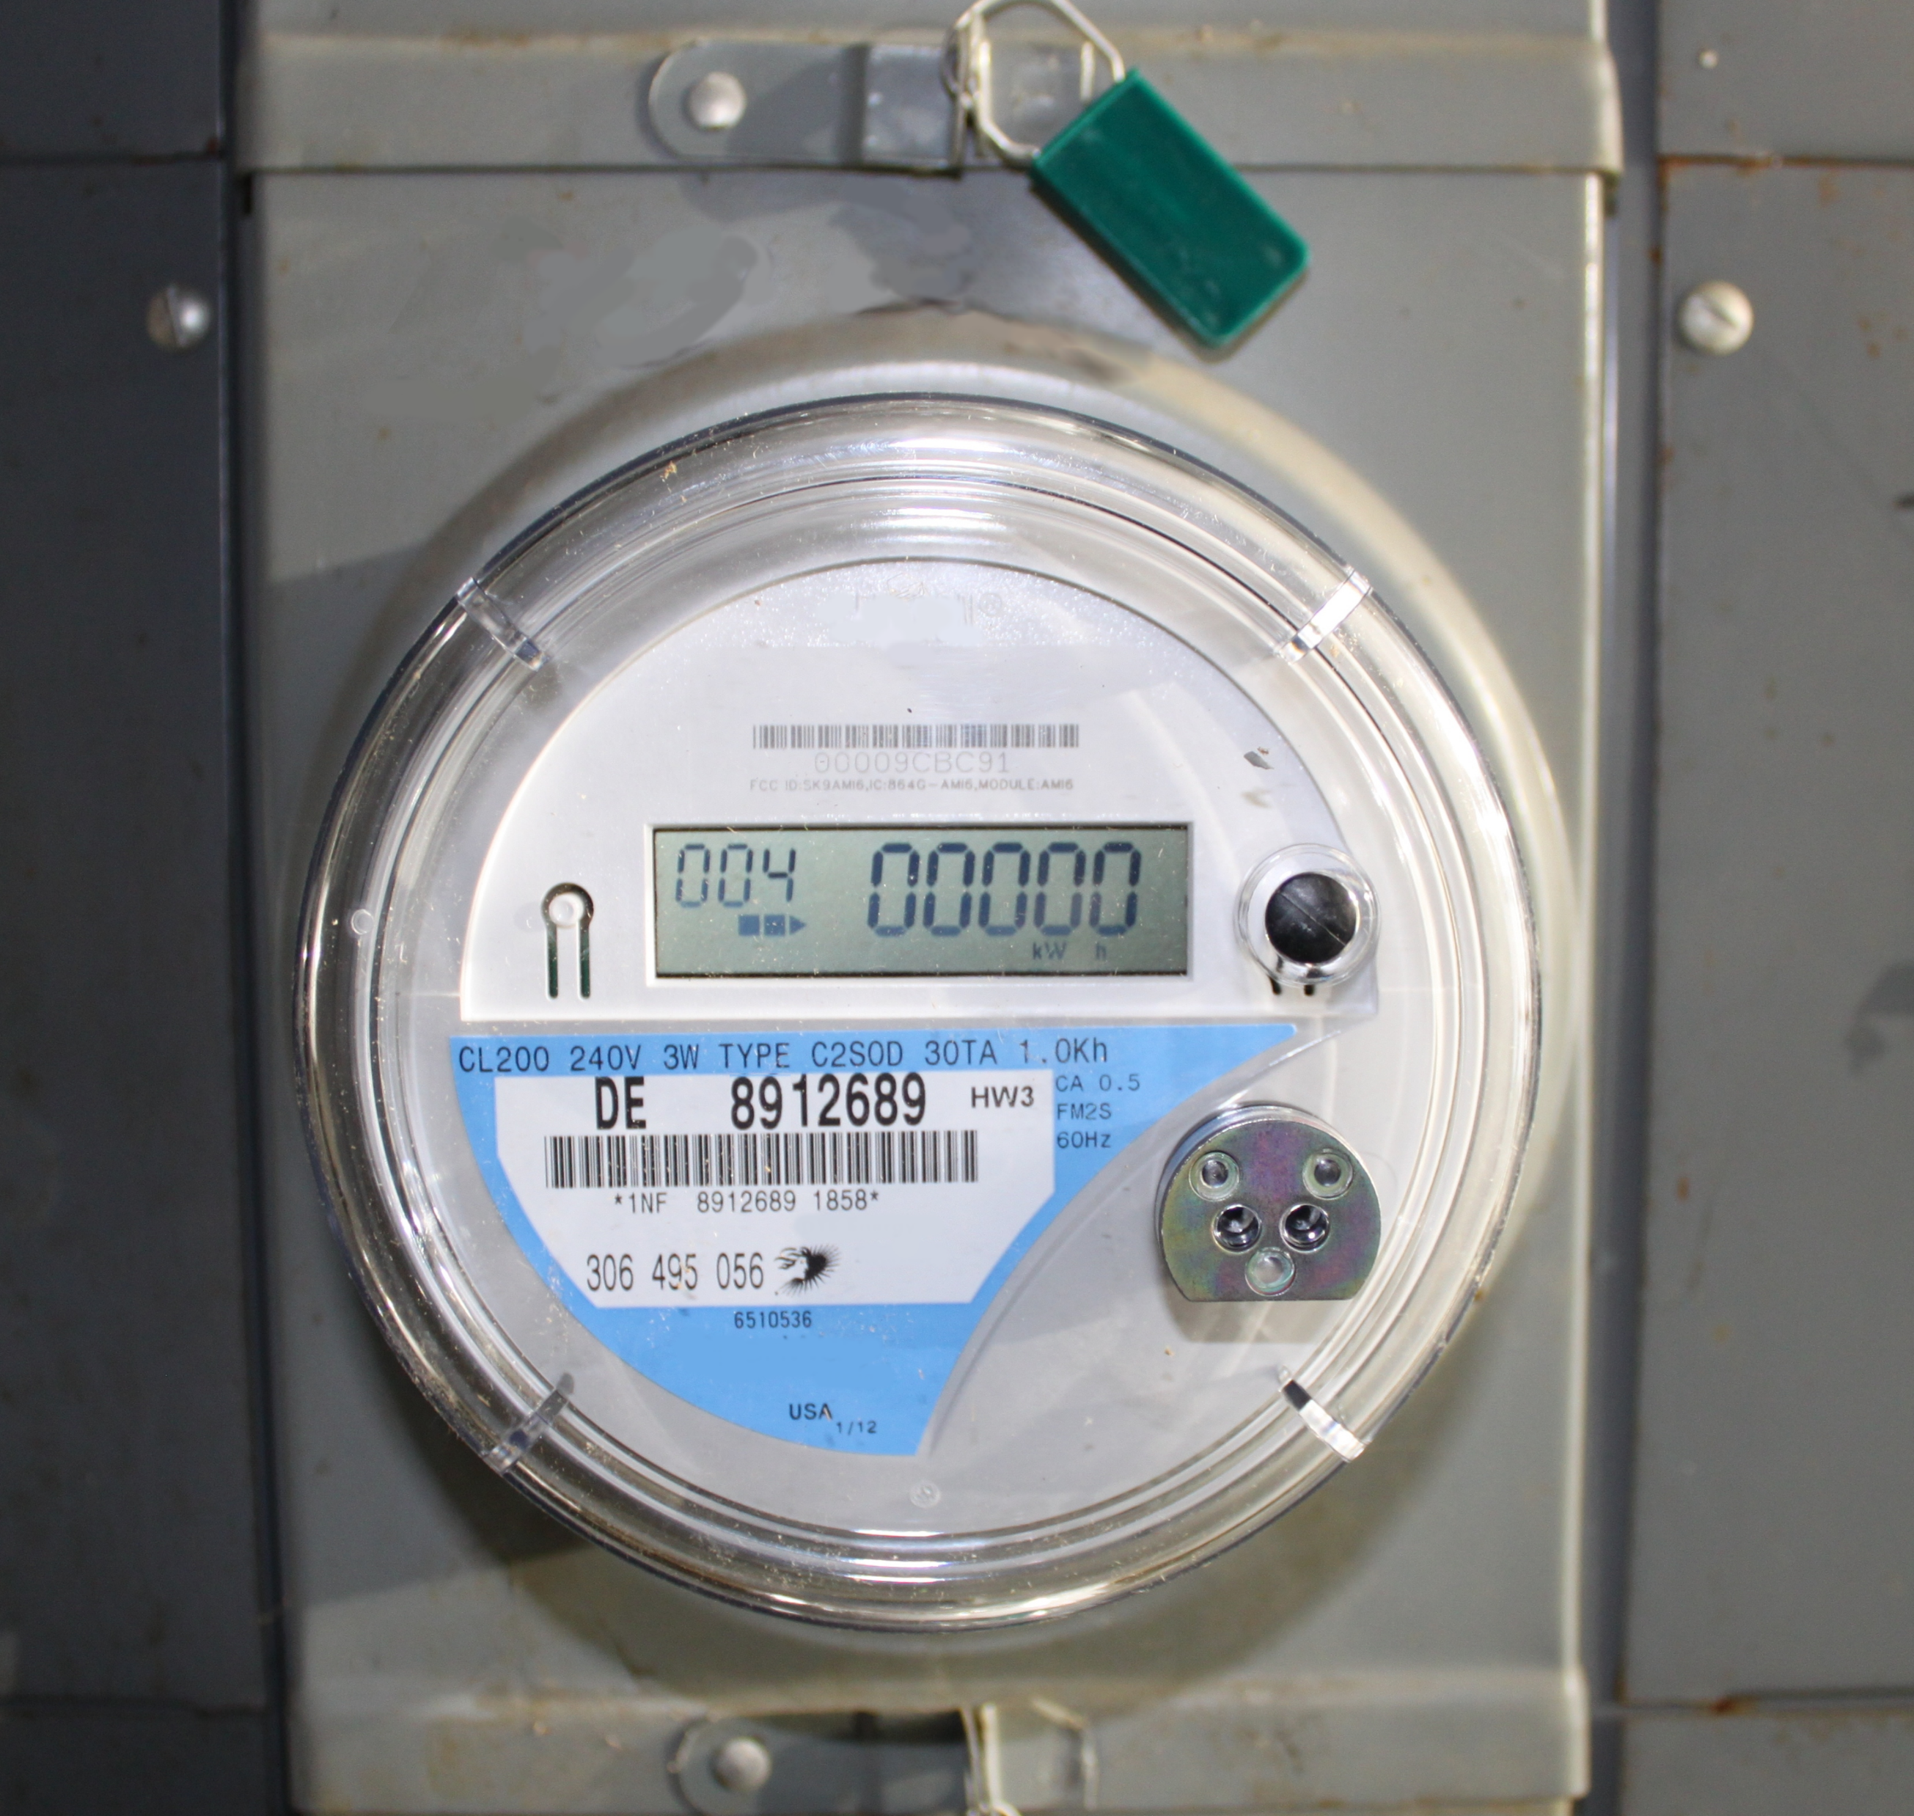

Energy and Utilities
Energy Sources
Inspection and Predictive Maintenance
Distribution and Delivery
Customer Service
and Billing
Safety, Security,
and Environment

Slide 10

Health, Medical, and Life Science
Personal Health and Welfare
Medical Devices
Hospital Logistics
Medical Services

Slide 11

Supply Chain
Monitoring Shipping Conditions
Managing Inventory
Tracking Shipments
Telematics

Slide 12







Agriculture
Crops and Livestock
Soil and Environment
Equipment
Irrigation
Drainage and Waste

Slide 13
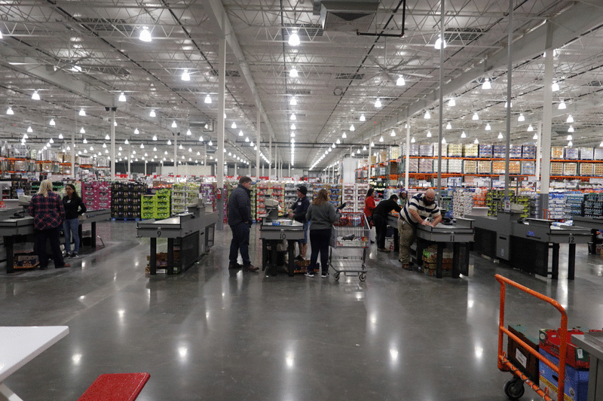



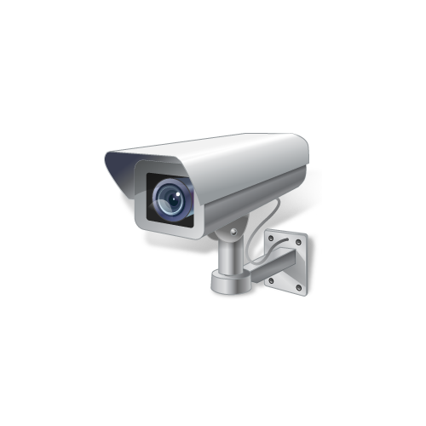

Retail
Inventory Management and Distribution
Customer Traffic and Presence
Advertising
Security
Vending and Payment

Slide 14

Defense
Matériel
Connected Warfighter
Logistics

Slide 15
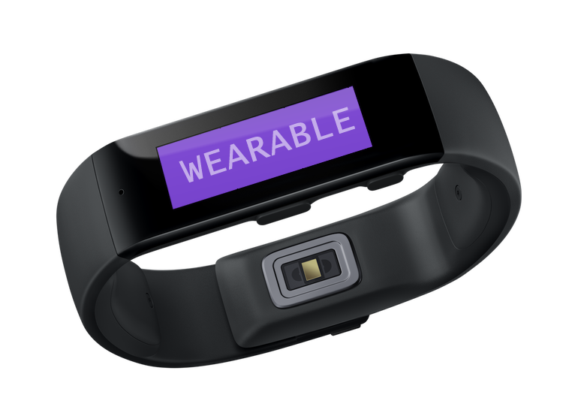
Connected Services (Slide 1 of 2)
Connected devices maintain connection between manufacturer and customer.
Customers must see benefits in allowing such a connection.
Help to:
  Establish relationship with customers.
  Provide more value to customers.
  Enable companies to learn more about customers.
  Make improvements to products/services over time.

Slide 16
Connected Services (Slide 2 of 2)
Fitness watch features:
  Dashboard for viewing data collected by watch.
  Social networking with other watch users.
  Access to an app store.
  Exercise recommendations.
  Ability to view watch data on other devices.

Slide 17

Identify Goals for an IoT Implementation
Look for opportunities to:
  Improve decision making.
  Understand customers better.
  Deliver new value to customers.
  Make operations more efficient and effective.
  Reduce adverse impact on the environment.
  Improve bottom line and increase business value.

Slide 18
Identify Areas Where IoT Can Improve Your Business
Can we obtain real-time data that would help us respond faster or better?
Would it help if we could accomplish work in remote locations with less intervention?
Would it help to collect and analyze data about any of the following?
  Location and status of raw materials.
  Operations performed.
  Equipment, assets, and inventory.
  How operations impact environment.
  How customers interact with products.
  Customer shopping behavior.

Slide 19
Use Models to Design a Solution
Use a good reference architecture as a general model for your own projects, such as:
  IEEE P2413.2 Standard for a Reference Architecture for Power Distribution IoT (PDIoT)
  Industrial Internet Reference Architecture (IIRA)

Slide 20
Use Vendor References to Guide Your Design
Take time to learn practices vendors recommend for their platform.
Example vendor-specific guides include:
  AWS Pragma architecture
  IBM IoT reference architecture
  Intel IoT platform reference architecture
  Microsoft Azure IoT reference architecture

Slide 21
Activity: Using IoT to Solve Problems (Slide 1 of 2)
Best Elevators company:
  Has a reputation for high quality and dependable customer service.
  Is subject to increasing competition in its market.
  Is constantly at risk of losing market share to competitors.

Slide 22
Activity: Using IoT to Solve Problems (Slide 2 of 2)
Areas the company wants to improve:
  Increase customer loyalty.
  Improve service maintenance and predictive maintenance.
  Manage spare-parts inventory more efficiently.
  Improve product design and technician training.
  Improve uptime and field service efficiency.
  Allocate scarce service technicians more efficiently.
  Communicate more effectively with suppliers.

Slide 23
The IoT Development Lifecycle

Slide 24

Complexity of IoT Projects
Many IoT projects don't get past POC stage.
IoT projects are often complex.
Requires new strategies and approaches.
Significant risks involved.

Slide 25
The IoT Development Lifecycle
IoT Lifecycle
Integrate and Test
Develop
Design
Implement
Operate and Maintain
Dispose
Initiate
Plan
Analyze Requirements

Slide 26

Return on Investment
Significant challenge for IoT projects.
Can be difficult to estimate:
  Benefits to business.
  Cost (network design, cybersecurity, aggregating data, etc.).

Slide 27

Focus on Business Goals
IoT projects have seen success.
IoT projects can be transformative.
Don't be tempted by hype.
Don't try to shoehorn IoT into the business.
Focus on specific problems you need to address.
Consider how IoT can address problems.

Slide 28
Cybersecurity Throughout the IoT Lifecycle
IoT Lifecycle
Integrate and Test
Develop
Design
Implement
Operate and Maintain
Dispose
Initiate
Plan
Analyze Requirements
How do I ensure no security/privacy problems are created when components are retired or uninstalled?
How do I identify security requirements?
How do I design for security?
How do I monitor how security is affected by updates in other software and services?
What steps can I take to harden my code against attacks?
How do I plan, develop, and release security updates?
How do I keep my software protected as new vulnerabilities are found?
How do I test security during unit and integration testing?

Slide 29
Prepare for an IoT Initiative
To prepare for an IoT initiative:
  Understand the organization's current state.
  Perform pilot projects and experimentation.
  Manage change and corporate culture.

Slide 30
Follow Best Practices for IoT Development (Slide 1 of 2)
To ensure success in your IoT projects:
  Work with project stakeholders to define business goals.
  Build security and privacy into every phase of development.
  Employ a dedicated IoT architect.
  Update skillsets and job descriptions as needed.
  Include various business groups when planning the target architecture.

Slide 31
Follow Best Practices for IoT Development (Slide 2 of 2)
To ensure success in your IoT projects:
  Appraise legacy infrastructure.
  Appraise the organization's capabilities.
  Utilize resources from various business groups.
  Provide training to staff as needed.
  Design the entire solution as a system.

Slide 32
Activity: Preparing for an IoT Initiative
Areas the company wants to improve:
  Increase customer loyalty.
  Improve service maintenance and predictive maintenance.
  Manage spare-parts inventory more efficiently.
  Improve product design and technician training.
  Improve uptime and field service efficiency.
  Allocate scarce service technicians more efficiently.
  Communicate more effectively with suppliers.

Slide 33
Increasing Customer Loyalty (Slide 1 of 2)
Establish closer relationship with customers.
Provide services to help customers meet their own needs.
Provide customers peace of mind they associate with Best Elevators.

Slide 34
Increasing Customer Loyalty (Slide 2 of 2)
Each elevator will come with services that include:
  Continuous monitoring of elevator safety and performance factors.
  Comprehensive data dashboards.
  Faster maintenance and repairs.
  Reduced elevator downtime.

Slide 35
Problems and IoT Solutions (Slide 1 of 4)
Improve service maintenance and predictive maintenance:
  Data collection from sensors and analytics to improve maintenance.
  Provides early-warning data and remote diagnostics.

Slide 36
Problems and IoT Solutions (Slide 2 of 4)
Manage spare parts more efficiently:
  Keep inventories in warehouses and service vehicles stocked.
  Supply side, track inventory using typical IoT devices.
  Demand side, monitor and analyze elevator equipment.
  Combine historical data of part failure rates with analytic algorithms.

Slide 37
Problems and IoT Solutions (Slide 3 of 4)
Improve training, improve service efficiency, and allocate technicians:
  Collect and analyze usage patterns over time.
  Use info to improve product design and technician training.

Slide 38
Problems and IoT Solutions (Slide 4 of 4)
Communicate more effectively with suppliers:
  Share insights gained through IoT with distributors and resellers.
  Share experience and knowledge with manufacturers.

Slide 39
Where does IoT have the greatest potential to benefit your organization?
What steps should your organization take to ensure its success in IoT projects?

