Slide 1

Data Science Fundamentals

Slide 2
Data Science Fundamentals
What Is Data Science?
Types of Data
The Data Science Lifecycle

Slide 3
What Is Data Science?

Slide 4
Data Science
Data science: The scientific study of data to gain knowledge.
Multiple disciplines
Data
Goals
Phases

Slide 5

The Elements of Data Science
Data Science
Data analysis
Data analytics
ML engineering
Data cleaning
Statistical analysis
Data engineering

Slide 6
Data Teams
Data team: A group of individuals involved in the strategic development, implementation, and management of business analytics technologies, processes, and the overall success of business analytics at the organization.
Data scientists
Data architects
Statisticians
Database administrators
Data engineers
Data analysts
ML engineer
Data-team manager

Slide 7
Required Skills and Knowledge
Mathematical Skills
Industry/Domain Knowledge
Computing Skills
Data scientists
Data architects
Statisticians
Database admins
Data engineers
Data analysts
ML engineers
Data scientists
Statisticians
Data analysts
Database admins
Data-team managers
Data Science

Slide 8
Data Analytics
Data analytics: The science of examining raw data to derive insights and conclusions that help businesses make better decisions or to verify or disprove existing models or theories.
Subset of required mathematical skills.
Four main types:
  Descriptive
  Diagnostic
  Predictive
  Prescriptive

Slide 9
Descriptive Analytics
Descriptive analytics: A form of data analytics that uses data to summarize past behaviors.
Any time in the past.
Answers the question "What has happened?"
Mathematical operations like summation and average.
  Total stock in inventory
  Averages sales by department
  Sales growth month over month
Use descriptive analytics when:
  You need a high-level understanding of what's going on in your company.
  You want to summarize and describe different aspects of your business.

Slide 10
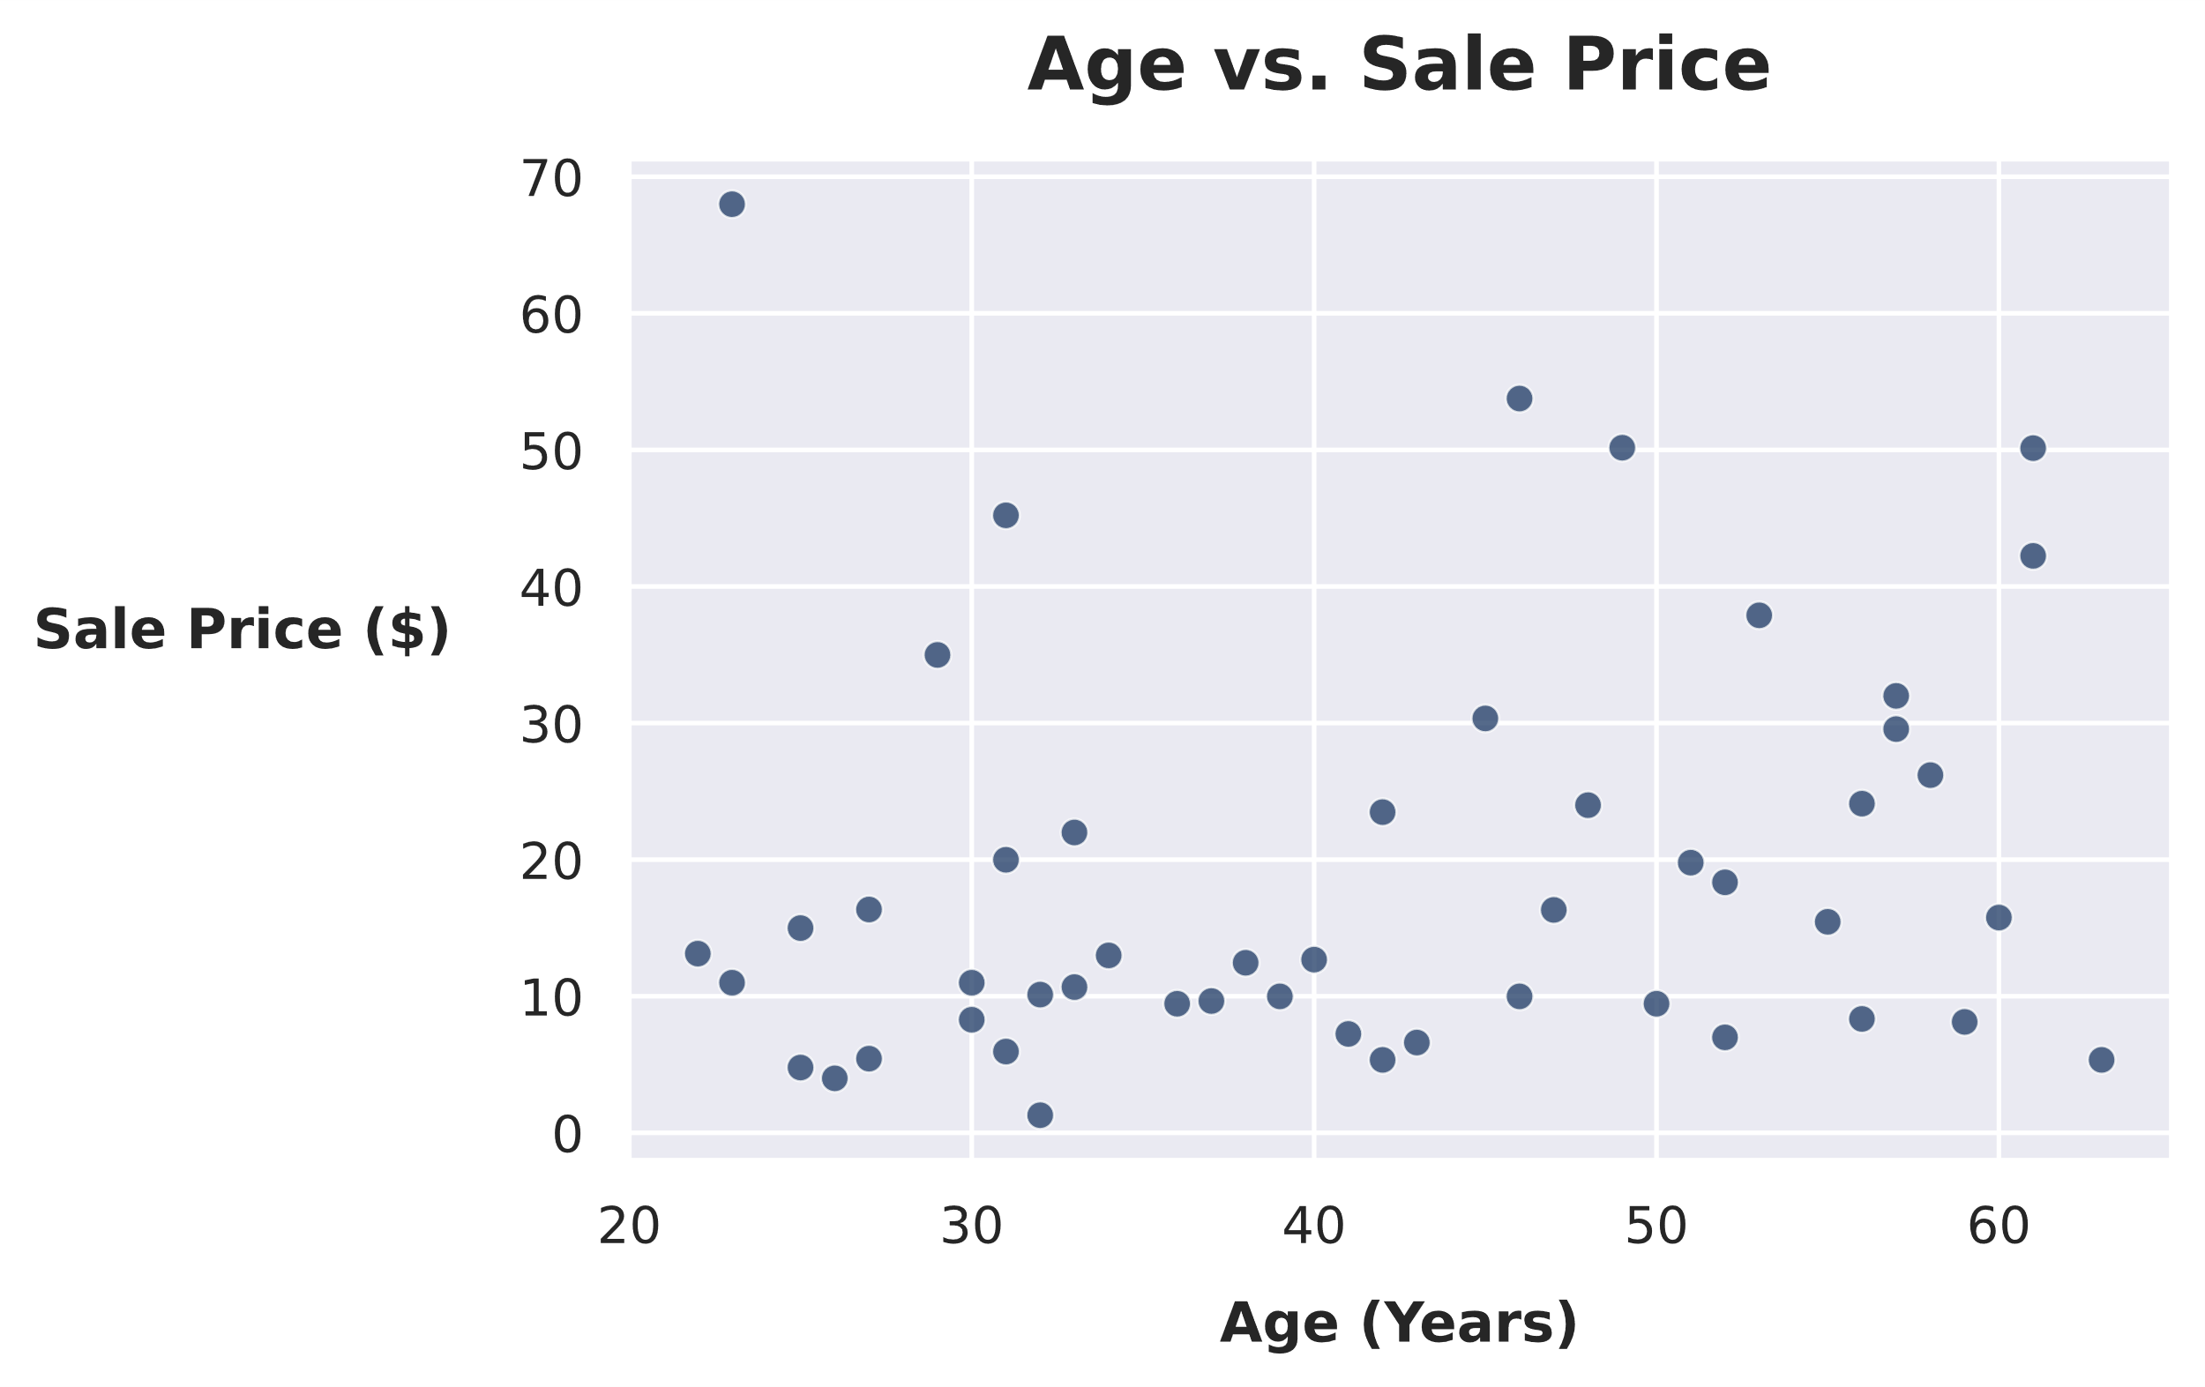
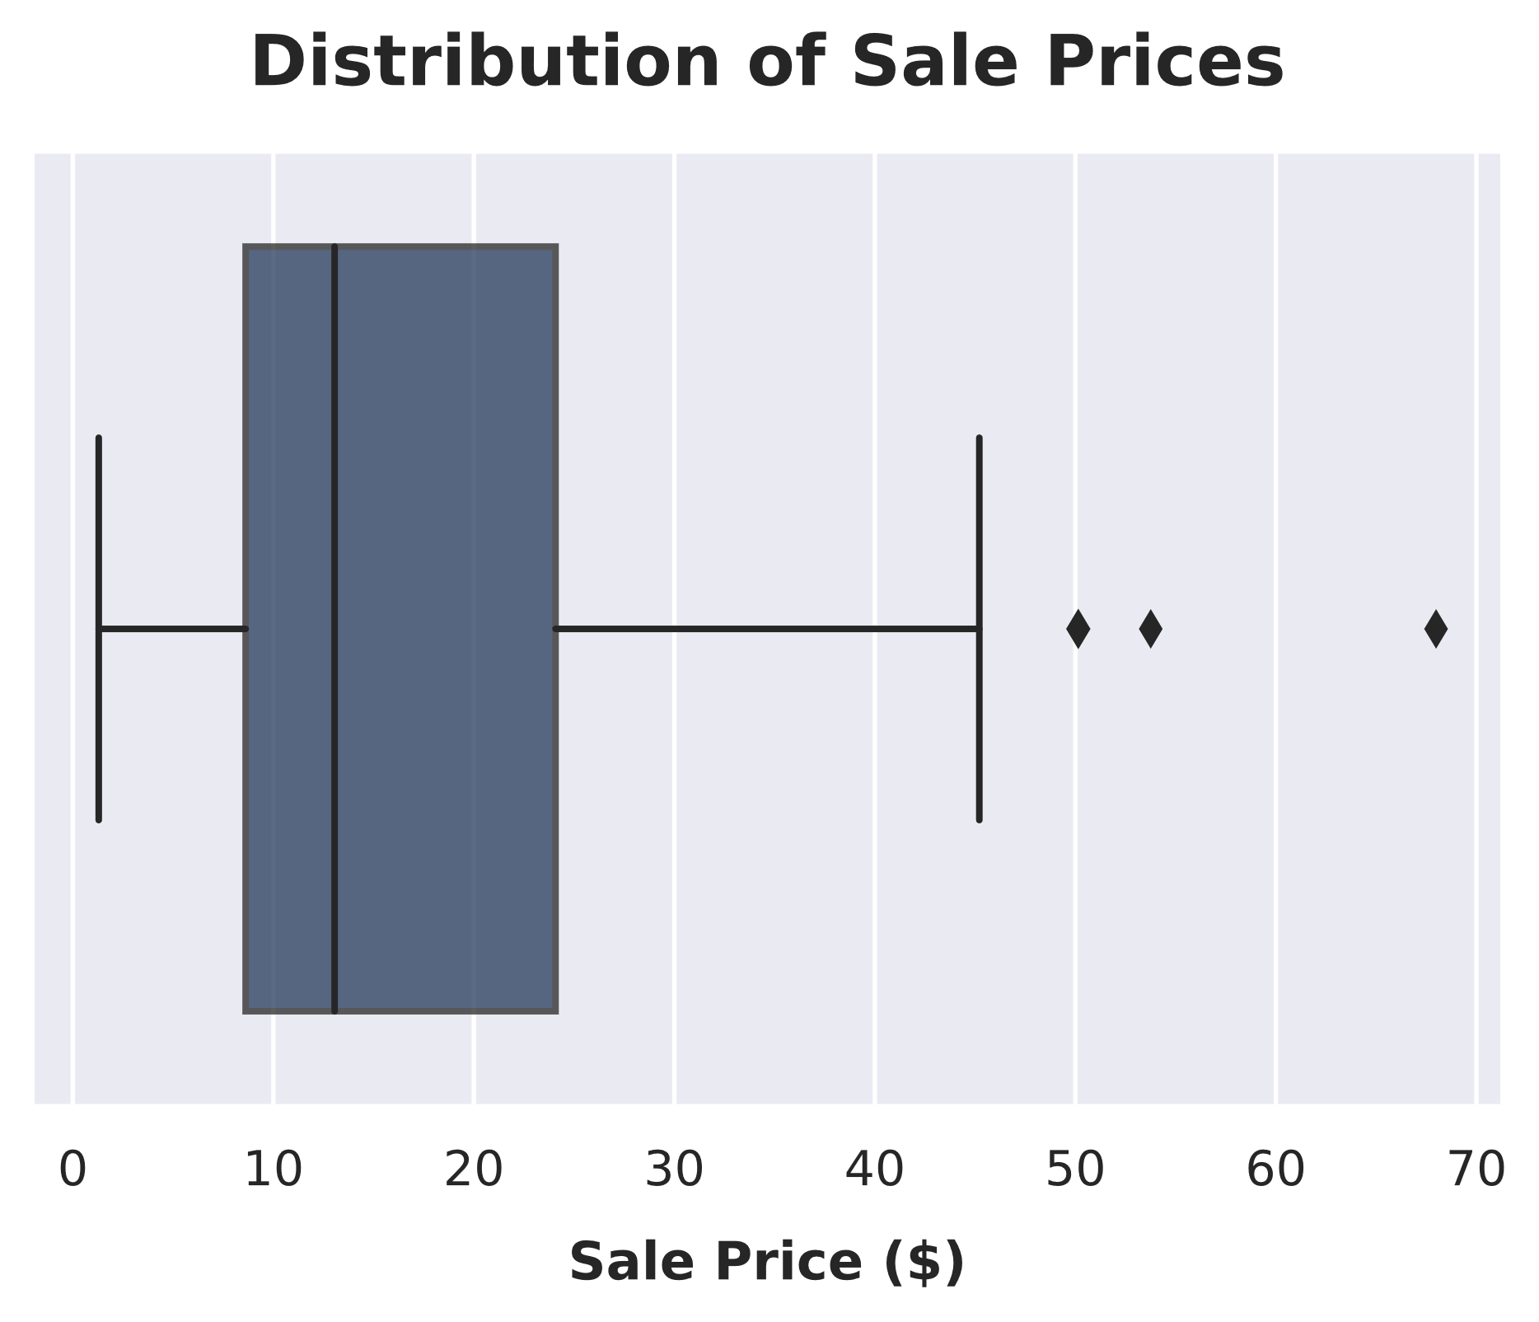
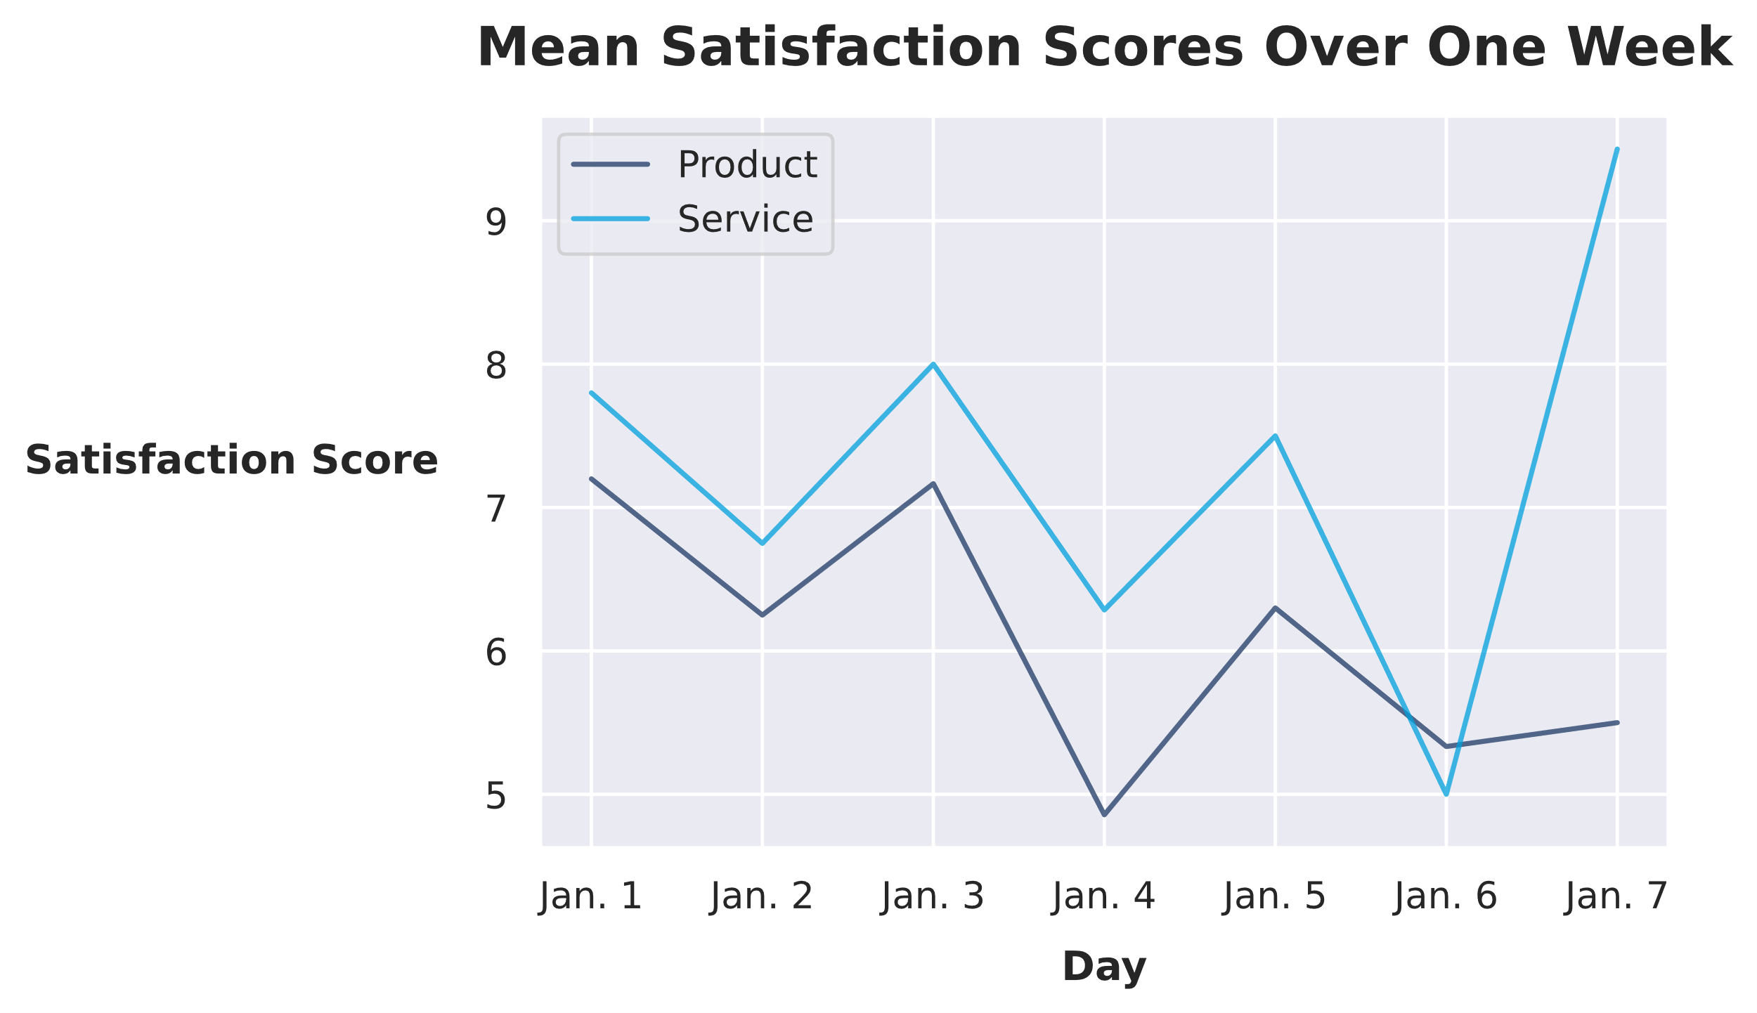
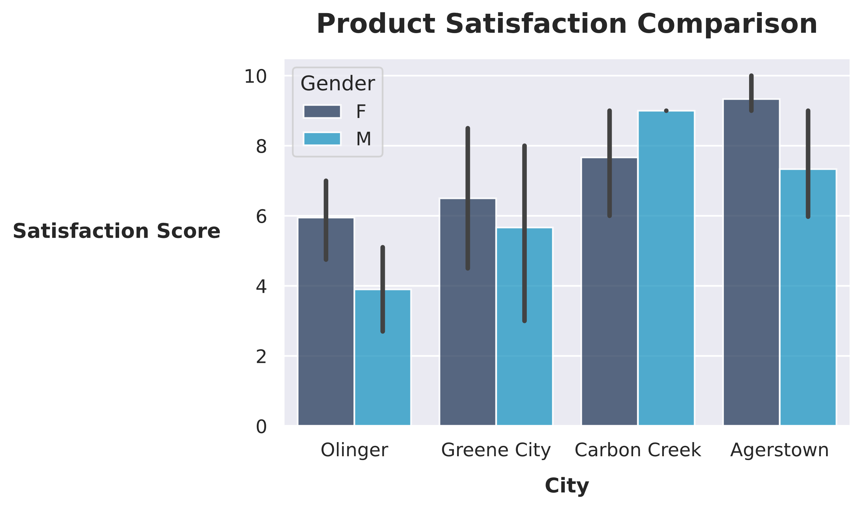
Types of Descriptive Analytics
Business intelligence (BI)
Data mining
Data visualization

Slide 11
Diagnostic Analytics
Diagnostic analytics: A form of data analytics that focuses on examining past data to identify the causes of specific events.
Goes beyond descriptive analytics.
Answers the question "Why did this happen?"
Examples:
  Analyzing market demand.
  Identifying reasons behind customer churn.

Slide 12



Types of Diagnostic Analytics
Identification of reasons for changes in market demand.
Explanation of customer behavior.
Identification of technology issues.
Event Log
Performance Analysis
Likely cause: Memory leak
Suggested fix: Close app.exe

Slide 13
Predictive Analytics
Predictive analytics: A form of data analytics that uses data to forecast future behaviors.
Estimation of future outcomes.
Answers the question "What could happen in the future?"
Commonly used in forecasting.

Slide 14
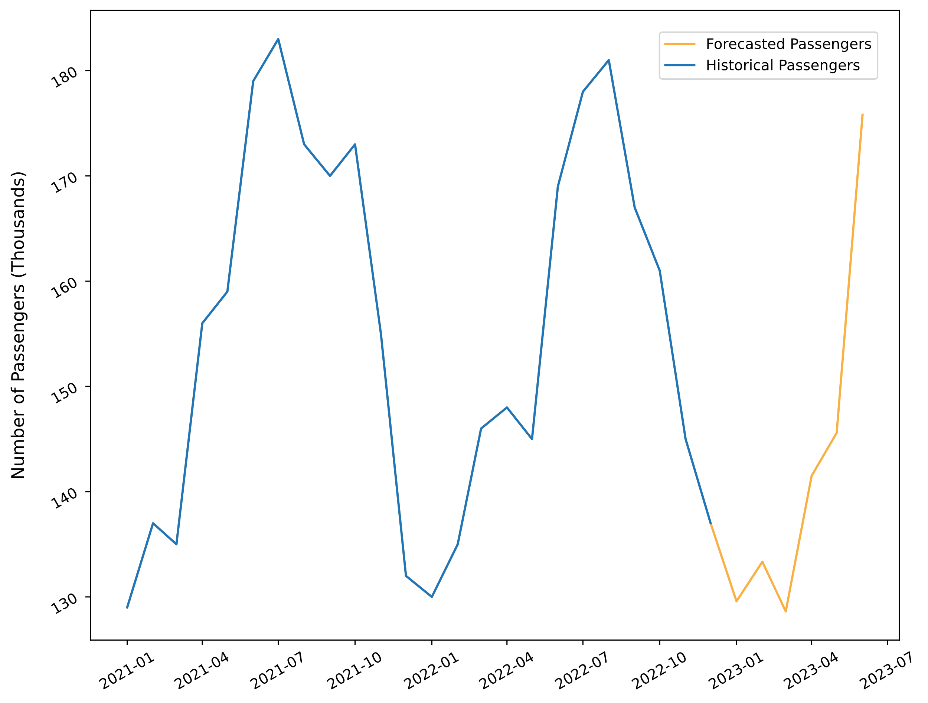
Types of Predictive Analytics
Predictive modeling
Root-cause analysis
Data mining
Pattern identification and alerts
Ride-Sharing Passengers

Slide 15
Prescriptive Analytics
Prescriptive analytics: A form of data analytics that uses data to predict multiple possible outcomes and then offers recommendations for actions based on those predictions.
A step beyond predictive analytics.
Answers the question "What should we do?"
Uses business rules, algorithms, ML, and computational modeling.
Data inputs:
  Historical data
  Transactional data
  Real-time data
  Big data

Slide 16




Types of Prescriptive Analytics
Simulation
Optimization

Slide 17
Statistical Analysis Concepts
Statistical modeling
Statistical inference
Hypothesis testing
Regression analysis
Linear regression
Correlation and causation
Sampling
Distribution of data

Slide 18
Related Concepts and Technologies
AI
Algorithms
Generative AI
ML and DL
Programming tools
APIs
Web scraping
BI

Slide 19
Pulling It All Together
Mathematical Skills
Industry/Domain Knowledge
Computing Skills
ML/DL
Data Science
Traditional Research
Traditional Analysis

Slide 20
Activity: Discussing Data Science and Related Technologies

Slide 21
Activity: Identifying Data Science Opportunities from a Dataset (Optional)

Slide 22
Types of Data

Slide 23
Big Data
Big data: Collections of data that are so large and complex that they require advanced tools to process and analyze them.
Volume
Velocity
Variety
Veracity
Validity
Volatility

Slide 24
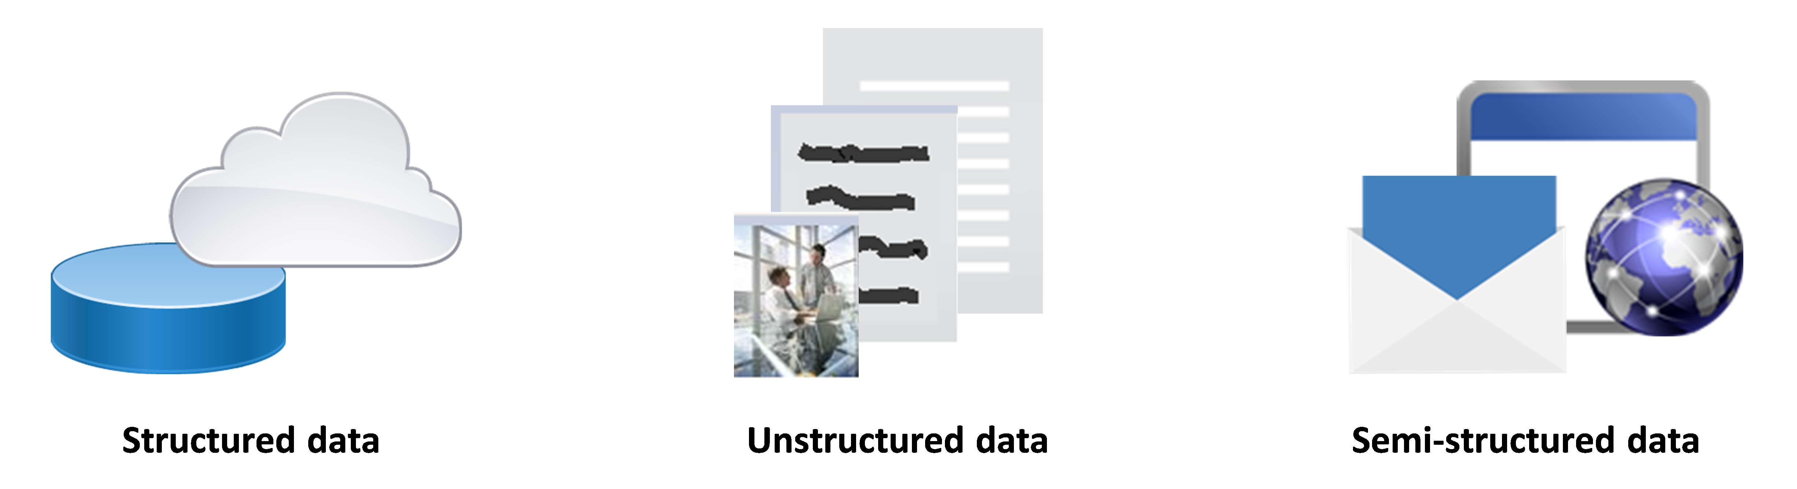
Structured, Unstructured, and Semi-Structured Data
Contains elements that are easily accessible for effective analysis.
Is not organized in an established manner and does not conform to a data model.
Data stored outside a relational database that has characteristics that support analysis.

Slide 25
Open and Proprietary Data
Open data:
  Freely available for use.
  Can be shared or built on by anyone for any reason.
  Should be legally and technically open.
Proprietary data:
  Owned/controlled by an individual, organization, or group.
  Protected by copyright, patent, or trade-secret legislation.

Slide 26


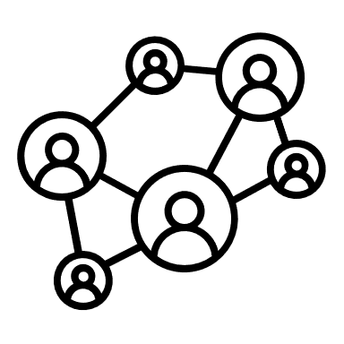
Data Sources
Data can come from numerous sources.
It can be difficult to ascertain the veracity of each dataset.
Categories:
  Transactional data
  Machine data
  Social data
Transactional
Machine
Social

Slide 27



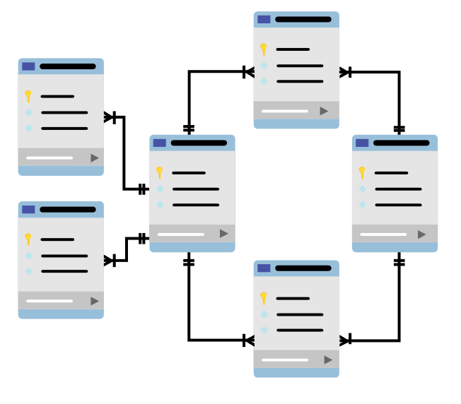

Data Repositories
Data Lake
Data Warehouse
Data Mart
DEV
SALES
1110
0010
11101100101101010100110101010011
0110010110101010011010101
10101001010010010101010
111100100100101010101
0000101010101
HR
IT
001
Operational data store

Slide 28
Activity: Discussing Types of Data Used in Data Science Projects

Slide 29
The Data Science Lifecycle

Slide 30
Lifecycle Stages
Problem Identification
Data Collection
Preprocessing
Exploratory Data Analysis
Modeling
Model Deployment
Communication of Results

Slide 31
Problem Identification
Problem Identification
Data Collection
Preprocessing
Exploratory Data Analysis
Modeling
Model Deployment
Communication of Results
Lays the foundation of the entire system.
Domain knowledge a must.
General process:
  State the problem.
  Describe the value of solving the problem.
  Identify stakeholders, resources, and risks.
  Record and communicate a plan.
Roles:
  Stakeholders
  Data-team manager
  Data scientist

Slide 32
Data Collection
Problem Identification
Data Collection
Preprocessing
Exploratory Data Analysis
Modeling
Model Deployment
Communication of Results
Focuses on collecting, exploring, and profiling data.
Gather data from identified sources.
Perform initial investigation of data.
Roles:
  Data scientist
  Data analyst
  Data-team manager
  Database administrator

Slide 33
Preprocessing
Problem Identification
Data Collection
Preprocessing
Exploratory Data Analysis
Modeling
Model Deployment
Communication of Results
Improves data quality to facilitate analysis.
Tasks:
  Data wrangling/munging
  Data cleaning
  ETL
Results provide insight into the data model.
Roles:
  Data scientist
  Data analyst
  Data-team manager
  Database administrator

Slide 34
Exploratory Data Analysis
Problem Identification
Data Collection
Preprocessing
Exploratory Data Analysis
Modeling
Model Deployment
Communication of Results
Summarizes main characteristics of datasets.
Visual representation of summary information.
Can use different plot types.
Can identify when additional preprocessing is needed.
Roles:
  Data scientist
  Data analyst

Slide 35
Modeling
Problem Identification
Data Collection
Preprocessing
Exploratory Data Analysis
Modeling
Model Deployment
Communication of Results
Develops an ML model to solve the problem.
ML models: algorithms and model data.
Feature engineering.
Model training and evaluation.
Model validation.
Roles:
  Data scientist
  Data architect
  Database administrator
  Data engineer
  ML engineer
  Data-team manager

Slide 36
Model Deployment
Problem Identification
Data Collection
Preprocessing
Exploratory Data Analysis
Modeling
Model Deployment
Communication of Results
Integrates the ML model into existing systems.
Operationalizing:
  Moving into production.
  Integration via APIs/executables.
  Results: repeatable, scalable, and flawless.
Monitoring:
  Outside influences affect performance.
  Periodically verify the model generates expected results.
  When thresholds are exceeded, revisit earlier stages to adjust the model.
Roles:
  Data engineer
  Database administrator
  Software engineer and other IT personnel

Slide 37
Communication of Results
Problem Identification
Data Collection
Preprocessing
Exploratory Data Analysis
Modeling
Model Deployment
Communication of Results
Gather results and communicate them to stakeholders.
Identify key findings documented throughout the process stages.
Create visual representations of insights.
Package it all into reports for stakeholders.
Roles:
  Stakeholders
  Data scientist
  Data-team manager

Slide 38
Activity: Discussing the Data Science Lifecycle

Slide 39
Of the various practices that exist under the data science umbrella, which practice are you most intrigued with and why?
Which data science lifecycle stage will be most challenging for your organization to implement? Briefly explain your response.

