Slide 1

Functions of Data Science in Business

Slide 2
Functions of Data Science in Business
Improve Customer Experience
Improve Marketing Efforts
Optimize Operational and Transactional Security
Enhance Operational Practices

Slide 3
Improve Customer Experience

Slide 4
Customer Experience (CX)
CX: The overall perception of a company based on customers' interactions with that company.
Based on subjective responses.
Covers all stages of the customer journey.
Highly individualized in details but improving CX benefits the business.
Potential use cases:
  Personalization
  Sentiment analysis
  Recommender systems
  Self-service support
  Chatbots
  Virtual assistants

Slide 5
Personalized CX
Helps customers feel valued.
Identify services and interactions that lead to positive reactions.
Collect data at all stages of the customer journey.
Initial enquiry
Comparison
Purchase
Implementation and use
Loyalty

Slide 6
Sentiment Analysis
Sentiment analysis: A process that determines the emotional tone of textual data, often grouping results in positive, negative, and neutral categories.
Common sources:
  Emails
  Customer-support chat transcripts
  Online reviews
  Social media comments
Technologies used: ML, statistics, and NLP.
Insight into customers' mindsets.
Uncover possible ways to increase customer satisfaction.

Slide 7
Recommender Systems
Recommender system: A form of ML that suggests potential items of interest based on a customer's profile, search history, and inventory metadata.
Past interest becomes a factor to predict future interest.
Examples:
  Books by same author
  Books in same genre
  Companion products
  Clothing in similar styles or colors

Slide 8




Self-Service Support
Get help when you need it.
Optimal for resolving basic issues.
Implementation options:
  Chatbots
  Knowledgebases/documentation
  Online forums/communities
Combine with traditional customer support.
How does data science help?
Customer
Live support
Self-service

Slide 9
Chatbots and Virtual Assistants
Generative AI: creates content that appears convincingly humanlike.
  Text, audio, images, and video
Chatbots
  Simulate human conversation via text or voice messages.
  On websites, in apps, and on messaging platforms.
  Use a conversational interface.
  Primary goal: to provide customer support.
Virtual assistants
  Assist users with performing simple tasks.
  Commonly built into devices.
  No interface needed.
  Primary goal: to help users conduct business or personal activities.

Slide 10
Activity: Improving Customer Experience
Customers who use the GCE online store and other online resources have been experiencing substantial wait times to speak with customer service agents. This has led to some dissatisfaction and less-than-optimal online reviews.
How could the company address this issue?
To increase sales of some items, a suggestion was made to create some in-store displays that show the items in a typical scene. For example, a seasonal display including a beach umbrella, chairs, towels, and a drinks cooler.
How can you tell how effective these displays are?

Slide 11
Improve Marketing Efforts

Slide 12
Audience Segmentation
Audience segmentation: The process of dividing individuals into groups based on common characteristics.
Demographic
Geographic
Psychographic
Behavioral

Slide 13

Targeted Advertising
Major goal of audience segmentation.
Focus on traits, preferences, and interests.
  Then send different messages to each segment.
Data sources:
  Web tracking
  Location tracking
  Cross-device tracking
Mixed reviews for acceptance.

Slide 14
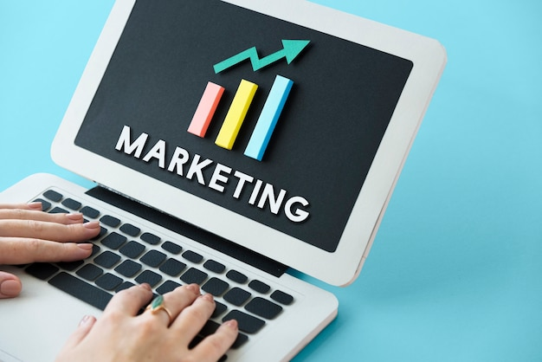
Campaign Optimization
Increase the effectiveness of marketing and advertising campaigns.
  Maximize ROI.
Campaign optimization software can suggest metrics and KPIs.
  ROAS
  Cost per click
  Conversion rate

Slide 15
Marketing Measurement Analysis
The process of collecting, analyzing, and interpreting data to measure the effectiveness of marketing activities.
A step beyond campaign optimization.
Analyzing effectiveness of prior activities helps drive success of future campaigns.
Metric | Description
Reach | Number of people who are exposed to a marketing message.
Frequency | Number of instances a person is exposed to a marketing message.
Engagement | Level of interaction with a marketing message.
Conversion | Number of people who react to a marketing message as was intended by the organization.
ROI | Amount of money generated by a marketing campaign divided by the amount of money spent on the campaign.

Slide 16
Activity: Improving Marketing Efforts
The executive team is concerned that GCE's marketing campaign for new products is not getting to enough of the right people, because initial sales numbers are below expectations.
How can the use of data science help alleviate their concerns?
After GCE's marketing department implements the suggested changes for the new product campaign, they want to see how this campaign stacks up against campaigns from last year.
How can data science help address this issue?

Slide 17
Optimize Operational and Transactional Security

Slide 18

Fraud Detection
Banks analyze transactional data.
Flags anomalous activity that is not overtly fraudulent.
  But possibly related to fraud.
  Example: several consecutive small transactions followed by a larger transaction.
Once the flag has been raised, the bank can:
  Contact the account holder to verify the transactions.
  Take corrective action if necessary.

Slide 19
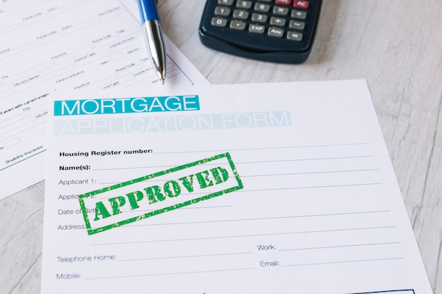
Minimization of Loan Defaults
Predicting if loan applicants will repay loans.
Historical data can show higher-risk loan types.
  Weighting system to factor in the risk.
Other factors to consider:
  Applicant's identifying information.
  Applicant's financial history.
  Applicant's current work status and financial standing.
  Estimated value of the property to be acquired.
  Loan amount.

Slide 20
Reduction of Intellectual Property Theft
IP: (intellectual property) A category of property that includes intangible creations of human intellect, such as literary and artistic works, inventions, designs, and so forth.
Patents, copyrights, trademarks, and trade secrets.
IP theft causes:
  Loss of competitive edge.
  Damage to reputation.
  Slow/stagnant growth.
  Loss of customer trust.
Best practices for protecting IP:
  Monitor user activity.
  Real-time investigations.
  UEBA.
  Honey trap.

Slide 21
Risk Identification and Mitigation
Operational risk: disrupts day-to-day business.
Strategic risk: inability to react to changing market conditions.
Example: failure of mission-critical equipment.
  Predictive modeling
Example: changes in customer requirements.
  Prescriptive modeling

Slide 22
Cybersecurity Considerations
Analyzing network traffic.
Conducting UEBA.
Analyzing historical data.
Analyzing online content.

Slide 23
Activity: Optimizing Organizational and Transactional Security
Management is concerned about the security of the online store, especially with regard to minimizing the effects of identity theft and other fraudulent activities.
How would you explain possible uses of data science to prevent fraudulent activity in the online store?
Store managers received an email warning of people trying to return counterfeit goods for store credit.
What security issues might this be an example of, and how would you suggest that the issues be addressed?

Slide 24
Enhance Operational Practices

Slide 25
System or Component Failure
Availability: percentage of uptime (99.999%).
Predictive maintenance:
  What: monitoring performance and equipment conditions.
  When: during regular operations.
  Goal: avoid unplanned downtime.
Predictive analytics:
  Estimate probability of system/component failure.
  Based on historical information about past failures.
  Schedule planned downtime for maintenance.

Slide 26
Sales Forecasting
Creating and refining sales forecasts.
  Analyze historical data, identify trends and patterns, and apply ML models.
  Results in better decisions about staffing, inventory, marketing, and pricing.
Short term or long term.
Common methods:
  Time series
  Regression
  Historical
  Opportunity stage

Slide 27
Dynamic Pricing
Dynamic pricing: The process of adjusting the price of goods or services according to customer behavior or changes in the market.
Example: changing price of airline tickets.
  Seat type
  Number of available seats
  Time before flight

Slide 28
Customer Churn
Customer churn: The tendency of customers to cancel subscriptions to a service, or otherwise cease their relationship with a business.
Some churn occurs naturally.
It's crucial to recognize changes in churn, why they happen, and how you can control them.
Predictive analytics for identifying the "why."
Once identified, the company can address causes.
Relevant data: demographic/behavioral data, interactions with the company.
Find common characteristics/patterns; offer incentives to stay.

Slide 29
Talent Acquisition
TA analytics: The process of analyzing recruitment data and candidate data to optimize the recruiting and hiring process.
HR/recruiting software
  Automated candidate sourcing and tracking, résumé parsing, and email communication.
  Fewer tedious/repetitive tasks for humans.
Common metrics:
  Time to fill
  Time to hire
  Offer acceptance rate
  Recruitment channel effectiveness
  Quality of hire

Slide 30
Transportation and Logistics
Optimize delivery routes.
Reduce costs for customer and company.
Warehouse management/optimization.
Operational capacity planning.

Slide 31
Activity: Enhancing Operational Practices
Last month, a colleague's store did not meet its forecasted sales goals, and the shift managers mentioned that they have noticed a sharp drop in shoppers before and after peak hours. The store manager has asked for suggestions on how to improve the numbers.
What do you think the issue is? What advice would you offer?
GCE is building two new stores and needs them fully staffed within two weeks of the completion of construction. HR is concerned about finding and hiring qualified candidates within the allotted time frame.
How can TA analytics help streamline the recruitment and hiring process?

Slide 32
Which CX enhancements are presently used at your workplace? Which would you suggest be considered?
Which of the organizational and transactional security issues are most relevant to your company? Were any issues discussed that your workplace does not address?

