Slide 1

Implementing Business Requirements for Data Science

Slide 2
Implementing Business Requirements for Data Science
Develop a Data-Centric Organization
Develop an Implementation Strategy
Identify Impact of Data Science on Business
Identify Governance Measures

Slide 3
Develop a Data-Centric Organization

Slide 4
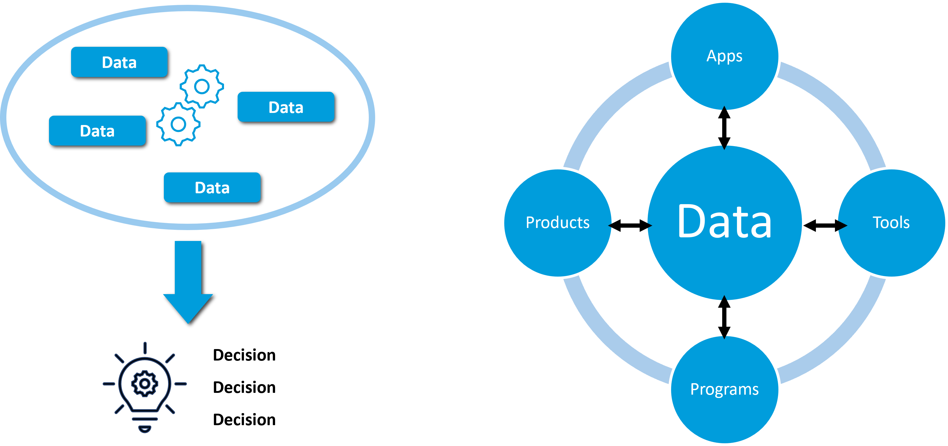

What Is a Data-Centric Organization?
Management and employees believe data analytics are critical to the overall business strategy.
Implements a framework where data is stored independently of applications and tools.
Generates relevant information and uses it collaboratively to achieve outcomes.

Slide 5
Challenges Associated with Building a Data-Centric Organization
Data silos
Data quality
Data governance
Trust
Changing roles and responsibilities
Data
Apps
Programs
Products
Tools

Slide 6
Organizational Preparation
Getting management buy-in.
Aligning with organizational objectives/values.
Identifying potential contributors.
Preparing teams to succeed.

Slide 7

Team Preparation
Training
Talent recruiting and acquisition
Combining roles

Slide 8
Activity: Discussing the Development of Data-Centric Organizations
The executive team has embraced the idea of incorporating data science practices throughout the organization.
What recommendations would you make to ensure the success of the endeavor?
After performing a resource assessment, several new job roles were identified as needing to be filled.
Which staffing option or options would you recommend the company use to optimize costs?

Slide 9
Develop an Implementation Strategy

Slide 10
Selection of Business Cases for Implementation
Option A
Benefit?
Cost?
Option B
Benefit?
Option C
Time?
Cost?
Time?
Benefit?
Cost?
Time?
Numerous possible implementations.
Identify the most viable options.
  What provides the most benefit?
  What can be done at a low cost?
  What can be done quickly?
Prioritize the projects.
Cost vs. benefits.

Slide 11
Implementation Investments
People
Technology
Data
Governance
Time

Slide 12
Data Collection Considerations
Collect only relevant data.
Identify collection options.
Generate synthetic data.
Identify storage solution.
Decide how to combine data from different sources.
Data
Data
Data
Centralized data

Slide 13



Data Preparation Considerations
Find/use tools that streamline preprocessing tasks.
  Data wrangling
  Data cleaning
Find/use tools that support EDA activities.
  Examine datasets.
  Summarize main characteristics.
  Visualize summary information.

Slide 14
Modeling and Deployment Considerations
Select algorithms/ML models that support solving the identified business problem.
Tune the model's hyperparameters to optimize performance.
During model testing, identify/use multiple algorithms.
Evaluate the model's performance and results.
Don't deploy a model too soon.
Verify that repeatable, scalable, and flawless results are achieved.
Monitor output for performance and quality.
Train
Test
Evaluate
Deploy

Slide 15

Results Communication Considerations
Identify audience and adjust communications when needed.
Summarize the project and provide context.
Highlight/explain key findings.
Use visualizations.
Create reports (findings and visualizations).
Ask for feedback.

Slide 16
Activity: Developing an Implementation Strategy
You are brainstorming ideas for possible data science projects, including recommender systems for the online store and reducing customer churn. You need to identify the order in which the ideas should be addressed.
What are some determining factors you would use to prioritize the project ideas?
The customer churn project is approved.
What is one issue that the implementation team should consider before beginning data collection?

Slide 17
Identify Impact of Data Science on Business

Slide 18
Effects on Overall Business Operations
Reputational impact
Impact on talent pool
Legal and regulatory compliance

Slide 19
Effects on Business Processes and Practices
Cost management
Management of infrastructure requirements
Employee impact
Organizational changes

Slide 20
Data Issues
Security
Controls
Quality
Privacy

Slide 21

AI-Related Risks
Lack of formal governance for AI.
Acquisition of third-party data and AI products.
Lack of domain expertise.
Using black-box models and technologies.

Slide 22
Activity: Discussing the Impact of Data Science on Business
Management asks if you can categorize upcoming data science projects according to the level of impact they will have on the overall operation of the business.
Of the issues discussed. which do you think carries the most weight? Why?
Someone suggests using third-party data and AI systems to control costs and streamline implementation. Not everyone on the team agrees.
What side of the discussion would you take?

Slide 23
Identify Governance Measures

Slide 24
Ethical Considerations
Data ethics: A collection of moral principles that govern how organizations gather, protect, and use data.
Privacy
Accountability
Transparency/explainability
Fairness/non-discrimination
Safety/security

Slide 25
Legal and Regulatory Considerations, Frameworks, and Guidelines
Data privacy
  GDPR
  PCI DSS
  OECD Privacy Guidelines
  APEC CBPR
AI implementations
  China: provisional regulations governing generative AI.
  Proposed legislation in other countries (EU, Canada).
Be aware of what applies to your company.
Rapidly changing landscape—keep up with new developments.

Slide 26
Activity: Discussing Governance Measures
In the customer churn project, a large percentage of the data appears to represent only a few small geographical areas.
Would you consider this a cause for concern? Why or why not?
Of the laws, regulations, and guidelines discussed in this topic, which do you think has the largest reach?

Slide 27
Try to envision your company transforming to a data-centric organization. In your opinion, what do you think the greatest roadblocks will be?
Of the various effects on business discussed in this lesson, which do you think will have the largest impact at your workplace?

