Slide 1

AI Fundamentals

Slide 2
AI Fundamentals
A Brief History of AI
AI Concepts

Slide 3
A Brief History of AI

Slide 4
What Is Artificial Intelligence (AI)?
Artificial intelligence (AI): The ability of machines to exhibit human-like intelligence.
Common factors:
  Perceiving one's environment.
  Taking actions to achieve goals.
  Obtaining knowledge and applying it for problem solving.
AI will revolutionize business.
Anyone can understand its impact.

Slide 5
Timeline of AI
Enabling technologies:
Cloud
Big data
GPUs
Turing test
Unimate
Deep Blue
DeepMind
Shakey
Grand Challenge
Expert systems
1956
1964
1973
1980
1987
1993
2000
2011
2020
1950
1961
1966
1997
2005
2016
First AI winter
Second AI winter
Birth of AI
ELIZA
Kismet
Watson
GPT-3
Siri
DALL·E
Google Brain
ChatGPT

Slide 6


AI-Enabling Technologies: Cloud Computing
Cloud computing: An approach to providing computing services and other resources over a network of distributed servers and other infrastructure.
Offload high AI costs.
Match ever-changing demands.
Example: Virtual meeting software.
AWS EC2 released in 2006.
Many services and vendors since then.
6

Slide 7
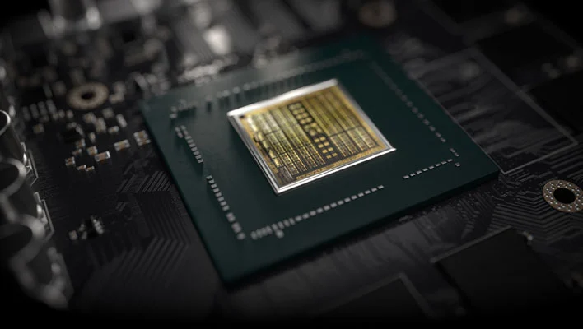
AI-Enabling Technologies: GPUs
GPU: A computer chip designed to process graphics, images, and other visual media.
General-purpose GPUs do more.
CPU is like a small sports car.
GPU is a like a big delivery truck.
GPUs better for doing AI calculations.
Example: Online store recommendations.
First general-purpose GPUs released in 2007.
High-performance GPUs now more common.
7

Slide 8

AI-Enabling Technologies: Big Data
Big data: Collections of data that are so large and complex that they require advanced tools to process and analyze them.
Volume, variety, velocity, etc.
AI is data driven; more data is usually better.
Big data makes AI more viable.
Example: Searches used in targeted ads/customized results.
2008 whitepaper by CCC outlined rise of big data.
8

Slide 9
Activity: Discussing the History of AI
Identify at least two events, people, or systems since the end of the second AI winter that have had a direct impact on the trajectory of AI.
Identify at least two relatively recent technologies that have enabled AI to flourish in the business world, and briefly explain how they have done so.

Slide 10
AI Concepts

Slide 11
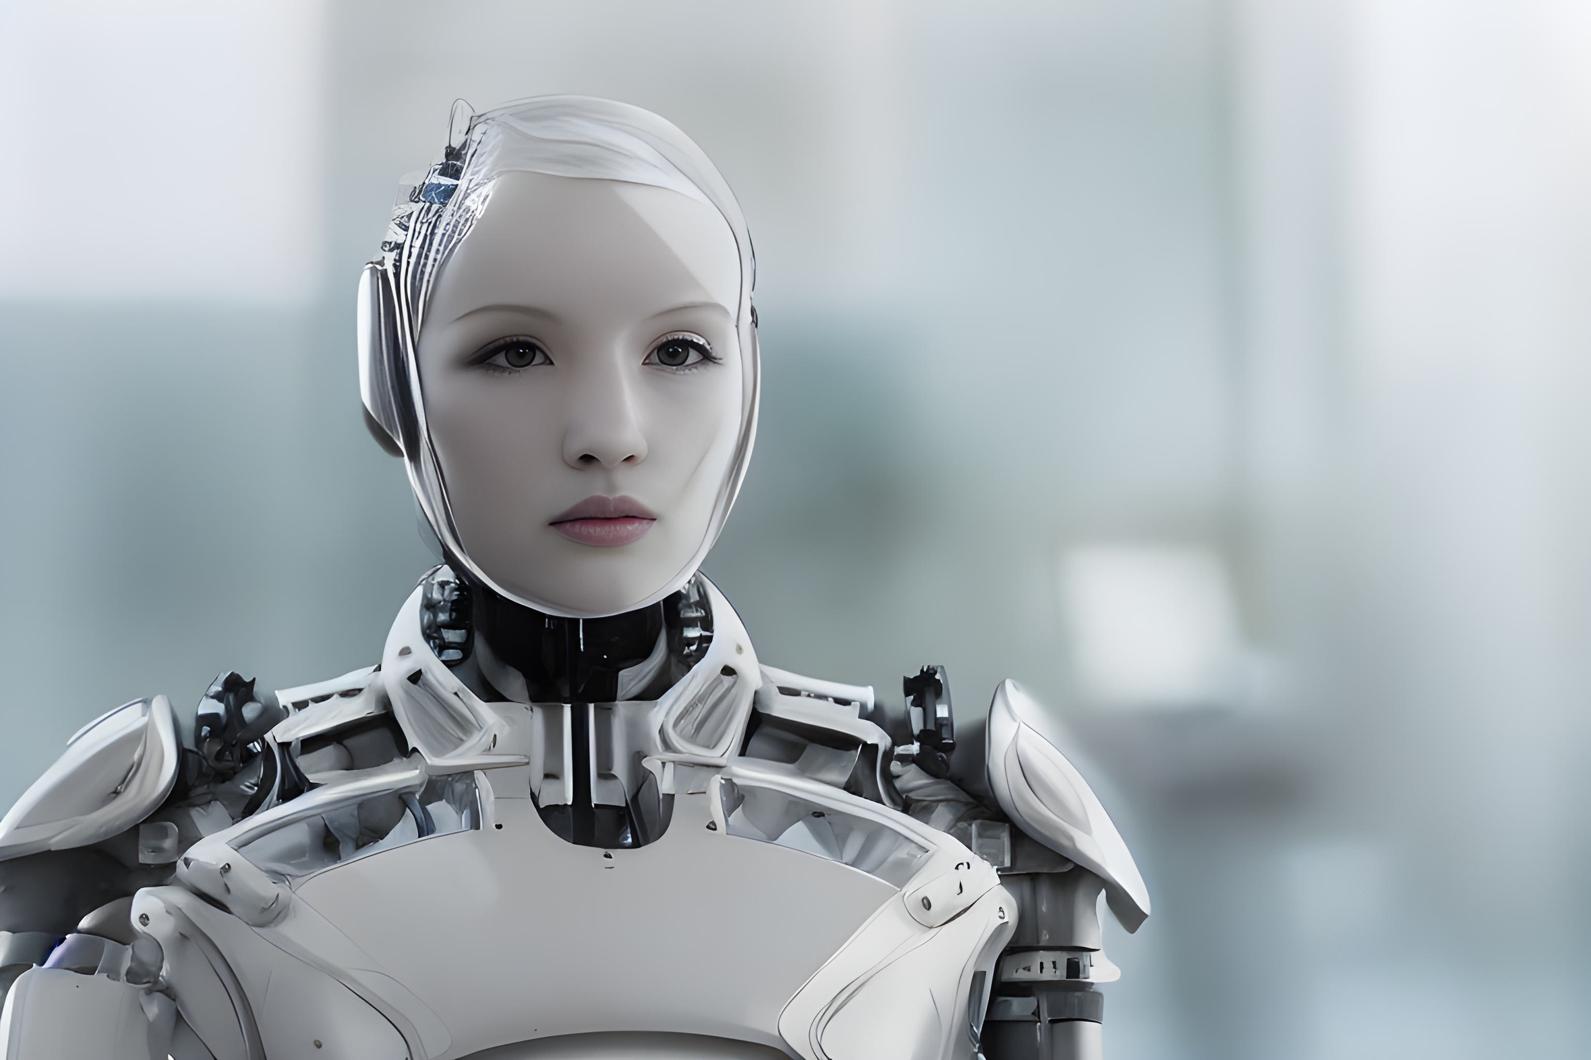
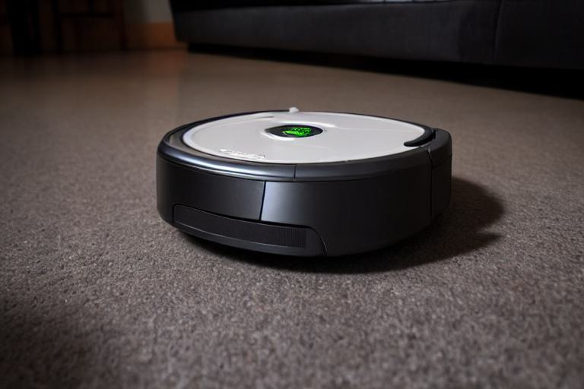
General AI and Narrow AI
General AI
Narrow AI
Same or better cognition than humans
Extrapolates reasoning
Solves multiple novel problems
Not yet a reality
Approximates human cognitive traits
No true capacity for reason
Solves one or a few designated problems
Currently a reality

Slide 12






Machine Learning
Data input to algorithm
Creates model
Makes predictions
Evaluates predictions
Data
Algorithm
Model
Improves
Learns

Slide 13
Machine Learning Datasets
Features
ID | Weight (lbs) | Height (in) | Blood Pressure
554389 | 156.5 | 65 | 120/80
840933 | 167.3 | 64 | 135/86
913221 | 212.8 | 73 | 123/75
453772 | 256.1 | 68 | 140/90
Examples
Note that "ID" is not a feature because it is not relevant to making predictions in this case.
The model is said to train on this data.

Slide 14









Deep Learning
Image Input
Low Layer (simple)
A type of machine learning that makes decisions using multiple layers of information.
Middle Layer (complex)
High Layer (very complex)
Decision

Slide 15



Deep Learning Applications
Natural language processing (NLP)
Computer vision
Robotics

Slide 16
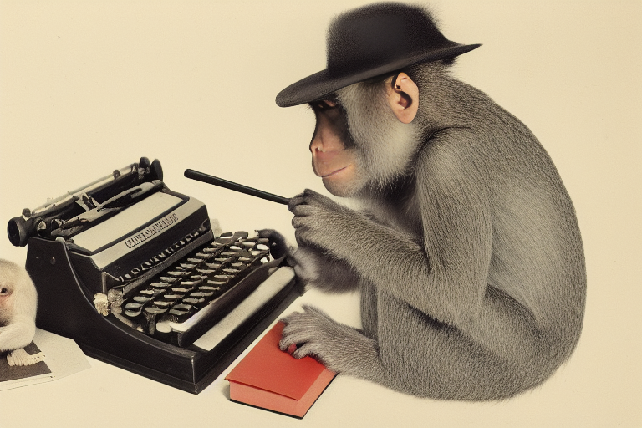
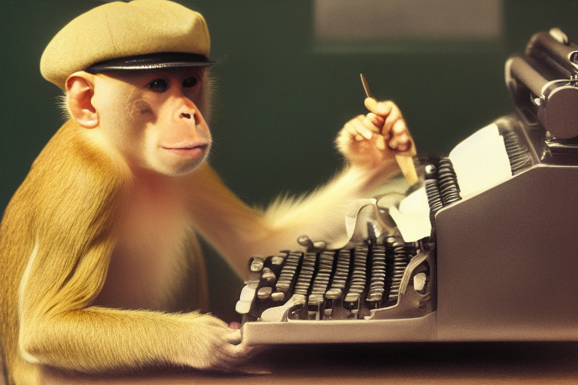
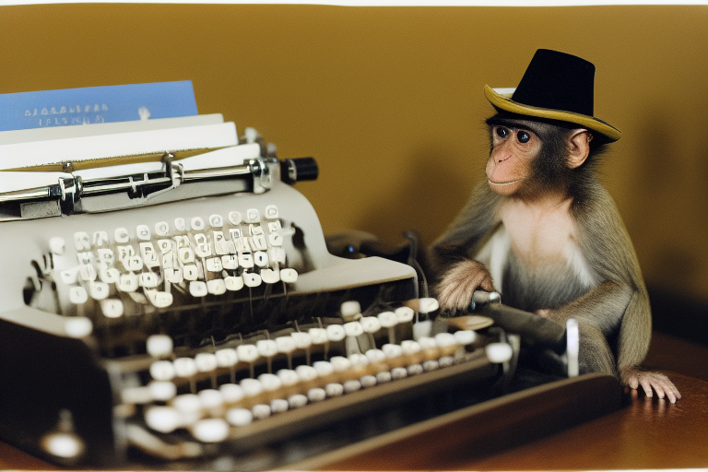
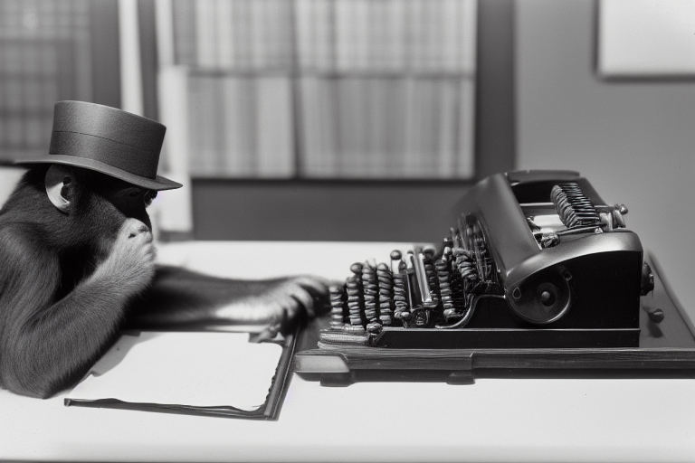
Generative AI
Prompt:
a photograph of a monkey typing at a typewriter, wearing a small hat, in an office, realistic, highly detailed

Slide 17

Machine Learning vs. Deep Learning
Traditional Machine Learning
Human Face
Input image
Human identifies features
Model learns patterns
Model makes decision
Deep Learning
Human Face
Input image
Model extracts features and learns patterns
Model makes decision

Slide 18

The Choice Between Machine Learning and Deep Learning
Traditional machine learning:
  Used with smaller datasets.
  Expert has determined features.
  Customer surveys, health records, bank activity, etc.
Deep learning:
  Used with larger datasets.
  Difficult for human to extract features.
  Object recognition, speech understanding, etc.
MACHINE LEARNING
DEEP LEARNING

Slide 19
How AI Concepts Relate
Artificial Intelligence
Machine Learning
Deep Learning

Slide 20



Machine Learning Approaches
Supervised Learning
Unsupervised Learning
Reinforcement Learning

Slide 21




Supervised Machine Learning
Labeled dataset
Weight | Height | Label
156.5 | 65 | No
167.3 | 64 | Yes
212.8 | 73 | No
256.1 | 68 | Yes
Model outputs classification
Model learns patterns from labeled data
Weight | Height
234.5 | 63
New, unlabeled data sent to model

Slide 22





Unsupervised Machine Learning
Unlabeled dataset
Customer # | Gender | Age Group
1 | M | 18–24
2 | F | 25–34
3 | F | 18–24
4 | M | 55–64
5 | M | 18–24
6 | F | 45–54
7 | M | 25–34
8 | F | 45–54
1
Cluster A
2
3
5
7
Model clusters similar data
Model learns patterns from unlabeled data
4
6
Cluster B
8

Slide 23




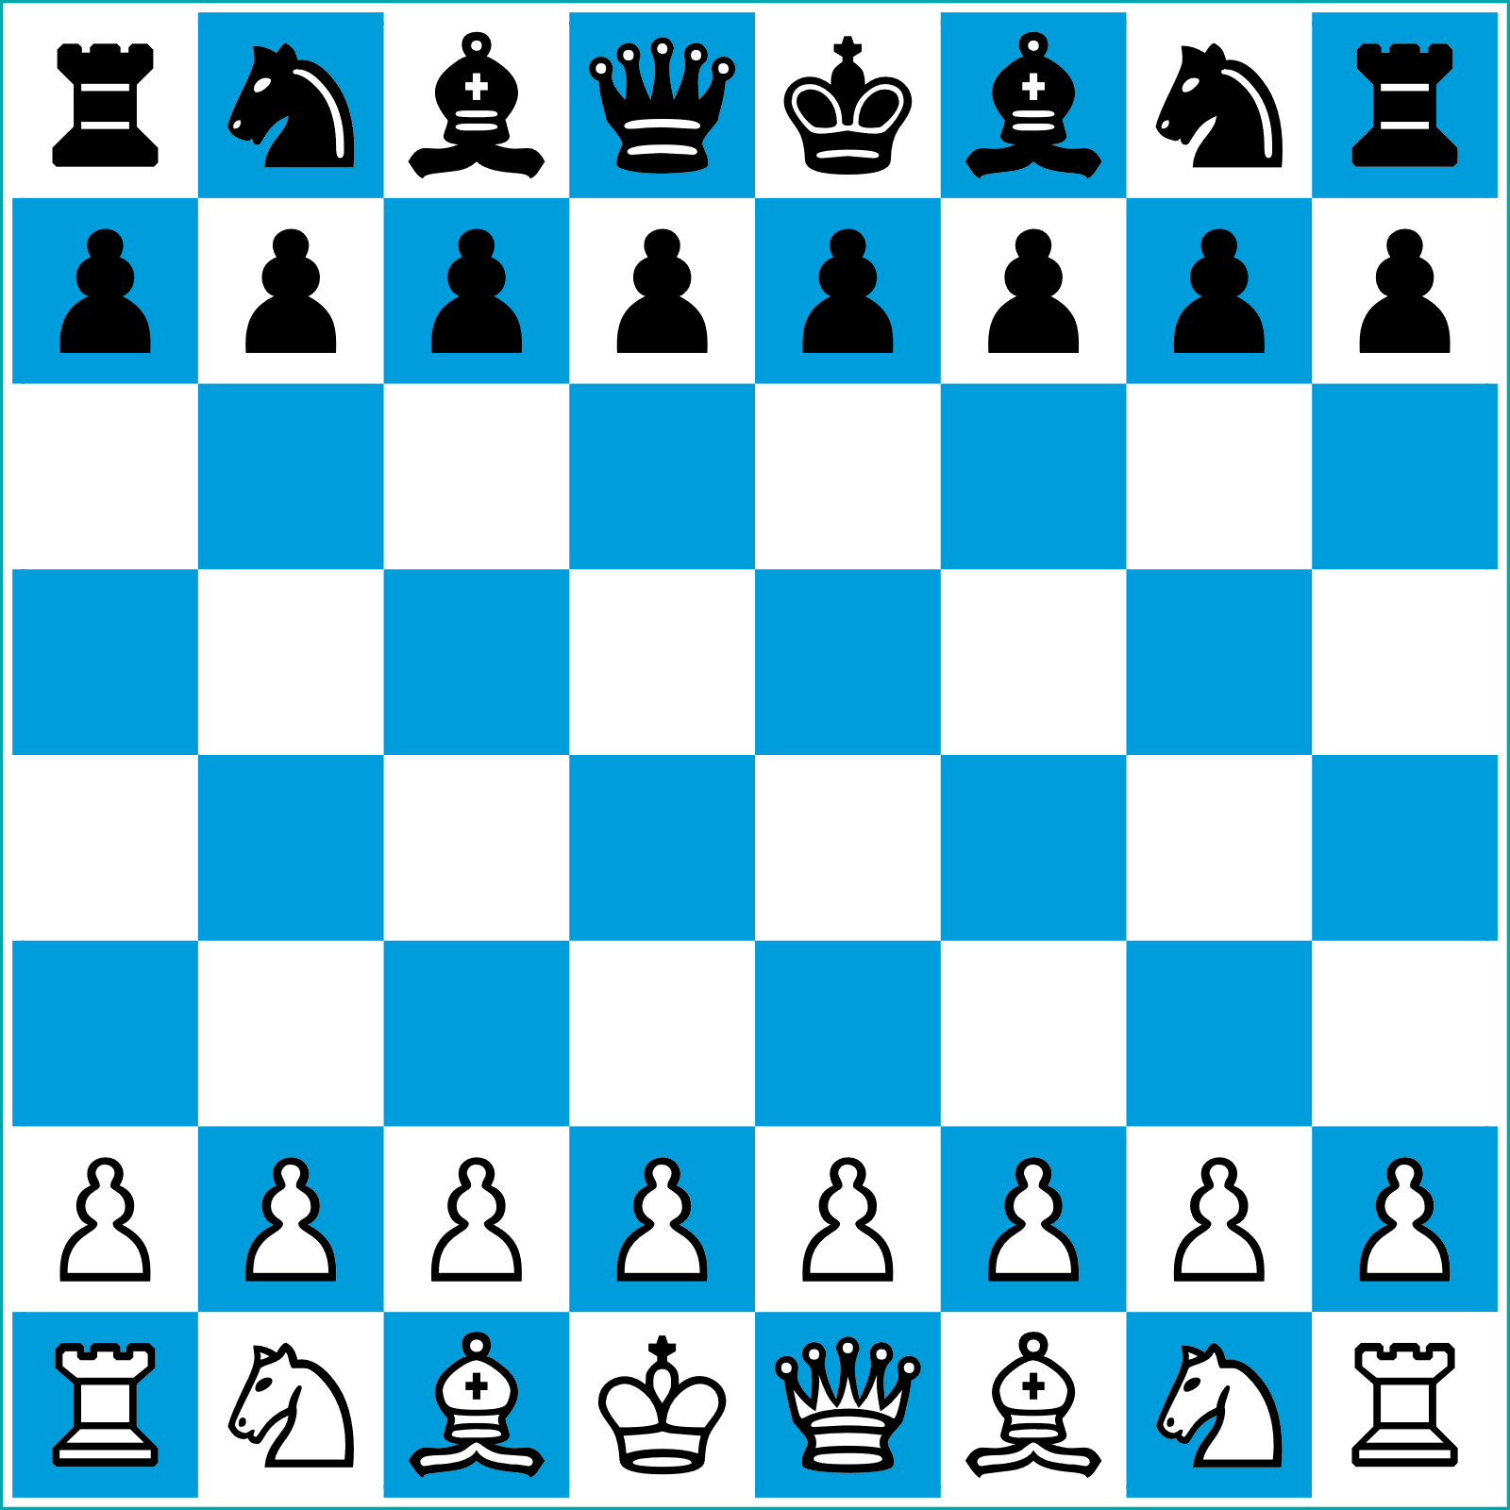
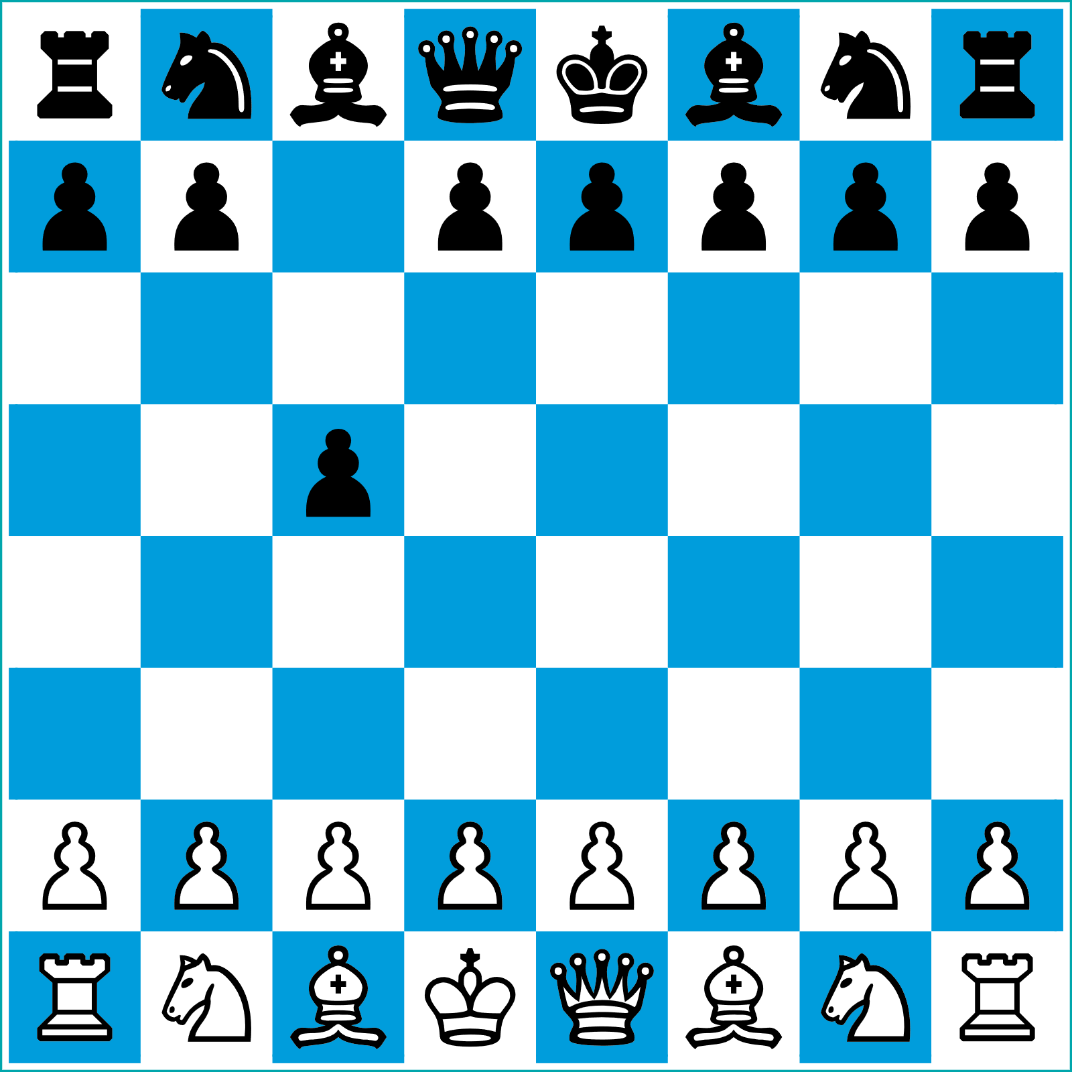

Reinforcement Learning
1
Action selected
2
Action performed
3
Environment changed
4
Reward given
5
Process repeats

Slide 24
Activity: Discussing AI Concepts
Read the question scenario in the text. Which technique, traditional machine learning or deep learning, would be most suitable to achieving this business objective? Why did you make this choice and not the other?
Read the question scenario in the text. Is this an example of supervised, unsupervised, or reinforcement learning? Explain why.

Slide 25
What sort of additional research, if any, do you plan on doing to learn more about the concepts behind AI?
Does your organization currently use, or plan to use, machine learning or deep learning techniques? How? What about you personally—how are you affected by AI in your daily life?

