Slide 1

Functions of AI in Business

Slide 2
Functions of AI in Business
Improve User Experiences
Segment Audiences
Secure Assets
Optimize Processes

Slide 3
Improve User Experiences

Slide 4





Natural Language Processing
Text Analysis
Speech Recognition
Natural Language Understanding
Natural Language Generation
Natural Language Translation

Slide 5




Chatbots
Chatbot: An AI system that uses NLP to engage in real-time, text-based chatting with a human user.
Customer service
Appointment scheduling
HR management
Information research
Hello! My name is Robo.
How can I help you today?
I'm having trouble with my computer. It keeps crashing.
Don't worry, I'm here to help. What are you doing when it crashes?
5

Slide 6

Agent Assistance
Agent assistance: Automation technology that helps human agents in a call center do their jobs more efficiently and effectively.
Call context
Immediate responses
Suggested responses
Live transcription and summarization
User Context
Name
John Doe
Account #
43290645
Issue summary
Accessed billing page
Contacted agent
Claimed bill was inaccurate
6

Slide 7


Sentiment Analysis
Sentiment analysis: The technique of determining the attitudes and feelings someone has toward something.
Customer retention
Employee retention
Product development strategy
Recommendations
"I usually love Greene City BBQ's food, but this new smoked brisket sandwich is not up to their usual standards."
"I'm not a fan of most barbecue, but this brisket sandwich is amazing! I hope they keep it on the menu for a long time."
7

Slide 8
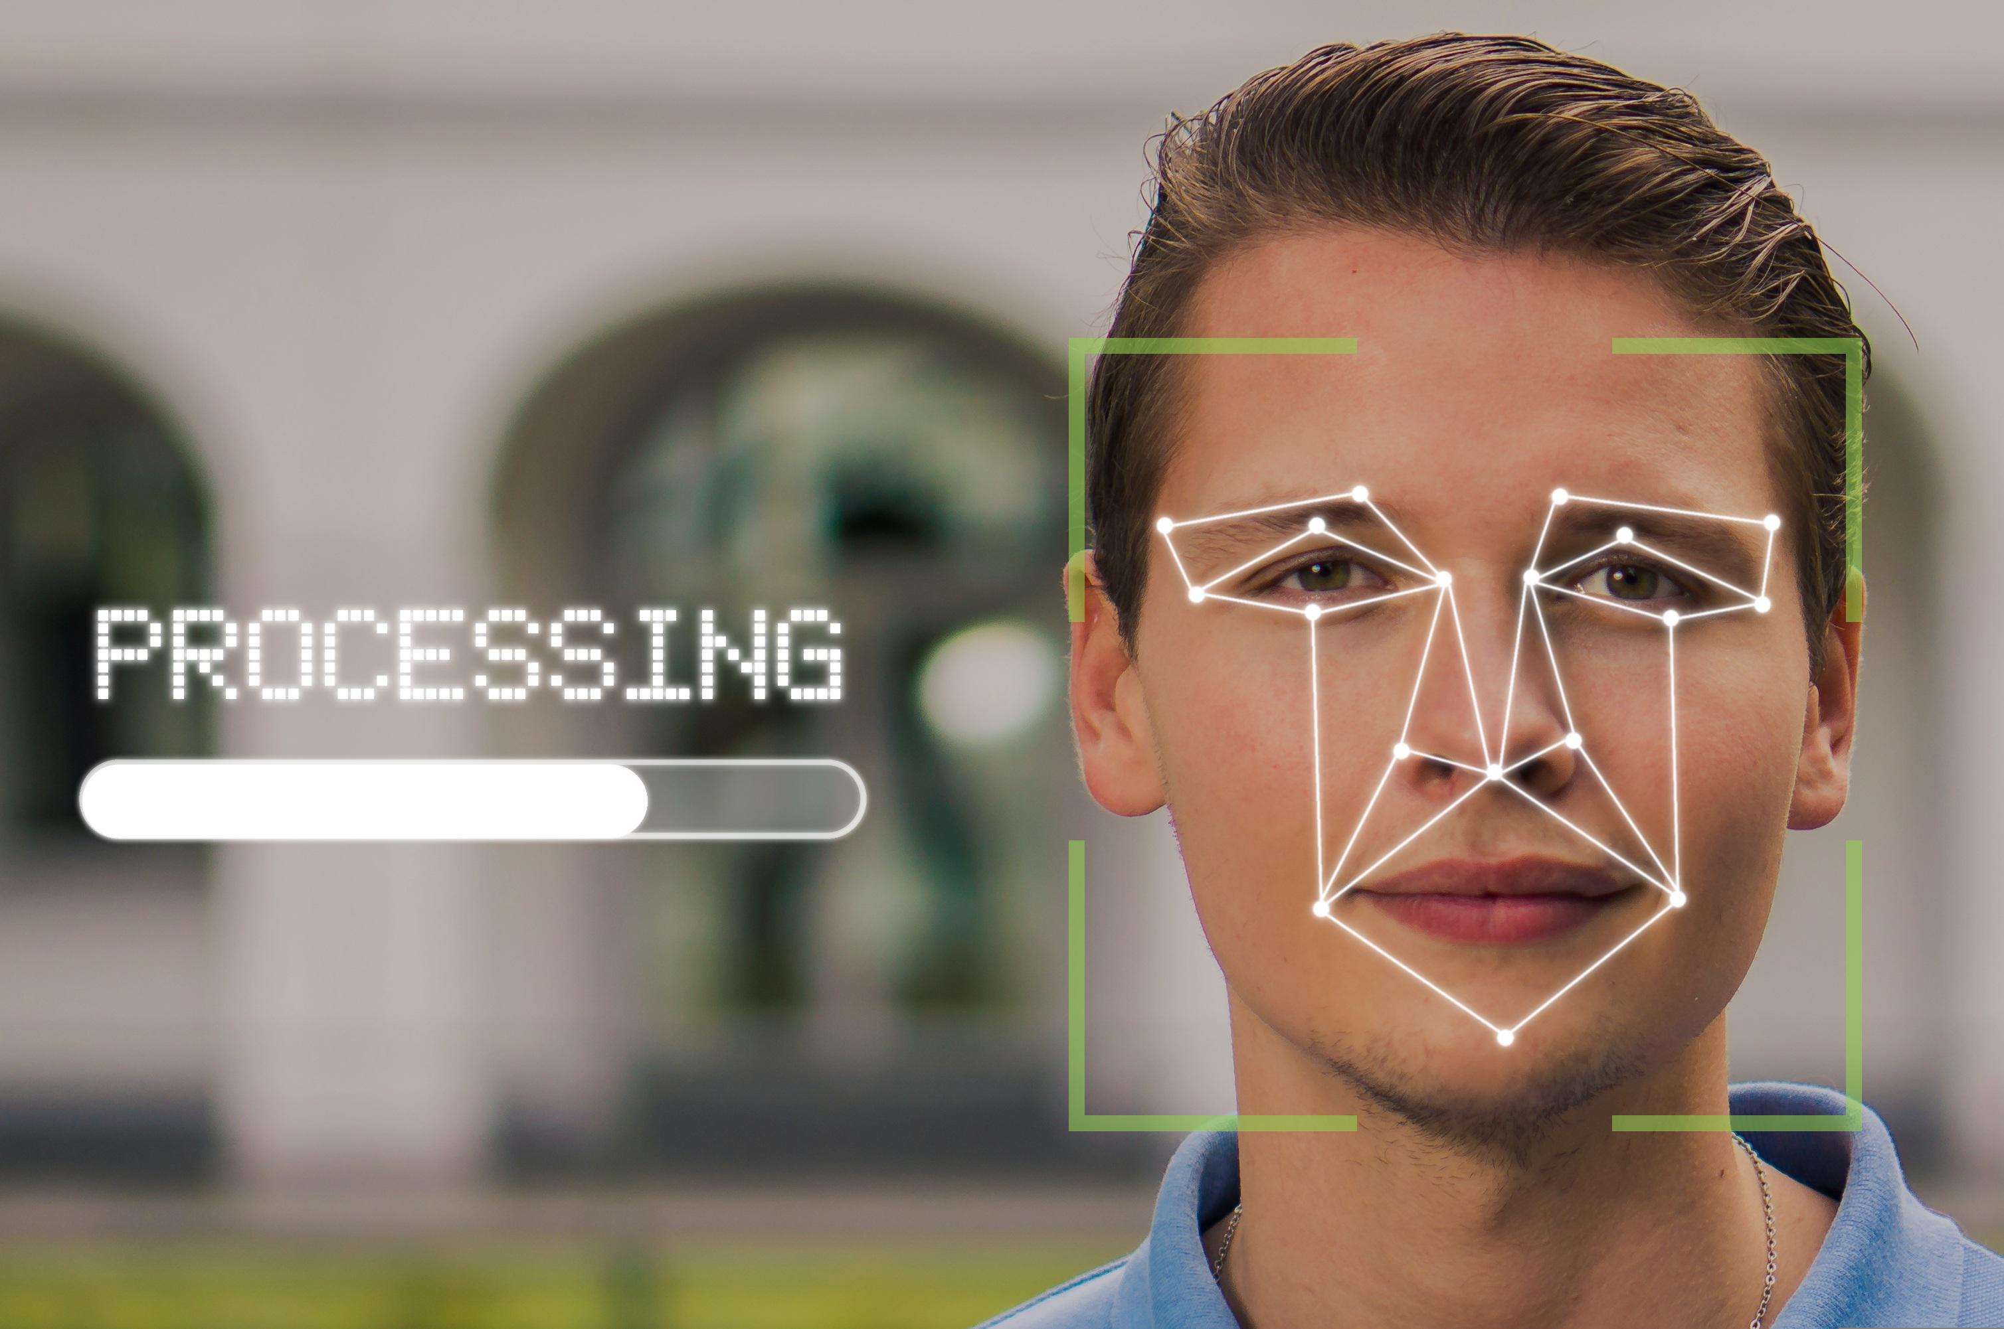
Emotion AI
Emotion AI: A type of sentiment analysis solution that focuses on the physical attributes of a person, particularly their facial expressions and features.
Uses computer vision to detect facial features.
  Object recognition, motion detection, etc.
Similar applications to sentiment analysis.
  More difficult and controversial to implement.
8

Slide 9
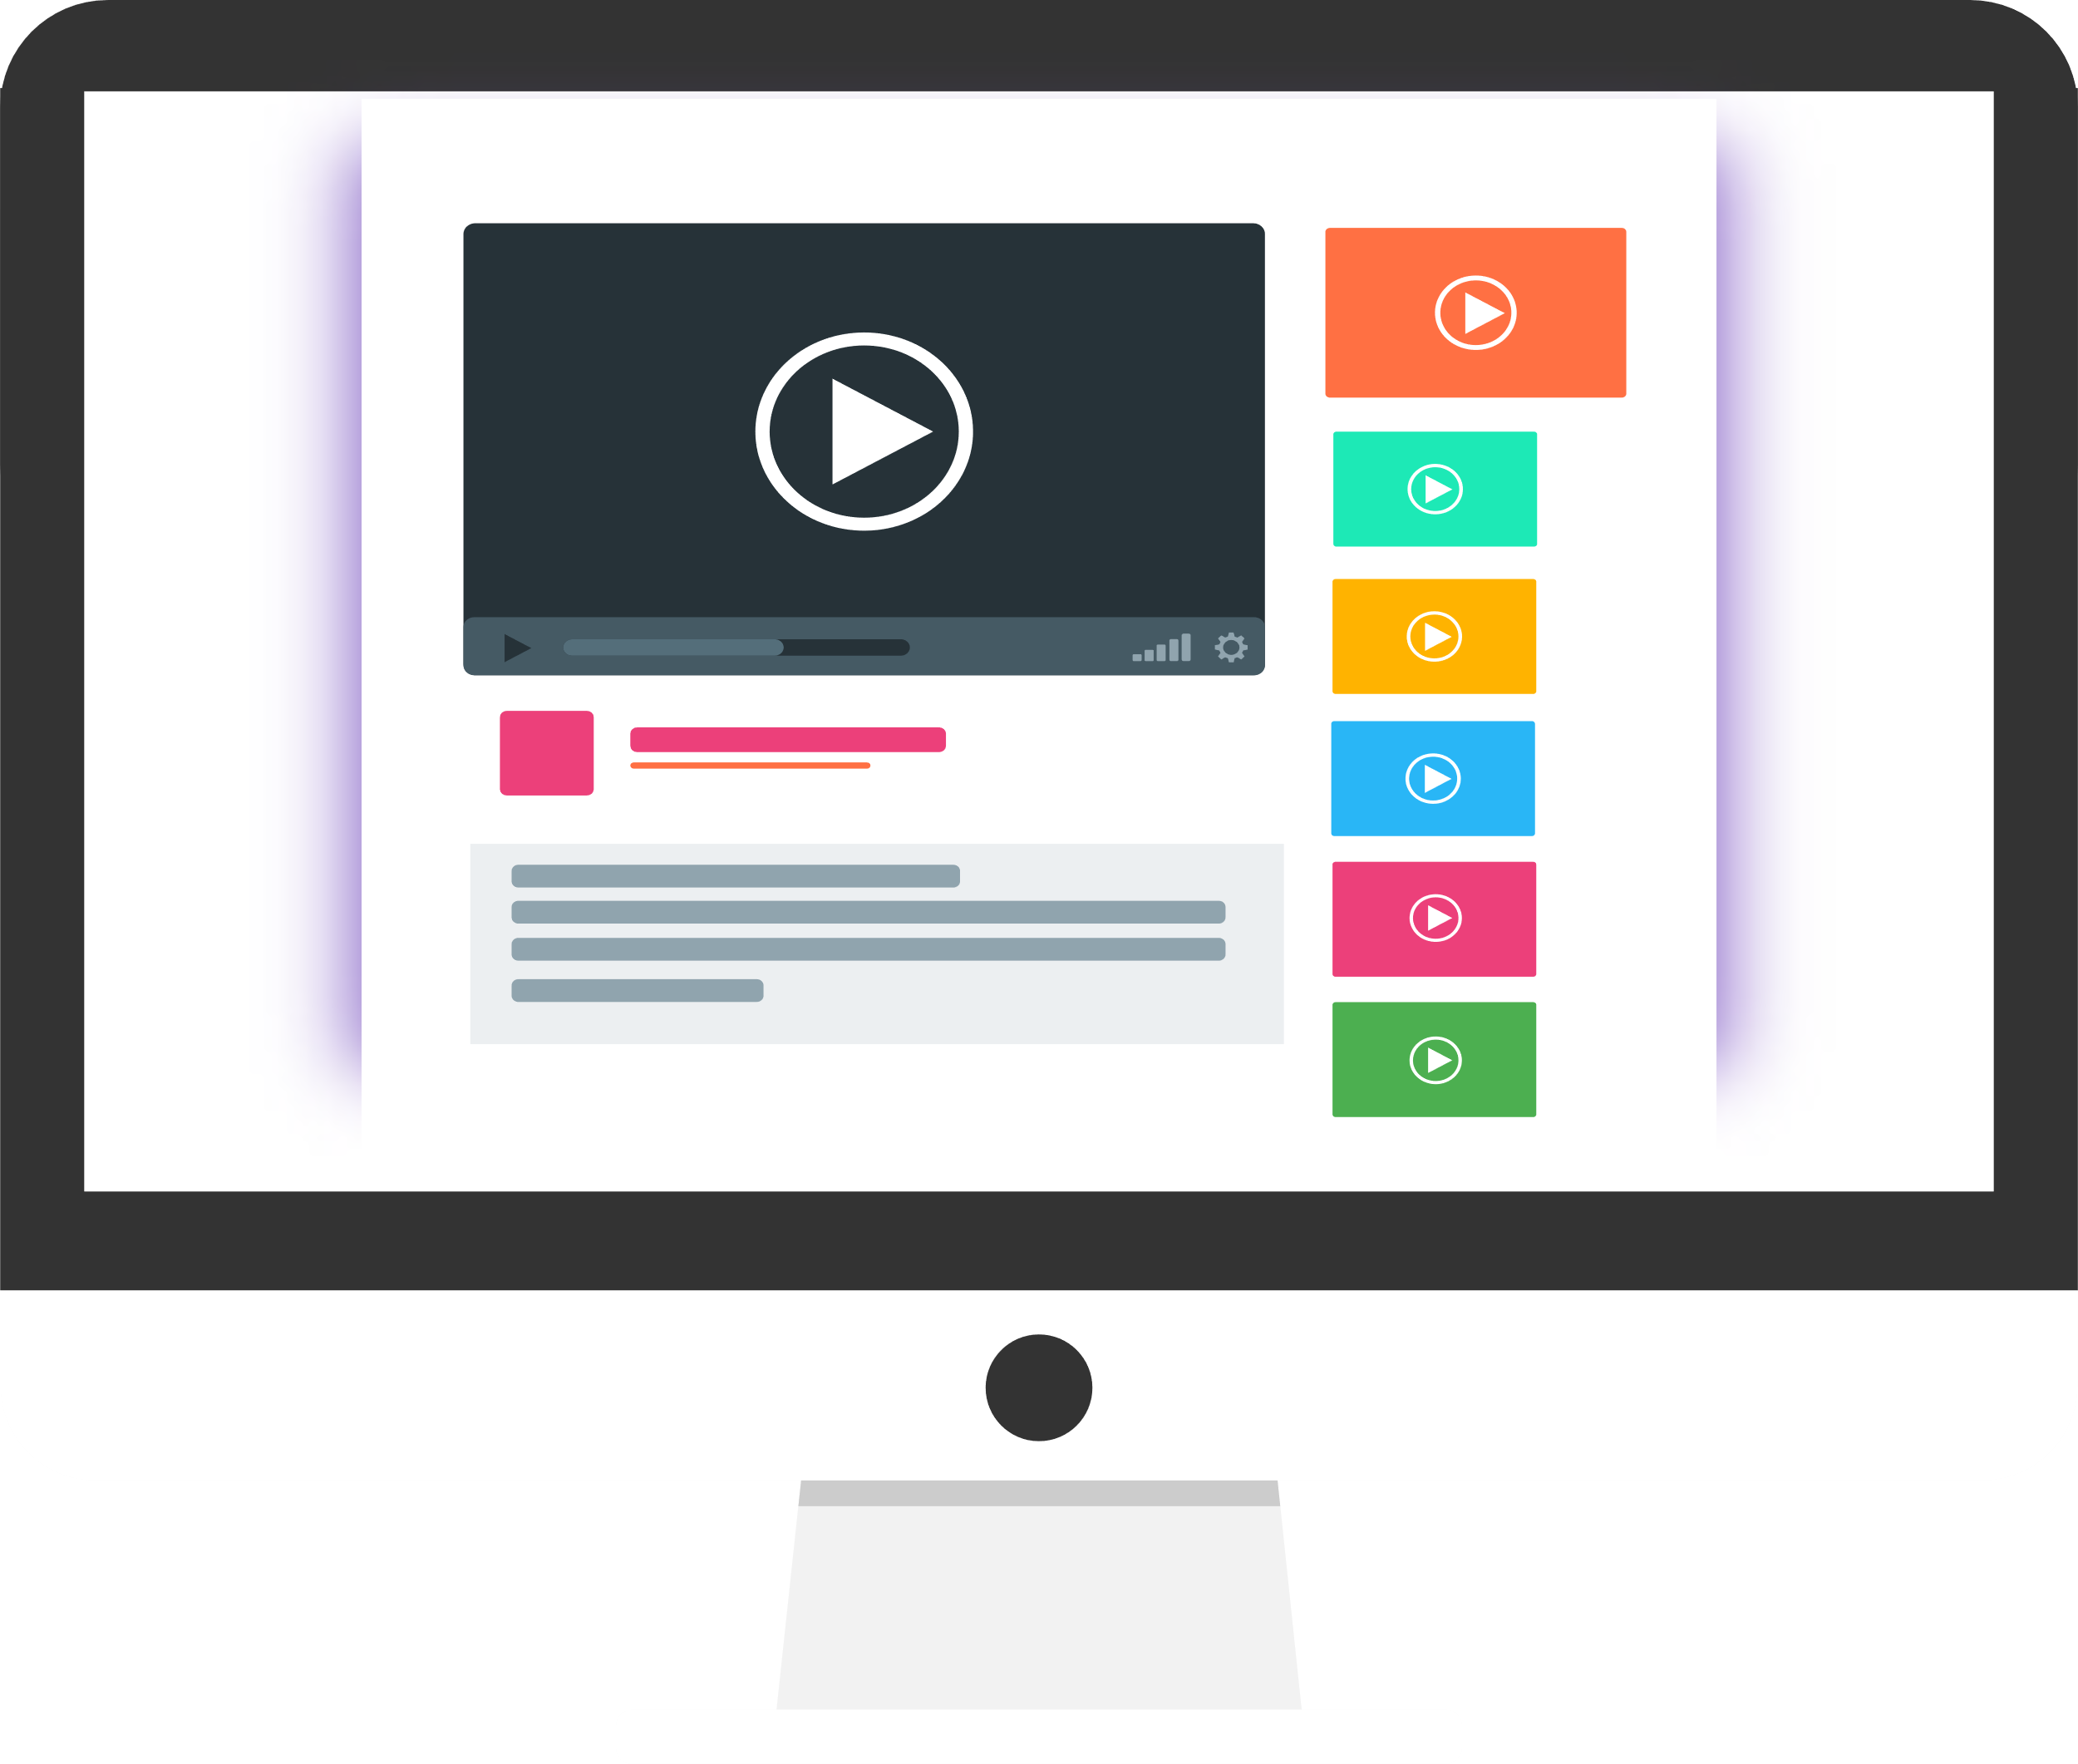
Recommendation Systems
Recommendation system: A system that suggests items, services, and other things of interest to users.
Content recommendation
Product recommendation
Social networking
Research
9

Slide 10
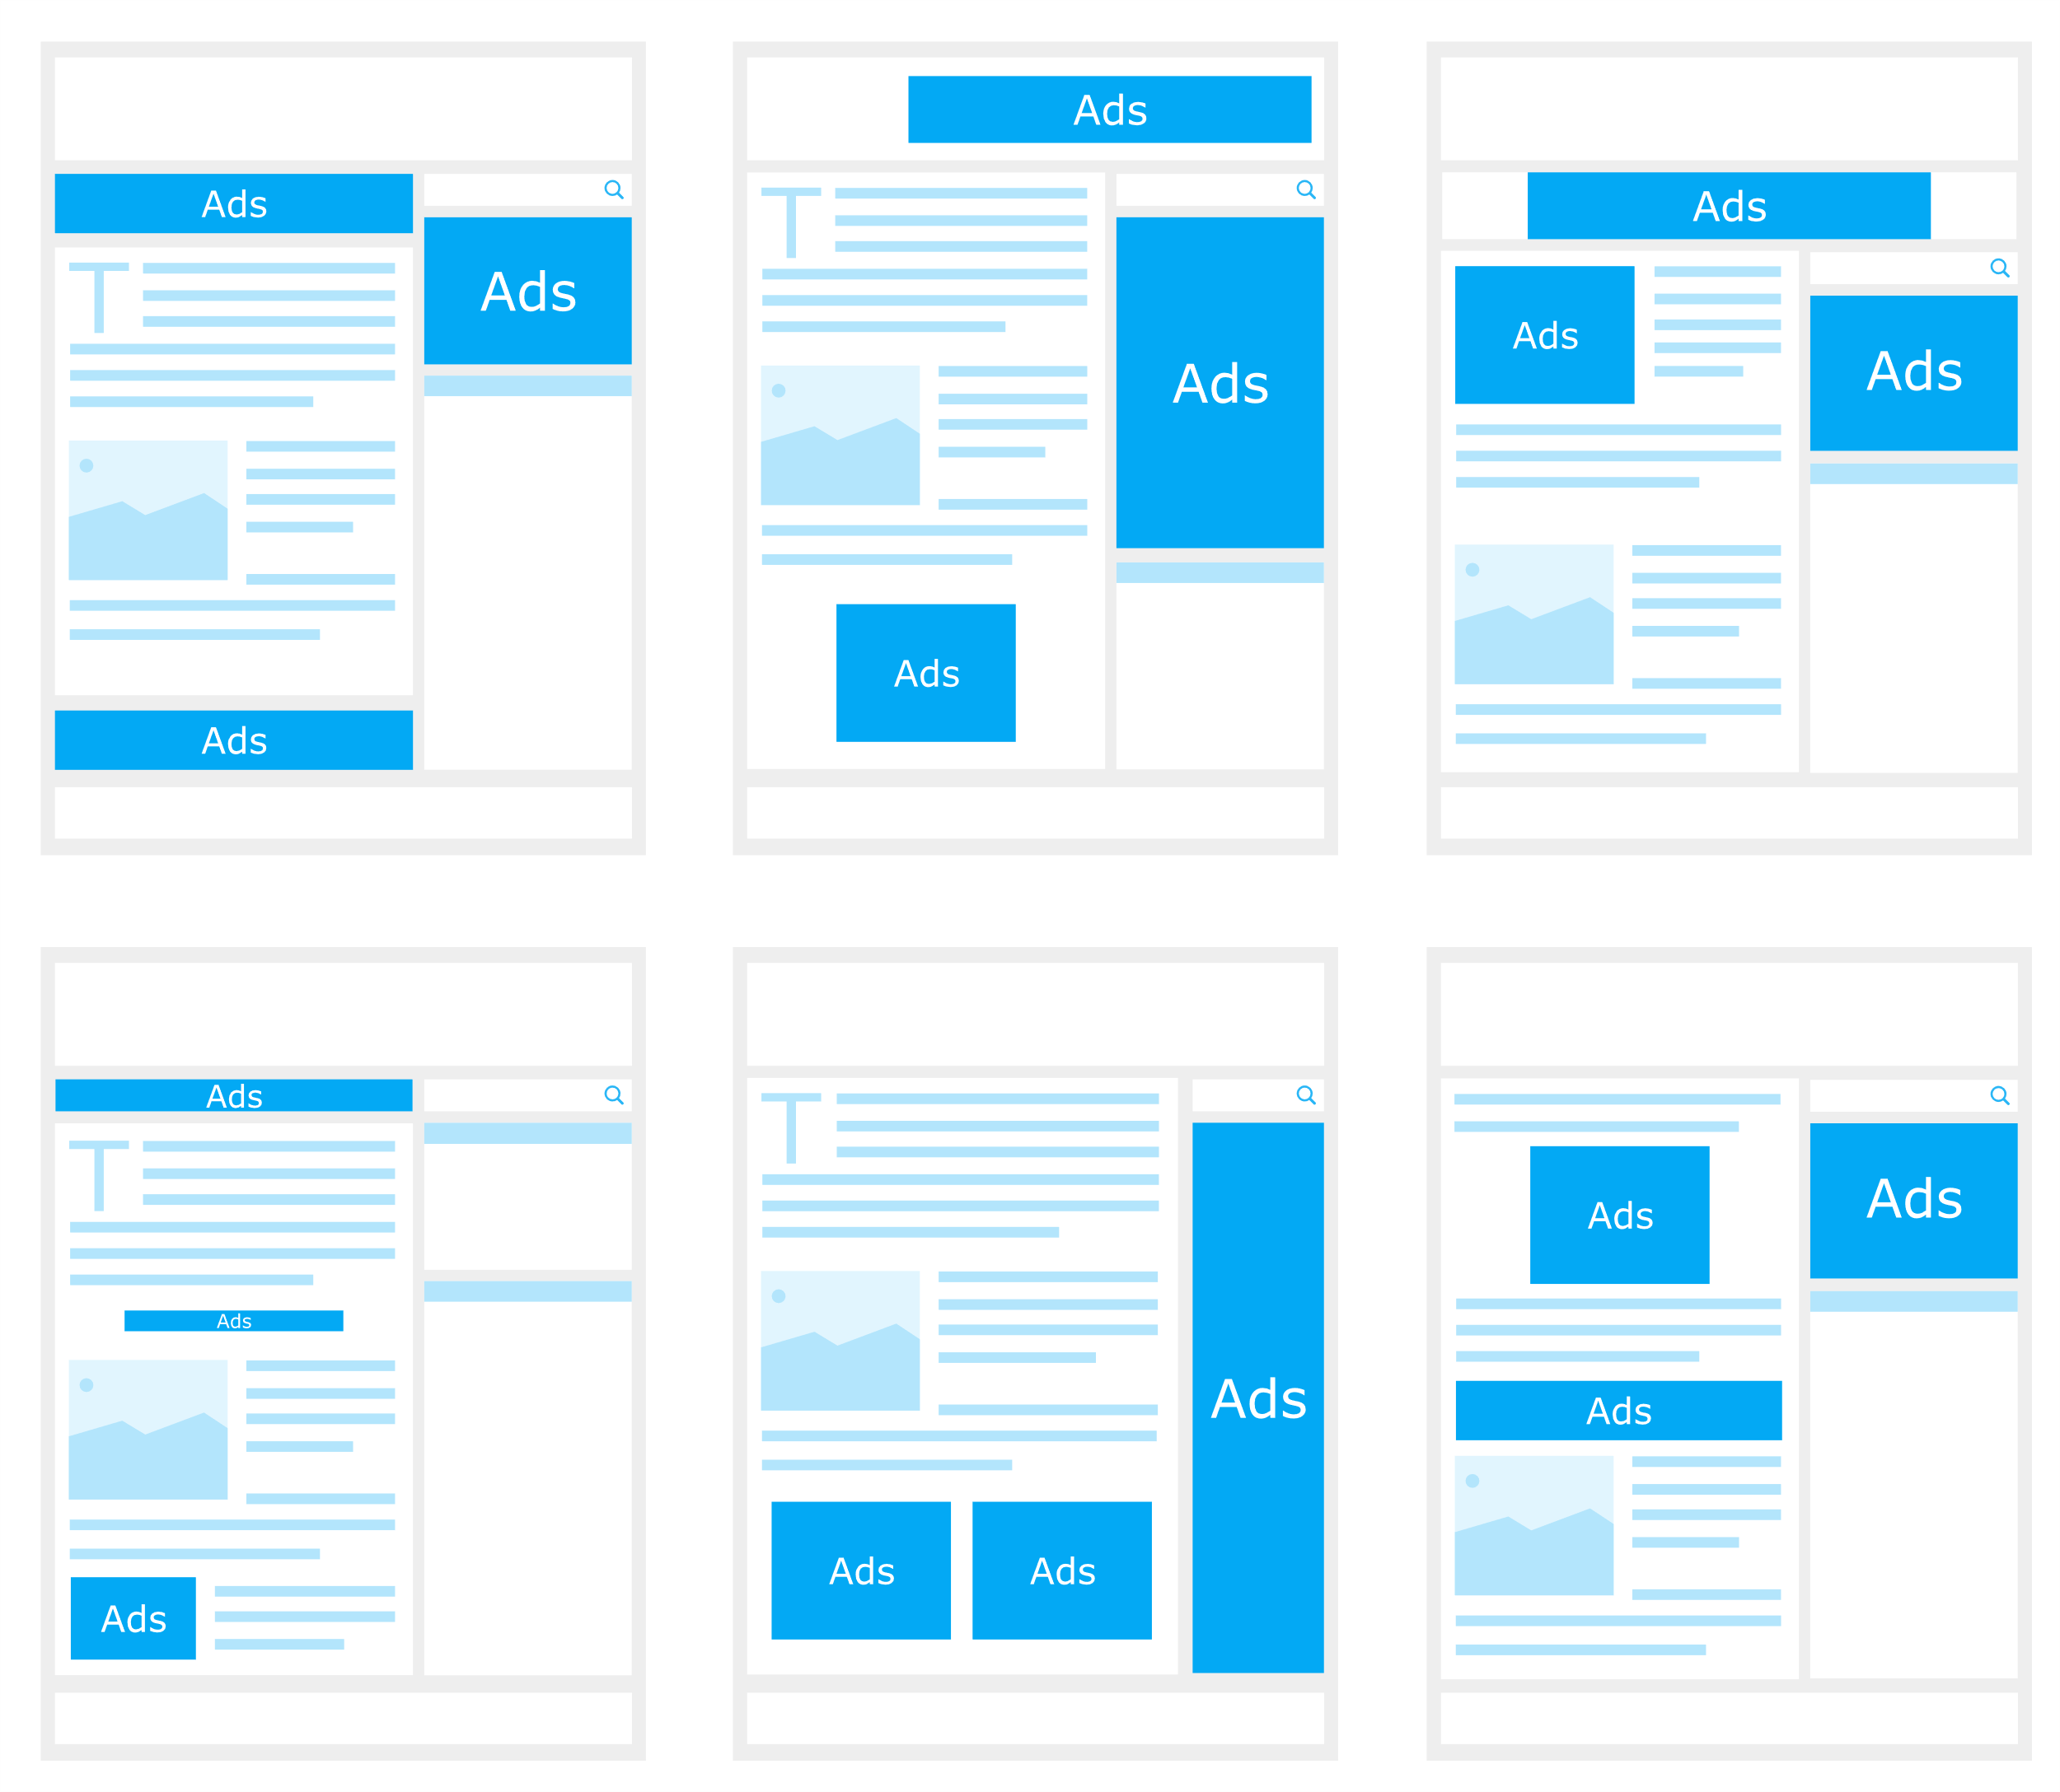
Digital Personalization
Personalization approaches:
  Serve specific content.
  Hide specific content.
  Rearrange content.
  Change visual themes.
User profile aspects that influence experience:
  Geolocation.
  Demographics.
  Socioeconomic status.
  Browsing and online shopping history.
  General sentiment toward business.
Model learns what experience fits best with what user.

Slide 11
Activity: Improving User Experiences Using AI
Read the question scenario in the text. What AI system(s) could help solve this problem to improve the customer experience, and how?
Read the question scenario in the text. How can an AI-driven recommendation system provide more effective product suggestions to customers?

Slide 12
Segment Audiences

Slide 13












Customer Segmentation
Students
Retirees
Academics
Executives
Professionals

Slide 14

Predictive Segmentation
Supervised learning can improve segmentation.
  Use classification or regression to predict label.
Example: Customer return status.
  Predict if future customers will return.
  Segment based on predicted result directly.
  Or, incorporate as part of clustering.

Slide 15

Targeted Campaigns and Customer Profiles
Profile A
Name: Gabriel Anderson
Age: 18–24
Location: London, Belfast, Glasgow
Job: Student, Intern, Sales
Income: £0–£35,000
Relationship: Single, Engaged
Interests: Hiking, Sports, Music

Slide 16
Activity: Segmenting Audiences Using AI
What machine learning technique can help you place customers into different groups for the purposes of market segmentation? Provide a basic explanation for how the technique works.
How can a machine learning model that makes predictions be used to enhance customer segmentation?

Slide 17
Secure Assets

Slide 18
Risk Management
Risk management: The cyclical process of identifying, assessing, analyzing, and responding to risks.
Risk detection
Risk analysis
Risk scoring
Risk response
Identification
Assessment
Analysis
Response
RISK MANAGEMENT
18

Slide 19
Threat Analysis
Threat analysis: The study of people, events, and technologies that can harm an organization's assets.
Threat classification
Threat ranking
Threat segmentation
Threat research
Social Engineering
Phishing
Impersonation
Malware
Virus
Ransomware
Denial of Service
DDoS
Botnet
19

Slide 20
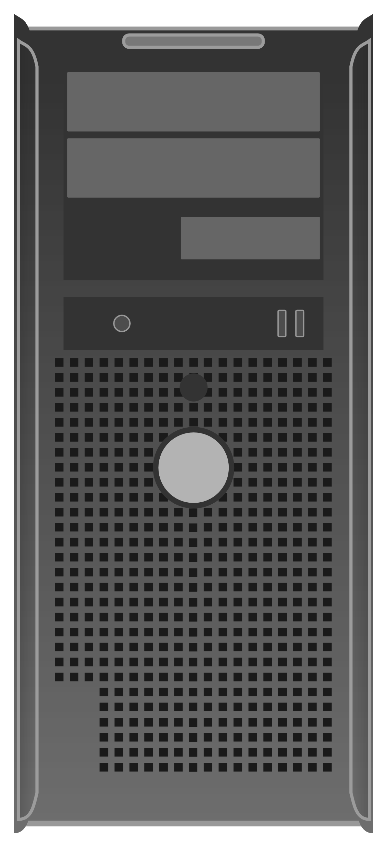



IT Asset Management (ITAM)
ITAM: The process of identifying, inventorying, tracking, and maintaining information technology assets as they are used across the organization.
User requests
Fault prediction
Asset procurement
Compliance issue identification
20

Slide 21

Fraud Identification
Transaction assessment
Outlier detection
Signature analysis
Identity theft detection

Slide 22

Security Notifications and Alerts
Alert sorting and filtering
Security dashboards
Notification dissemination
Remediation suggestions

Slide 23
Activity: Securing Assets Using AI
Read the question scenario in the text. How might AI help the security team focus on the real incidents that threaten the organization?
Read the question scenario in the text. How can AI improve your IT asset management process so that these kinds of incidents are avoided as much as possible?

Slide 24
Optimize Processes

Slide 25
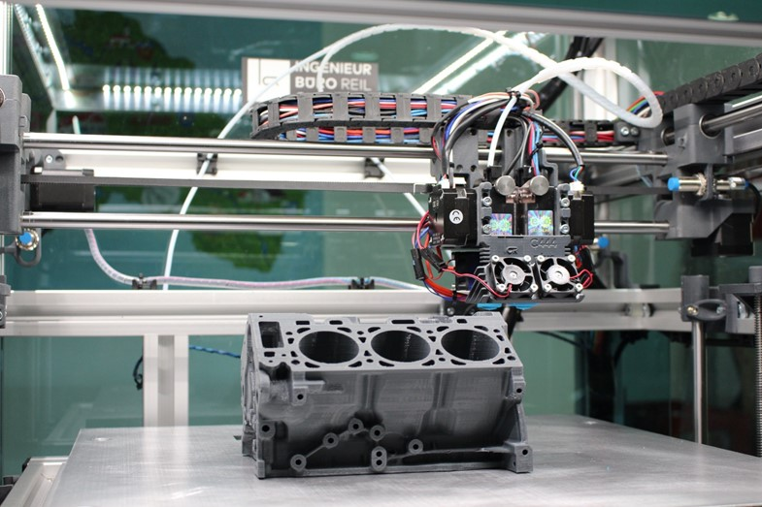
Industrial Robots
Industrial robot: A robot used in warehouses and manufacturing facilities to automate dangerous or difficult processes.
Welding
Assembly and disassembly
Inspection and testing
Packaging and labeling
25

Slide 26
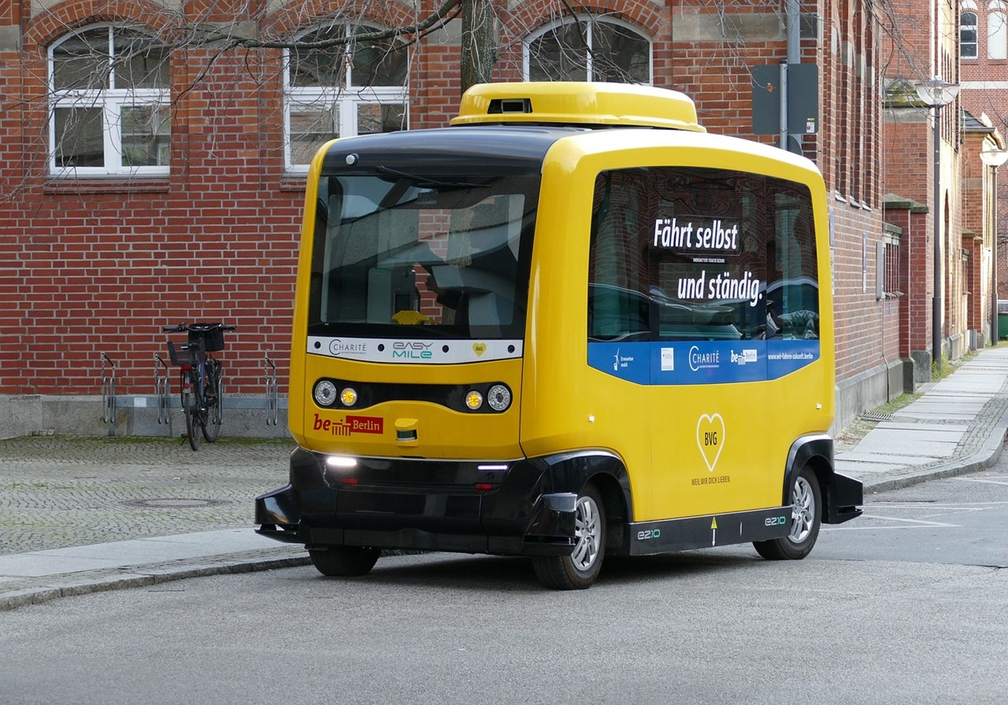
Autonomous Vehicles
Autonomous vehicle: A vehicle that has self-driving capabilities.
Product transport and freight
Delivery
Public transportation
Tourism
26

Slide 27

Robotic Process Automation
RPA: A method by which software agents, also called bots, automate the performance of one or more tasks.
Data entry and extraction
Software testing
Customer service
Financial processes
27

Slide 28

Predictive Analytics for AI
Predictive analytics: A form of data analytics that uses data to forecast future behaviors.
Inventory levels
Purchasing patterns
Staffing needs
Customer behavior
28

Slide 29

Supplier Relationship Management (SRM)
SRM: A process in which a business evaluates and attempts to strengthen the relationships it has with its suppliers, as well as better align those relationships with the business's overall goals and strategy.
Supplier segmentation
Supplier evaluation
Supplier collaboration
Risk management
29

Slide 30
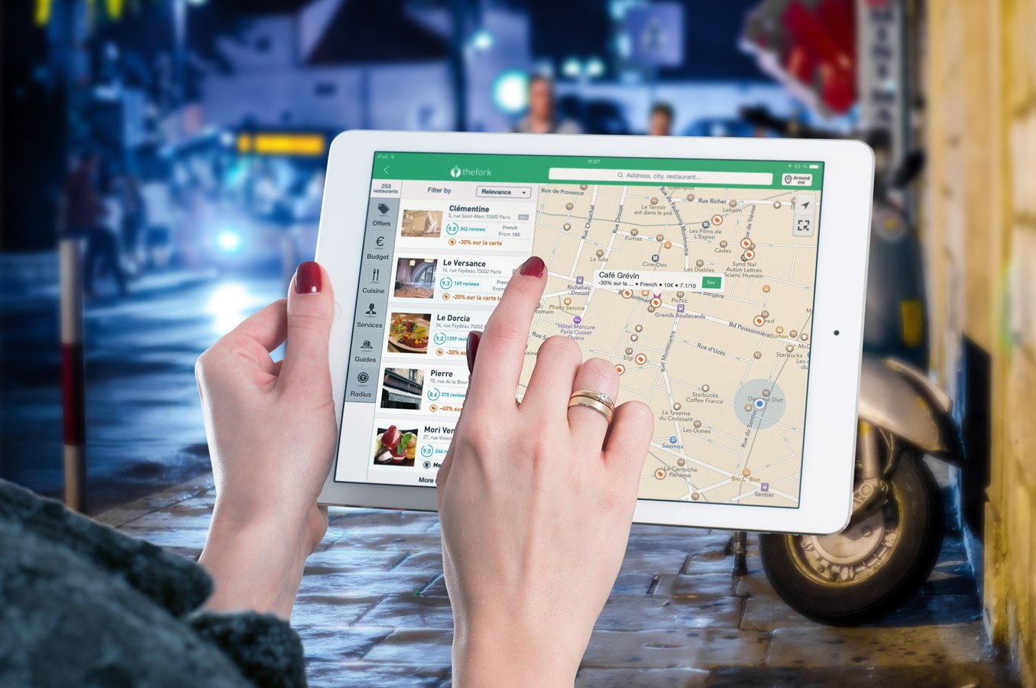
Route Optimization
Route optimization: The process of finding the shortest path between two points.
Delivery
Tourism
Warehouse navigation
Video games and virtual worlds
30

Slide 31
Activity: Optimizing Processes Using AI
Read the question scenario in the text. How might AI help address these inventory management challenges?
Read the question scenario in the text. How might AI help address assembly line challenges?

Slide 32
What function(s) of your own business are you most interested in applying AI to?
What other business functions not discussed in this lesson do you think AI could improve upon in your organization?

