Slide 1

Implementing Business Requirements for AI

Slide 2
Implementing Business Requirements for AI
Identify Design Requirements
Identify Data Requirements
Identify Risks in Implementing AI
Develop an AI Strategy

Slide 3
Identify Design Requirements

Slide 4

Use Case Identification
Don't shoehorn AI into your business.
Identify problems first, then how AI can help.
Factors for identifying use cases:
  Problems solved using traditional methods.
  Existing solutions.
  Overall goals.
  Relevant data.
  Similar problems solved by others.
Consult with stakeholders.
  Both technical and non-technical.

Slide 5

The Value Proposition of AI
Quantify the value that AI can bring.
Example: Recommendation system.
  Customers more likely to buy more products.
  Increase in sales worth the expense of AI?
  Increase in customer loyalty?
  Other ways to quantify value?

Slide 6

Prototype Assessment
Is the design efficient and effective?
Is the system scalable?
On-premises vs. cloud resources?
Can the model be moved elsewhere?
Can the model be improved later?
What are the maintenance costs?

Slide 7
Activity: Identifying Design Requirements for AI
Read the question scenario in the text. What are some important factors you should consider when identifying use cases for AI in your organization?
Read the question scenario in the text. What questions should you ask yourself or your team to help you assess the design of this prototype?

Slide 8
Identify Data Requirements

Slide 9


Data Quality and AI
Refers to:
  Accuracy
  Recentness
  Completeness
  Formatting
  Volume
  Usability
A deficiency in any will cause problems.
Determine which aspect(s) present highest risk.
Or, determine which are most important.

Slide 10

Data Control and AI
Techniques:
  Acquisition
  Storage
  Ownership
  Access permissions
  Modification permissions
  Sharing permissions
  Disposal
May repurpose general IT control processes.
AI has unique requirements for data control.

Slide 11

Data Security and AI
Data at risk of being:
  Copied/disseminated
  Modified
  Deleted
  Unavailable
Control access according to least privilege.
Implement encryption at rest, in transit, in use.
Consult with IT team.

Slide 12
Activity: Identifying Data Requirements for AI
Read the question scenario in the text. What are some data quality concerns that you have regarding this project?
Read the question scenario in the text. What are some security risks that could affect the data being used in this project?

Slide 13
Identify Risks in Implementing AI

Slide 14

Impact on Employees
AI can displace jobs.
  Mostly jobs with routine and predictable behavior.
Employees may feel "technostress."
  Lost productivity.
  Job insecurity.
Employees may struggle to adapt.
  AI can disrupt workflow.
  Reduced productivity during transitional period.

Slide 15

Operational Risks
Disruptive AI brings operational risks.
AI solution may:
  Outright fail.
  Not bring business value.
  Not be cost beneficial.
  Not be well integrated.
  Not be easily updated/maintained.
Change management can:
  Increase organizational readiness.
  Minimize risks.
  Better prepare org to harness AI.

Slide 16

Ethical Considerations
Privacy
Accountability
Transparency and explainability
Fairness and non-discrimination
Safety and security

Slide 17
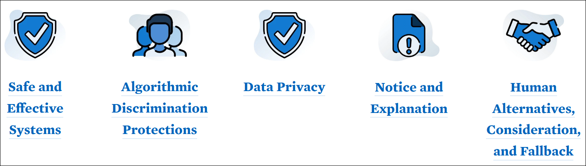
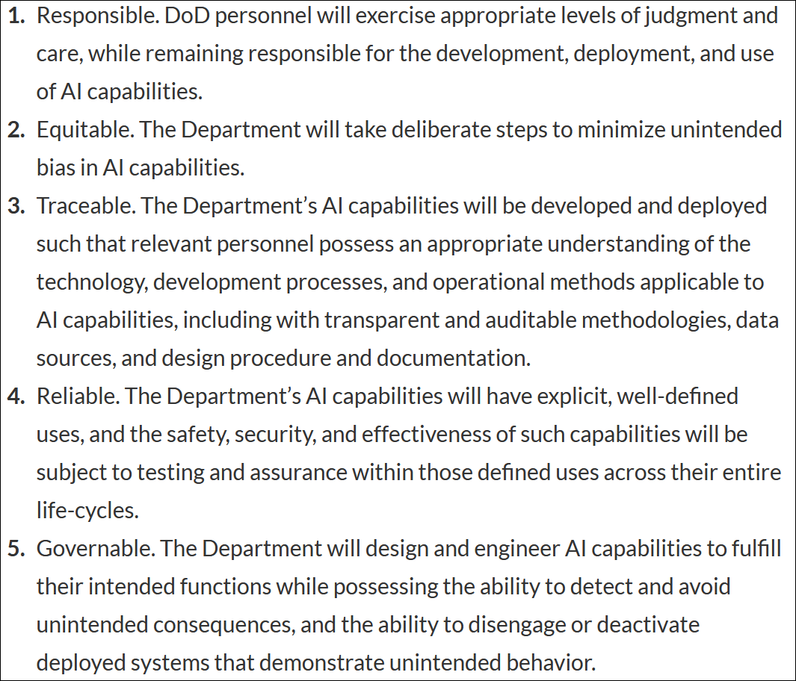
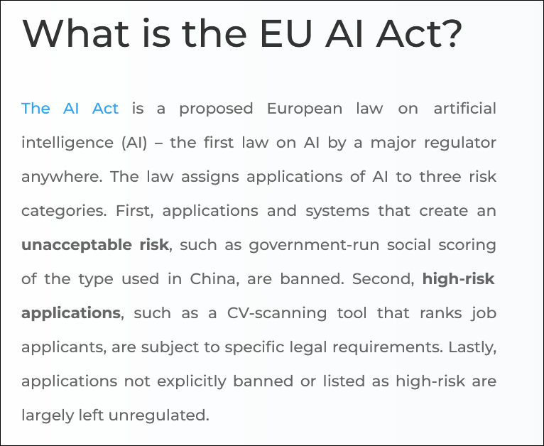
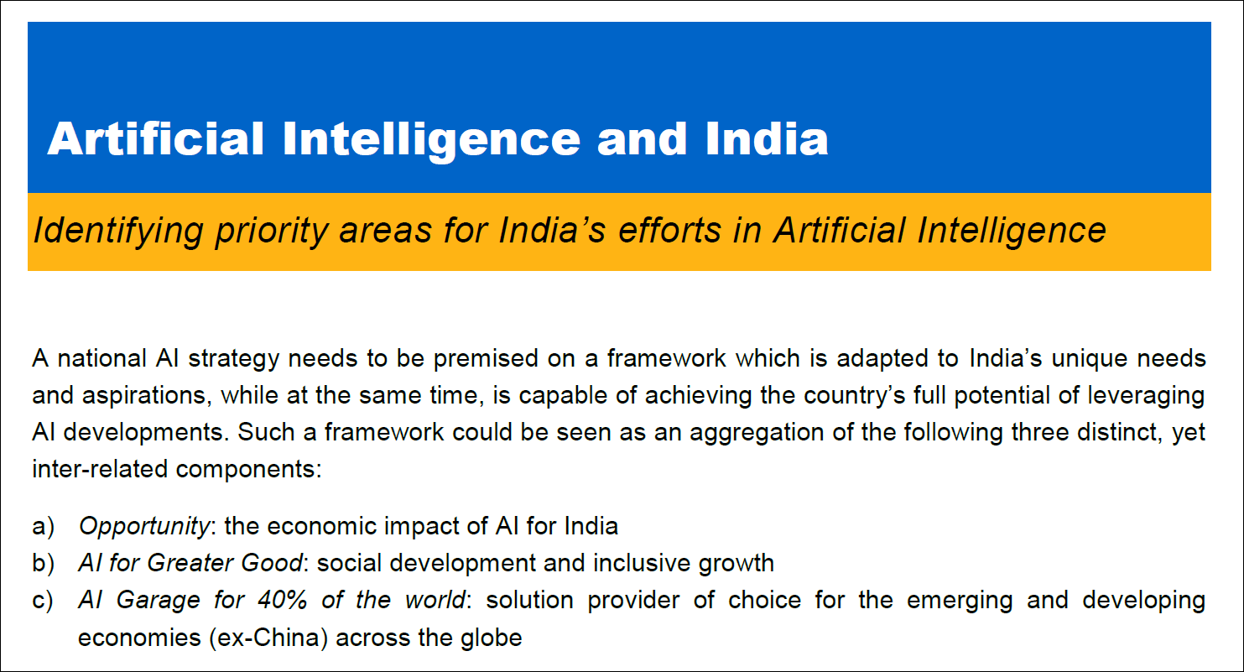
Legal and Regulatory Considerations
US AI Bill of Rights
DoD AI Principles
National Strategy for AI

Slide 18
Activity: Identifying Risks in Implementing AI
Read the question scenario in the text. What are some of the business risks involved in adopting this AI solution, from both an employee and an operational standpoint?
Read the question scenario in the text. What are some ethical concerns you would have regarding this solution?

Slide 19
Develop an AI Strategy

Slide 20

Alignment to Organizational Initiatives
AI solutions must align to initiatives/strategies.
  Otherwise, they won't bring much value.
  Could also be disastrous if not aligned.
Example: Digital transformation.
  Org seeks change through digital technologies.
  AI is an attractive option.
  AI fulfills initiative objectives.
Other relevant initiatives:
  Data strategy
  Growth strategy

Slide 21



Alignment to Environmental, Social, and Governance (ESG) Initiatives
E
S
G
Commitment to sustainability
Power efficiency of AI solutions
Commitment to treating people fairly
Supporting diversity, equity, and inclusion
Commitment to leadership and management
Supporting data protection processes

Slide 22

Organizational Resources
Talent resources
Data resources
Computing resources
Budget resources
Stakeholders

Slide 23

Competitive Considerations
AI gives orgs a competitive edge.
A way to obtain or maintain industry leadership.
Example competitive benefits:
  Improving existing products and services.
  Fostering innovation.
  Streamlining business processes.
  Generating renewed customer interest.
  Attracting new talent.

Slide 24
Activity: Developing an AI Strategy
Read the question scenario in the text. How might the AI job applicant screener impact each of the three aspects of the ESG framework? How might you address these impacts in your AI strategy?
Read the question scenario in the text. What are some organizational resources that you need to consider as part of your AI strategy? Why are these resources relevant to the job applicant screener?

Slide 25
When it comes to implementing AI in your organization, what risks most concern you, and why?
What organizational resources have the most bearing on your AI strategy, and why?

