Slide 1

AI Fundamentals

Slide 2
AI Fundamentals
AI Concepts
Generative AI Concepts

Slide 3
AI Concepts

Slide 4
What Is Artificial Intelligence (AI)?
Artificial intelligence (AI): The ability of machines to exhibit humanlike intelligence.
Common factors:
  Perceiving one's environment.
  Taking actions to achieve goals.
  Obtaining knowledge and applying it for problem solving.
AI will revolutionize business.
Anyone can understand its impact.

Slide 5
Activity: Exploring Generative AI

Slide 6
Recent Timeline of AI
Enabling technologies:
Cloud
Big data
GPUs
GPT-4
Bard
Duet AI
Agentic AI
DALL·E
LLaMA
Training efficiency
OpenAI
GPT-1
GH Copilot
M365 Copilot
AI Action Summit
New Bing
GPAI Code
'11
'16
'20
'22
'24
'06
'08
'15
'18
'21
'23
'25
Watson
DeepMind
GPT-3
ChatGPT
GPT-4
Siri
DALL·E 2
o1
Google Brain
Midjourney
Sora
Stable Diffusion
Gemini 1.5
Llama 3
RAG
EU AI Act

Slide 7


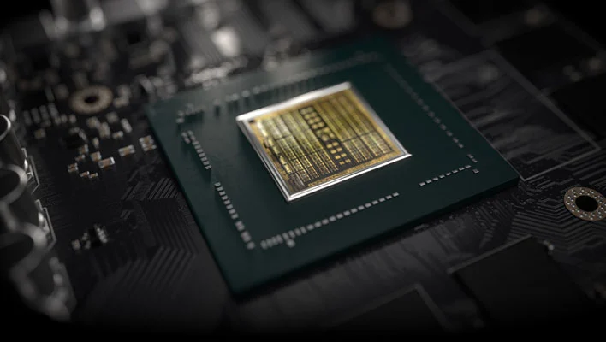
AI-Enabling Technologies
Cloud computing: An approach to providing computing services and other resources over a network of distributed servers and other infrastructure. Offloads AI hardware and bandwidth costs.
GPUs: Computer chips designed to process graphics, images, and other visual media. General-purpose GPUs excel at machine learning calculations.
Big data: Collections of data that are so large and complex that they require advanced tools to process and analyze them. AI is heavily data driven.

Slide 8
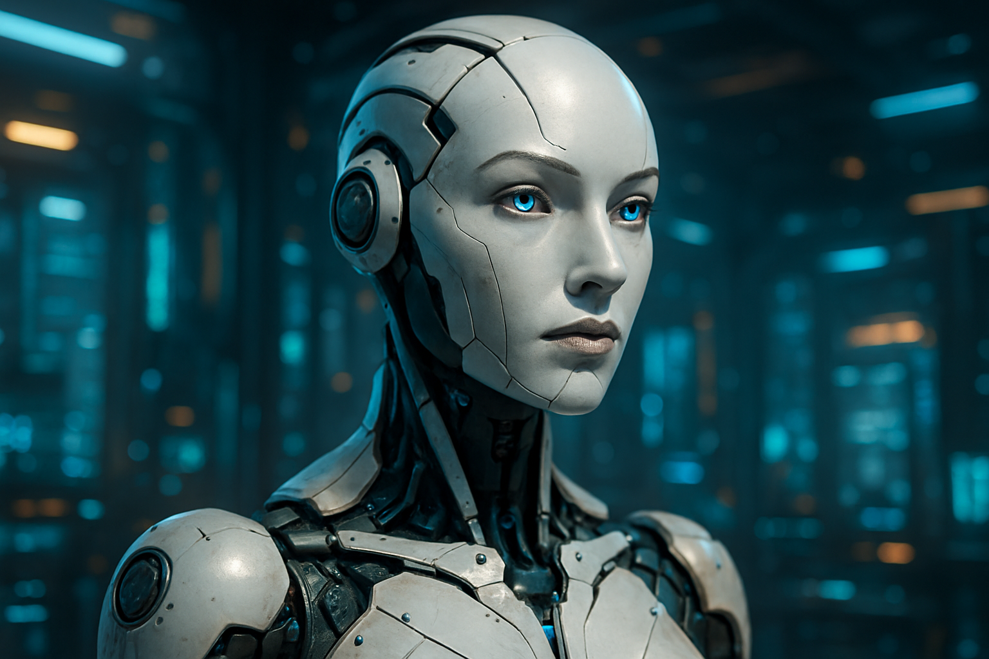
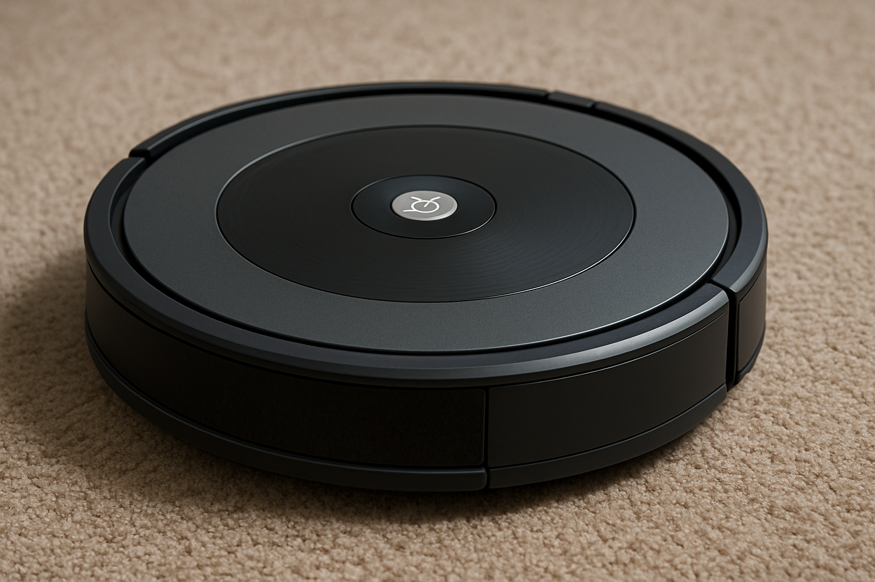
General AI and Narrow AI
General AI
Narrow AI
Same or better cognition than humans
Extrapolates reasoning
Solves multiple novel problems
Not yet a reality
Approximates human cognitive traits
No true capacity for reason
Solves one or a few designated problems
Currently a reality

Slide 9






Machine Learning
Data input to algorithm
Creates model
Makes predictions
Evaluates predictions
Data
Algorithm
Model
Improves
Learns

Slide 10
Machine Learning Datasets
Features
ID | Weight (lbs) | Height (in) | Blood Pressure
554389 | 156.5 | 65 | 120/80
840933 | 167.3 | 64 | 135/86
913221 | 212.8 | 73 | 123/75
453772 | 256.1 | 68 | 140/90
Examples
Note that "ID" is not a feature because it is not relevant to making predictions in this case.
The model is said to train on this data.

Slide 11









Deep Learning
Image Input
Low Layer (simple)
A type of machine learning that makes decisions using multiple layers of information.
Middle Layer (complex)
High Layer (very complex)
Decision (contains a face)

Slide 12
Artificial Neural Networks (ANN)
Input Layer
Hidden Layer
Output Layer
Neuron
Neuron
Neuron
Output A (contains a face)
Neuron
Neuron
Neuron
Neuron
Neuron
Output B (doesn't contain a face)
Neuron
Neuron

Slide 13
Parameters and Weights
Input Layer
Hidden Layer
Output Layer
Neuron
0.21
−0.41
Neuron
−0.13
−2.93
Neuron
Neuron
Output (contains a face)
−1.64
0.76
3.12
Neuron
2.34
Neuron

Slide 14

Model Checkpoints
Checkpoint: The state of a model's parameters saved to a file.
Can be used by systems, apps, and users.
Model can be loaded into custom environment.
Organization leverages model directly.
Size of model determines size of file.
  ANNs can be multiple GBs.

Slide 15

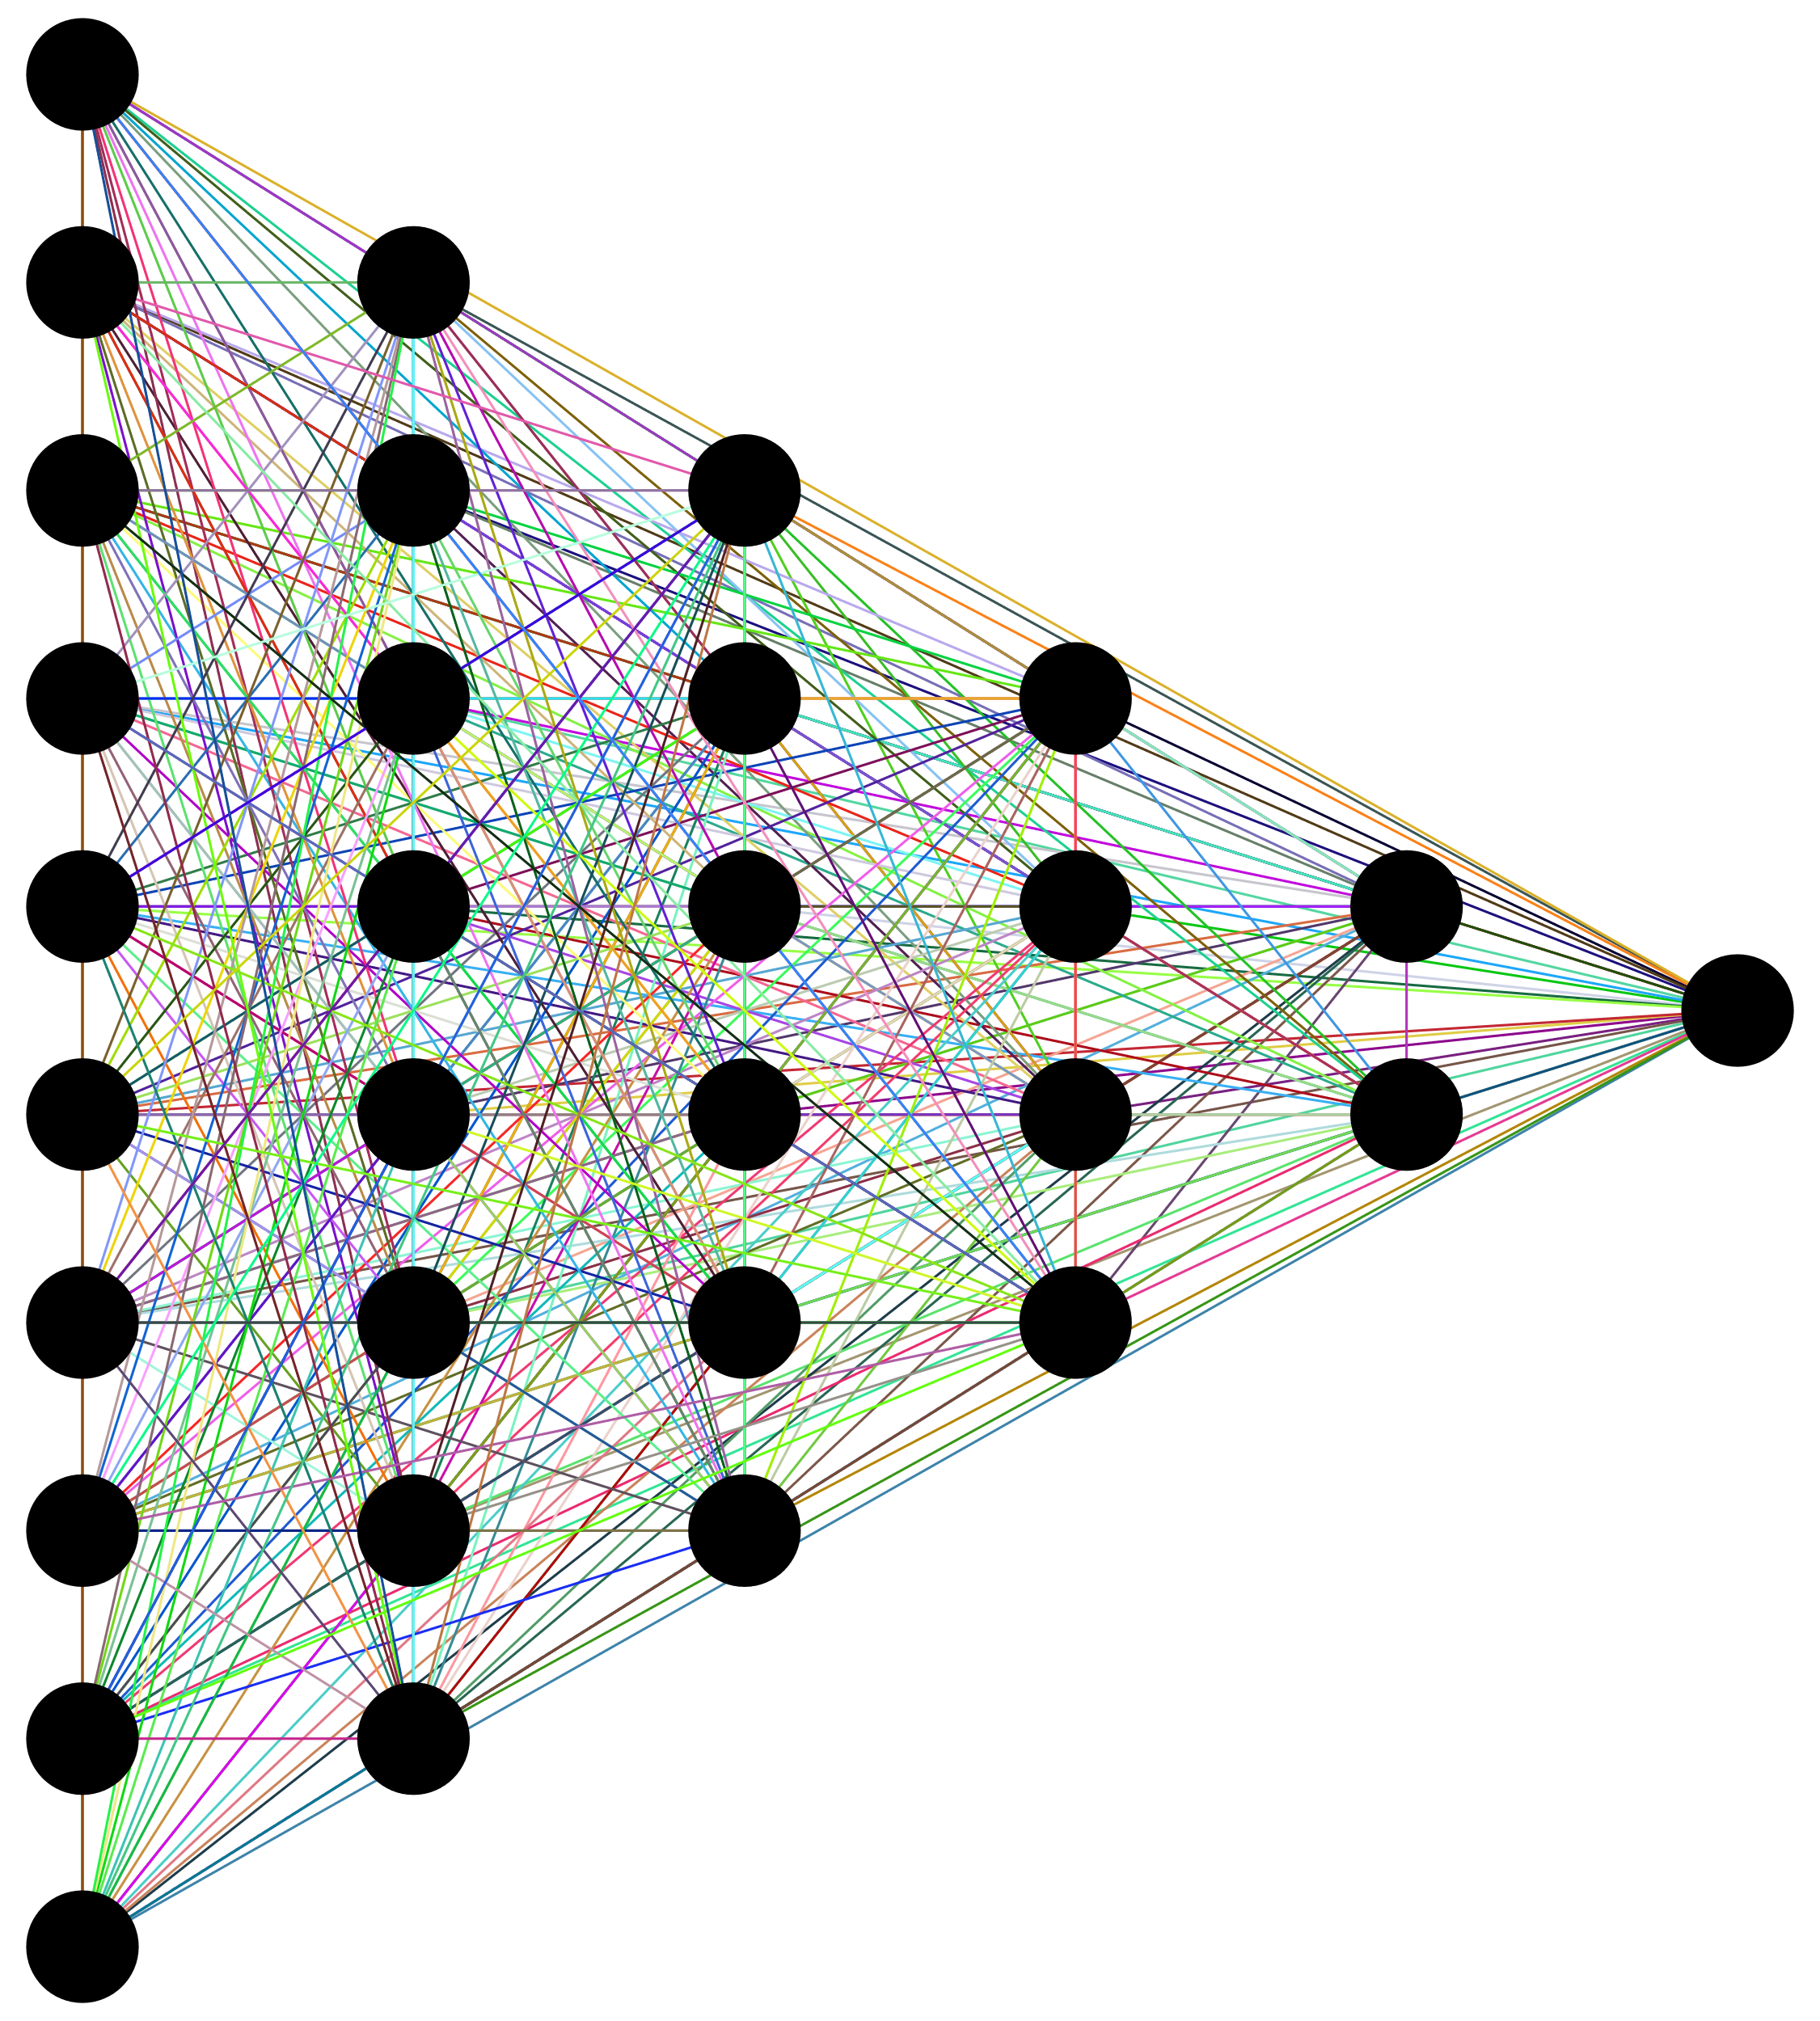


Deep Learning Applications
Natural-language processing (NLP)
Computer vision
Robotics

Slide 16

Machine Learning vs. Deep Learning
Traditional Machine Learning
Human Face
Input image
Human identifies features
Model learns patterns
Model makes decision
Deep Learning
Human Face
Input image
Model extracts features and learns patterns
Model makes decision

Slide 17
How AI Concepts Relate
Artificial Intelligence
Machine Learning
Deep Learning

Slide 18



Machine Learning Approaches
Supervised Learning
Unsupervised Learning
Reinforcement Learning

Slide 19
Activity: Discussing AI Concepts
Read the question scenario in the text. Which technique, traditional machine learning or deep learning, would be most suitable to achieving this business objective? Why did you make this choice and not the other?
Read the question in the scenario text. Is this data used in supervised, unsupervised, or reinforcement learning? Explain why.
Read the question and select an answer.

Slide 20
Generative AI Concepts

Slide 21
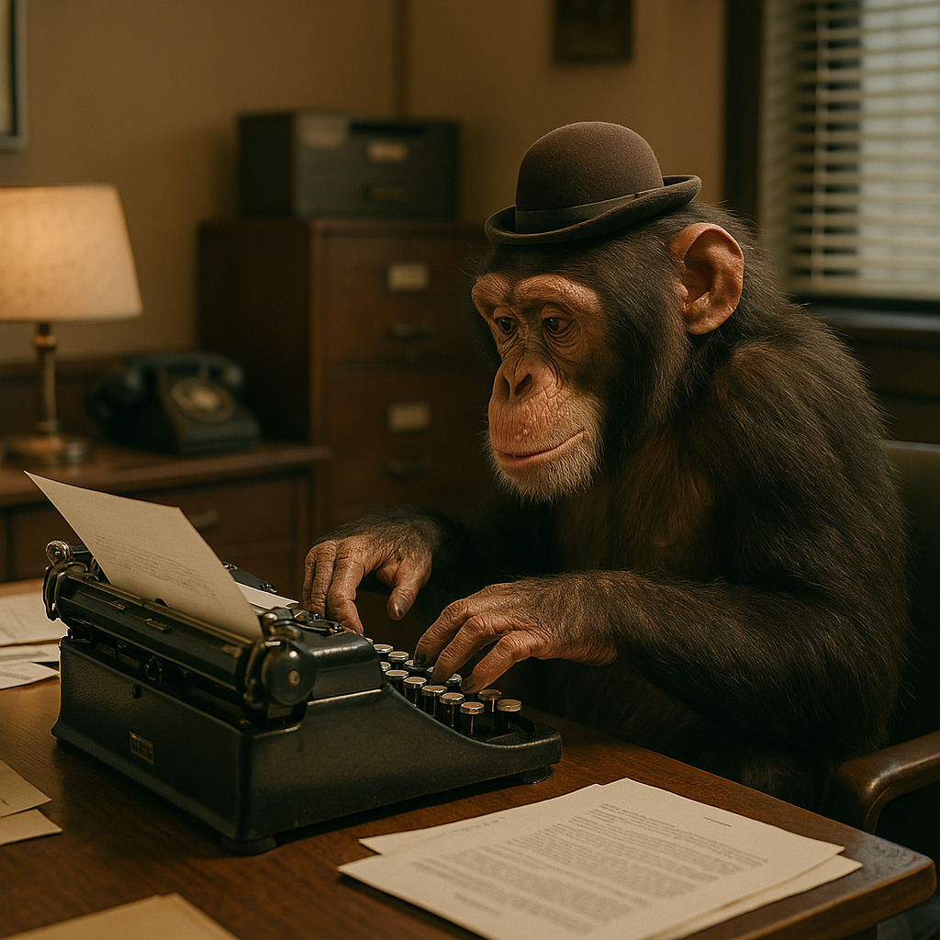
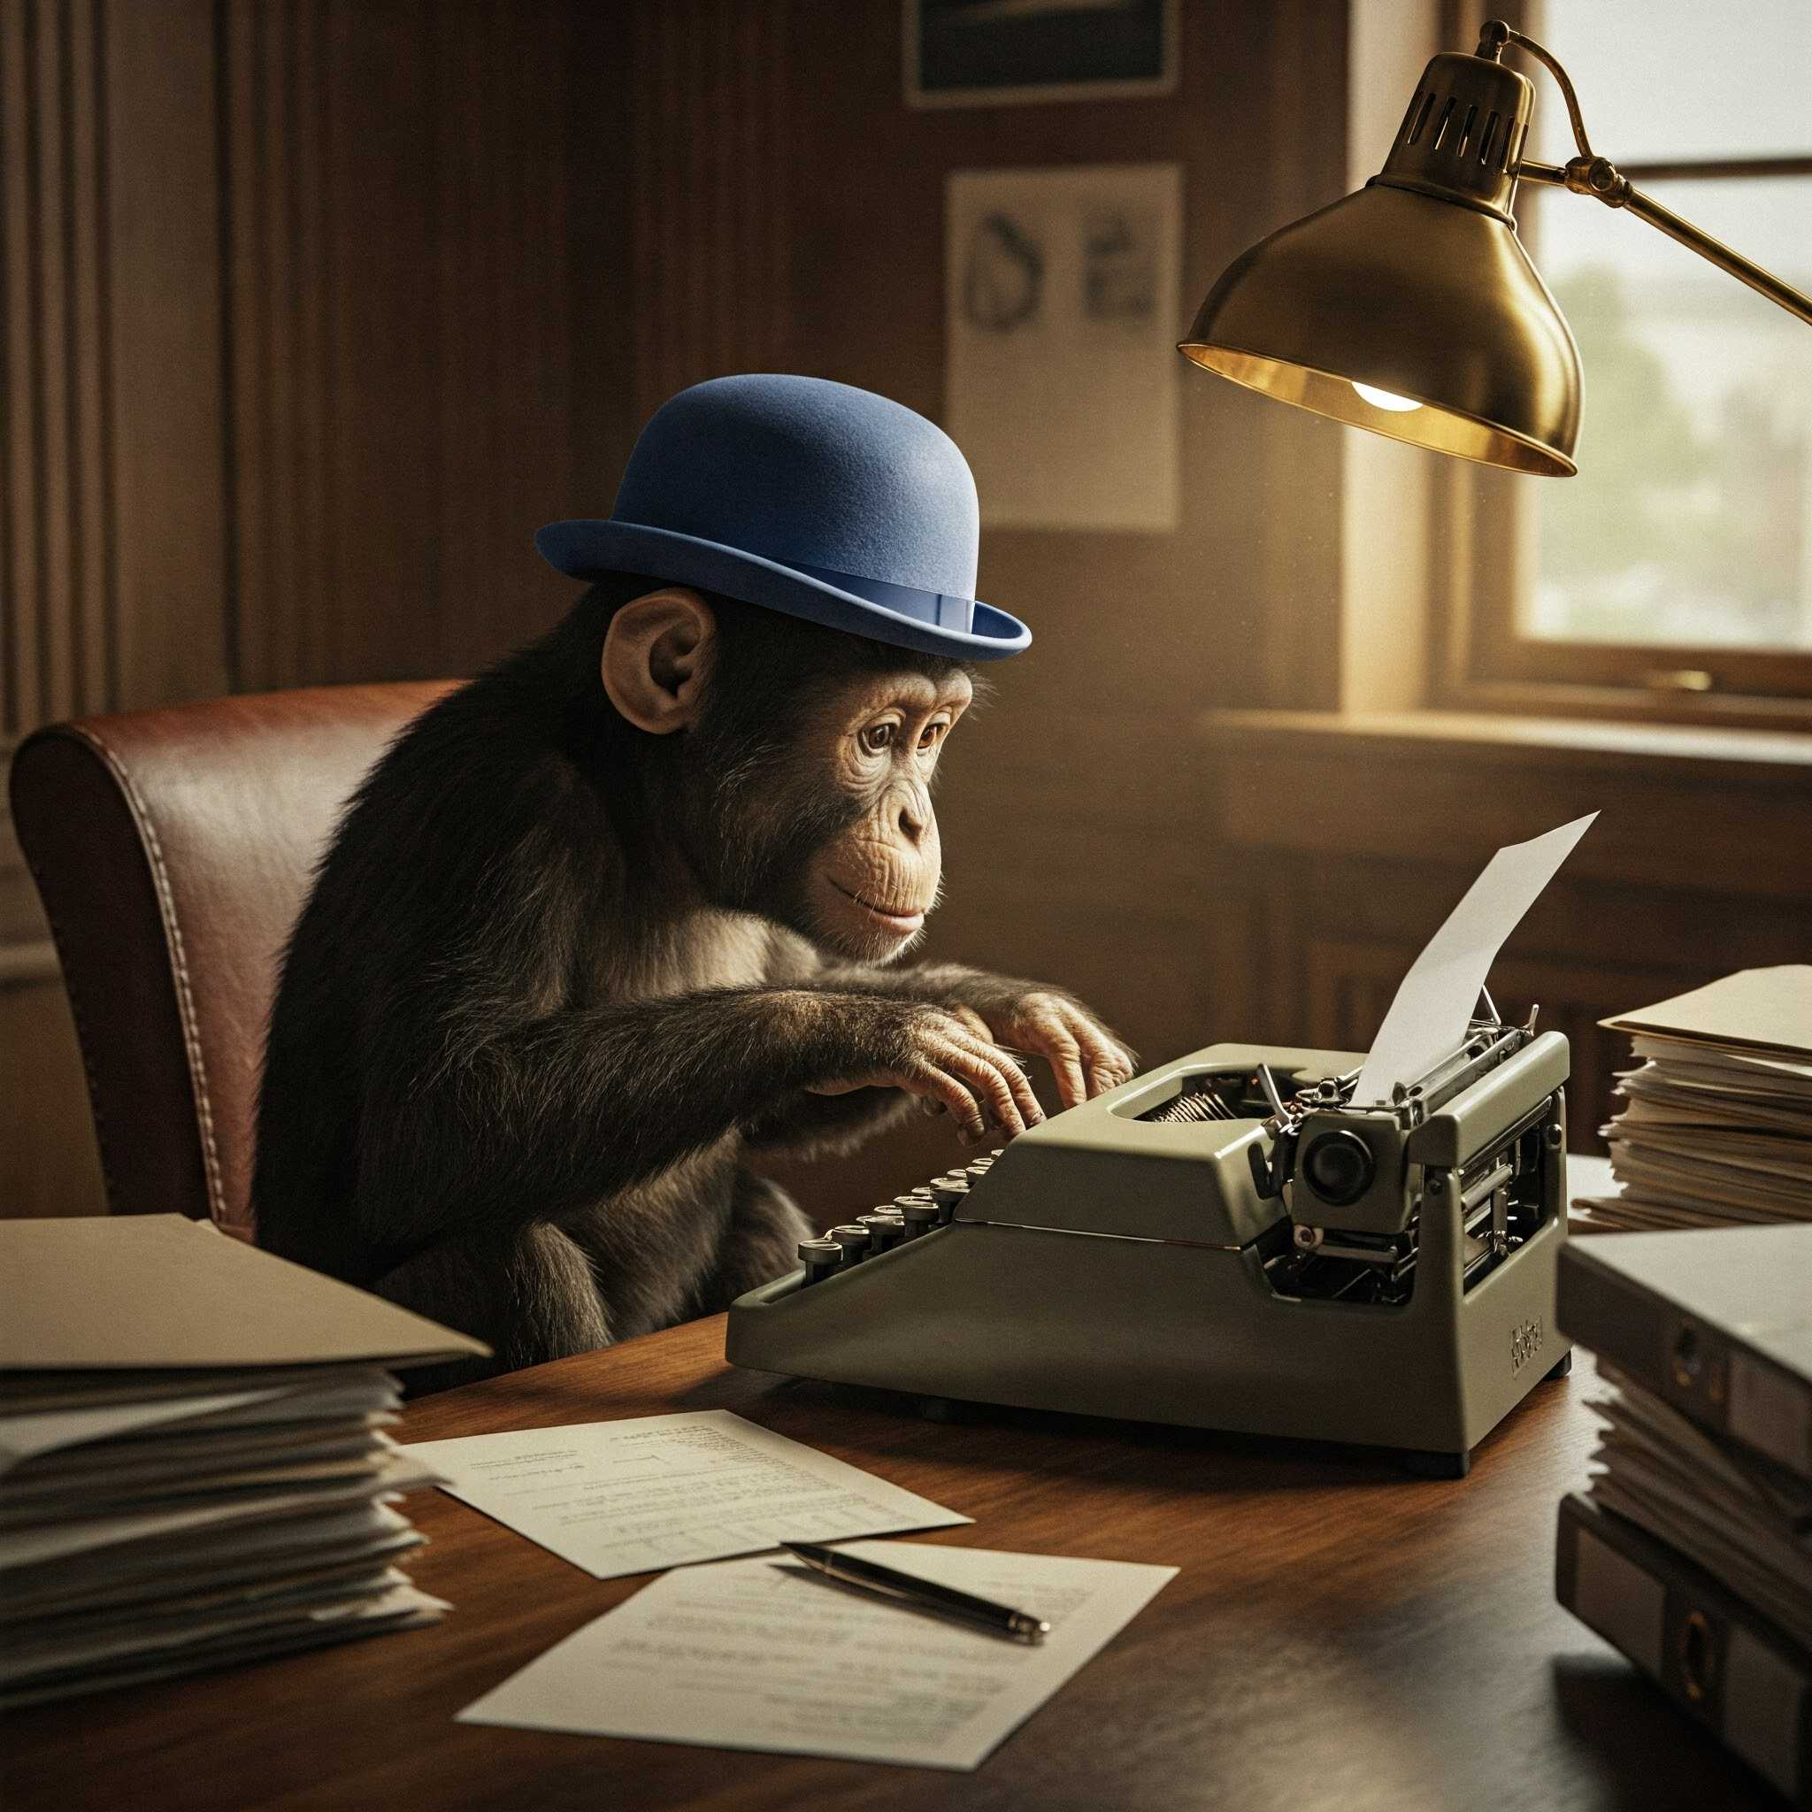

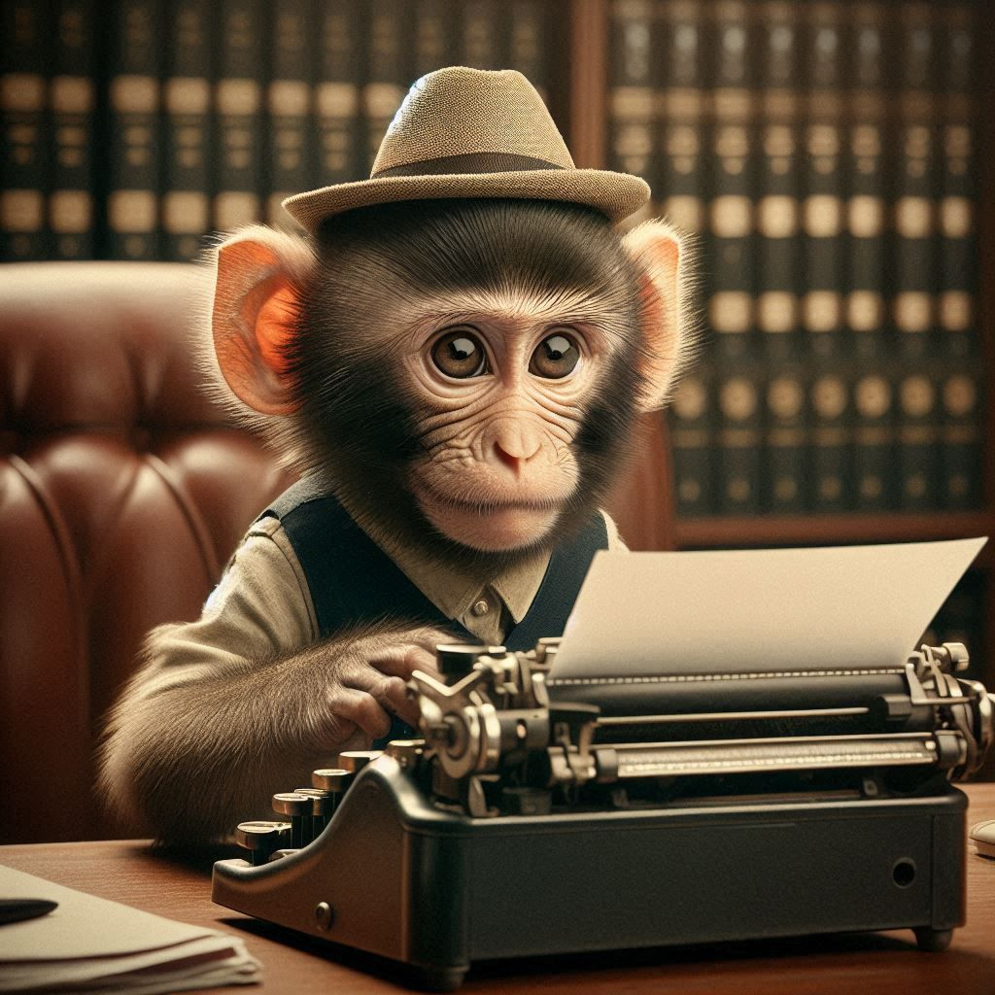
Generative AI
Generative AI: Deep learning models used to generate any kind of content that appears as if it were created by a human.
Trained on massive amounts of data.
  Disparate sources and types.
You can "ask" a model to create by:
  Providing a written prompt.
  Providing media to use as an example.
  Providing media for transformation.
  Receiving suggestions based on work.
  Any combination of these.

Slide 22









Key Generative AI Organizations

Slide 23

Generative AI Resources
Python + libraries
  https://www.python.org/
  https://pytorch.org/
  https://www.tensorflow.org/
Hugging Face
  https://huggingface.co/
Hard Fork
  https://www.nytimes.com/column/hard-fork
Towards AI
  https://towardsai.net

Slide 24






Generative AI Modalities
Text
Images
Video
Audio
Code
Multimodal

Slide 25

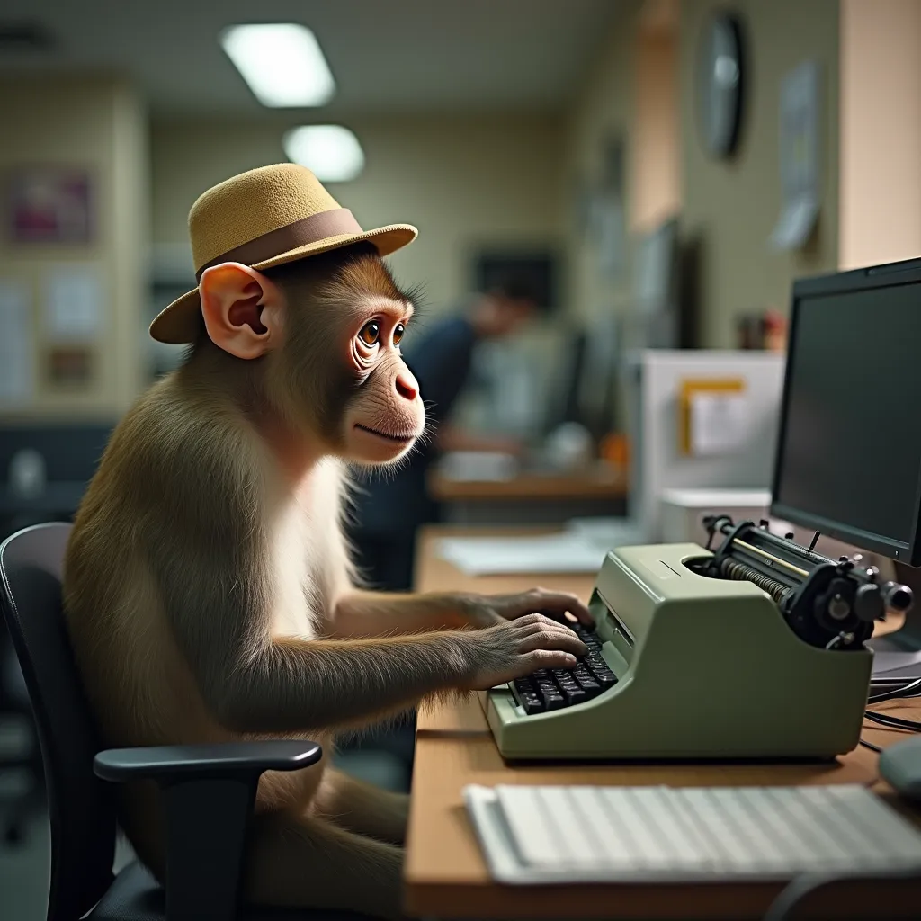
Generative AI Prompting
Prompt:
a photograph of a monkey typing at a typewriter, wearing a small hat, in an office

Slide 26

Prompt Engineering
Prompt engineering: The process of refining an input prompt until it produces a desired output from a generative AI model.
Necessary skill for anyone using generative AI.
No universal "good" prompt.
General best practices:
  Build prompts iteratively.
  Be descriptive.
  Prefer clarity to verbosity.
  Provide relevant examples.
  Save and reuse successful prompts.
Prompt Engineer

Slide 27
In-Context Prompting
Zero-shot:
<Text of customer complaint.> Why is the customer asking for a refund?
One-shot:
Complaint: The product was broken when it arrived. Reason: Defect.
Complaint: <text of customer complaint.> Reason:
Few-shot:
Complaint: The product was broken when it arrived. Reason: Defect.
Complaint: I ordered the red version but got the blue one instead. Reason: Wrong color.
Complaint: <text of customer complaint.> Reason:
The purpose is to get the model to format the reason in a concise way.

Slide 28

Fine Tuning
Fine tuning: The process by which an existing model's weights are updated based on new training data.
Augments model outputs.
Customizes model for specialized domains.
Reduces need for in-context prompting.
Requires data, time, and resources.

Slide 29
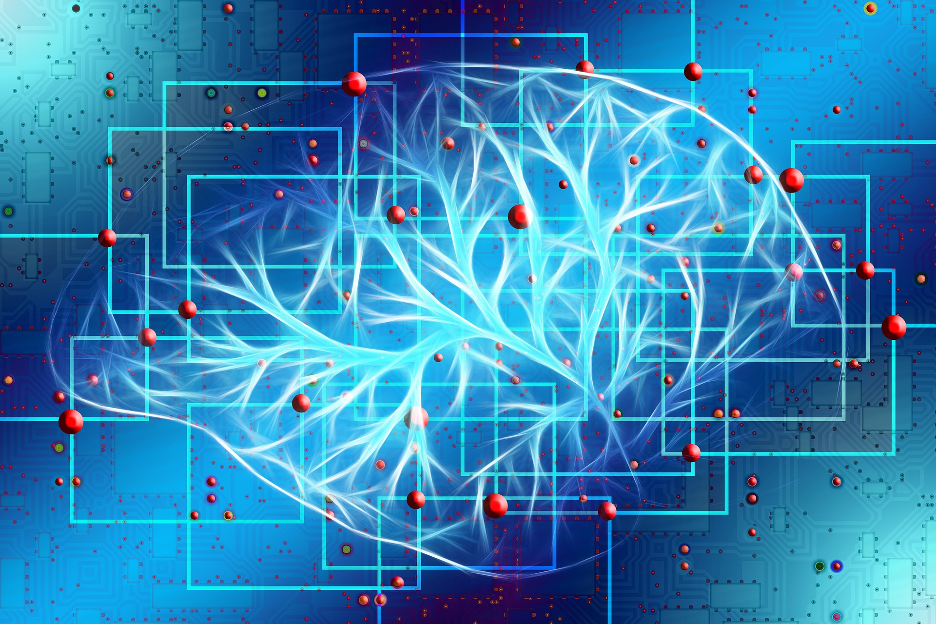
Generative AI Approaches
Diffusion models
Generative pre-trained transformers (GPTs)
Reinforcement learning from human feedback (RLHF)

Slide 30
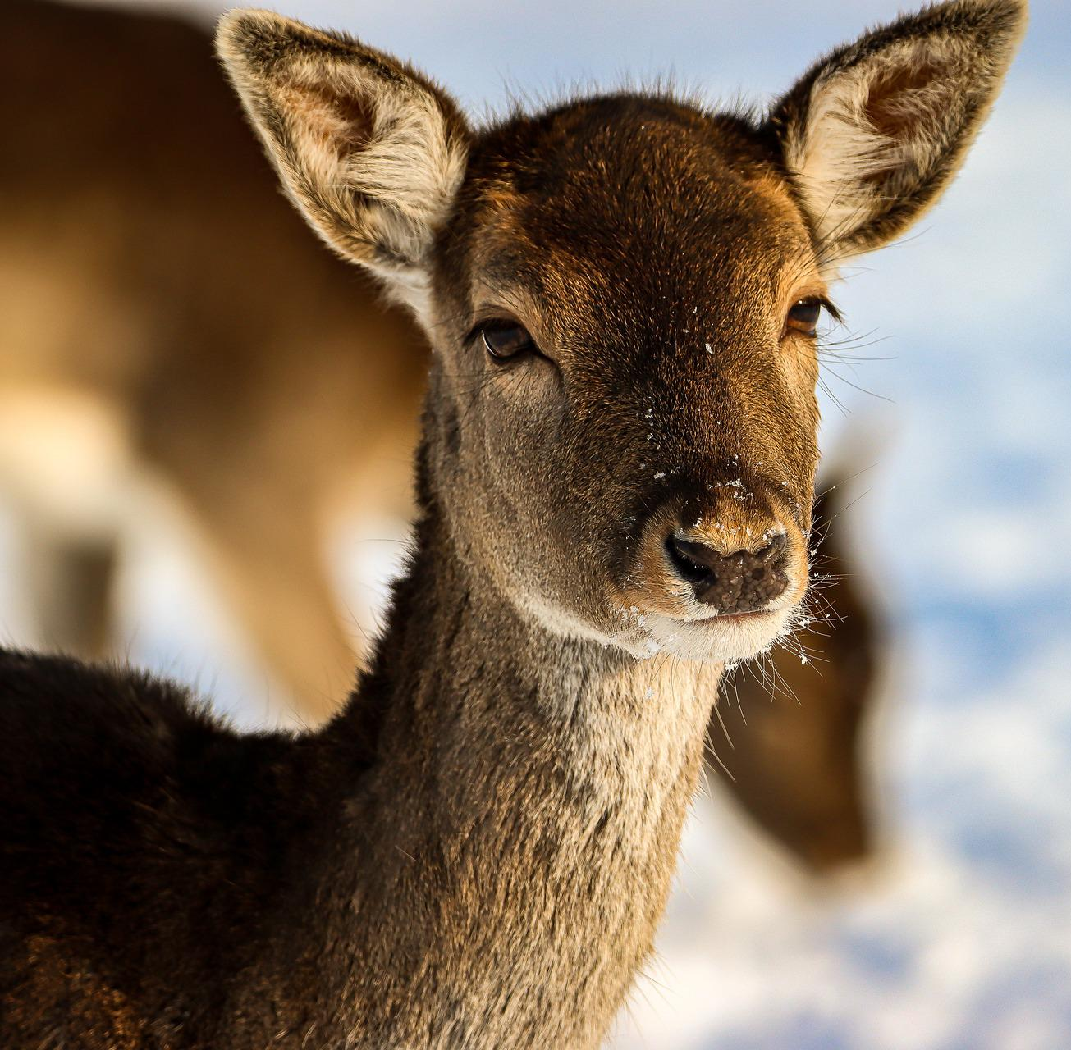
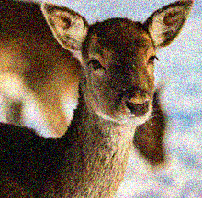
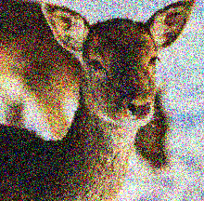
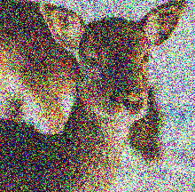



Diffusion Models
Forward Diffusion
Reverse Denoising

Slide 31



Generative Pre-trained Transformers (GPT)
Based on a transformer architecture.
Processes sequential input all at once (self-attention).
Encoder
Self-Attention
Decoder
He was tired, so he sat
down

Slide 32

Reinforcement Learning from Human Feedback (RLHF)
RLHF: A technique used to enhance neural networks through a reward system based on human feedback.
Humans rank/score language model's outputs.
Reward model predicts scores.
Predictions guide language model's outputs.
Part of model optimization:
  Pre-train model with unlabeled data.
  Fine tune model with labeled data.
  Apply RLHF.

Slide 33
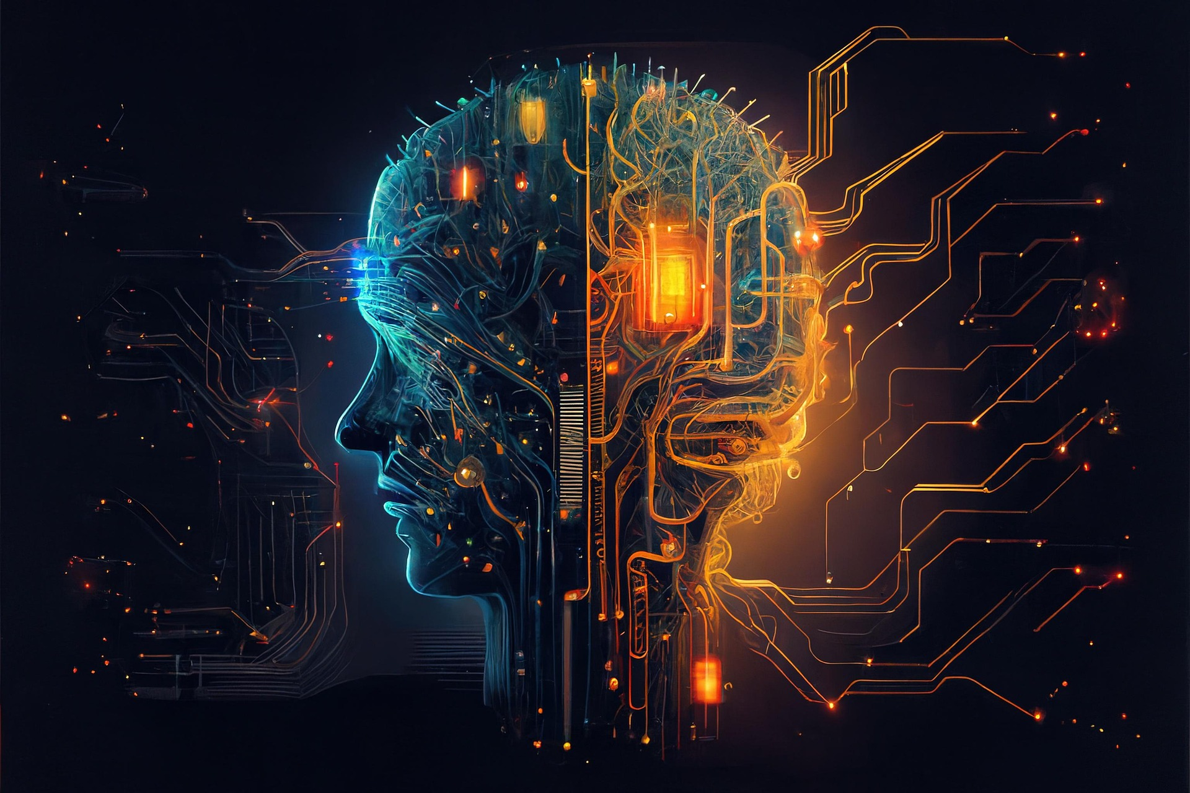
Agentic AI
Agentic AI: The AI discipline in which systems can make decisions based on input and act on them autonomously in the pursuit of one or more goals.
Minimal human oversight.
Context aware, can adapt to changes.
Uses same underlying tech as generative AI.
The next step beyond generative AI.
Benefits:
  Increase speed/scale of tasks.
  Minimize disruptions due to changes.
  Bridge gaps between data and tools.
  Free humans up to focus on creative pursuits.

Slide 34








Agentic AI Example
1. User Goal
"Plan my next business trip"
2. Analysis
Evaluates request
Begins planning
Planner breaks down request into subtasks
Tool runner calls external systems
Monitor watches for changes
3. Preparation
4. Execution
Books flight and hotel
Schedules on calendar
5. Validation
Verifies success
Ensures ticket is valid
6. Output
Returns itinerary
7. User Review
Tweaks actions/results
Switches to cheaper flight

Slide 35





API Access
API: A component that connects disparate pieces of software together.
Developers can use external models in their apps.
APIs provide connections to those models.
Not all providers have APIs.
APIs usually have a cost per usage.
App
API
Model
Request
Response

Slide 36

Myths and Misconceptions About Generative AI
Generative AI always provides satisfactory results.
Generative AI never provides satisfactory results.
Results don't need to be reviewed by a human.
Content generated by AI is plagiarized.
Content generated by AI is combined.
Tools that detect AI-generated content are reliable.
Outputs violate authors' and artists' copyrights.
Generative AI will completely replace human labor.

Slide 37
Activity: Discussing Generative AI Concepts
Read the question scenario in the text. Which generative AI modality or modalities would be relevant to solving this problem, and how?
Read the question scenario in the text. How can you guide the AI's outputs using prompt engineering?
Read the question scenario in the text. How might you use your data to improve the AI's relevance to your specialized field?
Read the question and select an answer.

Slide 38
What sort of additional research, if any, do you plan on doing to learn more about the concepts behind AI?
Does your organization currently use, or plan to use, generative AI or agentic AI? How?

