Slide 1

Generating Text Using AI

Slide 2
Generating Text Using AI
Identify Text Generation Concepts
Solve Business Problems Using Text Generation

Slide 3
Identify Text Generation Concepts

Slide 4

Large Language Models (LLMs)
LLM: A deep learning model that analyzes patterns in very large bodies of text in order to determine how best to predict some kind of textual output.
Answers questions, solves problems, etc.
Based on GPT architecture.
Foundational models.
Trillions of parameters.

Slide 5
Tokens
Token: A small sequence of written language that has been partitioned from the whole.
1 token = ~4 characters.
100 tokens = ~75 words.
APIs usually charge by the token.
Art
ificial
neural
networks
power
gener
ative
AI
.

Slide 6
Text Completion
Predicts tokens following prompt.
Can also continue ideas/themes.
Suitable for telling stories/finishing ideas.
Limited at answering questions.
Prompt
Completion
Think outside of
Think outside of the box.
Prompt
Completion
List the planets in the solar system from largest to smallest.
List the planets in the solar system from biggest to smallest.
List the planets in the solar system by distance from the Sun.
List the stars in the sky from largest to smallest.

Slide 7
Instruction Following
Input prompt includes instructions.
Outputs factual info and/or direct response to query.
Example:
Can be more useful than text completion.
Better alternative than traditional search engines.
Humanlike qualities are limited.
Prompt
Response
List the planets in the solar system from largest to smallest.
Jupiter, Saturn, Uranus, Neptune, Earth, Venus, Mars, Mercury

Slide 8


Chatbots
Can you help me settle a bet with a friend?
Of course! Please provide me with the details of the bet and the specific question or issue you need assistance with.
I need to know the size of the planets from largest to smallest.
Certainly! Here's a list of the planets in our solar system, arranged in order from largest to smallest based on their approximate equatorial diameter: 1. Jupiter; 2. Saturn; 3. Uranus; 4. Neptune; 5. Earth; 6. Venus; 7. Mars; 8. Mercury
Sorry, I meant to say smallest to largest.
No problem! Here's the revised list of the planets in our solar system, arranged in order from smallest to largest based on their approximate equatorial diameter: 1. Mercury; 2. Mars; 3. Venus; 4. Earth; 5. Neptune; 6. Uranus; 7. Saturn; 8. Jupiter

Slide 9




Integrated AI for Text
What do you want to say?
Summarize meeting notes for the team.
To: sales@mixedmessagesmedia.net
Subject: Meeting summary
Hi everyone,
Here's a summary of what we discussed in the meeting:
We're switching to a new CRM system July 1.
We're focusing on new opportunities in EMEA.
Leaps & Bounds Travel was recently added as a new client.
Our revenue in Q2 was 105% of expectations.
We're currently hiring for a new Sales Associate position.
Thanks,
John Brady
Sales Manager

Slide 10

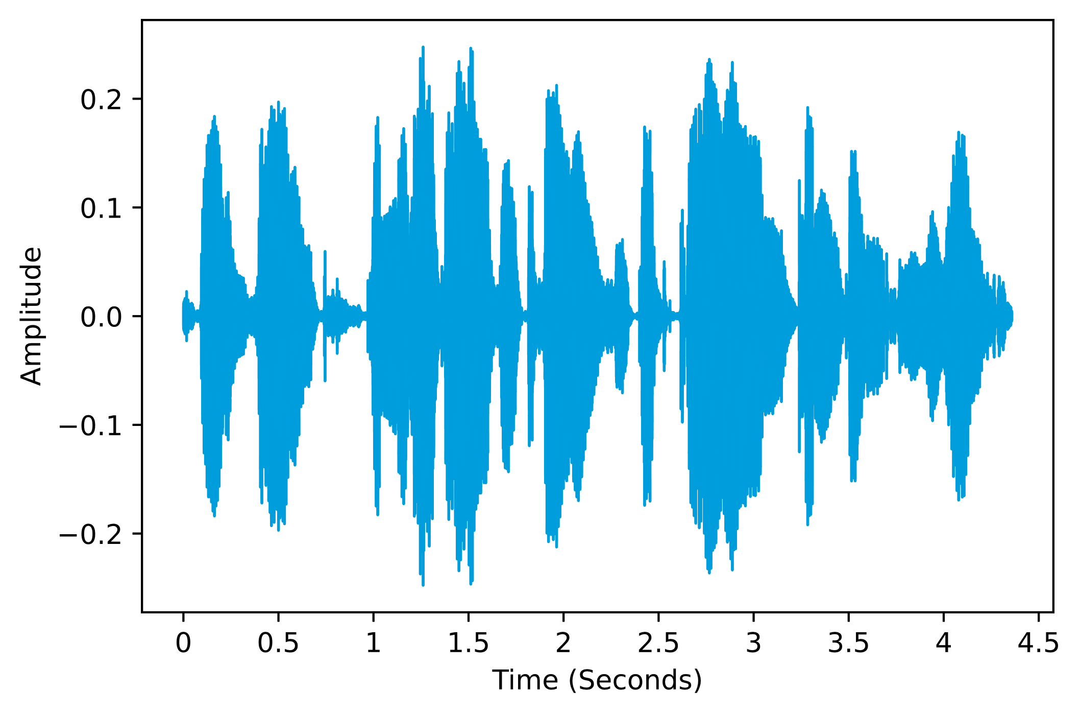
Speech to Text
'Twas brillig, and the slithy toves did gyre and gimble in the wade.

Slide 11







Additional Text-Generation Approaches
Summarization
Inference
Evaluation
Translation
Troubleshooting
Sentiment Analysis
Content Generation

Slide 12
In-Context Prompting Example
Prime a model using examples.
Used for text generation.
Example:
Prompt
Response
Use the following format to identify the sentiment of a customer review.
Review: Normally I love Company A's products, but this one was a disappointment.
Sentiment: Negative
Review: Another great product from Company A!
Sentiment: Positive
Review: Overall, the latest product from Company A measures up to expectations.
Sentiment: Positive

Slide 13
Best Practices for Prompt Engineering with Text Generation
Assign a chatbot a persona or role.
Write as clearly as you can.
Provide any relevant conditions.
Ask for sources.
Know the model's restrictions.
Keep trying until you get it right.

Slide 14

Reasoning Models
Reasoning model: A type of LLM that follows a chain of thought to break down a complex problem step by step before providing a response.
Explore, evaluate, re-evaluate.
Chain-of-thought prompt engineering not needed.
Slower, but better results.
OpenAI o1 was first.
Trained/fine tuned on logic processes.

Slide 15
Fine Tuning Text Models
Sentiment Analysis
Make sure data:
  Is labeled.
  Is high quality.
  Is appropriately formatted.
  Includes many examples.
Prompt
Response
This T-shirt fits great and looks great, too!
Sentiment: Positive
Product Description
Prompt
Response
Model: T-shirt; Colors: Green, Red, Pink; Sizes: S, M, L, XL; Fabric: Cotton
Our comfortable, stylish T-shirts are 100% cotton and come in a variety of sizes and colors. Pick one out today!
Product-Return Summary
Prompt
Response
The shirt is too loose and feels more like an XL than an L.
Reason for return: Wrong size

Slide 16
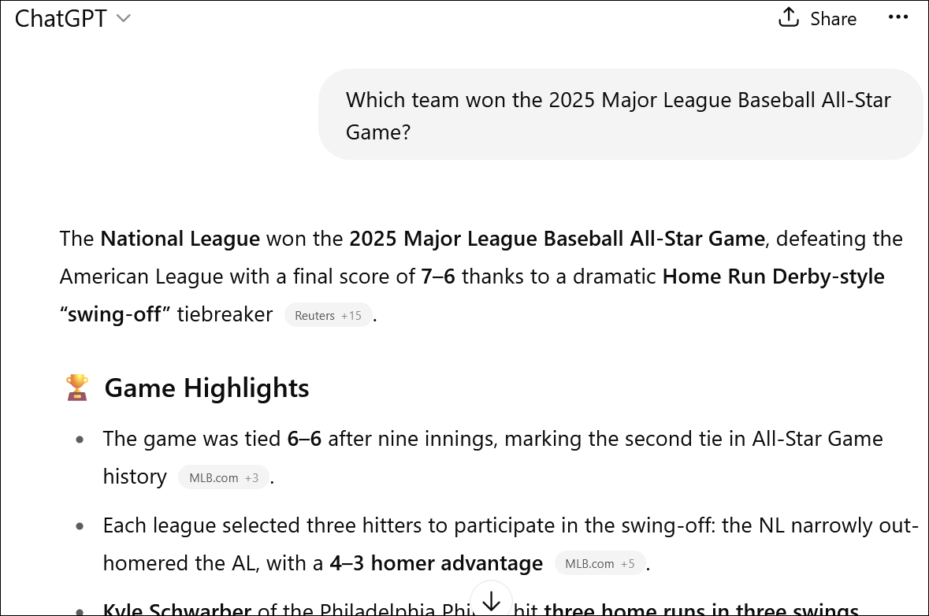
Retrieval-Augmented Generation (RAG)
RAG: A technique that enhances traditional LLMs by retrieving relevant, up-to-date information from a knowledge base before generating a response.
Cites documentation, database entries, etc.
Minimizes need for fine tuning.
Used by chatbots to search the web.
Results in more accurate, current info.

Slide 17
Text-Generation Tools
Tool | Description
GPT-n models | OpenAI's foundational models. GPT-4 released in 2023.
ChatGPT | OpenAI's chatbot. Free and paid tiers.
Microsoft Copilot | Microsoft's chatbot. Based on GPT-4o. Free and paid tiers.
Gemini | Google's chatbot. Based on model of same name. Free and paid tiers.
Claude | Chatbot developed by Anthropic. Free and paid tiers.
Grok | Chatbot built by xAI and integrated with X (Twitter). Free and paid tiers.
Llama | Family of open-access LLMs. Developed by Meta.
Microsoft 365 Copilot | AI integrated into Microsoft 365 productivity apps. Paid subscription.
Gemini for Google Workspace | AI integrated into Google Workspace productivity apps. Paid subscription.
Whisper | Open-source speech-to-text models. Can transcribe and translate.

Slide 18
Activity: Prompting an AI to Generate Text

Slide 19
Solve Business Problems Using Text Generation

Slide 20

Customer Service
Real-time customer communication
Automated email responses
Agent assistance
Personalized surveys

Slide 21

Helpdesk Service
Automated ticket responses
Ticket categorization and escalation
Knowledge-base generation
Automated status updates

Slide 22

Online Ordering Systems
Personalized product recommendations
Personalized surveys
Automated order updates
Natural-language order processing

Slide 23

Marketing Campaigns
Personalized email marketing
Social media marketing
Landing page optimization
Campaign calendars

Slide 24

Product Descriptions
Personalized descriptions
Dynamic price matching and promotions
Review testimonials
Storytelling descriptions

Slide 25

Automated Note Taking
Automatic transcription
Meeting summarization
Contextual suggestions
Task assignment

Slide 26

Information Summarization
Documentation summarization
Social media summarization
Email summarization
News summarization

Slide 27

Information Mining and Inference
Process-documentation retrieval
Fact retrieval
Automated decision making
Customer-needs anticipation

Slide 28
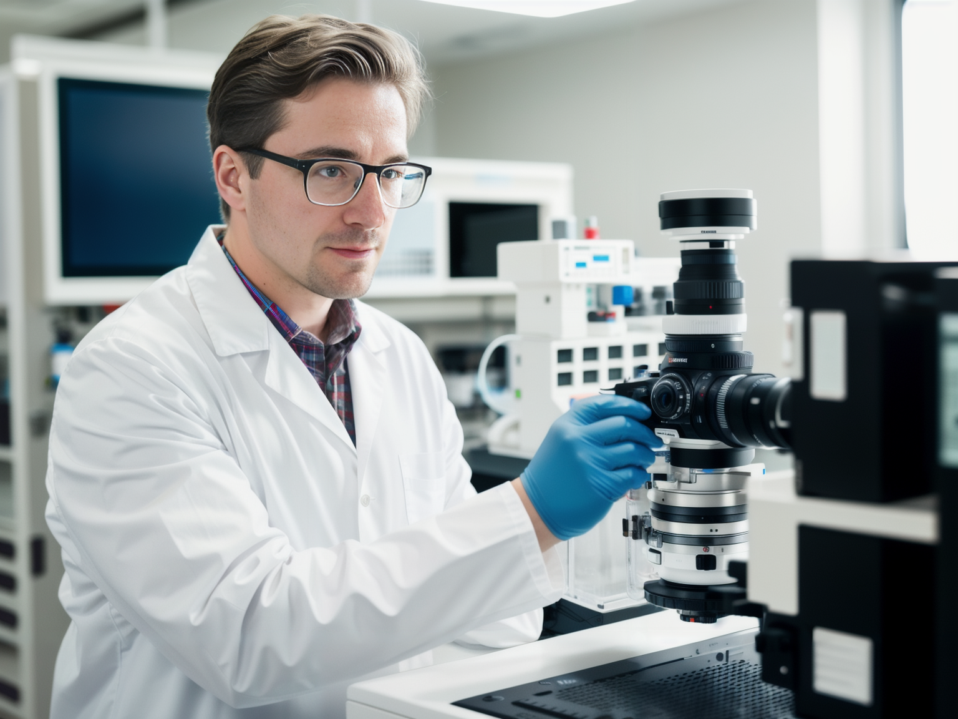
Research Assistance
Fact checking
Citation and reference generation
Data analysis
Research-materials organization

Slide 29
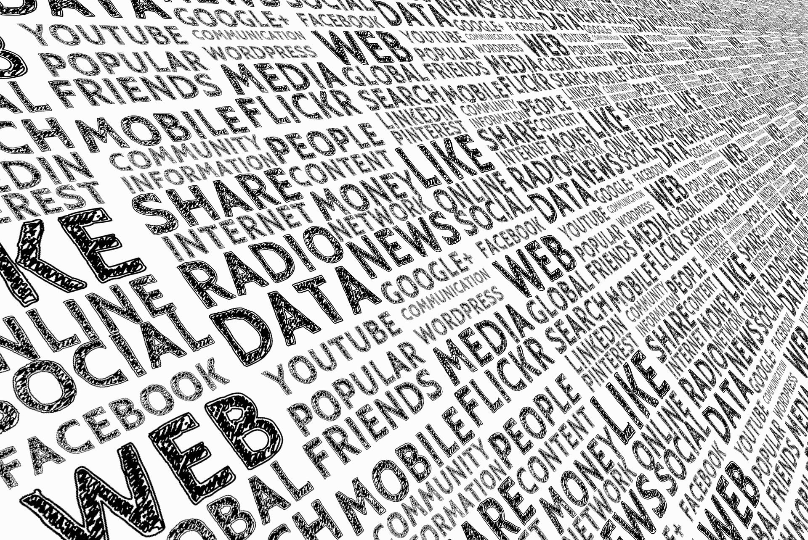
Metadata Creation
Documentation metadata
Multimedia metadata
Web-content metadata
Geographic metadata

Slide 30
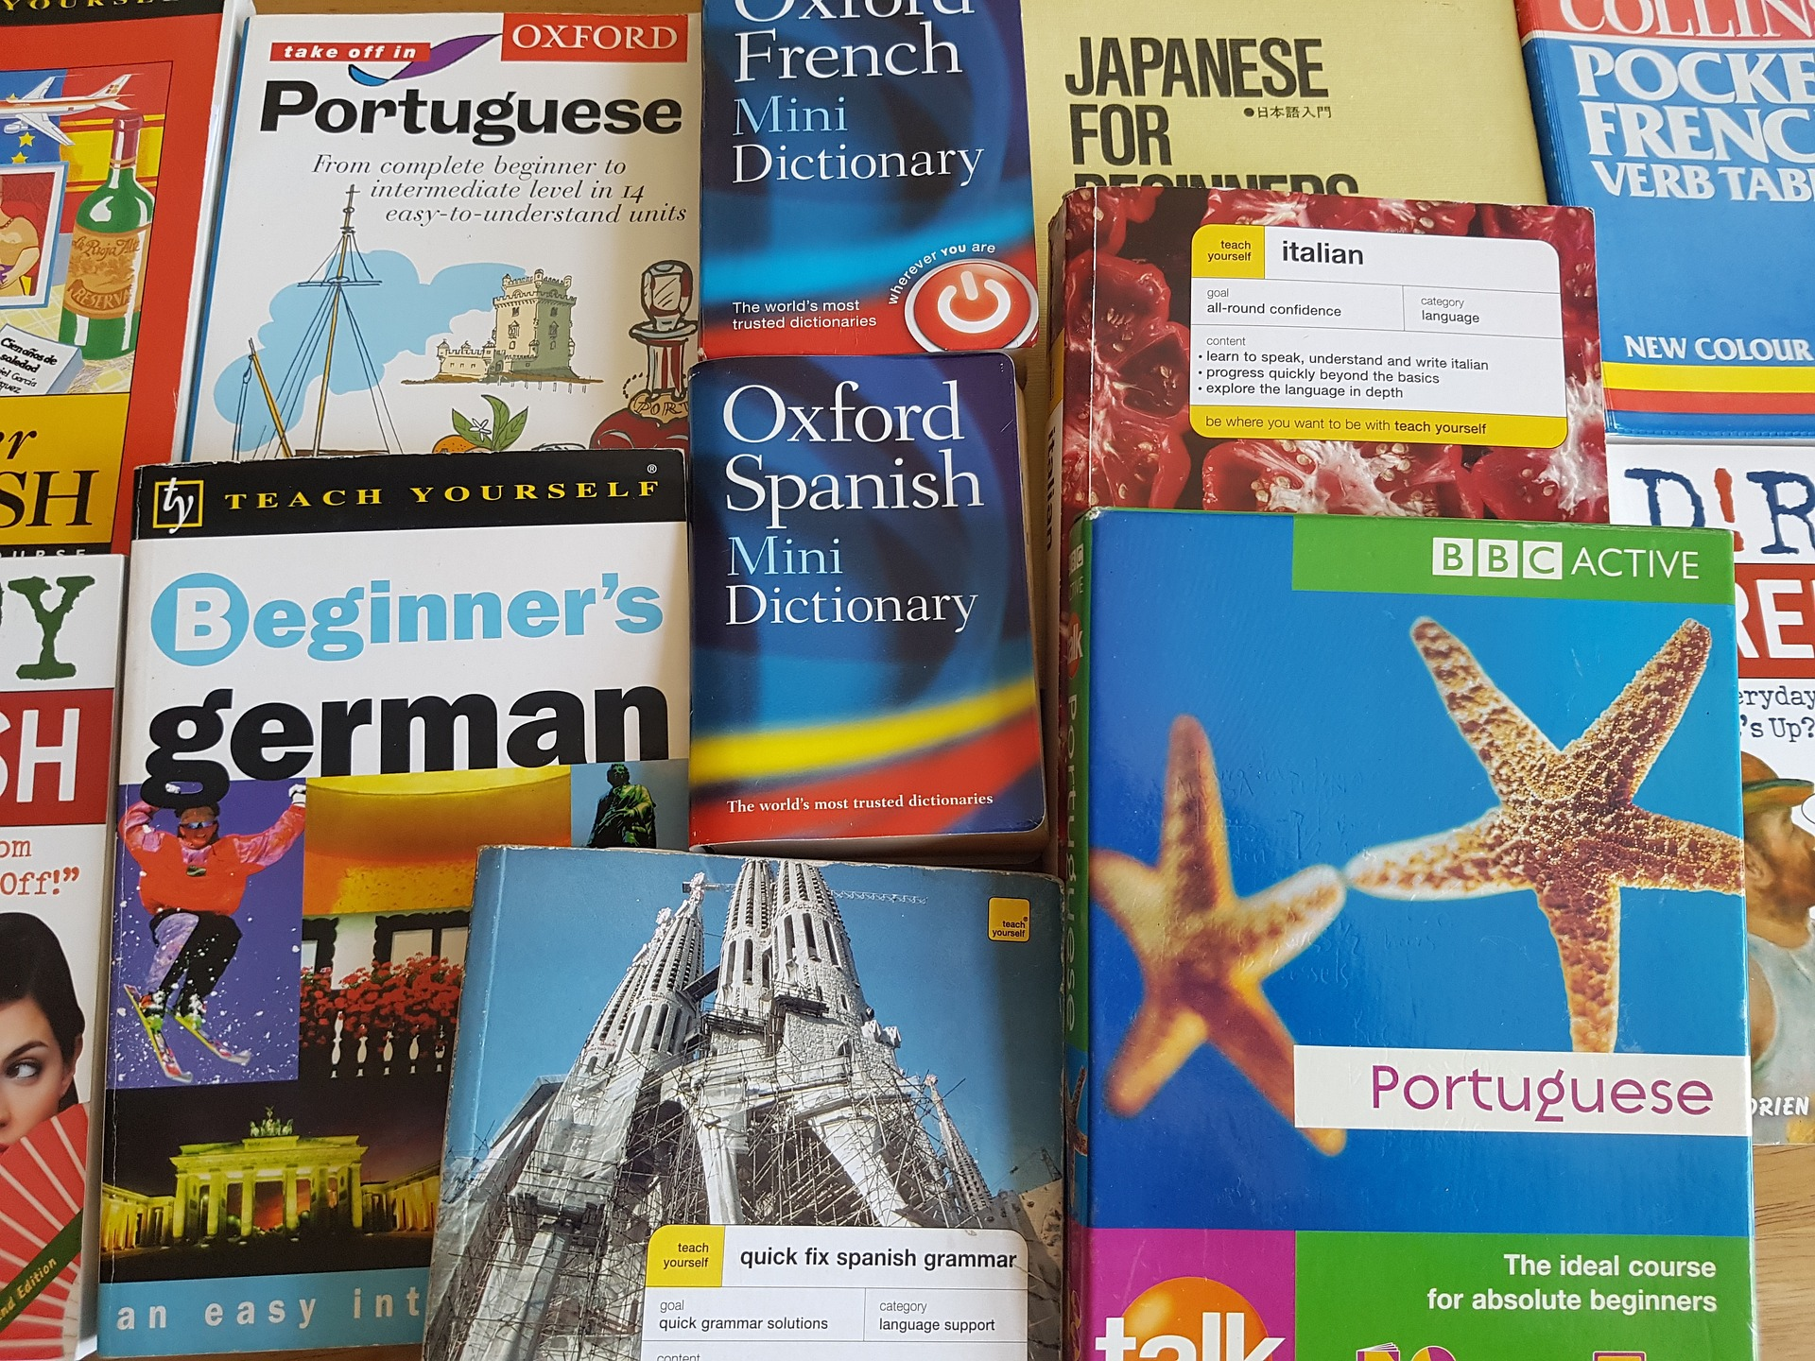
Language Translation
Multilingual product descriptions
Cross-language research
Real-time language switching
Software localization

Slide 31

Dialogue and Story Enhancement
Interactive storytelling
Scene enhancement
Dialogue enhancement
Idea brainstorming

Slide 32
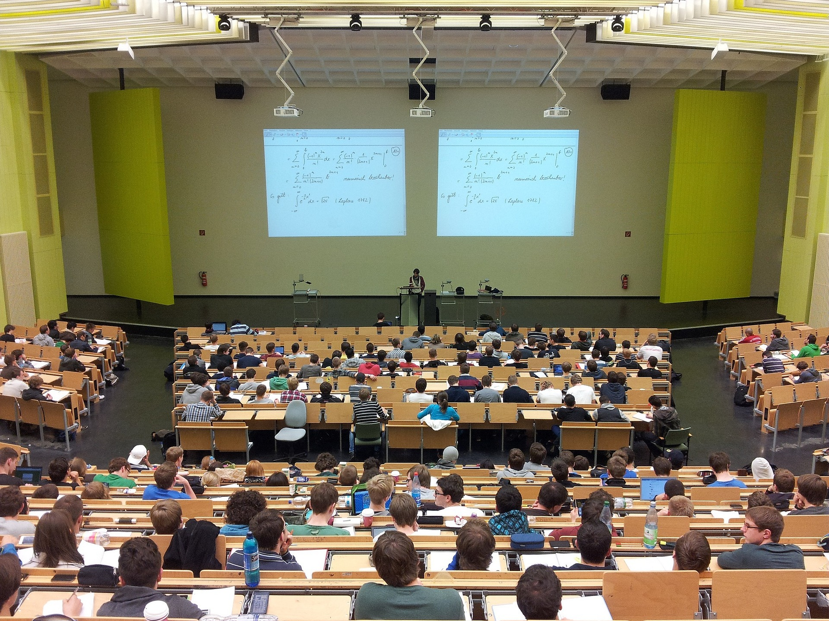
Courseware and Syllabus Creation
Lesson planning
Learning-materials creation
Assessment creation
Objectives alignment

Slide 33

Interviews and Onboarding
Candidate profiling
Interview-question generation
Onboarding documentation
Performance evaluation

Slide 34
Activity: Solving Business Problems Using Text Generation
Read the question scenario in the text. How might a text-generation system help improve the customer experience?
Read the question scenario in the text. How might a text-generation system help improve these marketing efforts?
Read the question scenario in the text. How might a text-generation system help improve the helpdesk experience?

Slide 35
How might you or other personnel use text generation in your own organization?
What text-generation tools do you or your organization use or plan to use in the future?

