Slide 1

Generating Images and Video Using AI

Slide 2
Generating Images and Video Using AI
Identify Image and Video Generation Concepts
Solve Business Problems Using Image and Video Generation

Slide 3
Identify Image and Video Generation Concepts

Slide 4
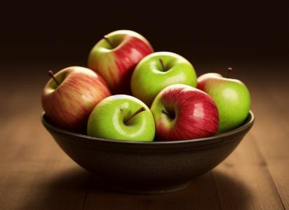
Text to Image
Medium ("a photo")
Subject ("a bowl of apples")
Aesthetic property ("dark background")
Quality markers ("8k," "highly detailed," "realistic")
Other options: style, color profile, artist, details, positioning
Prompt
Output
a photo of a bowl of apples, dark background, 8k, highly detailed, realistic

Slide 5
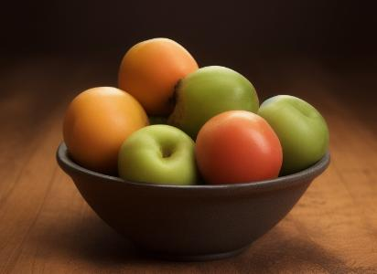
Image to Image
Source Image
Output

Slide 6

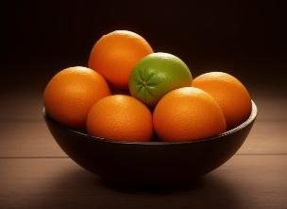
Text + Image to Image
Source Image
Prompt
Output
a photo of a bowl of oranges, dark background, 8k, highly detailed, realistic

Slide 7
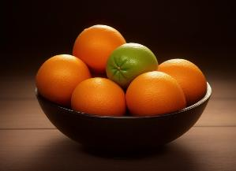
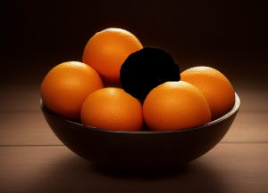
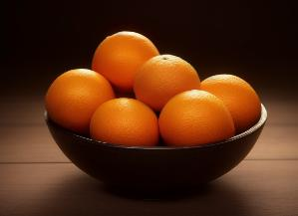
Image Inpainting
Source Image
Masked Image
Inpainting Prompt
Output
orange

Slide 8

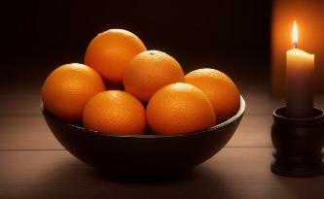
Image Outpainting
Source Image
Prompt
Output
a photo of a bowl of oranges, candle, dark background, 8k, highly detailed, realistic

Slide 9
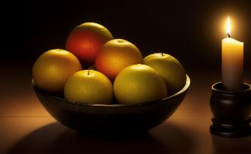
Image Control
Control Image
Prompt
Output
a photo of a bowl of fruit, candle, dark background, 8k, highly detailed, realistic

Slide 10
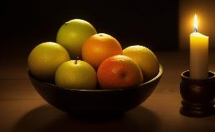
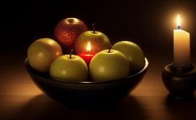
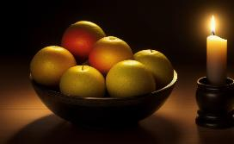
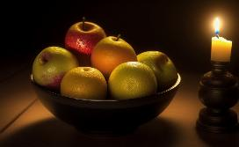
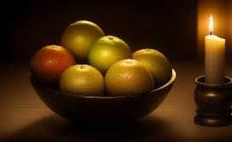
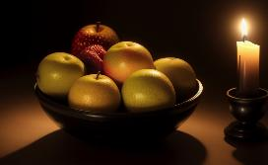
Comparison of Control vs. No Control
With Control
Without Control

Slide 11

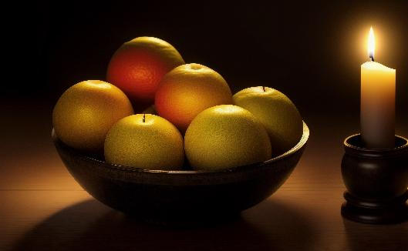
Image Upscaling (Upscaler Only)
Source Image
Upscaled Image
(832 × 512)
(3328 × 2048)

Slide 12

Image Upscaling (Upscaler + Control)
Source Image
Upscaled Image
(832 × 512)
(3328 × 2048)

Slide 13
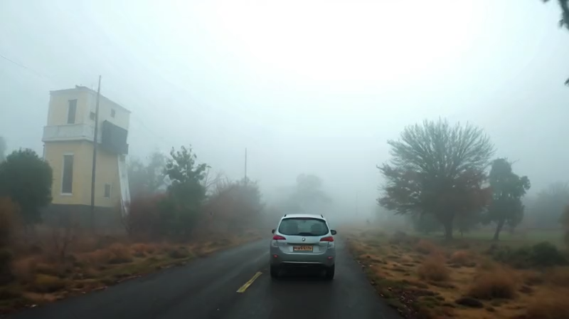
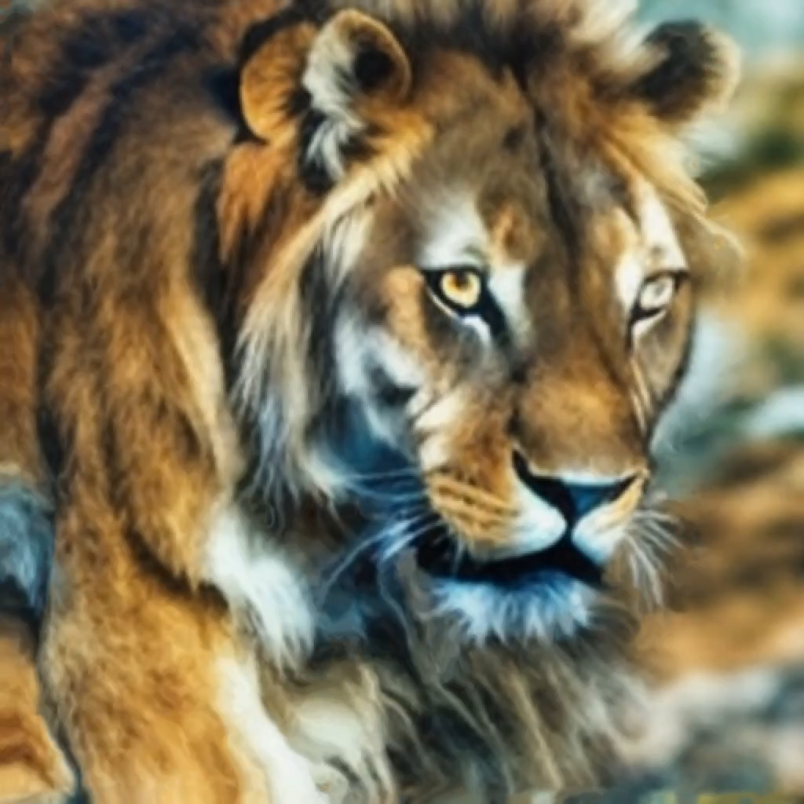
Video-Generation Techniques
Prompt
Text to video
Script to video
Image to video
Text + image to video
Video to video
Text + video to video
Frame interpolation
Video customization
A car drives down a foggy road.
Output Video

Slide 14



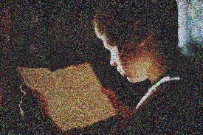


Integrated AI for Images and Video
Reading Initiative
Encourage reading from a young age
Donate physical books
Provide low-cost e-readers
Focus on struggling students

Slide 15
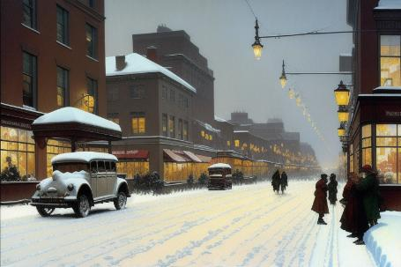
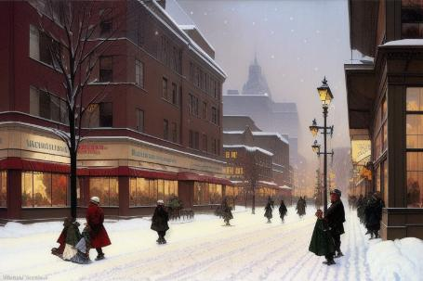
Negative Prompting
Positive
Negative
painting of a snowy day, city street, winter, street lights, Norman Rockwell
Positive
painting of a snowy day, city street, winter, street lights, Norman Rockwell
cars, vehicles

Slide 16
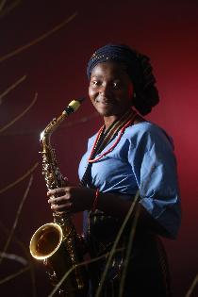
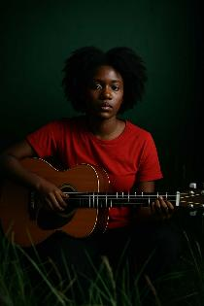
Image Interrogation
Interrogated Image
Generated Image
a woman in a blue shirt playing a saxophone in a dark room with red walls and grass in the foreground
a woman in a red shirt, guitar, dark room, green walls, grass in foreground

Slide 17
Best Practices for Prompt Engineering with Image and Video Generation
Be as descriptive as possible.
Research and reuse effective prompts.
Ask an LLM to write prompts.
Use reference images whenever possible.
Consider image aspect ratio.
Consider training data.
Generate as many images as feasible.

Slide 18


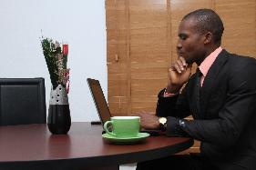
Fine Tuning Image and Video Models
Training Image
Image Label
a group of business people sitting around a table
a woman sitting at a table with a laptop and a cup of coffee
a man in a suit sitting at a table with a laptop

Slide 19
Image-Generation Tools
Tool | Description
DALL·E | Developed by OpenAI. In the past, it powered image generation in ChatGPT and Copilot.
Midjourney | Image generator by Midjourney. Available as a paid subscription.
Adobe Firefly | Adobe's image generator. Available through Photoshop and other CC apps.
Stable Diffusion | Image-generation model by Stability AI. Publicly accessible.
FLUX.1 | Image-generation model by Black Forest Labs. Publicly accessible.

Slide 20
Video-Generation Tools
Tool | Description
Sora | OpenAI's video generator. Available to paid ChatGPT subscribers only.
Veo | Google DeepMind's video generator. Available in Gemini, including to free users.
Runway | Video generator by Runway AI, Inc. Uses a paid subscription model.
Synthesia | Generates realistic avatars of people speaking. Requires a paid subscription.

Slide 21
Activity: Prompting an AI to Generate Images

Slide 22
Solve Business Problems Using Image and Video Generation

Slide 23
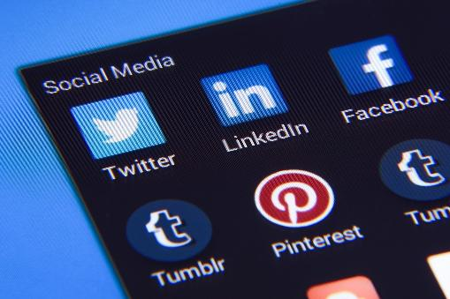
Visual Assets for Promotional Materials
Social media posts
Product stylizing
Explanatory visuals
Dynamic content generation

Slide 24
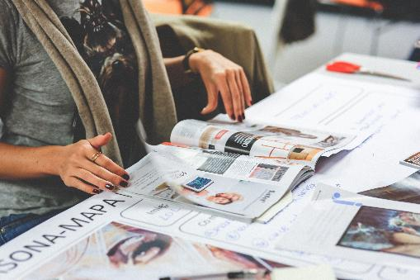
Visual Assets for Press Releases
Video testimonials
Improved localization
Historical-footage recreation
Stock-asset enhancement

Slide 25

Visual Assets for Training Materials
Slide-show visuals
Virtual trainer videos
Interactive scenarios and quizzes
Adaptive learning

Slide 26
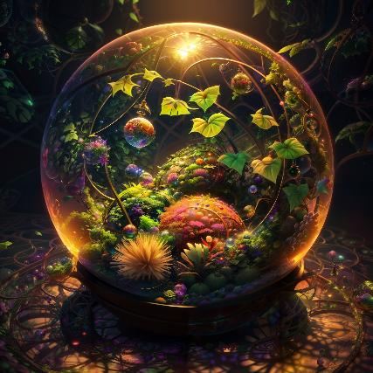
Visual Assets for Games and Virtual Worlds
Cutscene generation
Character customization
Environment generation
User-interface design

Slide 27
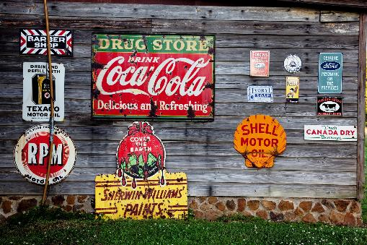
Corporate Branding
Logo design
Packaging design
Brand imagery
Brand personalization

Slide 28
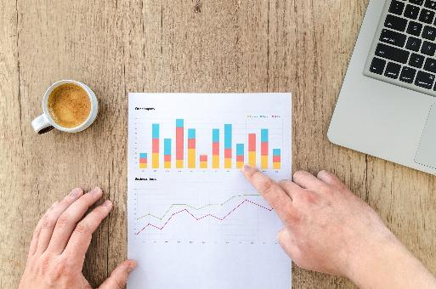
Data Visualization
Infographic design
Storytelling visualizations
Interactive visualizations
Icon design

Slide 29
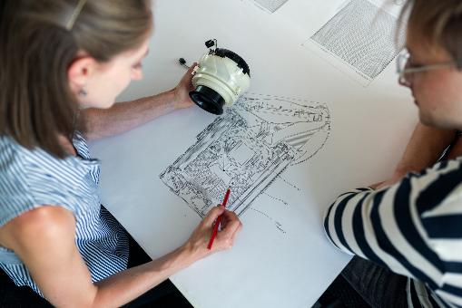
Product Design and Prototyping
Concept generation
Virtual prototyping
Material exploration
Assembly visualization

Slide 30

Website and App Styling
Visual product listings
Background-image generation
Layout generation
Dynamic image generation

Slide 31
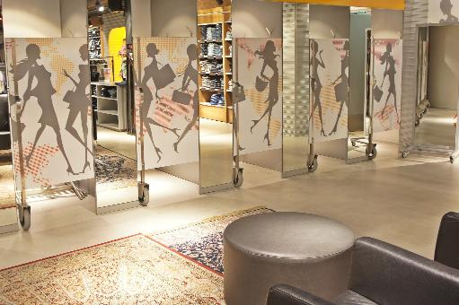
Virtual Changing Rooms and Other Try-On Experiences
Virtual clothing demonstration
Virtual furniture demonstration
Virtual travelling
Augmented-reality (AR) visual overlays

Slide 32
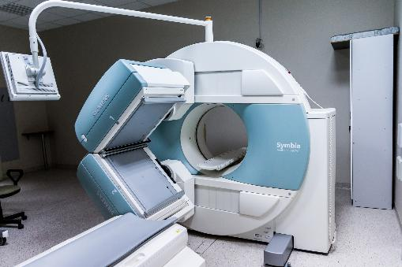
Medical Imaging and Diagnostics
Image enhancement
Image presentation
Disease-progression modeling
Treatment-plan visualization

Slide 33
Activity: Solving Business Problems Using Image and Video Generation
Read the question scenario in the text. How might an image-generation system help create the promotional material?
Read the question scenario in the text. How might an image-generation system help make the try-on experience more realistic?
Read the question scenario in the text. How might a video-generation system help make the product demonstrations more exciting and engaging?

Slide 34
How might you or a visual artist use image or video generation in your own organization?
What image- and video-generation tools do you or your organization use or plan to use in the future?

