Slide 1

Generating Audio Using AI

Slide 2
Generating Audio Using AI
Identify Audio Generation Concepts
Solve Business Problems Using Audio Generation

Slide 3
Identify Audio Generation Concepts

Slide 4

Text to Audio (Music)
Mood/tone ("meditative song," "calming and soothing")
Specific instruments ("with flutes and guitars")
Tempo ("the music is slow")
Additional details ("a sense of peace and tranquility")
Other options: genre, era, location, skill
Prompt
Output
Meditative song, calming and soothing, with flutes and guitars. The music is slow, with a focus on creating a sense of peace and tranquility.

Slide 5
Text to Audio (Speech Synthesis)
Script
Output
A computer would deserve to be called intelligent if it could deceive a human into believing that it was human.

Slide 6
Audio to Audio
Input Audio
Text Prompt
Output
country music with acoustic guitars

Slide 7
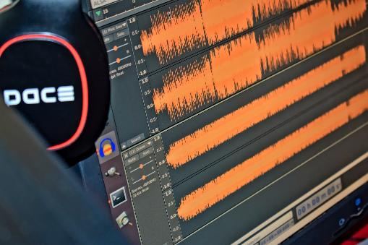
Audio Editing and Cleaning
Remove background noise.
Separate desirable sounds from undesirable ones.
"Upscale" heavily compressed audio.

Slide 8










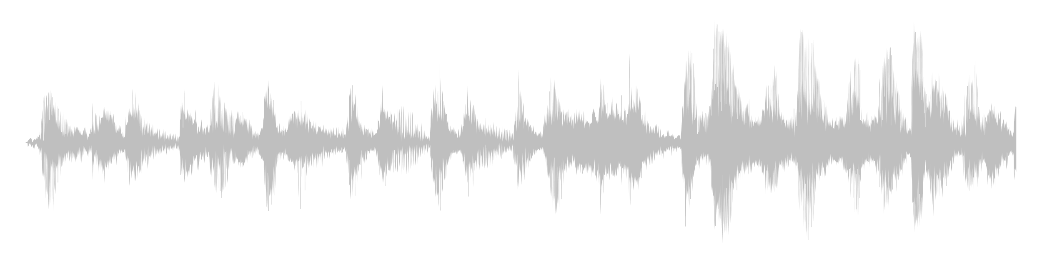

Integrated AI for Audio
Relaxing piano played at mid tempo.

Slide 9
Prompt Engineering for Audio Generation
Be descriptive, but experiment with variation.
Provide context clues for speech.
Use text to speech in chunks.
Generate as many audio samples as you can.

Slide 10
Fine Tuning Audio Models
Example goals:
  Better output for specific music genres.
  Create new voices to use in text to speech.
  Voice cloning.
Make sure audio data is good quality and labeled.
Training Audio
Audio Label
elevator music, mid tempo, bongos, acoustic guitar, light and breezy

Slide 11
Audio-Generation Tools
Tool | Description
MusicGen | Meta's music generator. No official app yet, but open source.
Udio | Music generator by company of same name. Free and paid plans.
Suno | Music generator by company of same name. Free and paid plans.
Adobe Firefly | Offers sound-effects generation as part of suite.
Murf Studio | Audio-generation tool by Murf AI. Primarily focuses on speech generation. Paid subscription and limited free tier.
ElevenLabs | Audio-generation tool by company of same name. Primarily focuses on speech generation. Paid subscription and limited free tier.

Slide 12
Activity: Prompting an AI to Generate Audio

Slide 13
Solve Business Problems Using Audio Generation

Slide 14
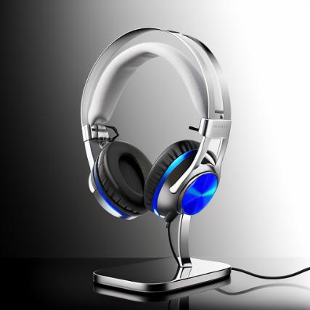
Audio Assets for Promotional Materials
Advertisement jingles
Advertisement background music
Promotional voiceovers
Podcast production

Slide 15
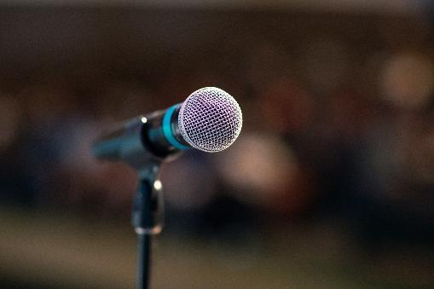
Audio Assets for Press Releases
Press-release narration
Voice translations
Voice consistency and authority
Audiovisual press releases

Slide 16

Audio Assets for Training Materials
Training-material narration
Voice-guided simulations
Pronunciation guidance
Multilingual training materials

Slide 17
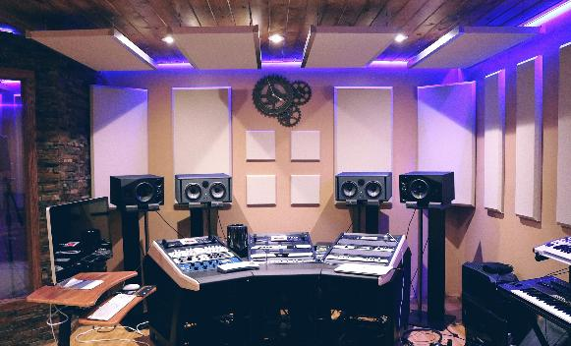
Audio Assets for Games and Virtual Worlds
Dialogue voiceovers
Soundtrack generation
Sound-effect variation
Enrichment of audio soundscapes

Slide 18
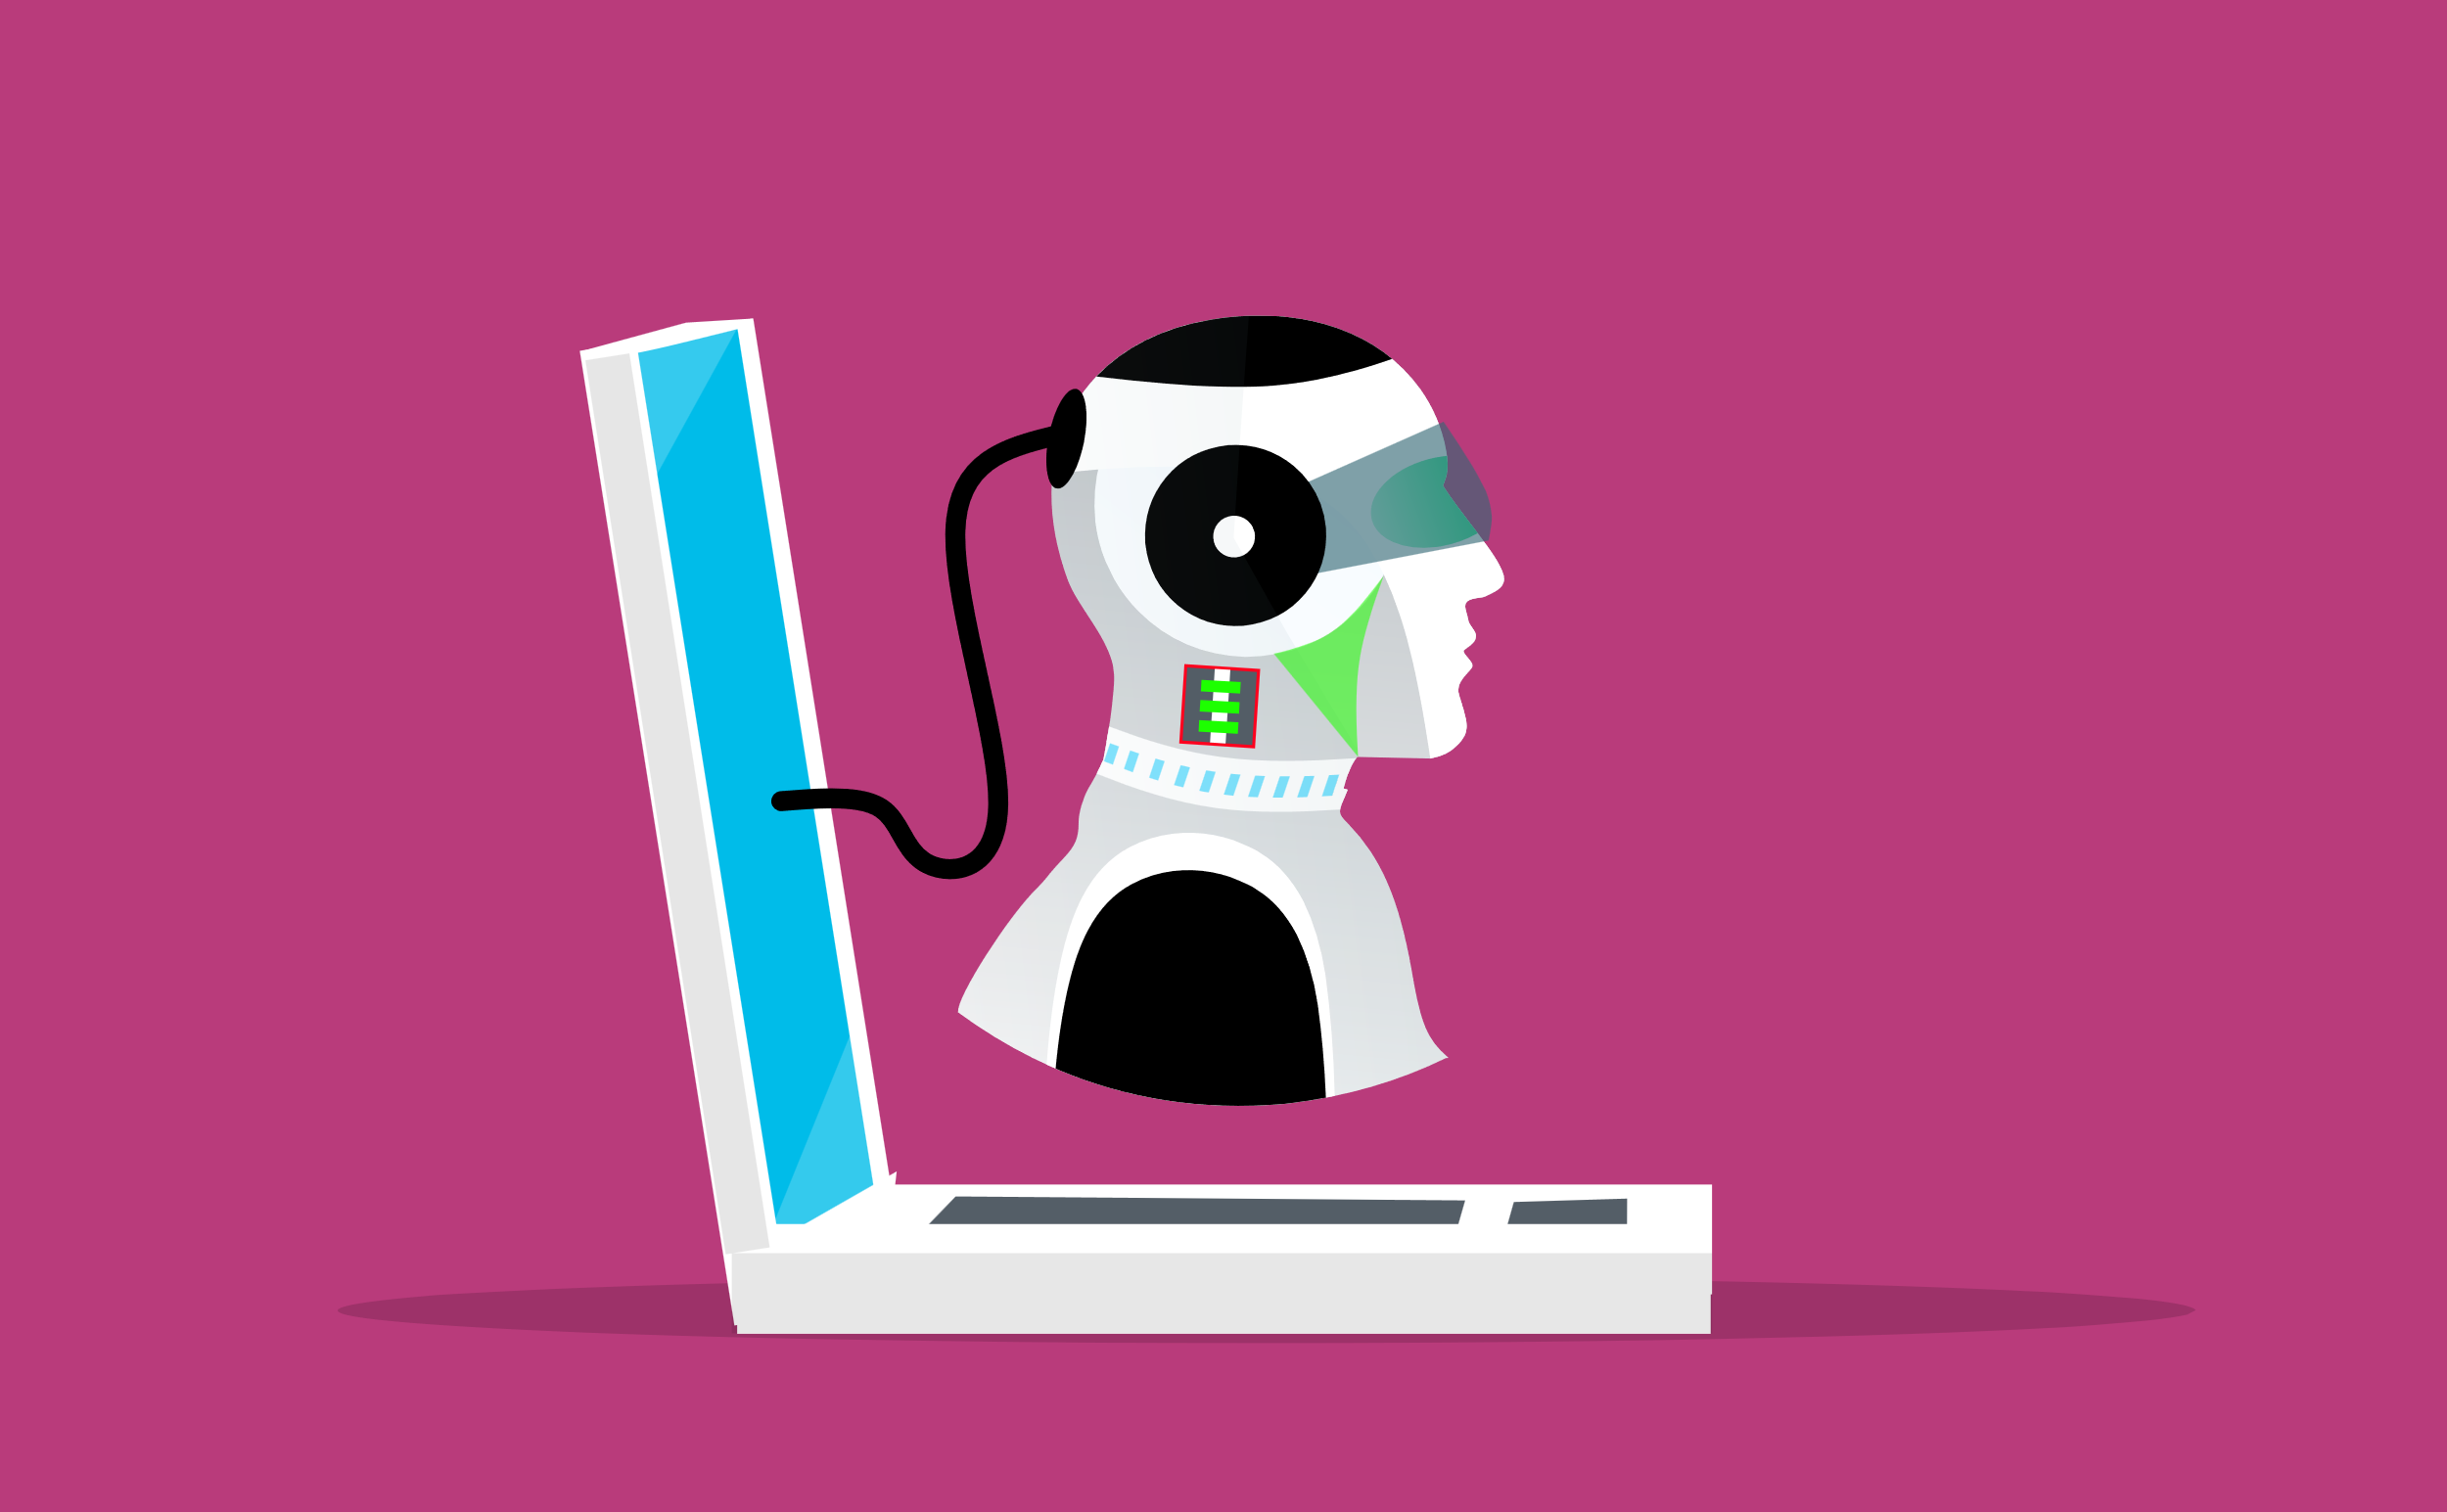
Voiced Chatbots and Virtual Assistants
User interactivity
Tone emulation
Personalized music generation
Personalized notifications and reminders

Slide 19

Accessibility
Voiced descriptions of visual media
Audio navigation
User-interface audio feedback
Voice cleanup

Slide 20
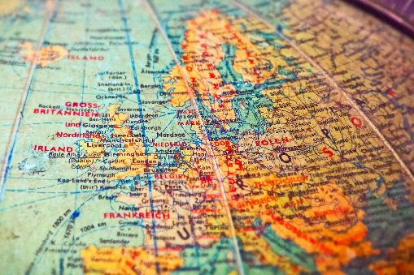
Localization
Voice adaptation
Pronunciation guidance
Language learning
Music localization

Slide 21
Activity: Solving Business Problems Using Audio Generation
Read the question scenario in the text. How might an audio-generation system help produce the podcast?
Read the question scenario in the text. How might an audio-generation system enhance the chatbot?
Read the question scenario in the text. How might an audio-generation system help improve the advertisements?

Slide 22
How might you or a sound artist use audio generation in your own organization?
What audio-generation tools do you or your organization use or plan to use in the future?

