Slide 1

Implementing Business Strategies for Generative AI

Slide 2
Implementing Business Strategies for Generative AI
Apply Best Practices for Generative AI in the Organization
Evaluate the Results of Generative AI Projects

Slide 3
Apply Best Practices for Generative AI in the Organization

Slide 4

Define Project Factors
Scope
Strategy
Goals
Objectives
Requirements

Slide 5

Align to Organizational Initiatives
Generative solutions must align to initiatives/strategies.
  Otherwise, they won't bring much value.
  Could also be disastrous if not aligned.
Example: Digital transformation.
  Org seeks change through digital technologies.
  Generative AI fulfills initiative objectives.
Other relevant initiatives:
  Data strategy
  Growth strategy

Slide 6



Align to Environmental, Social, and Governance (ESG) Initiatives
E
S
G
Commitment to sustainability
Power efficiency of AI solutions
Commitment to treating people fairly
Supporting non-discrimination
Commitment to leadership and management
Supporting data-protection processes

Slide 7

Align to Ethics and Compliance Initiatives
Must operationalize ethical principles.
Use various policies, tools, techniques.
  Example: Encrypt data to uphold privacy.
  Build guardrails into agentic solutions.
If possible, consult with regulatory bodies.
  Can influence future regulations regarding generative AI.
Ensure org can align business with new regulations.
  Plan before the regulations go into effect.
Ensure supervisory personnel are informed of risks.

Slide 8

Acquire Resources and Job Expertise
Talent resources
Data resources
Computing resources
Budget resources
Stakeholders

Slide 9

Educate End Users and Employees
Employees become:
  Better equipped to make decisions.
  More creative and innovative in their thinking.
End users become:
  Empowered to make ethical decisions.
  More effective at providing feedback.
Approaches:
  Deliver end-user training.
  Deliver agentic-workflow training.
  Deliver practitioner training.
  Deliver workshops/webinars.
  Promote knowledge sharing on social media.
  Be transparent about generated content.
  Demonstrate use cases.
  Provide support resources.
  Promote continuous learning.

Slide 10

Be Transparent About AI-Generated Content
Be up front to end users about the use of generative AI.
No hard rules for what this means.
  Example: generated images with watermarks.
  How should watermark appear, if at all?
  Example: generated text has disclaimer.
  Where should disclaimer be, if at all?
Unless required by future regulations, this is up to you.

Slide 11

Select Appropriate Generative AI Modalities
Project goals and objectives influence choice of modality.
Other factors:
  Supplemental modalities.
  Available data for fine tuning.
  Deliverability of modality.
  Ethical/legal ramifications.
Audio
Image
Video
Text
Code

Slide 12

Select Appropriate Generative AI Tools
Finding the right tool is a challenge.
Factors when selecting a tool:
  Can it implement the chosen modality?
  Can it support project needs?
  Does it support advanced techniques?
  How is it available?
  How well supported is it?
  How well established is the provider?
  Are costs justifiable?
  Does it fit with company policy?

Slide 13
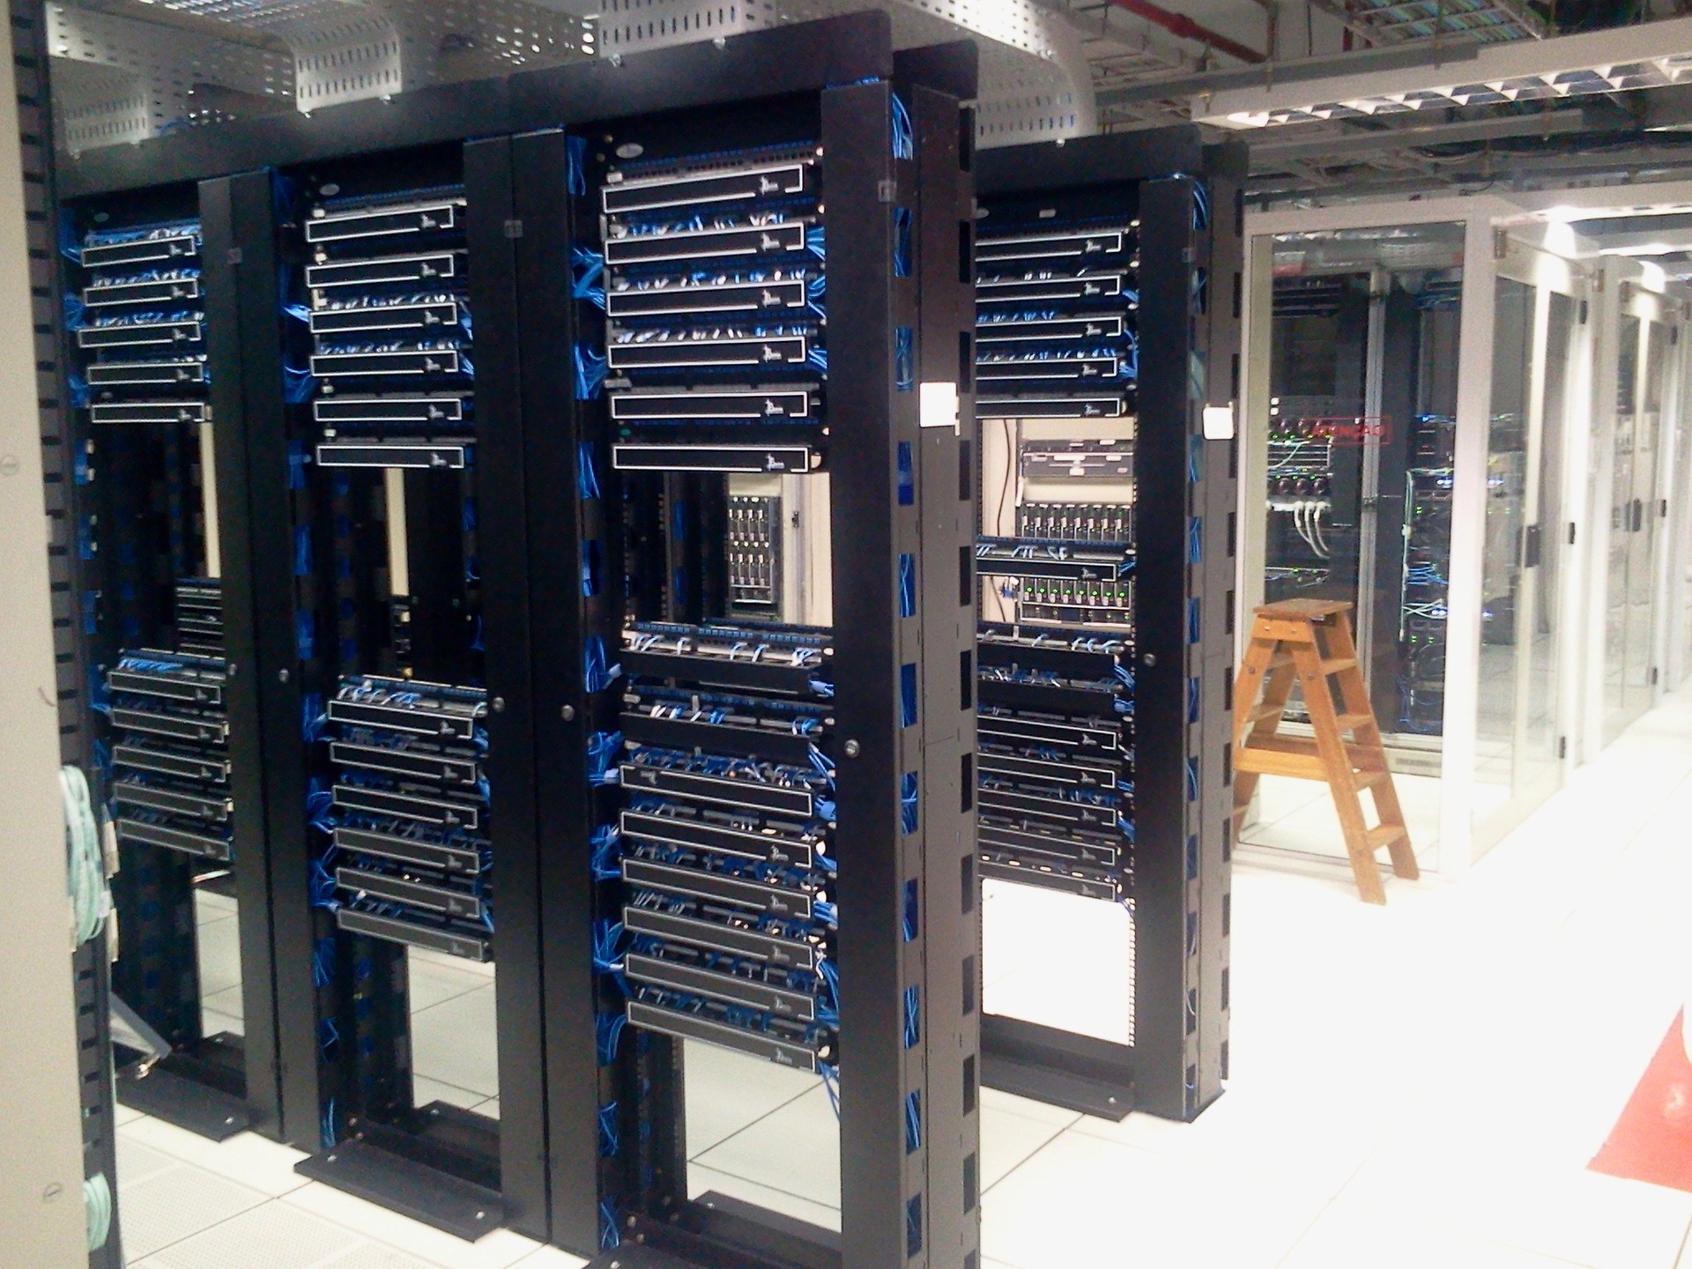
Apply IT Strategy and Infrastructure
IT must establish tech stack.
  Set up servers that process requests.
  Construct network architecture.
  Create development environments.
  Establish inter-agent communication channels.
May also need to support training/fine tuning.
  Providing data.
  Cleaning data.
  Providing auto-labeling tools.
Choice of cloud vs. on-premises hosting.
  Your input and requirements influence choice.

Slide 14






Example Infrastructure
User
Chatbot
API
Model
Request
Response

Slide 15

Prototype Generative AI Systems
Is the design efficient and effective?
Is the system scalable?
On-premises vs. cloud resources?
Can the model be used elsewhere?
Can the model be improved later?
Is an agentic approach viable?
What are the maintenance costs?

Slide 16

Implement Change Management
Minimizes disruption due to changes.
Important for generative AI.
Key roles:
  Change agents
  Knowledge translators
  Humans in the loop

Slide 17

Guidelines for Applying Best Practices for Generative AI in the Organization
Define all necessary factors that affect the success of a generative AI project.
Ensure generative AI aligns with organizational initiatives.
Ensure generative AI aligns with ESG initiatives.
Ensure generative AI aligns with ethical and compliance initiatives.
Acquire the necessary resources and talent.
Educate employees and end users.
Be transparent about the use of generative AI.
Select the appropriate generative AI modalities.
Select the appropriate generative AI tools.
Incorporate generative AI into an IT strategy.
Prototype generative AI solutions before public release.
Implement change-management processes and roles.

Slide 18
Activity: Applying Best Practices for Generative AI in the Organization
Read the question scenario in the text. How can you help the sales team select the right generative AI tool for their needs?
Read the question scenario in the text. How might you ensure that all employees in the organizations are properly educated on the basics and use of generative AI?
Read the question scenario in the text. How might you assess the design of this prototype to ensure any issues will be addressed in the final release?

Slide 19
Evaluate the Results of Generative AI Projects

Slide 20

Assess Business Impact
Is generative AI accomplishing goals and providing value?
Aspects of impact analysis:
  Degree to which goals/objectives are achieved.
  Tracing goal outcomes to objectives.
  Identifying ROI.
  Identifying ethical and brand impacts.
  Finding out what decision makers think.
Conclusions could prompt different actions.

Slide 21

Perform Comparative Analysis
Evaluate generative AI solution against alternatives.
Is the solution worth the time, effort, and money?
General best practices:
  Create a baseline of acceptable results.
  Perform A/B testing.
  Track efficiency gains/losses.
Can also compare two generative solutions.
  System vs. system.
  Modality vs. modality.

Slide 22

Collect User Feedback
First, identify who your users are.
Methods of collecting feedback:
  Surveys and questionnaires
  Interviews and focus groups
  Online reviews and feedback
  Customer support channels
  Beta testing

Slide 23

Monitor and Analyze Usage of Generative AI Systems
Usage data reveals factors like:
  Performance
  Areas for improvement
  User behavior
Useful tactics:
  Track user/system behavior.
  Monitor system performance.
  Continuously monitor usage.
  Process and store usage data.
  Perform data analysis.
  Define relevant metrics.

Slide 24

Measure Key Performance Indicators (KPIs)
Metrics that align with business goals/objectives.
Potential generative AI KPIs:
  User-engagement metrics
  Quality metrics
  Efficiency metrics
  User-feedback metrics
  Error metrics
  Scalability metrics
  Cost metrics
  Productivity metrics

Slide 25

Identify Project Limitations
Identify limitations using aforementioned techniques.
Additional techniques:
  Perform extensive testing.
  Consult AI experts.
  Consult business stakeholders.
Recall common limitations/challenges.
  Confabulation, output delays, ethics, etc.

Slide 26

Identify Undesirable Outcomes
Outcomes include:
  Brand damage, workforce disruption, financial loss, etc.
Tactics:
  Define criteria.
  Monitor public perceptions.
  Solicit stakeholder feedback.
  Conduct audits.
  Watch for agentic drift.
  Review/update policies.
  Support governance measures.
  Participate in ethics-driven communities.

Slide 27

Assess Long-Term Sustainability
Long-term viability is crucial in most instances.
Questions to ask about the solution:
  Will it be cost effective over a long period of time?
  Does it have enough maintenance resources?
  Is there an update plan?
  Is there a steady flow of training data?
  Can it meet user needs/satisfaction?
  Is it forward compatible?
  Can it sustain ethics/security principles?
  Can it adapt to changing needs?

Slide 28
Guidelines for Evaluating the Results of Generative AI Projects
Assess the business impact of solutions.
Perform comparative analysis of solutions and alternatives.
Collect feedback from users.
Monitor and analyze usage.
Define and measure KPIs.
Identify limitations of solutions.
Identify undesired outcomes from solutions.
Assess the long-term sustainability of solutions.

Slide 29
Activity: Evaluating the Results of Generative AI Projects
Read the question scenario in the text. What are some KPIs that could help you evaluate the success of this generative AI project?
Read the question scenario in the text. How might you evaluate usage of the app and collect user feedback?
Read the question scenario in the text. How might you assess the long-term sustainability of this chatbot?

Slide 30
What best practices for implementing generative AI do you think will be most challenging for your organization? Why?
What techniques for evaluating the results of generative AI is your organization most likely to implement? Why?

