Slide 1
Everyone Can Be Root
Matthew Lister & Ethan Payne

Slide 2
USU Free Software & Linux Club
Notes:
Introduce ourselves
What does FSLC do
Membership

Slide 3
Getting everyone a Linux box
Notes:
Not everyone has the knowledge (or even the hard drive space) to install linux.
Remember- this is a commitment, and people are afraid to leave windows

Slide 4
Getting everyone a Linux Box- two ways to fix this
InstallFest
Pros- community building
Cons- bricked machines, debugging
VM Server
Pros- quick and easy new machines
Cons- networking & administration
Notes:
Over the years, we generally do Installfest at the beginning of semesters, and it’s been successful- but the drawbacks are hard to ignore
VM servers are cool, and if we could make an easy way / guide to do it, they would fulfill our need pretty easily. This setup will make takeover / maintenance a lot easier too.

Slide 5
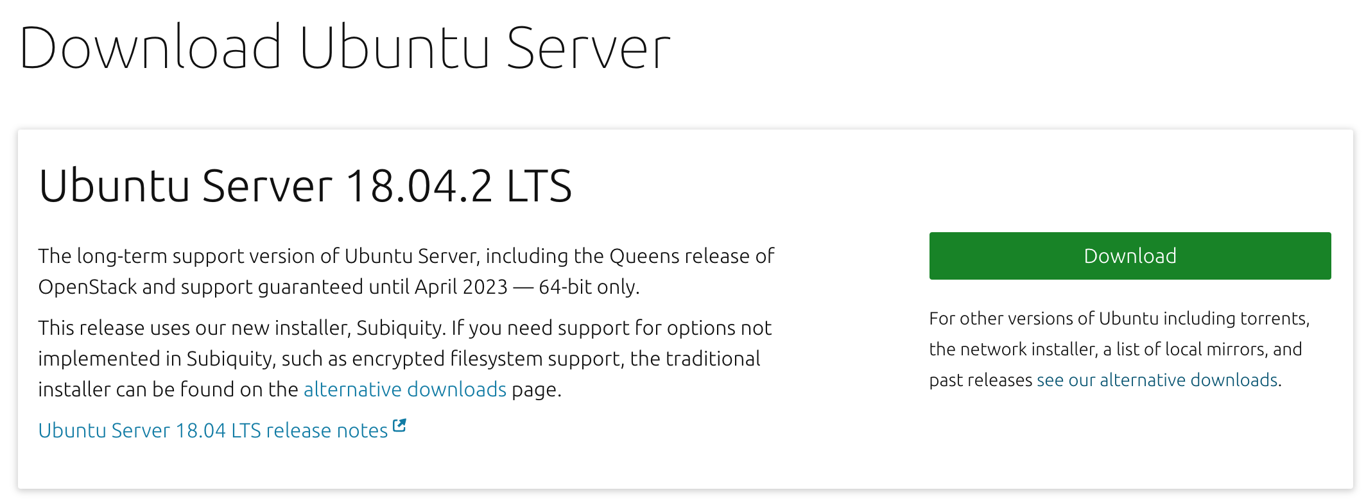
Download ISO
Notes:
To start, we’ll install ubuntu server on our main host machine. If you’re not familiar with Linux, go ahead and download ubuntu server from their site.
Depending on the machine you have, it may be easier to use the alternate installer- we had to use it, but if one doesn’t work just try the other.

Slide 6
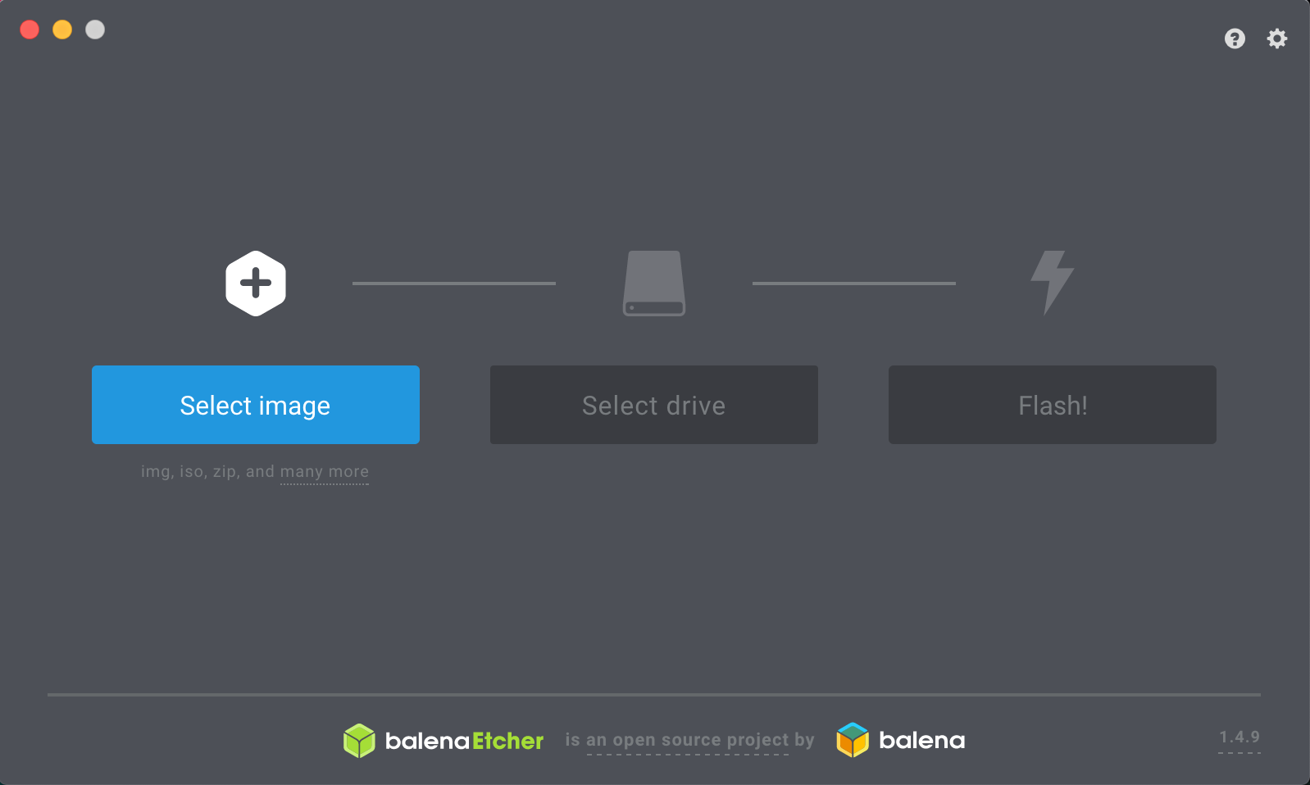
Bootable USB in Windows / Mac - balena.io/etcher
Notes:
For any scrubs out there using windows who’ve never made a bootable USB before, just use etcher or rufus
Be aware that it will completely format the USB, so don’t get too attached to any saved data
You may need to format your USB, setting it as MBR & leave it unpartitioned is easiest

Slide 7
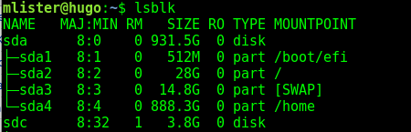
Bootable USB for cool people
Find your device
$ lsblk | $ diskutil list
Copy image with disk destroyer
$ sudo dd if=ubuntu-server.iso of=/dev/sdX
Done!
Notes:
If you’re cool and use a unix-based system, you can do this in a terminal with just a couple commands.

Slide 8
Plug in USB & Install
Don’t forget to include OpenSSH Server!
Notes:
Go ahead and plug in your USB to your server and install. Once complete, you should have a barebones ubuntu server.

Slide 9
Obtain Dependencies
$ sudo apt update
$ sudo apt install virtualbox \
virtualbox-guest-additions-iso
$ sudo apt install xorg
$ sudo apt install nginx

Slide 10
Linux Club- Why do you need one?
Notes:
What is Linux Club?
It’s a group where a bunch of nerds get to hang out together
Anecdote - when I started using linux, I didn’t know other people who were cool
Membership / who shows up / improvements?
Why is it important- two reasons- segue-

Slide 11
Community
Notes:
fostering a CS community (which can be rare) and engaging programmers in social activities
Other majors / aspects of study tend to build communities and relationships, but programmers tend to be a bit a-social
Creating connections is very important - also important is -

Slide 12
Skill Development
Notes:
Some people take to linux easily, some need a hand
Teaching people about why linux is cool can get them interested / ahead of the game in industry techniques
I got my job almost primarily off of linux experience, these are valuable skills that can be difficult to learn without introduction- making linux less scary

Slide 13
Linux Club- What
Notes:
How do we run the club? We talk about anything that interests us in linux. Usually start with introductory / beginner stuff, progress to more advanced presentations
Community involvement is important here- taking time to have discussion about technical topics, or having community members give presentations about what interests them

Slide 14
Challenges & Solutions
Notes:
Linux club sounds cool, and it’s definitely something you can pull off, but there’s also work that you need to put in to get the ball rolling.
Here are some of the issues we ran into, and how we’ve overcome them.

Slide 15
Not a 1-man job
Notes:
Running a club can be tough for just one person- getting community involvement and building leadership is really important.

Slide 16
Linux Club- How
Notes:
How do I start one- talk to administration, you’ll probably find a professor who’s enthusiastic.
In our experience, a faculty advisor doesn’t have to be particularly involved for the club to be successful, but it can help.

