Slide 1
Everyone Can Be Root
Matthew Lister & Ethan Payne

Slide 2
USU Free Software & Linux Club
Notes:
Introduce ourselves
What does FSLC do
Membership

Slide 3
Getting everyone a Linux box
Notes:
Not everyone has the knowledge (or even the hard drive space) to install linux.
Remember- this is a commitment, and people are afraid to leave windows

Slide 4
Getting everyone a Linux Box- two ways to fix this
InstallFest
Pros- community building
Cons- bricked machines, debugging
VM Server
Pros- quick and easy new machines
Cons- networking & administration
Notes:
Over the years, we generally do Installfest at the beginning of semesters, and it’s been successful- but the drawbacks are hard to ignore
VM servers are cool, and if we could make an easy way / guide to do it, they would fulfill our need pretty easily. This setup will make takeover / maintenance a lot easier too.

Slide 5
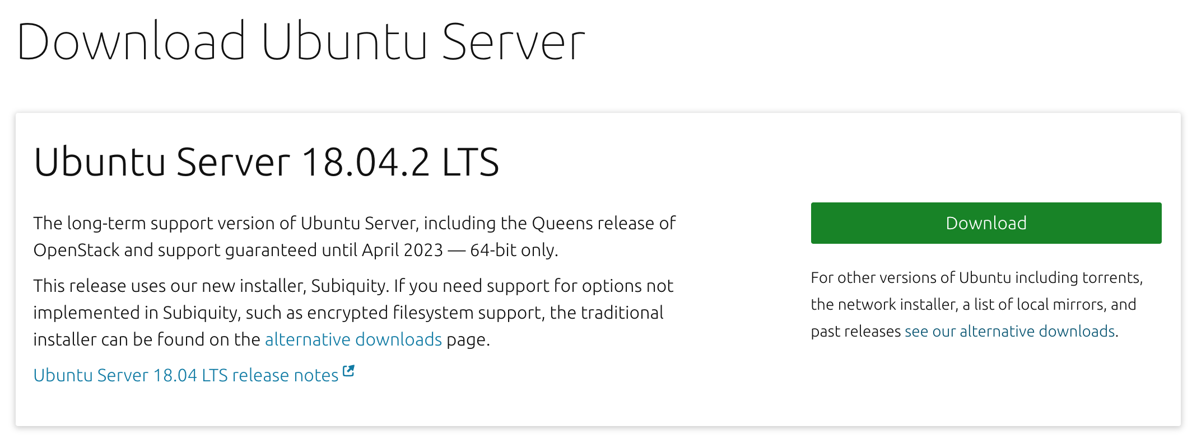
Download ISO
Notes:
To start, we’ll install ubuntu server on our main host machine. If you’re not familiar with Linux, go ahead and download ubuntu server from their site.
Depending on the machine you have, it may be easier to use the alternate installer- we had to use it, but if one doesn’t work just try the other.

Slide 6
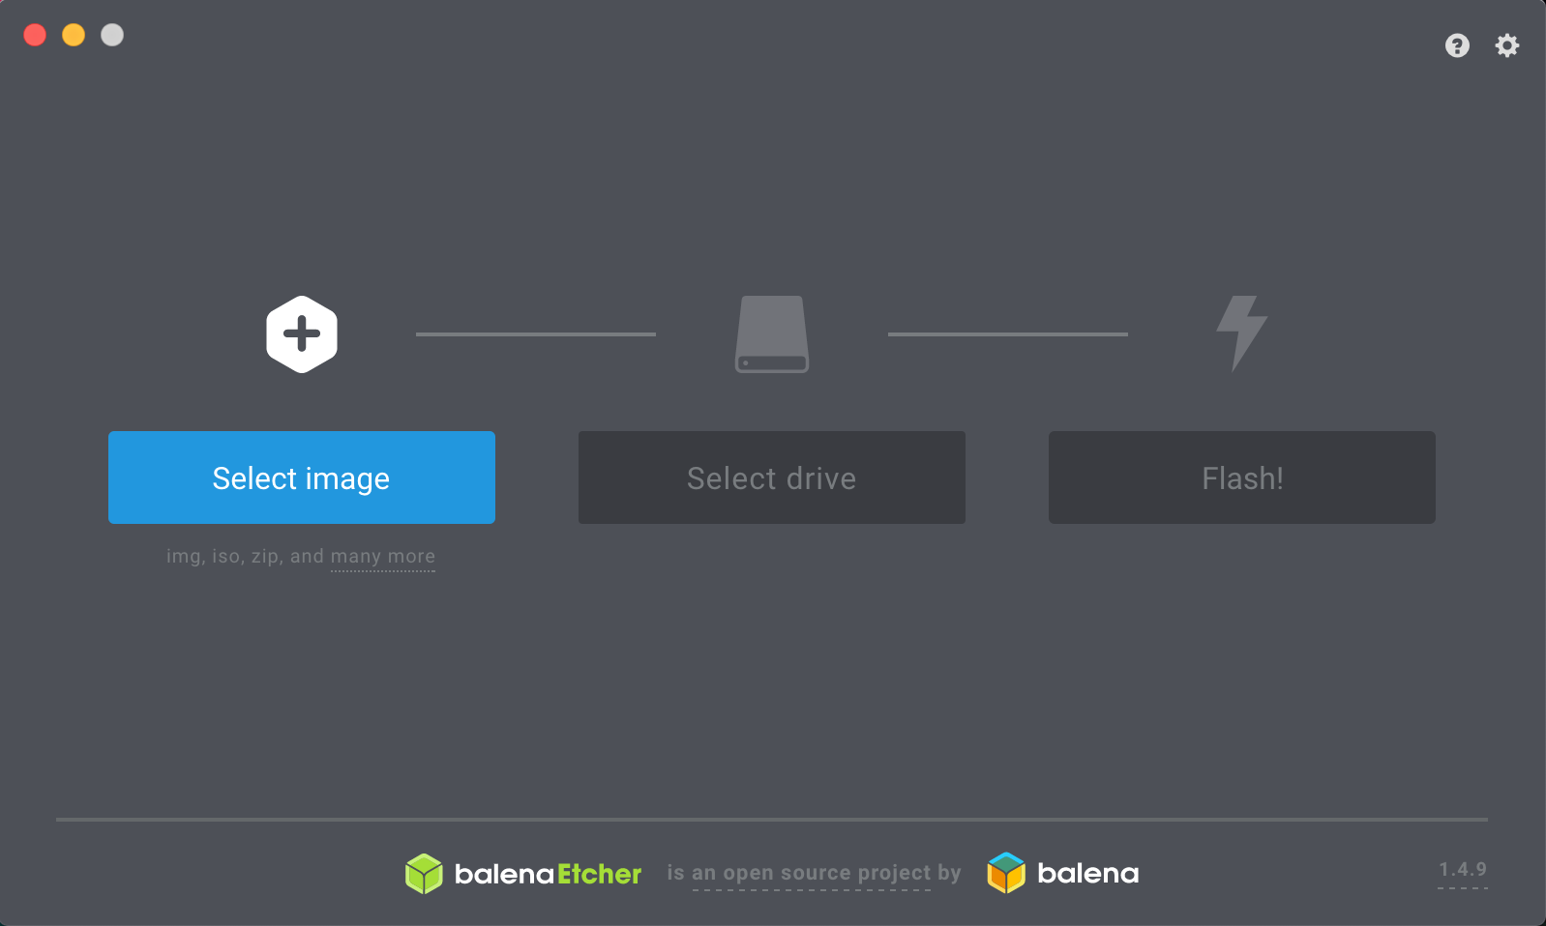
Bootable USB in Windows / Mac - balena.io/etcher
Notes:
For any scrubs out there using windows who’ve never made a bootable USB before, just use etcher or rufus
Be aware that it will completely format the USB, so don’t get too attached to any saved data
You may need to format your USB, setting it as MBR & leave it unpartitioned is easiest

Slide 7
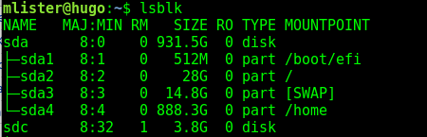
Bootable USB for cool people
Find your device
$ lsblk | $ diskutil list
Copy image with disk destroyer
$ sudo dd if=ubuntu-server.iso of=/dev/sdX
Done!
Notes:
If you’re cool and use a unix-based system, you can do this in a terminal with just a couple commands.

Slide 8
Plug in USB & Install
Don’t forget to include OpenSSH Server!
Notes:
Go ahead and plug in your USB to your server and install. Once complete, you should have a barebones ubuntu server.

Slide 9
Obtain Dependencies
$ sudo apt update
$ sudo apt install virtualbox \
virtualbox-guest-additions-iso
$ sudo apt install xorg
$ sudo apt install nginx
And download another copy of Ubuntu Server.

Slide 10
Start X11 Server & Enable nginx
$ sudo systemctl start graphical.target
$ sudo sytemctl start nginx
$ sudo systemctl enable nginx
systemctl is a service manager for Linux

Slide 11
Use S SHell to Remotely Administer
$ ssh -X user@server
/etc/ssh/sshd_config -
X11Forwarding yes
Notes:
Nobody likes to drive out to campus just to add a new user- you can do it all remotely with SSH.

Slide 12
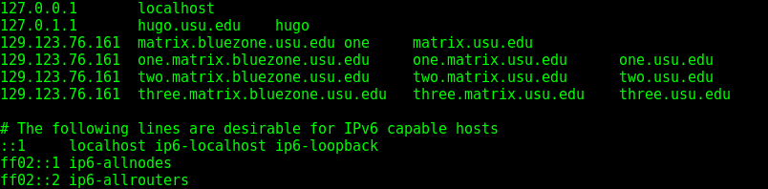
Create Local DNS Records

Slide 13
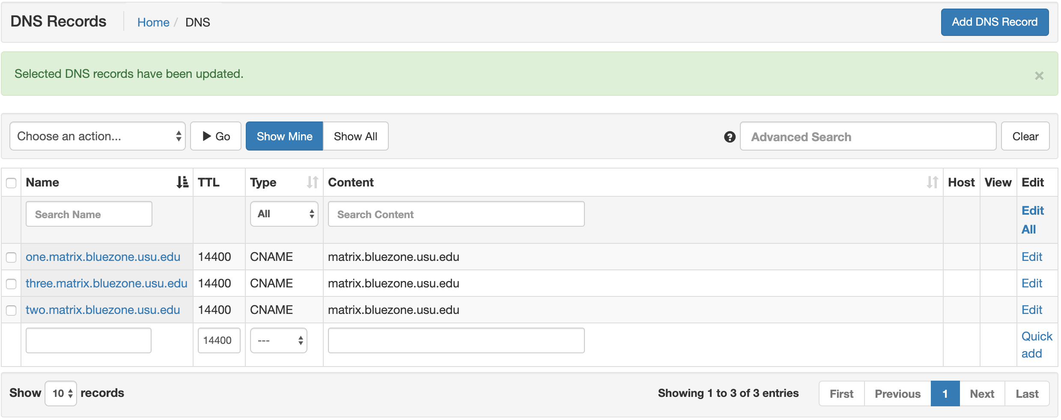
Campus DNS
Notes:
When we get a public IP from campus, we’ll have an A-record listed here.
Display chaosreader.tk & chaosreader.ddns.net
You can stack any number of CNAME’s to any single IP.

Slide 14
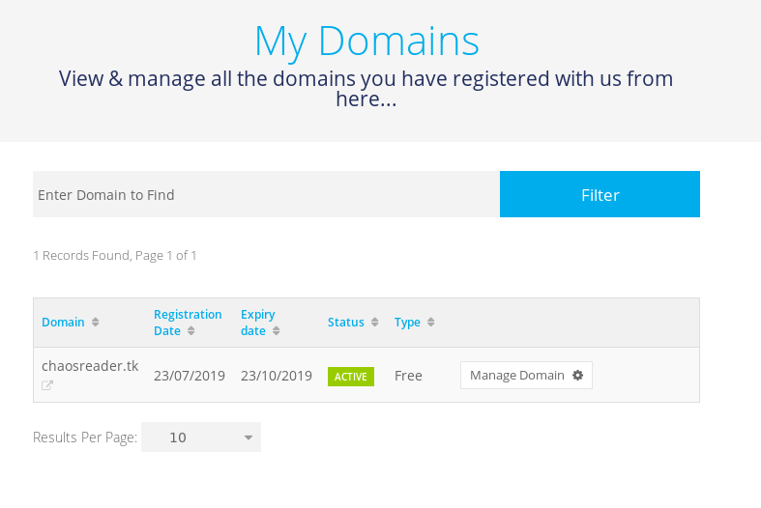
DNS Management
Notes:
DNS records can be hosted through 3rd party services- we used Freenom (not sponsored) to register a .tk domain, which just points to our .ddns.net address.

Slide 15
IP Forwarding
$ vim /etc/sysctl.conf
net.ipv4.ip_forward = 1
Reload kernel parameters on the fly to enable IP Forwarding
$ sudo sysctl -p

Slide 16
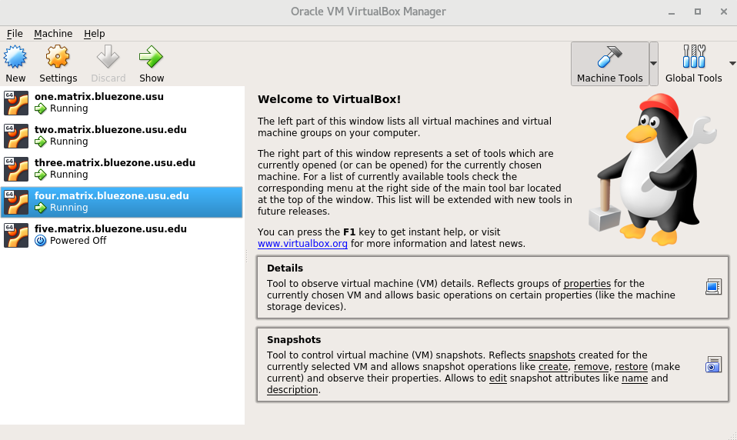
Start Virtualbox- $ virtualbox

Slide 17
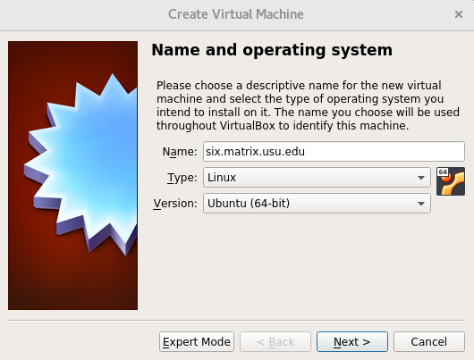
Create new VM’s
Notes:
At least 2GB RAM, VDI, we gave ours around 40GB but whatever works for your setup.

Slide 18
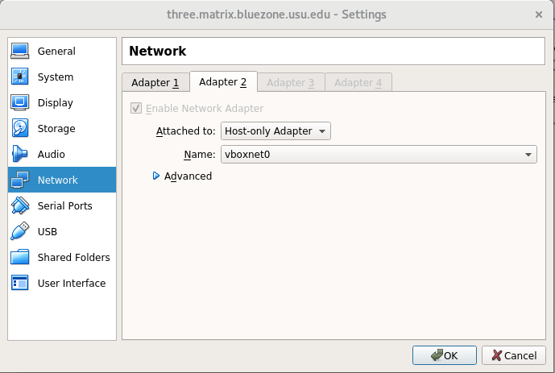
Networking
Notes:
This is the tricky part- you get a NAT out of the box on Adapter 1, but we need a Host-only Adapter to connect out the back.

Slide 19
Run your VM!
Notes:
Congrats- that’s the bare minimum to get a VM server running. You may want to install Apache w/ Ubuntu Server just so you have something to do, but at this point it’s useable but not accessible.

Slide 20
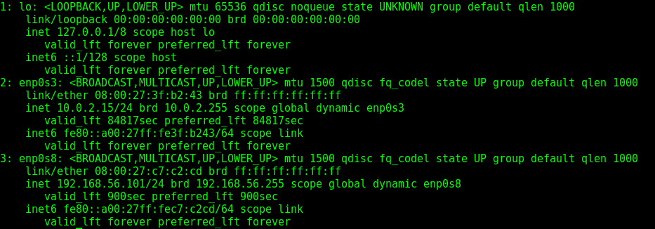
VM Networking
$ ip addr
Notes:
Note that our host-only adapter is referenced as device enp0s8 and pulls from our 192.168.56.0/24 subnet

Slide 21
VM Networking Cont.
$ ip route show default - List default Network Device
$ ip route add default via \
192.168.56.1 dev enp0s8

Slide 22
Host Networking
$ iptables -t nat -A POSTROUTING \
-o eno2 -j MASQUERADE
Note that ‘-o’ signifies our output interface, so replace ‘eno2’ with whatever your network interface is listed as on your host.
Notes:
IP masquerading is a technique that hides an entire IP address space, usually consisting of private IP addresses, behind a single IP address in another, usually public address space. The hidden addresses are changed into a single (public) IP address as the source address of the outgoing IP packets so they appear as originating not from the hidden host but from the routing device itself. Because of the popularity of this technique to conserve IPv4 address space, the term NAT has become virtually synonymous with IP masquerading.

Slide 23
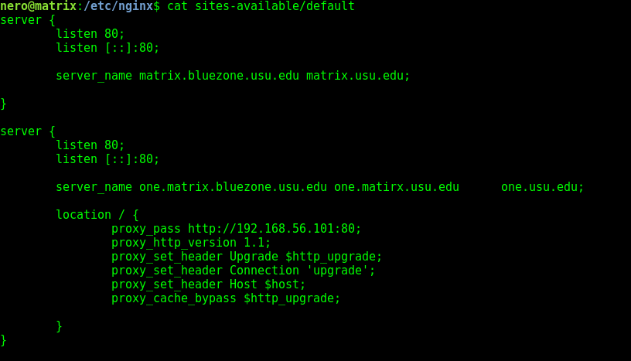
Set up nginx as a reverse proxy
Notes:
Nginx config reads this file to determine setup. This lets us re-use ports as much as we’d like, and why so many apps are run through the web- ports are made easily accessible.

Slide 24
Forward Specialized Services
# iptables -t nat -A PREROUTING -p tcp \
--dport 8000 -j DNAT \
–to-destination 192.168.56.104:8000
Notes:
Here’s a oneliner to forward a web server on port 8000 out of your VM to be publicly accessible at port 8000.
For example, we forwarded a 445, 136, 137, and 138 out for our samba server, available on the campus VPN. - samba demo

Slide 25
Permanent iptables config
# man iptables-save
Notes:
Unfortunately, how routing information is stored varies with Linux distributions we are not going to show how to script loading these configurations on startup- it varies wildly from distro to distro. However, we will use this opportunity to demonstrate the linux man command. For example the command # man iptables-save

Slide 26
SSH Jump Box
With the current setup, users will use the host as a jump box to administer to the individual vms. The syntax is:
$ ssh -J [user]@[hypervisor] [user]@[vm]
Alternatively, you can use iptables to send all port 22 requests to a vm and then jump from there. This shrinks the security footprint of the hypervisor. Just don’t forget to set up a way to administer to the hypervisor.

Slide 27
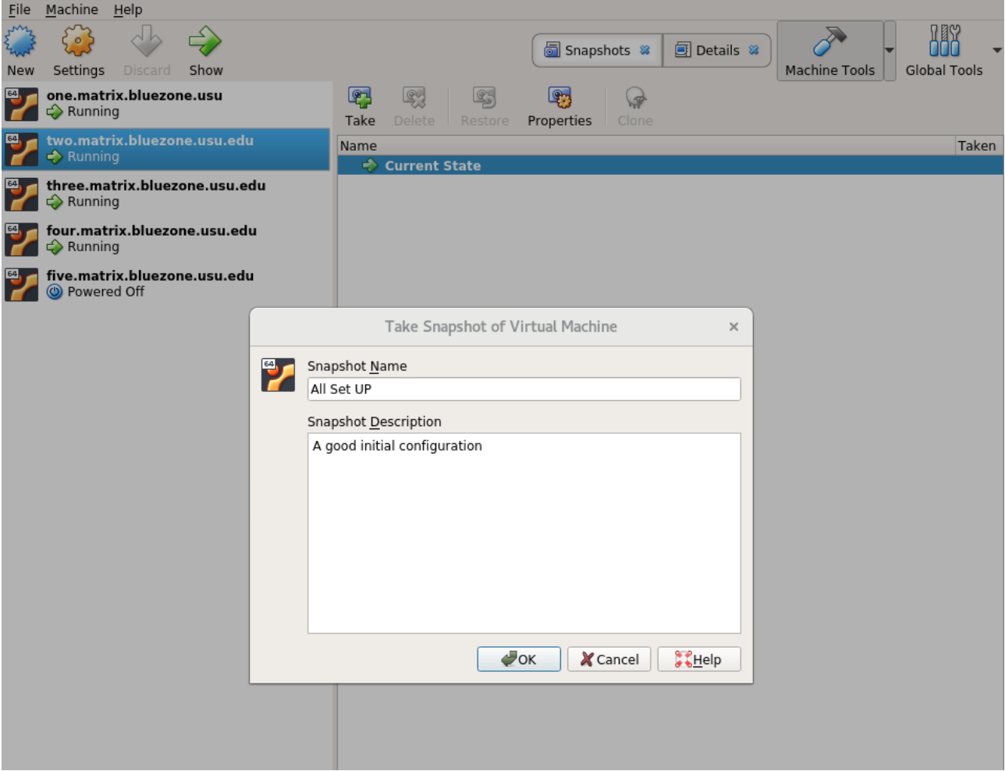
VM Snapshots & Exports
Notes:
cp will not behave the way you expect it to- to backup, use the export feature. Snapshots can be useful if you’re experimenting with your configuration.

Slide 28
Linux Club- Why do you need one?
Notes:
What is Linux Club?
It’s a group where a bunch of nerds get to hang out together
Anecdote - when I started using linux, I didn’t know other people who were cool
Membership / who shows up / improvements?
Why is it important- two reasons- segue-

Slide 29
Community
Notes:
fostering a CS community (which can be rare) and engaging programmers in social activities
Other majors / aspects of study tend to build communities and relationships, but programmers tend to be a bit a-social
Creating connections is very important - also important is -

Slide 30
Skill Development
Notes:
Some people take to linux easily, some need a hand
Teaching people about why linux is cool can get them interested / ahead of the game in industry techniques
I got my job almost primarily off of linux experience, these are valuable skills that can be difficult to learn without introduction- making linux less scary

Slide 31
Linux Club- What
Notes:
How do we run the club? We talk about anything that interests us in linux. Usually start with introductory / beginner stuff, progress to more advanced presentations
Community involvement is important here- taking time to have discussion about technical topics, or having community members give presentations about what interests them

Slide 32
Challenges & Solutions
Notes:
Linux club sounds cool, and it’s definitely something you can pull off, but there’s also work that you need to put in to get the ball rolling.
Here are some of the issues we ran into, and how we’ve overcome them.

Slide 33
Not a 1-man job
Notes:
Running a club can be tough for just one person- getting community involvement and building leadership is really important.

Slide 34
Linux Club- How
Notes:
How do I start one- talk to administration, you’ll probably find a professor who’s enthusiastic.
In our experience, a faculty advisor doesn’t have to be particularly involved for the club to be successful, but it can help.

