Slide 1
Hypothesis Testing for Lok-Sabha Elections Candidate Datasets
Shaunak Phatak

Slide 2
Presentation Overview
Data-sets used
Questions investigated with traditional hypothesis tests:
Are there more candidates in 2014 with a criminal case record ?
Has the proportion of candidates with a graduate level education or higher changed between 2009 and 2014 ?
Is there a difference in the candidates between two states in terms of net assets, criminal record and graduate education proportions ?
Permutation tests between the states of Maharashtra & Kerala for 2014:
Difference of candidate mean assets
Difference of candidate criminal record proportions
Difference of candidate graduate education proportions

Slide 3
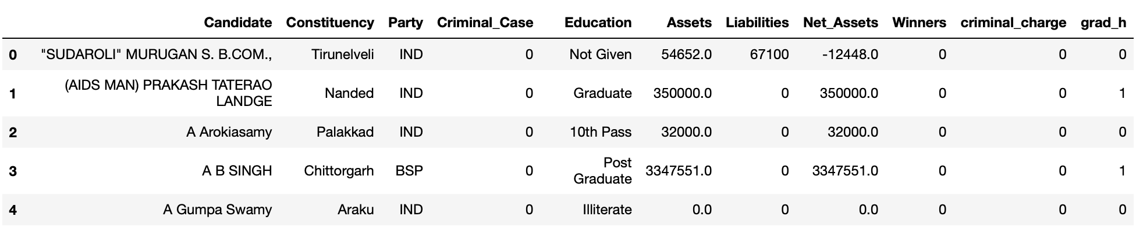
Candidate Datasets for Lok-Sabha Elections
All-Candidate datasets for 2009 & 2014 used for traditional hypothesis tests
State-level all-candidate datasets (2014 elections) used for permutation tests
Created new columns for net assets, binary indicators for presence of criminal charges and education being at or above a graduate level
Reference: https://myneta.info/

Slide 4
Steps that are followed for a Hypothesis Test
Define a question and formulate null and alternate hypotheses
Choose a hypothesis test: z-test / t-test, 1/2 tailed, mean / proportion and so on
Specify a significance level to make a decision based on the test results
Meet the test conditions:
Random sample (python’s sample() function to take a random sample without replacement)
Normality for the sampling distribution
Independence between observations in the sample
Calculate a test statistic and its corresponding probability (p-value)
Decide the test result by comparing the p-value with the chosen significance level

Slide 5
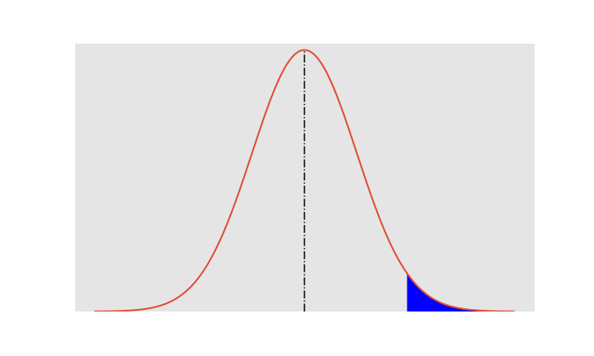



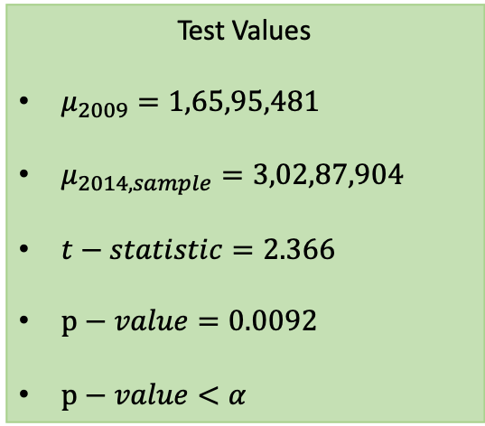

Has the average net asset value of candidates increased in 2014
Random $(n=700)$
Independence $(n ≤10 \% of population)$
Normality $(n>30)$
1-tailed/1 sample/t-test/mean
Significance level:
$$α=0.05$$
Test Values
$μ_{2009}=\text{1}\text{,}\text{65}\text{,}\text{95}\text{,}\text{48}\text{1}$
$μ_{2014,sample}=\text{3,02,87,904}$
$t−statistic=2.366$
$p−value=0.0092$
$p−value<α$
Null Hypothesis:
$${μ_{2014}= μ}_{2009}$$
Alternate Hypothesis:
$${μ_{2014}> μ}_{2009}$$
Region to reject Null Hypothesis
Test Recommendation: Reject the null hypothesis as p-value is below the chosen significance level.
Accept the alternate hypothesis that the mean net assets value has increased in 2014

Slide 6


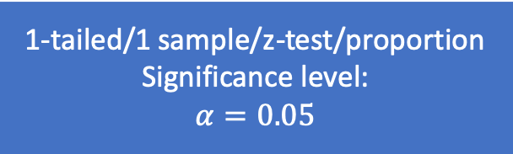
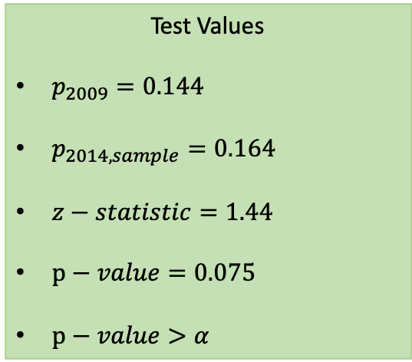

Has the fraction of candidates with a criminal record increased in 2014
Random $(n=700)$
Independence $(n ≤10 \% of population)$
Normality
$$(n∗p) \& n∗(1−p)>10$$
1-tailed/1 sample/z-test/proportion
Significance level:
$$α=0.05$$
Test Values
$p_{2009}=\text{0.144}$
$p_{2014,sample}=\text{0.164}$
$z−statistic=1.44$
$p−value=0.075$
$p−value>α$
Null Hypothesis:
$${p_{2014}= p}_{2009}$$
Alternate Hypothesis:
$${p_{2014}> p}_{2009}$$
Region to reject Null Hypothesis
Test Recommendation: Fail to reject the null hypothesis as p-value is greater than the chosen significance level.
Accept the null hypothesis that the fraction of candidates with a criminal record is the same as that in 2009

Slide 7
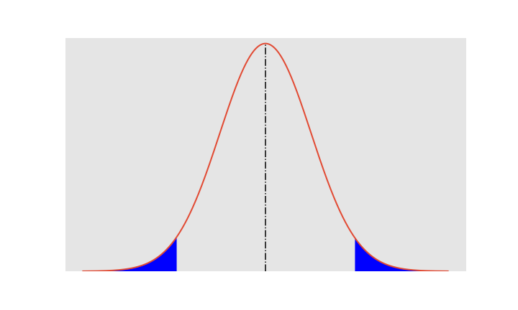
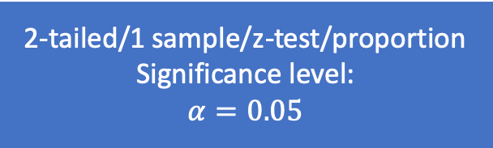
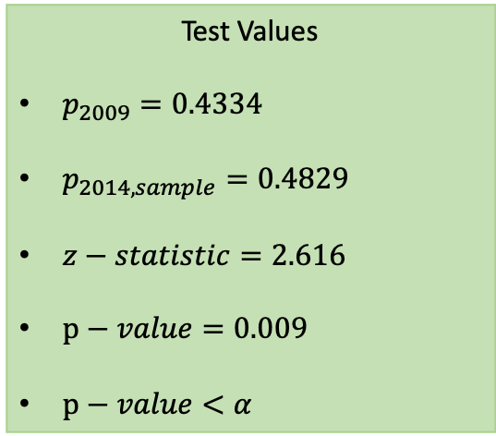

Has the proportion of candidates with a graduate education or higher changed between 2009 and 2014
Random $(n=700)$
Independence $(n ≤10 \% of population)$
Normality
$$(n∗p) \& n∗(1−p)>10$$
2-tailed/1 sample/z-test/proportion
Significance level:
$$α=0.05$$
Test Values
$p_{2009}=\text{0.4334}$
$p_{2014,sample}=\text{0.4829}$
$z−statistic=2.616$
$p−value=0.009$
$p−value<α$
Null Hypothesis:
$${p_{2014}= p}_{2009}$$
Alternate Hypothesis:
$${p_{2014}≠ p}_{2009}$$
Region to reject Null Hypothesis
Region to reject Null Hypothesis
Test Recommendation: Reject the null hypothesis as p-value is smaller than the chosen significance level.
Accept the alternate hypothesis that the proportion of candidates with a graduate level education or higher has changed between 2009 and 2014

Slide 8
Steps followed for 2-Sample Permutation Tests
Define a question and formulate null and alternate hypotheses
2-Sided Permutation Test for difference of means or proportions
Specify a significance level to make a decision based on the test results
Assuming null hypothesis (No difference in the test statistics) as true:
Run a for loop ‘k’ times to create a sampling distribution of the test statistic:
Pool both samples and permute
Create new sample sets with the same size as original samples
Calculate test statistic (difference of means or proportions)
Calculate corresponding probability (p-value)
Decide the test result by comparing the p-value with the chosen significance level

Slide 9
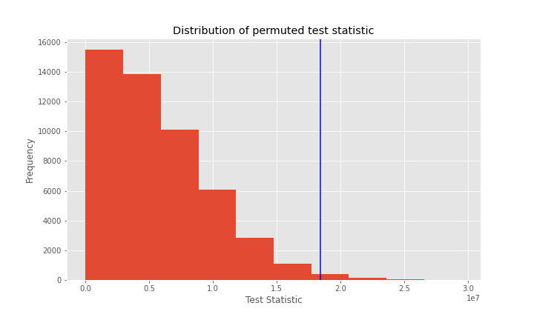
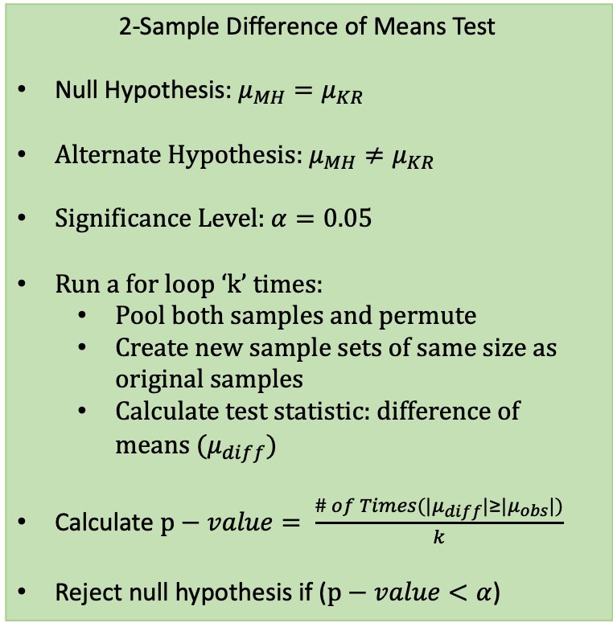


Permutation Test: Difference between net assets of candidates in Maharashtra and Kerala (2014)
2-Sample Difference of Means Test
Null Hypothesis: $μ_{MH}=μ_{KR}$
Alternate Hypothesis: $μ_{MH}≠μ_{KR}$
Significance Level: $α=0.05$
Run a for loop ‘k’ times:
Pool both samples and permute
Create new sample sets of same size as original samples
Calculate test statistic: difference of means ${(μ}_{diff})$
Calculate $p−value= \frac{\# of Times{(|μ}_{diff}|≥|μ_{obs}|)}{k}$
Reject null hypothesis if ($p−value<α$)
Observed difference of means
$${(|μ}_{obs}|)$$
$p−value=0.00906$
Test Recommendation: Reject the null hypothesis as p-value is smaller than the chosen significance level.
Accept alternate hypothesis: There is a difference in the mean assets value for both the states

Slide 10
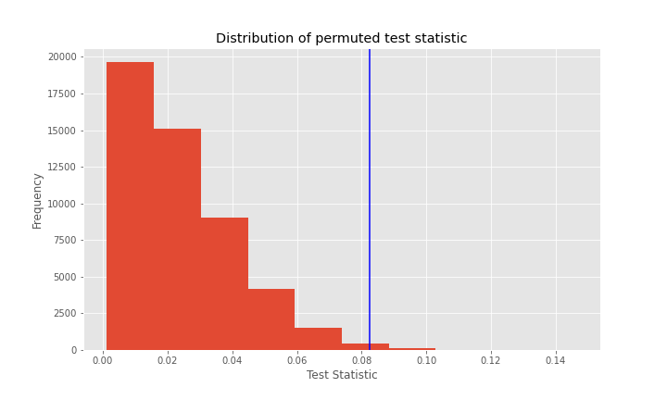
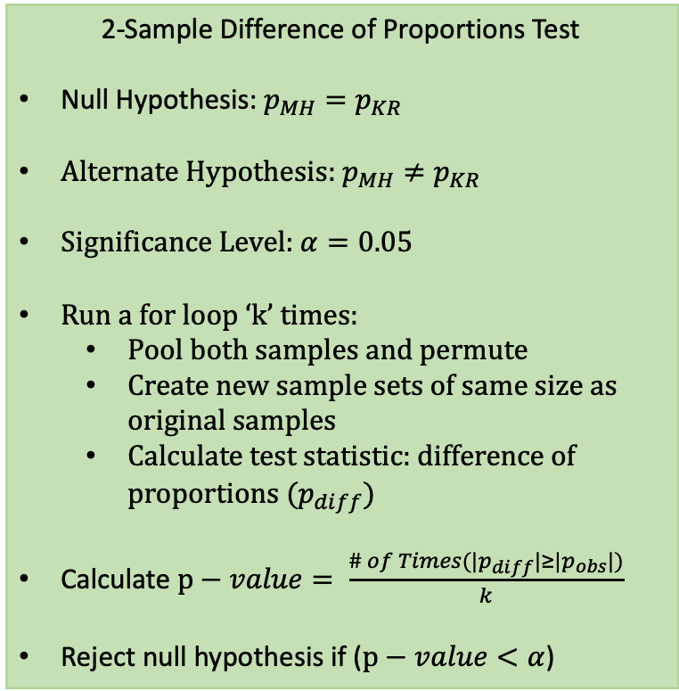


Permutation Test: Difference of candidate criminal record proportions in Maharashtra and Kerala (2014)
2-Sample Difference of Proportions Test
Null Hypothesis: $p_{MH}=p_{KR}$
Alternate Hypothesis: $p_{MH}≠p_{KR}$
Significance Level: $α=0.05$
Run a for loop ‘k’ times:
Pool both samples and permute
Create new sample sets of same size as original samples
Calculate test statistic: difference of proportions ${(p}_{diff})$
Calculate $p−value= \frac{\# of Times{(|p}_{diff}|≥|p_{obs}|)}{k}$
Reject null hypothesis if ($p−value<α$)
Observed difference of means
$${(|p}_{obs}|)$$
$p−value=0.00536$
Test Recommendation: Reject the null hypothesis as p-value is smaller than the chosen significance level.
Accept alternate hypothesis: There is a difference in proportion of candidate criminal case records in the two states

Slide 11
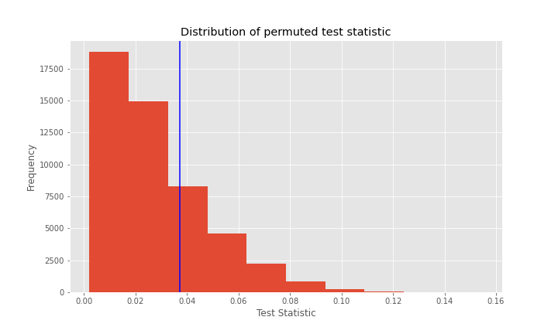


Permutation Test: Difference of candidate graduate education proportions in Maharashtra and Kerala (2014)
2-Sample Difference of Proportions Test
Null Hypothesis: $p_{MH}=p_{KR}$
Alternate Hypothesis: $p_{MH}≠p_{KR}$
Significance Level: $α=0.05$
Run a for loop ‘k’ times:
Pool both samples and permute
Create new sample sets of same size as original samples
Calculate test statistic: difference of proportions ${(p}_{diff})$
Calculate $p−value= \frac{\# of Times{(|p}_{diff}|≥|p_{obs}|)}{k}$
Reject null hypothesis if ($p−value<α$)
Observed difference of means
$${(|p}_{obs}|)$$
$p−value=0.29372$
Test Recommendation: Fail to reject null hypothesis as p-value is smaller than the chosen significance level.

