Slide 1
NATURAL LANGUAGE PROCESSING (NLP)
Chapter 1: INTRODUCTION TO NLP
Trương Quốc Định
Faculty of Information Systems – College of Information & Communication Technology

Slide 2
Motivation
INTRODUCTION TO NLP
Thank to an increased interest in human-to-machine communications, plus an availability of big data.
It is possible for computers to read text, hear speech, interpret it, measure sentiment and determine which parts are important?
Considering the staggering amount of unstructured data that’s generated every day, from medical records to social media.
Machines must analyse more language-based data than humans.

Slide 3
Motivation
INTRODUCTION TO NLP
Go beyond the keyword matching
Identify the structure and meaning of words, sentences, texts and conversations.

Slide 4
Definition
INTRODUCTION TO NLP
Wiki: NLP is a field of computer science, artificial intelligence, and computational linguistics concerned with the interactions between computers and human (natural) languages.
Computational methods for understanding or generating natural language.

Slide 5
Approaches to NLP
INTRODUCTION TO NLP
Classical divide and conquer
break up into smaller tasks,
develop methods to solve those tasks,
combine tasks into a “pipeline” to solve overall task,
for each task, there can be many different possible approaches,
some or all of the sub-tasks may be based on some form of machine learning.

Slide 6
Approaches to NLP
INTRODUCTION TO NLP
End-to-end
Single (Deep-Learning) model that does it all in one go
But, some NLP tasks (Tokenization) and ML tasks (data-loaders, batching..) are still needed.

Slide 7
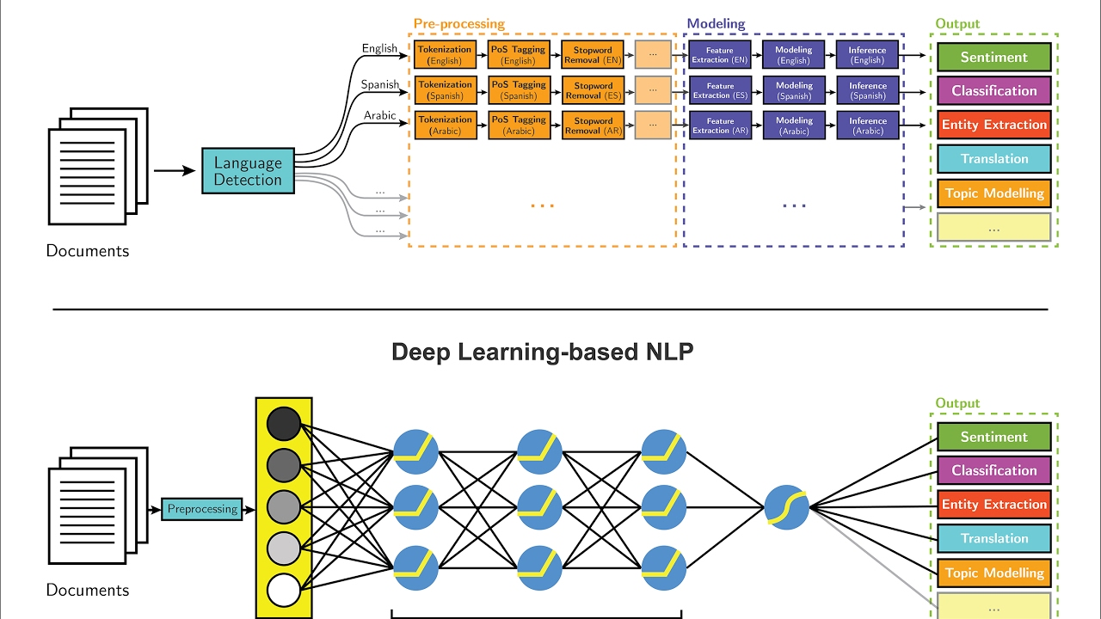
Approaches to NLP
INTRODUCTION TO NLP

Slide 8
NLP tasks
INTRODUCTION TO NLP
Sentence splitting, Tokenization
Stemming, Lemmatization, POS tagging
Parsing
Named Entity Recognition

Slide 9
NLP tasks
INTRODUCTION TO NLP
Sentence splitting
The process of separating free-flowing text into sentences.
It is one of the first steps in any natural language processing (NLP) application.
A period (.) may indicate the end of a sentence
or may denote an abbreviation, a decimal point, an ellipsis, or an email address, among other possibilities.
Question marks and exclamation marks can be similarly ambiguous due to use in emoticons, computer code, and slang.

Slide 10
NLP tasks
INTRODUCTION TO NLP
Tokenization
What is a word?
“It’s”, “don’t”, “data-mining”, “trường”, “trường học”
Divide into units to process and call it a “Token”.
White space does not work for each language (e.g. Chinese, Turkish, Vietnamese) → sub-word units
Can have multi-word tokens, e.g. “New York Times”, “kick the bucket”, “Công nghệ thông tin”
Result: text is represented as a sequence of Tokens.

Slide 11
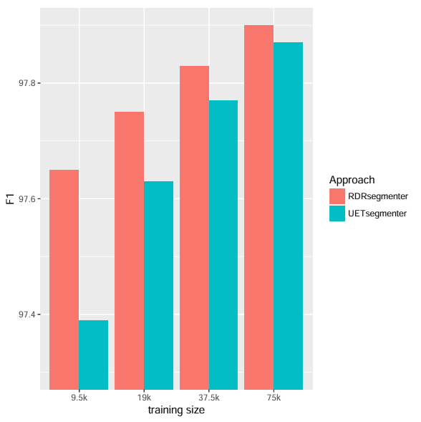
NLP tasks
INTRODUCTION TO NLP
Vietnamese word segmentation
Approach | Precision | Recall | F1
vnTokenizer | 96.98 | 97.69 | 97.33
JVnSegmenter-Maxent | 96.60 | 97.40 | 97.00
JVnSegmenter-CRFs | 96.63 | 97.49 | 97.06
DongDu | 96.35 | 97.46 | 96.90
UETsegmenter | 97.51 | 98.23 | 97.87
VnCoreNLP (RDRSegmenter) | 97.46 | 98.35 | 97.90

Slide 12
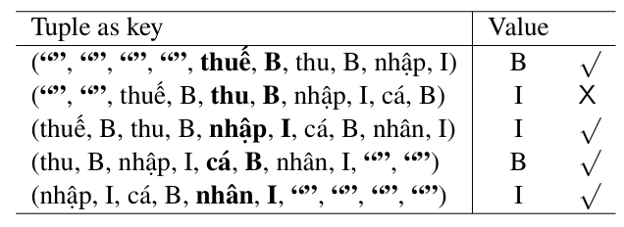
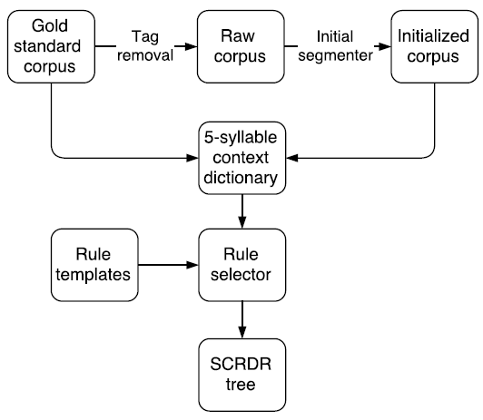
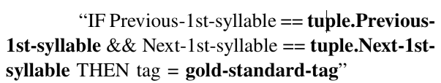
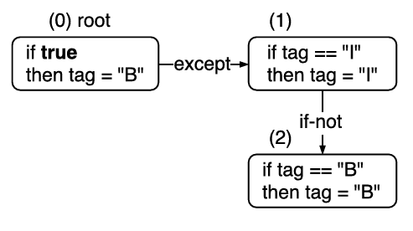
NLP tasks
INTRODUCTION TO NLP
VnCoreNLP

Slide 13
NLP tasks
INTRODUCTION TO NLP
VnCoreNLP: A Fast and Accurate Vietnamese Word Segmenter.
The method starts with a manually word segmented sentences (e.g. “thuế_thu_nhập cá_nhân”) and its BI-formed representation (e.g. “thuế/B thu/I nhập/I cá/B nhân/I”).
Then the syllables are extracted to construct the raw corpus (“thuế thu nhập cá nhân”).
The initial segmenter (the longest matching strategy) is applied on the input raw corpus.
“thuế thu nhập cá nhân” → “thuế/B thu/B nhập/I cá/B nhân/I.”
The BI-formed gold standard corpus and the BI-formed initialized corpus are compared to generate a 5-syllable context dictionary D where each key-value pair consists of a 5-syllable window tuple as key and a gold standard tag as value.
Based on the 5-syllable context dictionary D, the rule selector selects the most suitable rules to construct the SCRDR (Single Classification Ripple Down Rules) tree.

Slide 14
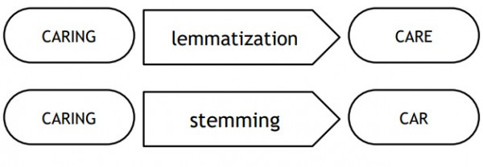
NLP tasks
INTRODUCTION TO NLP
Stemming
The process of producing morphological variants of a root/base word.
“retrieval”, “retrieved”, “retrieves” → “retrieve”.
Lemmatization
The process of grouping together different inflected forms of the same word.
Lemmatization links similar meaning words as one word, making tools such as chatbots and search engine queries more effective and accurate.

Slide 15
NLP tasks
INTRODUCTION TO NLP
POS tagging
The process of assigning one of the parts of speech to the given word.
In simple words, we can say that POS tagging is a task of labelling each word in a sentence with its appropriate part of speech.
Parts of speech include nouns, verb, adverbs, adjectives, pronouns, conjunction and their sub-categories.
Most of the POS tagging falls under Rule Base POS tagging, Stochastic POS tagging, Hidden Markov Model (HMM) POS Tagging.

Slide 16
NLP tasks
INTRODUCTION TO NLP
POS tagging
Rule-based POS Tagging
Words are assigned POS tags based on their characteristics and the context in which they appear.
Rule-based POS taggers can be relatively simple to implement and are often used as a starting point for more complex machine learning-based taggers.
For example:
If the word ends in “-tion,” assign the tag “noun.”
If the word ends in “-ment,” assign the tag “noun.”
If the word is all uppercase, assign the tag “proper noun.”
…

Slide 17
NLP tasks
INTRODUCTION TO NLP
POS tagging
Stochastic POS Tagging
Word Frequency Approach
based on the probability that a word occurs with a particular tag.
it may yield inadmissible sequence of tags.
Tag Sequence Probabilities
It is also called n-gram approach.
The best tag for a given word is determined by the probability at which it occurs with the n previous tags.

Slide 18
NLP tasks
INTRODUCTION TO NLP
POS tagging
Hidden Markov Model
Consists of a set of states, each corresponding to a possible POS tag, and a set of transitions between the states.
The model is trained on the training data to learn the probabilities of transitioning from one state to another and the probabilities of observing different words given a particular state.
tag transition probabilities: P(t_{i}|t_{i−1})
word likelihood probabilities: P(w_{i}|t_{i})

Slide 19
NLP tasks
INTRODUCTION TO NLP
POS tagging
Hidden Markov Model

Slide 20
NLP tasks
INTRODUCTION TO NLP
POS tagging
Hidden Markov Model

Slide 21
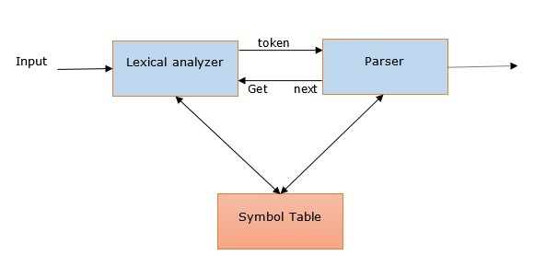
NLP tasks
INTRODUCTION TO NLP
Parsing
It is also called Syntactic analysis or syntax analysis.
Comparing the rules of formal grammar, syntax analysis checks the text for meaningfulness.

Slide 22
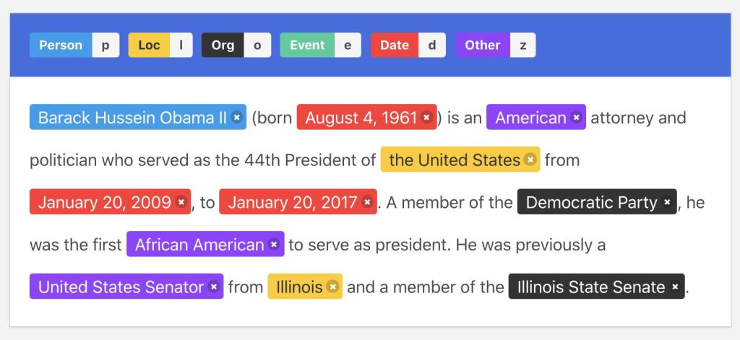
NLP tasks
INTRODUCTION TO NLP
Named Entity Recognition
Focuses on identifying and classifying entities within textual data.
These entities encompass a diverse range of information, including names of individuals, organizations, locations, dates, numerical values, and more.

Slide 23
NLP tasks
INTRODUCTION TO NLP
Named Entity Recognition
Its functioning can be distilled into several key steps:
Text Preprocessing: This typically includes tasks like tokenization (breaking the text into words or phrases) and part-of-speech tagging.
Entity Identification: NER algorithms scan it to identify sequences of words that correspond to entities.
Entity Classification: NER categorizes the recognized entities into predefined classes or types. Common categories include Person, Organization, Location, Date, and more.
Contextual Analysis: NER considers the context in which these entities appear, ensuring accurate classification.

Slide 24
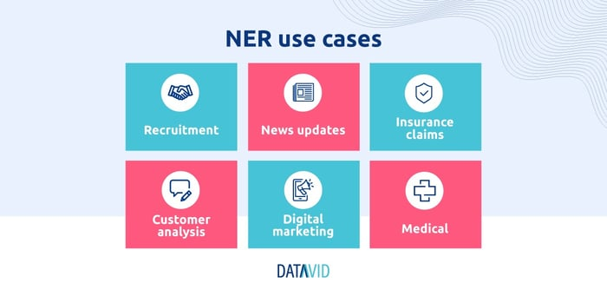
NLP tasks
INTRODUCTION TO NLP
NER use case

Slide 25
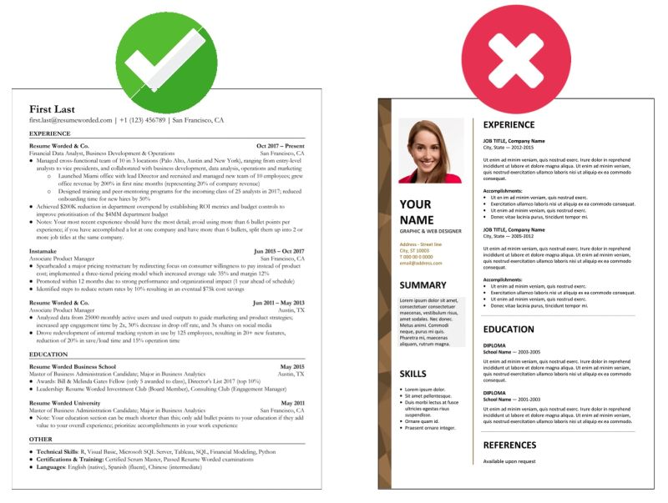
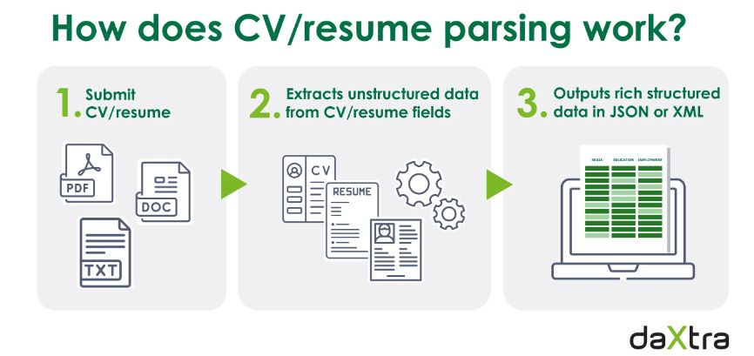
NLP tasks
INTRODUCTION TO NLP
NER use case
Recruitment
NER can help we scan many CVs and identify relevant candidates.

Slide 26
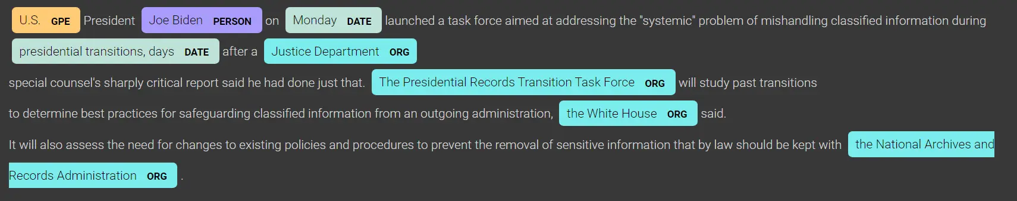
NLP tasks
INTRODUCTION TO NLP
NER use case
New updates
NER can help quickly identify key information from different channels.
This can be highly helpful for businesses monitoring stock markets, technological updates, compliance changes, and much more.

Slide 27
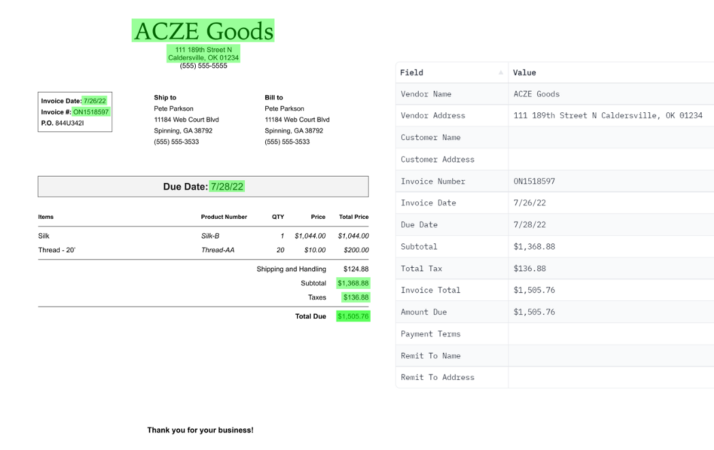
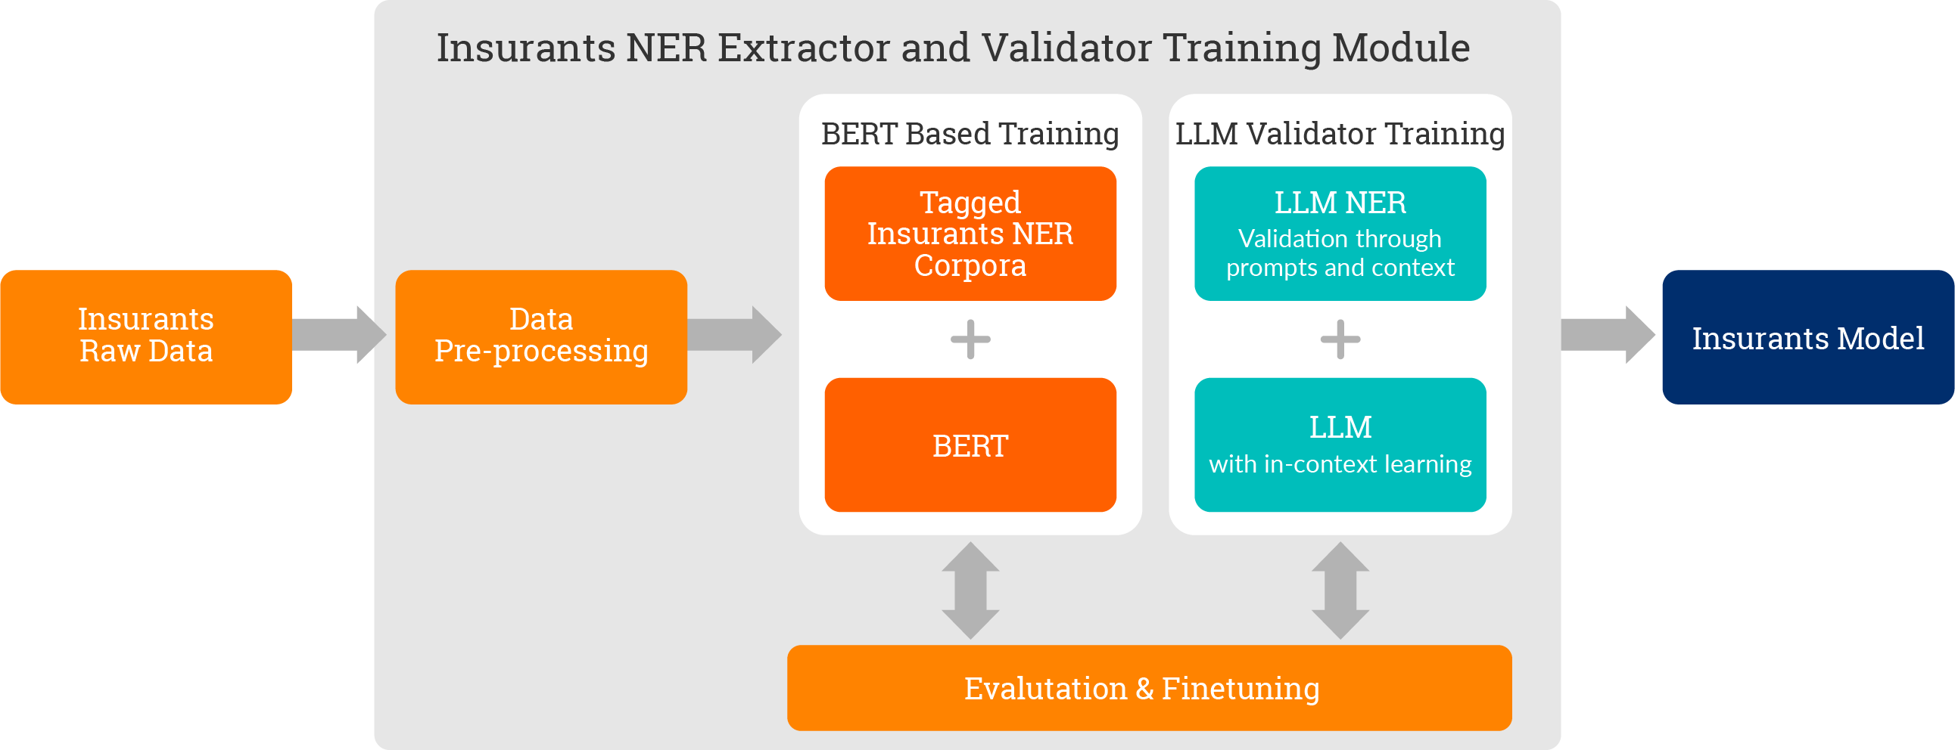
NLP tasks
INTRODUCTION TO NLP
NER use case
Insurance claims
NER can help review insurance claims and identify key information instantaneously.

Slide 28
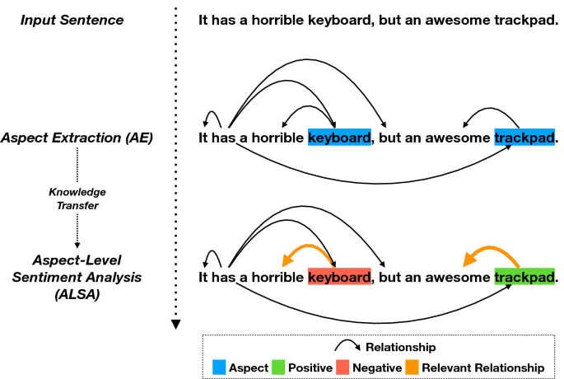
NLP tasks
INTRODUCTION TO NLP
NER use case
Customer analysis
NER can be used to analyze reviews, support tickets, survey results, and feedback.

Slide 29
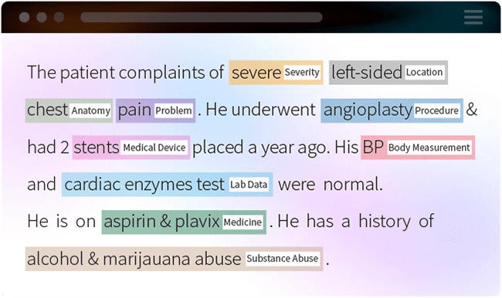
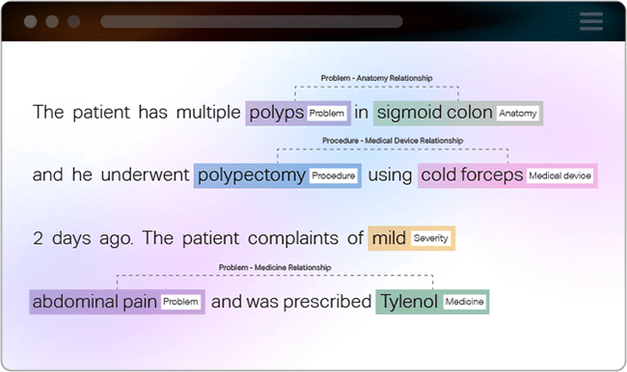
NLP tasks
INTRODUCTION TO NLP
NER use case
Medical
NER can help review patient information, test results, family history, statistics, and other data to identify important patterns.

Slide 30
NLP applications
INTRODUCTION TO NLP
Two main areas
Massive management of textual information sources
For human use
For automatic collection of linguistic resources
Person/Machine interaction

Slide 31
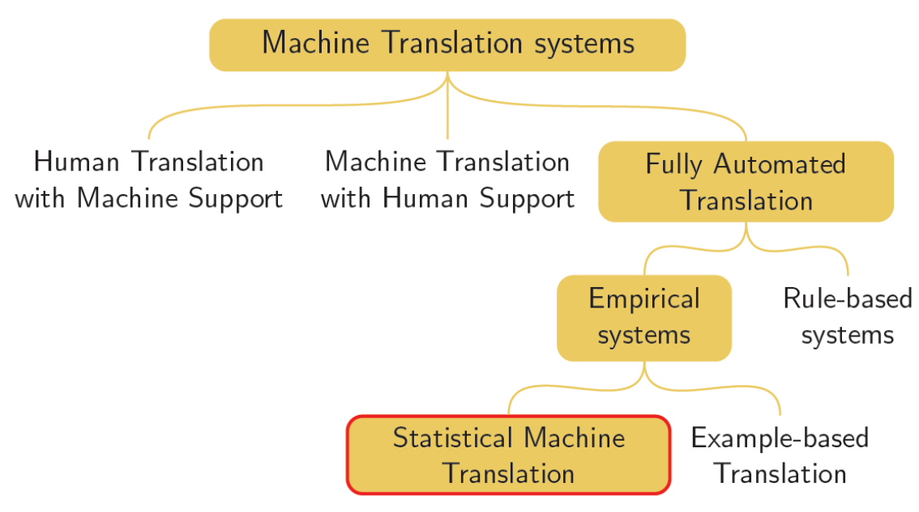
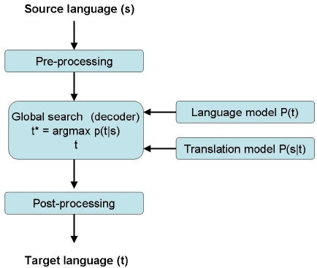
NLP applications
INTRODUCTION TO NLP
Machine translation
Process of translating a text from a source language to a target language preserving some properties.
The main property to preserve (but not the only one) is the meaning.

Slide 32
NLP applications
INTRODUCTION TO NLP
Machine translation
Model for each word in the source language
Its translation
The number of necessary words in the target language
The position of the translation in the sentence
The number of words that need to be generated from scratch.

Slide 33
NLP applications
INTRODUCTION TO NLP
Information Retrieval
Input
A collection of documents
The Web
A corporate document collection
...
A user information need represented as a query
Output
The documents that satisfy the user needs.

Slide 34
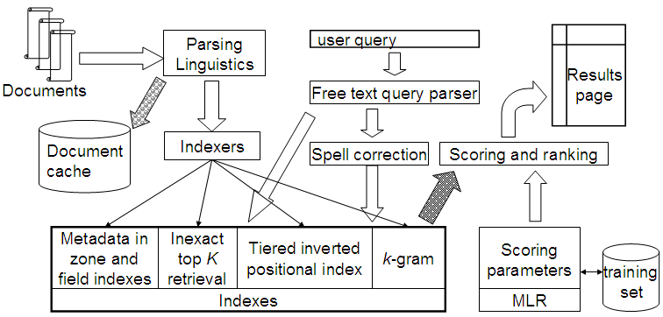
NLP applications
INTRODUCTION TO NLP
Information Retrieval

Slide 35
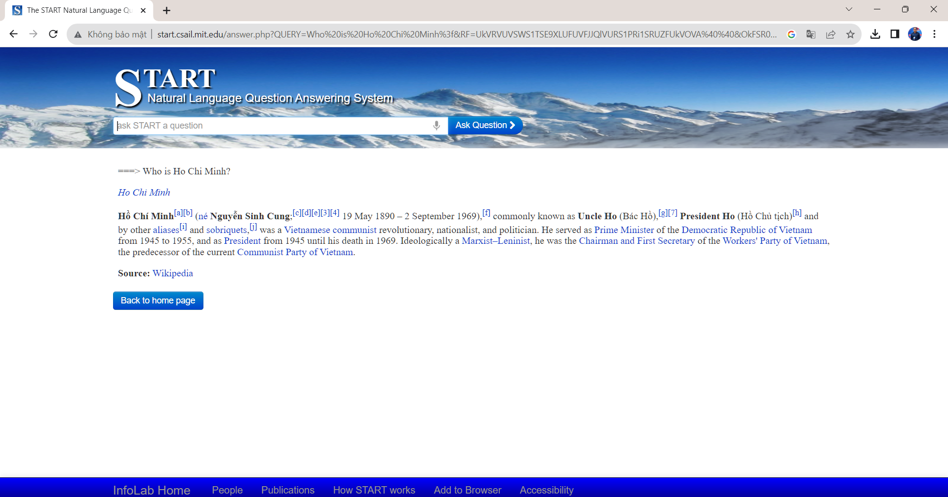
NLP applications
INTRODUCTION TO NLP
Question Answering
Natural extension of IR, QA systems provide not a document containing the answer but the proper answer (usually a fact).

Slide 36
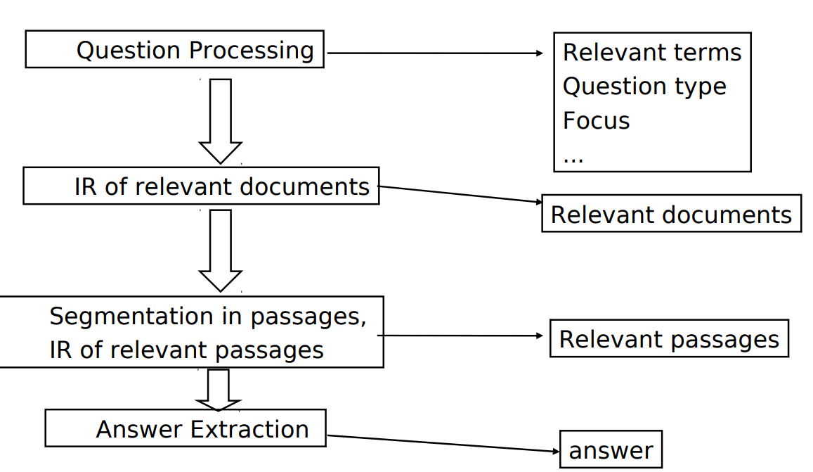
NLP applications
INTRODUCTION TO NLP
Question Answering

Slide 37
NLP applications
INTRODUCTION TO NLP
Information Extraction
Information extraction (IE) tools make it possible to pull information from text documents, databases, websites or multiple sources.
IE may extract info from unstructured, semi-structured or structured, machine-readable text.
Usually, IE is used in natural language processing (NLP) to extract structured from unstructured text.

Slide 38
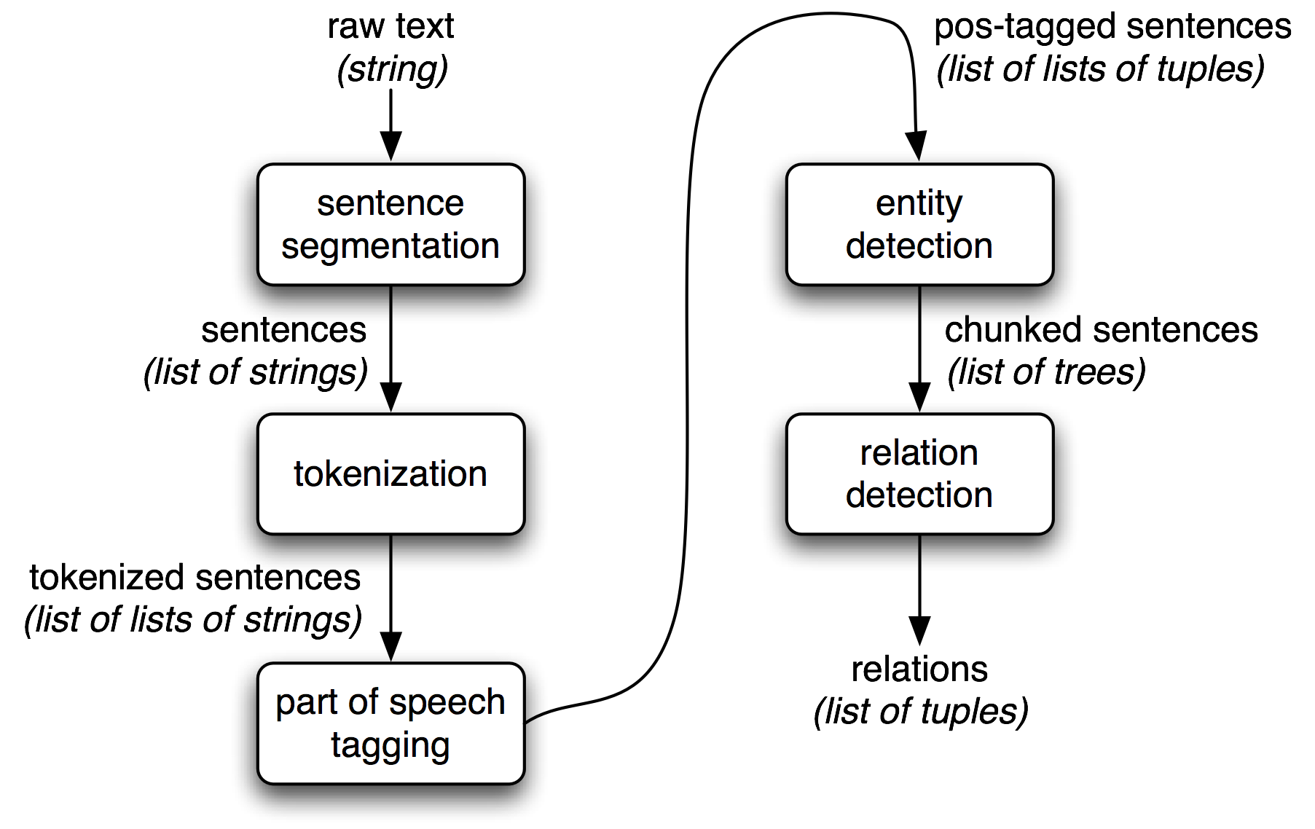
NLP applications
INTRODUCTION TO NLP
Information Extraction
Initial processing.
Proper names identification.
Parsing.
Extraction of events and relations.
Anaphora resolution.
Output result generation.

Slide 39
NLP applications
INTRODUCTION TO NLP
Information Extraction
Initial processing
The first step is to break down a text into fragments such as zones, phrases, segments, and tokens.
In the initial processing stage, part-of-speech tagging, and phrasal unit identification (noun or verb phrases) are usually the next tasks.
Proper names identification
One of the most important stages is the identification of various classes of proper names, such as names of people or organizations, dates, monetary amounts, places, addresses, and so on.
Regular expressions, which are a collection of patterns, are used to recognize these names.

Slide 40
NLP applications
INTRODUCTION TO NLP
Information Extraction
Parsing
The sentences are processed to find the noun groups that surround some of those entities and verb groups.
Extraction of events and relations
This stage establishes relations between the extracted ideas.
This is accomplished by developing and implementing extraction rules that describe various patterns.
The text is compared to certain patterns, and if a match is discovered, the text element is labelled and retrieved later.

Slide 41
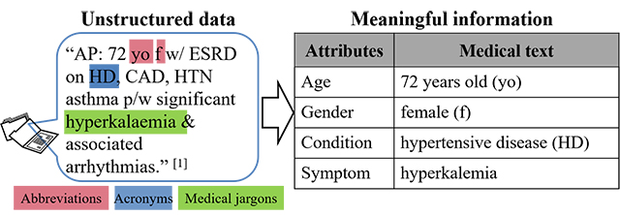
NLP applications
INTRODUCTION TO NLP
Information Extraction
Coreference or Anaphora resolution
The step where noun phrases are decided if they relate to the same entity or not is called coreference or anaphora resolution.
Output results generation
This stage entails converting the structures collected during the preceding processes into output templates that follow the format defined by the user.

Slide 42
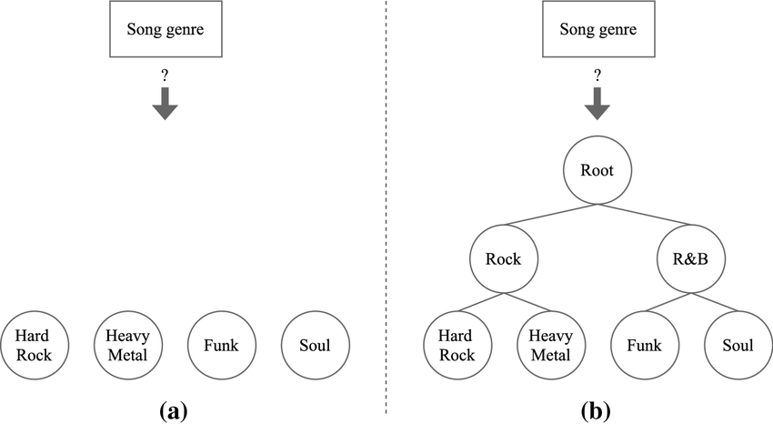
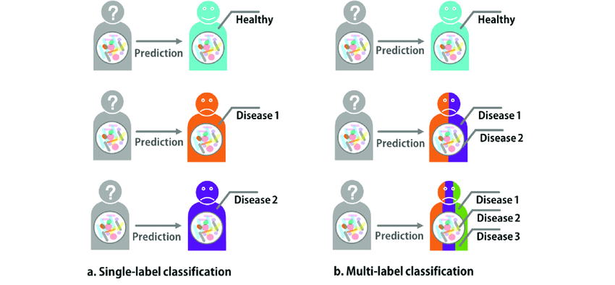
NLP applications
INTRODUCTION TO NLP
Text Classification
Text classification is a machine learning technique that assigns a set of predefined categories to open-ended text.
Text classifiers can be used to organize, structure, and categorize pretty much any kind of text – from documents, medical studies and files, and all over the web.

Slide 43
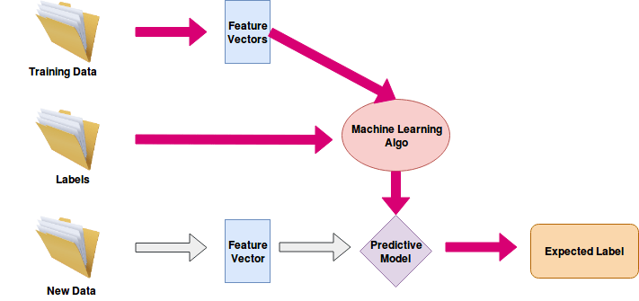
NLP applications
INTRODUCTION TO NLP
Text Classification

Slide 44
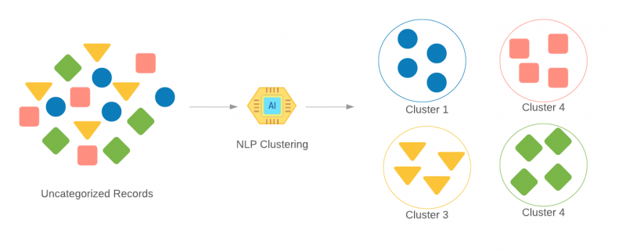
NLP applications
INTRODUCTION TO NLP
Text Clustering
The task of grouping a set of unlabelled texts in such a way that texts in the same cluster are more similar to each other than to those in other clusters.
Text clustering algorithms process text and determine if natural clusters (groups) exist in the data.

Slide 45
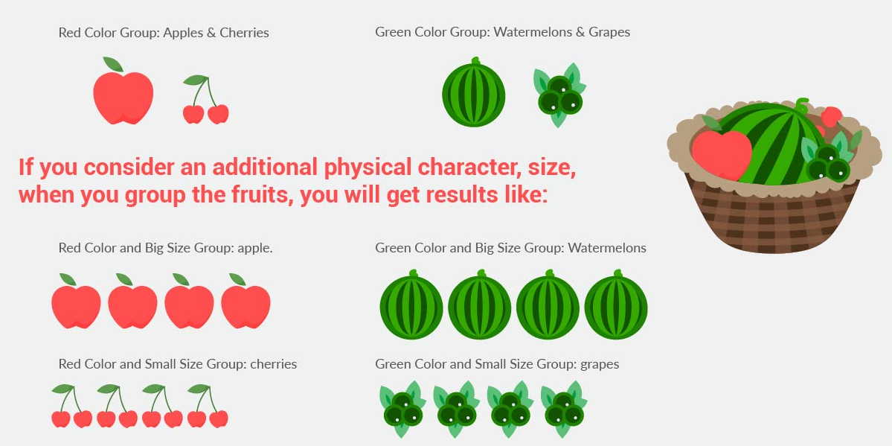

Slide 46
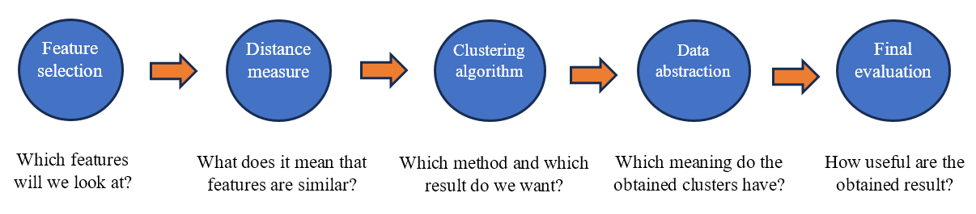
NLP applications
INTRODUCTION TO NLP
Text Clustering

Slide 47
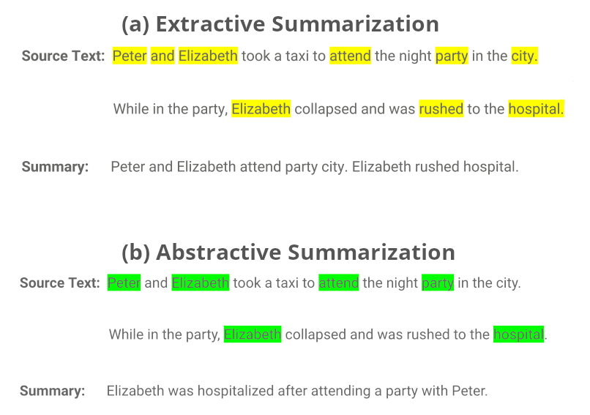
NLP applications
INTRODUCTION TO NLP
Automatic Summarization
A summary is a reductive transformation of a source text into a summary text by extraction or generation.

Slide 48
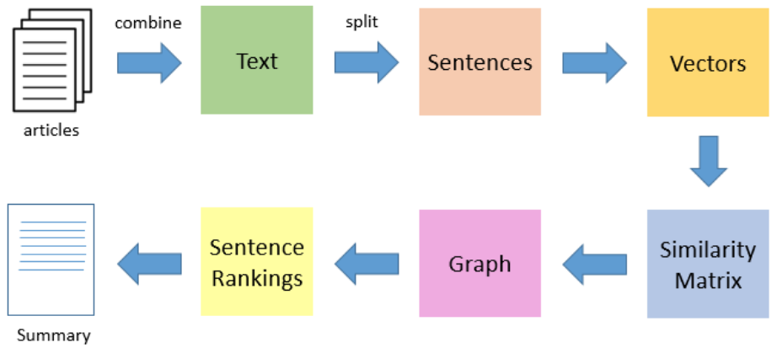
NLP applications
INTRODUCTION TO NLP
Automatic Summarization
Extractive summarization

Slide 49
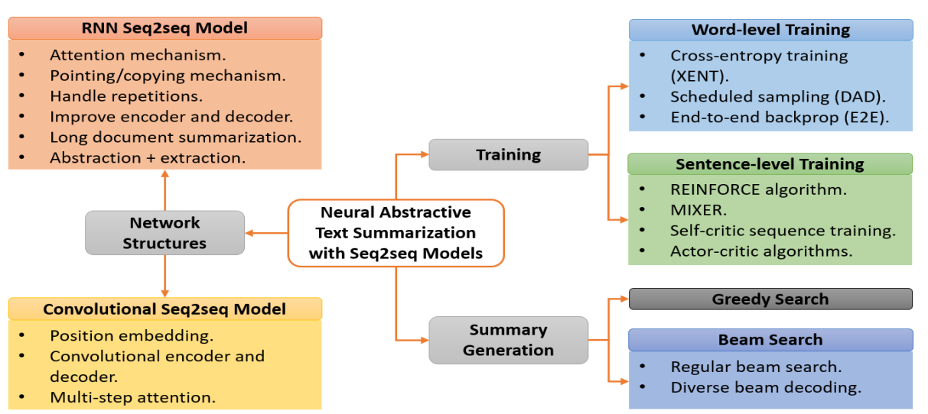
NLP applications
INTRODUCTION TO NLP
Automatic Summarization
Abstractive summarization

Slide 50
NLP applications
INTRODUCTION TO NLP
Sentiment analysis (Opinion mining)
An approach to natural language processing that identifies the emotional tone behind a body of text.
A popular way for organizations to determine and categorize opinions about a product, service or idea.
Sentiment analysis can extract the polarity or the amount of positivity and negativity, subject and opinion holder within the text.

Slide 51
NLP applications
INTRODUCTION TO NLP
Sentiment analysis (Opinion mining)
General steps
Collect data.
Clean the data. The data is processed and cleaned to remove noise and parts of speech that don't have meaning relevant to the sentiment of the text.
Extract features. A machine learning algorithm automatically extracts text features to identify negative or positive sentiment.
Pick an ML model. A sentiment analysis tool scores the text using a rule-based, automatic or hybrid ML model.
Sentiment classification. Once a model is picked and used to analyse a piece of text, it assigns a sentiment score to the text including positive, negative or neutral.

Slide 52
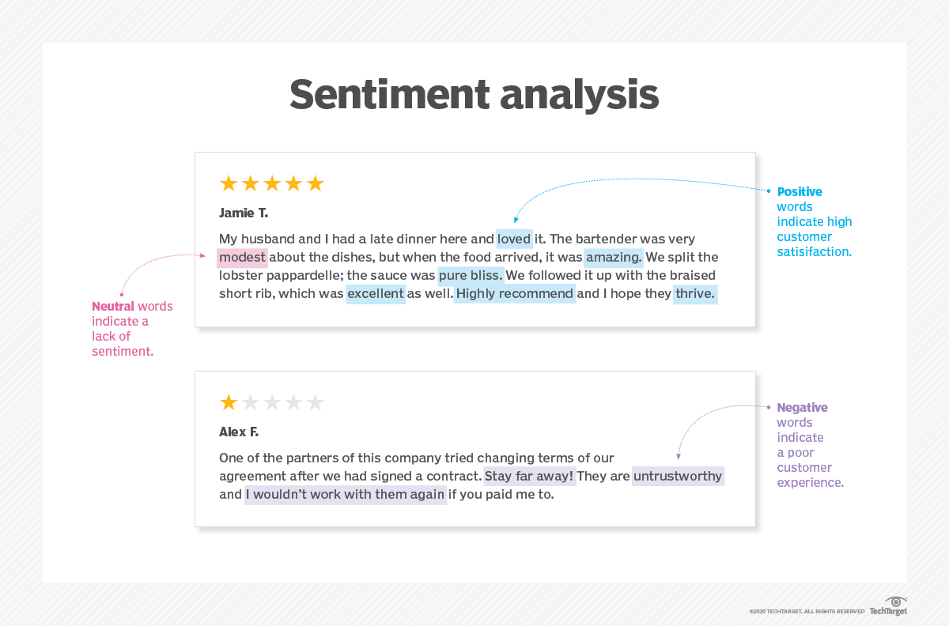
NLP applications
INTRODUCTION TO NLP
Sentiment analysis (Opinion mining)

Slide 53
NLP applications
INTRODUCTION TO NLP
Sentiment analysis (Opinion mining)
Fine-grained sentiment analysis breaks down sentiment indicators into more precise categories, such as very positive and very negative.
Emotion detection analysis identifies emotions rather than positivity and negativity. Examples include happiness, frustration, shock, anger and sadness.
Intent-based analysis recognizes motivations behind a text in addition to opinion. For example, an online comment expressing frustration about changing a battery may carry the intent of getting customer service to reach out to resolve the issue.
Aspect-based analysis examines the specific component being positively or negatively mentioned. For example, a customer might review a product saying the battery life was too short.

Slide 54
NLP applications
INTRODUCTION TO NLP
Chatbot
They are simulations that can understand human language, process it, and interact back with humans while performing specific tasks.
A chatbot is a conversational agent that interacts with users using natural language.

Slide 55
NLP applications
INTRODUCTION TO NLP
Chatbot
Types of Chatbots
Text-based chatbot: In a text-based chatbot, a bot answers the user’s questions via a text interface.
Voice-based chatbot: In a voice or speech-based chatbot, a bot answers the user’s questions via a human voice interface.
There are mainly two approaches used to design the chatbots
In a Rule-based approach, a bot answers questions based on some rules on which it is trained on. The rules defined can be very simple to very complex.
Self-learning bots are the ones that use some Machine Learning-based approaches and are definitely more efficient than rule-based bots.

Slide 56
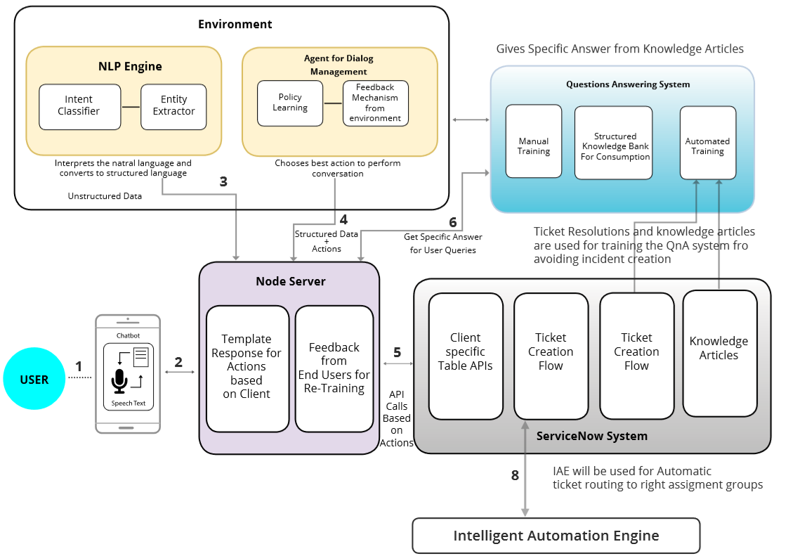
NLP applications
INTRODUCTION TO NLP
Chatbot

Slide 57
NLP challenges
INTRODUCTION TO NLP
Synonyms (words, sentences with the same meaning)
Season of the year
Fall
Autumn
Book delivery time
When will my book arrive?
When will I receive my book?

Slide 58
NLP challenges
INTRODUCTION TO NLP
Polysemy (a single word or phrase has multiple related meanings)
Fall
The third season of the year
Moving down towards the ground or towards a lower position
The door is open.
Expressing a fact
A request to close the door

Slide 59
NLP challenges
INTRODUCTION TO NLP
Homonymy (words with different meanings but with the same pronunciation and/or spelling)
Con đường này thật rộng! Chúng ta nên pha thêm đường.
Chú ấy câu được nhiều cá quá! Vài câu nói ấy thì được cái gì!
Ông ấy cười khanh khách! Nhà ông ấy đang có khách.
Ông ấy đang sút giảm sức khỏe! Cầu thủ sút bóng.

Slide 60
NLP challenges
INTRODUCTION TO NLP
Attachment ambiguity (the doubt is about the syntactic structure of the sentence)

Slide 61
NLP challenges
INTRODUCTION TO NLP
Discourse analysis
Alice understands that you like your mother, but she …
Does she refer to Alice or your mother?

Slide 62



NLP challenges
INTRODUCTION TO NLP
Language is compositional

Slide 63
NLP challenges
INTRODUCTION TO NLP
Scale
Oxford Dictionary has 273,000 headwords; 171,476 of them being in current use, 47,156 being obsolete words and around 9,500 derivative words included as subentries.
The Penn Treebank, produced approximately 7 million words of part-of-speech tagged text, 3 million words of skeletally parsed text, over 2 million words of text parsed for predicate argument structure, and 1.6 million words of transcribed spoken text annotated.
Wikipedia - 2.9 billion word (English)
Web - several billions of words

