Slide 1
NATURAL LANGUAGE PROCESSING (NLP)
Chapter 2: LANGUAGE MODELS
Trương Quốc Định
Faculty of Information Systems – College of Information & Communication Technology

Slide 2
Motivation
LANGUAGE MODELS
Many NLP tasks return output in natural language
Machine translation
Speech recognition
Natural language generation
Spell-checking
Language models define probability distributions over (natural language) strings or sentences.
We can use them to score/rank possible sentences
If P_{LM}(A) > P_{LM}(B), choose sentence A over B

Slide 3
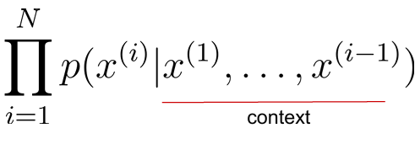
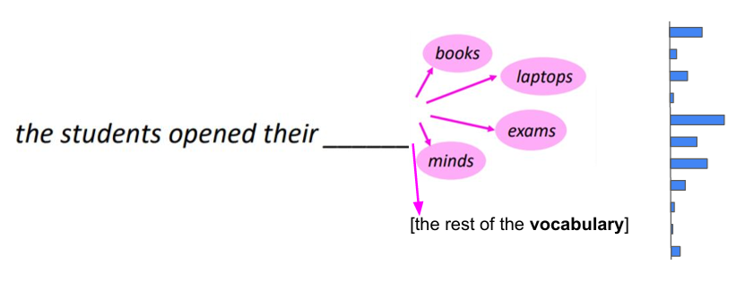
The language modeling problem
LANGUAGE MODELS
context

Slide 4
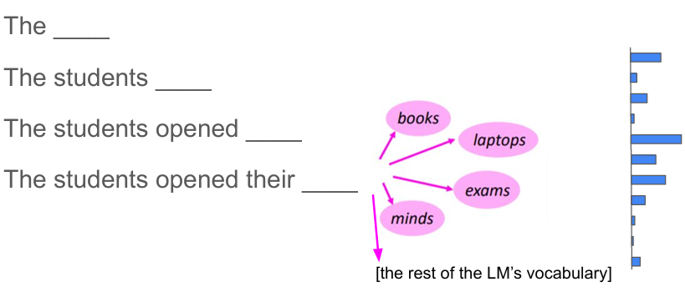
The language modeling problem
LANGUAGE MODELS
This language models form can generate text
At each timestep, sample a token from the language model’s new probability distribution over next tokens.

Slide 5
Language models play the role of ...
LANGUAGE MODELS
a judge of grammaticality
e.g., should prefer “The boy runs.” to “The boy run.”
a judge of semantic plausibility
e.g., should prefer “The woman spoke.” to “The sandwich spoke.”
an enforcer of stylistic consistency
e.g., should prefer “Hello, how are you this evening? Fine, thanks, how are you?” to
“Hello, how are you this evening? Has your house ever been burgled?”
a repository of knowledge (?)
e.g., “Barack Obama was the 44th President of the United States”

Slide 6
Why language modelling?
LANGUAGE MODELS
Machine translation
p(strong winds) > p(large winds)
Spelling correction
The office is about fifteen minuets from my house
p(about fifteen minutes from) > p(about fifteen minuets from)
Speech recognition
p(I saw a van) >> p(eyes awe of an)
Summarization, question-answering, handwriting recognition, OCR, etc.

Slide 7
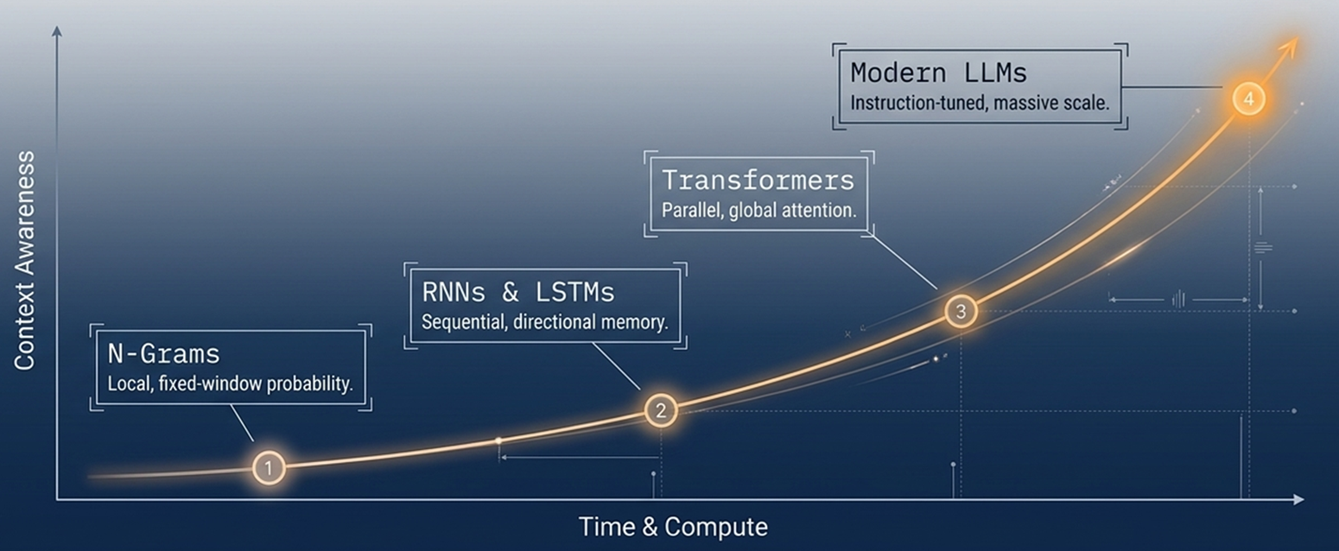
Language model evolution
LANGUAGE MODELS

Slide 8
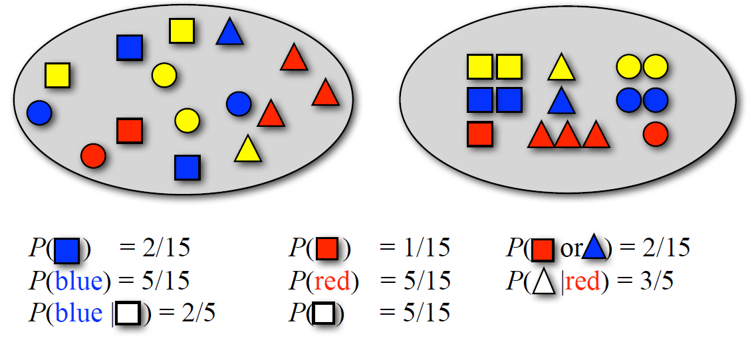
Basic Probability Theory
LANGUAGE MODELS
Pick a random shape, then put it back in the bag

Slide 9
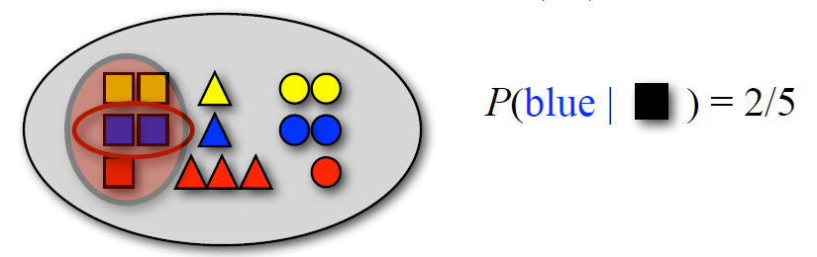
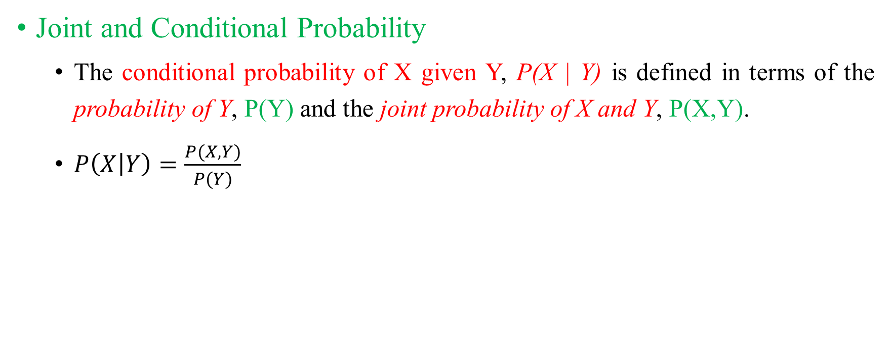
Basic Probability Theory
LANGUAGE MODELS
Joint and Conditional Probability
The conditional probability of X given Y, P(X | Y) is defined in terms of the probability of Y, P(Y) and the joint probability of X and Y, P(X,Y).
$P\left(X | Y\right)=\frac{P(X, Y)}{P(Y)}$

Slide 10
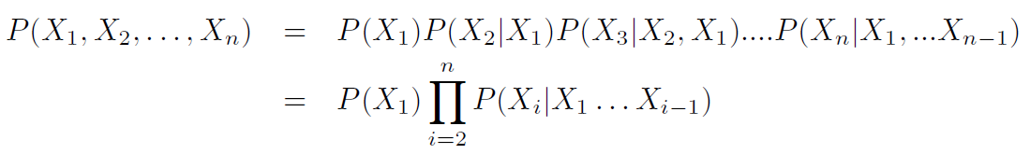
Basic Probability Theory
LANGUAGE MODELS
The chain rule
The joint probability P(X,Y) can also be expressed in terms of the conditional probability P(X | Y).
P(X, Y) = P(X | Y) * P(Y)
This leads to the so-called chain rule:

Slide 11
Basic Probability Theory
LANGUAGE MODELS
Independence
Two random variables X and Y are independent if P(X, Y) = P(X) * P(Y).
If X and Y are independent, then P(X | Y) = P(X)

Slide 12
Probability models
LANGUAGE MODELS
Building a probability model consists of two steps:
Defining the model
Estimating the model’s parameters (training/learning)
Models (almost) always make independence assumptions.
That is, even though X and Y are not actually independent, our model may treat them as independent.
This reduces the number of model parameters that we need to estimate (e.g. from n² to 2n)

Slide 13
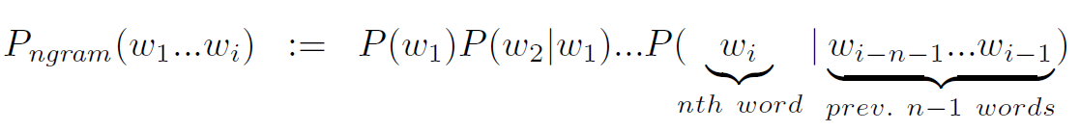
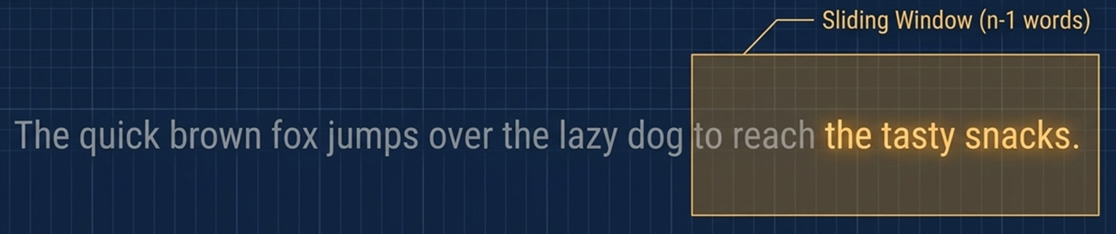
Language modeling with n-grams
LANGUAGE MODELS
A language model over a vocabulary V assigns probabilities to strings drawn from V*.
An n-gram language model assumes each word depends only on the last n−1 words

Slide 14
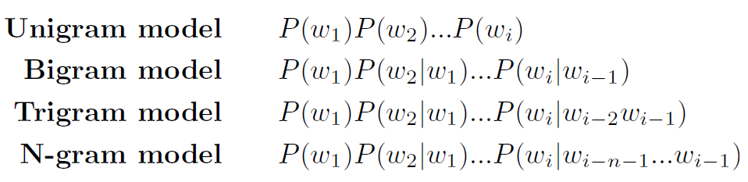
Language modeling with n-grams
LANGUAGE MODELS

Slide 15

Estimating N-gram models
LANGUAGE MODELS
Bracket each sentence by special start and end symbols
<s> Alice was beginning to get very tired… </s>
Count the frequency of each n-gram
C (Alice) = 1, C (Alice was) = 1, …
Normalize these frequencies to get the probability

Slide 16
Estimating N-gram models
LANGUAGE MODELS
Parameter estimation (training)
Parameters: the actual probabilities P(w_{i} = ‘the’ | w_{i-1} = ‘on’) = ???
We need (a large amount of) text as training data to estimate the parameters of a language model.
The most basic estimation technique: relative frequency estimation
P(w_{i} = ‘the’ | w_{i-1} = ‘on’) = C(‘on the’) / C(‘on’)

Slide 17
How do we use language models?
LANGUAGE MODELS
Independently of any application, we can use a language model as a random sentence generator.
Systems for applications such as machine translation, speech recognition, spell-checking, generation, often produce multiple candidate sentences as output.
We prefer output sentences S_{Out} that have a higher probability,
argmax_{SOut} P(S_{Out} | Input) = argmax_{SOut} P(Input | S_{Out}) * P(S_{Out})

Slide 18
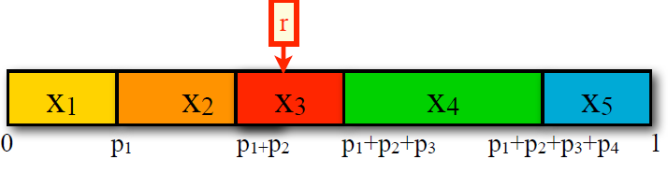
Using n-gram models to generate language
LANGUAGE MODELS
How do we sample from a distribution P(X |Y=y)?
Assume X has N possible outcomes (values): {x₁, …, x_{N}} and P(X=x_{i} | Y=y) = p_{i}
Divide the interval [0,1] into N smaller intervals according to the probabilities of the outcomes.
Generate a random number r between 0 and 1.
Return the x_{i} whose interval the number is in.

Slide 19
Using n-gram models to generate language
LANGUAGE MODELS
Generating the Wall Street Journal

Slide 20
How do we evaluate models?
LANGUAGE MODELS
Define an evaluation metric (scoring function).
We will want to measure how similar the predictions of the model are to real text.
Train the model on a ‘seen’ training set
Perhaps: tune some parameters based on held-out data (disjoint from the training data, meant to emulate unseen data)
Test the model on an unseen test set (usually from the same source (e.g. WSJ) as the training data)
Test data must be disjoint from training and held-out data
Compare models by their scores.

Slide 21
How do we evaluate models?
LANGUAGE MODELS
Intrinsic vs Extrinsic Evaluation
Intrinsic evaluation captures how well the model captures what it is supposed to capture (e.g. probabilities)
Extrinsic (task-based) evaluation captures how useful the model is in a particular task.

Slide 22
Intrinsic Evaluation of Language Models: Perplexity
LANGUAGE MODELS
Perplexity is the inverse of the probability of the test set (as assigned by the language model), normalized by the number of word tokens in the test set.
Language model LM₁ is better than LM₂ if LM₁ assigns lower perplexity (= higher probability) to the test corpus w₁…w_{N}
the perplexity of LM₁ and LM₂ can only be directly compared if both models use the same vocabulary.

Slide 23
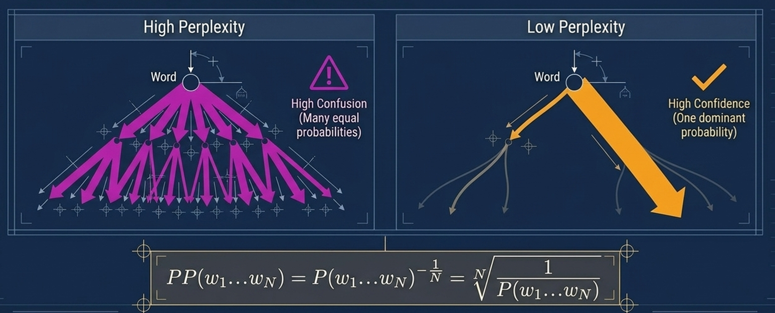
Intrinsic Evaluation of Language Models: Perplexity
LANGUAGE MODELS

Slide 24
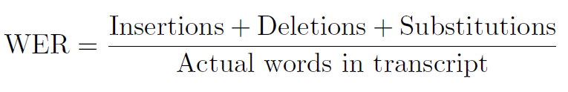
Extrinsic Evaluation of LMs: Word Error Rate
LANGUAGE MODELS
Originally developed for speech recognition.
How much does the predicted sequence of words differ from the actual sequence of words in the correct transcript?
But unseen test data will contain unseen words.

Slide 25
Word embedding
LANGUAGE MODELS
An approach with which we represent documents and words.
It is defined as a numeric vector input that allows words with similar meanings to have the same representation.
Word Embeddings in NLP is a technique where individual words are represented as real-valued vectors in a lower-dimensional space and captures inter-word semantics.

Slide 26

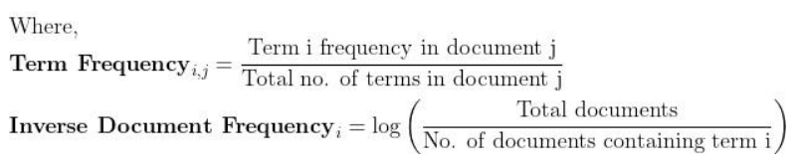
Word embedding
LANGUAGE MODELS
Term frequency - Inverse document frequency (TF-IDF)
TF score measures the frequency of words in a particular document.
IDF score measures the rarity of the words in the text.
TF-IDF algorithm is used in some tasks like information retrieval, stop words removal, keyword extraction, and basic text analysis.

Slide 27
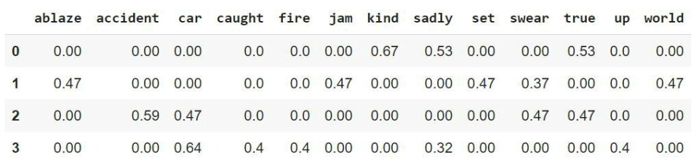
Word embedding
LANGUAGE MODELS
Term frequency - Inverse document frequency (TF-IDF)
‘kind true sadly’, ‘swear jam set world ablaze’, ‘swear true car accident’, ‘car sadly car caught up fire’

Slide 28
Word embedding
LANGUAGE MODELS
Bag of words (BOW)
BOW is one of the popular word embedding techniques of text where each value in the vector would represent the count of words in a document/sentence.
To create BOW:
In the first step, tokenize the text into sentences.
Next, the sentences tokenized in the first step have further tokenized words.
Eliminate any stop words or punctuation.
Then, convert all the words to lowercase.
Finally, move to create a frequency distribution chart of the words.

Slide 29
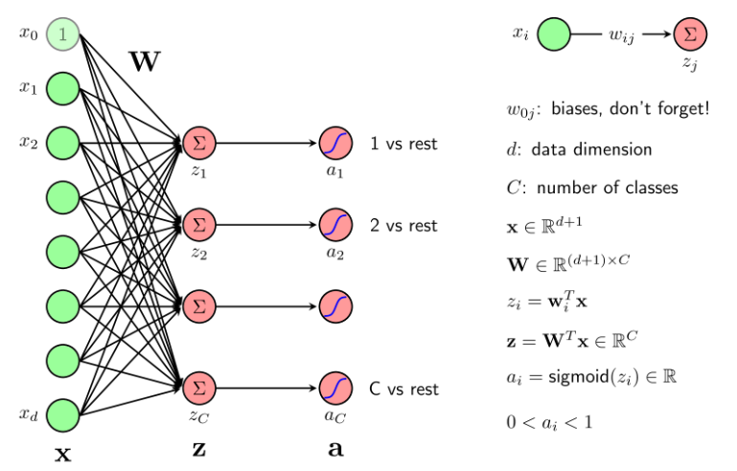
Word embedding
LANGUAGE MODELS
Basic neuron network

Slide 30
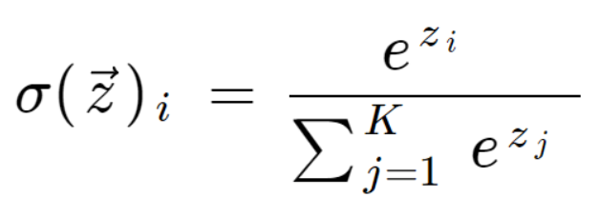
Word embedding
LANGUAGE MODELS
Basic neuron network
The softmax function is a function that converts a vector of K real values into a vector of K real values that add up to 1.
The input values could be positive, negative, zero, or even greater than one, but the softmax transforms them into values between 0 and 1 which makes it possible for them to be interpreted as probabilities.

Slide 31
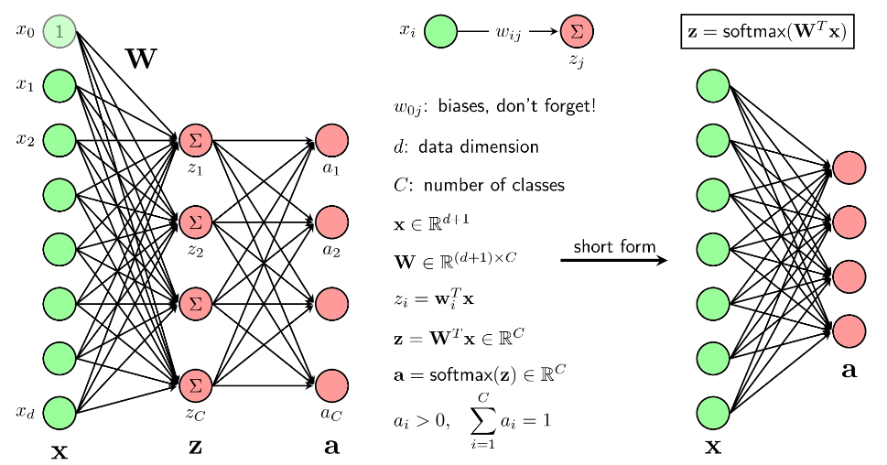
Word embedding
LANGUAGE MODELS
Basic neuron network

Slide 32
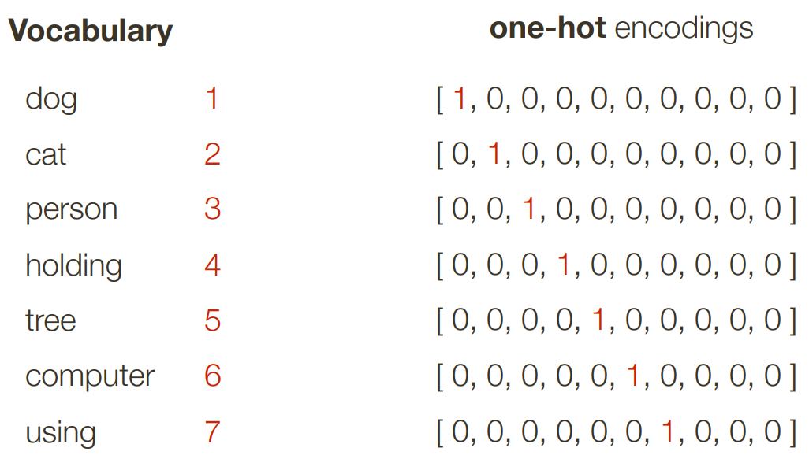
Representing a word
LANGUAGE MODELS
One Hot Encoding

Slide 33
word2vec: Representing the Meaning of Words
LANGUAGE MODELS
Key idea: Predict surrounding words of every word.
Benefits: Faster and easier to incorporate new document, words, etc.
Continuous Bag of Words (CBOW): use context words in a window to predict middle word.
Skip-gram: use the middle word to predict surrounding ones in a window.

Slide 34
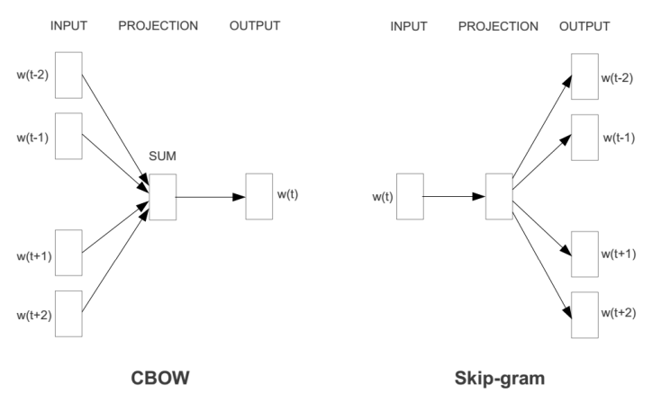
word2vec: Representing the Meaning of Words
LANGUAGE MODELS

Slide 35
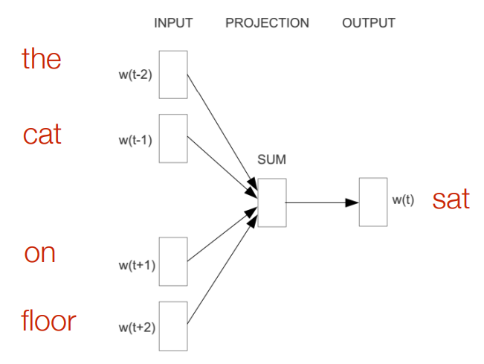
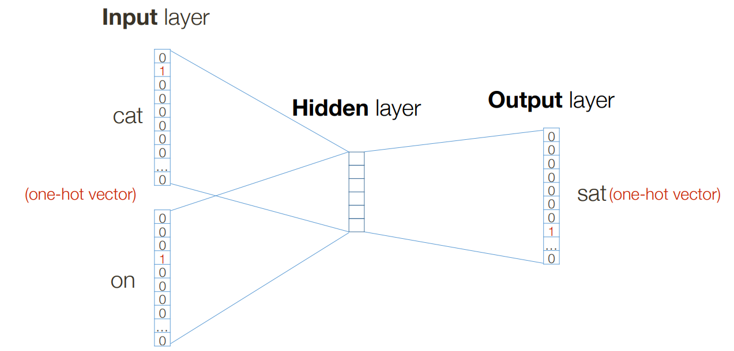
word2vec: Representing the Meaning of Words
LANGUAGE MODELS
CBOW
Example: “The cat sat on floor” (window size 2)

Slide 36
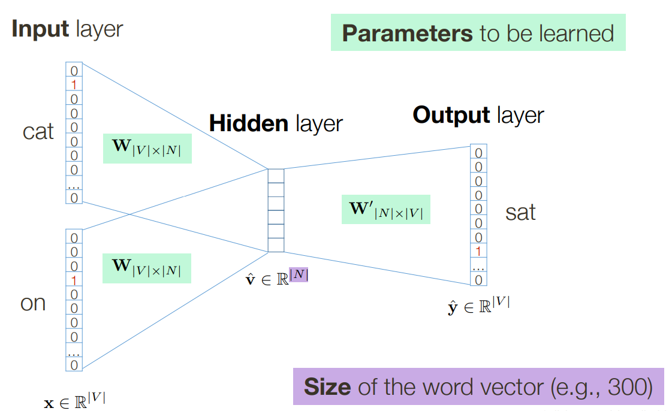
word2vec: Representing the Meaning of Words
LANGUAGE MODELS
CBOW

Slide 37
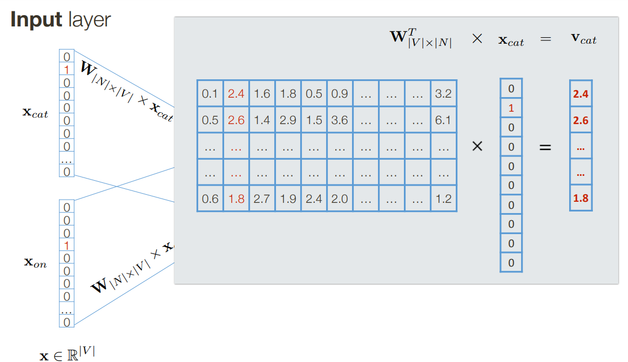
word2vec: Representing the Meaning of Words
LANGUAGE MODELS
CBOW

Slide 38
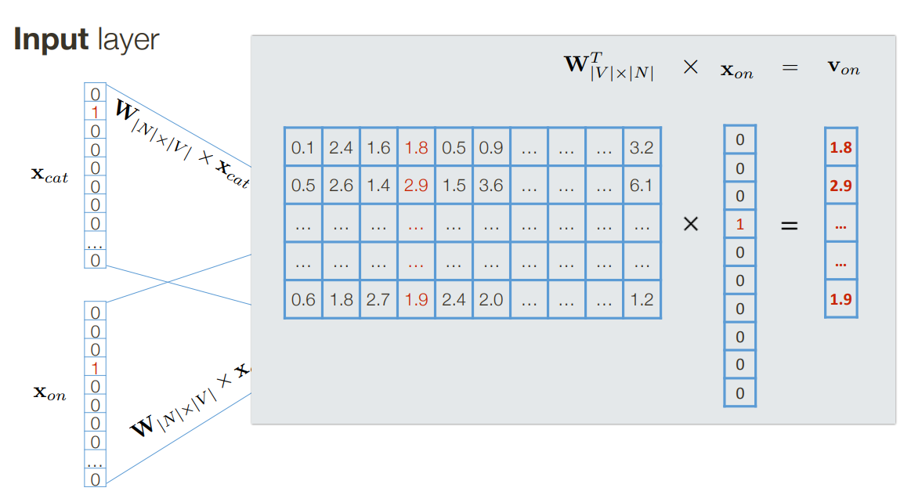
word2vec: Representing the Meaning of Words
LANGUAGE MODELS
CBOW

Slide 39
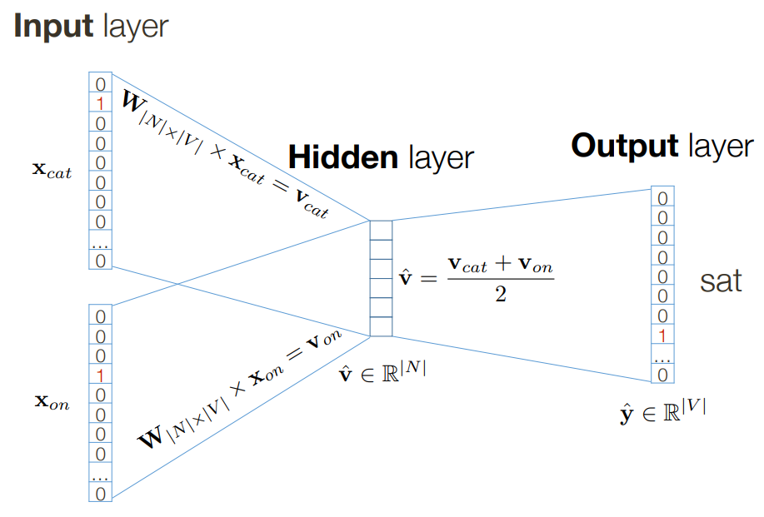
word2vec: Representing the Meaning of Words
LANGUAGE MODELS
CBOW

Slide 40
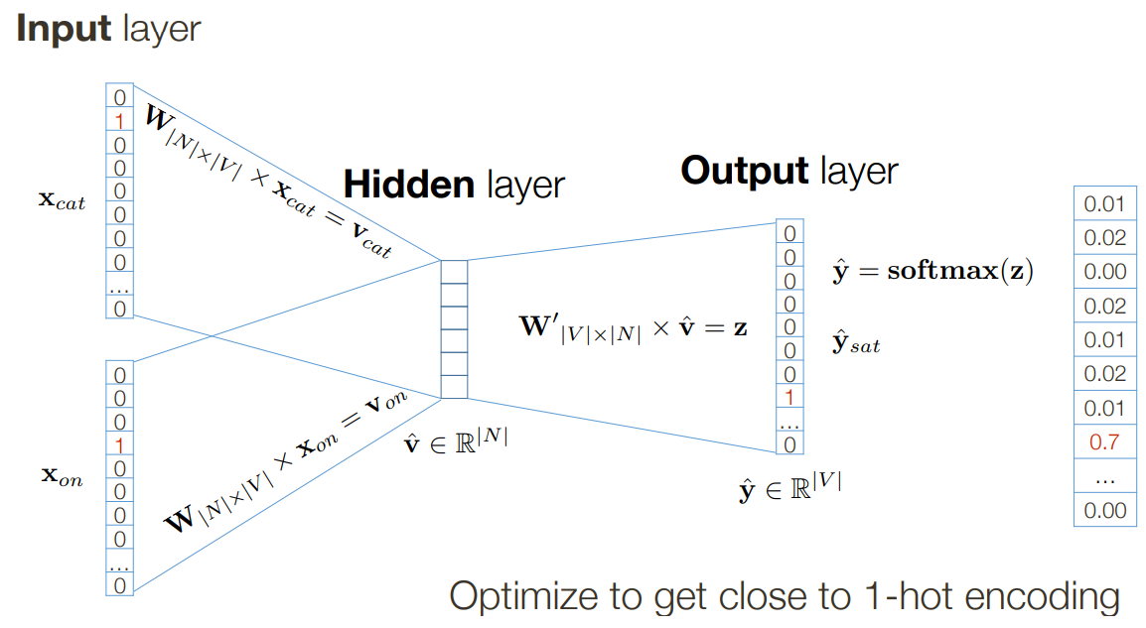
word2vec: Representing the Meaning of Words
LANGUAGE MODELS
CBOW

Slide 41
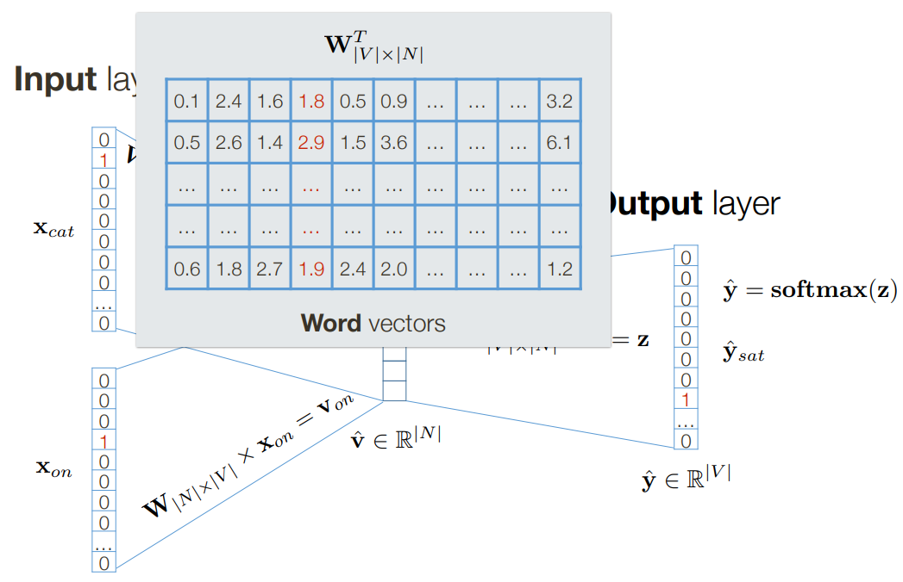
word2vec: Representing the Meaning of Words
LANGUAGE MODELS
CBOW

Slide 42
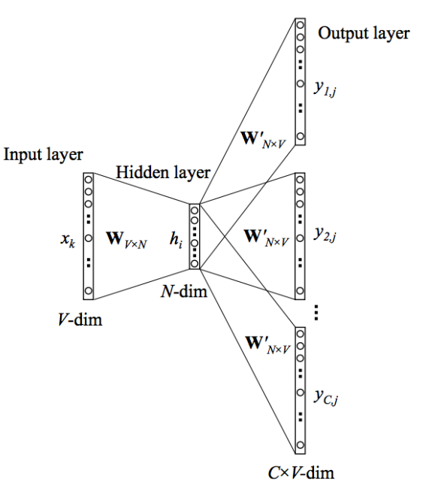
word2vec: Representing the Meaning of Words
LANGUAGE MODELS
Skip-Gram Model

Slide 43
word2vec: Representing the Meaning of Words
LANGUAGE MODELS
Comparison
CBOW is not great for rare words and typically needs less data to train.
Skip-gram better for rate words and needs more data to train the model.

Slide 44
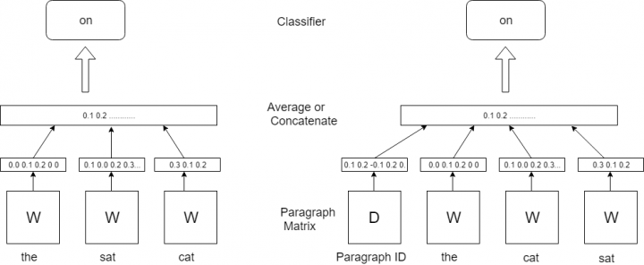
doc2vec
LANGUAGE MODELS

Slide 45

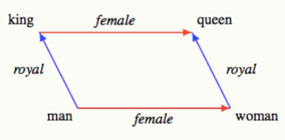

word2vec: Representing the Meaning of Words
LANGUAGE MODELS
Word Analogies
A word analogy is a statement of the form “a is to b as x is to y”, which asserts that a and x can be transformed in the same way to get b and y, and vice-versa.
A word analogy f is an invertible transformation that holds over a set of ordered pairs S iff

Slide 46
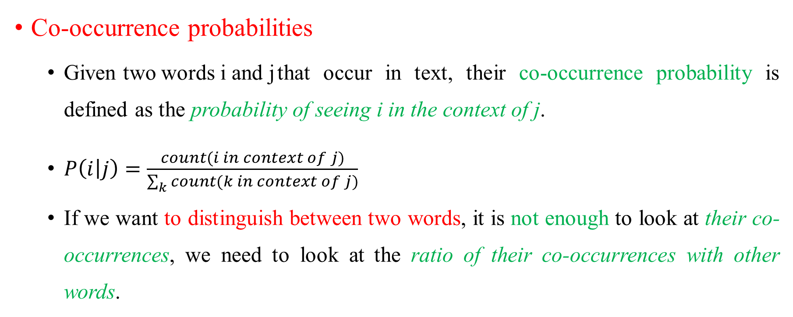
GloVe: Global Vectors for Word Representation
LANGUAGE MODELS
Co-occurrence probabilities
Given two words i and j that occur in text, their co-occurrence probability is defined as the probability of seeing i in the context of j.
$P\left(i | j\right)=\frac{count(i in context of j)}{\sum_{k}{count(k in context of j)}}$
If we want to distinguish between two words, it is not enough to look at their co-occurrences, we need to look at the ratio of their co-occurrences with other words.

Slide 47

GloVe: Global Vectors for Word Representation
LANGUAGE MODELS
Model
Notation
X - Matrix of word-word co-occurrence, X_{ij} - the number of times word j occurs in the context of word i. X_{i} = $\sum_{k}{X_{ik}}$ be the number of times any word appears in the context of word i.
P_{ij} = P(j | i) = X_{ij} / X_{i} be the probability that word j appear in the context of word i.

Slide 48
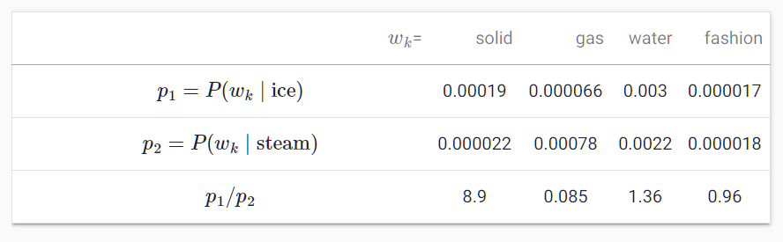
GloVe: Global Vectors for Word Representation
LANGUAGE MODELS
Model
For a word w_{k} that is related to “ice” but unrelated to “steam”, we expect a larger ratio of co-occurence probabilities (8.9)
For a word w_{k} that is related to “steam” but unrelated to “ice”, we expect a smaller ratio of co-occurence probabilities ( 0.085).
For a word w_{k} that is related to both “ice” and “steam”, we expect a ratio of co-occurence probabilities that is close to 1 (1.36).
For a word w_{k} that is unrelated to both “ice” and “steam”, we expect a ratio of co-occurence probabilities that is close to 1 (0.96).

Slide 49
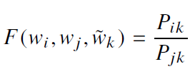
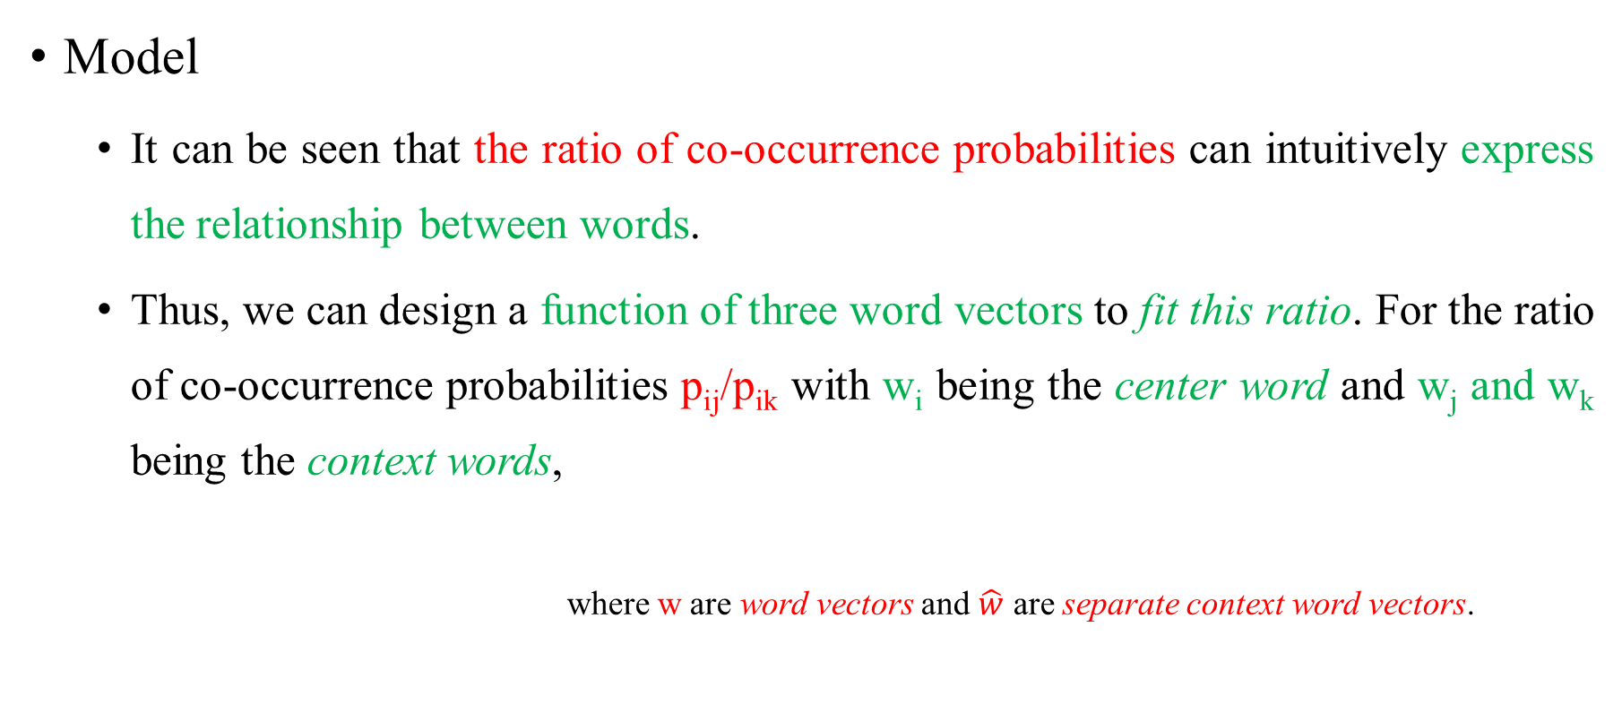
GloVe: Global Vectors for Word Representation
LANGUAGE MODELS
Model
It can be seen that the ratio of co-occurrence probabilities can intuitively express the relationship between words.
Thus, we can design a function of three word vectors to fit this ratio. For the ratio of co-occurrence probabilities p_{ij}/p_{ik} with w_{i} being the center word and w_{j} and w_{k} being the context words,
where w are word vectors and $\hat{w}$ are separate context word vectors.

Slide 50


GloVe: Global Vectors for Word Representation
LANGUAGE MODELS
Model
We would like F to encode the information present the ratio P_{ik} / P_{jk} in the word vector space. Since vector spaces are inherently linear structures, the most natural way to do this is with vector differences.
The arguments of F are vectors while the right-hand side is a scalar, so we can first take the dot product of the arguments

Slide 51
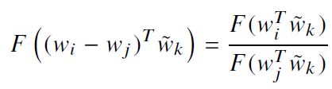



GloVe: Global Vectors for Word Representation
LANGUAGE MODELS
Model
For word-word co-occurrence matrices, the distinction between a word and a context word is arbitrary and that we are free to exchange the two roles.
So we can exchange w ↔ $\hat{w}$and X ↔ X^{T}
where so

Slide 52

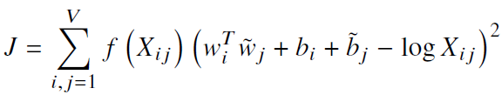

GloVe: Global Vectors for Word Representation
LANGUAGE MODELS
Model
log(X_{i}) is independent of k so it can be absorbed into a bias b_{i} for w_{i}.
Training the GloVe model is to find the minimum value of
f(0) = 0
f(x) should be non-decreasing so that rare co-occurrences are not overweighted.
f(x) should be relatively small for large values of x, so that frequent co-occurrences are not overweighted.

Slide 53
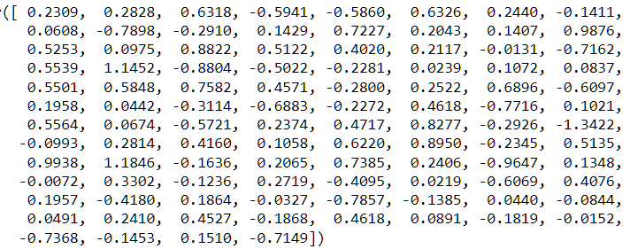
GloVe: Global Vectors for Word Representation
LANGUAGE MODELS
Example
Cat’s vector in 50 dimensions

Slide 54
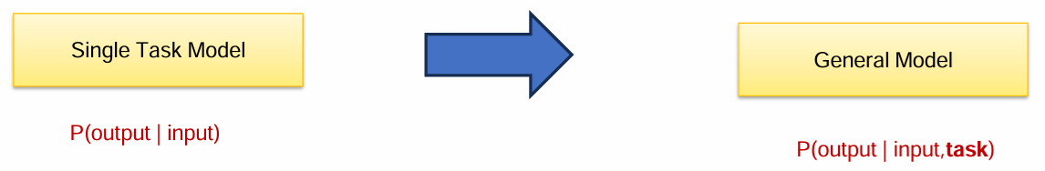
Practical issues
LANGUAGE MODELS
Too many copies of the model
Need for large-scale labelled data for fine-tuning
How we can train a model that can perform NLP tasks in a zero-shot manner?

Slide 55
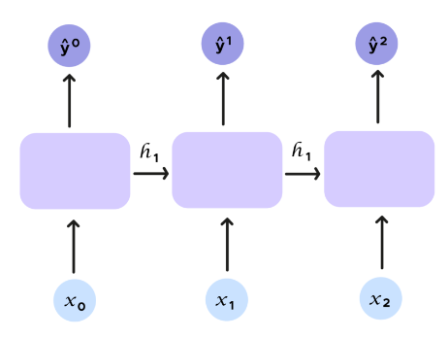
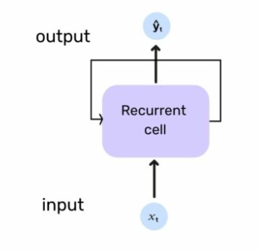
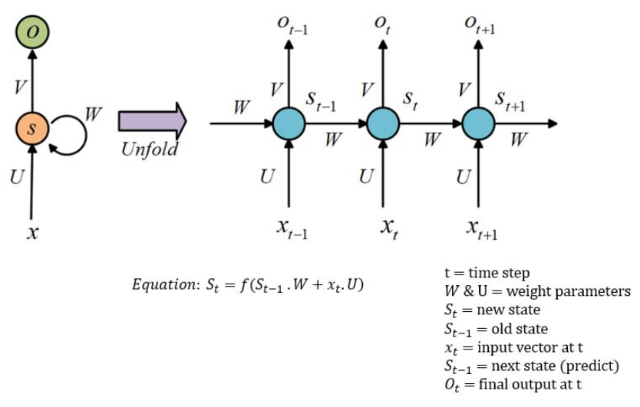
Recurrent Neural Networks (RNNs) - ReCap
LANGUAGE MODELS
With RNNs the concept of recurrence is introduced.
An input h_t, called hidden state, is added. This hidden state embodies ŷ_t and is given as an argument to the next prediction in addition to the input x_t.

Slide 56
Recurrent Neural Networks (RNNs) - ReCap
LANGUAGE MODELS
One to many, the RNN receives a single input and returns multiple outputs (e.g. image legend).
Many to one, there are several inputs and there is a single output (e.g. sentiment analysis of texts).
Many to many, the model can take several inputs and get several outputs (e.g. machine translation).

Slide 57
A Simple RNN Language Model
LANGUAGE MODELS
RNN Advantages
Can process any length input.
Computation for step t can (in theory) use information from many steps back.
Model size doesn’t increase for longer input context.
Same weights applied on every timestep, so there is symmetry in how inputs are processed.

Slide 58
A Simple RNN Language Model
LANGUAGE MODELS
RNN Disadvantages
Recurrent computation is slow.
In practice, difficult to access information from many steps back.

Slide 59
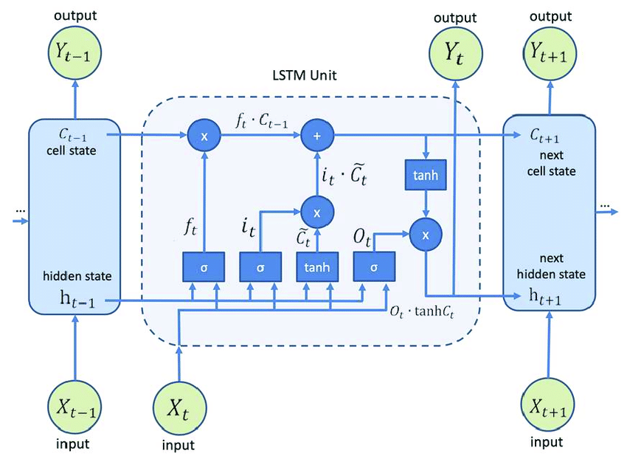
Long Short Term Memory (LSTM)
LANGUAGE MODELS
LSTM is a type of RNN that is specifically designed to handle long-term dependencies in sequential data, such as time series, speech, and text.
LSTMs introduce a memory cell, which can hold information for an extended period of time. The memory cell is controlled by three gates:
the input gate, the forget gate, and the output gate.
These gates decide what information to add to, remove from, and output from the memory cell.

Slide 60

Long Short Term Memory (LSTM)
LANGUAGE MODELS
Forget Gate
The information that is no longer useful in the cell state is removed with the forget gate.
The resultant is passed through an activation function which gives a binary output.
If the output is 0, the piece of information is forgotten,
and for output 1, the information is retained for future use.

Slide 61

Long Short Term Memory (LSTM)
LANGUAGE MODELS
Input gate
The addition of useful information to the cell state is done by the input gate.
Then, a vector is created using tanh function that gives an output from -1 to +1, which contains all the possible values from h_{t-1} and x_{t}.

Slide 62


Long Short Term Memory (LSTM)
LANGUAGE MODELS
Output gate
The task of extracting useful information from the current cell state to be presented as output is done by the output gate.
The information is regulated using the sigmoid function and filter by the values to be remembered using inputs h_{t-1} and x_{t}.

Slide 63
Sequence-to-Sequence
LANGUAGE MODELS
seq2seq Model
First introduced for machine translation, by Google.
A type of model that is used for tasks such as machine translation, text summarization, and image captioning. The model consists of two main components:
Encoder
Decoder
Trained using a dataset of input-output pairs, where the input is a sequence of tokens and the output is also a sequence of tokens.

Slide 64
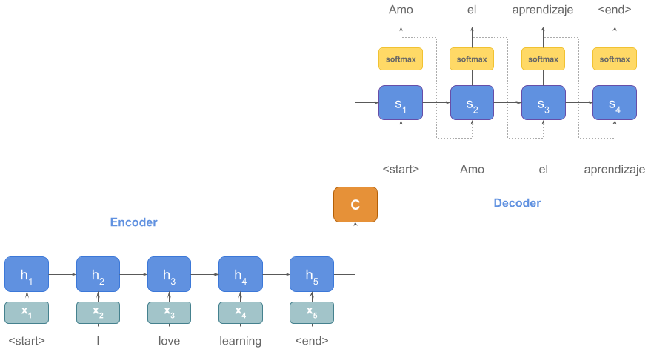
Sequence-to-Sequence
LANGUAGE MODELS
seq2seq Model

Slide 65
Sequence-to-Sequence
LANGUAGE MODELS
Encoder-Decoder Stack
Encoder Stack
Converts the input words to corresponding hidden vectors (each vector represents the current word and the context of the word).
The encoder takes the input sequence, one token at a time, and uses an RNN or transformer to update its hidden state, which summarizes the information in the input sequence.
The final hidden state of the encoder is then passed as the context vector to the decoder.

Slide 66
Sequence-to-Sequence
LANGUAGE MODELS
Encoder-Decoder Stack
Decoder Stack
Takes as input the hidden vector generated by the encoder, its own hidden states, and the current word to produce the next hidden vector and finally predict the next word.
At each time step, the decoder uses the current hidden state, the context vector, and the previous output token to generate a probability distribution over the possible next tokens.
The token with the highest probability is then chosen as the output.

Slide 67
Introduction
LARGE LANGUAGE MODELS
Language models that have many parameters (over 1B) and can perform multiple tasks through prompting.
Parameters are factors that an AI system learns from its training data and subsequently utilizes to process input and formulate output.
Eg. GPT, Llama2, Gemini, PaLM, Mistral, Mixtral etc.

Slide 68
Introduction
LARGE LANGUAGE MODELS
The transformer model allows fast parallel computations on many GPUs (large amounts of compute).
It allows training on large amounts of data
It allows adding many and many layers in the model (large model)
A large language model is a language model with a large number of parameters, trained on large amounts of data, for long period of time.

Slide 69
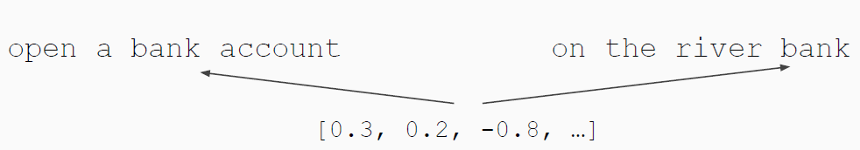
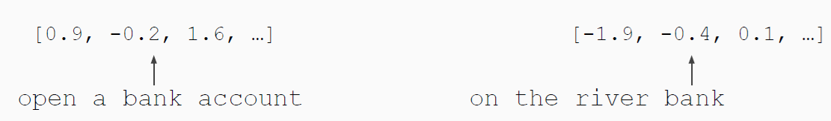
Pre-training in NLP
LARGE LANGUAGE MODELS
Word embeddings are the basis of deep learning for NLP.
Word embeddings (word2vec, GloVe) are often pre-trained on text corpus from co-occurrence statistics.
Problem: Word embeddings are applied in a context free manner.

Slide 70
Architecture
LARGE LANGUAGE MODELS
Encoder-only (BERT)
Pre-training : Masked Language Modeling (MLM)
Great for classification tasks, but hard to do generation
Decoder-only (GPT)
Pre-training: Auto-regressive Language Modeling
Stable training, faster convergence
Better generalization after pre-training
Encoder-decoder (T0/T5)
Pre-training : Masked Span Prediction
Good for tasks like MT, summarization

Slide 71
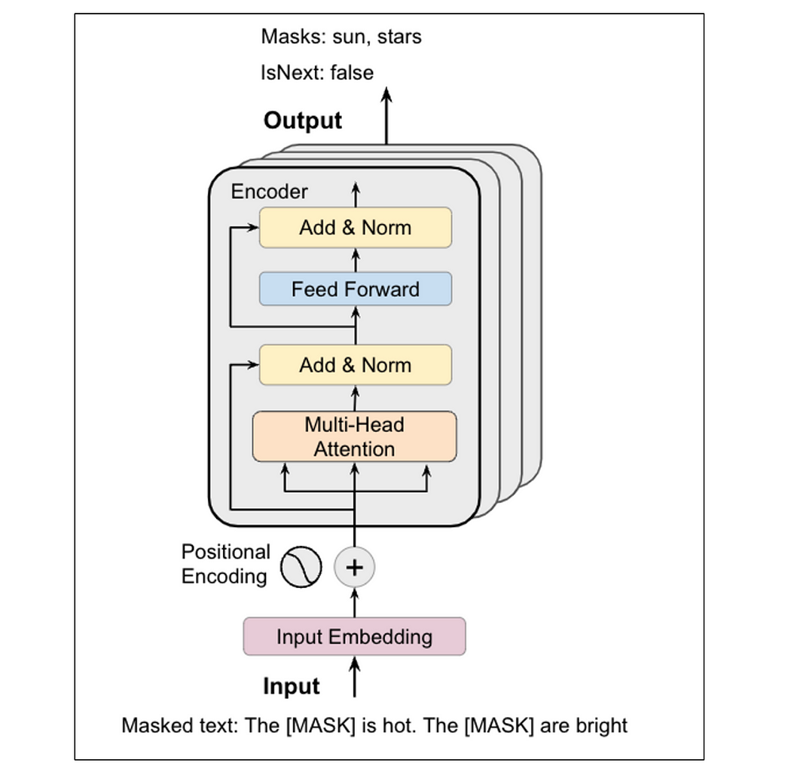
BERT model architecture
LARGE LANGUAGE MODELS

Slide 72
BERT model architecture
LARGE LANGUAGE MODELS
Input Embedding
Input text is first converted into input embeddings, which are vectorized representations of the words that encapsulate semantic meaning.
GloVe, Fasttext, Word2Vec … can be used.

Slide 73


BERT model architecture
LARGE LANGUAGE MODELS
Positional Encoding
The position of the k^{th} object within input sequence of length L.
Where
k: position of an object in the input sequence, $0 ≤k<L$
d: dimension of the output embedding space
P(k, j): position function for mapping a position k in the input sequence to index (k, j) of the positional matrix
n: User-defined scalar, set to 10,000; i: used for mapping to column indices $0 ≤i ≤ d/2$

Slide 74

BERT model architecture
LARGE LANGUAGE MODELS
Positional Encoding

Slide 75

BERT model architecture
LARGE LANGUAGE MODELS
Self-Attention at a High Level
Say the following sentence is an input sentence: “The animal didn't cross the street because it was too tired”
What does “it” in this sentence refer to?
Self-attention allows model to associate “it” with “animal”

Slide 76

BERT model architecture
LARGE LANGUAGE MODELS
Self-Attention at a High Level

Slide 77

Masked LM
LARGE LANGUAGE MODELS
Solution: Mask out k% of the input words, and then predict the masked words.
k = 15%
Too little masking: Too expensive to train; Too much masking: Not enough context.

Slide 78
Masked LM
LARGE LANGUAGE MODELS
Problem: Mask token never seen at fine-tuning.
Solution: don’t replace with [MASK] 100% of the time.
80% of the time, replace with [MASK]
went to the store → went to the [MASK]
10% of the time, replace random word
went to the store → went to the running
10% of the time, keep same
went to the store → went to the store

Slide 79

Next Sentence Prediction
LARGE LANGUAGE MODELS
To learn relationships between sentences, predict whether Sentence B is actual sentence that proceeds Sentence A, or a random sentence.

Slide 80

Full Decoder-Only Transformer Model
LARGE LANGUAGE MODELS
GPT (Generative Pre-trained Transformer) is the first decoder-only Transformer model.

Slide 81
Full Decoder-Only Transformer Model
LARGE LANGUAGE MODELS
Layer Normalization
It calculates the mean and standard deviation of all feature dimensions for each sample independently.
This assists in stabilizing the learning process and reduces the required number of training steps.

Slide 82
Full Decoder-Only Transformer Model
LARGE LANGUAGE MODELS
Masked Self-Attention
Used to ensure that the model doesnʼt attend to some of the tokens in the input sequence during training or generation.
For example, when working with sequence-to-sequence tasks like Machine Translation, we wouldnʼt want the model to attend to words that come after the current word being translated.
In terms of implementation, tokens are masked by setting their weights to -inf before applying the SoftMax normalization.

Slide 83

From raw text to aligned assistant
LARGE LANGUAGE MODELS

Slide 84

Prompting as inference-time programming
LARGE LANGUAGE MODELS

