Slide 1
NATURAL LANGUAGE PROCESSING (NLP)
Chapter 3: INFORMATION RETRIEVAL
Trương Quốc Định
Faculty of Information Systems – College of Information & Communication Technology

Slide 2
Definition
INFORMATION RETRIEVAL
Information Retrieval (IR) is finding material (usually documents) of an unstructured nature (usually text) that satisfies an information need from within large collections (usually stored on computers).

Slide 3
Basic assumptions of Information Retrieval
INFORMATION RETRIEVAL
Collection: Fixed set of documents
Goal: Retrieve documents with information that is relevant to the user’s information need and helps the user complete a task

Slide 4

The classic search model
INFORMATION RETRIEVAL
TASK
Get rid of mice in a politically correct way
Misconception?
Info Need
Info about removing mice
without killing them
Mistranslation?
Verbal form
How do I trap mice alive?
Misformulation?
Query
mouse trap
SEARCH ENGINE
Query Refinement
Results
Corpus

Slide 5
Inverted index
INFORMATION RETRIEVAL
For each term t, we must store a list of all documents that contain t.
Identify each by a docID, a document serial number.
Can we used fixed-size arrays for this?
Brutus
1
2
4
11
31
45
173
174
Caesar
1
2
4
5
6
16
57
132
Calpurnia
2
31
54
101

Slide 6
Inverted index
INFORMATION RETRIEVAL
We need variable-size postings lists
On disk, a continuous run of postings is normal and best.
In memory, can use linked lists or variable length arrays.
Some trade offs in size/ease of insertion
Posting
Brutus
1
2
4
11
31
45
173
174
Caesar
1
2
4
5
6
16
57
132
Calpurnia
2
31
54
101
Dictionary
Postings

Slide 7
Query processing: AND
INFORMATION RETRIEVAL
Consider processing the query: Brutus AND Caesar
Locate Brutus in the Dictionary;
Retrieve its postings.
Locate Caesar in the Dictionary;
Retrieve its postings.
“Merge” the two postings.
2
4
8
16
32
64
128
Brutus
1
2
3
5
8
13
21
34
Caesar

Slide 8
The merge
INFORMATION RETRIEVAL
Walk through the two postings simultaneously, in time linear in the total number of postings entries.
If the list lengths are x and y, the merge takes O(x+y) operations.
Crucial: postings sorted by docID.
2
2
4
4
8
8
16
16
32
64
128
32
64
128
Brutus
2
8
1
Caesar
1
2
2
3
5
5
8
8
13
13
21
21
34
3
34

Slide 9
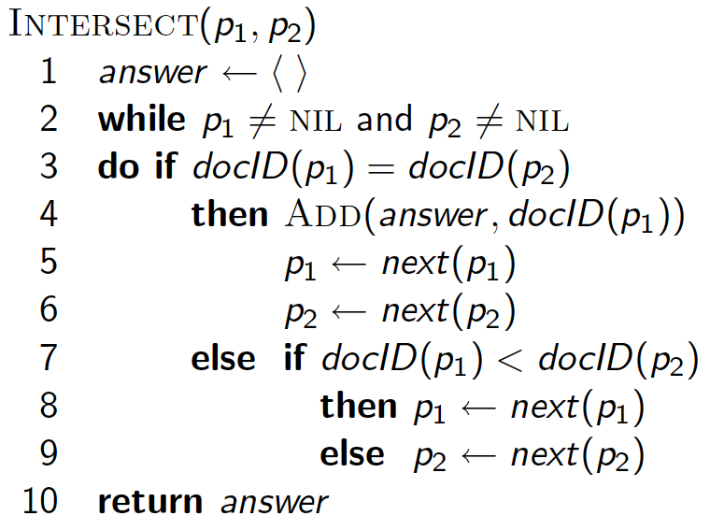
Intersecting two postings lists (a “merge” algorithm)
INFORMATION RETRIEVAL

Slide 10
Boolean queries: Exact match
INFORMATION RETRIEVAL
Boolean retrieval model: being able to ask a query that is a Boolean expression:
Boolean Queries: using AND, OR and NOT to join query terms
Views each document as a set of words
Is precise: document matches condition or not.
Perhaps the simplest model to build an IR system on.

Slide 11
Phrase queries
INFORMATION RETRIEVAL
Want to be able to answer queries such as “stanford university” – as a phrase
Thus the sentence “I went to university at Stanford” is not a match.
The concept of phrase queries has proven easily understood by users; one of the few “advanced search” ideas that works.
Many more queries are implicit phrase queries.

Slide 12
Positional indexes
INFORMATION RETRIEVAL
In the postings, store, for each term the position(s) in which tokens of it appear:
<term, number of docs containing term;
doc1: position1, position2 … ;
doc2: position1, position2 … ;
etc.>

Slide 13
Processing a phrase query
INFORMATION RETRIEVAL
Extract inverted index entries for each distinct term: to, be, or, not.
Merge their doc:position lists to enumerate all positions with “to be or not to be”.
to:
2:1,17,74,222,551; 4:8,16,190,429,433; 7:13,23,191; ...
be:
1:17,19; 4:17,191,291,430,434; 5:14,19,101; ...
Same general method for proximity searches

Slide 14
Index Compression
INFORMATION RETRIEVAL
Why compression for inverted indexes?
Dictionary
Make it small enough to keep in main memory
Make it so small that you can keep some postings lists in main memory too
Postings file(s)
Reduce disk space needed
Decrease time needed to read postings lists from disk
Large search engines keep a significant part of the postings in memory.
Compression lets you keep more in memory

Slide 15
Dictionary compression
INFORMATION RETRIEVAL
Array of fixed-width entries
~400,000 terms; 28 bytes/term = 11.2 MB.
Dictionary search
structure
20 bytes
4 bytes each

Slide 16
Dictionary compression
INFORMATION RETRIEVAL
Most of the bytes in the Term column are wasted – we allot 20 bytes for 1 letter terms.
And we still can’t handle supercalifragilisticexpialidocious or hydrochlorofluorocarbons.
Written English averages ~4.5 characters/word.
Ave. dictionary word in English: ~8 characters
How do we use ~8 characters per dictionary term?

Slide 17
Dictionary compression
INFORMATION RETRIEVAL
Dictionary-as-a-String
Store dictionary as a (long) string of characters:
Pointer to next word shows end of current word
Hope to save up to 60% of dictionary space.
….systilesyzygeticsyzygialsyzygyszaibelyiteszczecinszomo….
Total string length =
400K x 8B = 3.2MB
Pointers resolve 3.2M
positions: log₂3.2M =
22bits = 3bytes

Slide 18
Dictionary compression
INFORMATION RETRIEVAL
Blocking
Store pointers to every kth term string.
Example below: k=4.
Need to store term lengths (1 extra byte)
….7systile9syzygetic8syzygial6syzygy11szaibelyite8szczecin9szomo….
⎫ Save 9 bytes
⎬ on 3
⎭ pointers.
Lose 4 bytes on
term lengths.

Slide 19
Dictionary compression
INFORMATION RETRIEVAL
Front coding
Sorted words commonly have long common prefix – store differences only
(for last k-1 in a block of k)
8automata8automate9automatic10automation
→8automat*a1◊e2◊ic3◊ion
Encodes automat
Extra length
beyond automat.

Slide 20
Postings compression
INFORMATION RETRIEVAL
The postings file is much larger than the dictionary, factor of at least 10.
Key desideratum: store each posting compactly.
A posting for our purposes is a docID.
For Reuters (800,000 documents), we would use 32 bits per docID when using 4-byte integers.
Alternatively, we can use log2 800,000 ≈ 20 bits per docID.
The goal: use a lot less than 20 bits per docID.

Slide 21
Postings compression
INFORMATION RETRIEVAL
We store the list of docs containing a term in increasing order of docID.
computer: 33,47,154,159,202 …
Consequence: it suffices to store gaps.
33,14,107,5,43 …
Hope: most gaps can be encoded/stored with far fewer than 20 bits.

Slide 22
Ranked retrieval
INFORMATION RETRIEVAL
Rather than a set of documents satisfying a query expression, in ranked retrieval models, the system returns an ordering over the (top) documents in the collection with respect to a query.
Free text queries: Rather than a query language of operators and expressions, the user’s query is just one or more words in a human language.
In principle, there are two separate choices here, but in practice, ranked retrieval models have normally been associated with free text queries and vice versa.

Slide 23
Scoring as the basis of ranked retrieval
INFORMATION RETRIEVAL
We wish to return in order the documents most likely to be useful to the searcher.
How can we rank-order the documents in the collection with respect to a query?
Assign a score – say in [0, 1] – to each document
This score measures how well document and query “match”.

Slide 24
Weight matrix
INFORMATION RETRIEVAL
Each document is now represented by a real-valued vector of tf-idf weights ∈ R^{|V|}

Slide 25
Documents as vectors
INFORMATION RETRIEVAL
So we have a |V|-dimensional vector space.
Terms are axes of the space.
Documents are points or vectors in this space.
Very high-dimensional: tens of millions of dimensions when you apply this to a web search engine.
These are very sparse vectors - most entries are zero.

Slide 26
Queries as vectors
INFORMATION RETRIEVAL
Key idea 1: Do the same for queries: represent them as vectors in the space
Key idea 2: Rank documents according to their proximity to the query in this space.
proximity = similarity of vectors
proximity ≈ inverse of distance

Slide 27
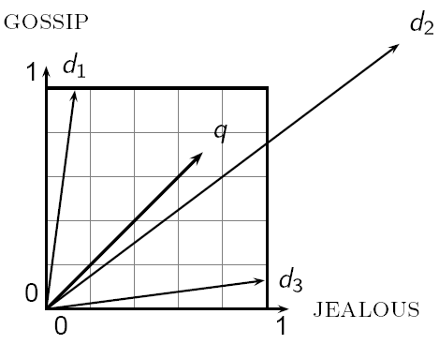
Why distance is a bad idea?
INFORMATION RETRIEVAL

Slide 28
Use angle instead of distance
INFORMATION RETRIEVAL
Take a document d and append it to itself. Call this document d′. “Semantically” d and d′ have the same content.
The Euclidean distance between the two documents can be quite large.
The angle between the two documents is 0, corresponding to maximal similarity.
Key idea: Rank documents according to angle with query.

Slide 29
From angles to cosines
INFORMATION RETRIEVAL
The following two notions are equivalent.
Rank documents in decreasing order of the angle between query and document
Rank documents in increasing order of cosine(query, document)
Cosine is a monotonically decreasing function for the interval [0º, 180º].

Slide 30
cosine(query, document)
INFORMATION RETRIEVAL
Dot product
Unit vectors

Slide 31
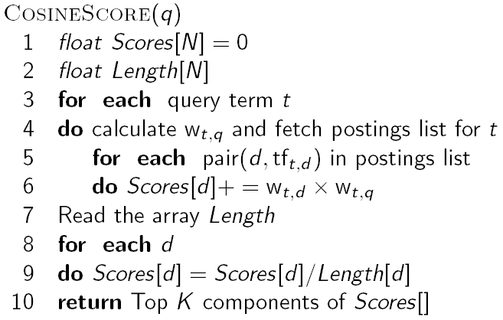
Computing cosine scores
INFORMATION RETRIEVAL

Slide 32
Spell correction
INFORMATION RETRIEVAL
Two main Flavors
Isolated word
Check each word on its own for misspelling
Will not catch typos resulting in correctly spelled words
e.g., from → form
Context-sensitive
Look at surrounding words,
e.g., I flew form Heathrow to Narita.

Slide 33
Isolated word correction
INFORMATION RETRIEVAL
Fundamental premise – there is a lexicon from which the correct spellings come.
Two basic choices for this
A standard lexicon such as
Webster’s English Dictionary
An “industry-specific” lexicon – hand-maintained
The lexicon of the indexed corpus
E.g., all words on the web
All names, acronyms etc.
(Including the mis-spellings)

Slide 34
Isolated word correction
INFORMATION RETRIEVAL
Given a lexicon and a character sequence Q, return the words in the lexicon closest to Q.
What’s “closest”?
We’ll study several alternatives
Edit distance (Levenshtein distance)
Weighted edit distance
n-gram overlap

Slide 35
Edit distance
INFORMATION RETRIEVAL
Given two strings S₁ and S₂, the minimum number of operations to convert one to the other.
Operations are typically character-level
Insert, Delete, Replace, (Transposition)
E.g., the edit distance from dof to dog is 1
From cat to act is 2 (Just 1 with transpose.)
from cat to dog is 3.
Generally found by dynamic programming.

Slide 36
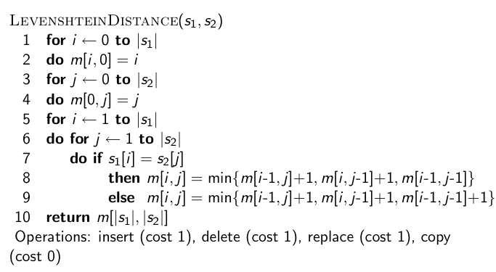
Edit distance
INFORMATION RETRIEVAL

Slide 37
n-gram overlap
INFORMATION RETRIEVAL
Enumerate all the n-grams in the query string as well as in the lexicon.
Use the n-gram index to retrieve all lexicon terms matching any of the query n-grams.
Threshold by number of matching n-grams
Variants – weight by keyboard layout, etc.

Slide 38
Example with trigrams
INFORMATION RETRIEVAL
Suppose the text is november
Trigrams are nov, ove, vem, emb, mbe, ber.
The query is december
Trigrams are dec, ece, cem, emb, mbe, ber.
So 3 trigrams overlap (of 6 in each term)
How can we turn this into a normalized measure of overlap?

Slide 39
Jaccard coefficient
INFORMATION RETRIEVAL
A commonly-used measure of overlap. Let X and Y be two sets then the J.C. is
Equals 1 when X and Y have the same elements and zero when they are disjoint
X and Y don’t have to be of the same size
Always assigns a number between 0 and 1
Now threshold to decide if you have a match
E.g., if J.C. > 0.8, declare a match

Slide 40
Context-sensitive spell correction
INFORMATION RETRIEVAL
Text: I flew from Heathrow to Narita.
Consider the phrase query “flew form Heathrow”
We’d like to respond - Did you mean “flew from Heathrow”?
because no docs matched the query phrase.

Slide 41
Context-sensitive spell correction
INFORMATION RETRIEVAL
Need surrounding context to catch this.
First idea: retrieve dictionary terms close (in weighted edit distance) to each query term.
Now try all possible resulting phrases with one word “fixed” at a time
flew from heathrow
fled form heathrow
flea form heathrow
…
Hit-based spelling correction: Suggest the alternative that has lots of hits.

Slide 42
Query expansion
INFORMATION RETRIEVAL
Improving results
For high recall. e.g., searching for aircraft doesn’t match with plane; nor thermodynamic with heat
Options for improving results…
Global methods: independent of queries
Query expansion
Thesauri
Automatic thesaurus generation
Local methods
Relevance feedback
Pseudo relevance feedback

Slide 43
Relevance Feedback
INFORMATION RETRIEVAL
User feedback on relevance of docs in initial set of results.
User issues a (short, simple) query
The user marks some results as relevant or non-relevant.
The system computes a better representation of the information need based on feedback.
Relevance feedback can go through one or more iterations.
Idea: it may be difficult to formulate a good query when you don’t know the collection well, so iterate.

Slide 44
Key concept: Centroid
INFORMATION RETRIEVAL
The centroid is the center of mass of a set of points.
Definition: Centroid
where C is a set of documents.

Slide 45
Rocchio 1971 Algorithm (SMART)
INFORMATION RETRIEVAL
Used in practice:
D_{r} = set of known relevant doc vectors
D_{nr} = set of known irrelevant doc vectors
q_{m} = modified query vector; q₀ = original query vector; α,β,γ: weights (hand-chosen or set empirically)
New query moves toward relevant documents and away from irrelevant documents.

Slide 46
Query Expansion
INFORMATION RETRIEVAL
In relevance feedback, users give additional input (relevant/non-relevant) on documents, which is used to reweight terms in the documents.
In query expansion, users give additional input (good/bad search term) on words or phrases.

Slide 47
Thesaurus-based query expansion
INFORMATION RETRIEVAL
For each term, t, in a query, expand the query with synonyms and related words of t from the thesaurus
feline → feline cat
May weight added terms less than original query terms.
Generally increases recall.
Widely used in many science/engineering fields.
May significantly decrease precision, particularly with ambiguous terms.
“interest rate” → “interest rate fascinate evaluate”
There is a high cost of manually producing a thesaurus
And for updating it for scientific changes

Slide 48
Automatic Thesaurus Generation
INFORMATION RETRIEVAL
Attempt to generate a thesaurus automatically by analyzing the collection of documents.
Fundamental notion: similarity between two words.
Definition 1: Two words are similar if they co-occur with similar words.
Definition 2: Two words are similar if they occur in a given grammatical relation with the same words.
Co-occurrence based is more robust, grammatical relations are more accurate.

Slide 49
Co-occurrence Thesaurus
INFORMATION RETRIEVAL
Simplest way to compute one is based on term-term similarities in C = AA^{T} where A is term-document matrix.
w_{i,j} = (normalized) weight for (t_{i} ,d_{j})
For each t_{i}, pick terms with high values in C.
d_{j}
t_{i}

