Slide 1
NATURAL LANGUAGE PROCESSING (NLP)
Chapter 4: OPINION MINING
Trương Quốc Định
Faculty of Information Systems – College of Information & Communication Technology

Slide 2
Introduction
OPINION MINING
Opinion mining is a computational study of opinion, sentiment, evaluation and emotion.
Why is it important?
Opinion are key influencers of our behaviors.
Whenever we need to make a decision we often seek out the opinions from others.
Rise of social media → opinion data.
Rise of AI and chatbots
Emotion and sentiments are key to human communication.

Slide 3
Introduction
OPINION MINING
Sentiment – an attitude, thought or judgment prompted by feeling.
Opinion – a view, judgment or appraisal formed in the mind about a particular matter.
Sentiment analysis - A Fascinating Problem
Intellectually challenging & major applications.
A popular research topic in recent years in NLP and Web data mining.
It touches every aspect of NLP and yet is restricted and confined.
Little research in NLP/Linguistics in the past.
Potentially a major technology from NLP
But “not yet” and not easy!
Data sourcing and data integration are hard too!

Slide 4
Introduction
OPINION MINING
Two main types of opinions
Regular opinions: Sentiment/opinion expressions on some target entities.
Direct opinions: “The touch screen is really cool”
Indirect opinions: “After taking the drug, my pain has gone”
Comparative opinions: Comparisons of more than one entity.
E.g., “iPhone is better than Blackberry”
We focus on regular opinions first, and just call them opinions.

Slide 5
A Model of opinion mining
OPINION MINING
An opinion is a quadruple (Liu, 2012)
(target, sentiment, holder, time)
Concise but not easy to use!!!
E.g. “The voice quality of iPhone is amazing.” (target = voice quality??? Not quite.)
An opinion is a quintuple
(entity, aspect, sentiment, holder, time)
Entity: target entity (or object).
Aspect: feature of the entity.
Sentiment: positive, negative, neutral, a rating or an emotion,
Holder: opinion holder.
Time: time when the opinion was expressed.

Slide 6
A Model of opinion mining
OPINION MINING
An example blog in quintuples
Id: XYZ567 on 08/10/2023 – “I bought iPhone13 yesterday. It is such a nice phone. The touch screen is really cool. The voice quality is great too. However, my mother was mad with me as I did not tell her before I bought the phone. She also thought the phone was too expensive.”
What do we see?
Opinion targets: entities and their features
Sentiments: positive and negative
Opinion holders: persons who hold the opinions
Time: when opinions were expressed

Slide 7
A Model of opinion mining
OPINION MINING
An example blog in quintuples
(iPhone13, GENERAL, +, XYZ567, 08/10/2023)
(iPhone13, touch_screen, +, XYZ567, 08/10/2023)
(iPhone13, prix, -, his_mother, 08/10/2023)
…

Slide 8
Opinion Summary
OPINION MINING
With a lot of opinions, a summary is necessary.
A multi-document summarization task.
For factual texts, summarization is to select the most important facts and present them in a sensible order while avoiding repetition.
1 fact = any number of the same fact
But for opinion documents, it is different because opinions have a quantitative side & have targets
1 opinion ≠ a number of opinions
Aspect-based summary is more suitable.

Slide 9
Opinion Summary
OPINION MINING
Feature Based Summary
Feature1: Touch screen
Positive: 212
The touch screen was really cool.
The touch screen was so easy to use and can do amazing things.
…
Negative: 6
The screen is easily scratched.
I have a lot of difficulty in removing finger marks from the touch screen.
…
Feature2: battery life
…
Aspect-based summary
I bought an iPhone a few days ago. It was such a nice phone. The touch screen was really cool. The voice quality was clear too. Although the battery life was not long, that is ok for me. However, my mother was mad with me as I did not tell her before I bought the phone. She also thought the phone was too expensive, and wanted me to return it to the shop. …

Slide 10
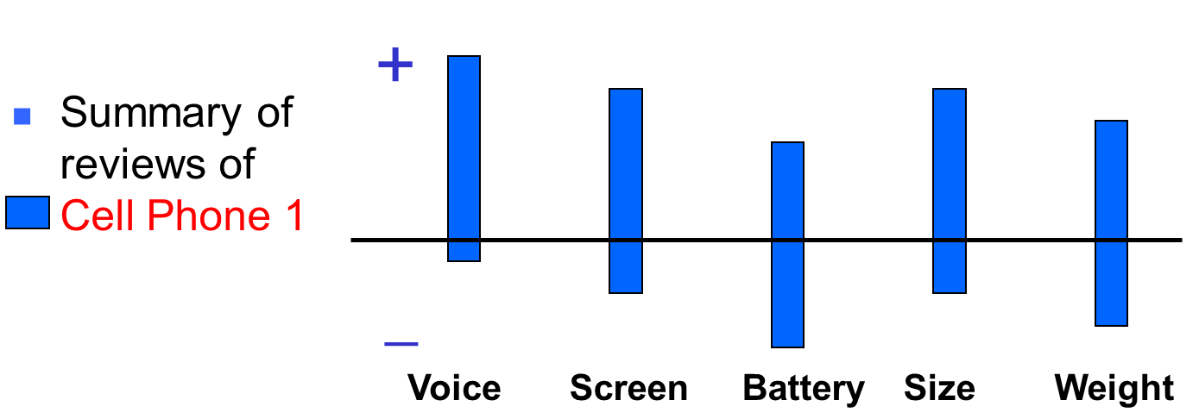
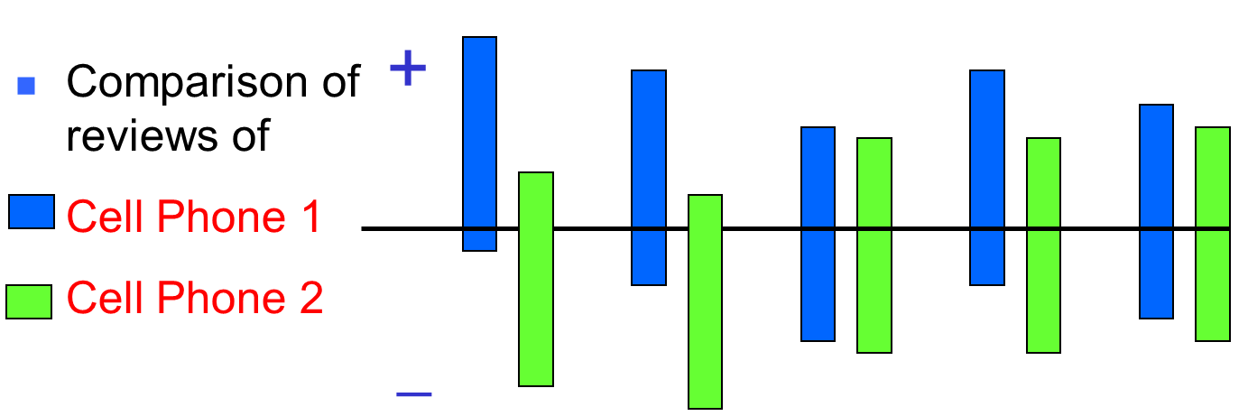
Opinion Summary
OPINION MINING

Slide 11
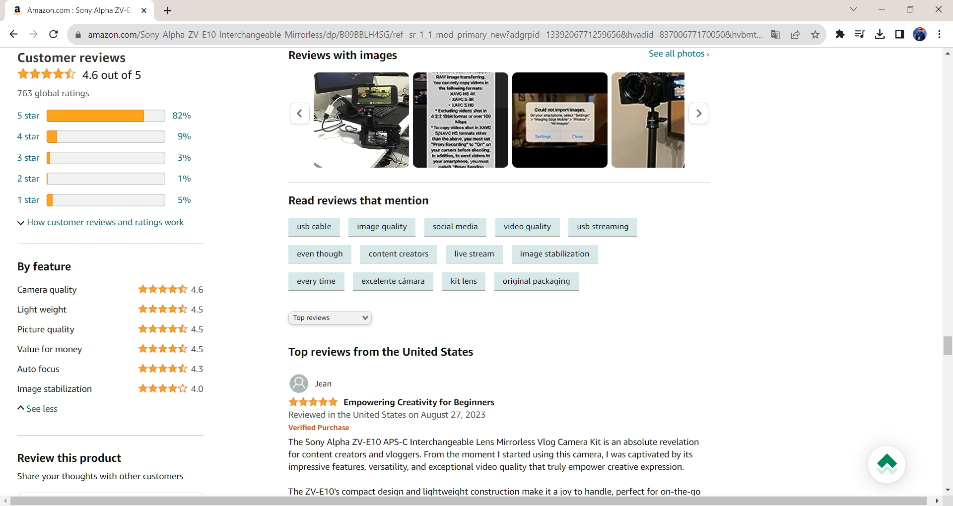
Aspect-based Opinion Summary
OPINION MINING

Slide 12
Reason for Opinion
OPINION MINING
A reason is the justification or explanation of the opinion.
There are two main cases:
Negative about an entity due to a bad aspect.
I hate this car as it eats to much gas.
Negative about an aspect because of a reason.
This car is too small.

Slide 13
Qualifier of Opinion
OPINION MINING
A qualifier of an opinion limits or modifies the meaning of the opinion.
It tells what an opinion is useful for, e.g.
This car is too small for a tall person.
The picture quality of night shots is bad.
Not every opinion comes with an explicit reason and/or qualifier.
This car is bad.

Slide 14
Sentiment classification
OPINION MINING
Classify a whole opinion document (review) based on the overall sentiment of the opinion holder.
Classes: Positive, Negative, Neutral.
It is basically a text classification problem.

Slide 15
Sentiment classification
OPINION MINING
Assumption
The doc is written by a single person and express opinion on a single entity.
Reviews usually satisfy the assumption.
Forum postings and blogs do not
They may mention and compare multiple entities.
Many postings express no sentiments.

Slide 16
Sentiment classification
OPINION MINING
Supervised learning
Directly apply supervised learning techniques to classify reviews in to appropriate class.
Best features has been studied by numerous researchers.
Terms weighting schemes.
POS tags.
Opinion words.
Negation
Syntactic dependency

Slide 17
Sentiment classification
OPINION MINING
Lexicon - based approach (Taboada et al., 2011 )
Using a set of sentiment terms, called the sentiment lexicon.
Positive words: great, beautiful, amazing, …
Negative words: bad, unreliable, terrible awful, …
The score opinion value for each sentiment term is assigned a value from [-5, +5].
Decide the sentiment of a review by aggregating scores from all sentiment terms.

Slide 18
Sentiment classification
OPINION MINING
Review rating prediction
Predict the rating scores of reviews (e.g. 1 to 5 stars).
Training and testing are reviews with star ratings.
The problem is formulated as regression since the rating scores are ordinal.

Slide 19
Sentence sentiment analysis
OPINION MINING
Usually consist of two steps
Subjective classification
To identify subjective sentence.
Sentiment classification of subjective sentence
But bear in mind
Many objective sentences can imply sentiment.
Many subjective sentences do not express positive/negative opinions.
E.g. I believe he went home yesterday.

Slide 20
Sentence sentiment analysis
OPINION MINING
Assumption
Each sentence is written by a single person and express a single opinion.
True for simple sentence
E.g. I like this car.
But not true for many compound or complex sentences
E.g. I like the picture quality but battery life sucks.

Slide 21
Segmentation and classification
OPINION MINING
A single sentence may contain multiple opinions and subjective and factual clauses.
A study of automatic clause opinion classification is needed.

Slide 22
Aspect extraction
OPINION MINING
Given an opinion corpus, extract all aspects
Four main approaches
Finding frequent nouns and noun phrases.
Exploiting opinion and target relations.
Supervised learning.
Topic modelling.

Slide 23
Aspect extraction
OPINION MINING
Frequent nouns and noun phrases
Nouns (NN) that are frequently mentioned are likely to be true aspects.
Why?
Most aspects are nouns or noun phrases.
When product aspects/features are discussed, the words we used often converge.
Those frequent ones are usually the main aspects that people are interested in.

Slide 24
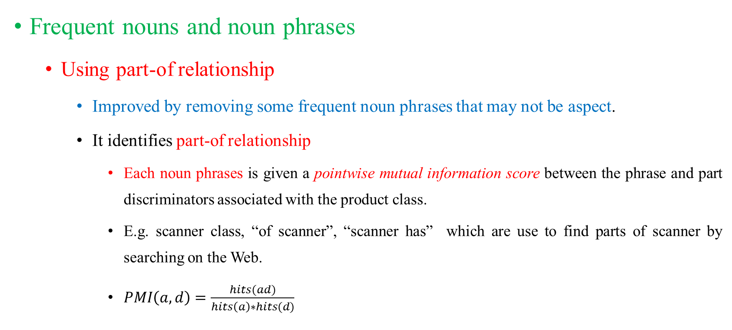
Aspect extraction
OPINION MINING
Frequent nouns and noun phrases
Using part-of relationship
Improved by removing some frequent noun phrases that may not be aspect.
It identifies part-of relationship
Each noun phrases is given a pointwise mutual information score between the phrase and part discriminators associated with the product class.
E.g. scanner class, “of scanner”, “scanner has” which are use to find parts of scanner by searching on the Web.
$PMI\left(a, d\right)=\frac{hits(ad)}{hits\left(a\right)∗hits(d)}$

Slide 25
Aspect extraction
OPINION MINING
Exploiting opinion and target relations
Key idea: opinions have targets; opinion terms are used to modify aspects and entities.
The pictures are absolutely amazing.
This is an amazing software.
The syntactic relation is approximated with the nearest noun phrases to the opinion word in.

Slide 26
Aspect extraction
OPINION MINING
Exploiting opinion and target relations
Explicit aspects: Aspect explicitly mentioned as noun or noun phrase in a sentence.
The picture quality of this phone is great.
Implicit aspects: Aspect not explicitly mentioned in a sentence but are implied.
This car is so expensive.
This phone will nots easily fit in a pocket.
Include 16GB is stingy.

Slide 27
Aspect extraction
OPINION MINING
Using supervised learning
Using sequence labelling methods such as Hidden Markov Models, Conditional Random Fields …
Once aspect expressions are discovered, group them into aspect categories.
E.g. power usage, battery life.
Based on some similarity methods but it needs a taxonomy of aspects.
Mapping: the system maps each discovered aspect to an aspect node in the taxonomy.
Similarity metrics: string similarity, synonym and other distance measures using WordNet.

Slide 28
Aspect extraction
OPINION MINING
Using unsupervised learning for grouping aspect synonyms
Clustering, Constrained topic modelling …
A variety of information/similarities are used to cluster aspect expressions into aspect categories
Lexical similarity based on WordNet
Distribution information
Syntactical constraints
…

Slide 29
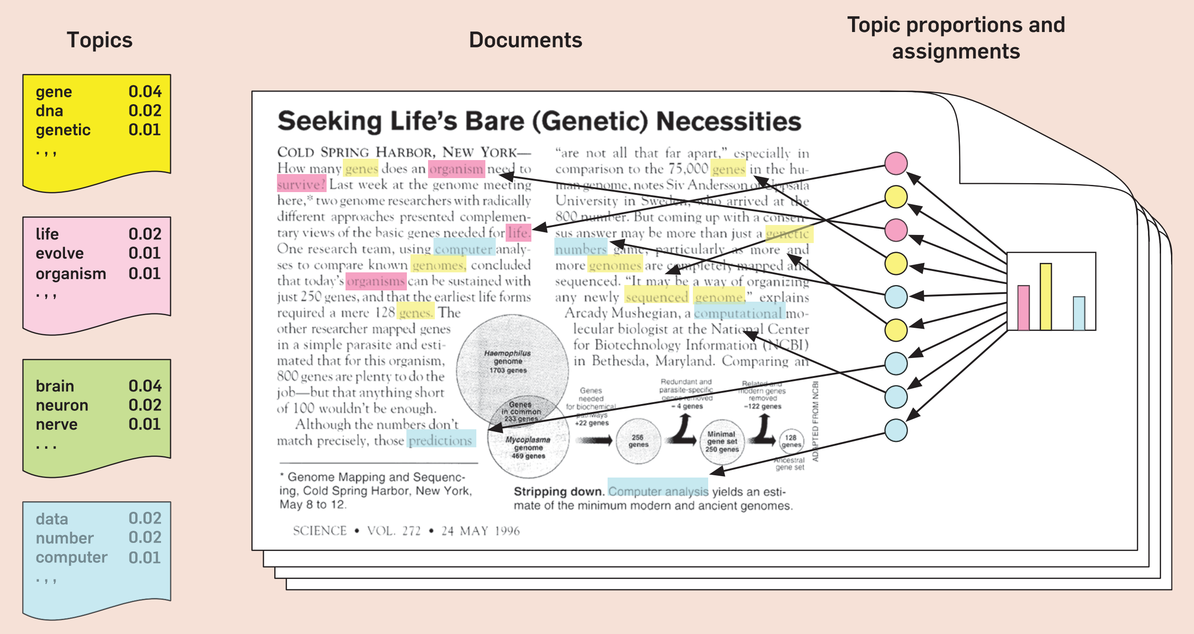
Aspect extraction
OPINION MINING
Topic modelling

Slide 30
Aspect extraction
OPINION MINING
Topic modelling
A topic is basically an aspect.
A document is a distribution over topics.
A topic is a distribution over words (price, cost, cheap, expensive …).
Aspect extraction has two tasks
Extract aspect expressions
Cluster them (same: picture, photo, image)
Top models such as: pLSA (Hofmann, 1999 ) and LDA (Blei et al, 2003).

Slide 31
Aspect extraction
OPINION MINING
Topic modelling
Use topic models to model aspects.
Jointly model both aspects and sentiments.
Knowledge-based modelling: unsupervised models are often insufficient.
Not producing coherent topics/aspects.
Knowledge-based topic models have been proposed
Guided by user-specified prior domain knowledge.

Slide 32
Sentiment (opinion) lexicon
OPINION MINING
List of words or expressions used to express people’s subjective feeling and sentiments/opinions.
They are instrumental for sentiment analysis.
There seem to be endless variety of sentiment bearing expression.
Many of them are context dependent, not just application domain dependent.
Three main ways to compile such list:
Manual approach
Corpus-based approach
Dictionary-based approach.

