Slide 1
NATURAL LANGUAGE PROCESSING (NLP)
Chapter 5: TEXT CLUSTERING
Trương Quốc Định
Faculty of Information Systems – College of Information & Communication Technology

Slide 2
Introduction
TEXT CLUSTERING
Cluster: A collection of data objects similar (or related) to one another within the same group dissimilar (or unrelated) to the objects in other groups.
Cluster analysis
Finding similarities between data according to the characteristics found in the data and grouping similar data objects into clusters.
Unsupervised learning: no predefined classes.
Typical applications
As a stand-alone tool to get insight into data distribution.
As a preprocessing step for other algorithms.

Slide 3
Introduction
TEXT CLUSTERING
Clustering for Data Understanding and Applications
Information retrieval: document clustering.
Land use: Identification of areas of similar land use in an earth observation database.
Marketing: Help marketers discover distinct groups in their customer bases, and then use this knowledge to develop targeted marketing programs.
Economic Science: market research.
…

Slide 4
Introduction
TEXT CLUSTERING
Clustering as a Preprocessing Tool (Utility)
Summarization: Preprocessing for regression, association analysis, …
Finding K-nearest Neighbours: Localizing search to one or a small number of clusters.
Outlier detection: Outliers are often viewed as those “far away” from any cluster.
…

Slide 5
Quality: What Is Good Clustering?
TEXT CLUSTERING
A good clustering method will produce high quality clusters
high intra-class similarity: cohesive within clusters
low inter-class similarity: distinctive between clusters
The quality of a clustering method depends on
the similarity measure used by the method,
its implementation, and
its ability to discover some or all of the hidden patterns.

Slide 6
Measure the Quality of Clustering
TEXT CLUSTERING
Dissimilarity/Similarity metric
Similarity is expressed in terms of a distance function, typically metric: d(i, j).
The definitions of distance functions are usually rather different for interval-scaled, boolean, categorical, ordinal ratio, and vector variables.
Weights should be associated with different variables based on applications and data semantics.
Quality of clustering
There is usually a separate “quality” function that measures the “goodness” of a cluster.
It is hard to define “similar enough” or “good enough”

Slide 7
Considerations for Cluster Analysis
TEXT CLUSTERING
Partitioning criteria
Single level vs. hierarchical partitioning (often, multi-level hierarchical partitioning is desirable).
Separation of clusters
Exclusive (e.g., one customer belongs to only one region) vs. non-exclusive (e.g., one document may belong to more than one class)
Similarity measure
Distance-based (e.g., Euclidian, road network, vector) vs. connectivity-based (e.g., density or contiguity)
Clustering space
Full space (often when low dimensional) vs. subspaces (often in high-dimensional clustering)

Slide 8
Requirements and Challenges
TEXT CLUSTERING
Scalability
Clustering all the data instead of only on samples.
Ability to deal with different types of attributes
Numerical, binary, categorical, ordinal, linked, and mixture of these
Constraint-based clustering
User may give inputs on constraints
Use domain knowledge to determine input parameters
Interpretability and usability
Others
Discovery of clusters with arbitrary shape
Ability to deal with noisy data
Incremental clustering and insensitivity to input order
High dimensionality

Slide 9
Major Clustering Approaches
TEXT CLUSTERING
Partitioning approach
Construct various partitions and then evaluate them by some criterion, e.g., minimizing the sum of square errors
Typical methods: k-means, k-medoids.
Hierarchical approach
Create a hierarchical decomposition of the set of data (or objects) using some criterion.
Typical methods: Diana, Agnes, …
Density-based approach
Based on connectivity and density functions
Typical methods: DBSCAN, …

Slide 10
Major Clustering Approaches
TEXT CLUSTERING
Model-based
A model is hypothesized for each of the clusters and tries to find the best fit of that model to each other.
Typical methods: SOM, GHSOM …
Frequent pattern-based
Based on the analysis of frequent patterns
Typical methods: p-Cluster
Link-based clustering
Objects are often linked together in various ways
Massive links can be used to cluster objects: SimRank, LinkClus

Slide 11
Partitioning Algorithms
TEXT CLUSTERING
Partitioning n objects into a set of k clusters, such that the sum of squared distances is minimized (where c_{i} is the centroid or medoid of cluster C_{i})
Given k, find a partition of k clusters that optimizes the chosen partitioning criterion
Global optimal: exhaustively enumerate all partitions
Heuristic methods: k-means and k-medoids algorithms
k-means (MacQueen’67, Lloyd’57/’82): Each cluster is represented by the center of the cluster.
k-medoids or PAM (Kaufman & Rousseeuw’87): Each cluster is represented by one of the objects in the cluster.

Slide 12
The K-Means Clustering Method
TEXT CLUSTERING
Given k, the k-means algorithm is implemented in four steps
Partition objects into k nonempty subsets
Compute seed points as the centroids of the clusters of the current partitioning
Assign each object to the cluster with the nearest seed point
Go back to Step 2, stop when the assignment does not change

Slide 13
Comments on the K-Means Method
TEXT CLUSTERING
Strength
Efficient: O(tkn), where n is # objects, k is # clusters, and t is # iterations. Normally, k, t << n.
Weakness
Need to specify k, the number of clusters, in advance (there are ways to automatically determine the best k (see Hastie et al., 2009).
Sensitive to noisy data and outliers.
Not suitable to discover clusters with non-convex shapes.

Slide 14
The K-Medoid Clustering Method
TEXT CLUSTERING
Select k random points out of the n data points as the medoids.
Associate each data point to the closest medoid by using any common distance metric methods.
While the cost decreases
For each medoid m, for each data o point which is not a medoid
Swap m and o, associate each data point to the closest medoid, and recompute the cost.
If the total cost is more than that in the previous step, undo the swap.

Slide 15
Hierarchical Clustering
TEXT CLUSTERING
Use distance matrix as clustering criteria.
This method does not require the number of clusters k as an input.
Step 0
Step 1
Step 2
Step 3
Step 4
agglomerative
(AGNES)
a
a b
b
a b c d e
c
c d e
d
d e
e
divisive
(DIANA)
Step 4
Step 3
Step 2
Step 1
Step 0

Slide 16
Hierarchical Clustering
TEXT CLUSTERING
Botom-up (Agglomerative) Clustering
Form all possible singleton clusters (each containing a single object).
Greedily combine clusters with “maximum similarity” (or “minimum distance”) together into a new cluster.
Continue until all objects are contained in a single cluster.
Top-down (Divisive) Clustering
Start with a cluster containing all objects.
Greedily split the cluster into two, assigning objects to clusters so as to maximize the within-group similarity.
Continue splitting clusters which are the least coherent until either having only singleton clusters or reaching the number of desired clusters.

Slide 17
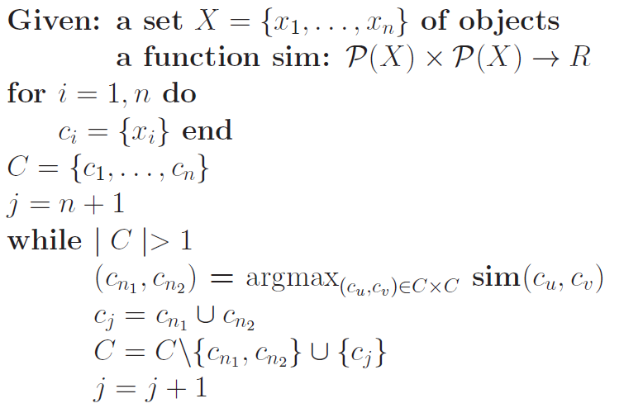
The Bottom-up Hierarchical Clustering Algorithm
TEXT CLUSTERING

Slide 18
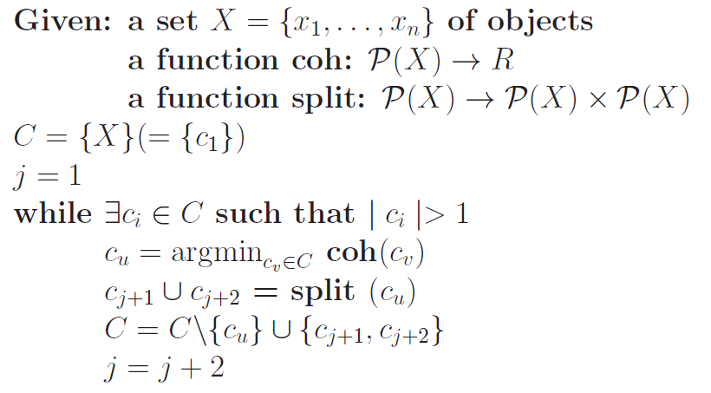
The Top-down Hierarchical Clustering Algorithm
TEXT CLUSTERING

Slide 19
Distance between Clusters
TEXT CLUSTERING
MIN (Single Link) Proximity
Cluster proximity is defined as the shortest distance between two points, 𝑥 and 𝑦, that are in different clusters, 𝐴 and 𝐵.
MAX (Complete Link) Proximity
Defines cluster proximity as the furthest distance between two points, 𝑥 and 𝑦, that are in different clusters, 𝐴 and 𝐵.
Group Average Proximity
Defines cluster proximity as the average distance between two points, 𝑥 and 𝑦, that are in different clusters, 𝐴 and 𝐵 (number of points in cluster 𝑗 is 𝑛_{𝑗})

Slide 20
Density-Based Clustering
TEXT CLUSTERING
Clustering based on density (local cluster criterion), such as density-connected points.
Major features
Discover clusters of arbitrary shape,
Handle noise,
One scan,
Need density parameters as termination condition.

Slide 21
Density-Based Clustering
TEXT CLUSTERING
Two parameters
Eps: Maximum radius of the neighbourhood.
MinPts: Minimum number of points in an Eps-neighbourhood of that point.
NEps(p): {q belongs to D | dist(p,q) ≤ Eps}
Directly density-reachable: A point p is directly density-reachable from a point q w.r.t. Eps, MinPts if
p belongs to NEps(q)
|NEps (q)| ≥ MinPts

Slide 22
Density-Based Clustering
TEXT CLUSTERING
Density-reachable
A point p is density-reachable from a point q w.r.t. Eps, MinPts if there is a chain of points p₁, …, p_{n}, p₁ = q, p_{n} = p such that p_{i+1} is directly density-reachable from p_{i}.
Density-connected
A point p is density-connected to a point q w.r.t. Eps, MinPts if there is a point o such that both, p and q are density-reachable from o w.r.t. Eps and MinPts.
p
p₁
q
p
q
o

Slide 23
DBSCAN: Density-Based Spatial Clustering of Applications with Noise
TEXT CLUSTERING
A cluster is defined as a maximal set of density-connected points.
Algorithm
Arbitrary select a point p.
Retrieve all points density-reachable from p w.r.t. Eps and MinPts.
If p is a core point, a cluster is formed.
If p is a border point, no points are density-reachable from p and DBSCAN visits the next point of the database
Continue the process until all of the points have been processed.
Outlier
Border
Eps = 1cm
MinPts = 5
Core

Slide 24
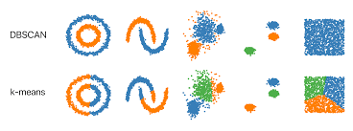
DBSCAN: Density-Based Spatial Clustering of Applications with Noise
TEXT CLUSTERING

Slide 25
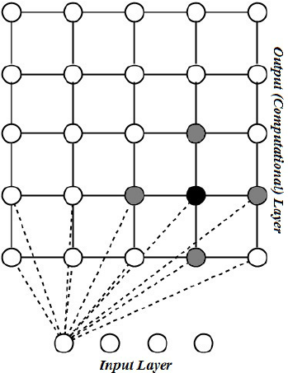
Self organizing map approach
TEXT CLUSTERING

Slide 26
SOM - Self Organizing Map
TEXT CLUSTERING
Description
SOM can map all these high-dimension data onto 2 dimensions space.
SOM are not very sensitive to some noisy data and the clustering quality can also be assured.
Architecture
Each neuron (node) corresponds a set of samples from the dataset.
Each neuron is associated a vector of weights (codebook).

Slide 27
SOM - Self Organizing Map
TEXT CLUSTERING
Map topology

Slide 28
SOM - Self Organizing Map
TEXT CLUSTERING
Input: dataset, size and topology of the map
Output: the codebook for each output node.
Method
1. Randomize the map’s nodes weight
2. Select randomly one instance
3. Find the closest node: best matching unit
4. The codebook of this node is updated
5. The codebooks of the adjacent (neighbour) nodes are also updated, by not to the same degree
6. Reduce the intensity of the update progressively
7. Repeat 2 to 6 for T_{max} iterations

Slide 29
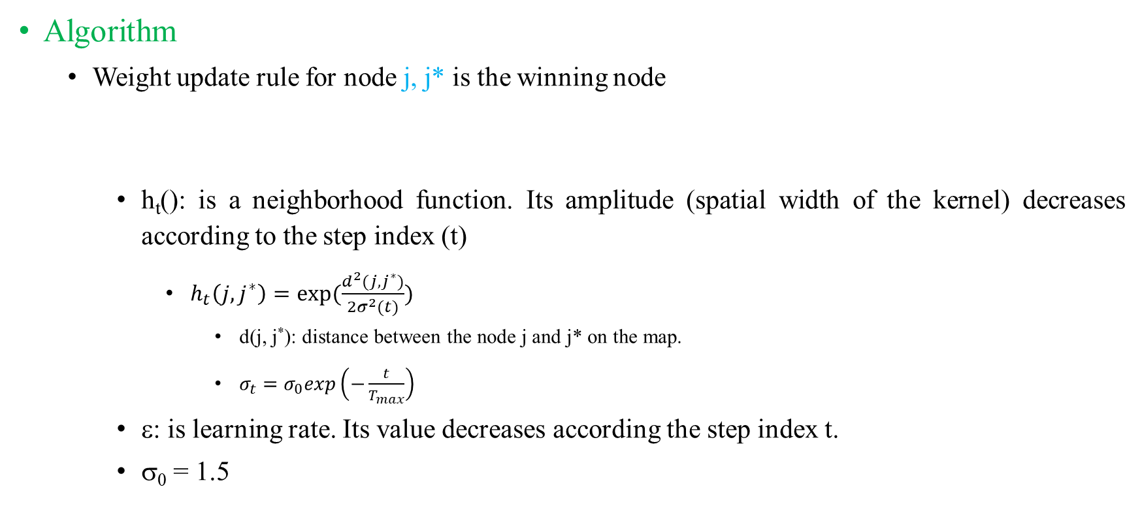
SOM - Self Organizing Map
TEXT CLUSTERING
Algorithm
Weight update rule for node j, j* is the winning node
h_{t}(): is a neighborhood function. Its amplitude (spatial width of the kernel) decreases according to the step index (t)
$h_{t}\left(j, j^{∗}\right)=exp⁡(\frac{d^{2}(j, j^{∗})}{2σ^{2}(t)})$
d(j, j*): distance between the node j and j* on the map.
$σ_{t}=σ_{0}exp\left(−\frac{t}{T_{max}}\right)$
ε: is learning rate. Its value decreases according the step index t.
σ₀ = 1.5
$$w_{t+1}\left(j\right)=w_{t}\left(j\right)+ε_{t}.h_{t}\left(j, j^{∗}\right).(w_{t}\left(j\right)−x)$$

Slide 30
SOM - Self Organizing Map
TEXT CLUSTERING
Advantages
It is very simple.
It classify data well and then are easily evaluate for their own quality so you can actually calculated how good a map is and how strong the similarities between objects are.
Disadvantages
SOMs organize sample data so that in the final product, the samples are usually surrounded by similar samples, however similar samples are not always near each other.

Slide 31
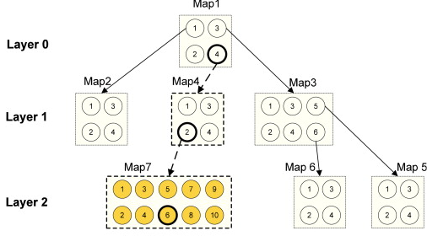
GHSOM - The Growing Hierarchical SOM
TEXT CLUSTERING
Description
The key idea of GH-SOM is to use a hierarchical structure of multiple layers where each layer consists of a number of independent self-organizing maps (SOMs).

Slide 32
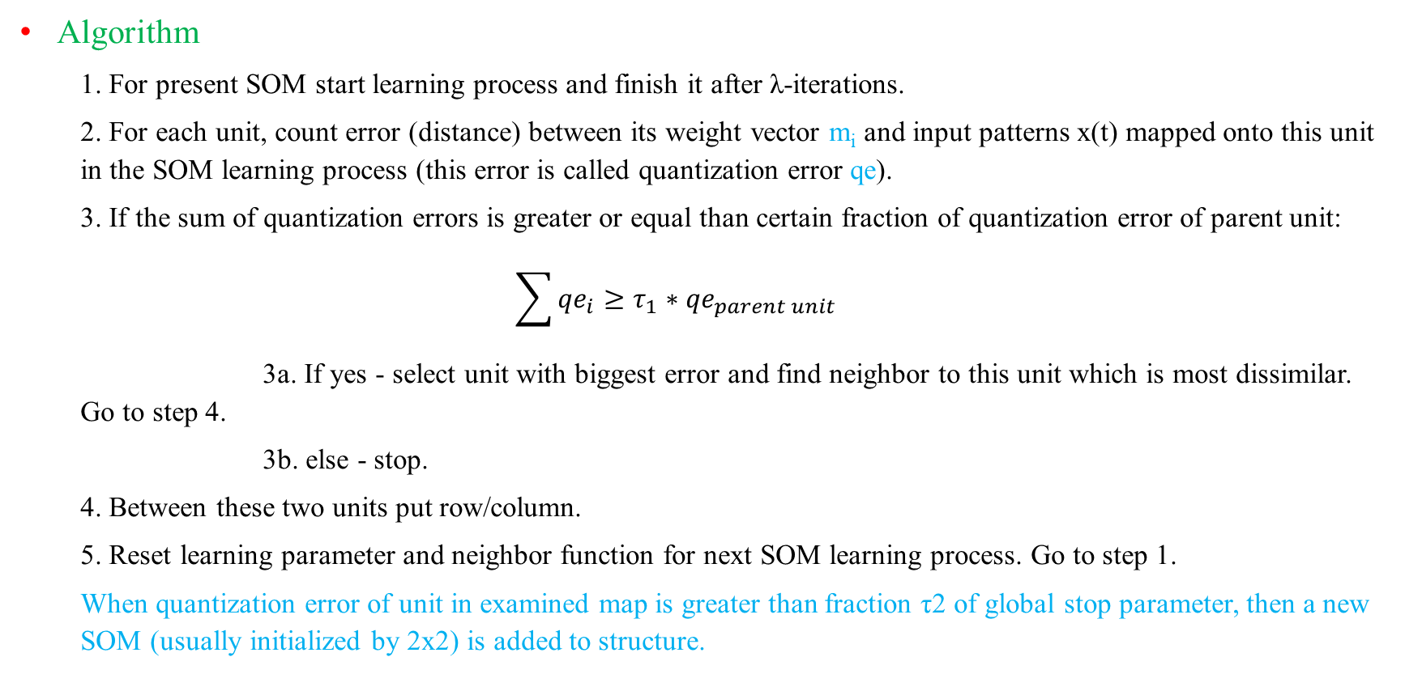
GHSOM - The Growing Hierarchical SOM
TEXT CLUSTERING
Algorithm
1. For present SOM start learning process and finish it after λ-iterations.
2. For each unit, count error (distance) between its weight vector m_{i} and input patterns x(t) mapped onto this unit in the SOM learning process (this error is called quantization error qe).
3. If the sum of quantization errors is greater or equal than certain fraction of quantization error of parent unit:
$$\sum{{qe}_{i}≥τ_{1}∗{qe}_{parent unit}}$$
3a. If yes - select unit with biggest error and find neighbor to this unit which is most dissimilar. Go to step 4.
3b. else - stop.
4. Between these two units put row/column.
5. Reset learning parameter and neighbor function for next SOM learning process. Go to step 1.
When quantization error of unit in examined map is greater than fraction τ2 of global stop parameter, then a new SOM (usually initialized by 2x2) is added to structure.

Slide 33
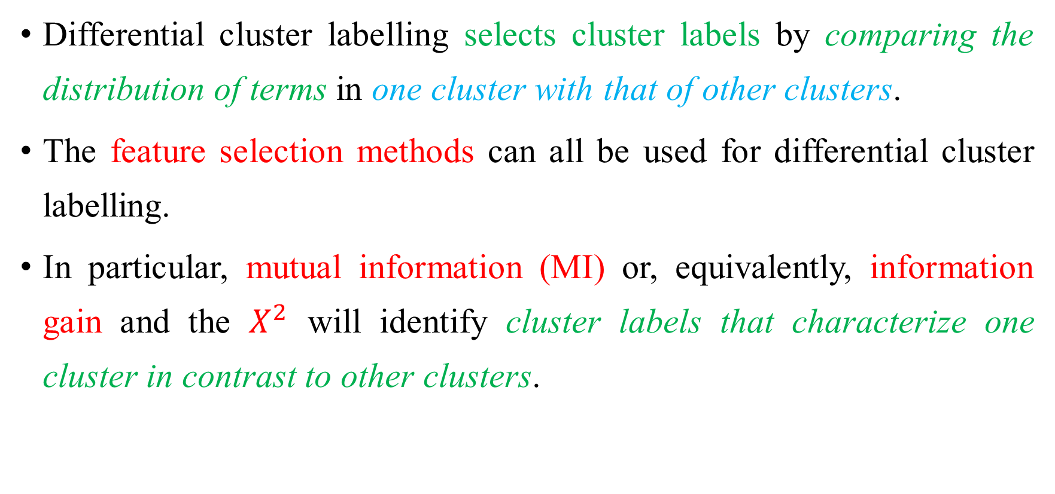
Cluster labelling
TEXT CLUSTERING
Differential cluster labelling selects cluster labels by comparing the distribution of terms in one cluster with that of other clusters.
The feature selection methods can all be used for differential cluster labelling.
In particular, mutual information (MI) or, equivalently, information gain and the $X^{2}$ will identify cluster labels that characterize one cluster in contrast to other clusters.

Slide 34




Joint entropy
TEXT CLUSTERING
The joint entropy of two discrete random variables X and Y with a joint distribution p(x, y) is:
The conditional entropy H(Y|X) quantifies the uncertainty of Y that remains if the outcome of X is given.

Slide 35

Joint entropy
TEXT CLUSTERING
The chain rule for entropy is analogous to the chain rule for probability and, in fact, derives directly from it.

Slide 36



Mutual information
TEXT CLUSTERING
The MI describes the amount of information about one random variable obtained through the other one or how different the joint distribution is from pure independence.
The MI I(X; Y) is the Kullback-Leibler Divergence between the joint distribution and the product distribution p(x)p(y)
We can rewrite the definition of mutual information I(X; Y) as

Slide 37
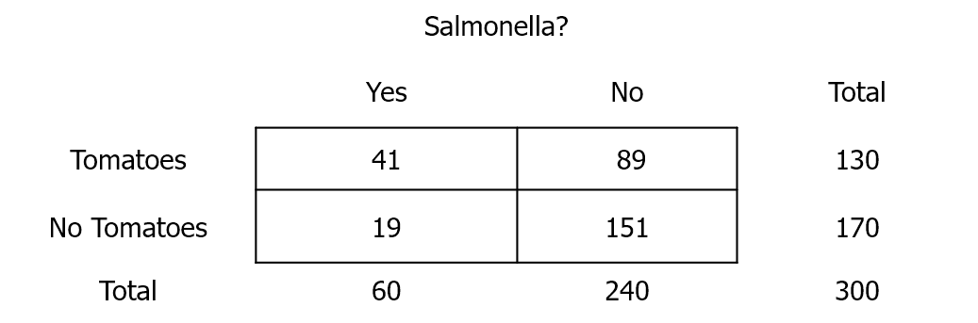
Chi-square test
TEXT CLUSTERING
A formal statistical test to determine whether results are statistically significant.
Example
Hypothetical outbreak of Salmonella on a cruise ship.
All 300 people on cruise ship interviewed, 60 had symptoms consistent with Salmonella.
Questionnaires indicate many of the case-patients ate tomatoes from the salad bar.

Slide 38
Chi-square test
TEXT CLUSTERING
To conduct a chi-square the following conditions must be met
There must be at least a total of 30 observations (people) in the table.
Each cell must contain a count of 5 or more.
To conduct a chi-square test we compare the observed data (from study results) with the data we would expect to see.

Slide 39
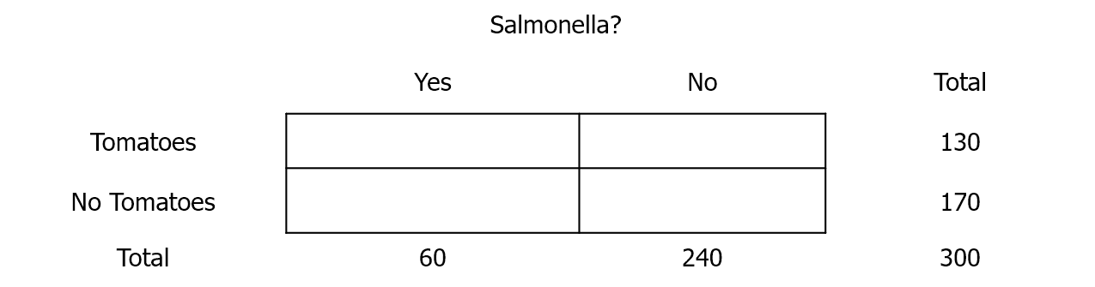
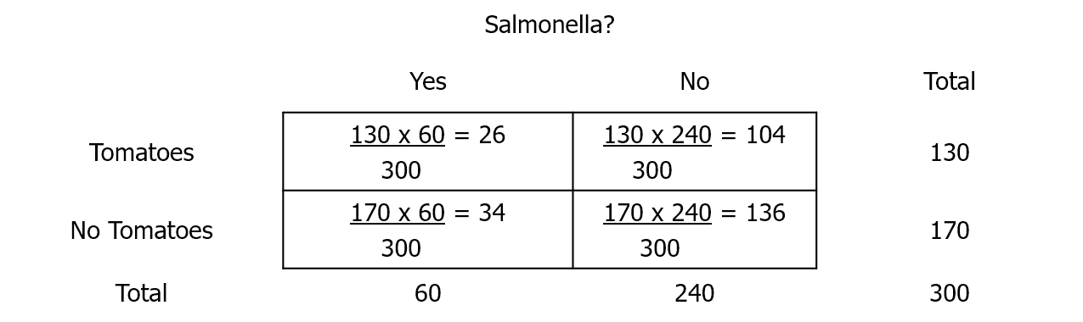

Chi-square test
TEXT CLUSTERING
Gives an overall distribution of people who ate tomatoes and became sick.
Based on these distributions we can fill in the empty cells with the expected values.
Expected Value = $\frac{Row total ∗ Col total}{Grand total}$

Slide 40
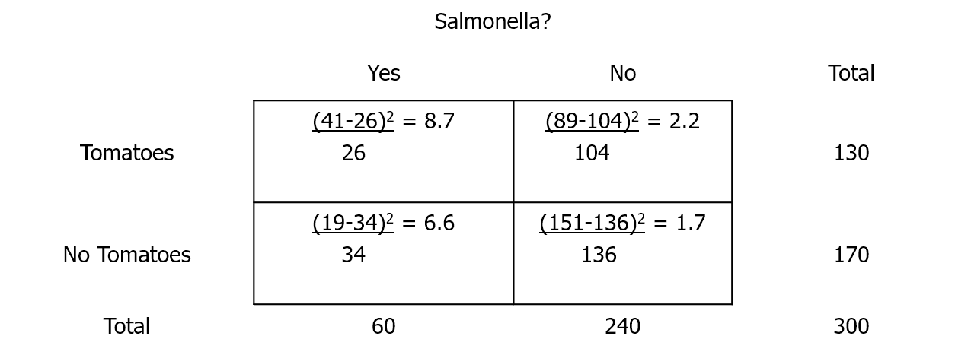
Chi-square test
TEXT CLUSTERING
Chi-square is [(Observed – Expected)²/Expected] for each cell of the table.
What does the chi-square tell you?
In general, the higher the chi-square value, the greater the likelihood there is a statistically significant difference between the two groups you are comparing.

