Slide 1

How to Make the World Happier
GROUP 13: LINING JIANG, POOSHAN SHAH, RACHEAL HU, RULAN PAN

Slide 2


Slide 3
OUTLINE
Data Description
Clustering
Goals
Feature Selection
Exploratory Data Analysis
Solution and Insights

Slide 4
Description of Data Set
Output: Happiness Score
156 countries
2005 - 2017
11 Numeric Variables
High-Level: GDP, corruption, life expectancy, freedom, confidence in government
Low-Level: positivity, negativity, social support, income, freedom, generosity

Slide 5
Our Goal
Findings
Find the factors that affect the happiness score the most and suggest ways to increase one’s happiness.
High-Level:
GDP
Life Expectancy
Freedom
Low-Level:
Social Support
Positivity
Freedom

Slide 6
Exploratory Data Analysis

Slide 7
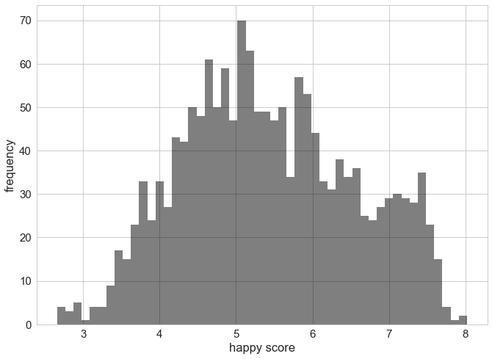
World Happiness Scores

Slide 8
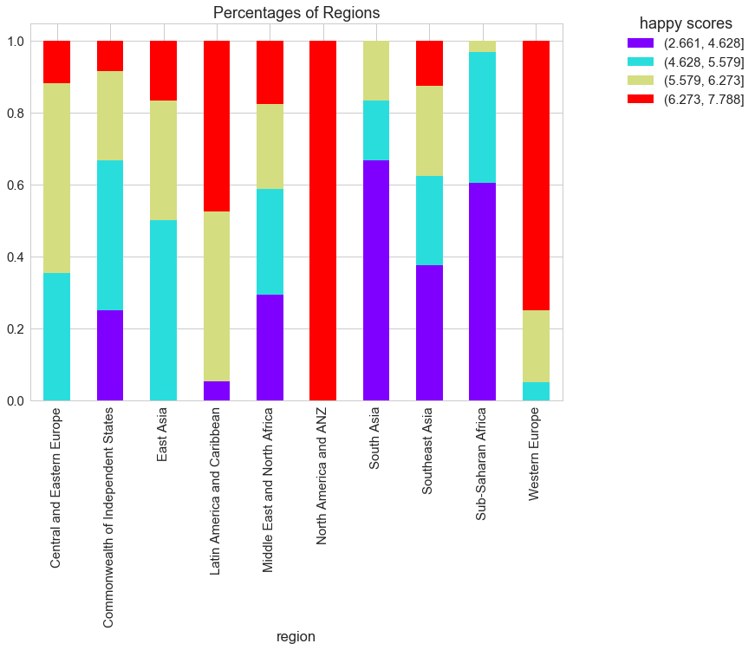
Happiness Score Composition

Slide 9
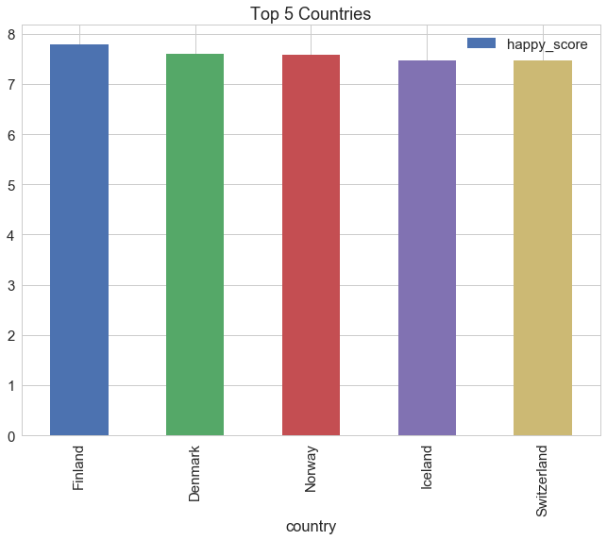
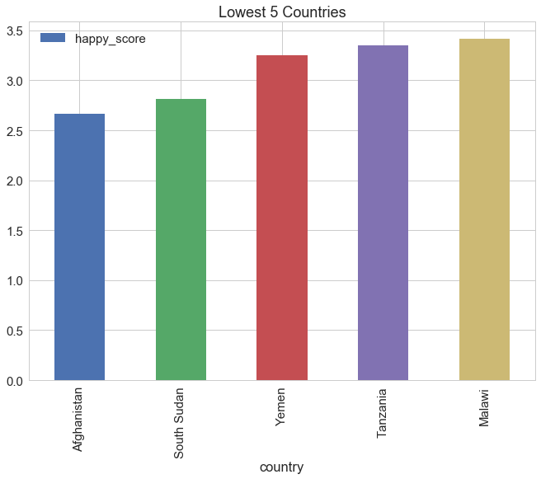
Highest Scores
Lowest Scores

Slide 10
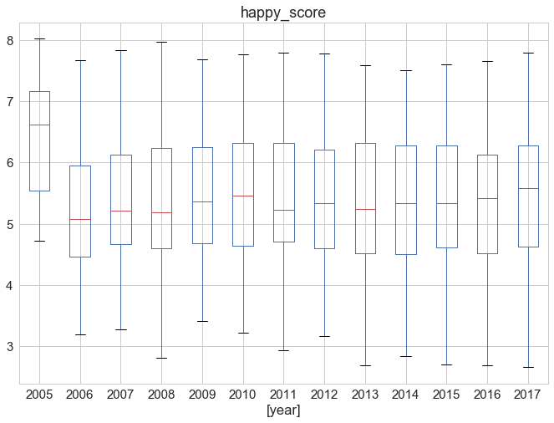
Distribution by Year

Slide 11
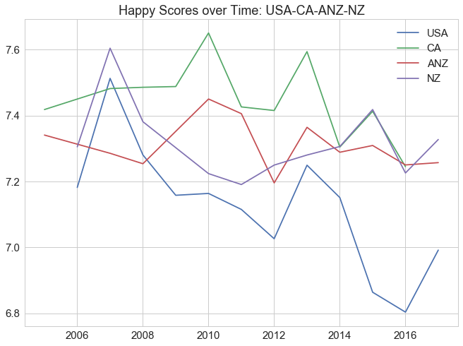
Happiness Scores Over Time

Slide 12
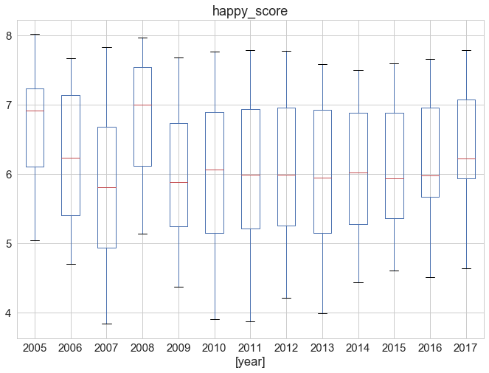
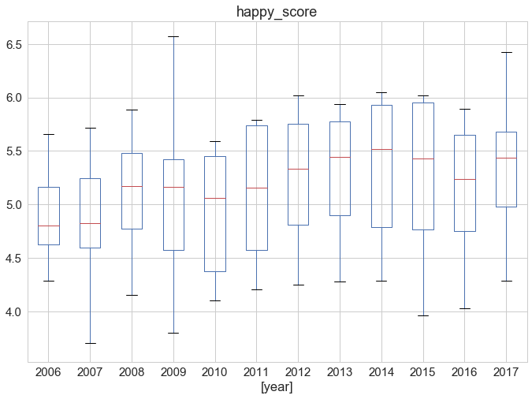
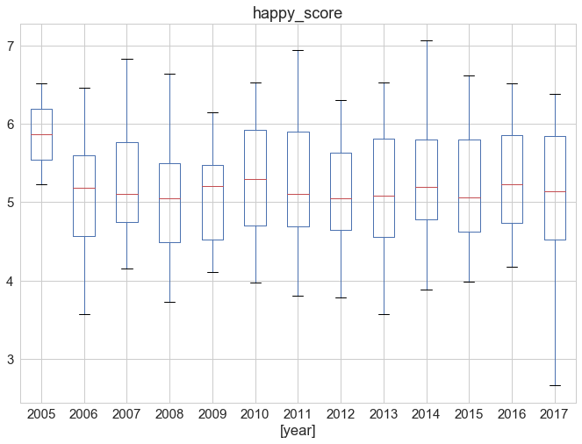
Spread by Region
Europe
Common Wealth of Independent States
Asia

Slide 13
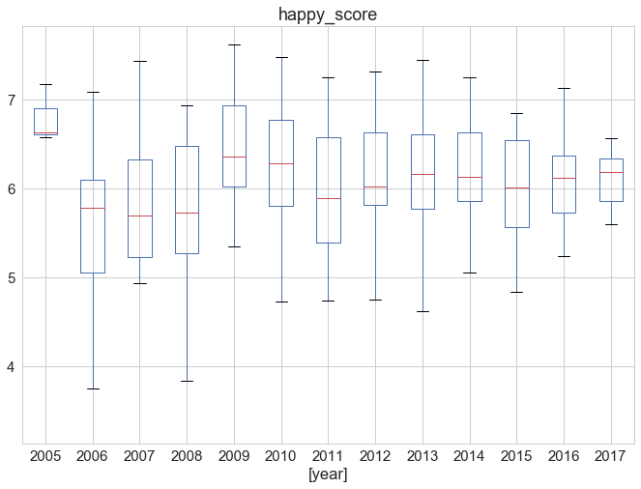
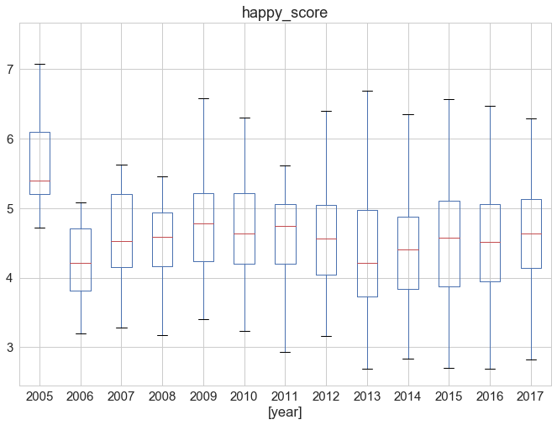
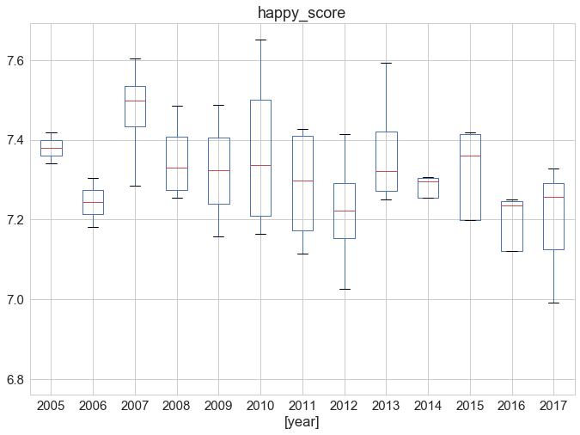
Spread by Region
Latin America
Africa
North American and ANZ

Slide 14

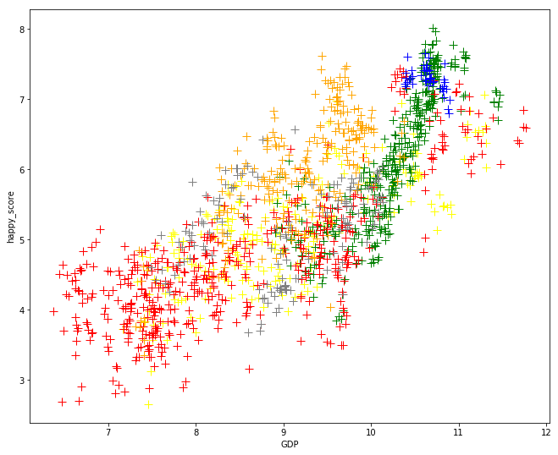
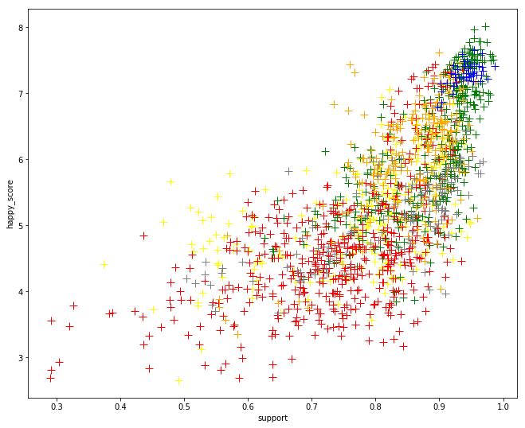
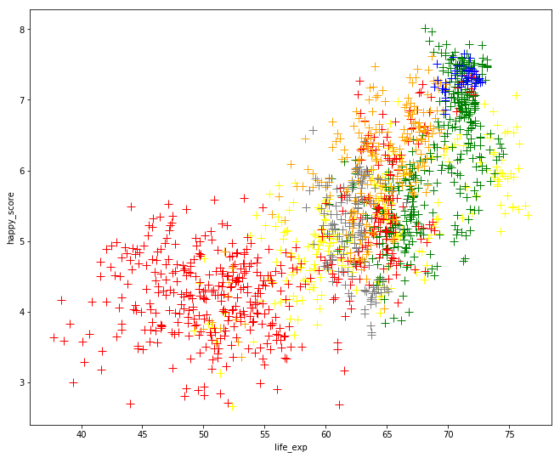
Happy Score vs Important Variables
GDP
Support
Life expectancy

Slide 15
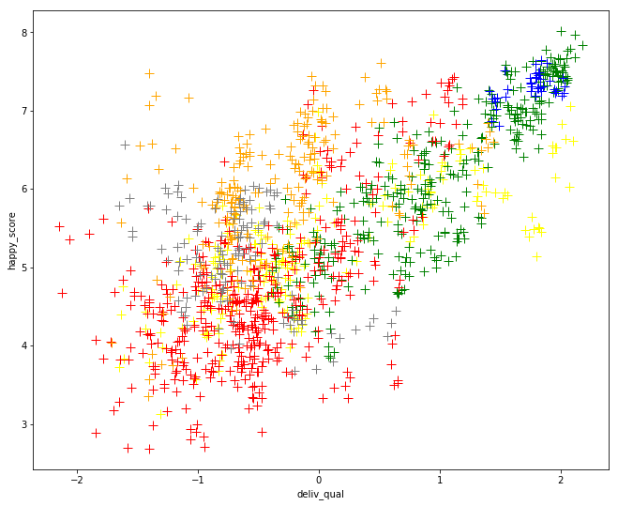
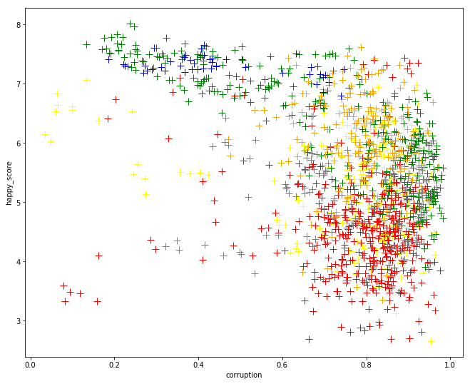
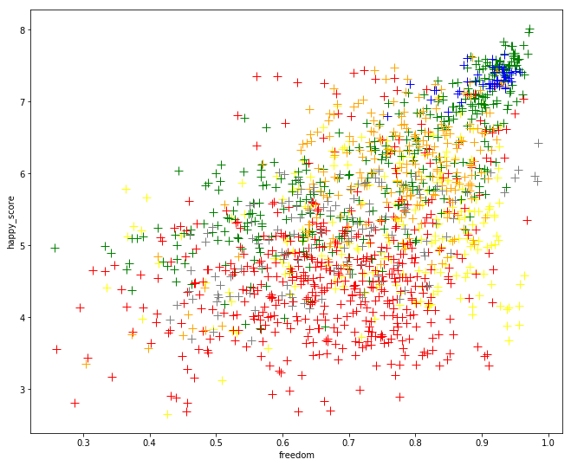
Happy Score vs Important Variables
Equality
Corruption
Freedom

Slide 16
2006-2013
Clustering
K-Means
Hierarchical Clustering
Notes:
looking at the data, we obviously can’t use every year to find what’s most important so we decided to split the data into recent and past. The past data will be used as a benchmark and checking entity and the recent data will be used to discover the sig vars.

Slide 17
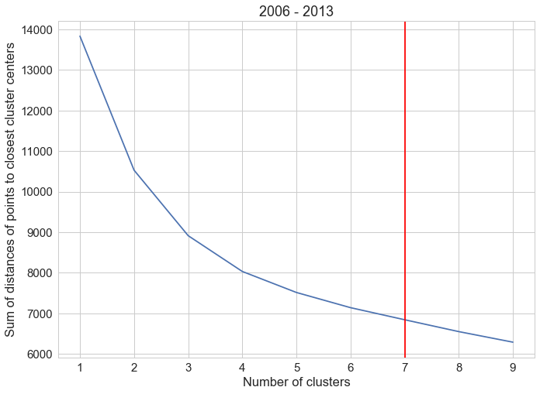
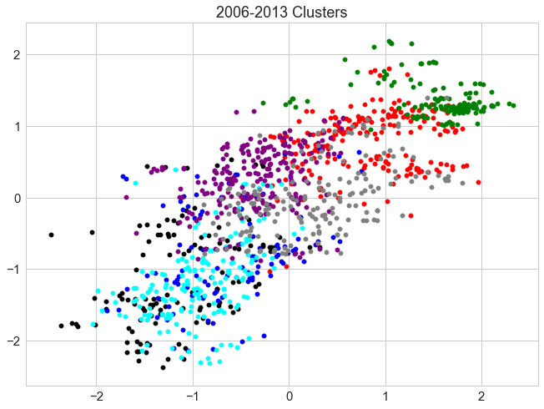
2006-2013

Slide 18
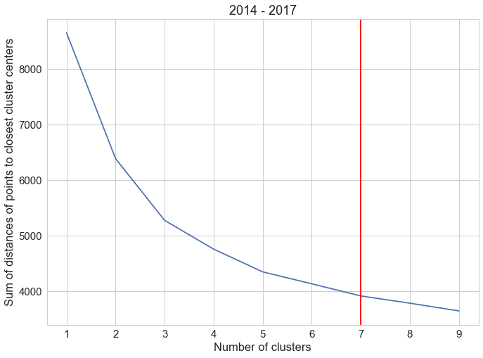
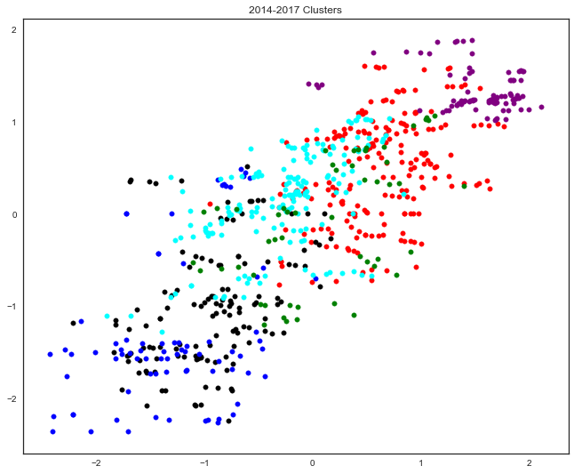
2014-2017

Slide 19
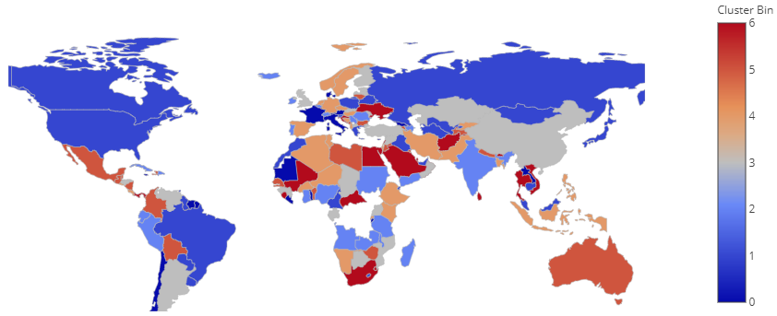
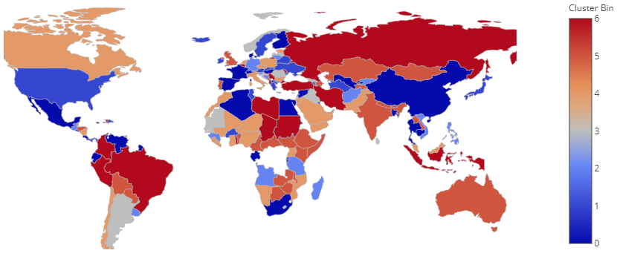
Happiness Map
2006-2013
2014-2017

Slide 20
Feature Selection
Linear Regression
SelectKBest
Lasso

Slide 21
F-regression: numeric output
F-score: a measure of how informative each feature is for the dataset
F-score percentage = F-score / sum(F-score)
Three typical countries: US, India, China

Slide 22
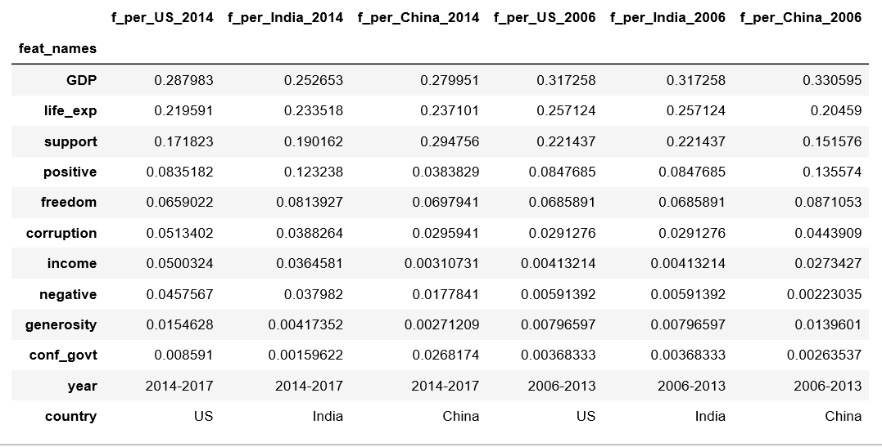
F-Statistics
support
support
support
life_exp
life_exp
life_exp
GDP
GDP
GDP

Slide 23
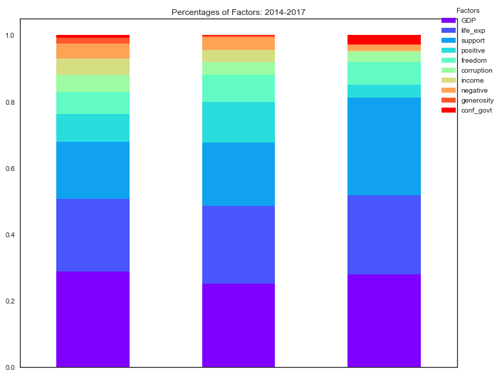
Important Variables
support
support
support
life_exp
life_exp
life_exp
GDP
GDP
GDP
USA
India
China

Slide 24
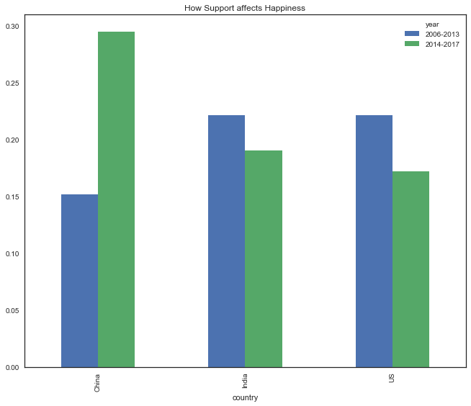
How Support affects Happiness
China
India
USA

Slide 25
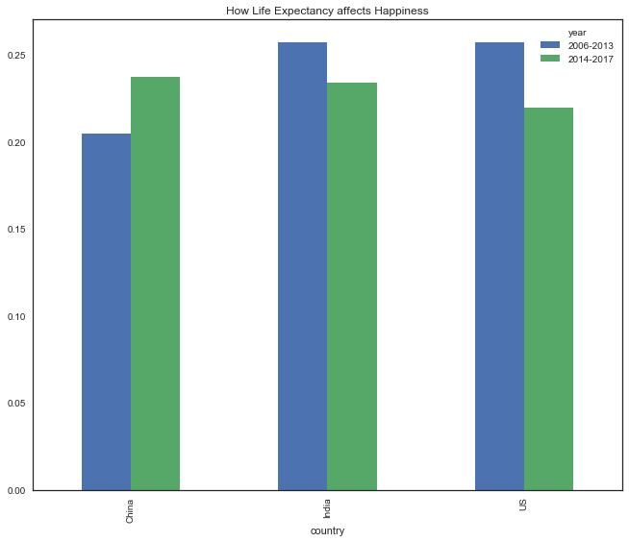
How Life Expectancy affects Happiness
China
India
USA

Slide 26
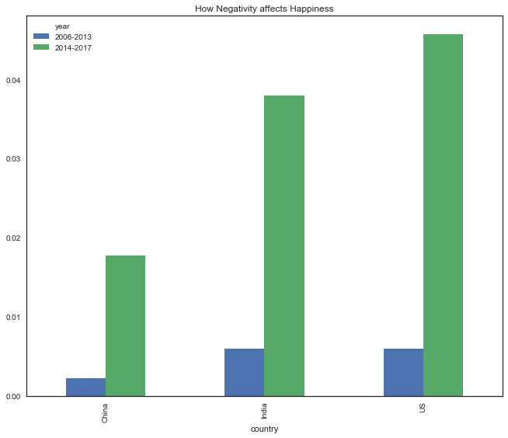
How Negativity Affects Happiness
China
India
USA

Slide 27
Solution and Insights

Slide 28

High-Level
Low-Level
GDP
Education
Consumption
Social Support
Relationships
Communication
Life Expectancy
Health Care
Environment/Food
Positivity
Laughter
Enjoyment
Freedom
Policies
Self-Environment

Slide 29
Lessons Learned
Impact of interaction variables
Don’t get caught up in the “stats black hole”
Clever way to deal with low number of data points
Python is better than R ;)

Slide 30
Q & A

