Slide 1

Project: Agricultural Product Management
THE DRIFTER
Group 6:
Phan Tan Phat CE130319(*)
Dang Buu Hoa CE130427
Ha Van Ngoan CE130192
Teacher: Vo Hong Khanh

Slide 2
Table of content
Problem definition
User requirement
Database diagram
Demo

Slide 3
Problem definition
There is a customer named 'A', he is very headache when facing with lots of bills and books every day. While other stores all use software to manage the store, Mr. A still manages the store in a traditional fashion every day. Mr. A wanted to build a store management software for his shop, so he went to meet the programmers to order.
Programmers introduced Mr. A to the benefits of using management programs compared to traditional-style management.

Slide 4
Advantages when using management program:
Save time and cost
Effectively manage resources.
Suitable for all businesses.
Coordinate different departments
Improve management ability.
Handling a large amount of data.
Improve business efficiency.

Slide 5
Hardware requirement
Client :
CPU: Intel Core i5 4th Gen or higher
Ram: 4GB or higher
HDD: 10GB
Server:
CPU: Quad-Core Q6600 or higher
Ram: 8GB or higher
HDD: 10GB disk free

Slide 6
Software requirement
Client:
OS: Windows 7 or newer
JRE: 1.8 or higher
Server:
OS: Windows Server 2008 or higher
Database system: Microsoft SQL server 2017

Slide 7
User requirement:
Functions requirement
List inputs to application:
Customer , employee, product information
List outputs expected from the application
Order product, product bought information
Overview of processes involved in the application
Input Customer , employee, product information
Display those information
Create a order

Slide 8
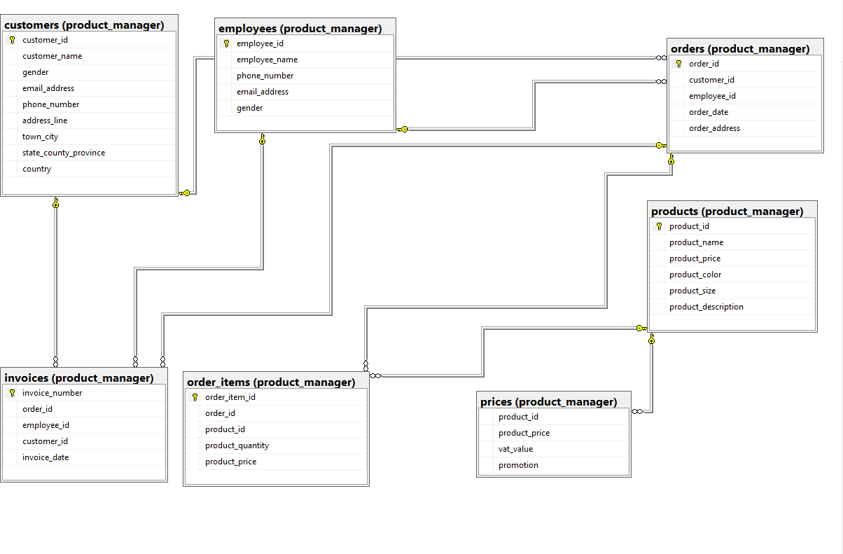
Database Diagram

Slide 9
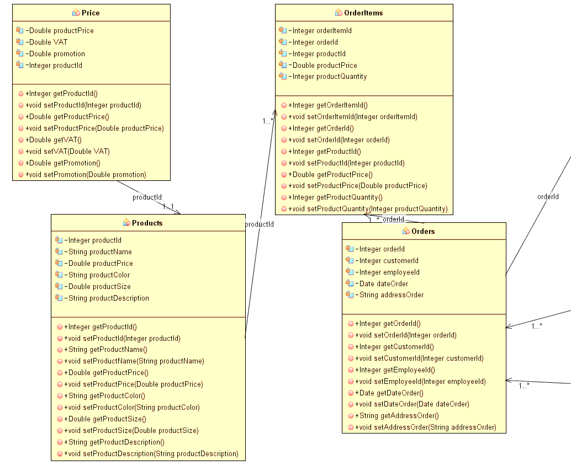
Class diagram

Slide 10
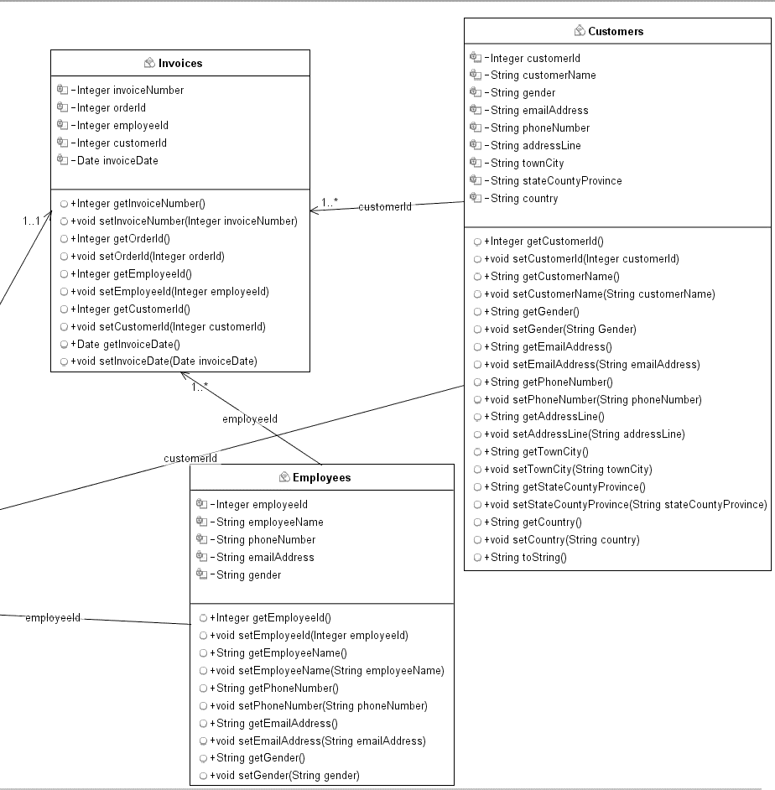

Slide 11
Demo

Slide 12
Thank for listening

