Slide 1
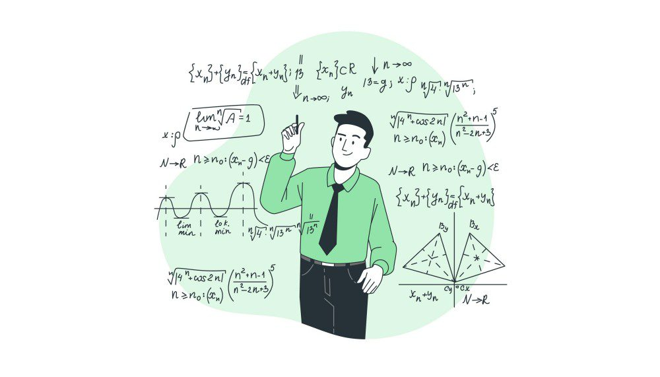
Interview presentation
Aqsone
Arnaud HUREL – 22/10/2022

Slide 2


Background & Goal
Data Science Interview
Car selling
Test Data science skills
Predict the price of a car
Analayze feature used and see improvement that can be done

Slide 3
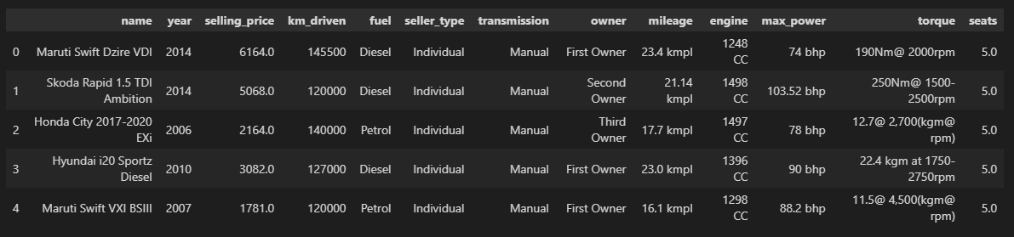
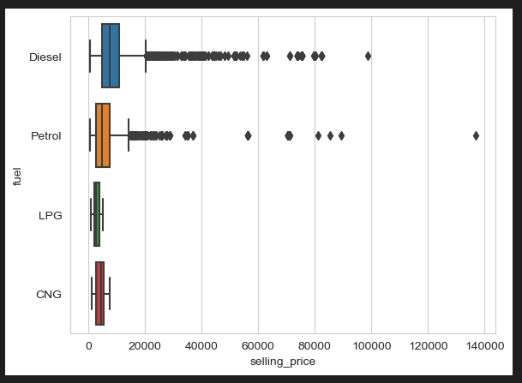
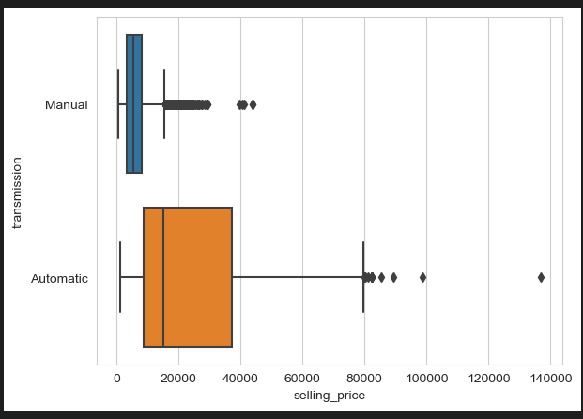
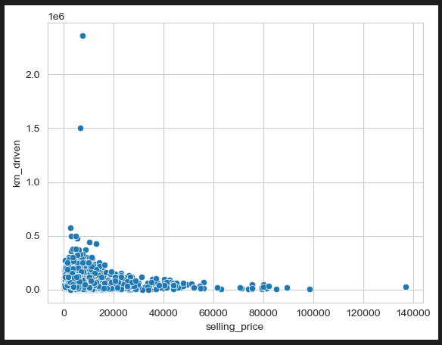
Data that we had at our disposal

Slide 4
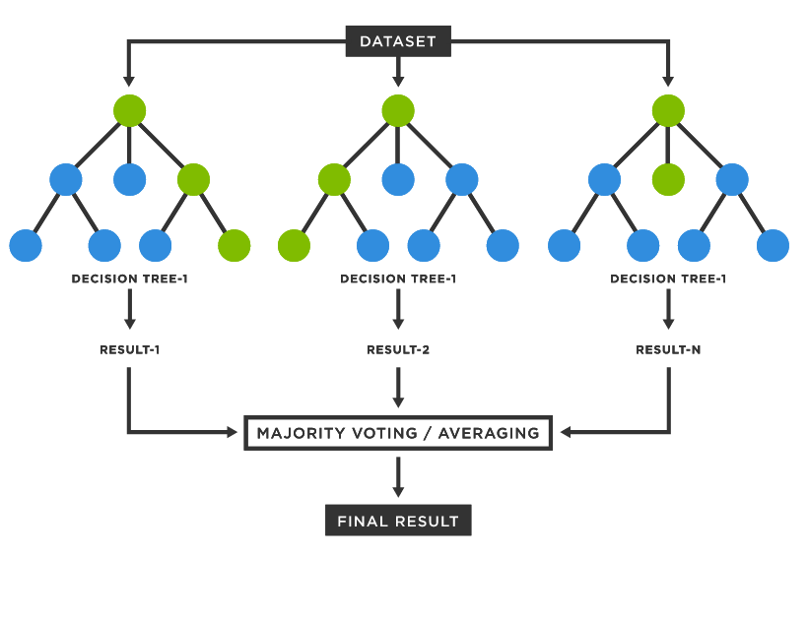
What we did we do?
Dataset
Data transformation
Dummies
Min/max scaler
Use a ML model to predict the selling price
A 70 / 30 split has been done to test the model

Slide 5
How could we improve it ?
Clean more data
Extracting features from unused variables
Look at other metrics to measure the accuracy of the prediction
Test other ML model and fine tune parameters
Cross validation instead of an 70/30

Slide 6
Thanks for watching

